Slide 1


Slide 2
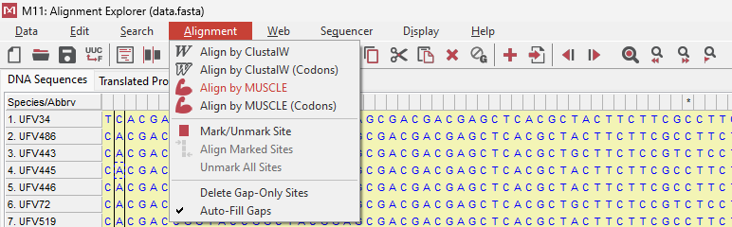


Slide 3
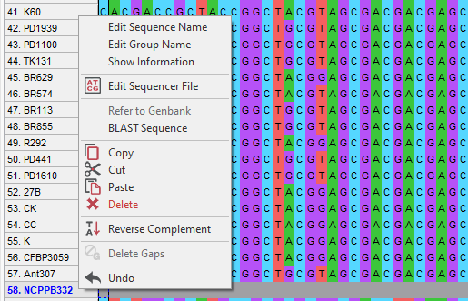

Slide 4
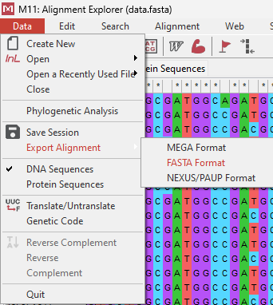

Slide 5

Detailed explanations can be found in Michael G. Milgroom's book "Population Biology of Plant Pathogens," Chapter 6, pages 123-128.

Slide 6
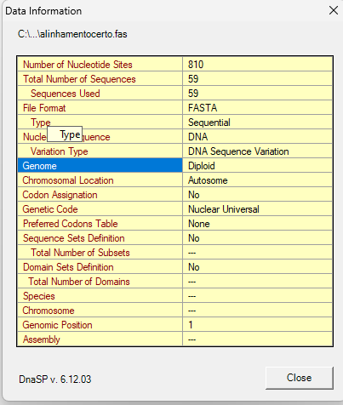

Slide 7
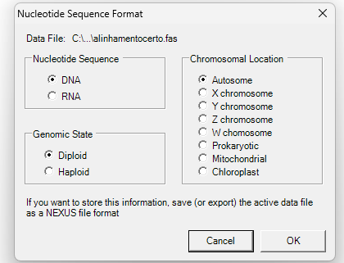

Slide 8
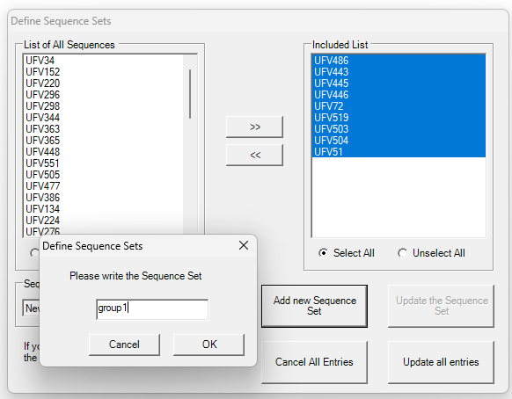
1º
2º
select
3º
5º
4º

Slide 9
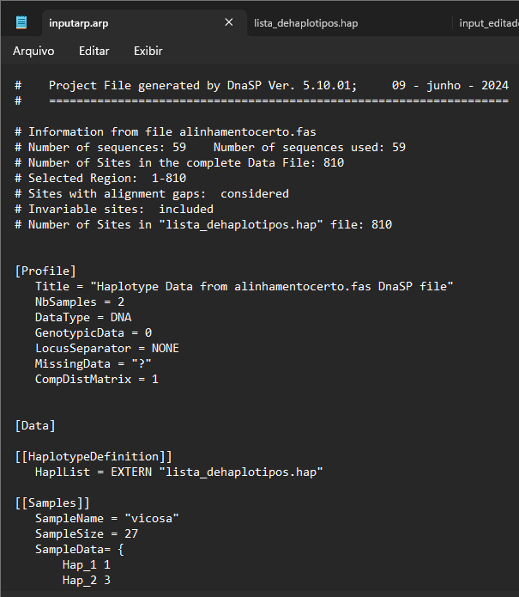
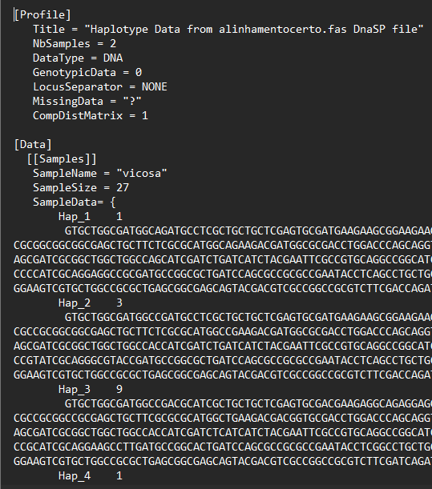
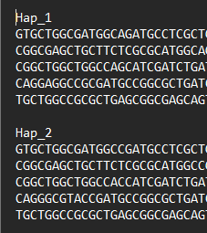
FILE.arp
Assembling a new one FILE.arp
PASTE
FILE.hap
COPY
COPY the sequence

Slide 10
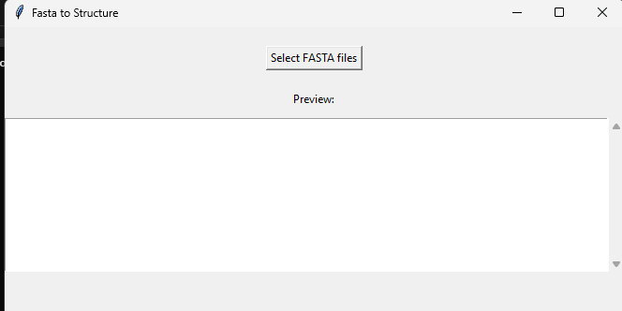
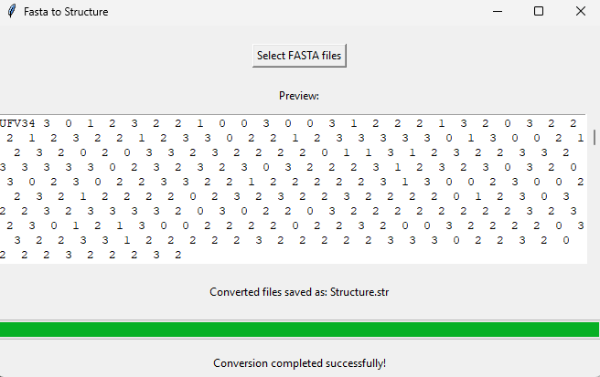



Slide 11
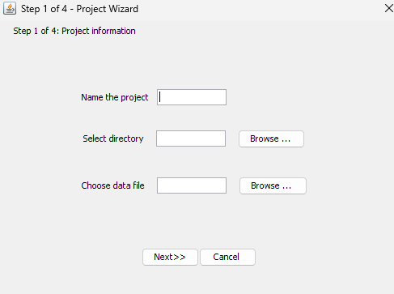
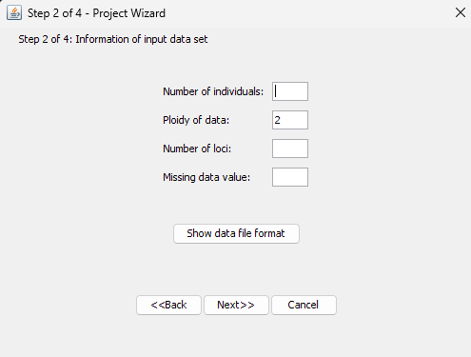
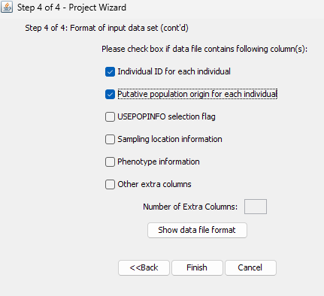
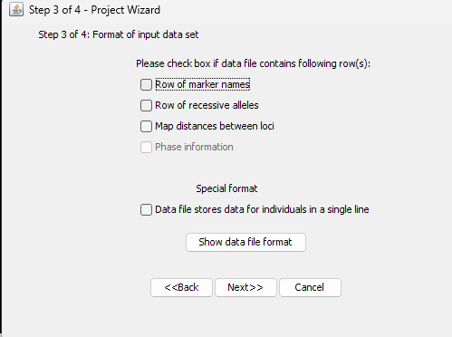
1º
2º
59
1
247
-9
4º
3º

Slide 12
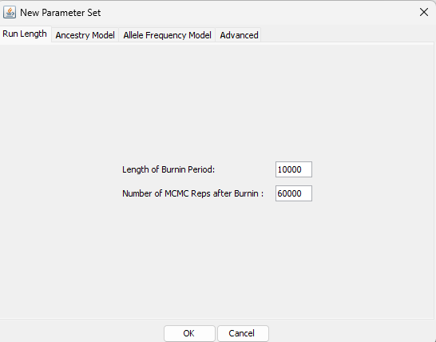
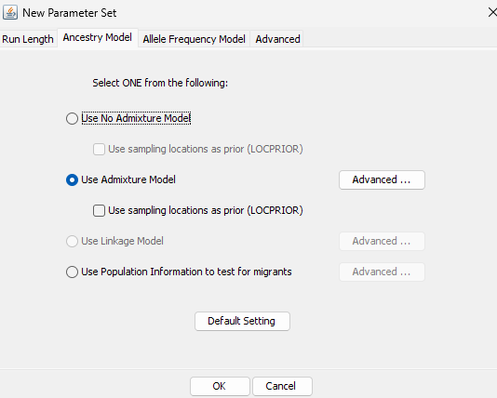
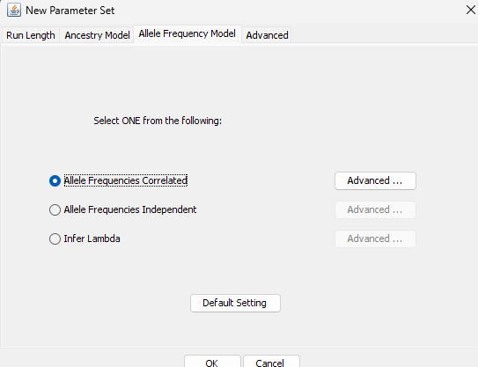

Slide 13
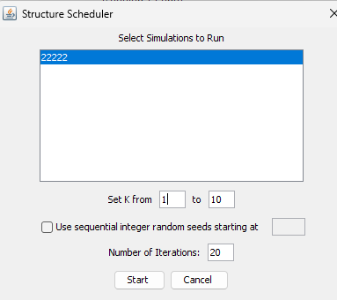

Slide 14

Exploring Population Biology Analyses: A Beginner's Guide
Shutter 2U, Getty images

Slide 15
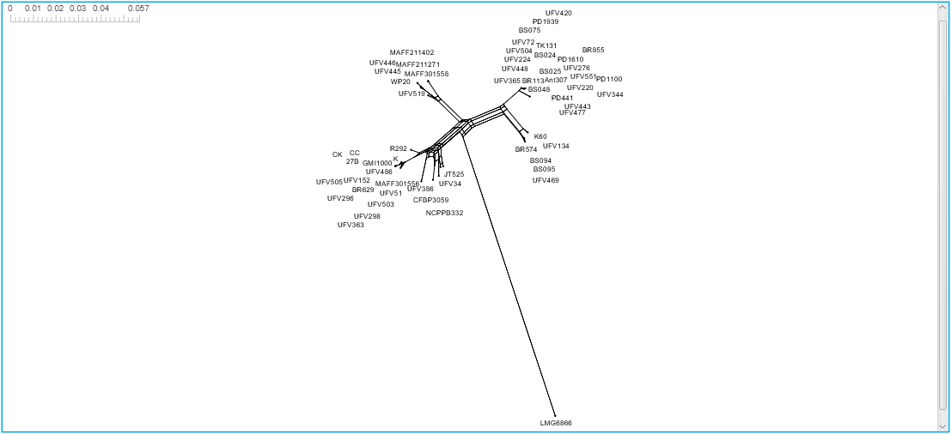

Slide 16
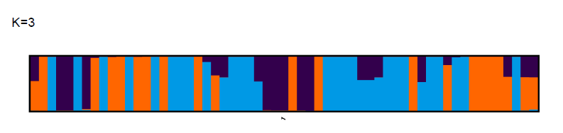
Viçosa
Concórdia

Slide 17
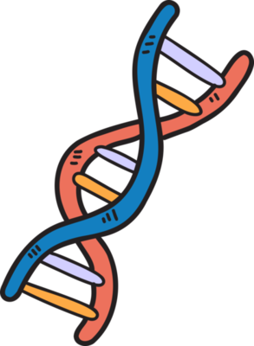

Exploring Population Biology Analyses:
A Beginner's Guide

Slide 18
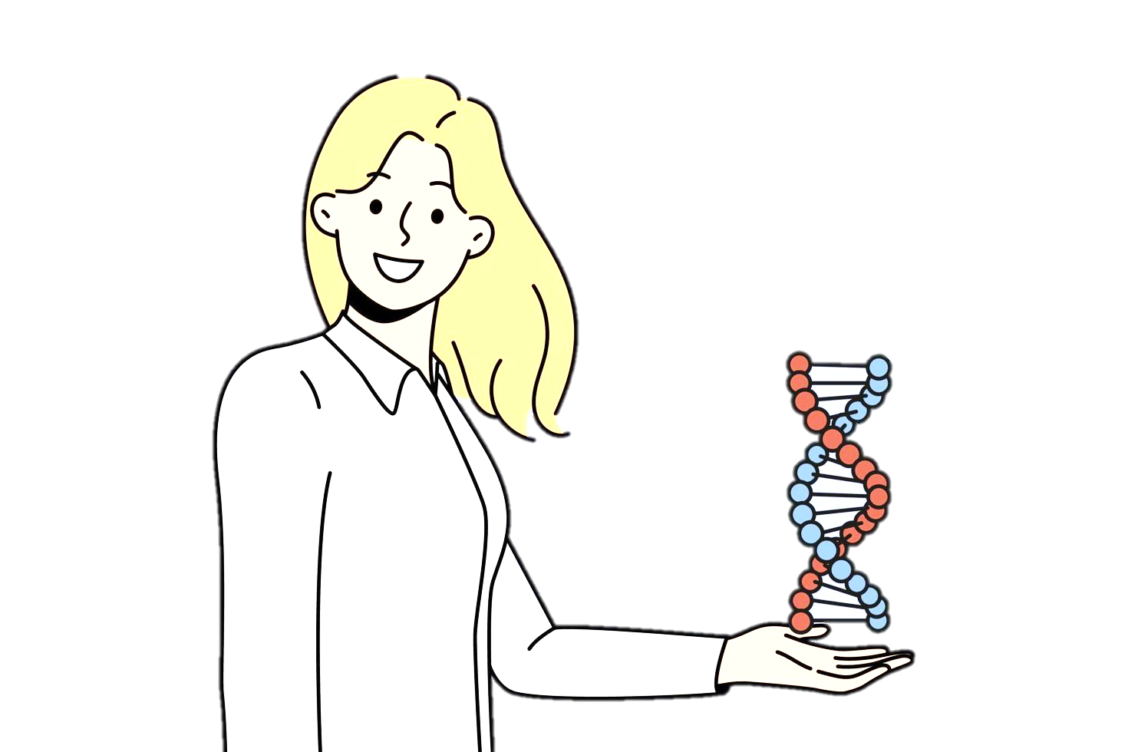

Slide 19
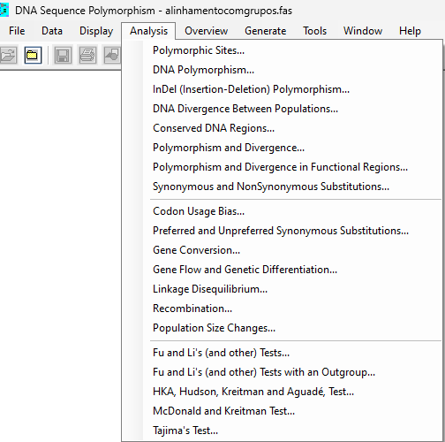

Slide 20
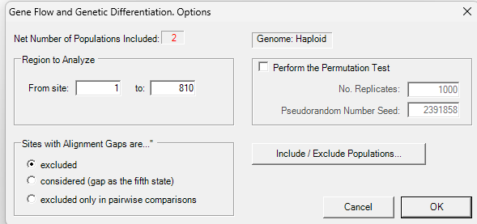

Slide 21
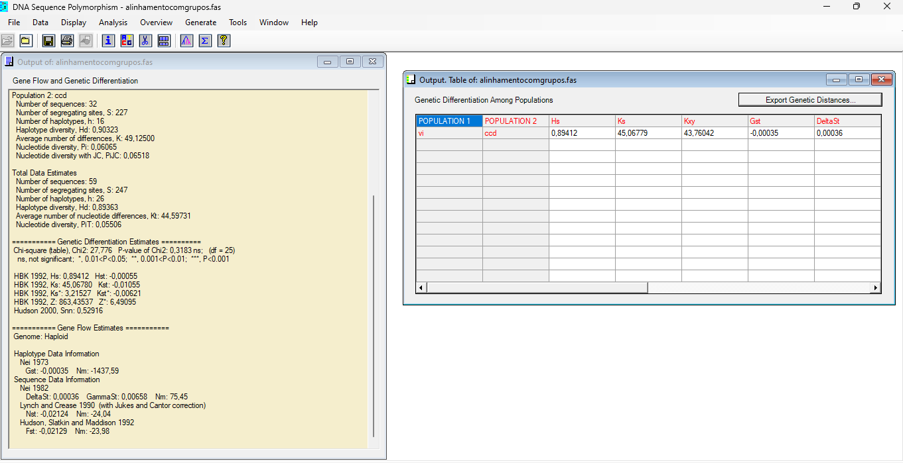

Slide 22
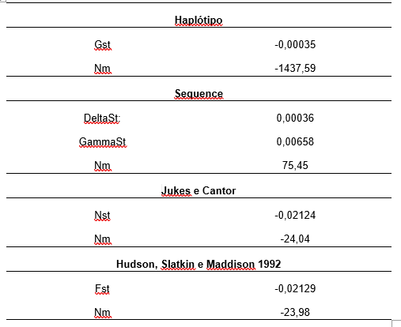

Slide 23
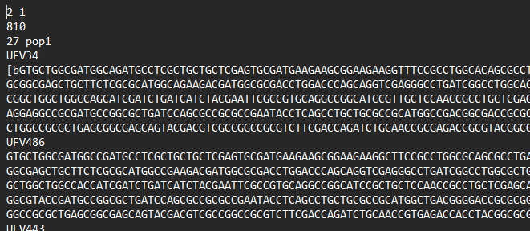
Populations number
Loci number
Individuals inside pop1
Individual name

Slide 24
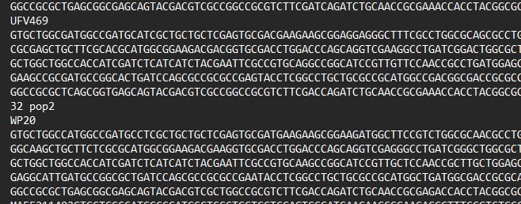

Slide 25
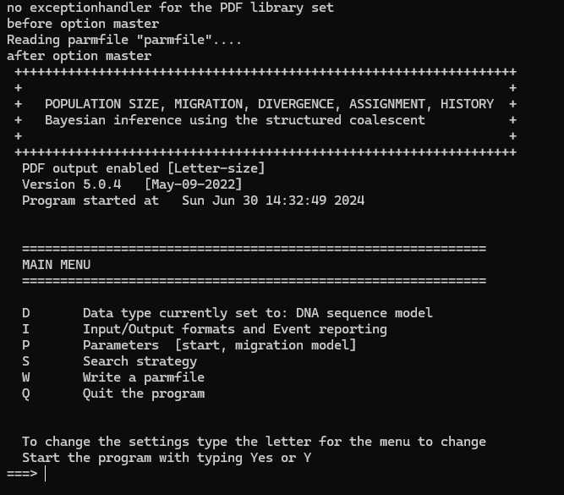

Slide 26
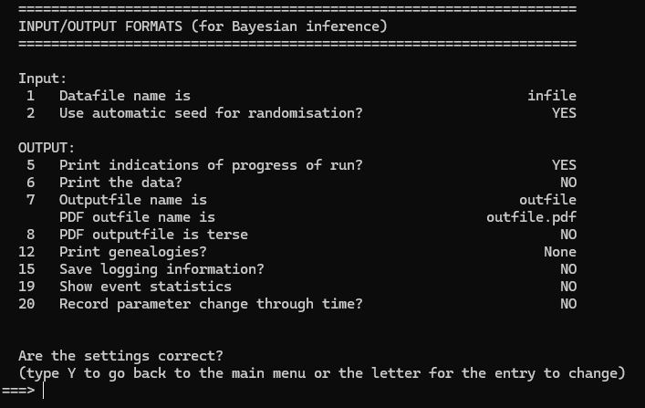
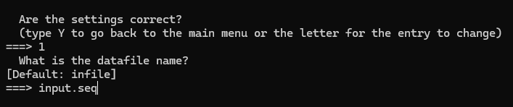
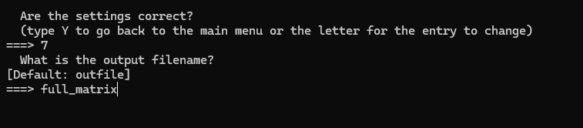

Slide 27
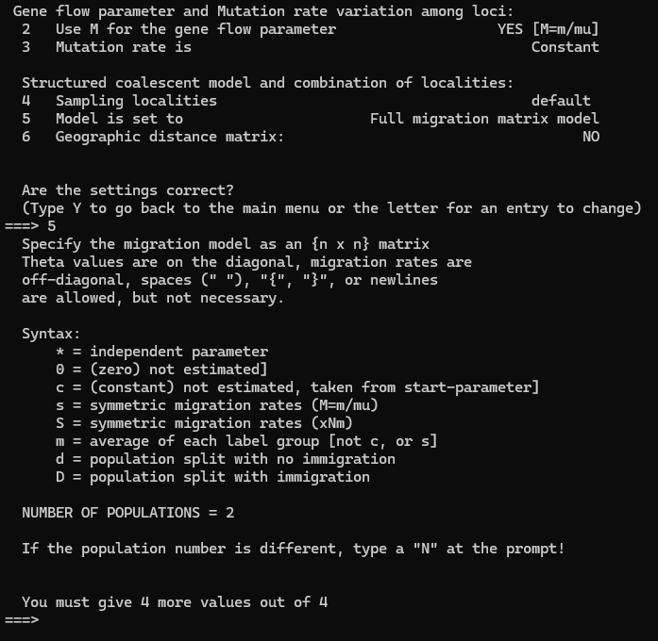

Slide 28
pop1
pop2
Pop
1
2
Bidirectional gene flow = Full Matrix
1
*
*
2
*
*
pop1
pop2
Pop
1
2
Pop1 to Pop2 gene flow = Model1
1
*
0
2
D
*
pop1
pop2
Pop
1
2
Pop2 to Pop1 gene flow = Model2
1
*
D
2
0
*

Slide 29
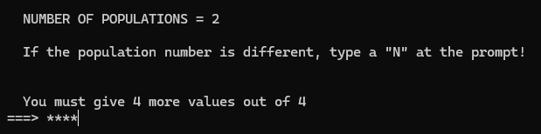
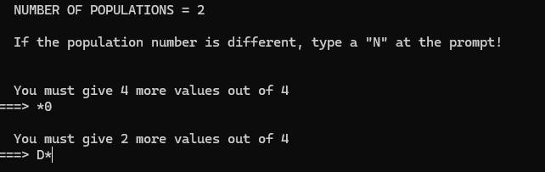
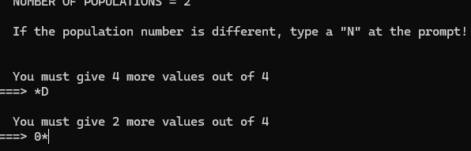
Pop
1
2
1
*
*
2
*
*
Pop
1
2
1
*
0
2
D
*
Pop
1
2
1
*
D
2
0
*

Slide 30
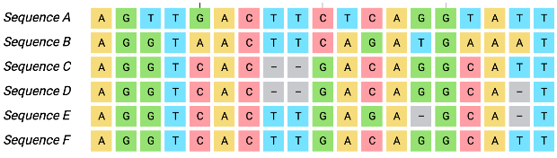
Is any population acting as a source
Structure
YES
Yes
Migrate-n
NO
DAPC, UPGMA, NJ
MSN, Splitstree, AMOVA, FST
NO
Align
Are the populations regionally differentiated?
No
Migration
Test of neutrality
Population in equilibrium H-W?
Is genetic flow occurring between the populations?
Genetic Structure
Linkage disequilibrium
Genetic Diversity
Are the populations clonal, sexual, or mixed?
highly diverse
Is this population neutral?
What is the diversity within the populations, and are they equally diverse?

Slide 31
1. Are the populations clonal, sexual, or mixed?
2. Are the populations regionally differentiated?
3. Is there genetic diversity?
4. Is there gene flow between the populations?
5. Is any population acting as a source?
Before beginning the analyses, it is advisable to check whether the population is clonal or not, as some tests rely on Hardy-Weinberg equilibrium.
Align
Structure
YES
DAPC, UPGMA, NJ
MSN, Splitstree, AMOVA, FST
NO
Population in equilibrium H-W?
Linkage disequilibrium
Genetic Structure

