Slide 1
Functional enrichment analysis (FEA)
Monash Genomics and Bioinformatics Platform
12-13 August 2026

Slide 2
Functional enrichment analysis
Functional enrichment analysis is a broad term that refers to various methods used to extract biological or functional insights from lists of biomolecules.
Identify biological functions, pathways, or molecular mechanisms that are significantly associated with a subset of biological molecules, such as those that are differentially expressed or mutated in a particular condition.

Slide 3
Synonyms
Enrichment analysis
Pathway analysis
Pathway enrichment analysis
Functional annotation analysis
Functional enrichment analysis

Slide 4
Functional enrichment analysis: when?
Post differential expression (omics datasets)
Transcriptomics (high-fat diet vs. low-fat diet)
Proteomics
Metabolomics/Lipidomics
Epigenomics (cancer vs. normal cells)
GWAS
…

Slide 5
Functional enrichment analysis: why?
Once a large-scale omics study undertaken:
Summarise long list of many significant genes/proteins into meaningful biological insights
Hypothesis generation
FEA doesn’t prove mechanisms; it points to them. It helps you move from
“What genes changed?” → to “What might be happening biologically, and how can I test it?”
Notes:
Example 1:
You perform RNA-seq on treated vs. untreated cells and find that FEA shows enrichment in:
“Apoptotic process” and “p53 signaling pathway”
Hypothesis generated: → “The treatment might be triggering apoptosis through p53 activation.” Next experiment: → Test p53 expression or caspase activity to confirm.
Example 2:
In a cancer dataset, FEA shows enrichment in:
“Angiogenesis” and “VEGF signaling”
Hypothesis generated: → “Tumor growth in this condition could be driven by increased VEGF signaling.” Next experiment: → Measure VEGF levels or inhibit VEGF receptors to see the effect.
Example 3:
In a microbiome study, FEA finds enrichment in:
“Lipid metabolism” and “Immune regulation”
Hypothesis generated: → “Microbial changes might influence host lipid metabolism and immune balance.” Next experiment: → Validate lipid levels or immune markers in host tissues.

Slide 6
Functional enrichment analysis: Input data?
Data captured from an -omics study
List of features
Background set
Ranked list
Gene sets
Gene | FC | p-value
ADAR | 2.57 | 2.34E-06
ACADSB | 2.53 | 0.000634
ADH1B | 2.48 | 0.00574
ABCC4 | 2.17 | 0.00249
ACLY | 2.02 | 1.98E-05
ACP2 | 1.94 | 3.75E-05
ACAD9 | 1.88 | 8.50E-06
ACTG2 | 1.85 | 0.00507
ACE | 1.82 | 0.025
ADPRHL2 | 1.79 | 0.00156
ACP1 | 1.55 | 0.00273
ADSL | 1.43 | 0.000453
A2M | 1.35 | 0.00283
AEBP1 | 1.28 | 0.002
AAK1 | -1.09 | 0.0238
ACAA2 | -1.11 | 0.0156
ABCF1 | -1.28 | 0.00147
A1BG | -1.34 | 5.15E-05
ACOX3 | -1.41 | 0.0197
ACIN1 | -1.64 | 2.57E-05
ACAD8 | -1.69 | 0.0116
ABHD10 | -1.77 | 0.00182
ACAA1 | -1.84 | 0.00414
ACSL3 | -1.91 | 0.00166
ABHD14B | -1.97 | 0.024
ACBD3 | -2.12 | 0.000444
ABAT | -2.15 | 0.00403
ACSM3 | -2.28 | 0.000703
ACSL1 | -2.68 | 0.000584
ACY1 | -2.72 | 2.61E-05
ACACA | -2.92 | 0.000124
ACSS1 | -3.04 | 2.16E-05
ABHD11 | -3.66 | 3.81E-06
Gene | Rank
ACLY | 12.0898294
ACP1 | 9.85374061
ABCC4 | 9.48401106
ACE | 7.11197165
ADH1B | 6.62515224
ADAR | 6.59826379
AEBP1 | 6.53661481
ACP2 | 6.37936782
ACAD9 | 6.28101832
ADPRHL2 | 6.20646376
ACAA1 | 6.14771005
ABAT | 5.92969843
ACTG2 | 5.89740654
ABHD11 | 5.86732359
ADSL | 5.74621125
A2M | 5.63339695
ACADSB | 5.52810629
ABHD14B | -6.2311846
ACAD8 | -6.3208579
ACSM3 | -6.386081
ABHD10 | -6.4047445
A1BG | -6.441692
ACY1 | -6.5349181
AAK1 | -6.6426254
ACIN1 | -6.9649449
ABCF1 | -7.1039408
ACOX3 | -7.1751947
ACSL3 | -7.220302
ACAA2 | -7.800639
ACSL1 | -8.0151174
ACBD3 | -8.5603888
ACSS1 | -1.00E+01
ACACA | -10.204292
HALLMARK_ADIPOGENESIS | https:// | ABCA1 | ABCB8 | ACAA2
HALLMARK_ALLOGRAFT_REJECTION | https:// | AARS1 | ABCE1 | ABI1 | ACHE
HALLMARK_ANDROGEN_RESPONSE | https:// | ABCC4 | ABHD2 | ACSL3
HALLMARK_ANGIOGENESIS | https:// | APOH | APP | CCND2 | COL3A1 | COL5A2
HALLMARK_APICAL_JUNCTION | https:// | ACTA1 | ACTB | ACTC1 | ACTG1
HALLMARK_APICAL_SURFACE | https:// | ADAM10 | ADIPOR2 | AFAP1L2

Slide 7
Concepts
Gene list (input set)
Background set
Gene set
Annotation database
P-value and false discovery rate (FDR)
Regulation
ID mapping
Notes:
Relevant concepts

Slide 8
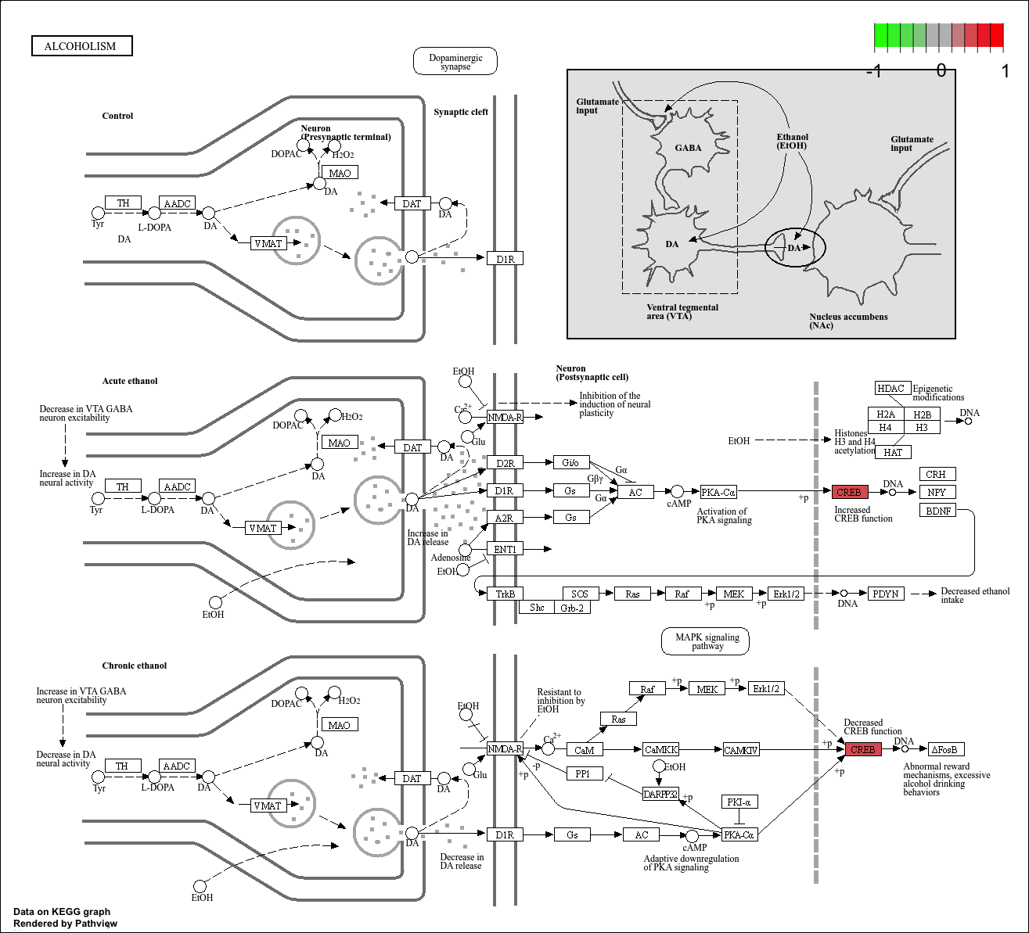

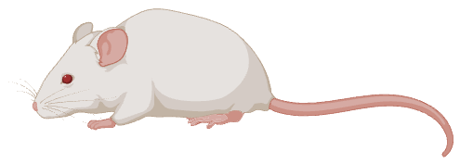
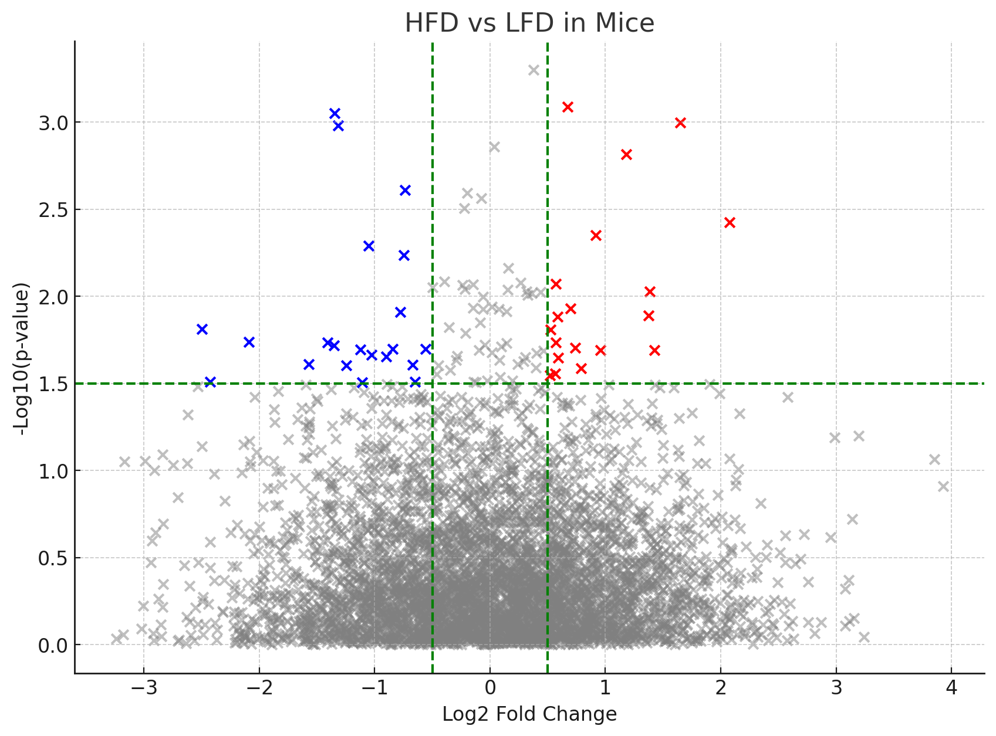
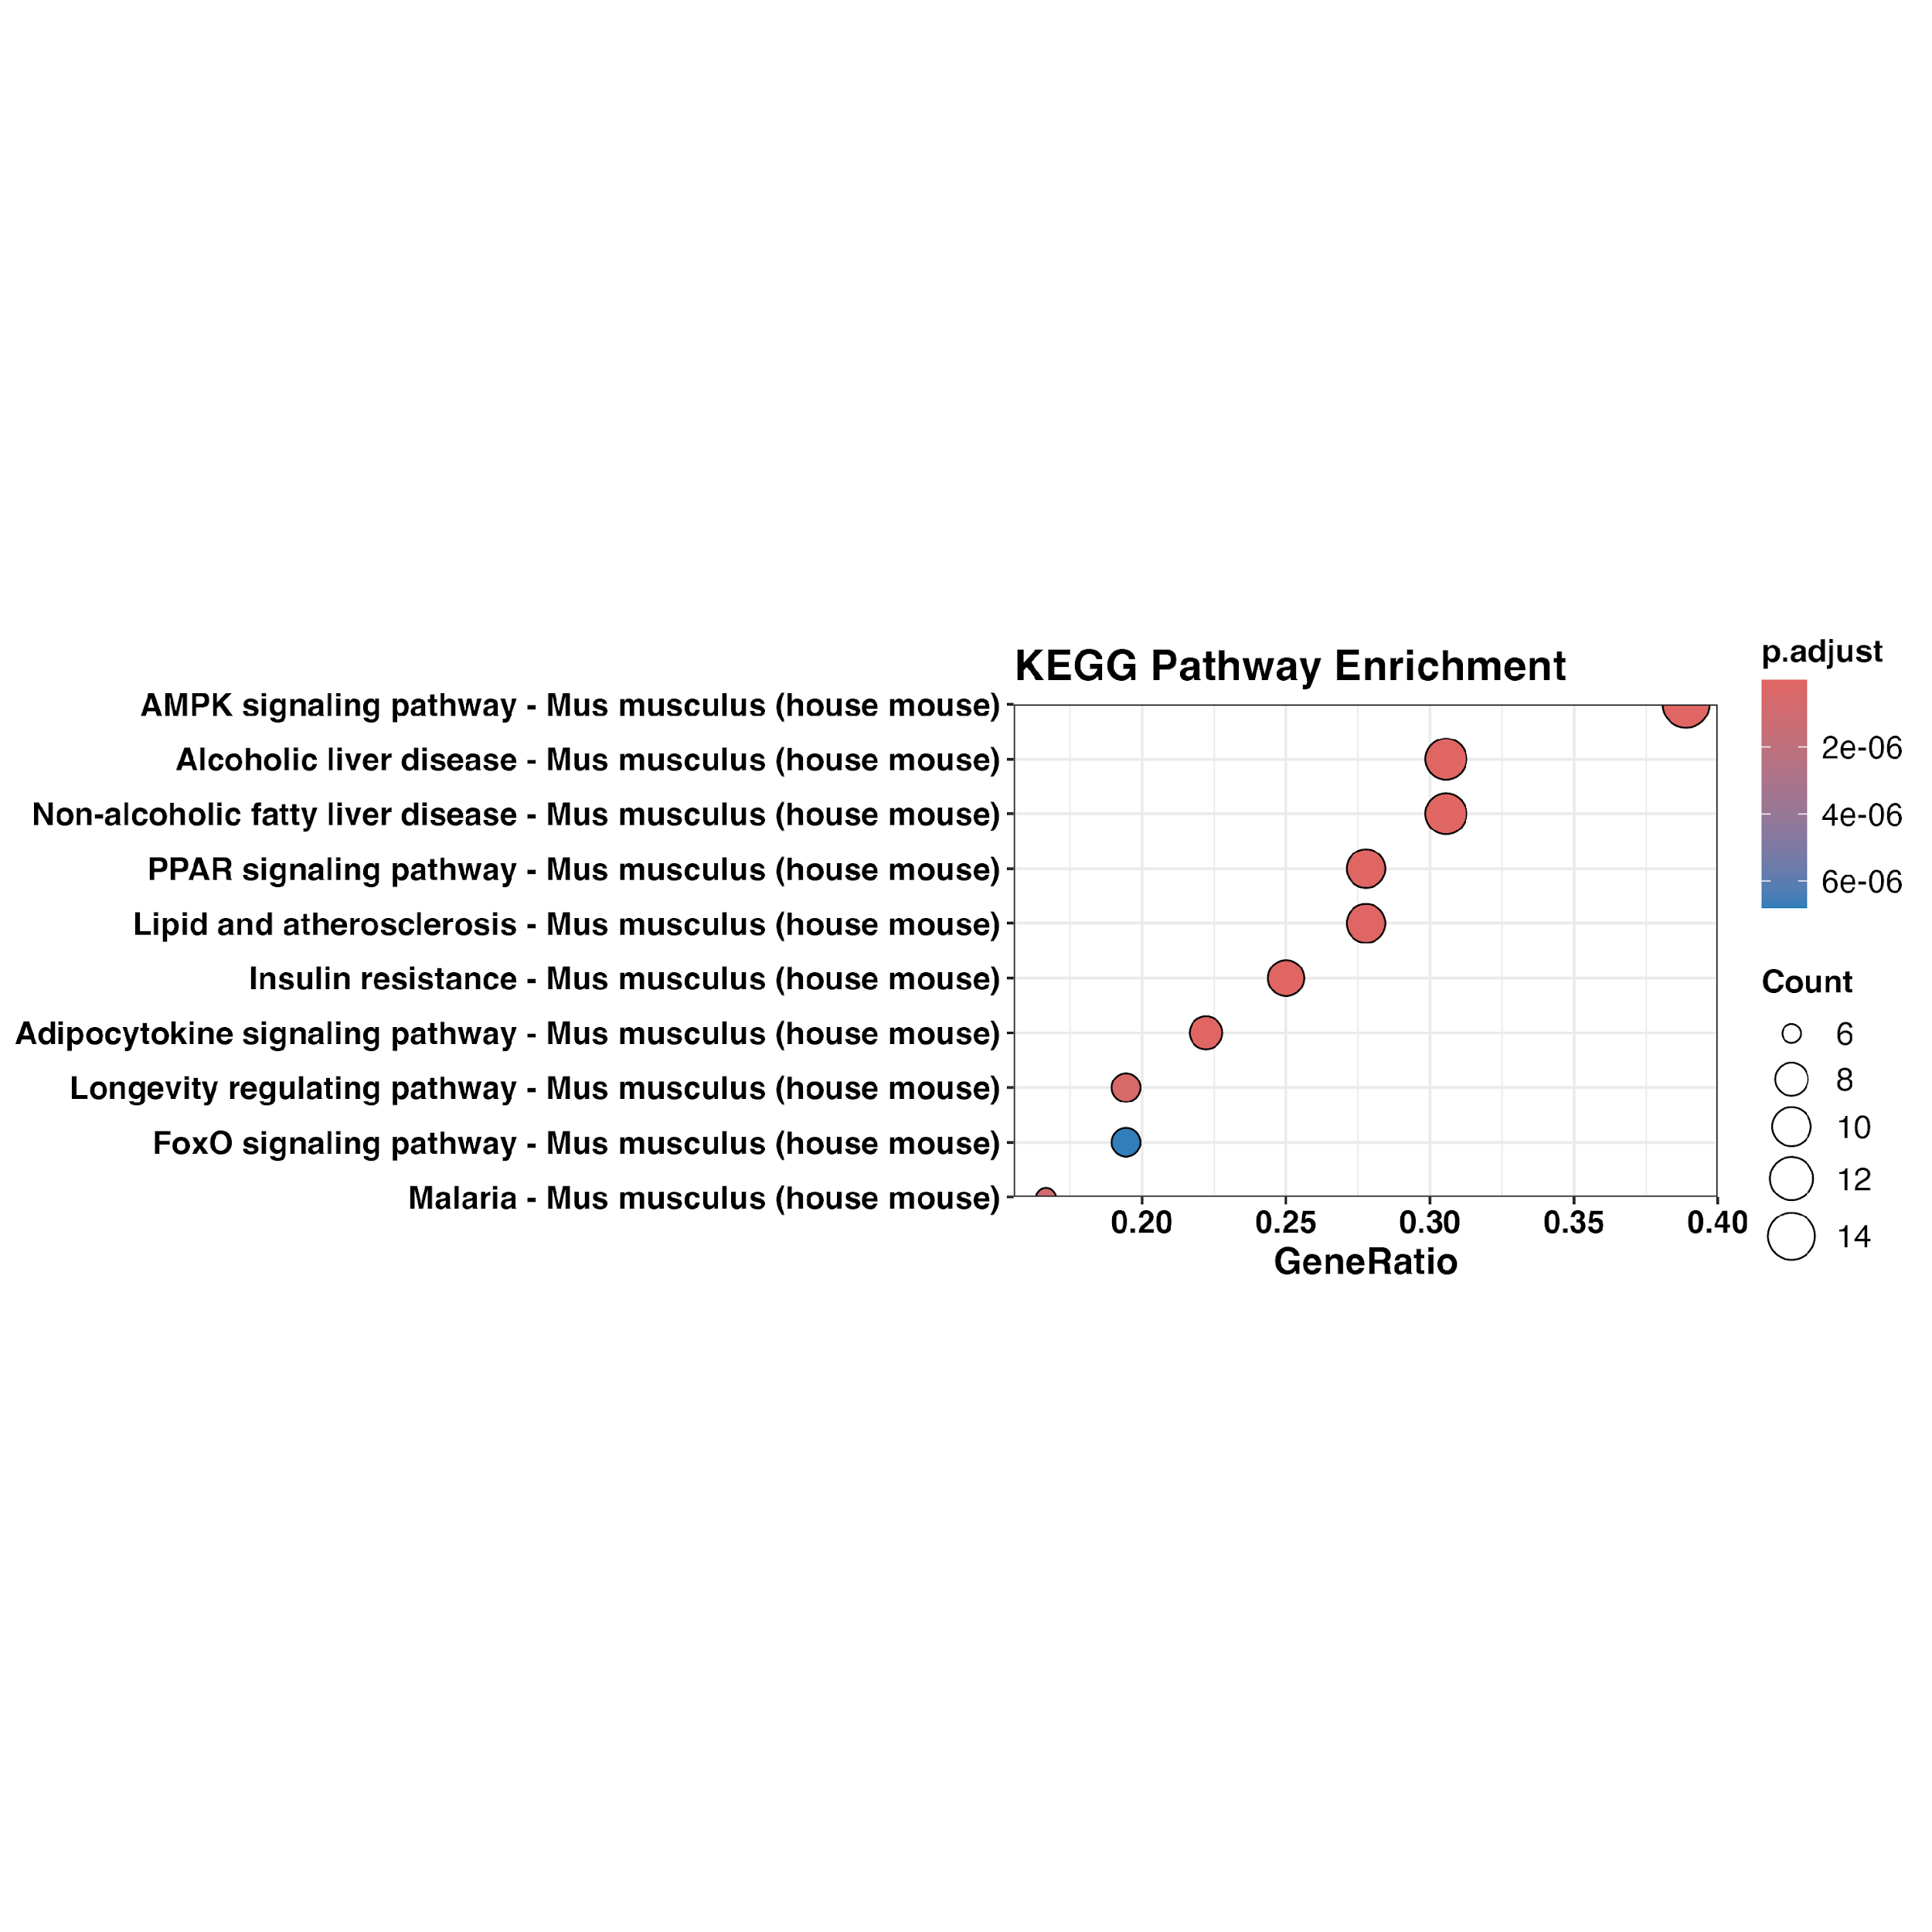
FEA at a glance: Mouse diet experiment
DEGs
Lep
Cd36
Fasn
Srebf1
Ccl2
Tnf
Il6
Il1b
Atf4
Dgat1
Dgat2
Cidea
Fabp4
Scd1
Irf7
Cxcl10
Resistin
Gdf15
Pparg
Adipoq
Cpt1a
Lpl
Ucp1
Slc2a4
Sod2
Irs1
Ppara
Pgc1a
Nrf1
Mc4r
Acadm
Gpr109a
Sod1
Nrf2
Hmgcr
Igf1
Foxo1
Il10
Il4
Eif2ak3
Annotation
Database
High Fat Diet
Low Fat Diet
Algorithms
Sort and organise annotation terms
Statistics
Calculate enrichment p-values
Results
Notes:
Typical Workflow

Slide 9
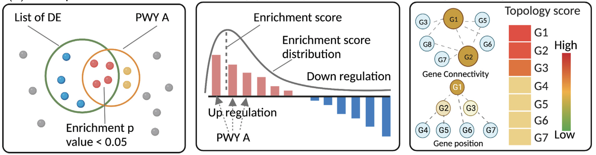
Types of Enrichment Analysis
Over Representation Analysis (ORA)
- Up-regulated features
- Down-regulated features
- Modular Enrichment (clusters)
- Cell-Specific ORA
Functional Class Scoring (Rank-based)
- Pre-ranked GSEA
- ssGSEA
- Camera
- ROAST
Topology-based Pathway Analysis (TPA)
- SPIA - TopologyGSEA
Zhao K, Rhee SY. Interpreting omics data with pathway enrichment analysis. Trends Genet. 2023
Notes:
Topology-based methods: A scoring system to measure gene location within a pathway, number of interactions, and expression levels.
*Note: TPA is not covered in our workshop.
Requires good understanding of network biology and pathway topology
Needs high-quality pathway topology information (detailed pathway data), which might not be always available for all organisms or conditions
ORA and GSEA have been mostly used by researchers
TPA

Slide 10
Comparison of Enrichment Methods
Method Type | Advantages | Disadvantages
Over-Representation Analysis (1st Generation) | • Straightforward • Widely implemented | • Ignores expression magnitude (treats all genes equally). • Requires arbitrary cutoff thresholds (information loss). • Assumes independence of each gene and pathway. • Ignores gene–gene correlation and pathway overlap. • May produce biased significance when pathways share genes.
Functional Class Scoring (2nd Generation) | • Uses all genes (no arbitrary cutoff). • Detects subtle, coordinated expression changes. • Incorporates gene-level statistics (fold-change, t-score, etc.). • Considers dependence among genes in a pathway. | • Still analyses each pathway independently. • Overlaps among gene sets can inflate significance. • Many methods use rank-based scores, ignoring magnitude differences. • Does not include interaction directionality or pathway structure.
Pathway Topology–based Analysis (3rd Generation) | • Incorporates pathway topology (interactions, direction, activation/inhibition). • Models propagation of perturbations through the network. • Identifies upstream/downstream effects and key nodes. • More mechanistic and biologically realistic. | •Requires experimental evidence for pathway structures and gene–gene interactions, which is largely unavailable for many organisms.

Slide 11
Why/when ora/gsea? Or both?
 | ORA | GSEA
Purpose | Is a set of genes overrepresented in a list of significantly expressed genes? | Does a set of genes appear more often at the top of bottom of a ranked list
Inputs | List of significant genes (e.g. based on Pvalue or some cutoff) | Ranked gene list ordered by continuous metric (e.g. p value)
Gene set definition | Predefined genes grouped by function, pathway, phenotype | Same as ORA but applied across whole ranked list
Outputs | Enriched gene sets, p values for enriched sets | Enrichment scores per gene set, normalised enrichment scores, p values/FDR adjusted
Stats used | Fishers exact for over-representation? | Permutation-based for significance testing?
Example research q | What biological pathways are overrepresented among significantly downregulated genes in condition X? | Are immune-related pathways enriched across patients with condition x compared with healthy controls?

Slide 12
Statistics - overview (ora, gsea)

Slide 13

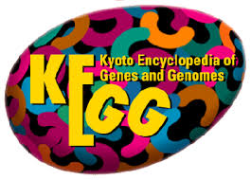










Annotation Databases
Notes:
Gene Ontology is a standardised system that describes what genes, and their products do in different organisms (Common language for gene function). GO is not pathway-based; it’s an ontology — a structured vocabulary that describes concepts and relationships between them.
A pathway is a map of how molecules interact to carry out a biological process.
The glycolysis pathway shows how glucose is broken down for energy,
A Gene Ontology (GO) term is a defined label that describes a specific biological concept.
A pathway is a map that shows how multiple genes or proteins work together to make something happen.
A GO term is like a tag or label that tells you what a gene does or where/how it works.
KEGG: Professionally curated Reactome: Expert curated (Human-specific mainly) Wikipathway: Community-curated resource
KEGG: Broad focus (metabolism, genetic info, diseases, drugs) Reactome: Detailed molecular reactions Wikipathway: Broad (editable)
KEGG: pathway maps Reactome: reaction network Wikipathway: pathway diagram

Slide 14
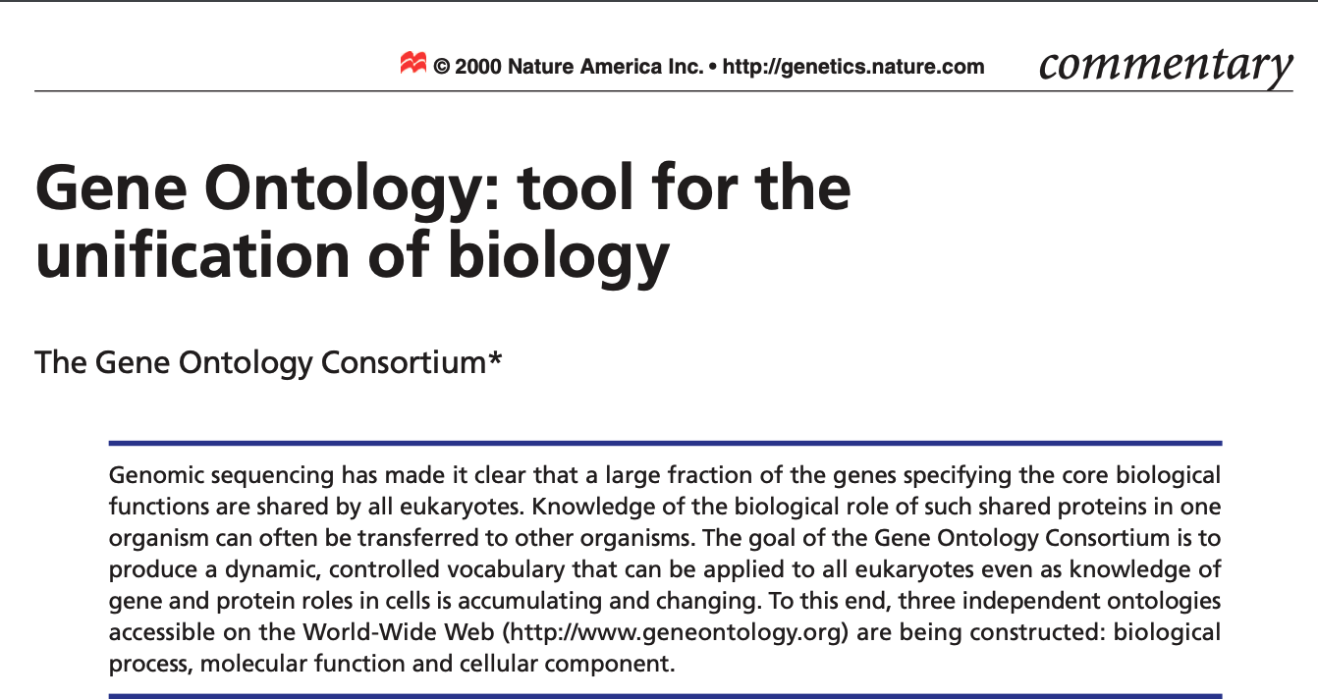
Gene Ontology (GO)
Definition
Categories
Biological Processes
Molecular Functions
Cellular Components
Notes:
The Gene Ontology (GO) provides a framework and set of concepts for describing the functions of gene products from all organisms
Integrate data about gene products across species
Two parts:
ontology (dictionary of terms)
annotations (association of a gene product to an ontology term)
Literature curation
Sequence analysis, infer information from unpublished genes

Slide 15
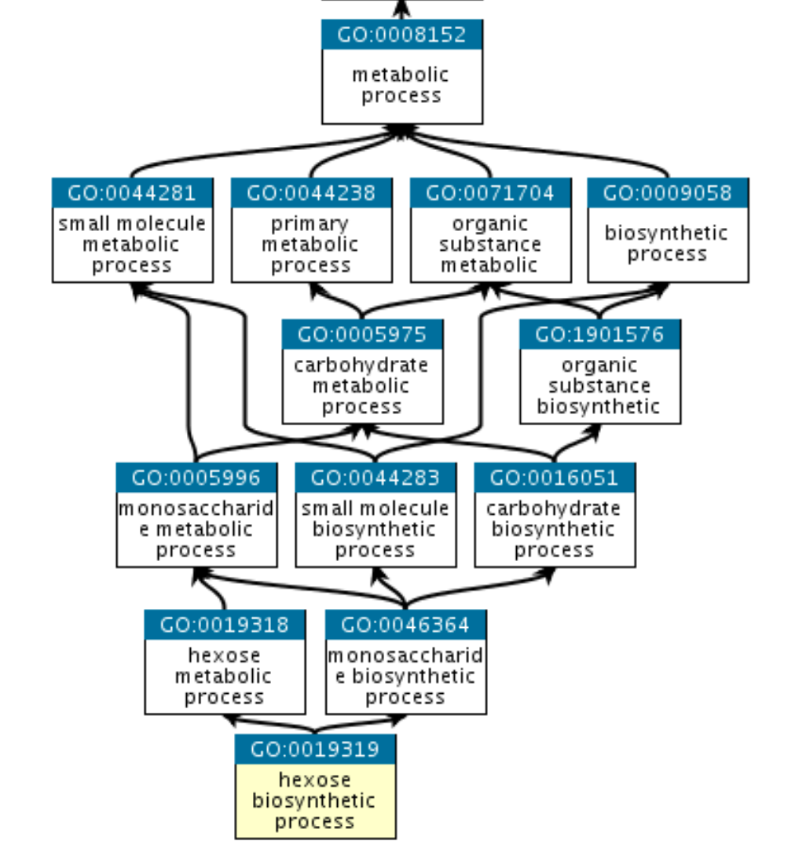
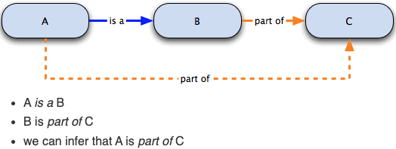
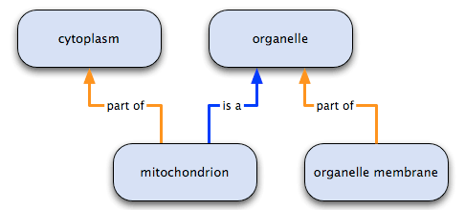
The GO Graph
Definition
Domains
Biological Processes
Molecular Functions
Cellular Components
mitochondrion has two parents:
it is an organelle
it is part of the cytoplasm
This reflect the fact that:
biosynthetic process is a subtype of metabolic process
a hexose is a subtype of monosaccharide
Exploring Gene Ontology by EMBL-EBL
Notes:
The Gene Ontology (GO) is a structured, controlled vocabulary that describes the functions of genes and gene products across all species in a consistent, hierarchical way
Directed Acyclic Graph (DAG)

Slide 16
GO Domains
Molecular Function (MF) | Molecular-level activities performed by gene products. catalytic activity and transporter activity; adenylate cyclase activity or Toll-like receptor binding. GO molecular functions are often appended with the word “activity” (a protein kinase would have the GO molecular function protein kinase activity).
Cellular Component (CC) | A location, relative to cellular compartments and structures. cellular anatomical entities, includes cellular structures such as the plasma membrane and the cytoskeleton, as well as membrane-enclosed cellular compartments such as the mitochondrion
Biological Process (BP) | The larger processes, or ‘biological programs’ accomplished by multiple molecular activities. DNA repair or signal transduction. pyrimidine nucleobase biosynthetic process or glucose transmembrane transport.
An example of GO annotation: human “cytochrome c”:
molecular function oxidoreductase activity,
the biological process oxidative phosphorylation, and
the cellular component mitochondrial intermembrane space.
Note: a biological process is not equivalent to a pathway.
https://geneontology.org/docs/ontology-documentation

Slide 17
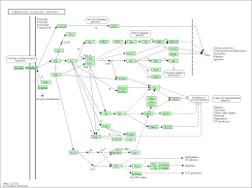
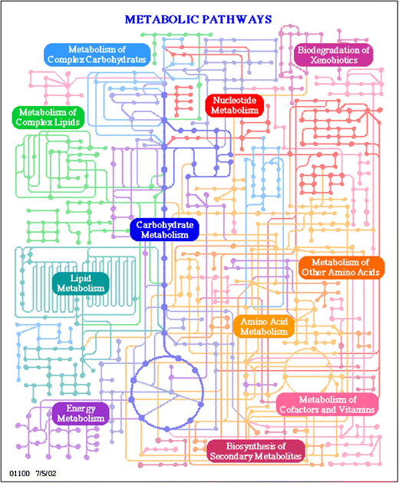
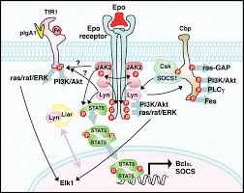
Pathways in Biology
Metabolic Pathways
Molecular Interactions
Signalling Networks
Regulatory Networks
Genetic Interactions

Slide 18




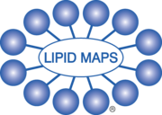


Annotation Databases
Enrichr
Notes:
Gene Ontology (GO)-Based Databases
Pathway Databases
Functional Category / Protein Family Databases:
InterPro: The focus is Protein families, domains, and functional sites (binding sites/ active sites)
BioGrid: The focus is protein and genetic interactions
pfam: protein domains and families
protein family is a group of proteins that are evolutionarily related
protein domain is a distinct structural and functional unit within a protein.
Integrated database's
Metabolomics/Lipidomics
SMPDB: The Small Molecule Pathway Database
BioCyc: Provides detailed information on the genomes, metabolic pathways, enzymes, reactions, and regulatory networks of thousands of organisms.

Slide 19
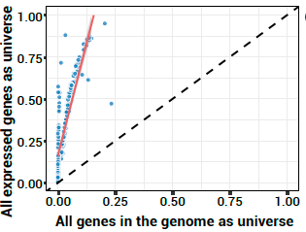
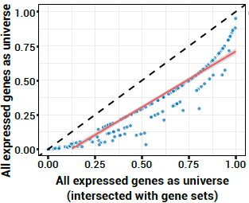
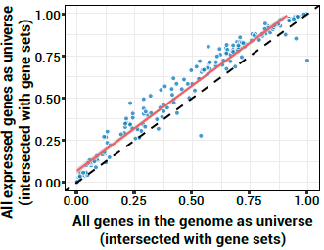
Considerations – Background sets
Total features of the species
Subset of features captured in the experiment
Subset of features captured in the experiment ∩ annotation
Yu G. (2026). Background bias in functional enrichment analysis: Insights from clusterProfiler. The Innovation Life 4:100181.

Slide 20
Considerations – Background sets
Total features of the species
Subset of features captured in the experiment
Subset of features captured in the experiment ∩ annotation
Subset of research-specific features (metabolism > metabolic genes only)
Notes:
For example, enrichment analysis was performed to examine whether genes associated with specialized metabolism were associated with specific epigenetic modification patterns relative to other types of metabolic genes.
In this analysis, total metabolic genes were chosen as the background set instead of total genes detected in epigenomic profiling.
Zhao, K. et al. (2021) A novel bivalent chromatin associates with rapid induction of camalexin biosynthesis genes in response to a pathogen signal in Arabidopsis. eLife 10, e69508

Slide 21
Considerations – Annotation Databases
Annotation databases use different ontologies to define pathways
KEGG vs EcoCyc
KEGG Modules are comparable
Multiple pathway databases or integrative ones
Pathway | Differences | MPath
Notch signalling | WikiPathways = significant ↑ KEGG/Reactome = ↑ (not sig.) | Significant ↓ (direction reversed)
DNA replication | Reactome = ↑ KEGG/WikiPathways = ↓ (not sig.) | Significant ↓
Hedgehog signalling | WikiPathways = ↑ KEGG/Reactome = ↑ (not sig.) | Significant ↓ (direction reversed)
TGF-β signaling | KEGG = activated WikiPathways = inhibited | Inhibited
Estrogen signalling | KEGG = inhibited WikiPathways = activated | Inhibited
Karp, P.D., Midford, P.E., Caspi, R. et al. Pathway size matters: the influence of pathway granularity on over-representation (enrichment analysis) statistics. BMC Genomics 2021
Mubeen S, Hoyt CT, et al.. The Impact of Pathway Database Choice on Statistical Enrichment Analysis and Predictive Modeling. Front Genet. 2019 Nov
Notes:
KEGG pathways: large (many biological processes merged)
EcoCyc pathways: finer granularity (typically one biological process)
The same number of “significant genes” results in more significant enrichment (smaller p‐values) compared to KEGG
KEGG contains only 348 metabolic modules (December 12, 2019) compared to the 2801 pathways in MetaCyc version 24.0 (December 12, 2019)
MPath (KEGG + Reactome + WikiPathways)
TPA method showed even greater variability due to structural differences between databases
Mpath: a more consistent databse
The reversal in the direction of pathway regulation (e.g., from overexpressed in KEGG/WikiPathways to underexpressed in MPath) arises from how MPath integrates and merges information across databases:
MPath’s includes all genes/interactions from multiple sources (Expands gene set dramatically)
Added genes may alter net enrichment direction

Slide 22
Special considerations - Proteomics
PSEA: relative abundance (label-free quantification methods)
PSEA-Quant: average abundance and variation between replicates (label-based n label-free)
- Rank proteins > weight > sum of weighted enrichment score of a term constituent proteins
Cha S, Imielinski MB, Rejtar T, Richardson EA, Thakur D, Sgroi DC, Karger BL. In situ proteomic analysis of human breast cancer epithelial cells using laser capture microdissection: annotation by protein set enrichment analysis and gene ontology. Mol Cell Proteomics. 2010
Lavallée-Adam M, Rauniyar N, McClatchy DB, Yates JR 3rd. PSEA-Quant: a protein set enrichment analysis on label-free and label-based protein quantification data. J Proteome Res. 2014
Notes:
PSEA-Quant: Average abundance and variation between replicates >>> Protein enrichment score.
High abundance and low variation proteins > higher score on the rank
Pathway enrichment score = the sum of weighted enrichment scores of its constituent proteins.

Slide 23
Special considerations - Metabolomics
MetPA: relies on compound annotation + network topology
- Annotating metabolites based of chemical standards, searching metabolic features like m/z or fragmentation patterns generated by MS against metabolite libraries.
Mummichog: to bypass annotation limitation
- Using spectral features like m/z and retention time
- Requires downstream analytical chemistry to identify specific metabolites associated with phenotypes of interest
Functional Analysis of Global Metabolomics
Jianguo Xia, David S. Wishart, MetPA: a web-based metabolomics tool for pathway analysis and visualization, Bioinformatics, Volume 26, Issue 18, September 2010, Pages 2342–2344
Li S, Park Y, Duraisingham S, Strobel FH, Khan N, Soltow QA, Jones DP, Pulendran B. Predicting network activity from high throughput metabolomics. PLoS Comput Biol. 2013;9(7):e1003123. doi: 10.1371/journal.pcbi.1003123. Epub 2013 Jul 4. PMID: 23861661; PMCID: PMC3701697.
Notes:
Quantification relies on fragmentation of compounds generated by MS
Compound annotation represent a bottleneck in analysing metabolomics data which makes metabolomic profiles sparser and more ambiguous
than transcriptomics.
However, MetPA and MSEA require metabolite identifications prior to use, which remains an important challenge in untargeted metabolomics. In comparison, the mummichog algorithm (Li et al. 2013) bypasses the bottleneck of metabolite identification prior to pathway analysis, leveraging a priori pathway and network knowledge to directly infer biological activity based on mass peaks

Slide 24
5 things to remember when doing FEA
The input gene lists for ORA and GSEA are different!
GSEA requires a ranked yet unfiltered gene list, while ORA requires a filtered unranked gene list and experimental background gene list
Always correct for multiple testing!
Use adjusted P values/FDR/qvalues, never unadjusted P values
Ensure reproducibility!
Record all relevant details including tool and database names and versions, all default and custom parameters and options applied, and background gene list
Different analysis methods will return different results!
This is expected and OK, as long as your methods are sensible and detailed.
Interpret your results in their biological context!
Functional categories are often broad and redundant. Use visualisations to make sense of it all.

Slide 25
Further reading
Zhao and Rhee 2023: Interpreting omics data with pathway enrichment analysis
Gable et al 2022: Systematic assessment of pathway databases, based on a diverse collection of user-submitted experiments
Mubeen et al 2019: The Impact of Pathway Database Choice on Statistical Enrichment Analysis and Predictive Modeling
Timmons et al 2015: Multiple sources of bias confound functional enrichment analysis of global -omics data
Wijesooriya et al 2022: Urgent need for consistent standards in functional enrichment analysis
Reimand et al 2019 (Nature Protocol): Pathway enrichment analysis and visualization of omics data using g:Profiler, GSEA, Cytoscape and EnrichmentMap
Geistlinger et al 2020: Toward a gold standard for benchmarking gene set enrichment analysis

