Slide 1

Introduction to R, 16 July 2019
Your instructors:
[instructor names]
We'd like to take some photos of this session, please tell us if you don't want to be photographed.
[etherpad url]

Slide 2
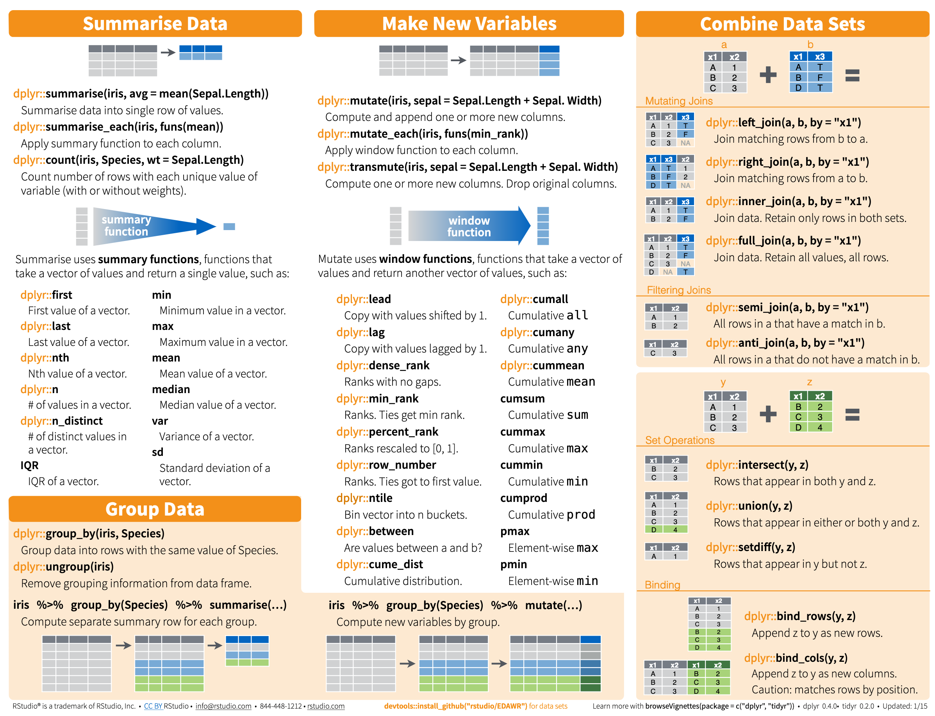
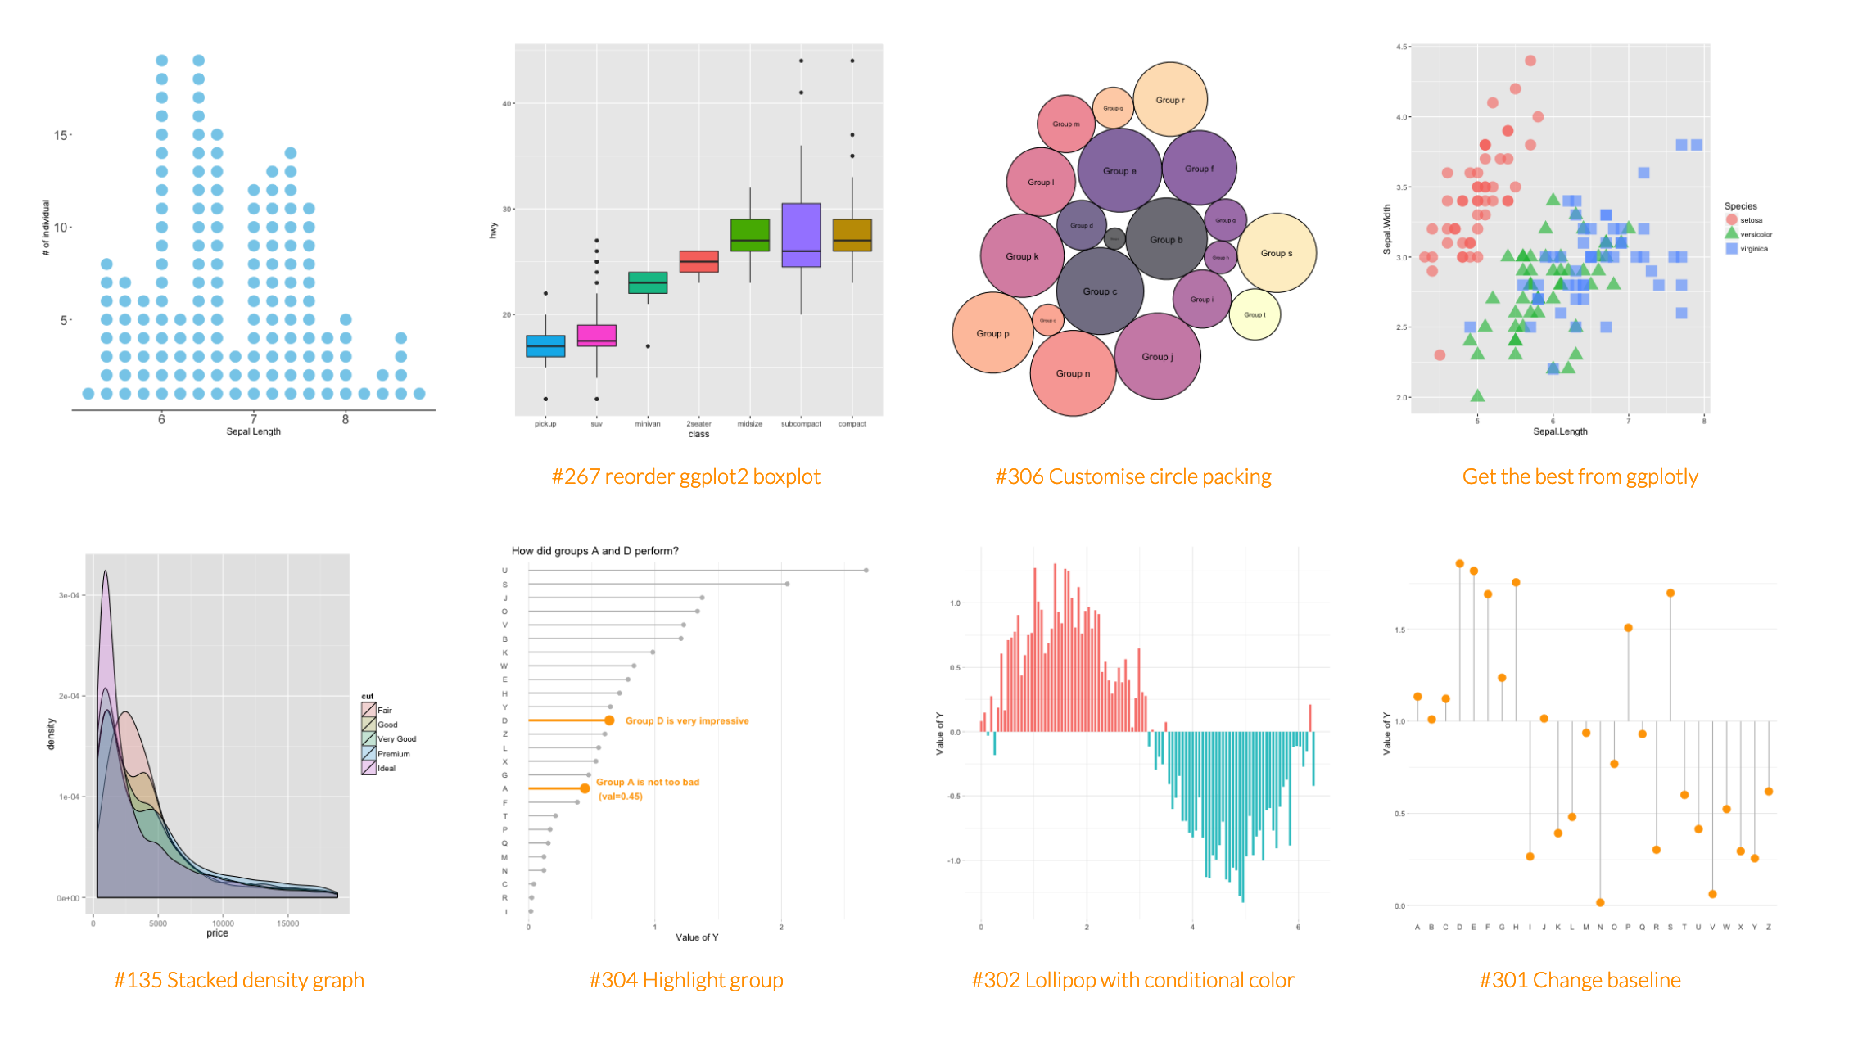
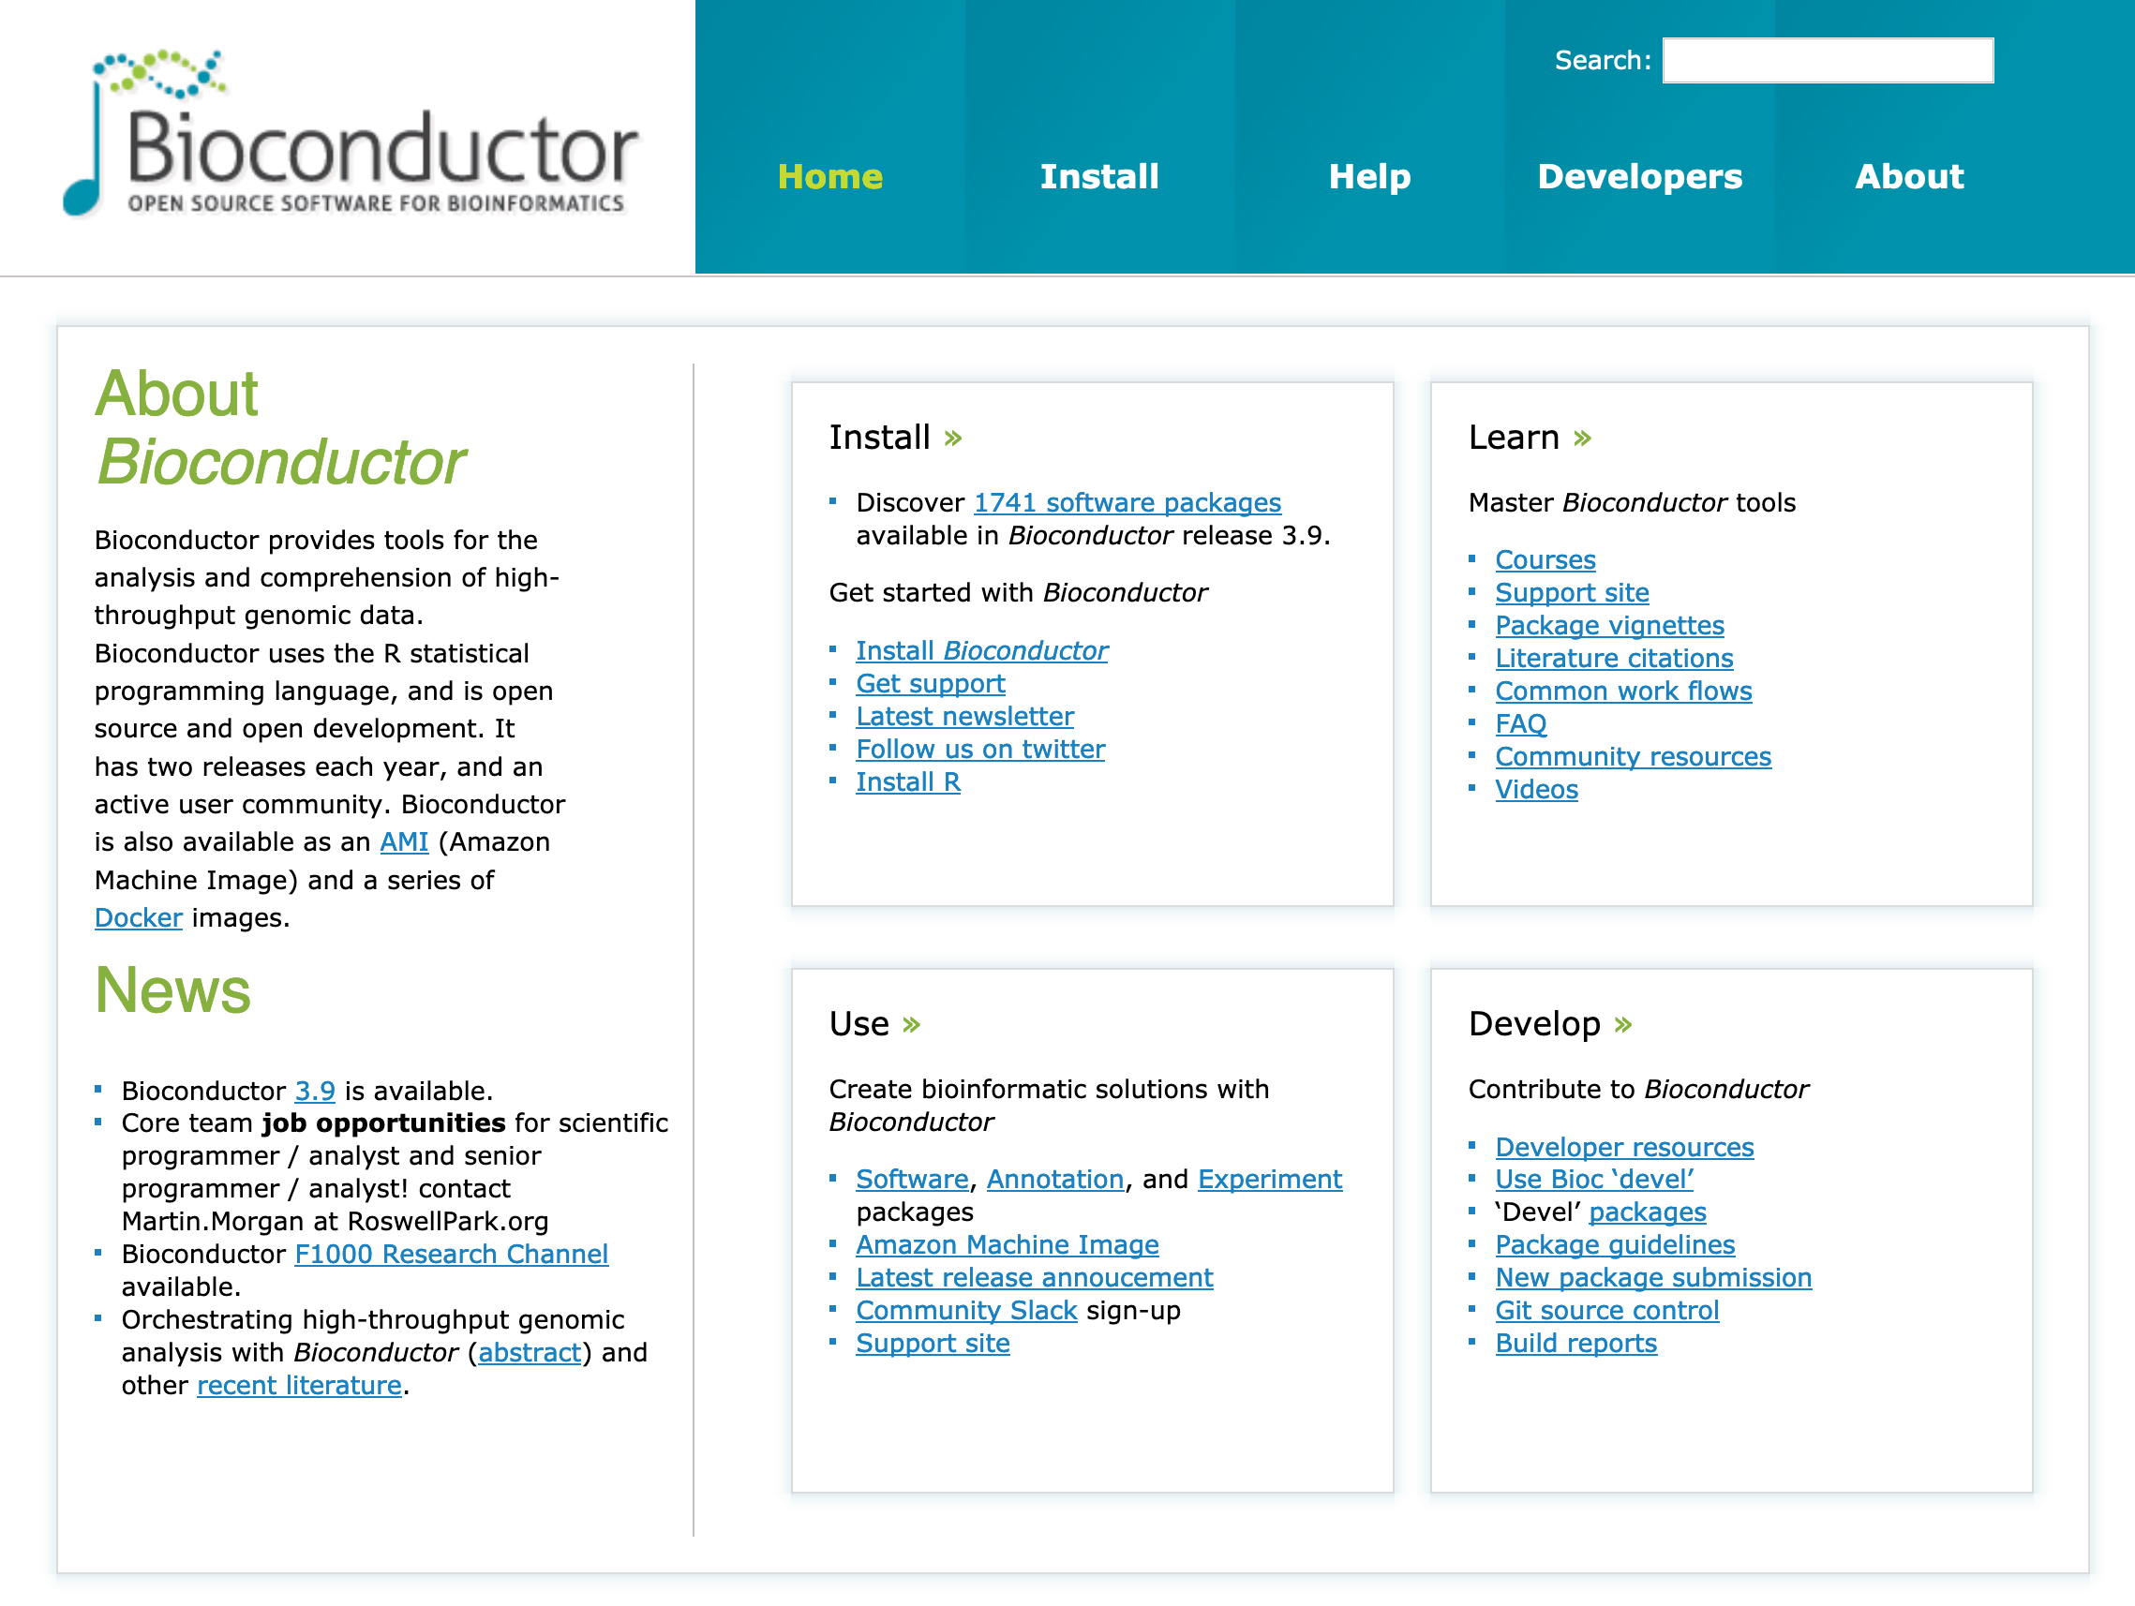
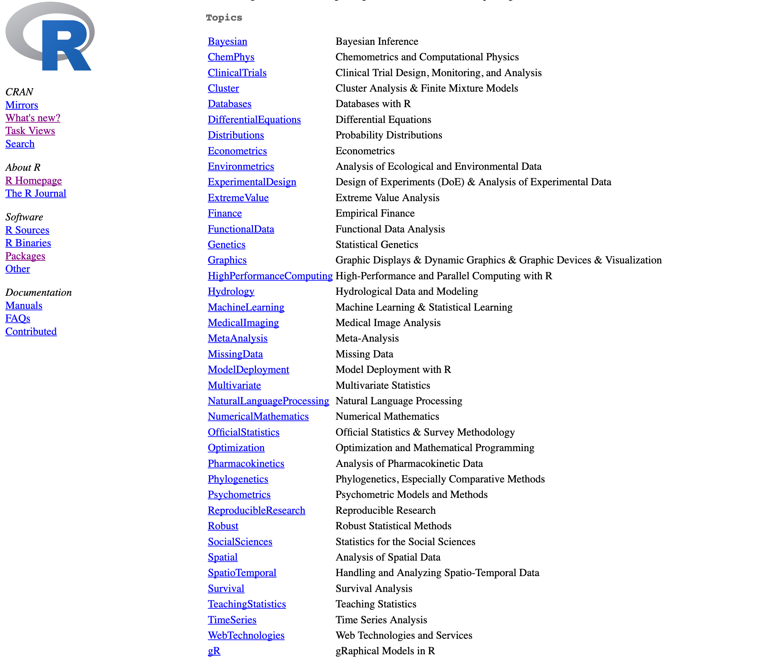
Why R?
R is an environment to
visualize, explore
summarize, model, test
Large community, many specialized packages
Notes:
You have some data, now what?

Slide 3
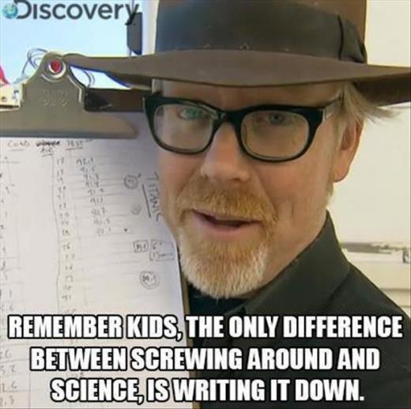
Why R?
R is a language
express what you want to do as text
reproducible - you can re-run everything you did
sharable - accurately describes what you did
R is free as in
beer
freedom
Notes:
Link freedom to good scientific practice.

Slide 4
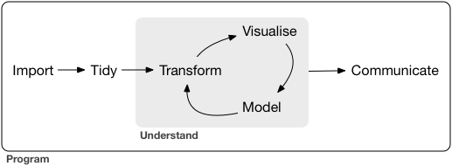
Data analysis almost always follows the same script
Diagram from "R for Data Science" book (https://r4ds.had.co.nz/)

Slide 5
Further workshops
Reproducible Research in R
Programming and Tidy Data Analysis in R
Bioconductor
Linear models in R
Notes:
The idea is to give you a foot in the door, especially for linear models and bioconductor.
Skills to give you a lot of flexibility looking at your data.

Slide 6
Icebreaker
Tell people at your table what kind of data you work with
Also introduce yourself in the Etherpad
Green sticky when finished
During the workshop
Challenge finished
Something is broken or unclear
1-on-1 help please
Notes:
Discussion is good.
Keep us busy, make us earn our keep!

