Slide 1
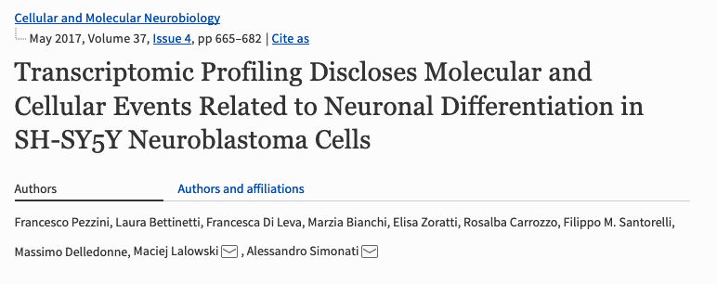
Example Analysis: SH-SY5Y Differentiation
SH-SY5Y is a neuroblastoma cell line.
They can be treated to differentiate into a ‘more neuronal’ form
RNAseq of untreated and differentiated cells:

Slide 2
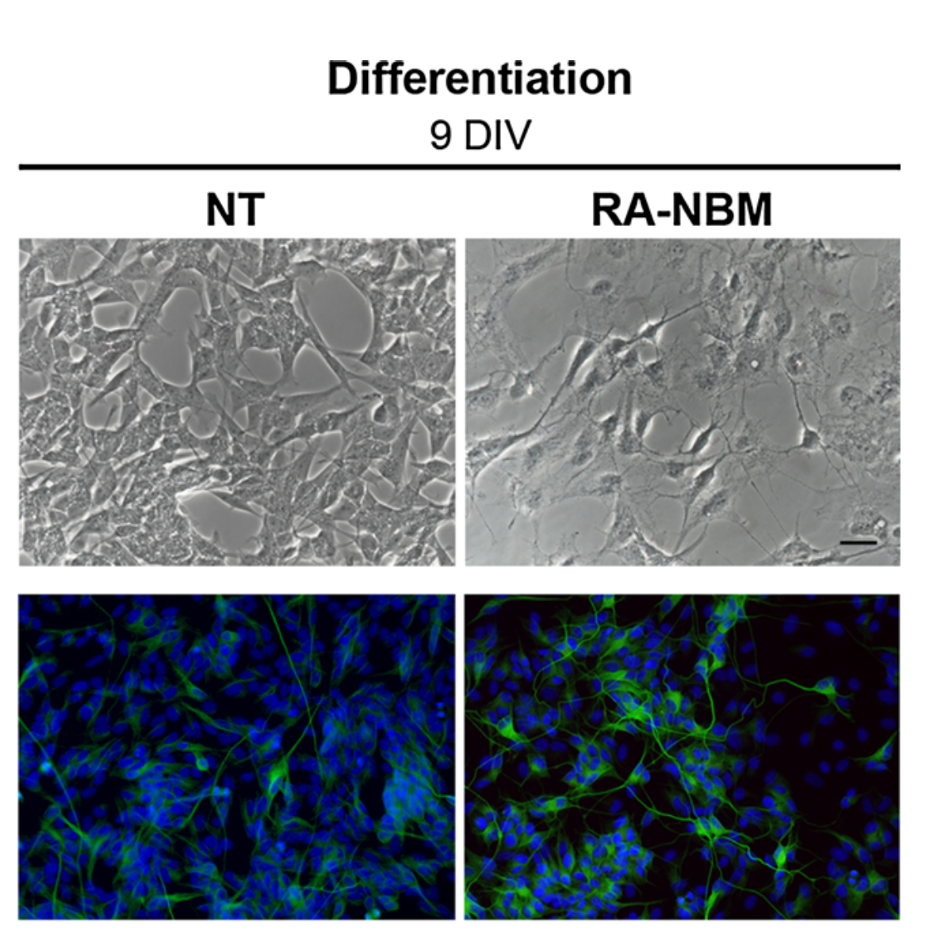
SH-SY5Y Differentiation
Undifferentiated
(NT)
Differentiated
(RA-NBM treated)
Bright Feild
Cells morphology changes:
What pathways are involved?
B-III Tubulin
Pezzini, F., … (2017). Transcriptomic Profiling Discloses Molecular and Cellular Events Related to Neuronal Differentiation in SH-SY5Y Neuroblastoma Cells. Cellular and Molecular Neurobiology, 37(4), 665–682. https://doi.org/10.1007/s10571-016-0403-y
Notes:
They slow replication, Grow out neurites, look more like neurons.
Expect cytoskeletel pathways, Neuonal growth pathways to be involved.

Slide 3
Differential Expression
3x Differentiated
3x Undifferentiated
Vs
The 4923(!) differentially expressed genes are here, in degust:
http://degust.erc.monash.edu/degust/compare.html?code=5b2c7805ab8f8c5f2dc8c72e61b049b0#?plot=mds
Pezzini, F., … (2017). Transcriptomic Profiling Discloses Molecular and Cellular Events Related to Neuronal Differentiation in SH-SY5Y Neuroblastoma Cells. Cellular and Molecular Neurobiology, 37(4), 665–682. https://doi.org/10.1007/s10571-016-0403-y

