Slide 1
Introducing R
Intro to R Workshop
Trainers – Nick Wong, Paul Harrison, Haroon Naeem
Helpers -

Slide 2
Today’s Objective(s) – What we hope you will get out of today
Introduction to R
The basics of R – data objects
Data plotting
How to find more information for a specific task
The start of the journey, a network of R learners/users around you.
Entry into more advanced and specialised uses of R for your research.

Slide 3
Why R? (as opposed to Excel?)
It’s free, legally free. Active development.
Reproducible analysis.
Document what you have done with your data in code.
Come back to it in days, months, years and you should know what was done.
Low risk of inadvertent data loss/mutation.
By design, R requires you to load your data in, what you do with the data is then written in code (R language).
R can handle really large datasets.
Excel is limited by 1,048,576 rows and 16,384 columns.
Collaborative.
Share your data and analysis.

Slide 4
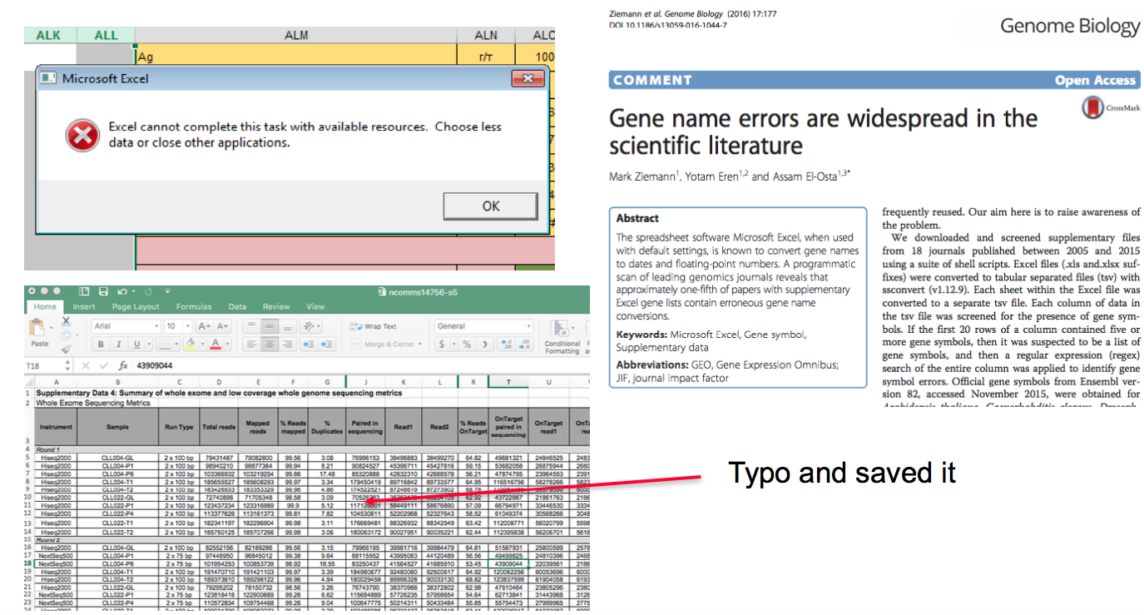
Why R? (as opposed to Excel?)

Slide 5
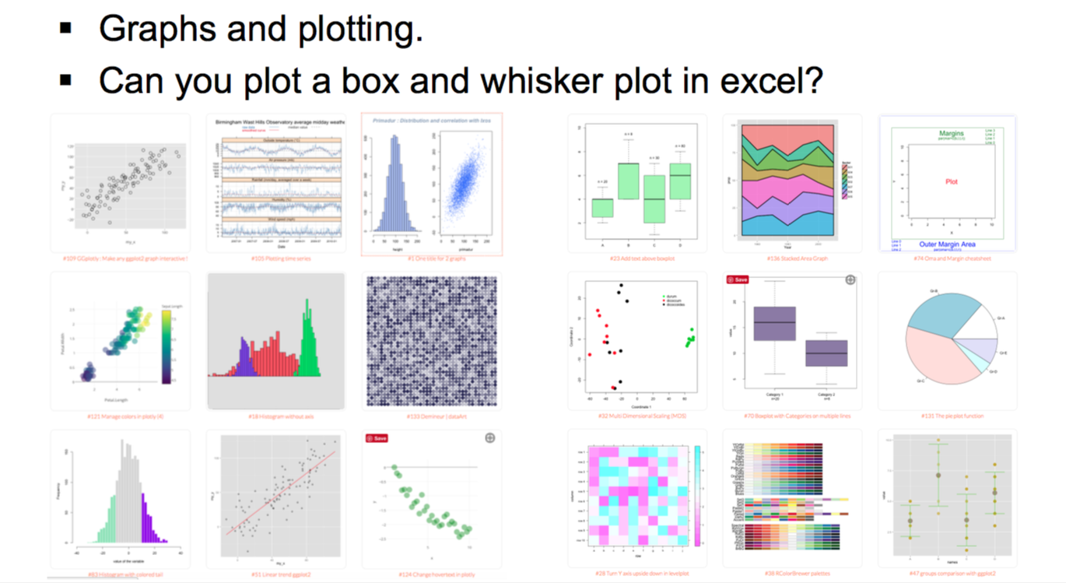
Why R? (as opposed to Excel?)

Slide 6
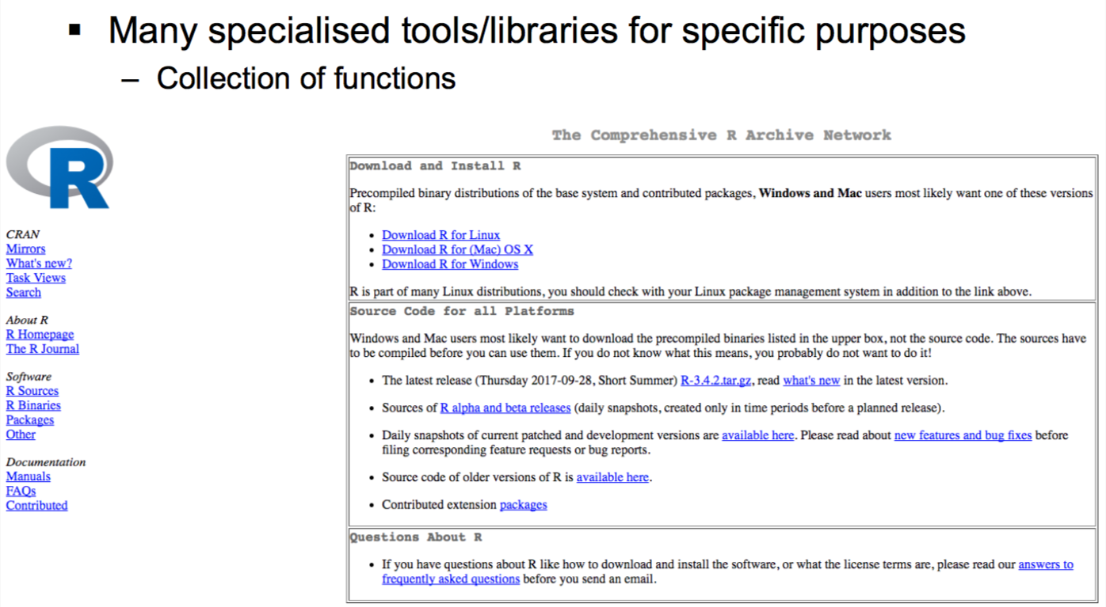
How to get R?
https://cran.r-project.org)

Slide 7
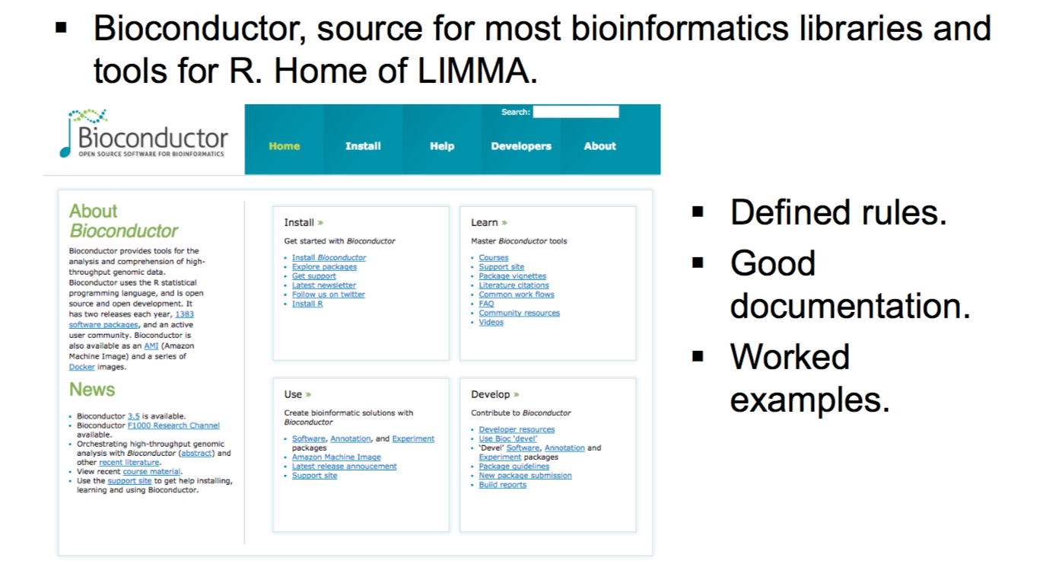
Tools and libraries used in R?

Slide 8
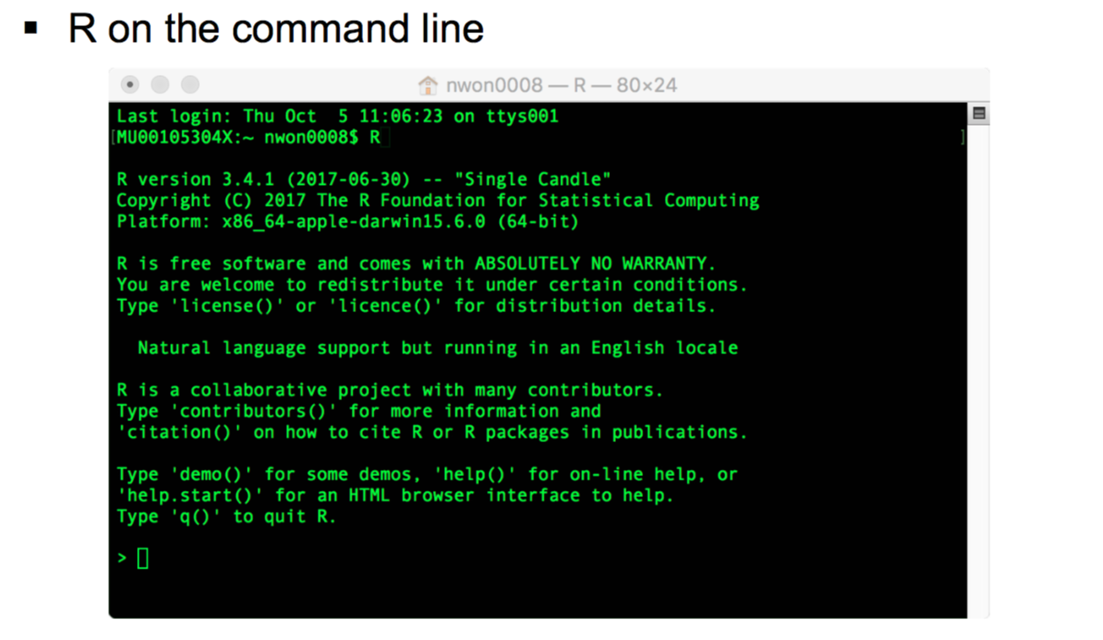
R and the interfaces to R

Slide 9
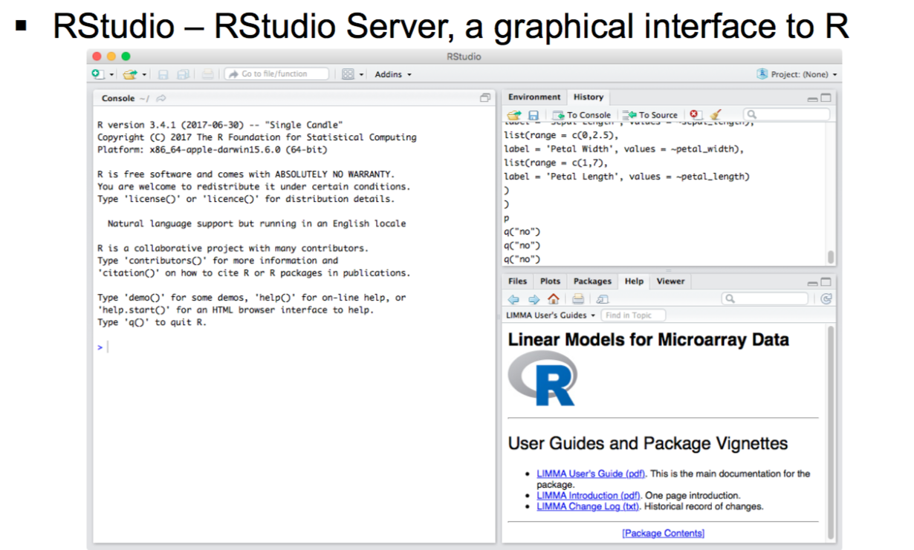
R and the interfaces to R
https://www.rstudio.com

Slide 10
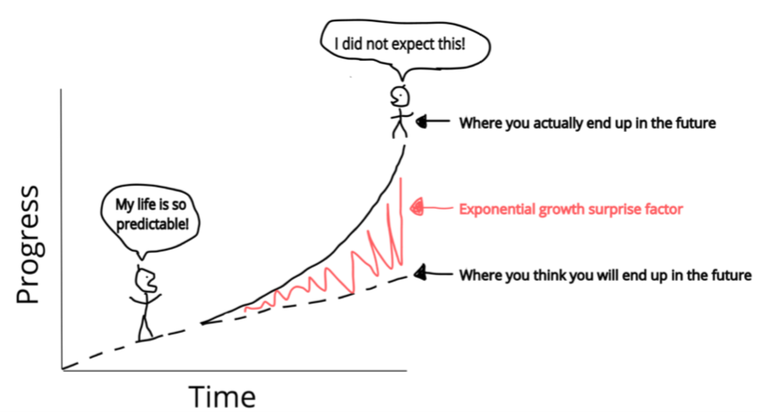
Today’s agenda
Starting out in R – Nick
Working with data in a matrix – Nick
Working with data frames – Paul
For loops – Haroon
Plotting with ggplot2 - Haroon

Slide 11
What we won’t be covering but are important in the interest of time.
Things we won’t be covering but are of note:
Statistical modelling (lm, glm……).
Packages specific to bioinformatics.
Tidyverse and Tidyr (except ggplots)

Slide 12
How today’s workshop works – signalling for help
Sticky notes

Slide 13
Rounding up
This is the start of your R journey, many others are at the same stage, share your questions.
Attend this workshop again, and others we offer
Advanced R
Specialised use-cases with R (eg: RNASeq)
MBP have Friday help sessions at Clayton 3:30pm.
Alfred to be determined, contact Nick for questions.

Slide 14

Shameless plug

Slide 15

Ice breaker activity
Introduce yourself to your neighbour(s) and tell them why you are here and what you want to achieve.

Slide 16
Basic concepts of R and take home messages
R is a programming language and your code can be recorded in an R script file.
Variable
Assignment operator <-
Functions name()
Run code from R script command/control <enter>
Swap between panes control 1/2

