Slide 1
Welcome to Intro to R Workshop
Friday 3 November 2017

Slide 2
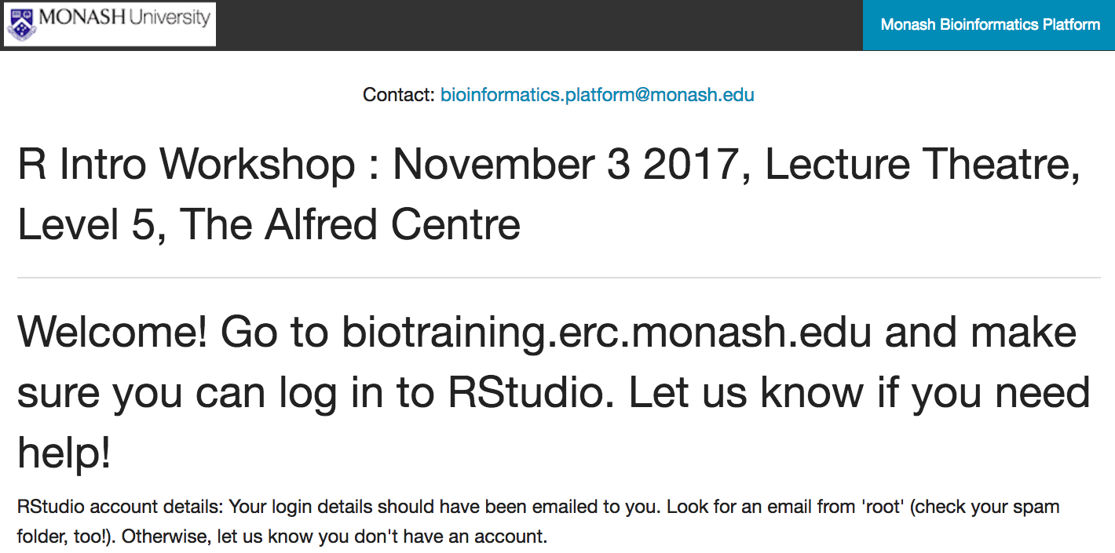

Slide 3
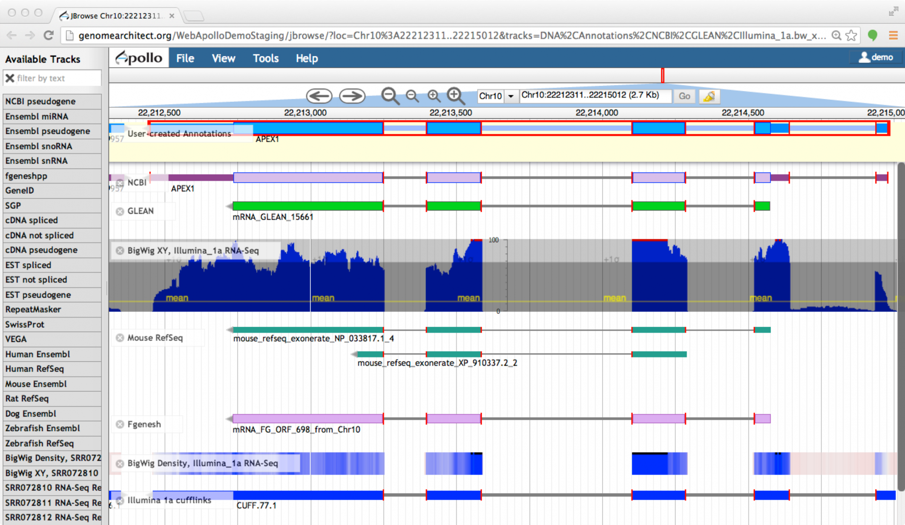
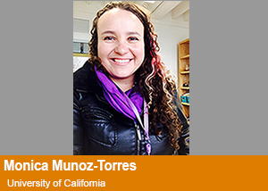
Upcoming events - Genome annotation using Apollo
Training material by:
Dr Monica Munoz-Torres from
Phoenix Bioinformatics who is an expert in genome annotation, current chair of the International Society for Biocuration Executive Committee, and
former Project Manager of the Apollo Project.
Date: 21-11-2017
Venue: Clayton Campus
Instructors: Monash Bioinformatics Platform
For expression of interest email sonika.tyagi@monash.edu

Slide 4

Upcoming events - Bioinfosummer

