Slide 1
Welcome to Intro to R Workshop

Slide 2
http://biotraining.erc.monash.edu

Slide 3
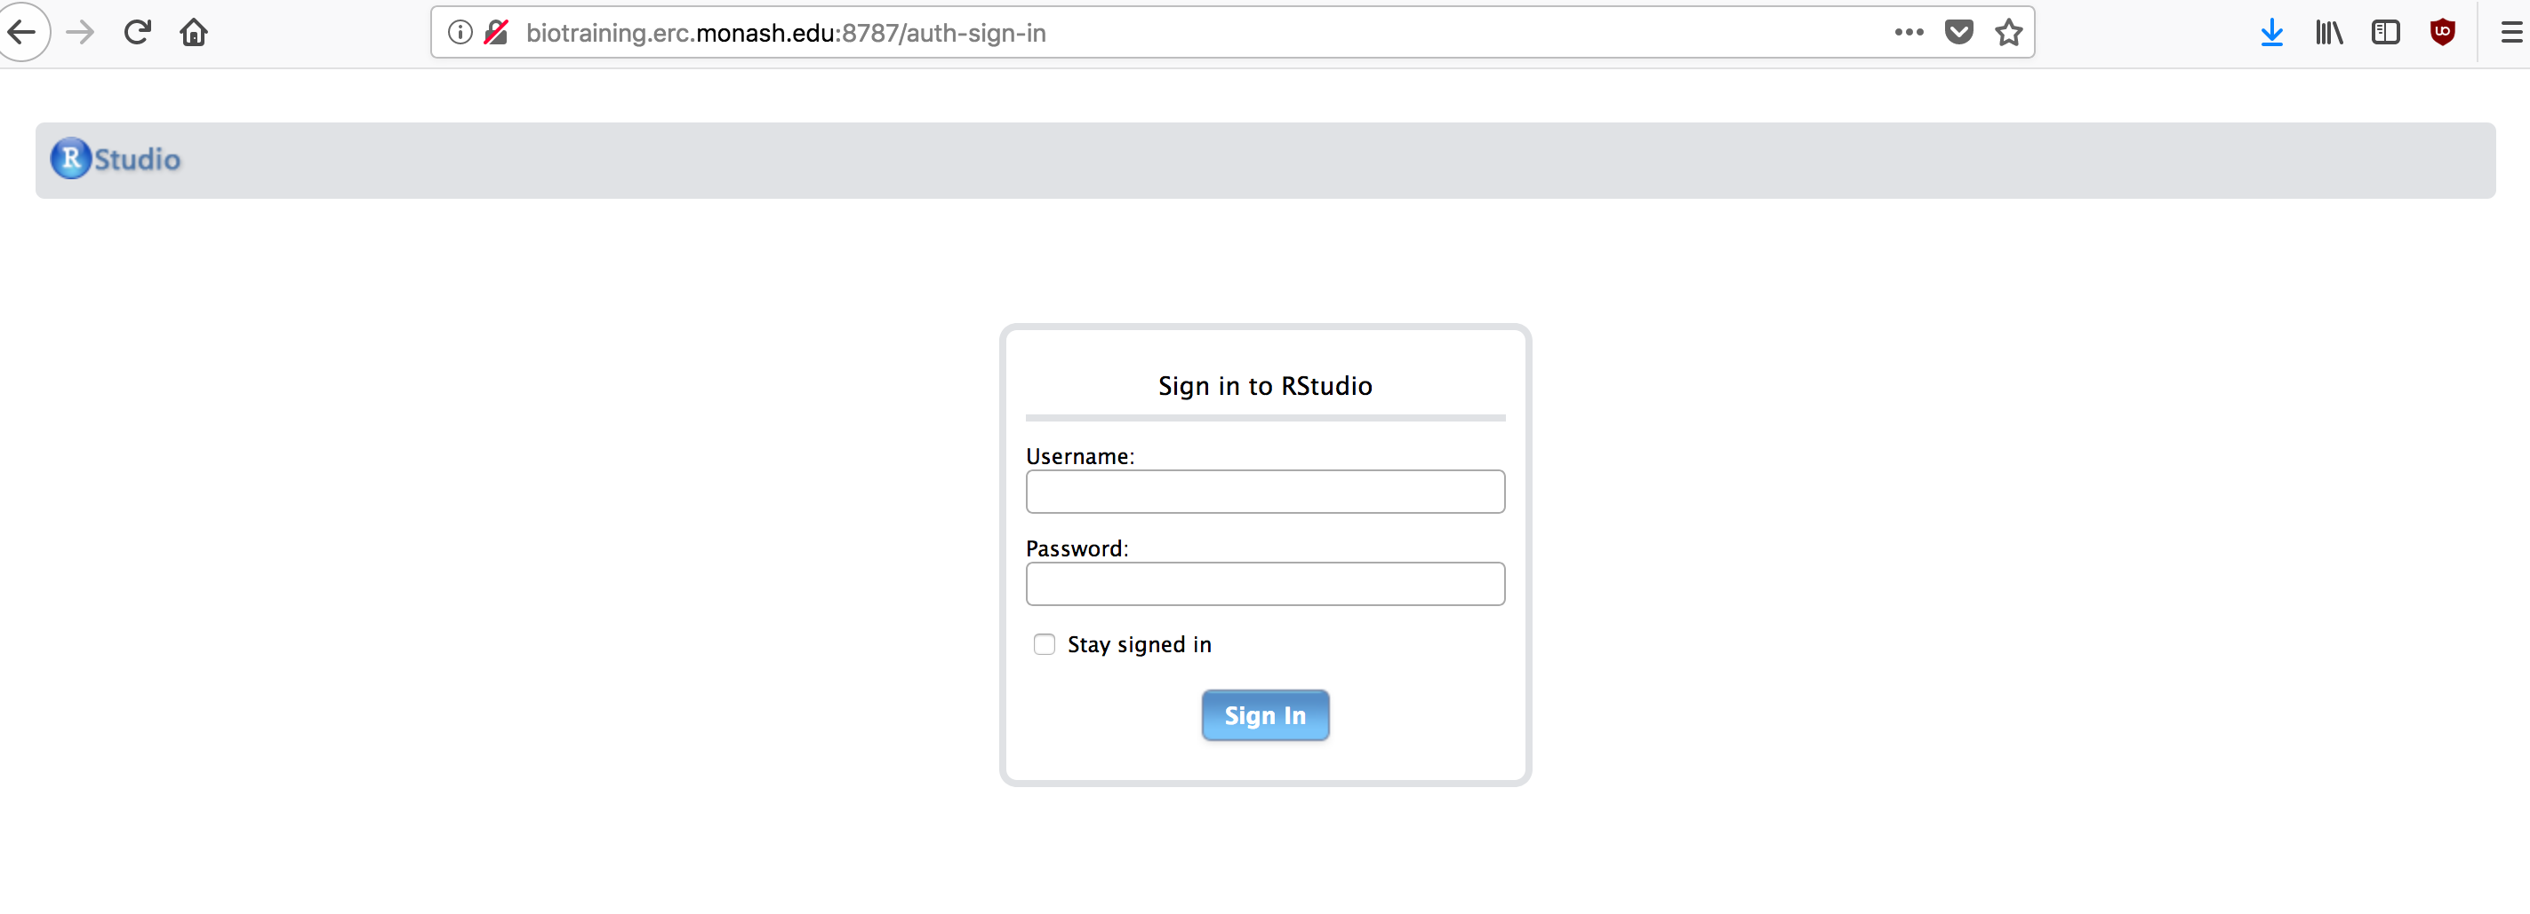
You would have an account and password for RStudio sent to your email address (Check your spam folder),
Otherwise, tell one of the workshop trainers/helpers.

