Slide 1

Week #
Tyler Swann

Slide 2



Agenda
Topic one
Topic two
Topic three
Topic four
Topic five

Slide 3
Discussion
Any questions?
Need help?
Open discussion.
Concerns?

Slide 4
Next Week
1
2
3
4
5

Slide 5


Thank You
Tyler Swann
https://github.com/MonashDeepNeuron/HPP

Slide 6

Topic one
Subtitle

Slide 7
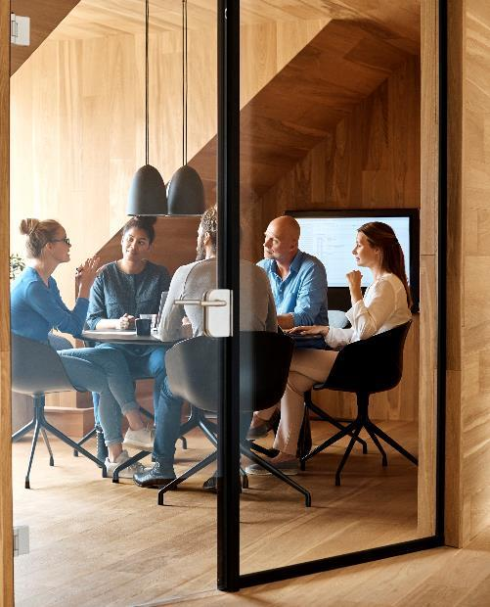



Introduction
With PowerPoint, you can create presentations and share your work with others, wherever they are. Type the text you want here to get started. You can also add images, art, and videos on this template. Save to OneDrive and access your presentations from your computer, tablet, or phone.

Slide 8
Chart

Slide 9
Table
 | Category 1 | Category 2 | Category 3 | Category 4
Item 1 | 4.5 | 2.3 | 1.7 | 5
Item 2 | 3.2 | 5.1 | 4.4 | 3
Item 3 | 2.1 | 1.7 | 2.5 | 2.8
Item 4 | 4.5 | 2.2 | 1.7 | 7

Slide 10

The way to get started is to quit talking and begin doing.
Walt Disney

Slide 11




Team
Name
Name
Name
Name
Title
Title
Title
Title

Slide 12
Timeline
Title
To start a presentation, go to the Slide Show tab, and select From Beginning.
Title
To display Presenter view, in Slide Show view, on the control bar at the bottom left select the three dots, and then Show Presenter View.
Title
During your presentation, the speaker notes are visible on your monitor, but aren't visible to the audience.
Title
Title
If you don’t see the Notes pane or it is completely minimized, click Notes on the task bar across the bottom of the PowerPoint window.
The Notes pane is a box that appears below each slide. Tap it to add notes.

Slide 13
Content
Subtitle
Subtitle
Add text, images, art, and videos.
Add transitions, animations, and motion.
Save to OneDrive, to get to your presentations from your computer, tablet, or phone.
Open the Design Ideas pane for instant slide makeovers.
When we have design ideas, we’ll show them to you right there.

Slide 14
Code Example
aAbBcCdD

Slide 15
Content 2
Subtitle
subtitle
subtitle
Add text, images, art, and videos.
Add transitions, animations, and motion.
Save to OneDrive, to get to your presentations from your computer, tablet, or phone.
Open the Design Ideas pane for instant slide makeovers.
When we have design ideas, we’ll show them to you right there.
Add text, images, art, and videos.
Add transitions, animations, and motion.
Save to OneDrive, to get to your presentations from your computer, tablet, or phone.
Open the Design Ideas pane for instant slide makeovers.
When we have design ideas, we’ll show them to you right there.
Add text, images, art, and videos.
Add transitions, animations, and motion.
Save to OneDrive, to get to your presentations from your computer, tablet, or phone.
Open the Design Ideas pane for instant slide makeovers.
When we have design ideas, we’ll show them to you right there.

Slide 16

Summary
With PowerPoint, you can create presentations and share your work with others, wherever they are. Type the text you want here to get started. You can also add images, art, and videos on this template. Save to OneDrive and access your presentations from your computer, tablet, or phone.

