Slide 1

Part 5 - Classes
Tyler Swann

Slide 2



Agenda
Classes
Templates
Generics
Concepts
Discussion

Slide 3

Classes

Slide 4
Classes
Classes are a way for users to create custom types for our programs.
Classes allow us to customize the behaviour of type from its construction and destruction, to the available operations that can be performed on a class.
Classes and structures are identical in C++ except the members of a class are private by default (inaccessible).
#include <iostream>
class Point
{
int x;
int y;
};
auto main() -> int
{
auto p = Point{ 2, 5 };
/// Fails as `x` and `y` are private std::cout << "( " << p.x << ", " << p.y << " )" << std::endl;
return 0;
}

Slide 5
Access Specifiers
Accessor Category | Meaning
private | Member can only be used by member functions of the same class or friends (functions or classes).
protected | Member can only be used by member functions of the same class, friends (functions or classes) or derived classes.
public | Can be accessed by anyone.

Slide 6
Access Specifiers Example
#include <iostream>
class Point
{
public: ///< Declare members `x` and `y` as public
int x;
int y;
};
auto main() -> int
{
Point p{ 2, 5 }; ///< Now succeeds
std::cout << "( " << p.x << ", " << p.y << " )" << std::endl; ///< Now succeeds
return 0;
}

Slide 7
Derived Access to Members
Base Classes Access Policy | private | protected | public
 | Always inaccessible with any derivation access | private in derived class if you use private derivation | private in derived class if you use private derivation
 |  | protected in derived class if you use protected derivation | protected in derived class if you use protected derivation
 |  | protected in derived class if you use public derivation | public in derived class if you use public derivation

Slide 8
Derived Access Specifiers Example
#include <iostream>
class Point
{
public:
int x;
int y;
};
class Point3D
: protected Point ///< Points members are `protected`
{
public:
int z;
};
auto main() -> int
{
Point p{ 2, 5 };
Point3D p3d{};
std::cout << "( " << p.x << ", " << p.y << " )" << std::endl;
std::cout << "p3d.z = " << p3d.z << std::endl;
std::cout << "( " << p3d.x << ", " << p3d.y << ", " << p3d.z << " )" << std::endl; ///< Fails, `x` and `y` are inaccessible
return 0;
}

Slide 9
Discussion
Any questions?
Need help?
Open discussion.
Concerns?

Slide 10
Next Week
1
2
3
4
5

Slide 11


Thank You
Tyler Swann
https://github.com/MonashDeepNeuron/HPP

Slide 12
Example
a

Slide 13
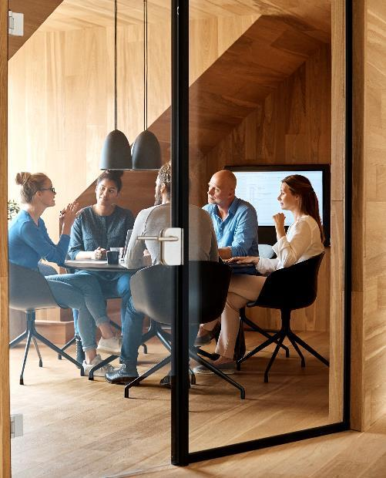



Introduction
With PowerPoint, you can create presentations and share your work with others, wherever they are. Type the text you want here to get started. You can also add images, art, and videos on this template. Save to OneDrive and access your presentations from your computer, tablet, or phone.

Slide 14
Chart

Slide 15

The way to get started is to quit talking and begin doing.
Walt Disney

Slide 16




Team
Name
Name
Name
Name
Title
Title
Title
Title

Slide 17
Timeline
Title
To start a presentation, go to the Slide Show tab, and select From Beginning.
Title
To display Presenter view, in Slide Show view, on the control bar at the bottom left select the three dots, and then Show Presenter View.
Title
During your presentation, the speaker notes are visible on your monitor, but aren't visible to the audience.
Title
Title
If you don’t see the Notes pane or it is completely minimized, click Notes on the task bar across the bottom of the PowerPoint window.
The Notes pane is a box that appears below each slide. Tap it to add notes.

Slide 18
Content
Subtitle
Subtitle
Add text, images, art, and videos.
Add transitions, animations, and motion.
Save to OneDrive, to get to your presentations from your computer, tablet, or phone.
Open the Design Ideas pane for instant slide makeovers.
When we have design ideas, we’ll show them to you right there.

Slide 19
Content 2
Subtitle
subtitle
subtitle
Add text, images, art, and videos.
Add transitions, animations, and motion.
Save to OneDrive, to get to your presentations from your computer, tablet, or phone.
Open the Design Ideas pane for instant slide makeovers.
When we have design ideas, we’ll show them to you right there.
Add text, images, art, and videos.
Add transitions, animations, and motion.
Save to OneDrive, to get to your presentations from your computer, tablet, or phone.
Open the Design Ideas pane for instant slide makeovers.
When we have design ideas, we’ll show them to you right there.
Add text, images, art, and videos.
Add transitions, animations, and motion.
Save to OneDrive, to get to your presentations from your computer, tablet, or phone.
Open the Design Ideas pane for instant slide makeovers.
When we have design ideas, we’ll show them to you right there.

Slide 20

Summary
With PowerPoint, you can create presentations and share your work with others, wherever they are. Type the text you want here to get started. You can also add images, art, and videos on this template. Save to OneDrive and access your presentations from your computer, tablet, or phone.

