Slide 1

Part 6
Tyler Swann

Slide 2



Agenda
Iterators
Data Structures
Algorithms
Ranges
Views
Discussion

Slide 3

Iterators

Slide 4
Iterators
Iterators are abstractions that represent an element or item that belongs to a range or container.
Iterators are traversal objects, as in they are used to traverse between data that has a common owner.
Iterators are a lot like pointers in most cases as they are used to hold or refer to some element somewhere else and can read and write to the stored value.

Slide 5
Iterator Categories
Iterator Category | Valid Operations
 | write | read | increment | multiple passes | decrement | random access | contiguous storage
Output | ✅ |  | ✅
Input | ❓(might support writing) | ✅ | ✅
Forward (Satisfies Input) |  | ✅ | ✅ | ✅
Bidirectional (Satisfies Forward) |  | ✅ | ✅ | ✅ | ✅
Random Access (Satisfies Bidirectional) |  | ✅ | ✅ | ✅ | ✅ | ✅
Contiguous (Satisfies Random Access) |  | ✅ | ✅ | ✅ | ✅ | ✅ | ✅

Slide 6
Obtaining Iterators
Iterators are generally defined for a container-like object.
Iterators to the beginning and end of the container can be obtained using the std::begin and std::end respectively.
The “end” iterator usually holds the element that is one-past-the-end in memory.
There are customizations of the iterator obtaining functions that can get constant (immutable underlying element), reverse and constant reverse iterators for a [some] container[s].
#include <array>
#include <iostream>
#include <iterator>
auto main() -> int
{
auto a = std::to_array<int>({1, 3, 4, 565, 868, 5, 46});
std::cout << std::begin(a) << std::endl;
std::cout << *std::begin(a) << std::endl;
std::cout << std::end(a) << std::endl;
std::cout << *(std::end(a) - 1) << std::endl;
return 0;
}

Slide 7
Iterator Operators
Most iterators; depending on there iterator category, support the same set of operators used by pointers to dereference, increment, decrement etc.
#include <array>
#include <iostream>
#include <iterator>
auto main() -> int
{
auto a = std::to_array<int>({1, 3, 4, 565, 868, 5, 46});
auto it = std::begin(a);
std::cout << *it << std::endl;
std::cout << *(it++) << std::endl;
std::cout << *(++it) << std::endl;
std::cout << *(it--) << std::endl;
std::cout << *(--it) << std::endl;
std::cout << *(it + 4) << std::endl;
std::cout << *(std::end(a) - 4) << std::endl;
std::cout << it[6] << std::endl;
auto v { *it };
*it = 757657;
std::cout << v << std::endl;
std::cout << *it << std::endl;
return 0;
}
Operation
dereference | *i | *i = v | v = *i
increment | i++ | ++i
decrement | i-- | --i
difference | i - j
advance | i + n | i - n
index | i[n]

Slide 8
Iterator Functions
There are also standard interfaces that allow for the manipulation of iterators.
These are able to find the correct set of operations for the general functionality (say moving to the nth next element) for a given iterator depending on its category.
#include <array>
#include <iostream>
#include <iterator>
auto main() -> int
{
auto a = std::to_array<int>({1, 3, 4, 565, 868, 5, 46});
auto it = std::begin(a);
std::cout << *it << std::endl;
std::cout << *std::next(it) << std::endl;
std::cout << *std::prev(it) << std::endl;
std::cout << *std::next(it, 4) << std::endl;
auto end = std::end(a);
std::cout << *std::next(end, -4) << std::endl;
std::cout << std::distance(it, end - 3) << std::endl;
std::advance(it, 3);
std::cout << *it << std::endl;
return 0;
}

Slide 9
Sentinels
Iterators have no internal notion of the end of a sequence they traverse through, much like pointers.
Sentinels are a marker that indicate the end of a sequence. A common sentinel that is used by any language that does string processing is the literal character \0 which denotes the end of string.
In C++, the ‘end’ iterator is used as a sentinel, indicating there are no more values that can be yielded by an iterator.
Any iterator can be used as a sentinel for a sequence of values if it doesn’t mark the true end of the sequence.

Slide 10
Data Structures

Slide 11

Data Structures
Data structures are a fundamental concept in all of Computer Science.
They are used to arrange and organize data into different shapes, memory layouts and access patterns.
Different data structures offer different complexities for reading, writing, insertion and erasure.
There are three main categories of data structures in C++; sequence, associative and unordered associative.

Slide 12
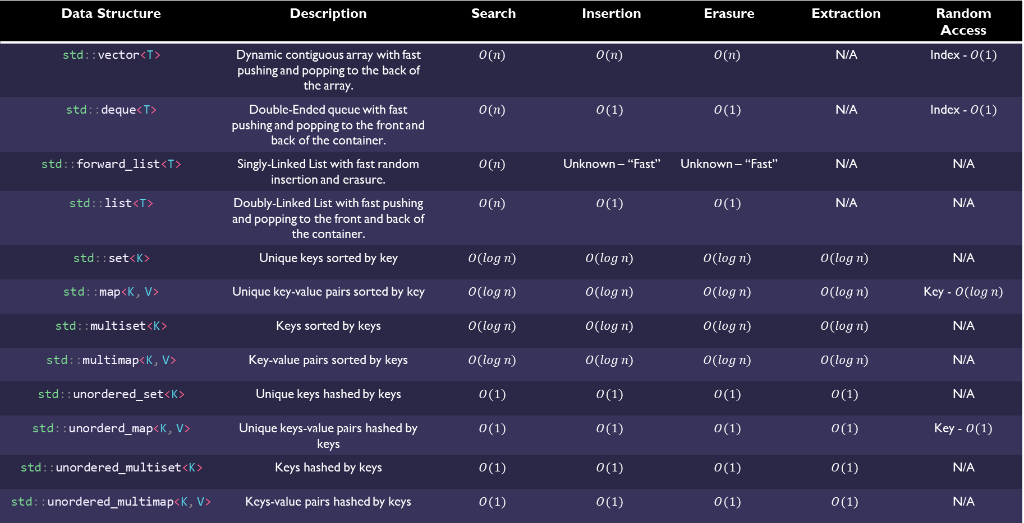
C++ Standard Containers
Data Structure | Description | Search | Insertion | Erasure | Extraction | Random Access
std::vector<T> | Dynamic contiguous array with fast pushing and popping to the back of the array. | $$O(n)$$ | $$O(n)$$ | $$O(n)$$ | N/A | Index - $O(1)$
std::deque<T> | Double-Ended queue with fast pushing and popping to the front and back of the container. | $$O(n)$$ | $$O(1)$$ | $$O(1)$$ | N/A | Index - $O(1)$
std::forward_list<T> | Singly-Linked List with fast random insertion and erasure. | $$O(n)$$ | Unknown – “Fast” | Unknown – “Fast” | N/A | N/A
std::list<T> | Doubly-Linked List with fast pushing and popping to the front and back of the container. | $$O(n)$$ | $$O(1)$$ | $$O(1)$$ | N/A | N/A
std::set<K> | Unique keys sorted by key | $$O(\log{n})$$ | $$O(\log{n})$$ | $$O(\log{n})$$ | $$O(\log{n})$$ | N/A
std::map<K, V> | Unique key-value pairs sorted by key | $$O(\log{n})$$ | $$O(\log{n})$$ | $$O(\log{n})$$ | $$O(\log{n})$$ | Key - $O(\log{n})$
std::multiset<K> | Keys sorted by keys | $$O(\log{n})$$ | $$O(\log{n})$$ | $$O(\log{n})$$ | $$O(\log{n})$$ | N/A
std::multimap<K, V> | Key-value pairs sorted by keys | $$O(\log{n})$$ | $$O(\log{n})$$ | $$O(\log{n})$$ | $$O(\log{n})$$ | N/A
std::unordered_set<K> | Unique keys hashed by keys | $$O(1)$$ | $$O(1)$$ | $$O(1)$$ | $$O(1)$$ | N/A
std::unorderd_map<K, V> | Unique keys-value pairs hashed by keys | $$O(1)$$ | $$O(1)$$ | $$O(1)$$ | $$O(1)$$ | Key - $O(1)$
std::unordered_multiset<K> | Keys hashed by keys | $$O(1)$$ | $$O(1)$$ | $$O(1)$$ | $$O(1)$$ | N/A
std::unordered_multimap<K, V> | Keys-value pairs hashed by keys | $$O(1)$$ | $$O(1)$$ | $$O(1)$$ | $$O(1)$$ | N/A

Slide 13
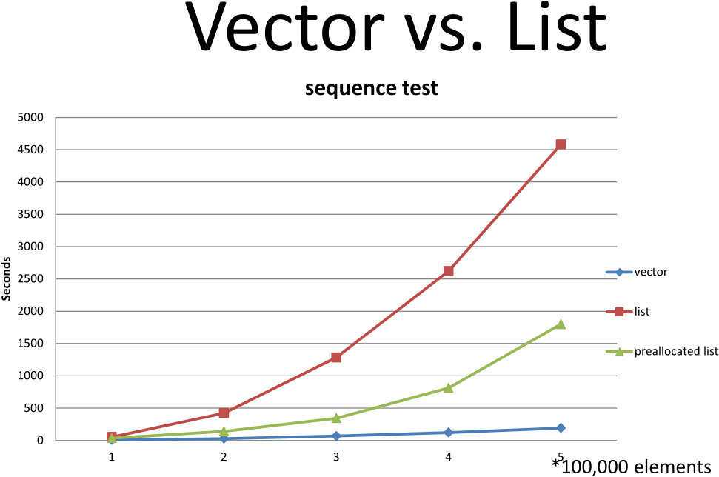

Arrays vs Linked-Lists
One big debate in Computer Science is; are Linked-Lists actually useful. The answer is, it depends. The biggest (and most naïve) argument made for linked-lists is that are great for inserting and erasing elements in the middle of the structure because you only need to allocate the nodes and correctly link the node for lists, but vectors need to move $n$ elements back in the array possibly causing reallocation.
The issue with this argument is that this doesn’t really apply to modern hardware. Due to arrays and vectors being contiguous in memory it makes it very easy for the CPU to operate and manipulate vectors. Even if insertion or erasure causes reallocation or copying of elements from a vector to a new memory location, because the CPU is often able to vectorize the operation causing the entire copy to occur in a single SIMD instruction. The reason it can do this is CPU caching. CPU’s will try to prefetch data it might need for future operations. Rather than getting a few elements it will page a whole chunk of memory into the cache. This means that vectors will often have a large amount or even all their data in the cache all at once meaning it save cycles on the most expensive operations, IO (fetching).
This means that allocation is often trivial for modern CPU’s to efficiently reallocate, insert or erase and copy elements from a vector. Linked lists can never benefit from this kind of optimization due entirely to the fundamental nature of a list. Because the list’s elements are broken into nodes that are spread randomly throughout memory, the CPU has no way of finding most or all of the list in one fetch without reading through the list (which is $O(n)$) to get each the next element. Because each element in a list must be fetched this maximizes the amount of cache misses that will occur. This is because if the next node does happen to randomly be in the cache, it must free some space in the cache, go through some pointer indirections and copy the node into the cache. It must repeat this for every node essentially performing $n$ fetch cycles.
Linked this do have their uses though. You need to store very large elements an they need to be stored for a long time where the fetching of only a few nodes is needed at a time and you need to maintain a linked relationship between data, linked lists are a great choice. The Linux kernel uses a generic linked list structure to connect different data across the kernel. Linked lists are also used in memory paging applications at the OS level.

Slide 14
OO Arrays vs C++ Vector
std::vector<int>
One reason people think linked lists perform better then dynamic arrays is that most languages with dynamic array like structures use an OO design. C++ does not.
C++ focuses on zero-cost abstraction. That is, you don’t pay for what you don’t use and there is often lots you don’t need.
With all of the indirections used in indirections and sub-objects used OO style arrays, a linked list doesn’t look so bad
padding
1
2
3
4
5
6
unused
unused
padding
1
padding
2
padding
3
std::list<int>
padding
Size: 6
padding
4
padding
5
padding
6
OO Style
padding
Size: 6
padding
4
padding
2
padding
6
padding
padding
1
padding
3
padding
5

Slide 15
Bitset
#include <bitset>
#include <iostream>
#include <string>
auto main() -> int
{
auto b = std::bitset<6>(0b011010uLL);
println(b);
b[2] = true;
println(b);
b.set(4) = false;
b.flip(0);
println(b);
b.flip();
println(b);
b.reset();
println(b);
std::cout << std::boolalpha;
std::cout << (b.test(5) == false) << std::endl;
std::cout << b.any() << std::endl;
std::cout << b.all() << std::endl;
std::cout << b.none() << std::endl;
std::cout << std::noboolalpha;
return 0;
}
Static range of individually addressable bits.
Can be used in constexpr contexts.
Overloads for bitwise operations.
Conversion functions to string representations of the bits.
Bit testing methods.

Slide 16
Any
#include <iostream>
#include <any> auto main() -> int
{
auto a = std::make_any<int>(6);
println<int>(a);
a.emplace<double>(6.797898);
println<double>(a);
std::cout << a.type().name() << std::endl;
std::cout << std::boolalpha;
std::cout << a.has_value() << std::endl;
a.reset();
std::cout << a.has_value() << std::endl;
std::cout << std::noboolalpha;
return 0;
}
Storage of dynamic type, copyable object.
Access to value through casting with std::any_cast<T>.
In-place construction and destruction of held object.

Slide 17
Algorithms

Slide 18
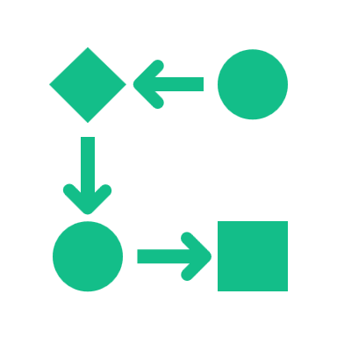
Algorithms
Algorithms are functions that perform a specific set of steps often to perform some computation.
Algorithms are mostly used to manipulate data. When paired with data structures, algorithms can make development far more seamless, especially when written in a generic style.
C++ Standard Algorithms were the brainchild of Alex Stepanov that used templates and generic techniques to create powerful interfaces and seamless interoperability between algorithms and data structures.
The focus of this section is not on how to write algorithms but rather how to use them. How to compose them together using functional techniques create expressible and type safe code that is also fast.
C++ algorithms take a begin and end iterator indicating the range of elements the algorithm applies to.

Slide 19
C++ Standard Algorithms
Category | C++ Algorithm | Common Name | Description
General | std::for_each | foreach | Applies a function (usually with side effects) to every element in a range.
Sorting | std::sort | sort | Sorts elements in-place according to a predicate (<).
 | std::partition | partition | Partially sort range so that every element for which predicate is true proceeds every element for which a predicate is false.
 | std::nth_element | nth | Partially sort range so that the nth element is in its sorted position.
Comparisons | std::equal | equal | Compares two ranges and returns false if the predicate (==) fails.
Comparisons | std::lexicographical_compare | lexicographical compare | Compares two ranges lexicographically using a predicate (<).
 | std::all_of | all | Checks if all elements in a range satisfy a predicate.
 | std::any_of | any | Checks if any elements in a range satisfy a predicate.
 | std::none_of | none | Checks if none elements in a range satisfy a predicate.
 | std::mismatch | mismatch | Finds the first pair of elements between two ranges that fail a predicate (==).

Slide 20
C++ Standard Algorithms cont.
Category | C++ Algorithm | Common Name | Description
Searching | std::find | find | Finds the first element equal to desired value.
 | std::search | search | Finds first occurrence of a subrange of desired values.
 | std::adjacent_find | adjacent find | Finds first occurrence of adjacent elements satisfying a predicate (==).
 | std::binary_search | binary search | Uses binary search on partially sorted range to check if a value exists.
 | std::equal_range | equal range | Finds the subrange of elements in a partially sorted range that are equal to the desired value.
 | std::lower_bound | lower bound | Finds the subrange of elements in a partially sorted range that are less than the desired value.
 | std::upper_bound | upper bound | Finds the subrange of elements in a partially sorted range that are greater than the desired value.
Generators | std::fill | repeat | Fills a range with a particular value.
 | std::iota | iota | Fills a range with incrementing values from a starting value.
 | std::generate | generate | Fills range with the result of a function.

Slide 21
C++ Standard Algorithms cont.
Category | C++ Algorithm | Common Name | Description
Modifying | std::copy | copy | Copies elements from one range to another.
 | std::move | move | Moves elements from one range to another.
 | std::swap_range | swap | Swaps elements between two ranges.
 | std::remove | filter | Logically removes elements (moves to the back of range) equal to the given value.
 | std::replace | replace | Replaces elements equal to the given value with a new value.
 | std::reverse | reverse | Reverses a range in-place.
 | std::transform | map | Applies a function to every element in a range or to two ranges, writing to a new range.
 | std::rotate | left rotate | Rearranges a range such that the desired element is the new beginning and the element previously just before is the new end of the range.
 | std::sample | sample | Uses a pseudo-random generator to sample random elements from a range.
 | std::shuffle | shuffle | Uses a pseudo-random generator to reorganise a ranges elements.

Slide 22
C++ Standard Algorithms cont.
Category | C++ Algorithm | Common Name | Description
Numeric | std::min_element | minimum | Returns the smallest element in a range.
 | std::max_element | maximum | Returns the largest element in a range.
 | std::count | count | Counts number if elements satisfying an unary predicate (e == v).
 | std::clamp | clamp | Clamps a scalar between particular bounds
 | std::accumulate | left fold | Performs a left-fold (reduction) on a range applying a binary function (+) between every element and an accumulator.
 | std::inner_product | map-reduce | Performs a binary map (*) on two ranges and then performs a left fold with a different binary function (+) between every mapped element.
 | std::partial_sum | left scan | Applies a binary operator (+) between every element in a range and an accumulator, saving intermediate values in a new range.
 | std::adjacent_difference | adjacent difference | Applies a binary function (-) between adjacent elements in a range.

Slide 23

Reductions

Slide 24
Ranges

Slide 25
Views

Slide 26
Discussion
Any questions?
Need help?
Open discussion.
Concerns?

Slide 27
Next Week
Parallel Algorithms
Atomics
Threads
Mutexes
Semaphores
Async/Await

Slide 28


Thank You
Tyler Swann
https://github.com/MonashDeepNeuron/HPP

Slide 29




Introduction
With PowerPoint, you can create presentations and share your work with others, wherever they are. Type the text you want here to get started. You can also add images, art, and videos on this template. Save to OneDrive and access your presentations from your computer, tablet, or phone.

Slide 30
Chart

Slide 31
Table
 | Category 1 | Category 2 | Category 3 | Category 4
Item 1 | 4.5 | 2.3 | 1.7 | 5
Item 2 | 3.2 | 5.1 | 4.4 | 3
Item 3 | 2.1 | 1.7 | 2.5 | 2.8
Item 4 | 4.5 | 2.2 | 1.7 | 7

Slide 32

The way to get started is to quit talking and begin doing.
Walt Disney

Slide 33




Team
Name
Name
Name
Name
Title
Title
Title
Title

Slide 34
Timeline
Title
To start a presentation, go to the Slide Show tab, and select From Beginning.
Title
To display Presenter view, in Slide Show view, on the control bar at the bottom left select the three dots, and then Show Presenter View.
Title
During your presentation, the speaker notes are visible on your monitor, but aren't visible to the audience.
Title
Title
If you don’t see the Notes pane or it is completely minimized, click Notes on the task bar across the bottom of the PowerPoint window.
The Notes pane is a box that appears below each slide. Tap it to add notes.

Slide 35
Content
Subtitle
Subtitle
Add text, images, art, and videos.
Add transitions, animations, and motion.
Save to OneDrive, to get to your presentations from your computer, tablet, or phone.
Open the Design Ideas pane for instant slide makeovers.
When we have design ideas, we’ll show them to you right there.

Slide 36
Content 2
Subtitle
subtitle
subtitle
Add text, images, art, and videos.
Add transitions, animations, and motion.
Save to OneDrive, to get to your presentations from your computer, tablet, or phone.
Open the Design Ideas pane for instant slide makeovers.
When we have design ideas, we’ll show them to you right there.
Add text, images, art, and videos.
Add transitions, animations, and motion.
Save to OneDrive, to get to your presentations from your computer, tablet, or phone.
Open the Design Ideas pane for instant slide makeovers.
When we have design ideas, we’ll show them to you right there.
Add text, images, art, and videos.
Add transitions, animations, and motion.
Save to OneDrive, to get to your presentations from your computer, tablet, or phone.
Open the Design Ideas pane for instant slide makeovers.
When we have design ideas, we’ll show them to you right there.

Slide 37

Summary
With PowerPoint, you can create presentations and share your work with others, wherever they are. Type the text you want here to get started. You can also add images, art, and videos on this template. Save to OneDrive and access your presentations from your computer, tablet, or phone.

