Slide 1

Week 0 Introduction
Tyler Swann

Slide 2
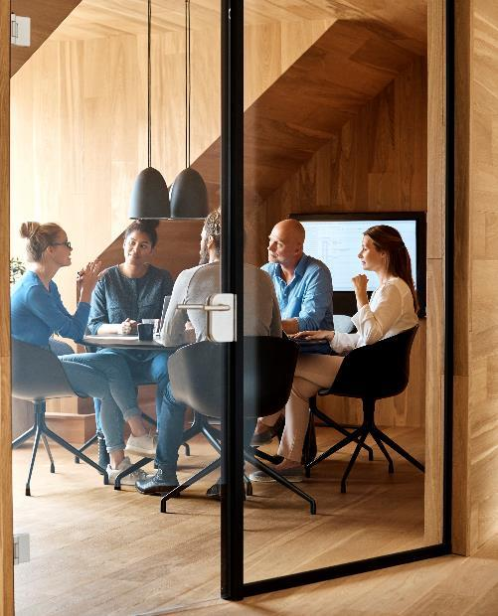



Welcome
Welcome to High Performance Programming Team. Over the course of this workshop series you will

Slide 3



Agenda
Introductions
Series overview & timeline
This week’s meetup
Resources
Content
Discussion

Slide 4




Meeting the Team
Tyler Swann
Name
Name
Name
Manager
Title
Title
Title

Slide 5
Series Overview
What we hope to teach
Technology you will use
A good, foundational understanding of programming techniques.
Knowledge of the C++ programming language.
Basics of computer software architecture
Ownership and memory concepts
Generic programming techniques
Algorithm intuition
Beginners guide to parallelism primitives and techniques
C++
Markdown
Bash | Powershell | CMD
Git + GitHub
Makefiles
bpt
VSCode

Slide 6
Timeline
Week 0
Data Types & Operators
Week 2
Week 3
Week 1
Introduction
Loops & Conditionals
Pointers, References, Slices & Memory
Week 4
Functions, Overloading & Scope
Week 5
Structures, Unions, Enumerations, Classes, Templates & Concepts
Week 6
Data Structures & Iterators
Week 7
Algorithms, Ranges, Views & Basic Parallelism
Week 8
Atomics, Mutexes, Semaphores, Futures & Threads

Slide 7

Installing Software
Week 0

Slide 8
Git & GitHub
About
Setup GitHub
Git is a software control management (SCM) tool that helps to manage software projects and keep a record or the software's history.
Projects are managed using repositories, which contains information about the branches, history and contributors of a project.
GitHub is a website that can host remote (online) repositories.
You can `clone` and `fork` repositories from GitHub allowing you to use and contribute to them.
Create a GitHub account. Use a personal email as you will most likely want to keep your account after university.
We will collect your Username + Email used to add you to the MDN GitHub organization and to add you to the relevant team.
Keep note of your username and email as you will need it later.

Slide 9
HPP Repository & MDN Organization
HPP Repository
MDN Organization
For this series, all content will be available on a repository on GitHub called HPP. It is highly recommended you bookmark or star this repository so you can easily access it.
The weekly slides (*.pptx and *.pdf formats), code examples, tasks, instructions and content are hosted here.
The instructions for each week will also be hosted on the repository in a read-only format. This should make copying commands and code snippets easier.
E.g. All commands and instructions for installing all the software this week are in `content/week0/tasks/README.md`. These slides are non-comprehensive so follow along with the GitHub.
Link: https://github.com/MonashDeepNeuron/HPP
The MDN organization hosts the projects and resources for MDN projects and members.
Permissions and access are managed through teams.
Each team has a private discussion, project board and different repository access.

Slide 10
Windows Terminal and WSL
Windows Terminal
WSL
Windows Terminal is an application by Microsoft that is able to host multiple shells.
Allows for a better developer experience as much of C++ development is in the terminal.
WSL is a native Linux Kernel that can run alongside Windows.
It also has access to your computers main filesystem along cross platform development.

Slide 11
Homebrew and VSCode
Homebrew
VSCode
Homebrew is a cross-platform package manager.
It allows us to install system packages without needing the systems package manager, such as apt.
VSCode is a text editor
It provides high utility through its extension marketplace so you can customize your developer tool kit as needed.

Slide 12
Other Software
wget – Online asset retrieval
cURL – Online asset retrieval
make – C build recipe tool
Cmake – Cross platform recipe builder
bpt – Build and packaging tool for C++
GCC – GNU Compiler Collection
LLVM – Toolchain for Clang compiler
GDB – GNU Debugger
g++ and clang++ compilers
Compiler Explorer – Online C++ Compiler

Slide 13
Hello World
Week 0

Slide 14
Chart

Slide 15
Table
 | Category 1 | Category 2 | Category 3 | Category 4
Item 1 | 4.5 | 2.3 | 1.7 | 5
Item 2 | 3.2 | 5.1 | 4.4 | 3
Item 3 | 2.1 | 1.7 | 2.5 | 2.8
Item 4 | 4.5 | 2.2 | 1.7 | 7

Slide 16

The way to get started is to quit talking and begin doing.
Walt Disney

Slide 17
Content
Subtitle
Subtitle
Add text, images, art, and videos.
Add transitions, animations, and motion.
Save to OneDrive, to get to your presentations from your computer, tablet, or phone.
Open the Design Ideas pane for instant slide makeovers.
When we have design ideas, we’ll show them to you right there.

Slide 18
Content 2
Subtitle
subtitle
subtitle
Add text, images, art, and videos.
Add transitions, animations, and motion.
Save to OneDrive, to get to your presentations from your computer, tablet, or phone.
Open the Design Ideas pane for instant slide makeovers.
When we have design ideas, we’ll show them to you right there.
Add text, images, art, and videos.
Add transitions, animations, and motion.
Save to OneDrive, to get to your presentations from your computer, tablet, or phone.
Open the Design Ideas pane for instant slide makeovers.
When we have design ideas, we’ll show them to you right there.
Add text, images, art, and videos.
Add transitions, animations, and motion.
Save to OneDrive, to get to your presentations from your computer, tablet, or phone.
Open the Design Ideas pane for instant slide makeovers.
When we have design ideas, we’ll show them to you right there.

Slide 19

Summary
With PowerPoint, you can create presentations and share your work with others, wherever they are. Type the text you want here to get started. You can also add images, art, and videos on this template. Save to OneDrive and access your presentations from your computer, tablet, or phone.

Slide 20


Thank You
Presenter name
Email address
Website address

