Slide 1

Part 6
Tyler Swann

Slide 2



Agenda
Iterators
Data Structures
Algorithms
Ranges
Views
Discussion

Slide 3

Iterators

Slide 4
Iterators
Iterators are abstractions that represent an element or item that belongs to a collection or container.
Iterators are traversal objects, as in they are used to traverse between data that has a common owner.
Iterators are a lot like pointers in most cases as they are used to hold or refer to some element somewhere else and can read and write to the stored value.

Slide 5
Iterator Categories
Iterator Category | Valid Operations
 | write | read | increment | multiple passes | decrement | random access | contiguous storage
Output | ✅ |  | ✅
Input | ❓(might support writing) | ✅ | ✅
Forward (Satisfies Input) |  | ✅ | ✅ | ✅
Bidirectional (Satisfies Forward) |  | ✅ | ✅ | ✅ | ✅
Random Access (Satisfies Bidirectional) |  | ✅ | ✅ | ✅ | ✅ | ✅
Contiguous (Satisfies Random Access) |  | ✅ | ✅ | ✅ | ✅ | ✅ | ✅

Slide 6
Obtaining Iterators
Iterators are generally defined for a container-like object.
Iterators to the beginning and end of the container can be obtained using the std::begin and std::end respectively.
The “end” iterator usually holds the element that is one-past-the-end in memory.
There are customizations of the iterator obtaining functions that can get constant (immutable underlying element), reverse and constant reverse iterators for a [some] container[s].
#include <array>
#include <iostream>
#include <iterator>
auto main() -> int
{
auto a = std::to_array<int>({1, 3, 4, 565, 868, 5, 46});
std::cout << std::begin(a) << std::endl;
std::cout << *std::begin(a) << std::endl;
std::cout << std::end(a) << std::endl;
std::cout << *(std::end(a) - 1) << std::endl;
return 0;
}

Slide 7
Iterator Operators
Most iterators; depending on there iterator category, support the same set of operators used by pointers to dereference, increment, decrement etc.
#include <array>
#include <iostream>
#include <iterator>
auto main() -> int
{
auto a = std::to_array<int>({1, 3, 4, 565, 868, 5, 46});
auto it = std::begin(a);
std::cout << *it << std::endl;
std::cout << *(it++) << std::endl;
std::cout << *(++it) << std::endl;
std::cout << *(it--) << std::endl;
std::cout << *(--it) << std::endl;
std::cout << *(it + 4) << std::endl;
std::cout << *(std::end(a) - 4) << std::endl;
std::cout << it[6] << std::endl;
auto v { *it };
*it = 757657;
std::cout << v << std::endl;
std::cout << *it << std::endl;
return 0;
}
Operation
dereference | *i | *i = v | v = *i
increment | i++ | ++i
decrement | i-- | --i
difference | i - j
advance | i + n | i - n
index | i[n]

Slide 8
Iterator Functions
There are also standard interfaces that allow for the manipulation of iterators.
These are able to find the correct set of operations for the general functionality (say moving to the nth next element) for a given iterator depending on its category.
#include <array>
#include <iostream>
#include <iterator>
auto main() -> int
{
auto a = std::to_array<int>({1, 3, 4, 565, 868, 5, 46});
auto it = std::begin(a);
std::cout << *it << std::endl;
std::cout << *std::next(it) << std::endl;
std::cout << *std::prev(it) << std::endl;
std::cout << *std::next(it, 4) << std::endl;
auto end = std::end(a);
std::cout << *std::next(end, -4) << std::endl;
std::cout << std::distance(it, end - 3) << std::endl;
std::advance(it, 3);
std::cout << *it << std::endl;
return 0;
}

Slide 9
Sentinels
Iterators have no internal notion of the end of a sequence they traverse through, much like pointers.
Sentinels are a marker that indicate the end of a sequence. A common sentinel that is used by any language that does string processing is the literal character \0 which denotes the end of string.
In C++, the ‘end’ iterator is used as a sentinel, indicating there are no more values that can be yielded by an iterator.
Any iterator can be used as a sentinel for a sequence of values if it doesn’t mark the true end of the sequence.

Slide 10
Data Structures

Slide 11

Data Structures
Data structures are a fundamental concept in all of Computer Science.
They are used to arrange and organize data into different shapes, memory layouts and access patterns.
Different data structures offer different complexities for reading, writing, insertion and erasure.
There are three main categories of data structures in C++; sequence, associative and unordered associative.

Slide 12
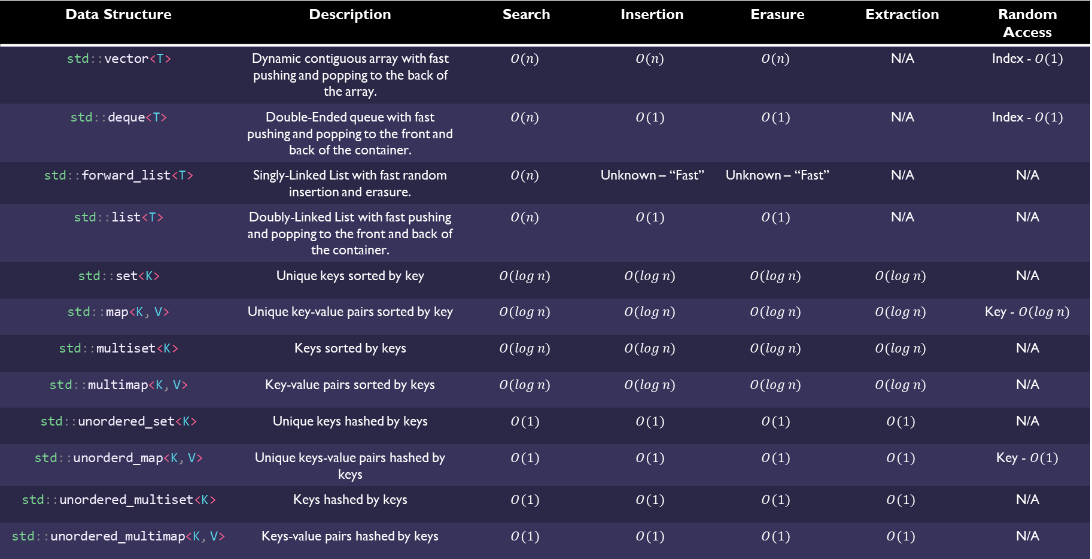
C++ Standard Containers
Data Structure | Description | Search | Insertion | Erasure | Extraction | Random Access
std::vector<T> | Dynamic contiguous array with fast pushing and popping to the back of the array. | $$O(n)$$ | $$O(n)$$ | $$O(n)$$ | N/A | Index - $O(1)$
std::deque<T> | Double-Ended queue with fast pushing and popping to the front and back of the container. | $$O(n)$$ | $$O(1)$$ | $$O(1)$$ | N/A | Index - $O(1)$
std::forward_list<T> | Singly-Linked List with fast random insertion and erasure. | $$O(n)$$ | Unknown – “Fast” | Unknown – “Fast” | N/A | N/A
std::list<T> | Doubly-Linked List with fast pushing and popping to the front and back of the container. | $$O(n)$$ | $$O(1)$$ | $$O(1)$$ | N/A | N/A
std::set<K> | Unique keys sorted by key | $$O(\log{n})$$ | $$O(\log{n})$$ | $$O(\log{n})$$ | $$O(\log{n})$$ | N/A
std::map<K, V> | Unique key-value pairs sorted by key | $$O(\log{n})$$ | $$O(\log{n})$$ | $$O(\log{n})$$ | $$O(\log{n})$$ | Key - $O(\log{n})$
std::multiset<K> | Keys sorted by keys | $$O(\log{n})$$ | $$O(\log{n})$$ | $$O(\log{n})$$ | $$O(\log{n})$$ | N/A
std::multimap<K, V> | Key-value pairs sorted by keys | $$O(\log{n})$$ | $$O(\log{n})$$ | $$O(\log{n})$$ | $$O(\log{n})$$ | N/A
std::unordered_set<K> | Unique keys hashed by keys | $$O(1)$$ | $$O(1)$$ | $$O(1)$$ | $$O(1)$$ | N/A
std::unorderd_map<K, V> | Unique keys-value pairs hashed by keys | $$O(1)$$ | $$O(1)$$ | $$O(1)$$ | $$O(1)$$ | Key - $O(1)$
std::unordered_multiset<K> | Keys hashed by keys | $$O(1)$$ | $$O(1)$$ | $$O(1)$$ | $$O(1)$$ | N/A
std::unordered_multimap<K, V> | Keys-value pairs hashed by keys | $$O(1)$$ | $$O(1)$$ | $$O(1)$$ | $$O(1)$$ | N/A

Slide 13
Bitset
#include <bitset>
#include <iostream>
#include <string>
auto main() -> int
{
auto b = std::bitset<6>(0b011010uLL);
println(b);
b[2] = true;
println(b);
b.set(4) = false;
b.flip(0);
println(b);
b.flip();
println(b);
b.reset();
println(b);
std::cout << std::boolalpha;
std::cout << (b.test(5) == false) << std::endl;
std::cout << b.any() << std::endl;
std::cout << b.all() << std::endl;
std::cout << b.none() << std::endl;
std::cout << std::noboolalpha;
return 0;
}
Static collection of individually addressable bits.
Can be used in constexpr contexts.
Overloads for bitwise operations.
Conversion functions to string representations of the bits.
Bit testing methods.

Slide 14
Any
#include <iostream>
#include <any> auto main() -> int
{
auto a = std::make_any<int>(6);
println<int>(a);
a.emplace<double>(6.797898);
println<double>(a);
std::cout << a.type().name() << std::endl;
std::cout << std::boolalpha;
std::cout << a.has_value() << std::endl;
a.reset();
std::cout << a.has_value() << std::endl;
std::cout << std::noboolalpha;
return 0;
}
Storage of dynamic type, copyable object.
Access to value through casting with std::any_cast<T>.
In-place construction and destruction of held object.

Slide 15
Algorithms

Slide 16
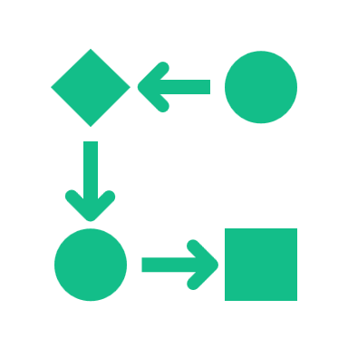
Algorithms
Algorithms are functions that perform a specific set of steps often to perform some computation.
Algorithms are mostly used to manipulate data. When paired with data structures, algorithms can make development far more seamless, especially when written in a generic style.
C++ Standard Algorithms were the brainchild of Alex Stepanov that used templates and generic techniques to create powerful interfaces and seamless interoperability between algorithms and data structures.
The focus of this section is not on how to write algorithms but rather how to use them. How to compose them together using functional techniques create expressible and type safe code that is also fast.
C++ algorithms take a begin and end iterator indicating the range of elements the algorithm applies to.

Slide 17
C++ Standard Algorithms
Category | C++ Algorithm | Common Name | Description
General
Sorting
Comparisons
Generators

Slide 18
C++ Standard Algorithms cont.
Category | C++ Algorithm | Common Name | Description
Searching
Modifying

Slide 19
C++ Standard Algorithms cont.
Category | C++ Algorithm | Common Name | Description
Modifying
Numeric

Slide 20
Ranges

Slide 21
Views

Slide 22
Discussion
Any questions?
Need help?
Open discussion.
Concerns?

Slide 23
Next Week
Parallel Algorithms
Atomics
Threads
Mutexes
Semaphores
Async/Await

Slide 24


Thank You
Tyler Swann
https://github.com/MonashDeepNeuron/HPP

Slide 25
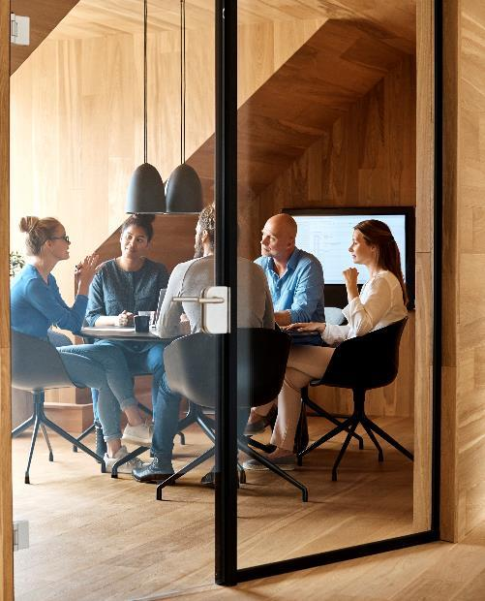



Introduction
With PowerPoint, you can create presentations and share your work with others, wherever they are. Type the text you want here to get started. You can also add images, art, and videos on this template. Save to OneDrive and access your presentations from your computer, tablet, or phone.

Slide 26
Chart

Slide 27
Table
 | Category 1 | Category 2 | Category 3 | Category 4
Item 1 | 4.5 | 2.3 | 1.7 | 5
Item 2 | 3.2 | 5.1 | 4.4 | 3
Item 3 | 2.1 | 1.7 | 2.5 | 2.8
Item 4 | 4.5 | 2.2 | 1.7 | 7

Slide 28

The way to get started is to quit talking and begin doing.
Walt Disney

Slide 29




Team
Name
Name
Name
Name
Title
Title
Title
Title

Slide 30
Timeline
Title
To start a presentation, go to the Slide Show tab, and select From Beginning.
Title
To display Presenter view, in Slide Show view, on the control bar at the bottom left select the three dots, and then Show Presenter View.
Title
During your presentation, the speaker notes are visible on your monitor, but aren't visible to the audience.
Title
Title
If you don’t see the Notes pane or it is completely minimized, click Notes on the task bar across the bottom of the PowerPoint window.
The Notes pane is a box that appears below each slide. Tap it to add notes.

Slide 31
Content
Subtitle
Subtitle
Add text, images, art, and videos.
Add transitions, animations, and motion.
Save to OneDrive, to get to your presentations from your computer, tablet, or phone.
Open the Design Ideas pane for instant slide makeovers.
When we have design ideas, we’ll show them to you right there.

Slide 32
Content 2
Subtitle
subtitle
subtitle
Add text, images, art, and videos.
Add transitions, animations, and motion.
Save to OneDrive, to get to your presentations from your computer, tablet, or phone.
Open the Design Ideas pane for instant slide makeovers.
When we have design ideas, we’ll show them to you right there.
Add text, images, art, and videos.
Add transitions, animations, and motion.
Save to OneDrive, to get to your presentations from your computer, tablet, or phone.
Open the Design Ideas pane for instant slide makeovers.
When we have design ideas, we’ll show them to you right there.
Add text, images, art, and videos.
Add transitions, animations, and motion.
Save to OneDrive, to get to your presentations from your computer, tablet, or phone.
Open the Design Ideas pane for instant slide makeovers.
When we have design ideas, we’ll show them to you right there.

Slide 33

Summary
With PowerPoint, you can create presentations and share your work with others, wherever they are. Type the text you want here to get started. You can also add images, art, and videos on this template. Save to OneDrive and access your presentations from your computer, tablet, or phone.

