Slide 1

High Performance Programming
Presented by: Tyler Swann

Slide 2

Purpose
DeepNeuron’s High Performance Programming series is a course aimed teaching the C++ programming language with a focus on building safe, reliable, fast and scalable software.
Throughout the series we look at modern C++ techniques and features introduced as recently as 2020.
The focus of the series is to build up algorithm intuition to allow complexity through composability.
This is also a heavy focus on creating generic code and customization through constraints.
The final objective was to learn about parallelism and concurrency primitives in order to effectively utilize compute resources in a declarative manner.

Slide 3
Timeline
Part 1
Data Types, Operators, Conditionals, Loops, Functions & IO
Part 2
Introduction
Pointers, References, Slices, Memory & the Standard Library
Part 5
Classes, Templates, Generics and Concepts
Part 6
Iterators, Data Structures, Algorithms, Ranges & Views
Part 7
Parallel Algorithms, Atomics, Threads, Mutexes, Semaphores & Async/Await
Break
Part 3
Part 4
Functional Programming, Namespaces, Unions, Enumerations and Structures
University and MDN Shutdown

Slide 4
Progress
Basic Syntax
Types, Data Value Categories and Semantics
Pointers, References and Dynamic Memory
Structures
Basic Sequences
Control Flow, Loops and Functions

Slide 5
Up and Coming for HPP
Generic programming through templates and concepts
Create a game or application in order to properly apply skills and techniques
Advanced type creation and polymorphic type relationships
Lazy evaluation, parallelism and concurrency techniques
Algorithm intuition through generics and analysis of iteration
Data Structures

Slide 6
Looking to the Future
One of the side purposes this series was to test the viability of a programming centric series from DeepNeuron and to see if this or something like this could serve a continued role in DeepNeuron’s.
I also tested new methods and tools for teaching and general utility within DeepNeuron that could aid in the delivery of content for both new recruits and in project transitions as well as storing and contributing to DeepNeuron’s collective knowledge and works, respectively.
The hopeful outcome from this series is for more; C++ or other, programming language centric workshops, series and course to be utilized by DeepNeuron to so that members can explore new paradigms, deepen our programming vocabulary and offer new outreach opportunities for DeepNeuron to the broader; Monash University or other, community.

Slide 7
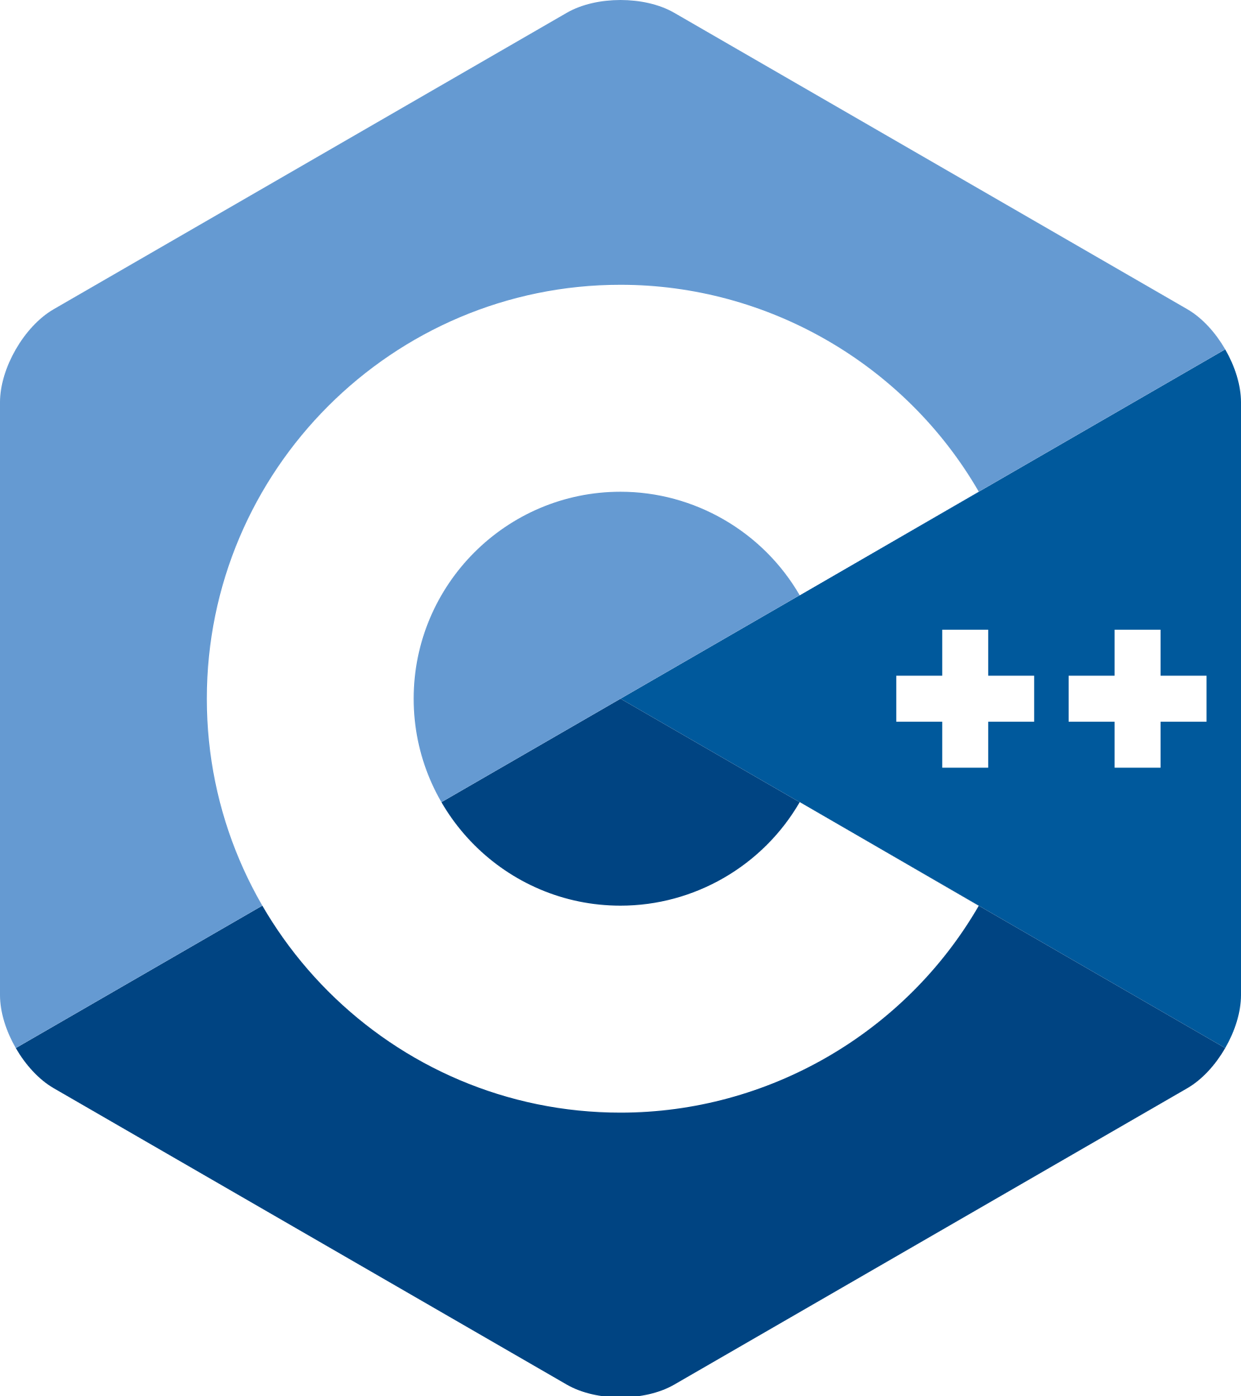


Questions?

Slide 8


Thank You For Your Time & Attention
https://github.com/MonashDeepNeuron/HPP

