Slide 1

Part 6
Tyler Swann

Slide 2



Agenda
Iterators
Data Structures
Algorithms
Ranges
Views
Discussion

Slide 3

Iterators

Slide 4
Iterators
Iterators are abstractions that represent an element or item that belongs to a collection or container.
Iterators are traversal objects, as in they are used to traverse between data that has a common owner.
Iterators are a lot like pointers in most cases as they are used to hold or refer to some element somewhere else and can read and write to the stored value.

Slide 5
Iterator Categories
Iterator Category | Valid Operations
 | write | read | increment | multiple passes | decrement | random access | contiguous storage
Output | ✅ |  | ✅
Input | ❓(might support writing) | ✅ | ✅
Forward (Satisfies Input) |  | ✅ | ✅ | ✅
Bidirectional (Satisfies Forward) |  | ✅ | ✅ | ✅ | ✅
Random Access (Satisfies Bidirectional) |  | ✅ | ✅ | ✅ | ✅ | ✅
Contiguous (Satisfies Random Access) |  | ✅ | ✅ | ✅ | ✅ | ✅ | ✅

Slide 6
Obtaining Iterators
Iterators are generally defined for a container-like object.
Iterators to the beginning and end of the container can be obtained using the std::begin and std::end respectively.
The “end” iterator usually holds the element that is one-past-the-end in memory.
There are customizations of the iterator obtaining functions that can get constant (immutable underlying element), reverse and constant reverse iterators for a [some] container[s].
#include <array>
#include <iostream>
#include <iterator>
auto main() -> int
{
auto a = std::to_array<int>({1, 3, 4, 565, 868, 5, 46});
std::cout << std::begin(a) << std::endl;
std::cout << *std::begin(a) << std::endl;
std::cout << std::end(a) << std::endl;
std::cout << *(std::end(a) - 1) << std::endl;
return 0;
}

Slide 7
Iterator Operators
Most iterators; depending on there iterator category, support the same set of operators used by pointers to dereference, increment, decrement etc.
#include <array>
#include <iostream>
#include <iterator>
auto main() -> int
{
auto a = std::to_array<int>({1, 3, 4, 565, 868, 5, 46});
auto it = std::begin(a);
std::cout << *it << std::endl;
std::cout << *(it++) << std::endl;
std::cout << *(++it) << std::endl;
std::cout << *(it--) << std::endl;
std::cout << *(--it) << std::endl;
std::cout << *(it + 4) << std::endl;
std::cout << *(std::end(a) - 4) << std::endl;
std::cout << it[6] << std::endl;
auto v { *it };
*it = 757657;
std::cout << v << std::endl;
std::cout << *it << std::endl;
return 0;
}
Operation
dereference | *i | *i = v | v = *i
increment | i++ | ++i
decrement | i-- | --i
difference | i - j
advance | i + n | i - n
index | i[n]

Slide 8
Iterator Functions
There are also standard interfaces that allow for the manipulation of iterators.
These are able to find the correct set of operations for the general functionality (say moving to the nth next element) for a given iterator depending on its category.
#include <array>
#include <iostream>
#include <iterator>
auto main() -> int
{
auto a = std::to_array<int>({1, 3, 4, 565, 868, 5, 46});
auto it = std::begin(a);
std::cout << *it << std::endl;
std::cout << *std::next(it) << std::endl;
std::cout << *std::prev(it) << std::endl;
std::cout << *std::next(it, 4) << std::endl;
auto end = std::end(a);
std::cout << *std::next(end, -4) << std::endl;
std::cout << std::distance(it, end - 3) << std::endl;
std::advance(it, 3);
std::cout << *it << std::endl;
return 0;
}

Slide 9
Sentinels
Iterators have no internal notion of the end of a sequence they traverse through, much like pointers.
Sentinels are a marker that indicate the end of a sequence. A common sentinel that is used by any language that does string processing is the literal character \0 which denotes the end of string.
In C++, the ‘end’ iterator is used as a sentinel, indicating there are no more values that can be yielded by an iterator.
Any iterator can be used as a sentinel for a sequence of values if it doesn’t mark the true end of the sequence.

Slide 10
Data Structures

Slide 11

Data Structures
Data structures are a fundamental concept in all of Computer Science.
They are used to arrange and organize data into different shapes, memory layouts and access patterns.
Different data structures offer different complexities for reading, writing, insertion and erasure.
There are three main categories of data structures in C++; sequence, associative and unordered associative.

Slide 12

Vectors
#include <iostream>
#include <vector>
auto main() -> int
{
auto v = std::vector<int>{ 1, 2, 3, 4, 5 };
println(v);
v.push_back(6);
println(v);
v.pop_back();
v.pop_back();
println(v);
v.insert(v.begin() + 3, 77);
println(v);
v.erase(v.end() - 4);
println(v);
std::cout << "v[4] = " << v[4] << std::endl; ///< Unsafe version
std::cout << "v.at(2) = " << v.at(2) << std::endl; ///< Range checked
std::cout << "Before v.shrink_to_fit()" << std::endl;
std::cout << "Size: " << v.size() << std::endl;
std::cout << "Capacity: " << v.capacity() << std::endl;
println(v);
v.shrink_to_fit();
std::cout << "After v.shrink_to_fit()" << std::endl;
std::cout << "Size: " << v.size() << std::endl;
std::cout << "Capacity: " << v.capacity() << std::endl;
println(v);
v.clear();
std::cout << "After v.clear()" << std::endl;
std::cout << "Size: " << v.size() << std::endl;
std::cout << "Capacity: " << v.capacity() << std::endl;
println(v);
return 0;
}
Dynamic array with efficient pushing and popping of elements to the back of the array.
Contiguous memory layout allowing for the most optimal caching performance.
$O(1)$ random access to elements via 0-based numeric indexing.
$O(n)$random insertion and deletion of elements.
Best choice for any sequence container.

Slide 13

Deque
#include <iostream>
#include <deque>
auto main() -> int
{
auto dq = std::deque<int>{ 1, 2, 3, 4, 5 };
println(dq);
dq.push_back(6);
println(dq);
dq.pop_back();
dq.pop_back();
println(dq);
dq.push_front(33);
dq.push_front(914);
dq.push_front(-44);
dq.push_front(0);
println(dq);
dq.pop_front();
dq.pop_front();
println(dq);
dq.insert(dq.begin() + 3, 77);
println(dq);
dq.erase(dq.end() - 4);
println(dq);
std::cout << "dq[4] = " << dq[4] << std::endl; ///< Unsafe version
std::cout << "dq.at(2) = " << dq.at(2) << std::endl; ///< Range checked
std::cout << "Before dq.shrink_to_fit()" << std::endl;
std::cout << "Size: " << dq.size() << std::endl;
println(dq);
dq.shrink_to_fit();
std::cout << "After dq.shrink_to_fit()" << std::endl;
std::cout << "Size: " << dq.size() << std::endl;
println(dq);
dq.clear();
std::cout << "After dq.clear()" << std::endl;
std::cout << "Size: " << dq.size() << std::endl;
println(dq);
return 0;
}
Double ended queue
$O(1)$ insertion and erasure at the front and back of the deque.
Never invalidates iterators or references when pushing or popping to the front or back of the deque.
$O(1)$ random access to elements via 0-based numeric indexing.
$O(n)$random insertion and deletion of elements.

Slide 14
Forward List
#include <iostream>
#include <forward_list>
auto main() -> int
{
auto f_lst = std::forward_list<int>{ 1, 2, 3, 4, 5 };
println(f_lst);
f_lst.push_front(33);
f_lst.push_front(914);
f_lst.push_front(-44);
f_lst.push_front(0);
println(f_lst);
f_lst.pop_front();
f_lst.pop_front();
println(f_lst);
f_lst.insert_after(f_lst.begin(), 77);
println(f_lst);
f_lst.erase_after(f_lst.begin());
println(f_lst);
f_lst.clear();
println(f_lst);
return 0;
}
Singly-Linked List with fast insertion and erasure anywhere in the list
Doesn’t invalidate iterators when inserting, erasing (except erased element) or merging lists.
More efficient when bidirectionality is not needed.

Slide 15
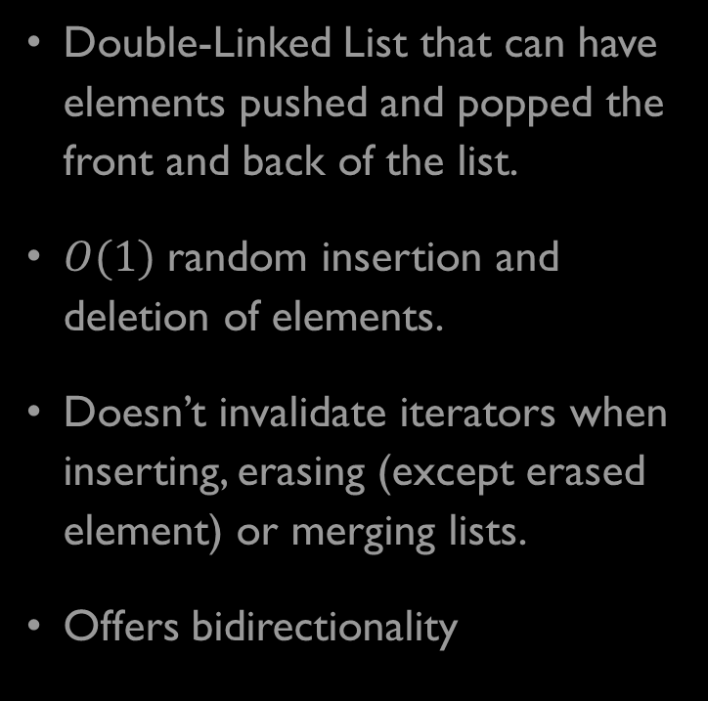
List
#include <iostream>
#include <list>
auto main() -> int
{
auto lst = std::list<int>{ 1, 2, 3, 4, 5 };
println(lst);
lst.push_back(6);
println(lst);
lst.pop_back();
lst.pop_back();
println(lst);
lst.push_front(33);
lst.push_front(914);
lst.push_front(-44);
lst.push_front(0);
println(lst);
lst.pop_front();
lst.pop_front();
println(lst);
lst.insert(lst.begin(), 77);
println(lst);
lst.erase(++lst.begin());
println(lst);
lst.clear();
std::cout << "After lst.clear()" << std::endl;
std::cout << "Size: " << lst.size() << std::endl;
println(lst);
return 0;
}
Double-Linked List that can have elements pushed and popped the front and back of the list.
$O(1)$random insertion and deletion of elements.
Doesn’t invalidate iterators when inserting, erasing (except erased element) or merging lists.
Offers bidirectionality

Slide 16
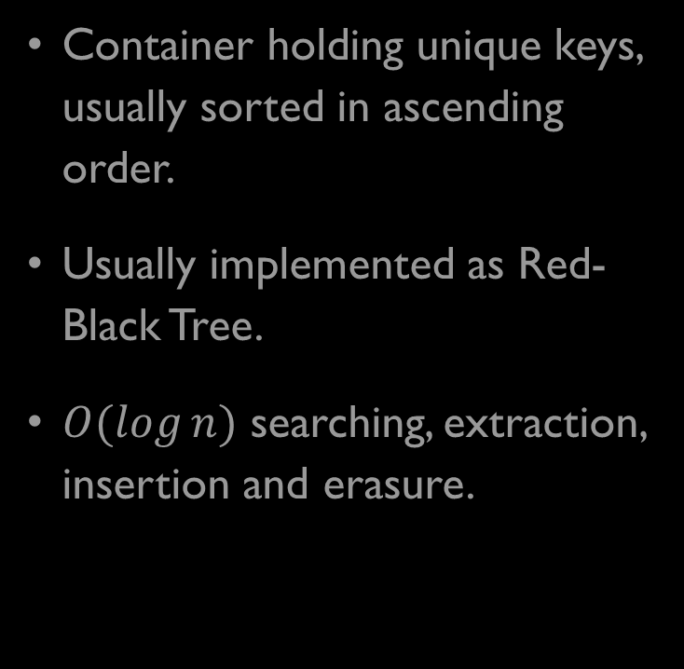
Set
#include <iostream>
#include <set>
auto main() -> int
{
auto st = std::set<int>{ 1, 2, 3, 4, 5 };
st.insert(77);
println(st);
st.erase(++st.begin());
println(st);
std::cout << "st.extract(++st.begin()).value() = "
<< st.extract(++st.begin()).value()
<< std::endl;
std::cout << "st.extract(5).value() = "
<< st.extract(5).value()
<< std::endl;
println(st);
st.merge(std::set<int>{ -1, 5, 4, 2, 0, 8, 6 });
std::cout << "After st.merge(...): " << std::endl;
println(st);
st.clear();
std::cout << "After st.clear()" << std::endl;
std::cout << "Size: " << st.size() << std::endl;
println(st);
return 0;
}
Container holding unique keys, usually sorted in ascending order.
Usually implemented as Red-Black Tree.
$O(\log{n})$ searching, extraction, insertion and erasure.

Slide 17
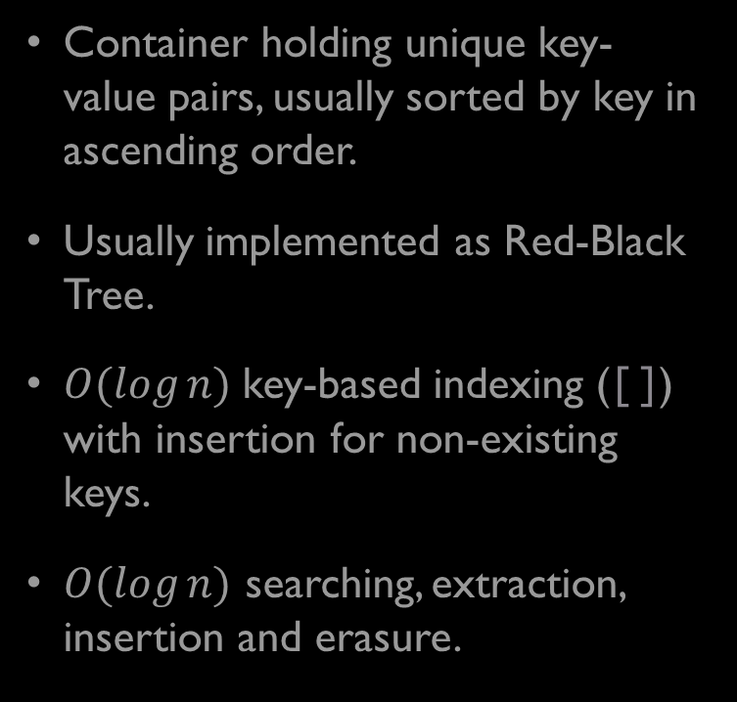
Map
#include <iostream>
#include <map>
auto main() -> int
{
auto m = std::map<std::string, int>{
{"z", 1}, {"f", 2}, {"a", 3}, {"g", 4}, {"x", 5}
};
println(m);
m["a"] = 5; ///< Can read, write and insert
println(m);
m["q"] = 7;
println(m);
m.at("g") = 265; ///< Can only be used for read or write, not insert
println(m);
m.insert({"w", 77});
println(m);
m.insert_or_assign("w", 354658);
println(m);
m.erase("a");
println(m);
m.erase(++m.begin());
println(m);
m.clear();
std::cout << "After m.clear()" << std::endl;
std::cout << "Size: " << m.size() << std::endl;
println(m);
return 0;
}
Container holding unique key-value pairs, usually sorted by key in ascending order.
Usually implemented as Red-Black Tree.
$O(\log{n})$key-based indexing ([]) with insertion for non-existing keys.
$O(\log{n})$ searching, extraction, insertion and erasure.

Slide 18
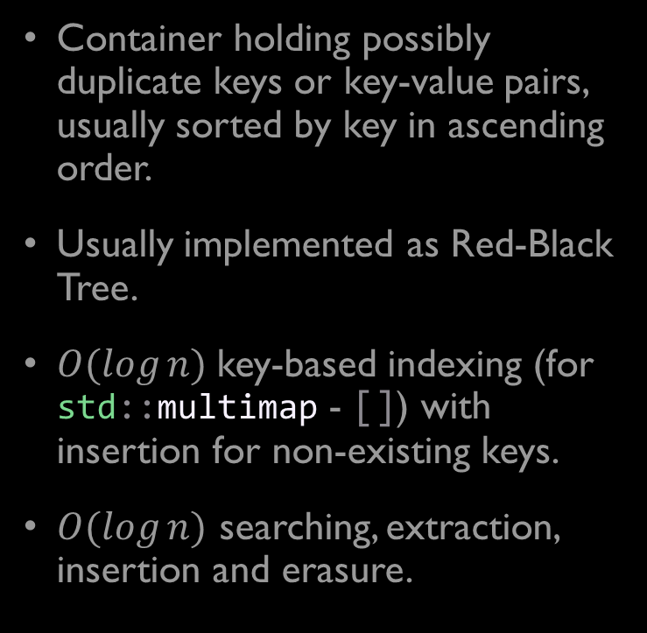
MultiSet & MultiMap
#include <iostream>
#include <map>
auto main() -> int
{
auto mm = std::multimap<std::string, int>{
{"z", 12}, {"f", 2}, {"a", 3}, {"g", 4}, {"x", 5}
};
println(mm);
mm.insert({"z", 77});
println(mm);
mm.erase("a");
println(mm);
mm.erase(++mm.begin());
println(mm);
mm.clear();
std::cout << "After mm.clear()" << std::endl;
std::cout << "Size: " << mm.size() << std::endl;
println(mm);
return 0;
}
Container holding possibly duplicate keys or key-value pairs, usually sorted by key in ascending order.
Usually implemented as Red-Black Tree.
$O(\log{n})$key-based indexing (for std::multimap - []) with insertion for non-existing keys.
$O(\log{n})$ searching, extraction, insertion and erasure.

Slide 19
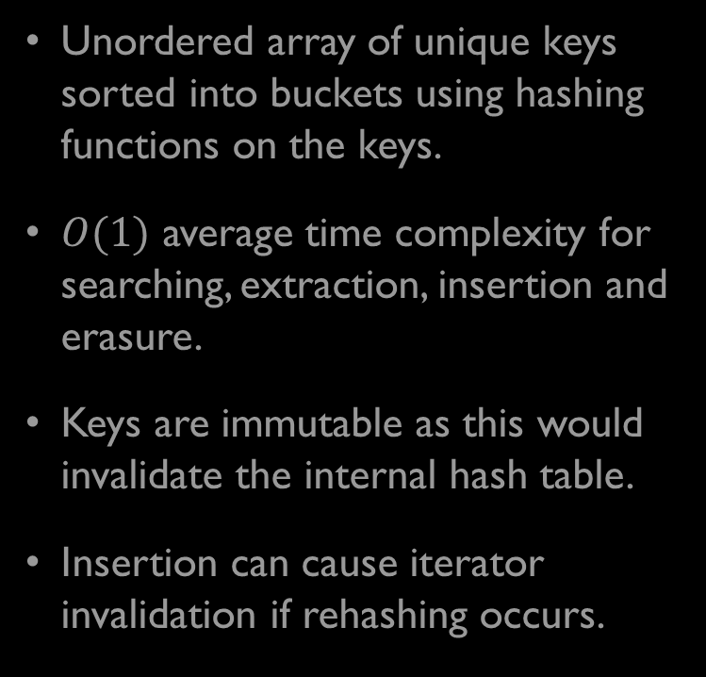
Unordered Set
#include <iostream>
#include <unordered_set>
auto main() -> int
{
auto ust = std::unordered_set<std::string>{ "z", "f", "a", "g", "x" };
println(ust);
ust.insert("k");
println(ust);
ust.erase("a");
println(ust);
ust.erase(++ust.begin());
println(ust);
std::cout << "Loading Factor: " << ust.load_factor() << std::endl;
std::cout << "Max Loading Factor: " << ust.max_load_factor() << std::endl;
std::cout << "Size: " << ust.size() << std::endl;
std::cout << "# Buckets: " << ust.bucket_count() << std::endl;
ust.insert("m");
println(ust);
std::cout << "Size: " << ust.size() << std::endl;
std::cout << "# Buckets: " << ust.bucket_count() << std::endl;
auto bckt = ust.bucket("f"); ///< returns index of bucket
std::cout << "Bucket Size: " << ust.bucket_size(bckt) << std::endl;
ust.clear();
std::cout << "After ust.clear()" << std::endl;
std::cout << "Size: " << ust.size() << std::endl;
println(ust);
return 0;
}
Unordered array of unique keys sorted into buckets using hashing functions on the keys.
$O(1)$ average time complexity for searching, extraction, insertion and erasure.
Keys are immutable as this would invalidate the internal hash table.
Insertion can cause iterator invalidation if rehashing occurs.

Slide 20

Unordered Map
#include <iostream>
#include <unordered_map>
auto main() -> int
{
auto umap = std::unordered_map<std::string, int>{
{"z", 12}, {"f", 2}, {"a", 3}, {"g", 4}, {"x", 5}
};
println(umap);
umap["h"] = 576;
println(umap);
umap.at("f") = 368548;
println(umap);
println(umap);
umap.insert({"k", 56});
println(umap);
umap.erase("a");
println(umap);
umap.erase(++umap.begin());
println(umap);
std::cout << "Loading Factor: " << umap.load_factor() << std::endl;
std::cout << "Max Loading Factor: " << umap.max_load_factor() << std::endl;
std::cout << "Size: " << umap.size() << std::endl;
std::cout << "# Buckets: " << umap.bucket_count() << std::endl;
umap.insert({"m", 78});
println(umap);
std::cout << "Size: " << umap.size() << std::endl;
std::cout << "# Buckets: " << umap.bucket_count() << std::endl;
auto bckt = umap.bucket("f"); ///< returns index of bucket
std::cout << "Bucket Size: " << umap.bucket_size(bckt) << std::endl;
umap.clear();
std::cout << "After umap.clear()" << std::endl;
std::cout << "Size: " << umap.size() << std::endl;
println(umap);
return 0;
}
Unordered array of unique key-value pairs sorted into buckets using hashing functions on the keys.
$O(1)$ average time complexity for searching, extraction, insertion and erasure.
$O(1)$key-based indexing ([]) with insertion for non-existing keys.
Keys are immutable as this would invalidate the internal hash table.
Insertion can cause iterator invalidation if rehashing occurs.

Slide 21
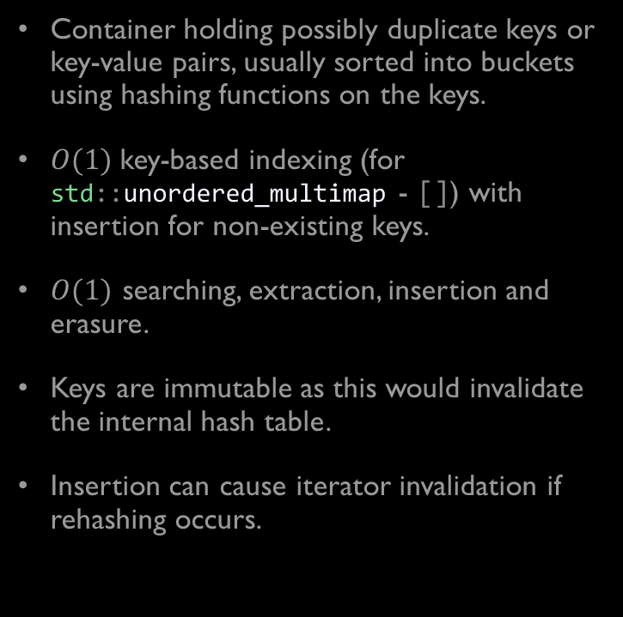
Unordered MultiSet & Unordered MultiMap
#include <iostream>
#include <vector>
auto main() -> int
{
auto ummap = std::unordered_multimap<std::string, int>{
{"z", 1}, {"f", 2}, {"a", 3}, {"g", 4}, {"x", 5}
};
println(ummap);
ummap.insert({"w", 77});
println(ummap);
ummap.insert({"w", 879});
println(ummap);
ummap.insert({"w", -23});
println(ummap);
ummap.insert({"w", 209538});
println(ummap);
std::cout << "Loading Factor: " << ummap.load_factor() << std::endl;
std::cout << "Max Loading Factor: " << ummap.max_load_factor() << std::endl;
std::cout << "Size: " << ummap.size() << std::endl;
std::cout << "# Buckets: " << ummap.bucket_count() << std::endl;
ummap.insert({"m", 78});
println(ummap);
std::cout << "Size: " << ummap.size() << std::endl;
std::cout << "# Buckets: " << ummap.bucket_count() << std::endl;
auto bckt = ummap.bucket("w"); ///< returns index of bucket
std::cout << "Bucket Size: " << ummap.bucket_size(bckt) << std::endl;
std::cout << "w: { ";
auto i { ummap.bucket_size(bckt) };
for (auto it = ummap.begin(bckt); it != ummap.end(bckt); ++it)
std::cout << it->first << ": " << it->second << (--i ? ", " : "");
std::cout << " }" << std::endl;
ummap.erase("a");
println(ummap);
ummap.erase(++ummap.begin());
println(ummap);
ummap.clear();
std::cout << "After ummap.clear()" << std::endl;
std::cout << "Size: " << ummap.size() << std::endl;
println(ummap);
return 0;
}
Container holding possibly duplicate keys or key-value pairs, usually sorted into buckets using hashing functions on the keys.
$O(1)$key-based indexing (for std::unordered_multimap - []) with insertion for non-existing keys.
$O(1)$ searching, extraction, insertion and erasure.
Keys are immutable as this would invalidate the internal hash table.
Insertion can cause iterator invalidation if rehashing occurs.

Slide 22
Unordered MultiSet & Unordered MultiMap
#include <iostream>
#include <vector>
auto main() -> int
{
auto ummap = std::unordered_multimap<std::string, int>{
{"z", 1}, {"f", 2}, {"a", 3}, {"g", 4}, {"x", 5}
};
println(ummap);
ummap.insert({"w", 77});
println(ummap);
ummap.insert({"w", 879});
println(ummap);
ummap.insert({"w", -23});
println(ummap);
ummap.insert({"w", 209538});
println(ummap);
std::cout << "Loading Factor: " << ummap.load_factor() << std::endl;
std::cout << "Max Loading Factor: " << ummap.max_load_factor() << std::endl;
std::cout << "Size: " << ummap.size() << std::endl;
std::cout << "# Buckets: " << ummap.bucket_count() << std::endl;
ummap.insert({"m", 78});
println(ummap);
std::cout << "Size: " << ummap.size() << std::endl;
std::cout << "# Buckets: " << ummap.bucket_count() << std::endl;
auto bckt = ummap.bucket("w"); ///< returns index of bucket
std::cout << "Bucket Size: " << ummap.bucket_size(bckt) << std::endl;
std::cout << "w: { ";
auto i { ummap.bucket_size(bckt) };
for (auto it = ummap.begin(bckt); it != ummap.end(bckt); ++it)
std::cout << it->first << ": " << it->second << (--i ? ", " : "");
std::cout << " }" << std::endl;
ummap.erase("a");
println(ummap);
ummap.erase(++ummap.begin());
println(ummap);
ummap.clear();
std::cout << "After ummap.clear()" << std::endl;
std::cout << "Size: " << ummap.size() << std::endl;
println(ummap);
return 0;
}
Container holding possibly duplicate keys or key-value pairs, usually sorted into buckets using hashing functions on the keys.
$O(1)$key-based indexing (for std::unordered_multimap - []) with insertion for non-existing keys.
$O(1)$ searching, extraction, insertion and erasure.
Keys are immutable as this would invalidate the internal hash table.
Insertion can cause iterator invalidation if rehashing occurs.

Slide 23
Bitset
#include <bitset>
#include <iostream>
#include <string>
auto main() -> int
{
auto b = std::bitset<6>(0b011010uLL);
println(b);
b[2] = true;
println(b);
b.set(4) = false;
b.flip(0);
println(b);
b.flip();
println(b);
b.reset();
println(b);
std::cout << std::boolalpha;
std::cout << (b.test(5) == false) << std::endl;
std::cout << b.any() << std::endl;
std::cout << b.all() << std::endl;
std::cout << b.none() << std::endl;
std::cout << std::noboolalpha;
return 0;
}
Static collection of individually addressable bits.
Can be used in constexpr contexts.
Overloads for bitwise operations.
Conversion functions to string representations of the bits.
Bit testing methods.

Slide 24
Any
#include <iostream>
#include <any> auto main() -> int
{
auto a = std::make_any<int>(6);
println<int>(a);
a.emplace<double>(6.797898);
println<double>(a);
std::cout << a.type().name() << std::endl;
std::cout << std::boolalpha;
std::cout << a.has_value() << std::endl;
a.reset();
std::cout << a.has_value() << std::endl;
std::cout << std::noboolalpha;
return 0;
}
Storage of dynamic type, copyable object.
Access to value through casting with std::any_cast<T>.
In-place construction and destruction of held object.

Slide 25
Algorithms

Slide 26
Ranges

Slide 27
Views

Slide 28
Discussion
Any questions?
Need help?
Open discussion.
Concerns?

Slide 29
Next Week
Parallel Algorithms
Atomics
Threads
Mutexes
Semaphores
Async/Await

Slide 30


Thank You
Tyler Swann
https://github.com/MonashDeepNeuron/HPP

Slide 31




Introduction
With PowerPoint, you can create presentations and share your work with others, wherever they are. Type the text you want here to get started. You can also add images, art, and videos on this template. Save to OneDrive and access your presentations from your computer, tablet, or phone.

Slide 32
Chart

Slide 33
Table
 | Category 1 | Category 2 | Category 3 | Category 4
Item 1 | 4.5 | 2.3 | 1.7 | 5
Item 2 | 3.2 | 5.1 | 4.4 | 3
Item 3 | 2.1 | 1.7 | 2.5 | 2.8
Item 4 | 4.5 | 2.2 | 1.7 | 7

Slide 34

The way to get started is to quit talking and begin doing.
Walt Disney

Slide 35




Team
Name
Name
Name
Name
Title
Title
Title
Title

Slide 36
Timeline
Title
To start a presentation, go to the Slide Show tab, and select From Beginning.
Title
To display Presenter view, in Slide Show view, on the control bar at the bottom left select the three dots, and then Show Presenter View.
Title
During your presentation, the speaker notes are visible on your monitor, but aren't visible to the audience.
Title
Title
If you don’t see the Notes pane or it is completely minimized, click Notes on the task bar across the bottom of the PowerPoint window.
The Notes pane is a box that appears below each slide. Tap it to add notes.

Slide 37
Content
Subtitle
Subtitle
Add text, images, art, and videos.
Add transitions, animations, and motion.
Save to OneDrive, to get to your presentations from your computer, tablet, or phone.
Open the Design Ideas pane for instant slide makeovers.
When we have design ideas, we’ll show them to you right there.

Slide 38
Content 2
Subtitle
subtitle
subtitle
Add text, images, art, and videos.
Add transitions, animations, and motion.
Save to OneDrive, to get to your presentations from your computer, tablet, or phone.
Open the Design Ideas pane for instant slide makeovers.
When we have design ideas, we’ll show them to you right there.
Add text, images, art, and videos.
Add transitions, animations, and motion.
Save to OneDrive, to get to your presentations from your computer, tablet, or phone.
Open the Design Ideas pane for instant slide makeovers.
When we have design ideas, we’ll show them to you right there.
Add text, images, art, and videos.
Add transitions, animations, and motion.
Save to OneDrive, to get to your presentations from your computer, tablet, or phone.
Open the Design Ideas pane for instant slide makeovers.
When we have design ideas, we’ll show them to you right there.

Slide 39

Summary
With PowerPoint, you can create presentations and share your work with others, wherever they are. Type the text you want here to get started. You can also add images, art, and videos on this template. Save to OneDrive and access your presentations from your computer, tablet, or phone.

