Slide 1
Bellabeat Activity Dashboard
Generated from Fitbit Daily Activity Data

Slide 2
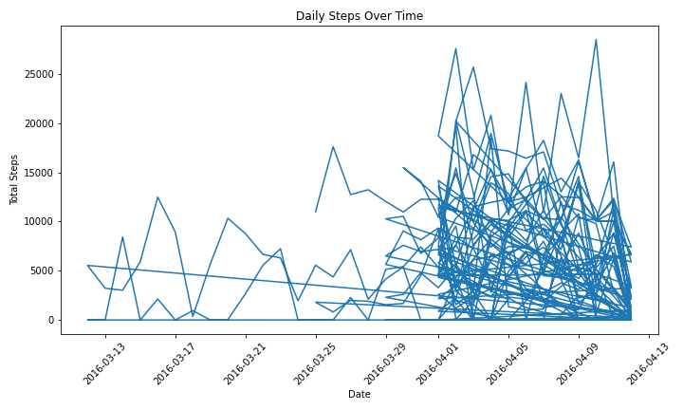
Daily Steps Over Time

Slide 3
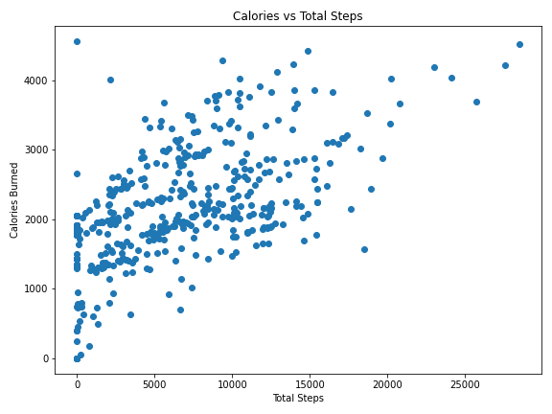
Calories vs Total Steps

Slide 4
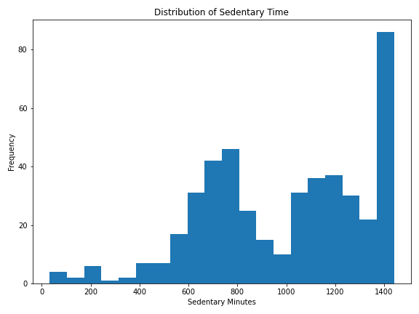
Sedentary Minutes Distribution

