Slide 1
PHOTOGRAPHS OF FACILITY
Northstar Motor Company — Dealer Sales and Service Agreement Term Renewal
Dealer | Ridgeline Northstar of Columbus, LLC (d/b/a Ridgeline Northstar)
Dealer code | 40718 • Great Lakes Region, District D-04
Facility address | 4825 Morse Road (Bldg A) and 4901 Morse Road (Bldg B), Columbus, OH 43230
Photos taken | October 6, 2026, by Thomas A. Brennan, Fixed Operations Director
Contents | Photo index, site plan, and 8 photographs covering all departments and signage
Submitted via DNAMS — 10/14/2026

Slide 2
Ridgeline Northstar of Columbus, LLC • Dealer Code 40718
Photographs of Facility
Photo Index
# | View | Department | Location / direction | Date
1 | Front elevation with fascia signage | Exterior — Building A | From customer lot, looking north | 10/06/2026
2 | Primary pylon sign | Signage | Morse Road frontage, looking north | 10/06/2026
3 | New vehicle showroom | Sales | Bldg A interior, looking west | 10/06/2026
4 | Covered service drive | Service | Bldg B south side, looking north | 10/06/2026
5 | Repair shop — bays 5–8 | Service | Bldg B interior, looking east | 10/06/2026
6 | Parts warehouse and counter | Parts | Bldg B interior, looking south | 10/06/2026
7 | Customer lounge | Customer amenities | Bldg A interior, looking east | 10/06/2026
8 | Pre-owned display lot | Used vehicles | West lot, looking north | 10/06/2026
Circled numbers on the site plan (next page) show where each photo was taken.
Northstar Motor Company Term Renewal — Element: Photographs of Facility
2 / 11

Slide 3
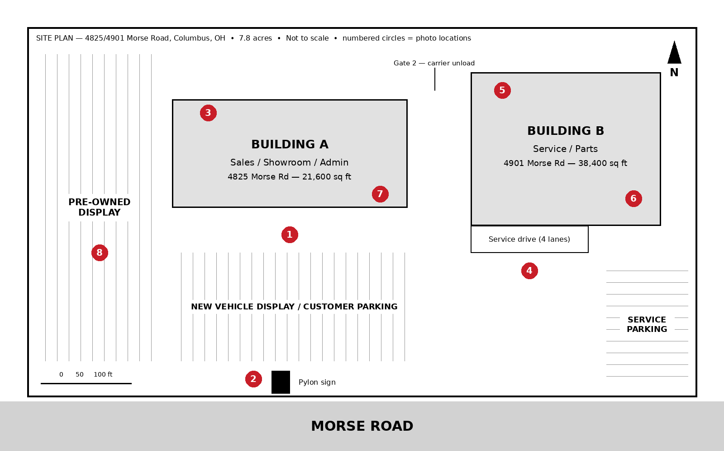
Ridgeline Northstar of Columbus, LLC • Dealer Code 40718
Photographs of Facility
Site Plan and Photo Locations
Northstar Motor Company Term Renewal — Element: Photographs of Facility
3 / 11

Slide 4
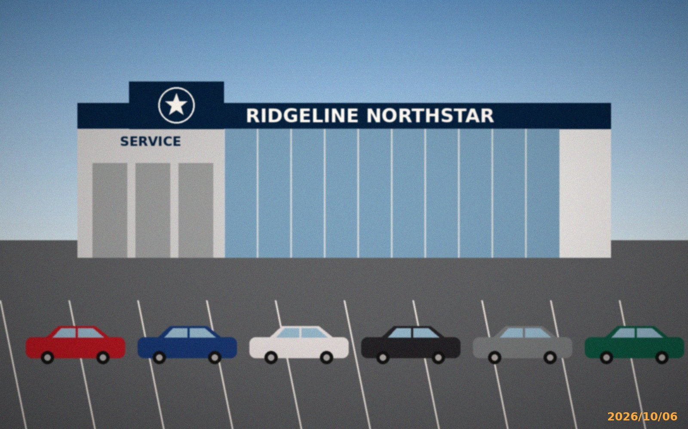
Ridgeline Northstar of Columbus, LLC • Dealer Code 40718
Photographs of Facility
Photo 1 — Front Elevation, Building A
Looking north from customer lot. Showroom glazing (right), service entrance (left). Fascia signage installed per Northstar Facility Image Program, 2024.
Northstar Motor Company Term Renewal — Element: Photographs of Facility
4 / 11

Slide 5
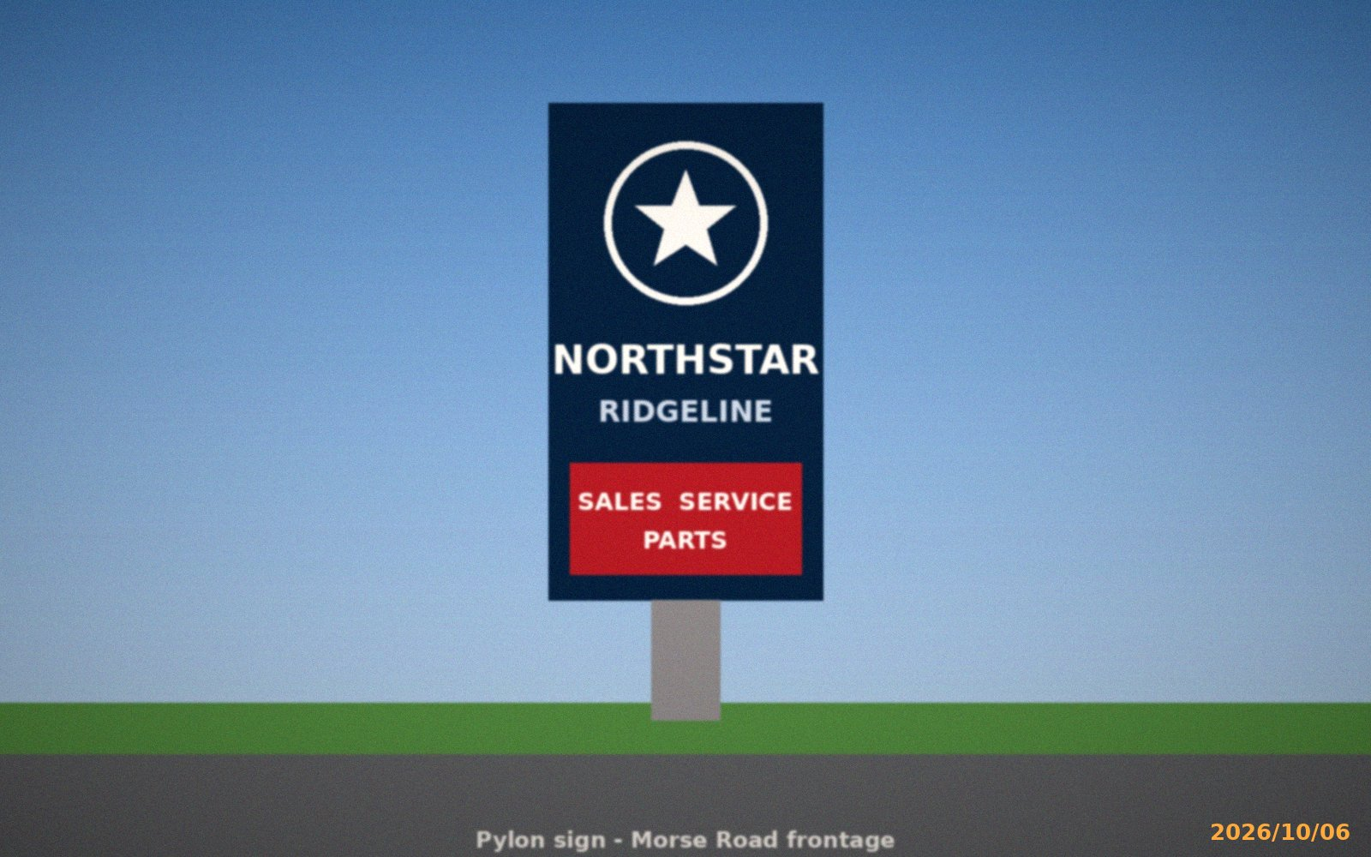
Ridgeline Northstar of Columbus, LLC • Dealer Code 40718
Photographs of Facility
Photo 2 — Primary Pylon Sign
Morse Road frontage. Internally illuminated, 28 ft overall height. Northstar mark with Sales / Service / Parts panel.
Northstar Motor Company Term Renewal — Element: Photographs of Facility
5 / 11

Slide 6
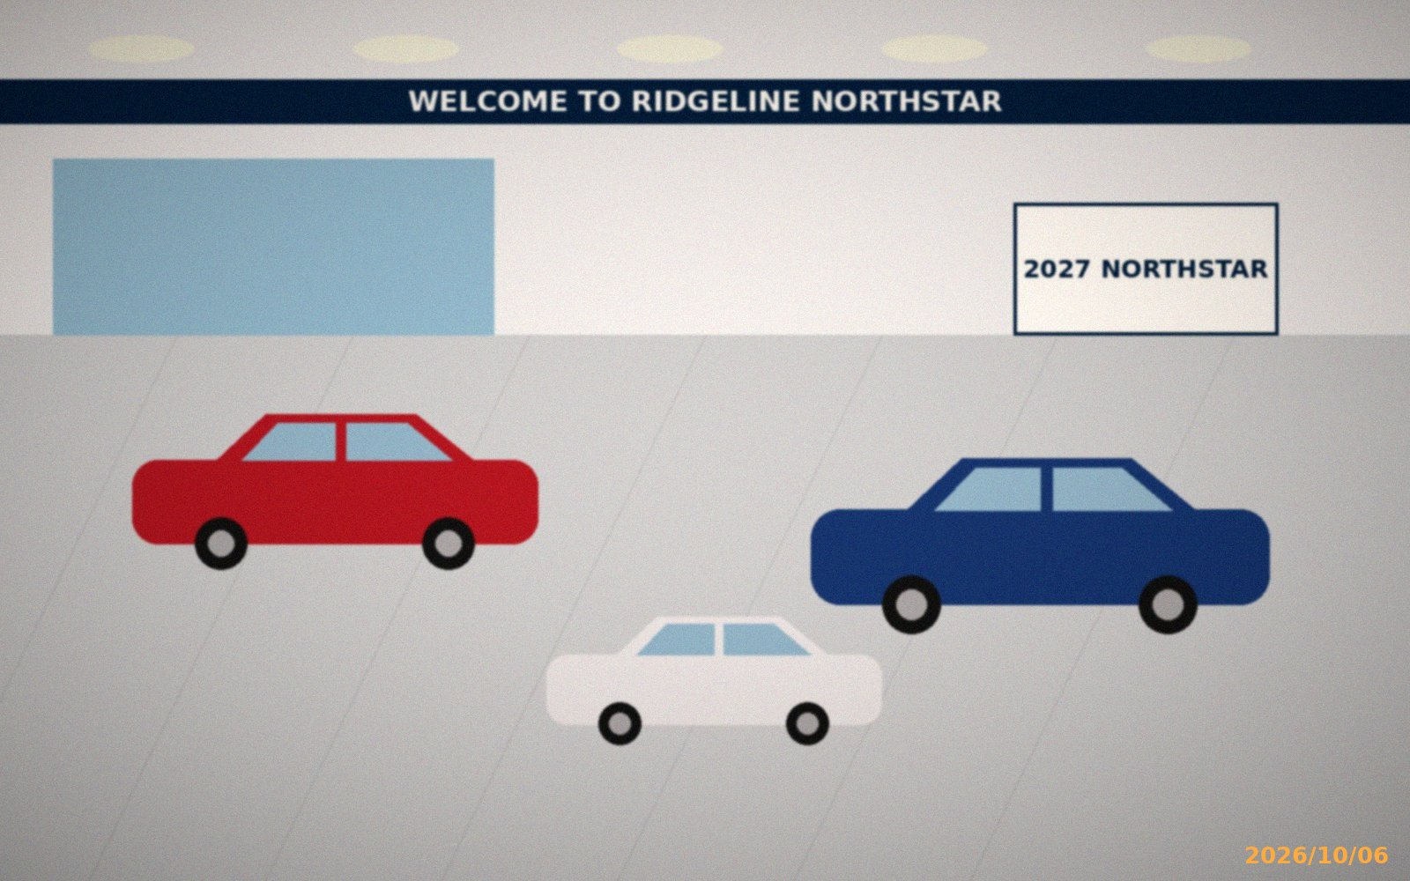
Ridgeline Northstar of Columbus, LLC • Dealer Code 40718
Photographs of Facility
Photo 3 — New Vehicle Showroom
Building A, looking west. 8,400 sq ft; display capacity 6 vehicles.
Northstar Motor Company Term Renewal — Element: Photographs of Facility
6 / 11

Slide 7
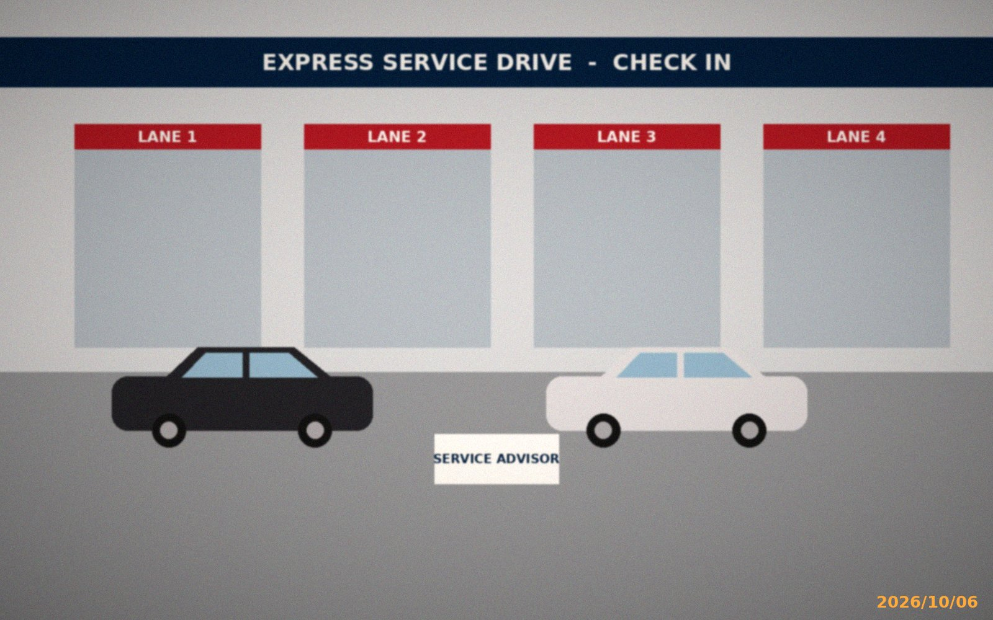
Ridgeline Northstar of Columbus, LLC • Dealer Code 40718
Photographs of Facility
Photo 4 — Covered Service Drive
Building B, looking north. Four write-up lanes with advisor stations.
Northstar Motor Company Term Renewal — Element: Photographs of Facility
7 / 11

Slide 8
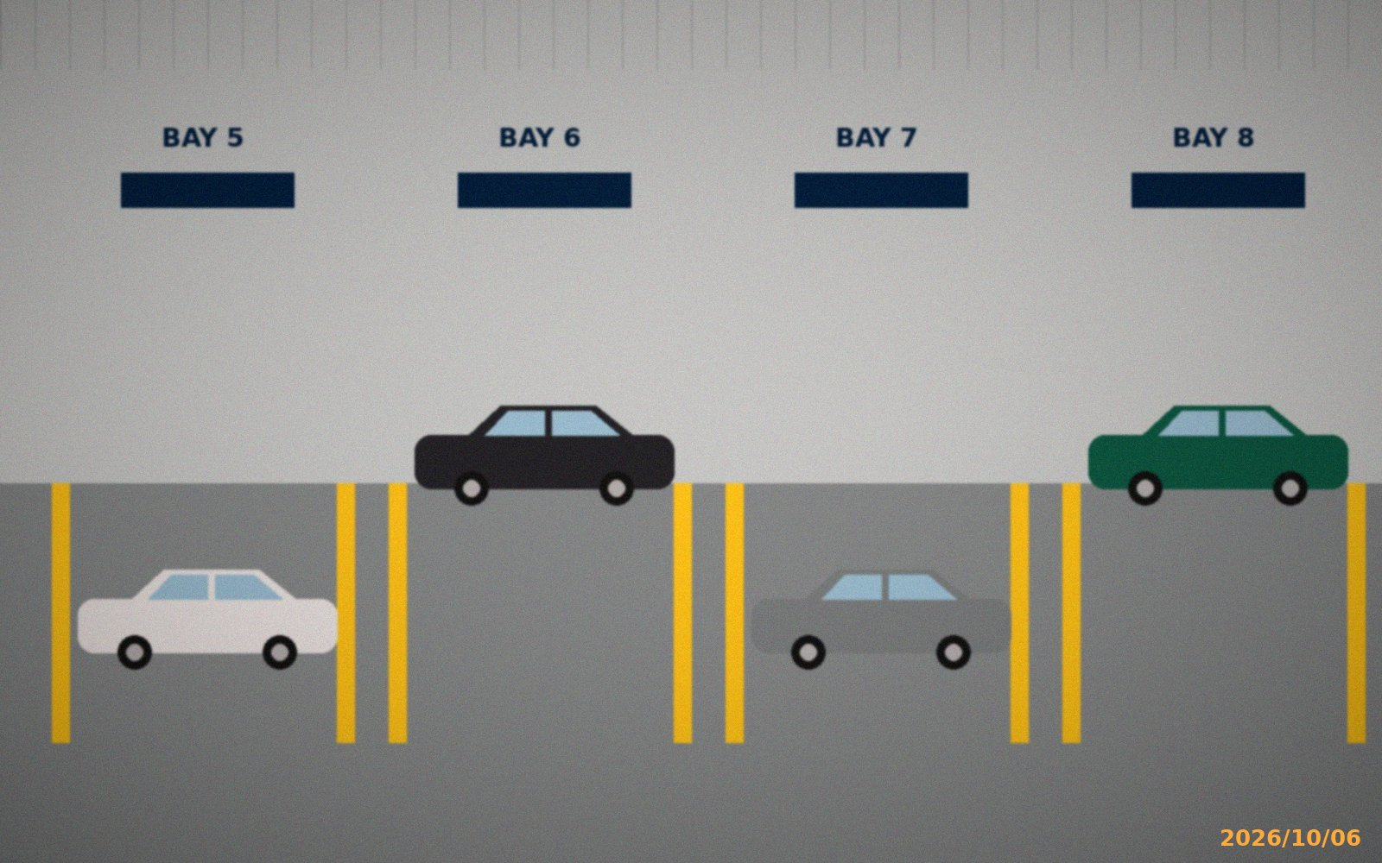
Ridgeline Northstar of Columbus, LLC • Dealer Code 40718
Photographs of Facility
Photo 5 — Repair Shop (Bays 5–8)
Building B, looking east. 22 bays total, including 4 EV-certified bays with Level 3 chargers.
Northstar Motor Company Term Renewal — Element: Photographs of Facility
8 / 11

Slide 9
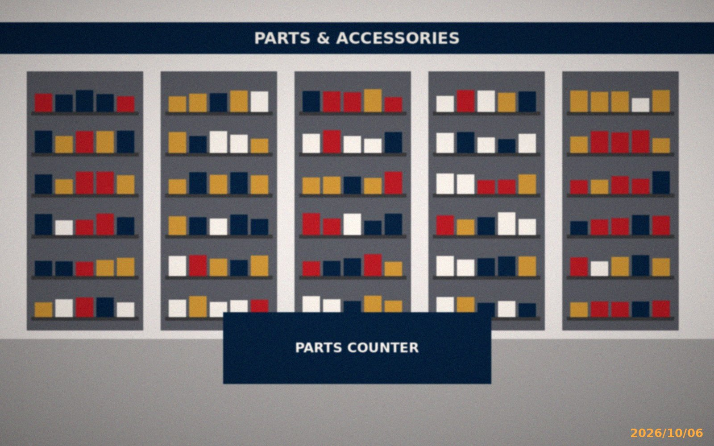
Ridgeline Northstar of Columbus, LLC • Dealer Code 40718
Photographs of Facility
Photo 6 — Parts Warehouse and Counter
Building B, looking south. 6,100 sq ft warehouse; retail and wholesale counter.
Northstar Motor Company Term Renewal — Element: Photographs of Facility
9 / 11

Slide 10
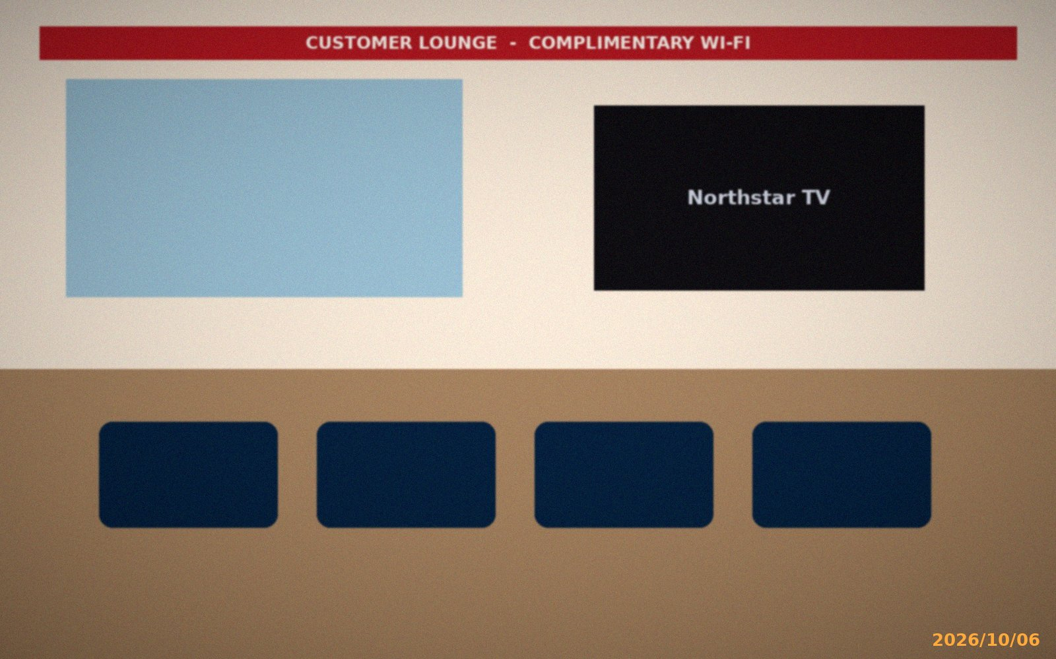
Ridgeline Northstar of Columbus, LLC • Dealer Code 40718
Photographs of Facility
Photo 7 — Customer Lounge
Building A, looking east. Seating for 40, Wi-Fi, refreshment area, work stations.
Northstar Motor Company Term Renewal — Element: Photographs of Facility
10 / 11

Slide 11

Ridgeline Northstar of Columbus, LLC • Dealer Code 40718
Photographs of Facility
Photo 8 — Pre-Owned Display Lot
West lot, looking north. Approx. 180 display spaces; Certified Pre-Owned signage.
Northstar Motor Company Term Renewal — Element: Photographs of Facility
11 / 11

