Slide 1
SMASH: Co-designing Software Compression and Hardware-Accelerated Indexing for Efficient Sparse Matrix Operations

Slide 2
Introduction
Goal:
1) high computation and storage efficiency by storing and operating on only non-zero elements
2) minimal overheads from the compression scheme (e.g., efficient discovery of non-zero elements)
3) generality and applicability to any sparse matrix, regardless of its structure or the extent of its sparsity
Key idea:
1) Software encoding is designed to maintain low storage requirements and be generally applicable to any sparse matrix without any assumption of structure or extent of sparsity.
2) Add hardware support for highly-efficient storage and retrieval of non-zero values in sparse matrices.

Slide 3
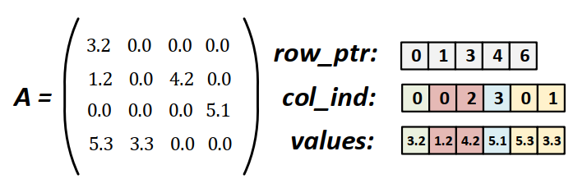
Compressed Sparse Row format
reduces the amount of memory needed to store a sparse matrix
the corresponding indices need to be retrieved for locating non-zero elements
reduce the benefits

Slide 4
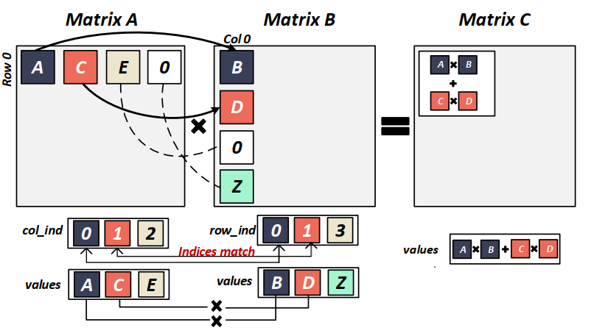
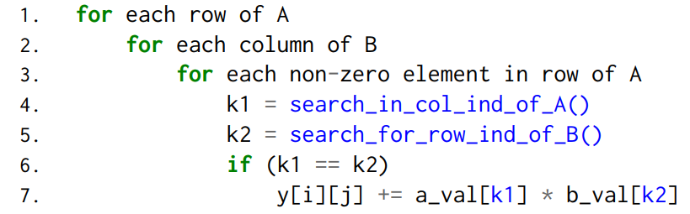
Compressed Sparse Row format
Sparse Matrix Matrix Multiplication

Slide 5
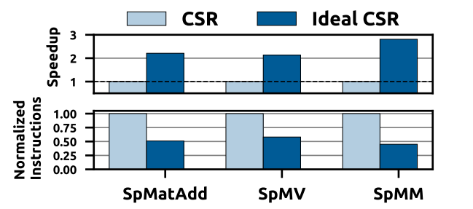
Limitations of Existing Methods
Ideal CSR: accessing the positions of non-zero elements does not incur any additional computation or memory access
The indices increases the computation burden and memory traffic, and hence lowers the potential gains from the compression scheme
The methods leverage a specific matrix structure or known pattern are not applicable to a wide range of applications

Slide 6
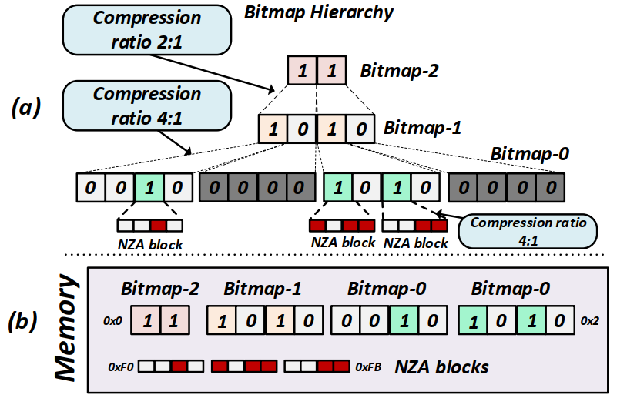
Hierarchy of Bitmaps

Slide 7
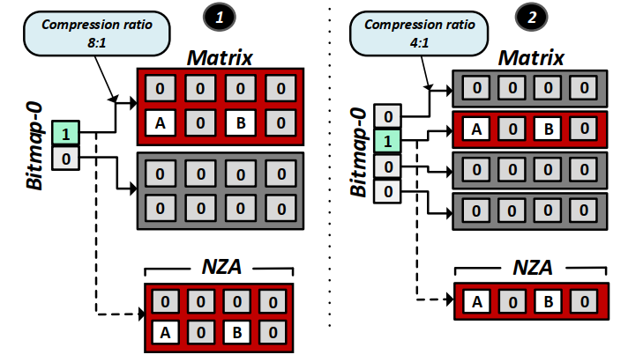
Hierarchy of Bitmaps
the compression ratio forms a tradeoff between:
1) smaller bitmaps that can be quickly scanned
2) more zero elements in the NZA storage and unnecessary computations on them.

Slide 8
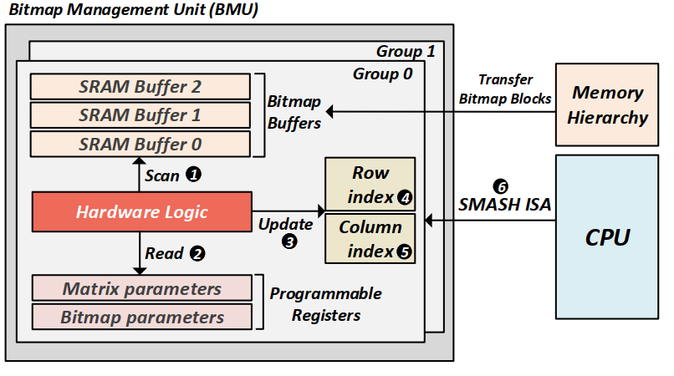
Hardware Indexing (Bitmap Management Unit)
hold the row and column indices
of the non-zero block
the matrix dimensions and the compression ratios to calculate the row and column indices of the current non-zero block

Slide 9
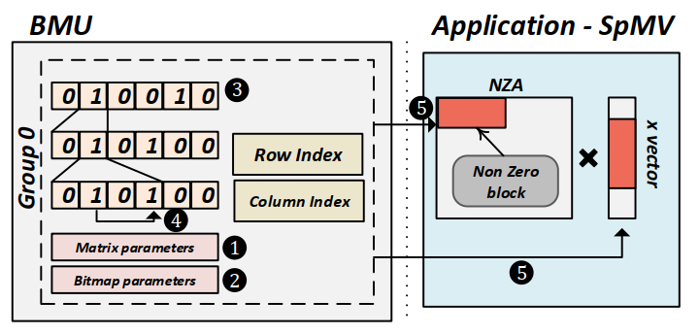
Example Use Case 1: SpMV

Slide 10
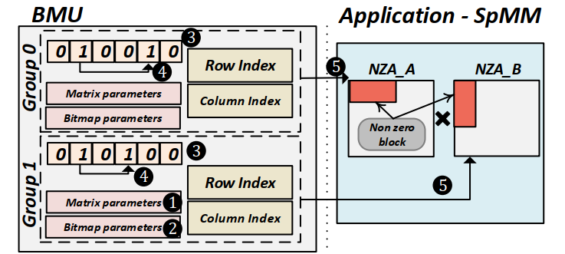
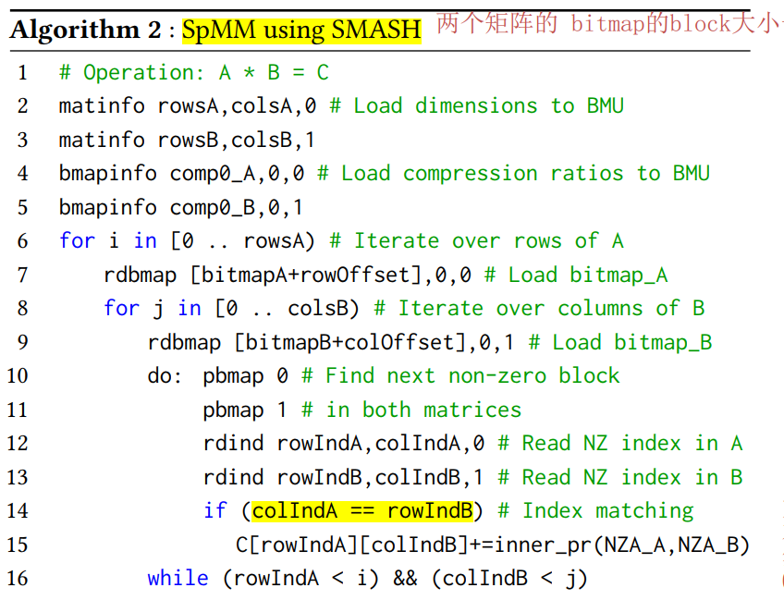
Example Use Case 2: SpMM

Slide 11
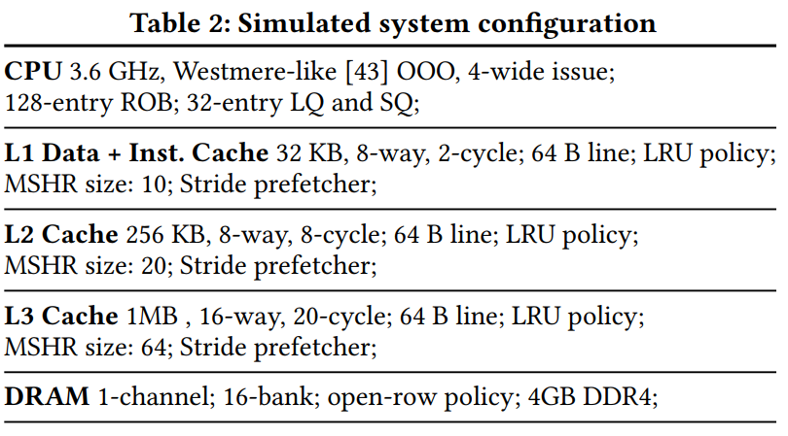
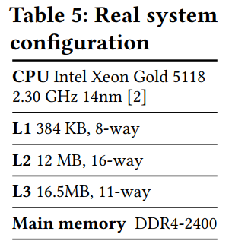
EXPERIMENTAL SETUP

Slide 12
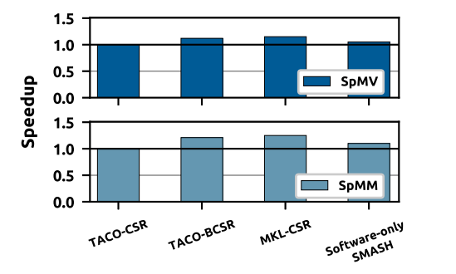
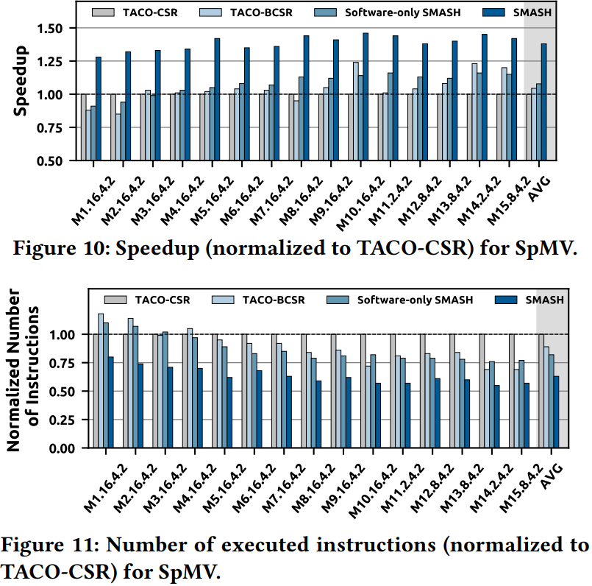
EXPERIMENT
Performance of software-only approaches on a real Intel Xeon system
Mi .b2.b1.b0:
Mi: the matrix id,
b2.b1.b0: the compression ratios of each level in the bitmap hierarchy.

Slide 13
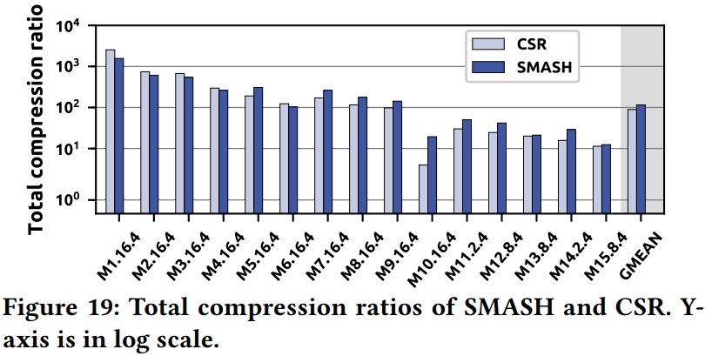
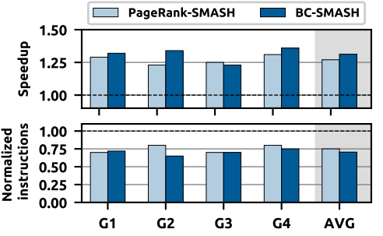
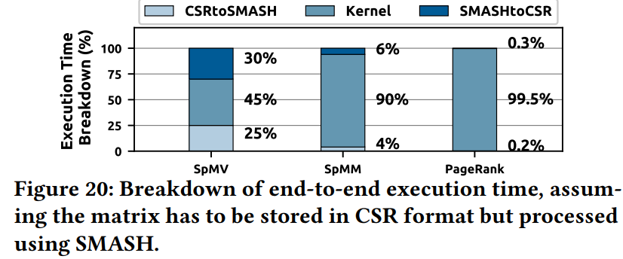
EXPERIMENT

Slide 14
谢 谢！

