Slide 1
Hardware is getting harder
Modern compute acceleration platforms are multi-level and explicit:
Scalar, SIMD/Vector/SIMT/Tensor, Multi-core, Many-core, Chiplet, Multi-package, Multi-rack
Non-coherent memory subsystems increase efficiency
Heterogeneous compute incorporating domain-specific accelerators
Standard in high-end SoCs, domain-specific hard blocks in FPGAs
CPU+Extension, SIMT+Tensorcore, CPU+NPU …
Special architectures: CGRA, PIM …
Many accelerator IPs are configurable:
Optional extensions, tile / core count, memory hierarchy, etc
🤯
How can “normal people” write Software for this in the first place?
… and how can you afford to build generation-specific SW?

Slide 2
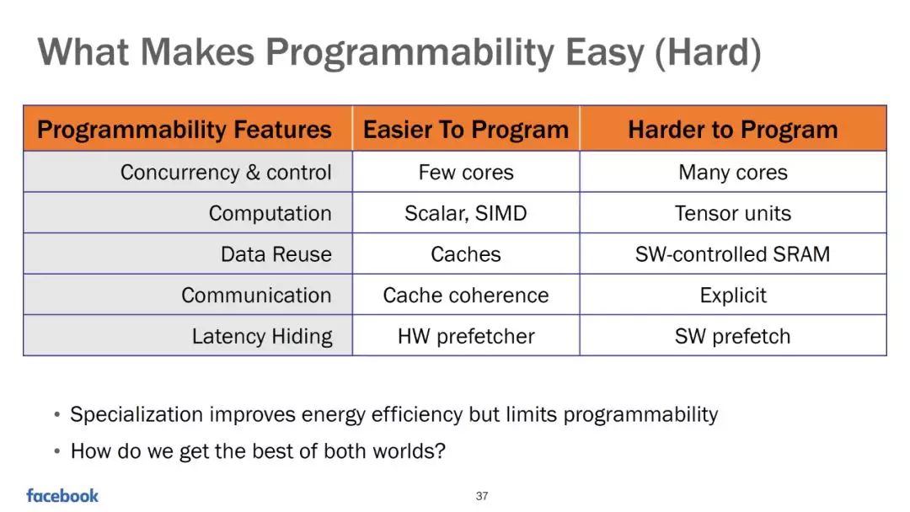

Slide 3
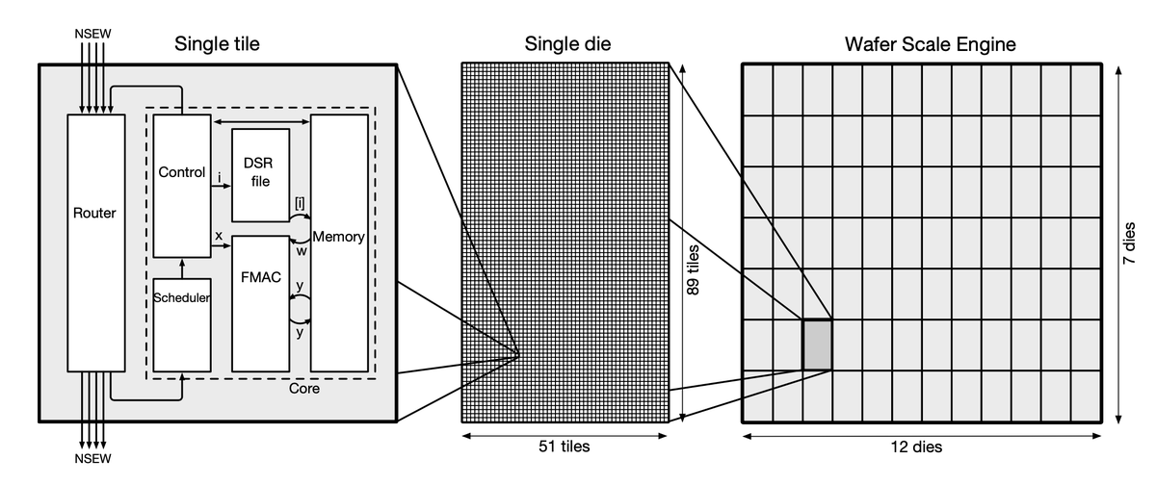
Source：“Fast Stencil-Code Computation on a Wafer-Scale Processor ” paper from Cerebras

Slide 4
Next-Gen compilers and PL are needed!
We need:
hardware abstraction spanning diverse accelerators
support for heterogeneous compute platforms
domain specific languages and programming models
quality, reliability, and scalability of infrastructure
This opportunity is beckoning a golden age in compiler and PL technology!
Let’s learn from the past, then project into the future 🚀

