Slide 1

Structural Transparency, Implementation and Runtime Optimization in Software Engineering - Theory and Practice
PhD Progress Report Semester 1
Author: Lorand KEDVES
Supervisor: Dr. Botond BERTOK
Presentation Date: 2017. 06. 23.
University of Pannonia
Doctoral School of Information Science and Technology

Slide 2
Abstract
2 / 10
Thesis introduction
Activities
OTDK – Software as Data Structure
Software Knowledge Layers
Knowledge Card Management
Studies
Academic Courses
Technical Research
„Augmented Thinking”
Next Steps

Slide 3

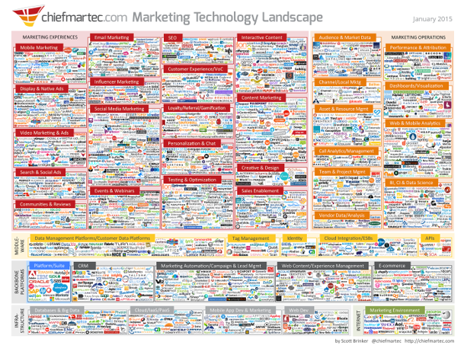
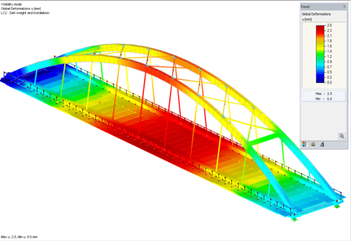
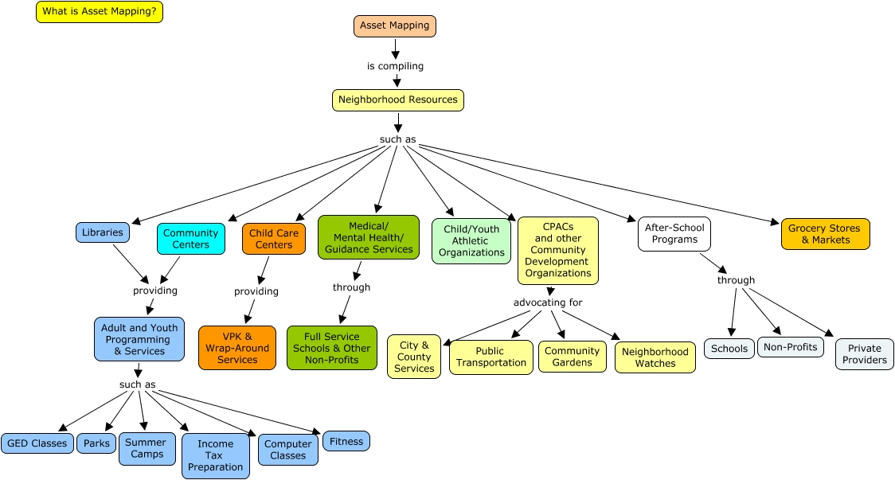
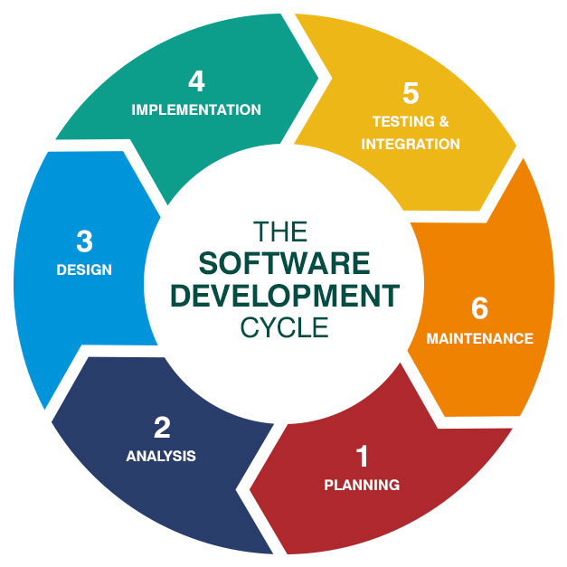
„Dynamic Knowledge Representation?”
3 / 10
Blob of facts and ideas, without structure, PC called „Big Data”
Structured knowledge that allows tests and conscious changes
Meta layer: attributes and behaviors of knowledge items
Do these „well known” ideas have practical value in IT today?

Slide 4
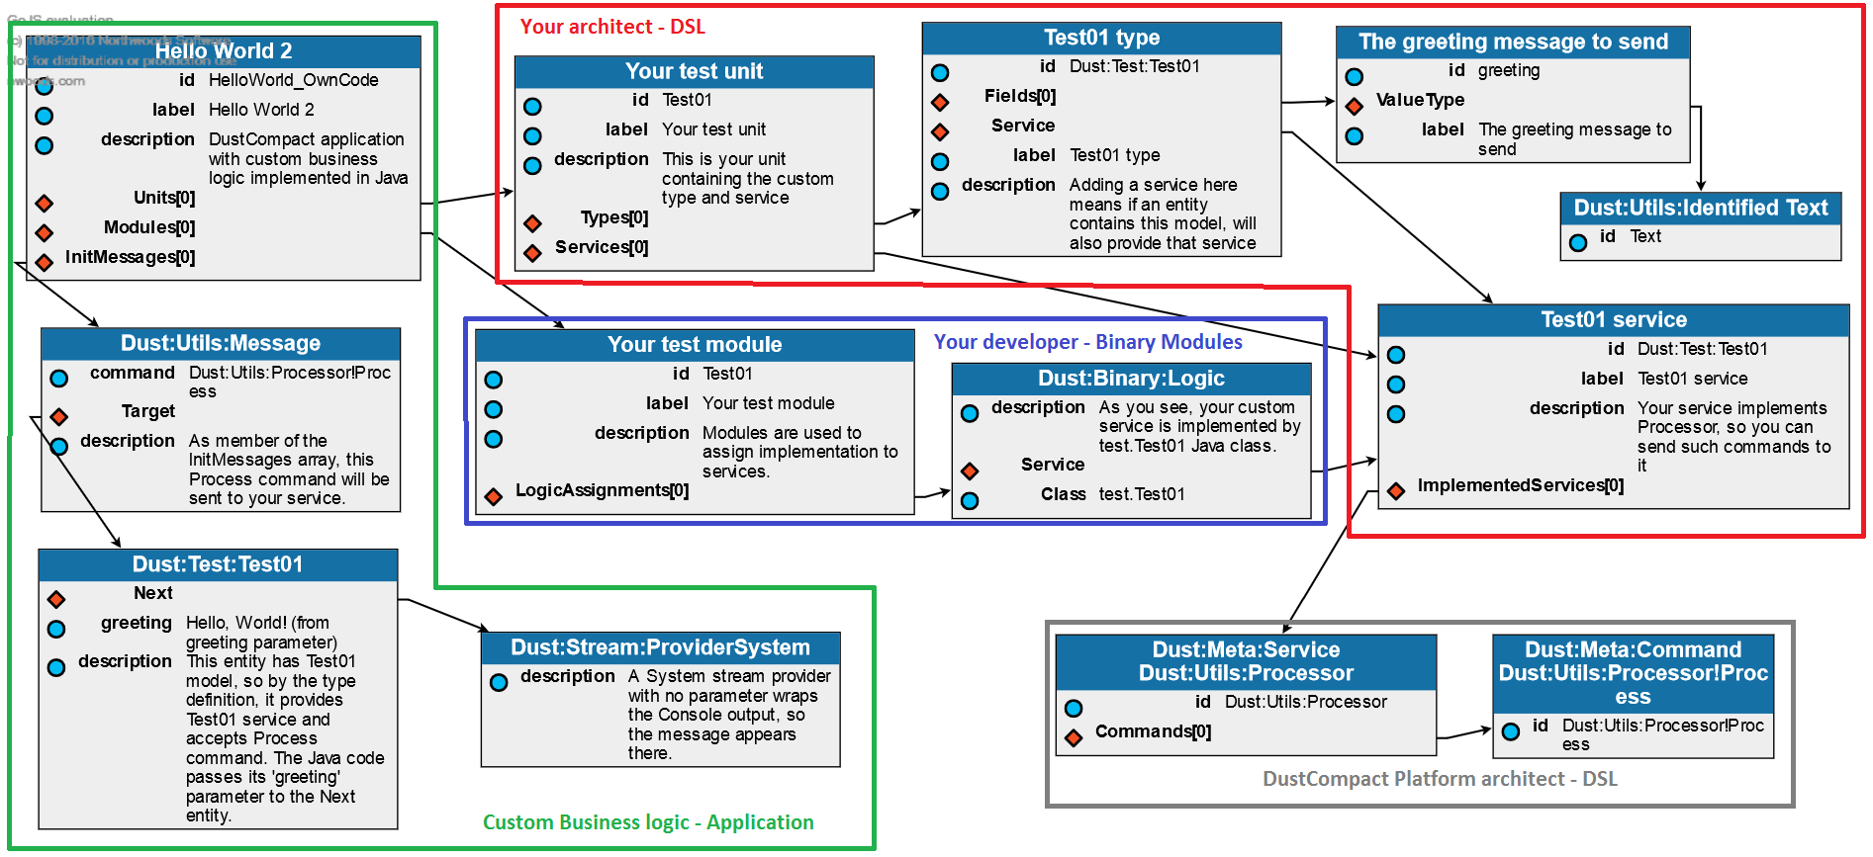
„Software as Data Structure”
4 / 10
OTDK presentation focused on practical examples
Failed to „deliver the message”…

Slide 5
Software knowledge layers
5 / 10
Application
Framework
View
WYSIWIG Display
Configuration Dialogs
SwingControlCenter
Model
Business Data
Services
Flexible Data Storage
Control
Event processing
Control Logic
Generic Utilities

Slide 6
Knowledge Card Management
6 / 10
Expert analysis
Decision support
Internal survey evaluation
Collect Knowledge Cards
Tag network to structure
Assign numeric values
Aggregation
Comparison, modification
Decision support
Filtered
Views
Scoring
Findings
Knowledge Card
Knowledge Card
Knowledge Card
Knowledge Card

Slide 7
Academic Courses
7 / 10
Graph Coloring (Prof. Zsolt Tuza)
Component separation in software
Modular decomposition
Engineering Process Analysis and Synthesis (Dr. Botond Bertok)
Overview of P-Graph representation
Experiment with this approach in software creation
Combinatorial Algorithms and Optimization (Dr. György Dósa)
Bin covering adapting algorithm
Overview of process optimization
IT Tools and Techniques for Process Optimization (Dr. Botond Bertok)
Performance measurement technologies
Implement and analyse a subset finding algorithm

Slide 8
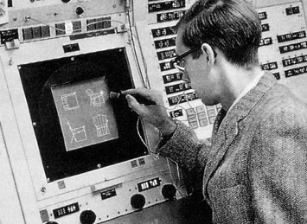
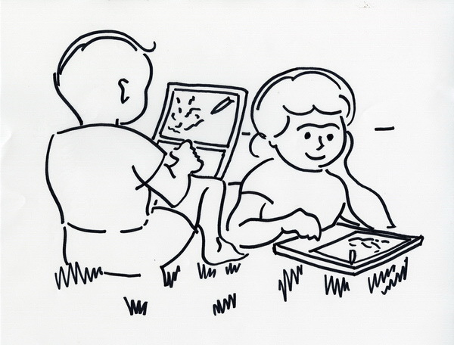
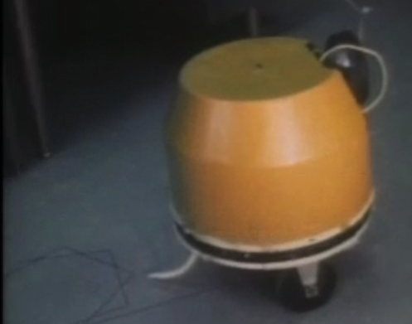
Technical Research
8 / 10
Dr. Ivan Sutherland
Sketchpad
Dr. Seymour Papert
IT in learning (LOGO)
Dr. Alan Kay
Articles (Dynabook)
Lectures (Power of Simplicity)
Software (Lisp / Smalltalk / Squeak)
Sketchpad, 1962
Dynabook, 1968
LOGO Turtle, 1969

Slide 9
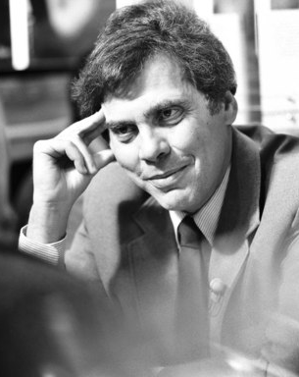
„Augmented Thinking”
9 / 10
Culture’s Surrender to Technology (Dr. Neil Postman)
What is the problem that this new technology solves?
Whose problem is it?
What new problems do we create by solving this problem?
Which people and institutions will be most impacted by a technological solution?
What changes in language occur as the result of technological change?
Which shifts in economic and political power might result when this technology is adopted?
What alternative (and unintended) uses might be made of this technology?

Slide 10
Next Steps
10 / 10
Continue background research
Graph theory
P-Graphs
„old” sources
Improve ongoing development projects
Measurement toolkit
Configurative application structure
Process as graphs
Publications, cooperation
Far from current paths, need solid results
Like BME VMTS, for example Models 2017 conference
Viewpoints Research Institute?
Thank you for your kind attention!

