Slide 1

Tensegrity in Software Development
PhD Progress Report Semester 2
Author: Lorand KEDVES
Supervisor: Dr. Botond BERTOK
Presentation Date: 2018. 01. 22.
University of Pannonia
Doctoral School of Information Science and Technology

Slide 2
Abstract
2 / 11
Introduction
Results of the Last Semester
Theoretic
VOA Model
Tensegrity
Lost Past – Lost Path
Practical
Knowledge cards (dropped)
Power of Transparency
Dust Platform
Academic
Next Steps

Slide 3
Introduction
3 / 11
A 20 years „quest for the Holy Grail”
Field Experience (since 1995, BSc)
Development process „giveth and taketh away”
The importance of the transparent structure
Why transform the network to text?
Proposed Answer (15+ years)
Dust: Distributed Unit System Technology
„Construct” – an ontology editor
„Platform” – Böhm-Jacopini, Engelbart, Nelson, P-Graph (ongoing and future plans)

Slide 4
Vision – Ontology – Action
4 / 11
V
Levels
Vision / Why? / Analyst
Ontology / What? / Architect
Action / How? / Developer
Development Process
Not sequential
Not final at start
No freeze at the end
Basic Approach
Fill (type all code)
Construct (glue modules)
Inflate (minimal wireframe)
Software
O
A
Simultaneous growth in ALL directions!

Slide 5
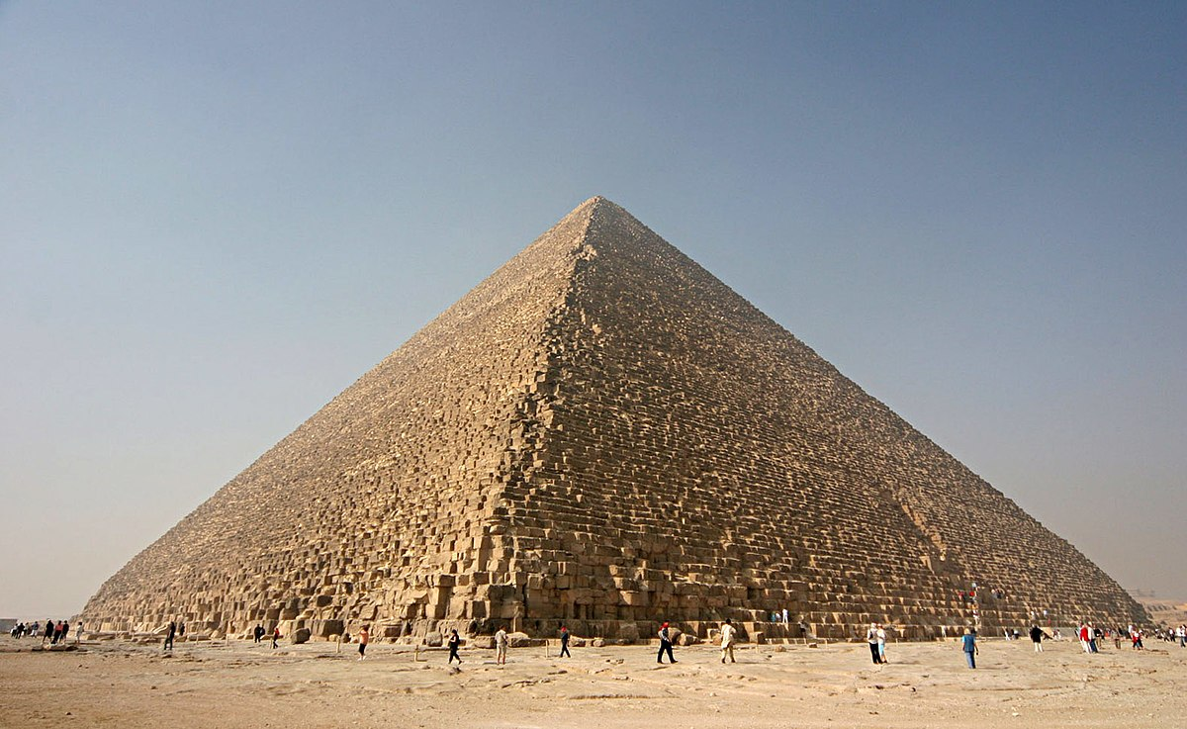
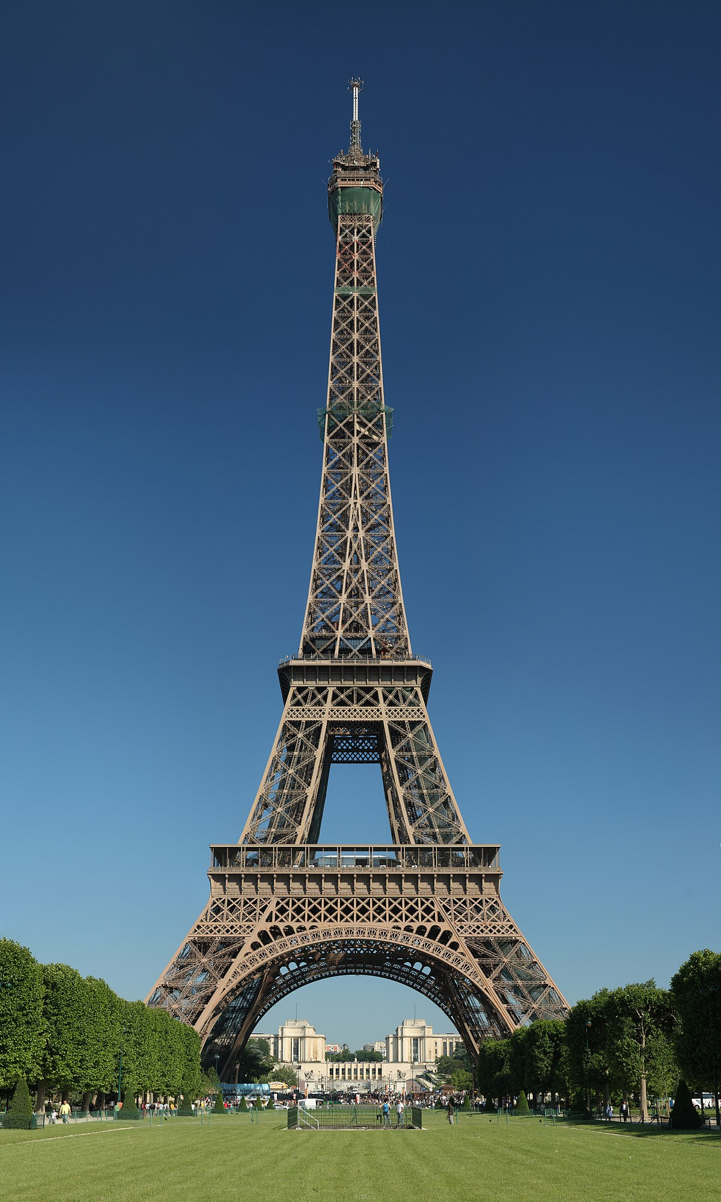
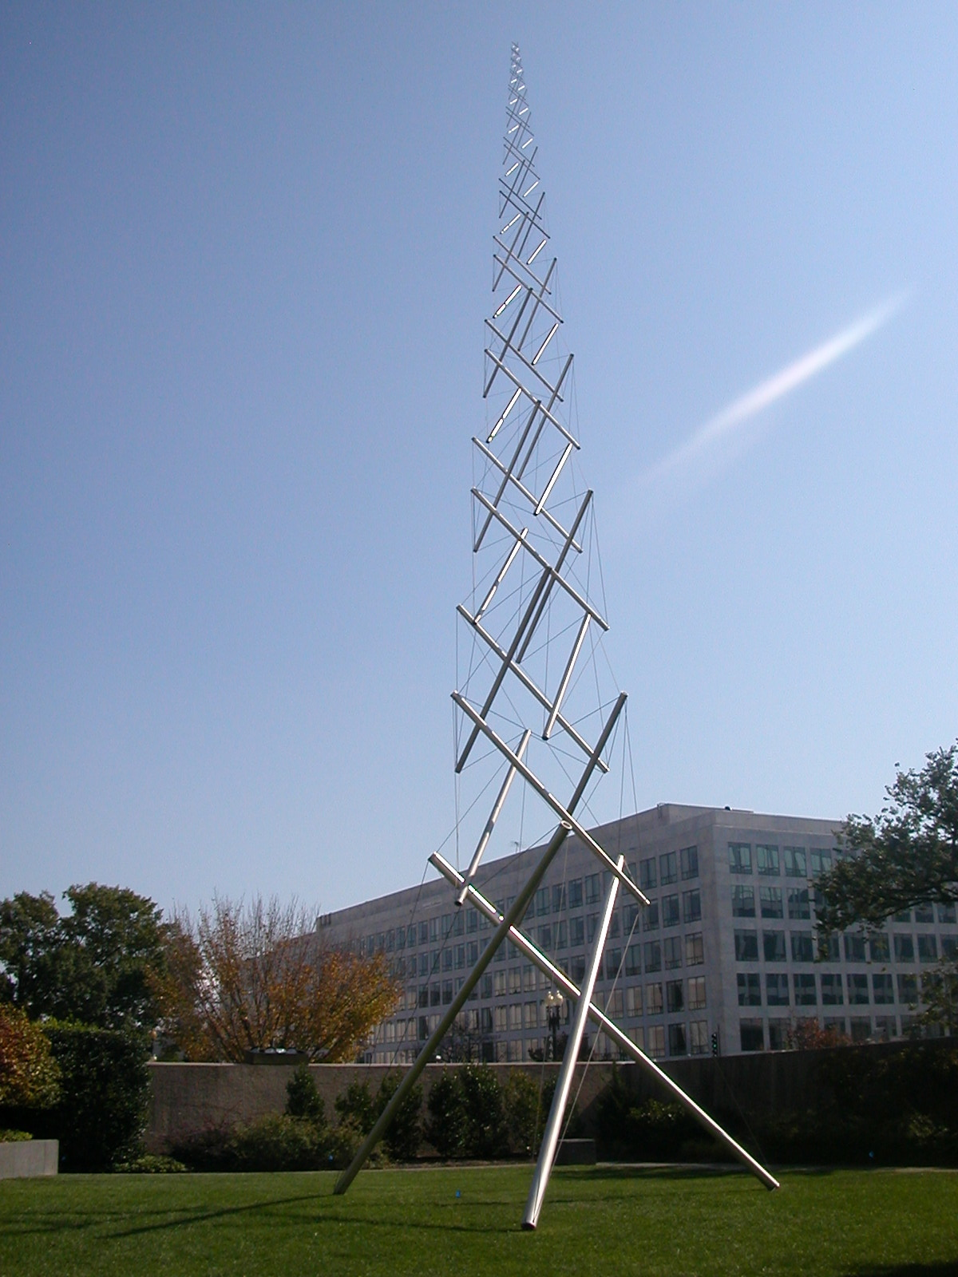
Tensegrity
5 / 11
1.
Fill (volume)
Uses lots of resource
No learning, reusability
Change is out of scope
Integrity (structure)
More efficient
Weakest link
Final product
Tensegrity (forces)
Compression/tension
Distributes the load
Can grow / change
2.
3.

Slide 6
Lost Past – Lost Path
6 / 11
The Forgotten History
As We May Think (Vannevar Bush, 1945)
Libraries of the Future (J.C.R. Licklider, 1965)
Augmenting Human Intellect (Douglas Engelbart, 1962-68)
A Dynamic Medium for Creative Thought (Alan Kay, 1974)
Technopoly: The Surrender of Culture to Technology (Neil Postman)
Boosting Collective IQ (Douglas Engelbart)
A: Practical knowledge behind organized activity - conscious?
B: Knowledge required to improve „A” - intelligent?
C: Tools and techniques of doing „B” better - wise?
Present
Informatics: Improving individual and community intellect
Information Technology: Business of making profitable products
Inevitable Result: Information poisoning and global role playing

Slide 7
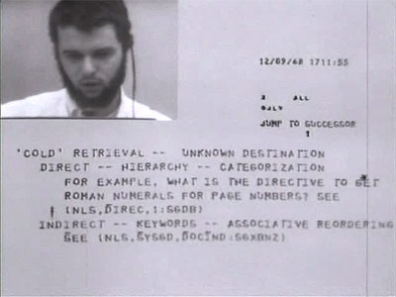
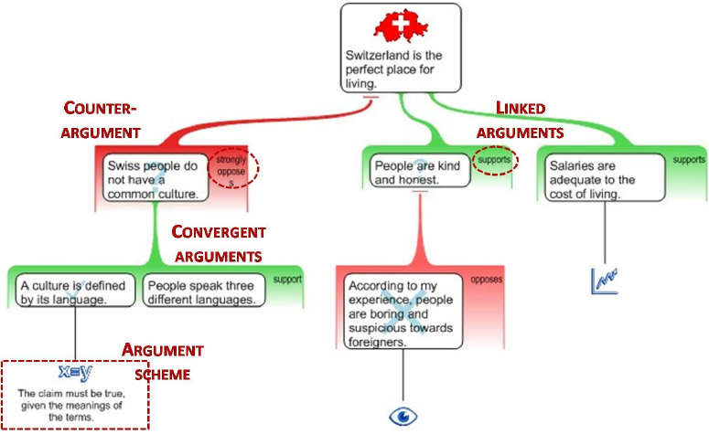
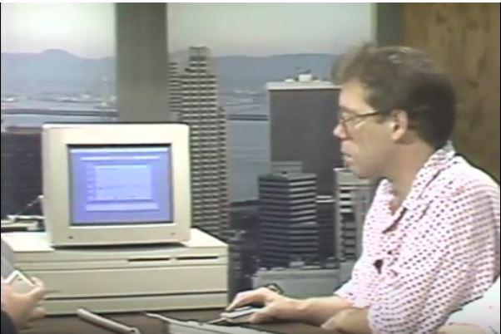
Knowledge Cards
Fiasco
7 / 11
Instead of writing a long document
Collect requirement items,
Keep and organize their structure,
Assign weight and use them in scoring
But...
Perfectly defined and used by Douglas Engelbart (NLS)
The analysis progress is known and researched as argument mapping
Storage and interaction was implemented by Apple in 1980-90: Hypercards

Slide 8
Power of Transparency
8 / 11
Application
Tools
User Interface
Undo
Graphical Designer
Special Operations
Property Editor
History Panel
Configuration
Object and setField taken away from the language and runtime
Data
(not Object)
Change digest
Field name Enum
Resource
App / Dev
Business Logic
Validator
Agent
Manager

Slide 9
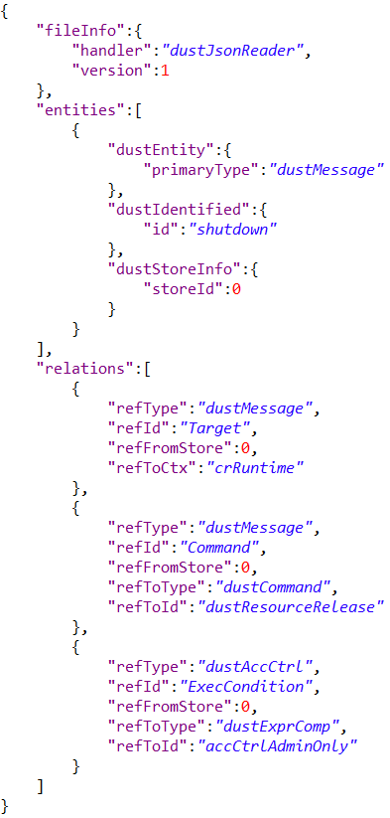
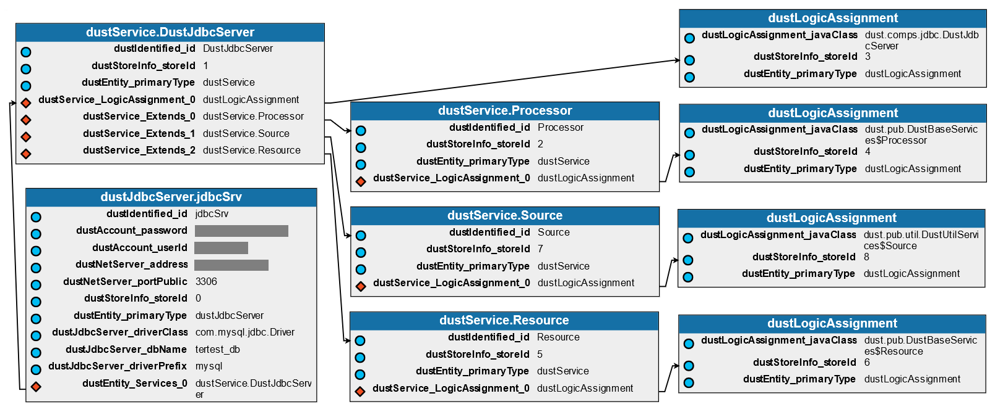
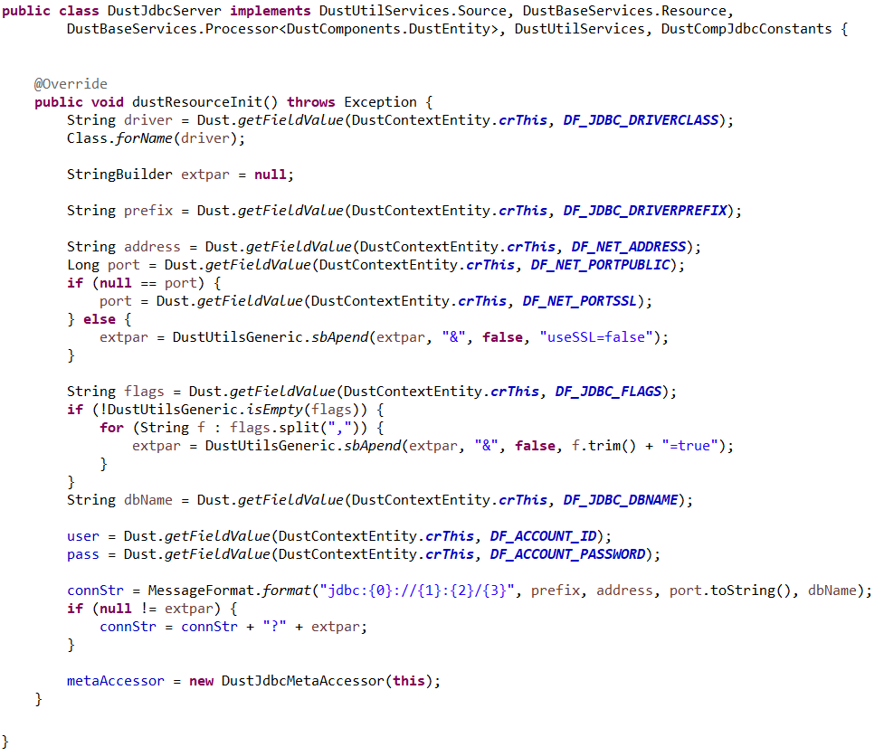
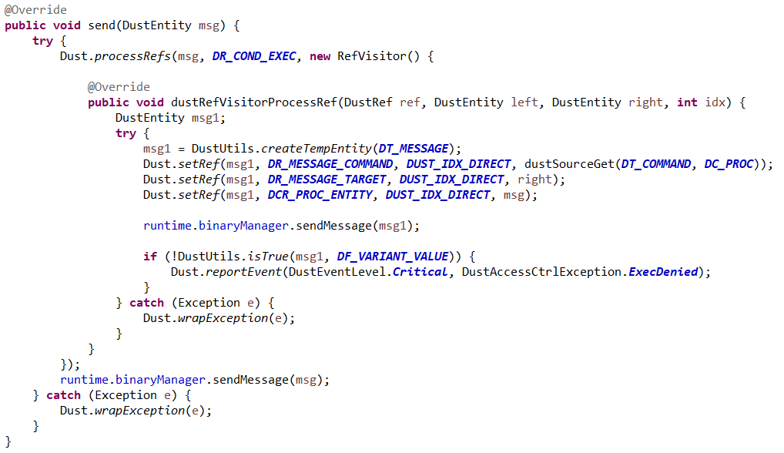
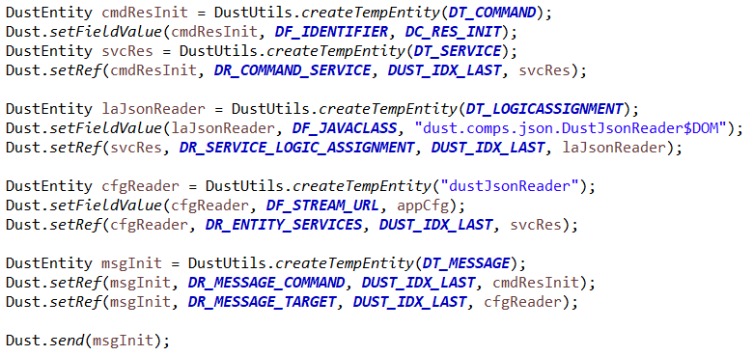
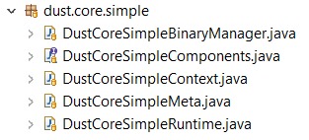
Dust Platform
9 / 11
Software as Configuration
Software as Graph
Module code: DB Connector
<ValType> ValType getFieldValue(DustEntity entity, DustField field);
DustEntity getRefEntity(DustEntity entity, DustRef... path);
void processRefs(DustEntity entity, DustRef ref, RefVisitor visitor);
void setFieldValue(DustEntity entity, DustField field, Object value);
void setRef(DustEntity entity, DustRef ref, int idx, DustEntity to);
void send(DustEntity msg);
The Whole Simple Kernel
Kernel code: global access control of execution
Software as Code

Slide 10
Academic Progress
10 / 11
Courses
Semester | Course Title | Teacher | Credit
2016/17/2 | IT Tools and Techniques for Process Optimisation | Dr. Bertók Ákos Botond | 8 | ✓
2016/17/2 | Ütemezés és ládapakolás | Dr. Dósa György | 8 | ✓
2016/17/2 | Beszámoló I. | Dr. Bertók Ákos Botond | 5 | ✓
2017/18/1 | Gráfszínezések | Dr. Tuza Zsolt | 8 | ✓
2017/18/1 | Műszaki folyamatok analízise és szintézise | Dr. Bertók Ákos Botond | 8 | ✓
2017/18/1 | Beszámoló II. | Dr. Bertók Ákos Botond | 5
Publications
Technological Forecasting and Social Change, International Journal, Impact Factor: 2.625
The Science of Being Wrong - Unsung Heroes of Informatics
Current status: Under Review
Article Type: Perspective article
Initial submission: 16/Dec/2017

Slide 11
Next Steps
11 / 11
Dreams
Work on this platform full time, in a team
Augmenting Human Intellect - Mother of all demos 50th anniversary
Reality
Part time, work on the platform behind actual projects
Process literature (Neil Postman, Dennis Gabor)
Renew old modules (Ontology editor 2 years, UI 10 years)
Academic path
Indirect Publication targets (ontology, argument mapping)
Find next courses
Thank you for your kind attention!

Slide 12
Informatics vs IT
12 / 11
Chance
Understand
Use and repeat
Improve
State of the art
“comfort zone”
Business research
Applied research
Fundamental research
Information
B
A
F
Barriers of improvement around the state of the art
Information Technology: Business of making profitable products
Informatics: Science of managing knowledge and learning(!)

