Slide 1

Idea Projection “What is Software Anyway?”
PhD Progress Report Semester 3 2018. 06. 21.
Author: Lorand KEDVES
Supervisor: Dr. Botond BERTOK Department of Computer Science and Systems Technology
University of Pannonia Veszprem, Hungary
Doctoral School of Information Science

Slide 2

Outline
2 / 8
Outline
What is Software?
Research Context
Idea Projection
Knowledge Broker
Law Reverse Engineering
Academic Progress

Slide 3
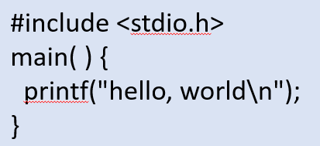
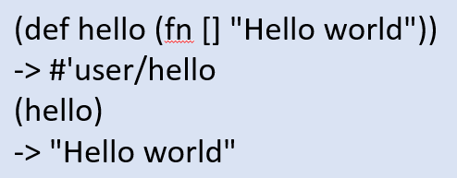
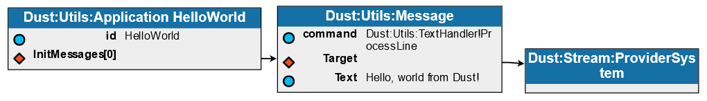
What is Software?
3 / 8
Business: a real system must have a plan (contract, test, quality, maintenance)
Science: in such case the information content of source code is zero (deviation)
Dust: the plan runtime
Montru: knowledge interaction environment (“show it!” in Esperanto)
fn main() {
println!("Hello, world!");
}
C, 1974
Clojure, 2007
Rust, 2015

Slide 4

Research Context
4 / 8
Dr. Botond Bertók, Dr. Gyula Simon, Dr. István Heckl
Why is this new? (minimal sufficient DSL of knowledge)
Self containing is the key (airplane vs. cableway)
Burden of code (Protégé, UML tools, Vanderbilt ISIS)
Doug@50 Group
Target: demo for the 50th anniversary of MOAD
Implementation: self or using frameworks
Not the same question (“MI n”, “write to trash”)
Documents
Complex documents: laws
Reach experts, design MVC
Similarity to Ted Nelson’s Xanadu

Slide 5


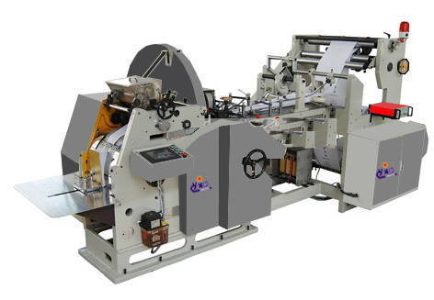
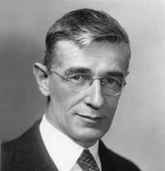
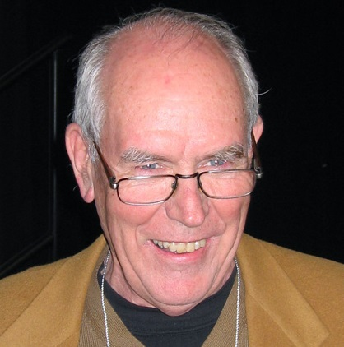
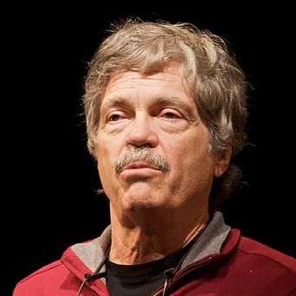
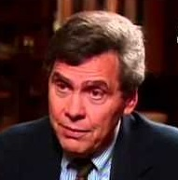
Idea Projection
5 / 8
Knowledge Representation
Store, publish, discuss
Generally have reliable background
Problems in IT environment
Information Science
Vannevar Bush: Memex
Ivan Sutherland: Sketchpad
Alan Kay: Smalltalk / Squeak
Neil Postman: realized forecasts and warnings
Idea Projection
Languages and tools are part of formalization process
Fill the gap between automata and Turing Machine
Web our way through the unknown, always wrong, always improve

Slide 6






Knowledge Broker
6 / 8
Bootstrapping the Kernel from JSON
Minimal preliminary knowledge
Separate syntax and semantics
Zero built-in knowledge in processor
Persistence layer consequence
Separation from background
Shared service for Meta identification
Inversion of Control
Further Consequences
“Avatar” is a general component
Interaction as human or artificial actors represented by avatars around a shared context

Slide 7
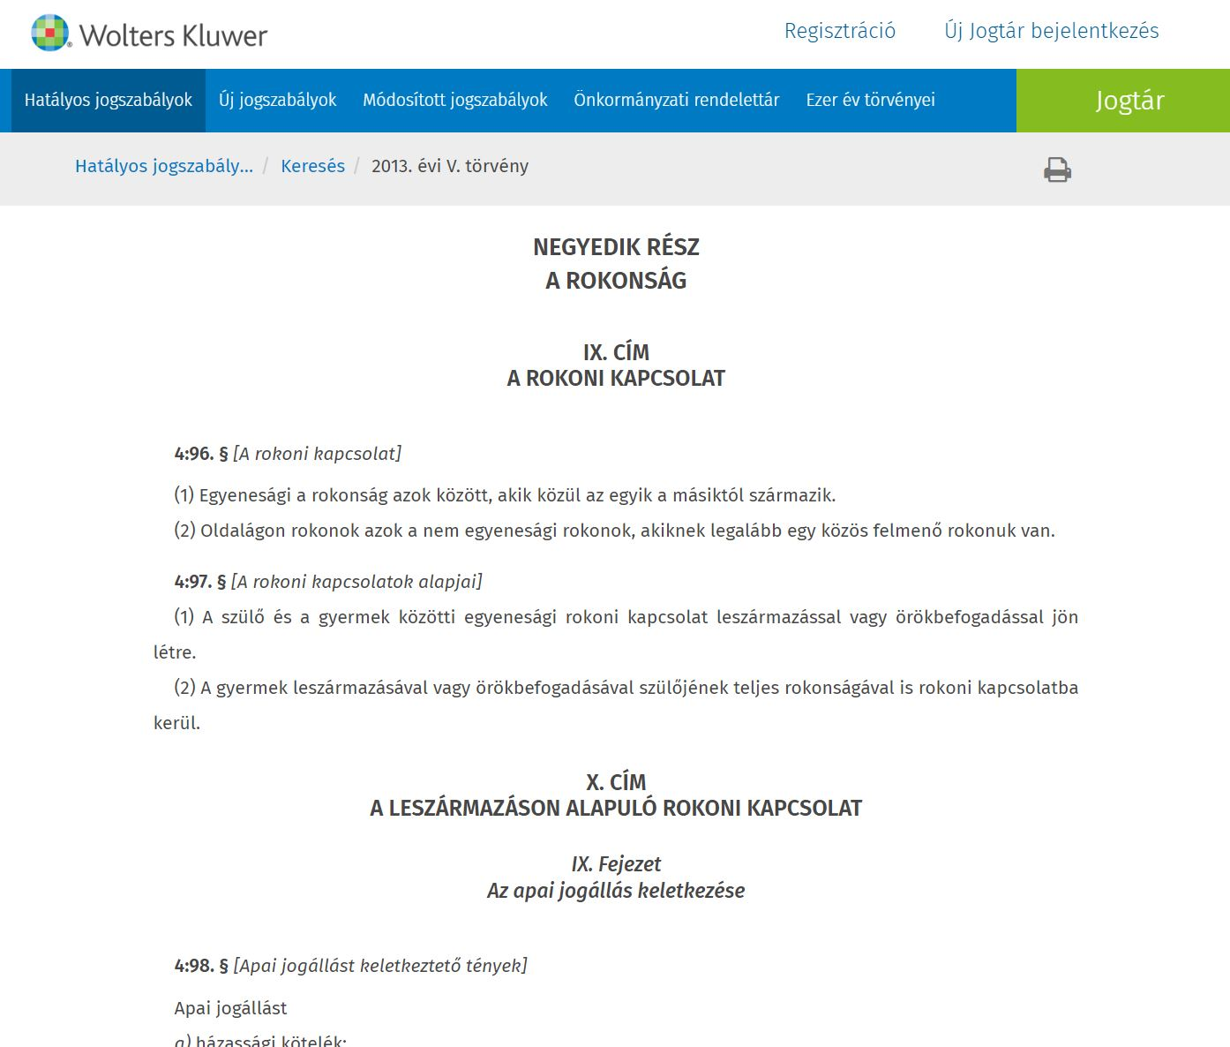
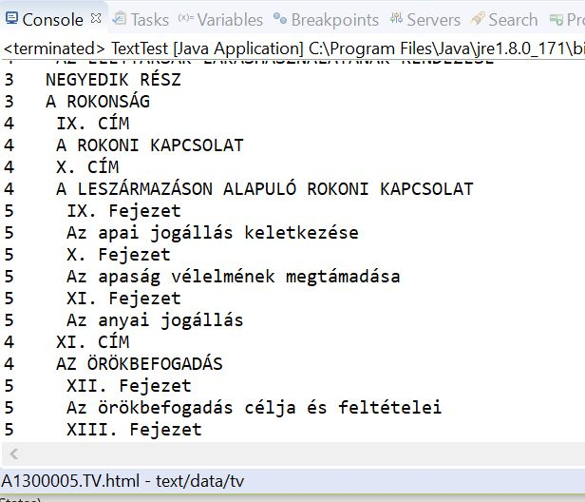
Law Reverse Engineering
7 / 8
Reasons
Easy to explain or publish
Relatively clean source
Complex requirements
Common interest: prototyping
Results
Net.jogtar.hu is a good source, relatively simple parsing
Meta exists, but must learn from source and clean once
Internal, outer and delta, two way references
Varying structure levels and naming schemes need adapting tools -> “Quick and Dirty Dust”

Slide 8
Academic Progress
8 / 8
Courses
Semester | Course Title | Teacher | Credit
2017/18/2 | Computation Theory | Dr. István Heckl | 8 | ✓
2017/18/2 | Global Optimization | Dr. Tibor Csendes | 8 | ✓
2017/18/2 | Presentation III. | Dr. Bertók Ákos Botond | 5
2017/18/1 | 2 courses + Presentation II. |  | 21 | ✓
2016/17/2 | 2 courses + Presentation I. |  | 21 | ✓
Update: Dropped Linear and Nonlinear Programming as the required course credits (48) are collected.
Publications
Update: the Knowledge and Information Systems Journal also rejected the article The Science of Being Wrong. Following the consequences, I will concentrate on conferences for publication credits in the 4th Semester, and plan to create more focused articles about the text reverse engineering project.
Conferences
Date | Conference | Location | Credit
Dec., 2018 | VOCAL Optimization Conference | Esztergom, HUN | 20?
Dec., 2018 | Legal Knowledge and Information Systems | Groningen, NED | 20?

Slide 9
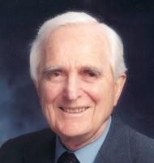
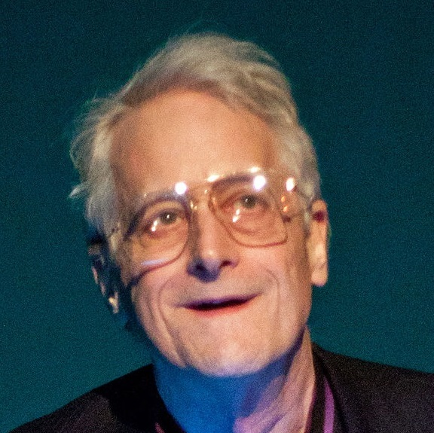
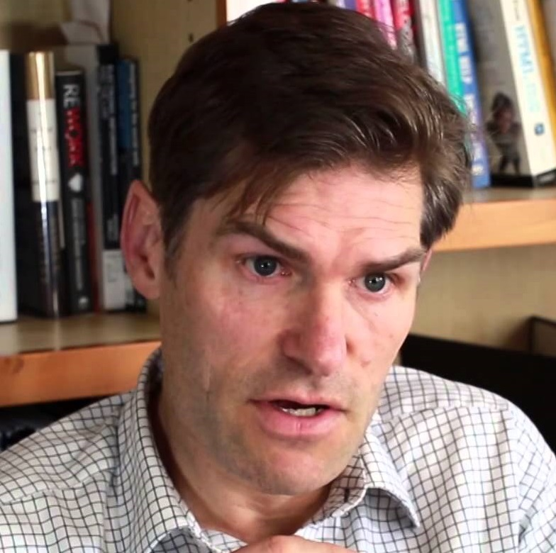
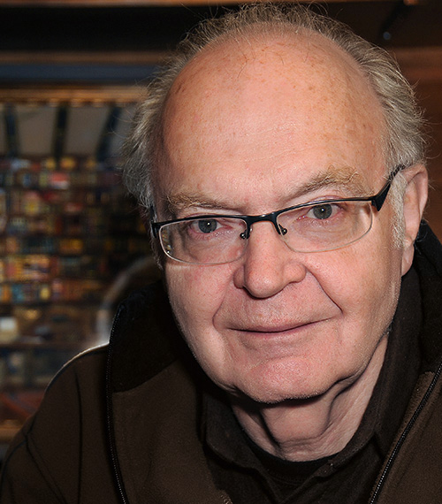
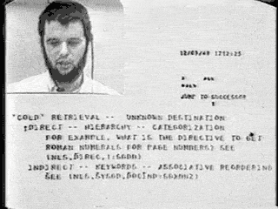
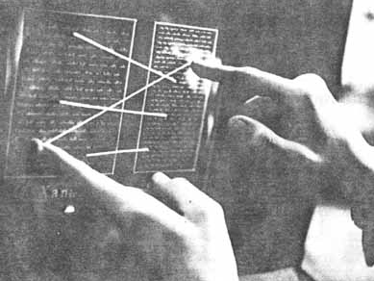
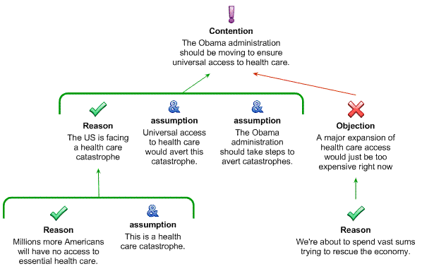
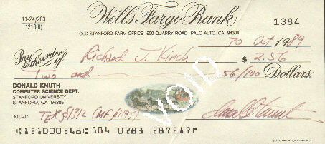
Documents
Bonus Slide
References
Douglas Engelbart (NLS, CoDIAK)
Ted Nelson (Xanadu/Zigzag)
Donald Knuth (TeX)
Tim van Gelder (Argument Mapping)
Cornerstones
Text atom: referable statement (not character)
Separate storage of structure and statement cloud
Support translation, change, writing direction
Internal and visual identifiers (not text only)
External and internal hierarchies
Special elements (Reference, Definition, Delta, Meta)

