Slide 1
Cloud Enabling Technologies

Slide 2
Topics
Service Oriented Architecture
Rest System
Web Services
Pub/sub model
Basics of virtualization
Types of virtualization
Implementation levels of Virtualization
Virtualization structures
Tools and mechanisms
Virtualization of CPU , Memory and I/O
Virtualization of supports and Disaster Recovery.

Slide 3

Service oriented Architecture (SOA)
The Service Oriented Architecture defines the use of loosely coupled software services to support the requirements of the business processes.
It is used for designing a software system that can make the use of services of new or legacy applications through their published or discoverable interfaces.
It is nothing but collection of services that communicates with each other using services interfaces.
In an SOA environment, resources on a network are made available as an independent service that can be accessed without knowledge of their underlying platform implementation.
The applications built using SOA are often distributed over the networks which aim to make services interoperable, extensible and effective.
The architecture styles of SOA provide service loose coupling, published interfaces, and a standard communication model.
The SOA is also useful in building of Grid and Cloud applications. The architecture style of SOA is defined by the World Wide Web Consortium (W3C) based on the three parameters namely logical perspective, message perspectives and description orientation.
Notes:
Choreography means art of flow or design,practice

Slide 4
Service oriented Architecture (SOA)
The logical perspective or view of SOA explains how the applications, business processes, services or databases perform a business-level operation and how the messages are exchanged between provider agents and consumer agents.
The message perspective explains the insight of messages including internal structure of providers and consumer’s message, their implementation languages, process construct, database structure and so on. These features are needed for representing the abstracted view of SOA.
The services in SOA are described by its metadata and which defines the public nature of the SOA. It allows exposing the specific details of services to the public and others are kept hidden.
It allows documenting the semantics of a service directly or indirectly, as per descriptor rule. It also maintains a granularity of services that are intended to utilize the small number of operations with relatively large and complex messages. The messages in SOA are always be platform neutral which are generated in a standardized format and delivered through the XML based interfaces.
Notes:
Choreography means art of flow or design,practice

Slide 5
Service oriented Architecture (SOA)
The SOA architecture is dissimilar to the component-based models. As component based models use tightly coupled components for designing and developing the applications based on different technologies such as CORBA (Common Object Request Broker Architecture) or DCOM (Distributed Component Object Model).
SOA centers around loosely coupled architecture for building software applications that uses common protocols and technologies like HTTP and XML.
It is identified with early efforts on the architectural style of distributed systems, especially Representational State Transfer (REST).
Notes:
Choreography means art of flow or design,practice

Slide 6
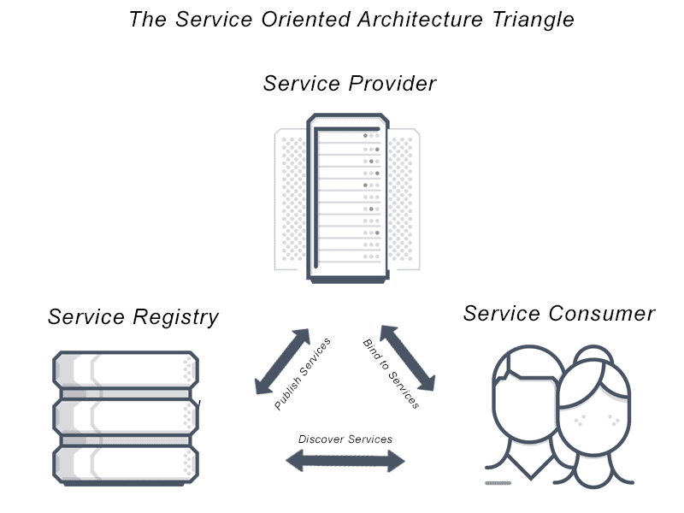
Architecture of SOA

Slide 7
Architecture of SOA
The generalized architecture of SOA has three components namely service providers, service consumers and service registry.
The service provider is responsible for publishing the services in to a registry and provides access to those using API and interfaces for the consumers. The provider defines Quality of services and security parameters through contract called service level agreement.
The service consumer is responsible for invoking and accessing the services published by provider through standard interfaces and APIs. Whenever service consumer invokes a service, initially it has to find it inside service registry using interfaces. If it is found in registry, then the discovery details are provisioned to the consumer through which consumer can access the service from service provider.
The service registry stores the references of services published by provider and allows consumers to locate and access those using references

Slide 8
Characteristics of SOA
The different characteristics of SOA are as follows :
Provides interoperability between the services.
Provides methods for service encapsulation, service discovery, service composition, service reusability and service integration.
Facilitates QoS (Quality of Services) through service contract based on Service Level Agreement (SLA).
Provides loosely couples services.
Provides location transparency with better scalability and availability.
Ease of maintenance with reduced cost of application development and deployment.

Slide 9
Advantages of SOA:
Service reusability: In SOA, applications are made from existing services. Thus, services can be reused to make many applications.
Easy maintenance: As services are independent of each other they can be updated and modified easily without affecting other services.
Platform independent: SOA allows making a complex application by combining services picked from different sources, independent of the platform.
Availability: SOA facilities are easily available to anyone on request.
Reliability: SOA applications are more reliable because it is easy to debug small services rather than huge codes
Scalability: Services can run on different servers within an environment, this increases scalability

Slide 10
Disadvantages of SOA:
High overhead: A validation of input parameters of services is done whenever services interact this decreases performance as it increases load and response time.
High investment: A huge initial investment is required for SOA.
Complex service management: When services interact they exchange messages to tasks. the number of messages may go in millions. It becomes a cumbersome task to handle a large number of messages.

Slide 11
Practical applications of SOA:
SOA is used in many ways around us whether it is mentioned or not.
SOA infrastructure is used by many armies and air force to deploy situational awareness systems.
SOA is used to improve the healthcare delivery.
Nowadays many apps are games and they use inbuilt functions to run. For example, an app might need GPS so it uses inbuilt GPS functions of the device. This is SOA in mobile solutions.
SOA helps maintain museums a virtualized storage pool for their information and content.

Slide 12
Rest and Systems of Systems

Slide 13
Representational state Transfer (REST)
REST is a software architecture style for distributed system that defines a set of constraints to be used for creating web based services.
Today it is used by many sites such as google,yahoo,amazon,etc.
The Web services that follows the Rest Arch. style are called Restful Web services.
Which allows the requesting systems to access and manipulate the web resources by using a uniform and predefined set of stateless operations.
REST server simply provides access to resources and REST client accesses and modifies the resources.
REST uses various representations to represent a resources like text,JSON,XML.

Slide 14
Representational state Transfer (REST)
REST stands for REpresentational State Transfer and API stands for Application Program Interface.
REST is a software architectural style that defines the set of rules to be used for creating web services.
Web services which follow the REST architectural style are known as RESTful web services.
It allows requesting systems to access and manipulate web resources by using a uniform and predefined set of rules.
Interaction in REST based systems happen through Internet’s Hypertext Transfer Protocol (HTTP).

Slide 15
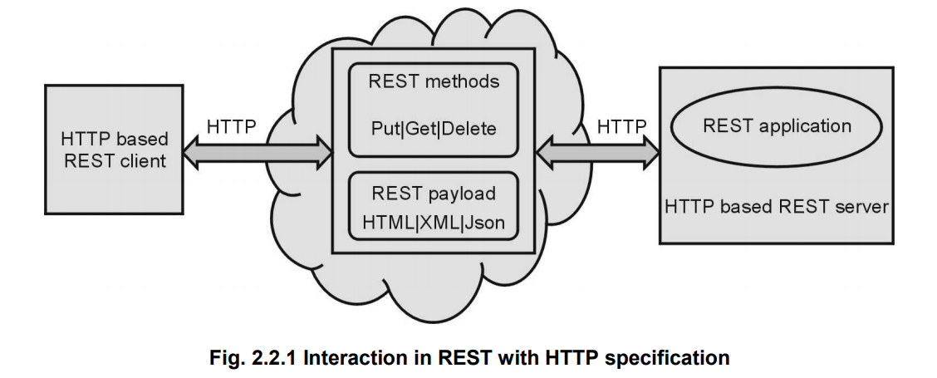
Representational state Transfer (REST)
REST architecture style has four basic principles

Slide 16
Representational state Transfer (REST)
REST Identifications:
In RESTful web services, the set of resources are often exposed by the publishers over the internet which are accessed by the clients through interaction mechanisms.
The key component for information abstraction in REST is a resource.
A resource can be any information stored in a document, image or temporal storage which uses conceptual mapping to a set of entities.
Each resource in a REST has a unique name identified by a Uniform Resource Identifier (URI) similar to URL on web.
The URI is utilized for giving a global addressing space tending to resources which are involved in an interaction between components and facilitates service discovery.
The URIs can be bookmarked or traded through a hyperlink which gives greater readability.

Slide 17
Representational state Transfer (REST)
Controlled Interfaces:
In RESTful web services, the interaction is happened through client/server protocols based on HTTP standards.
The primitives used to perform manipulation are fixed set of four CRUD (Create, Read, Update, Delete) operations.
which are implemented using HTTPs
Method | Operations
PUT | Create a new resource
GET | Retrieve the current state of resource
POST | Update or transfer a new state to a resource
DELETE | Delete or destroy a resource

Slide 18
Representational state Transfer (REST)
Self-Descriptive Messages:
A REST message contains brief description about message communication along with the processing information.
It enables intermediate users to process the message without parsing the contents.
The REST decouples the resources from their representations such that their content can be accessed in a variety of standard formats like HTML, XML, etc.
It also provides the alternate representations of each resource in multiple formats.
The message also contains metadata that can be used for detecting the transmission error, caching control, authentication, authorization, and access control.

Slide 19
Representational state Transfer (REST)
Stateless Communications:
In REST, the communication happens are mostly ‘stateless’ where messages do not have to rely on the state of the conversation.
The stateless communication facilitates improved visibility, task of recovering from partial failures, and increased scalability.
The limitations of stateless communication are degraded or decreased network performance because of collective repeated data.
However, there are some communications happened using Stateful interactions which performs explicit state transfer such as URI rewriting, hidden form fields or cookies. To point the future state of communication, the current state can be embedded in a response message.

Slide 20
Representational state Transfer (REST)
Stateless Communications:
Mostly the stateless RESTful web services are scalable in nature as they can serve very large number of clients with supporting caching mechanisms, clustering, and load balancing.
The common example of REST web service is Amazon AWS which uses various REST methods in its Simple Storage Service (S3). The Simple Storage Service uses bucket as a medium for storing the objects also called items.
For manipulating the bucket, it makes HTTP requests to create, fetch, and delete buckets using PUT, GET, POST and DELETE methods.
The RESTful web services are mainly used in web 2.0 applications where the mashup allows to combine the capabilities of one web application into another, for example, taking the videos from online YouTube repository and put into a Facebook page.

Slide 21
Web Services

Slide 22
Web Services
Web services are open standard (XML, SOAP, HTTP, etc.) based web applications that interact with other web applications for the purpose of exchanging data.
Web services can convert your existing applications into web applications.
Web service is a piece of software that makes itself available over the internet and uses a standardized XML messaging system.
XML is used to encode all communications to a web service.
For example, a client invokes a web service by sending an XML message, then waits for a corresponding XML response. As all communication is in XML, web services are not tied to any one operating system or programming language—Java can talk with Perl; Windows applications can talk with Unix applications
Web services are built on top of open standards such as TCP/IP, HTTP, Java, HTML, and XML.
Web service has an interface, which hides the implementation details so that it can be used independently of the hardware or software platform on which it is implemented, and independently of the programming language in which it is written.

Slide 23
Web Services
Web services are XML-based information exchange systems that use the Internet for direct application-to-application interaction.
Web service is a collection of open protocols and standards used for exchanging data between applications or systems.
Web services is a Interoperable machine-to-machine software function that is hosted at a network addressable location.
This independence encourages web service based applications to be loosely coupled, component-oriented, cross-technology implementations.
Web services can be used alone or with other web services to carry out a complex aggregation or a business transaction.
Components of Web services
The basic web services platform is XML + HTTP. All the standard web services work using the following components
SOAP (Simple Object Access Protocol)
UDDI (Universal Description, Discovery and Integration)
WSDL (Web Services Description Language)

Slide 24
Web Services
How Does a Web Service Work?
A web service enables communication among various applications by using open standards such as HTML, XML, WSDL, and SOAP.
A web service takes the help of −
XML to tag the data
SOAP to transfer a message
WSDL to describe the availability of service.
You can build a Java-based web service on Solaris that is accessible from your Visual Basic program that runs on Windows.
You can also use C# to build new web services on Windows that can be invoked from your web application that is based on JavaServer Pages (JSP) and runs on Linux.

Slide 25
Web Services
Example
Consider a simple account-management and order processing system. The accounting personnel use a client application built with Visual Basic or JSP to create new accounts and enter new customer orders.
The processing logic for this system is written in Java and resides on a Solaris machine, which also interacts with a database to store information.
The steps to perform this operation are as follows −
The client program bundles the account registration information into a SOAP message.
This SOAP message is sent to the web service as the body of an HTTP POST request.
The web service unpacks the SOAP request and converts it into a command that the application can understand.
The application processes the information as required and responds with a new unique account number for that customer.
Next, the web service packages the response into another SOAP message, which it sends back to the client program in response to its HTTP request.
The client program unpacks the SOAP message to obtain the results of the account registration process.

Slide 26
Web Services
Exposing the Existing Function on the network
A web service is a unit of managed code that can be remotely invoked using HTTP.
Interoperability
Web services allow various applications to talk to each other and share data and services among themselves. Other applications can also use the web services.Web services are used to make the application platform and technology independent.
Standardized Protocol
Web services use standardized industry standard protocol for the communication. All the four layers (Service Transport, XML Messaging, Service Description, and Service Discovery layers) use well-defined protocols in the web services protocol stack. This standardization of protocol stack gives the business many advantages such as a wide range of choices, reduction in the cost due to competition, and increase in the quality.
Low Cost Communication
Web services use SOAP over HTTP protocol, so you can use your existing low-cost internet for implementing web services.

Slide 27
Web Services
Characteristics of Web services :
XML- Based
Loosely Coupled
Coarse-Grained
Ability to be synchronous or asynchronous
Support Remote Procedure Calls
Support Document Exchange

Slide 28
Web Services
Web Service Roles
There are three major roles within the web service architecture −
Service Provider
This is the provider of the web service. The service provider implements the service and makes it available on the Internet.
Service Requestor
This is any consumer of the web service. The requestor utilizes an existing web service by opening a network connection and sending an XML request.
Service Registry
This is a logically centralized directory of services. The registry provides a central place where developers can publish new services or find existing ones. It therefore serves as a centralized clearing house for companies and their services.

Slide 29
Web Services
Web Service Protocol Stack >
Service Transport
This layer is responsible for transporting messages between applications.this layer includes HyperText Transport Protocol (HTTP), Simple Mail Transfer Protocol (SMTP), File Transfer Protocol (FTP), and newer protocols such as Blocks Extensible Exchange Protocol (BEEP).
XML Messaging
This layer is responsible for encoding messages in a common XML format so that messages can be understood at either end. Currently, this layer includes XML-RPC and SOAP.
Service Description
This layer is responsible for describing the public interface to a specific web service. Currently, service description is handled via the Web Service Description Language (WSDL).
Service Discovery
This layer is responsible for centralizing services into a common registry and providing easy publish/find functionality. Currently, service discovery is handled via Universal Description, Discovery, and Integration (UDDI).

Slide 30
Web Services -Components
SOAP
SOAP is an XML-based protocol for exchanging information between computers.
SOAP is a communication protocol.
SOAP is for communication between applications.
SOAP is a format for sending messages.
SOAP is designed to communicate via Internet.
SOAP is platform independent.
SOAP is language independent.
SOAP is simple and extensible.
SOAP allows you to get around firewalls.
SOAP will be developed as a W3C standard.
UDDI
UDDI is an XML-based standard for describing, publishing, and finding web services.
UDDI stands for Universal Description, Discovery, and Integration.
UDDI is a specification for a distributed registry of web services.
UDDI is platform independent, open framework.
UDDI can communicate via SOAP, CORBA, and Java RMI Protocol.
UDDI uses WSDL to describe interfaces to web services.
UDDI is seen with SOAP and WSDL as one of the three foundation standards of web services.
UDDI is an open industry initiative enabling businesses to discover each other and define how they interact over the Internet.

Slide 31
WSDL
WSDL is an XML-based language for describing web services and how to access them.
WSDL stands for Web Services Description Language.
WSDL was developed jointly by Microsoft and IBM.
WSDL is an XML based protocol for information exchange in decentralized and distributed environments.
WSDL is the standard format for describing a web service.
WSDL definition describes how to access a web service and what operations it will perform.
WSDL is a language for describing how to interface with XML-based services.
WSDL is an integral part of UDDI, an XML-based worldwide business registry.
WSDL is the language that UDDI uses.
WSDL is pronounced as 'wiz-dull' and spelled out as 'W-S-D-L'.

Slide 32
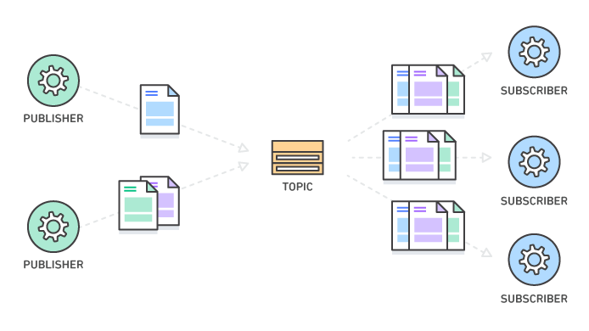
Pub/Sub-
Model

Slide 33
PUB/SUB Model :
Pub/Sub allows services to communicate asynchronously, with latencies on the order of 100 milliseconds.
Pub/Sub is used for streaming analytics and data integration pipelines to ingest and distribute data. It is equally effective as messaging-oriented middleware for service integration or as a queue to parallelize tasks.
Pub/Sub enables you to create systems of event producers and consumers, called publishers and subscribers. Publishers communicate with subscribers asynchronously by broadcasting events, rather than by synchronous remote procedure calls (RPCs).
Publishers send events to the Pub/Sub service, without regard to how or when these events will be processed. Pub/Sub then delivers events to all services that need to react to them.
Compared to systems communicating through RPCs, where publishers must wait for subscribers to receive the data, such asynchronous integration increases the flexibility and robustness of the system overall.
Publish/subscribe messaging, or pub/sub messaging, is a form of asynchronous service-to-service communication used in serverless and microservices architectures.
In a pub/sub model, any message published to a topic is immediately received by all of the subscribers to the topic. Pub/sub messaging can be used to enable event-driven architectures, or to decouple applications in order to increase performance, reliability and scalability.

Slide 34
PUB/SUB Model :
In modern cloud architecture, Publish/Subscribe (Pub/Sub) messaging provides instant event notifications for these distributed applications.
The Publish Subscribe model allows messages to be broadcast to different parts of a system asynchronously.
A sibling to a message queue, a message topic provides a lightweight mechanism to broadcast asynchronous event notifications, and endpoints that allow software components to connect to the topic in order to send and receive those messages.
To broadcast a message, a component called a publisher simply pushes a message to the topic. Unlike message queues, which batch messages until they are retrieved, message topics transfer messages with no or very little queuing, and push them out immediately to all subscribers.
All components that subscribe to the topic will receive every message that is broadcast, unless a message filtering policy is set by the subscriber.
The subscribers to the message topic often perform different functions and can each do something different with the message in parallel. The publisher doesn’t need to know who is using the information that it is broadcasting, and the subscribers don’t need to know who the message comes from.
This style of messaging is a bit different than message queues, where the component that sends the message often knows the destination it is sending to.

Slide 35
Benefits of PUB/SUB Model :
Eliminate Polling [ developers rely on real-time events,faster response time and reduces the delivery latency]
Dynamic Targeting [ less error , sub dynamic mood ]
Decouple and scale Independently [ flexible , decoupled , works independently , scale ]
Simplify Communication [ reuse of codes , what msg should deliver to particular sub ,callback result ]
Balance Workloads [ Divide the bulk process into small ones ]
Logs to Multiple Systems [ records events , capture log for operations and security ,compliance ]
Coordinate serverless Applications [ Asynchronous event notification to distributed fn ]
Stream IoT Data [ interact - devices can easily stream data to backend systems ]

Slide 36
Features of PUB/SUB Model :
Push Delivery [ Instantly pushes asynchronous event notifications and sub are notified when a msg is available ]
Multiple Delivery protocols [ connects to multiple types of endpoints ]
Fanout [ parallel processing ]
Filtering [msg filtering policy ]
Durability and Security [ copies of same msgs on multiple servers , authenticate , encrypted end to end ]

Slide 37
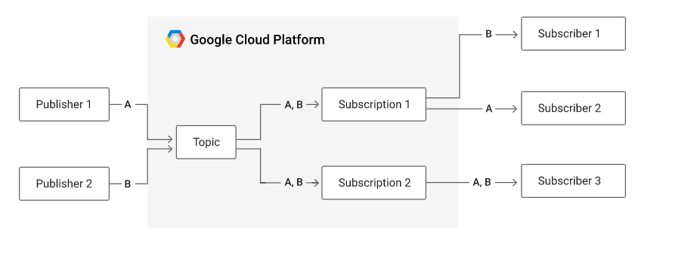
Pub/sub Model :
https://cloud.google.com/pubsub/architecture#the_basics_of_a_publishsubscribe_service

Slide 38
Issues in Pub/sub model:
SUB handling
Content filtering
Wildcard sub
Msg ordering
Msg Priority
Repeated Msg
Msg Expirations and Schedulings

Slide 39
Basics of Virtualization

Slide 40
Issues in Pub/sub model:

Slide 43
Service oriented architecture
https://www.geeksforgeeks.org/service-oriented-architecture/
https://www.mordorintelligence.com/industry-reports/cloud-enabling-technology-market
https://www.ibm.com/in-en/cloud/learn/soa
For Rest Systems
https://www.tutorialspoint.com/restful/restful_introduction.htm
https://www.geeksforgeeks.org/rest-api-architectural-constraints/
For web services
https://www.tutorialspoint.com/webservices/what_are_web_services.htm
https://www.javatpoint.com/what-is-web-service
https://slideplayer.com/slide/16141472/
For pub/sub model
https://aws.amazon.com/pub-sub-messaging/
https://docs.microsoft.com/en-us/azure/architecture/patterns/publisher-subscriber
https://cloud.google.com/pubsub/docs/tutorials (for experiment)
Links:

Slide 44
For basics of virtualization
https://www.tutorialspoint.com/cloud_computing/cloud_computing_virtualization.htm
https://www.geeksforgeeks.org/virtualization-cloud-computing-types/
Implementation of level of virtualization
http://stmarysguntur.com/wp-content/uploads/2018/02/PDFsam_merge.pdf
https://www.javatpoint.com/virtualization-in-cloud-computing
https://cloud.google.com/compute/?hl=en_US&_ga=2.188485032.-126505932.1629711797 (compute engine )
For Assignment :
https://www.qwiklabs.com/focuses/870?catalog_rank=%7B%22rank%22%3A5%2C%22num_filters%22%3A0%2C%22has_search%22%3Atrue%7D&parent=catalog&search_id=12566067

Slide 45
Extra notes

Slide 46
Service oriented Architecture (SOA)
SOA is an architectural approach in which applications make use of services available in the network. In this architecture, services are provided to create the applications, through a communication call over the internet.
SOA allows users to combine a large number of facilities from existing services.
SOA encompasses a set of design principles that structure system development and provide means for integrating components and decentralized system.
SOA based computing packages functionalities into a set of interoperable services, which can be integrated into different software systems belonging to separate business domains.
Services might aggregate information and data retrieved from other services or create workflows of services to satisfy the request of a given service consumer. This practice is known as service orchestration.
Another important interaction pattern is service choreography, which is the coordinated interaction of services without a single point of control.
Notes:
Choreography means art of flow or design,practice

Slide 47
Major Principles of SOA:
Standardized service contract: Specified through one or more service description documents.
Loose coupling: Services are designed as self-contained components, maintain relationships that minimize dependencies on other services.
Abstraction: A service is completely defined by service contracts and description documents. They hide their logic, which is encapsulated within their implementation.
Reusability: Designed as components, services can be reused more effectively, thus reducing development time and the associated costs.
Autonomy: Services have control over the logic they encapsulate and, from a service consumer point of view, there is no need to know about their implementation.
Discoverability: Services are defined by description documents that constitute supplemental metadata through which they can be effectively discovered. Service discovery provides an effective means for utilizing third-party resources.
Composability: Using services as building blocks, sophisticated and complex operations can be implemented. Service orchestration and choreography provide solid support for composing services and achieving business goals.

