Slide 1


• HEALTHCARE
Healthcare Stroke Data Analysis
Using (EDA)
Presented By:
Monesh Chaudhari
Batch 509

Slide 2
About me
Name : Monesh Chaudhari
Education : Bachelor of Technology (Computer science and engineering)
LinkedIn
Github

Slide 3
02 · WHY THIS PROJECT?
Motivation & Relevance
1
Stroke is a major global health concern.
2
Helps identify important stroke risk factors.
3
Demonstrates the power of EDA in healthcare analytics.
4
Provides real-world experience in data analysis and visualization.
3

Slide 4
01 · INTRODUCTION
Problem Statement
The objective of this project is to perform Exploratory Data Analysis (EDA) on a healthcare stroke dataset to identify patterns, trends, and relationships between demographic and medical factors that influence stroke occurrence.
5,110
Patient Records
The analysis focuses on:
12
Data cleaning and preparation
Visualization of key variables
Handling missing values and outliers
Generating insights into stroke risk factors
Laying groundwork for future predictive analytics
Original Features
~5%
Stroke Prevalence
2

Slide 5
03 · DATASET INFORMATION
About the Dataset
Dataset Description
At a Glance
The healthcare Stroke Prediction dataset contains patient-level demographic, lifestyle, and clinical attributes used to study factors associated with stroke occurrence. Each row represents one patient, with the target variable indicating whether the patient experienced a stroke.
Rows
5,110 patients
Columns
12 attributes
Target
stroke (0 / 1)
Source / Platform
Kaggle — "Stroke Prediction Dataset"
Missing data
BMI column only
Duplicates
None found
4

Slide 6
04 · UNDERSTANDING THE DATASET
Columns & Target Variable
Column | Description
id | Unique patient identifier (dropped)
gender | Male / Female / Other
age | Patient age in years
hypertension | 0 = No, 1 = Yes
heart_disease | 0 = No, 1 = Yes
ever_married | Yes / No
work_type | Private / Self-employed / Govt / Children
Residence_type | Urban / Rural
avg_glucose_level | Average blood glucose level
bmi | Body Mass Index
smoking_status | Formerly / Never / Smokes / Unknown
stroke | Target: 0 = No stroke, 1 = Stroke
Initial Observations
Target variable: stroke (binary classification)
Mix of numerical (age, bmi, glucose) and categorical (gender, work_type, smoking) features
id carries no predictive value and is removed early
hypertension, heart_disease, stroke are binary flags, not continuous variables
smoking_status includes a sizeable "Unknown" category to be analyzed as-is
5

Slide 7
05 · DATA CLEANING & PREPARATION
Getting the Data Analysis-Ready
Missing Values
Duplicate Records
bmi had 201 missing entries (3.93%). Imputed using the median to avoid distortion from skew/outliers.
Checked with df.duplicated().sum() — zero duplicate rows found in the dataset.
Outlier Treatment
Class Imbalance
Boxplots reviewed for age, bmi, avg_glucose_level. Extreme values retained as genuine medical conditions (e.g. obesity, diabetes), not errors.
stroke target is highly imbalanced — ~95% "No Stroke" vs ~5% "Stroke". Flagged for any future modeling work.
6

Slide 8
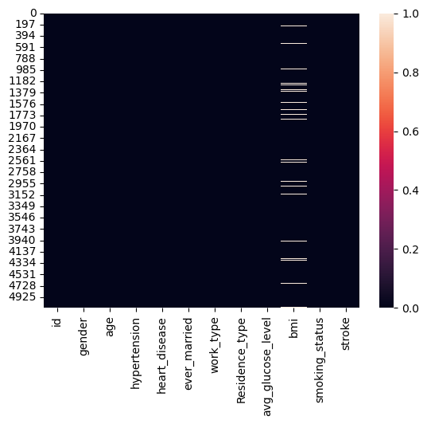
05 · DATA CLEANING & PREPARATION
Missing Value Detection
Observations
Heatmap highlights missing entries only in the bmi column
All other columns are fully populated — no missing data elsewhere
Missing bmi values (3.93%) were imputed with the column median to preserve the sample size
Median chosen over mean since bmi is right-skewed and sensitive to outliers
7

Slide 9
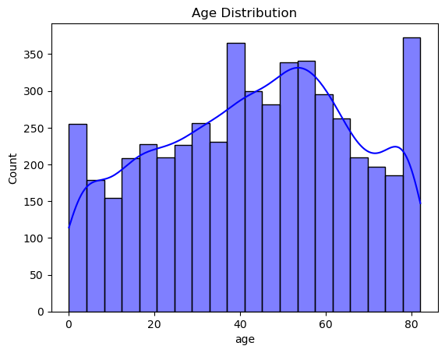
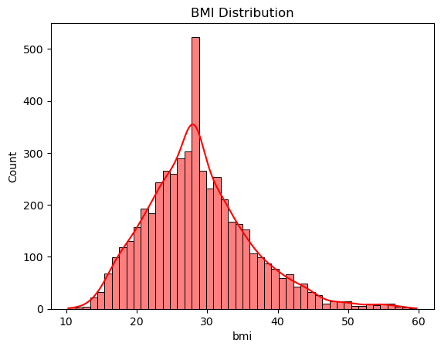
06 · EDA — UNIVARIATE ANALYSIS
Distribution of Age & BMI
Why this plot
Histograms with KDE overlay show the shape, spread and skew of each numeric variable.
Observations
Most patients are middle-aged to elderly; very few young patients
BMI is slightly right-skewed with some extreme high values
Both distributions suggest the patient pool skews toward older, higher-risk individuals
8

Slide 10
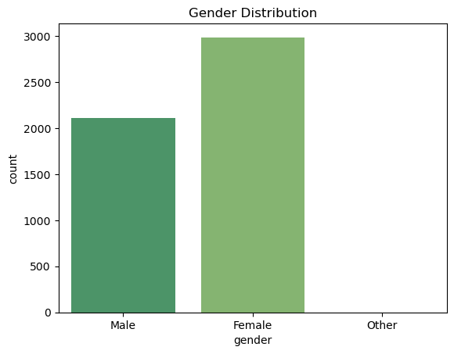
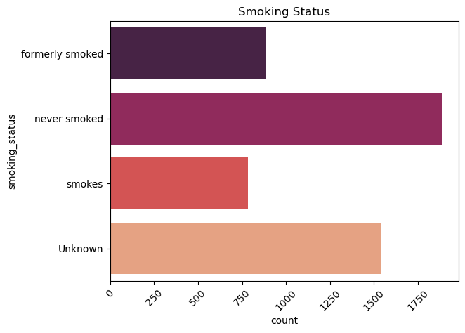
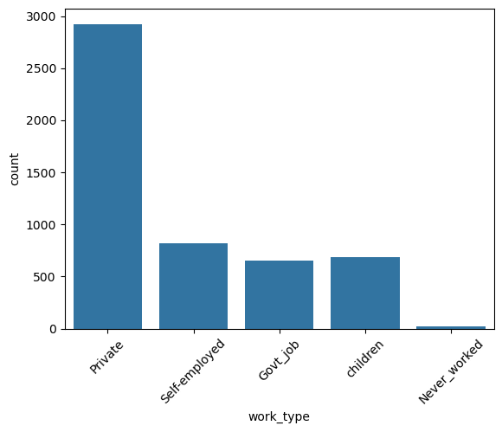
06 · EDA — UNIVARIATE ANALYSIS
Categorical Variables — Gender, Smoking & Work Type
Why this plot
Count plots summarize the frequency of each category for key categorical features.
Observations
Female and Male dominate gender; "Other" is negligible
"Never smoked" is the largest smoking group; "Unknown" is also significant
Private-sector employees form the largest work_type group; children are the smallest
10

Slide 11
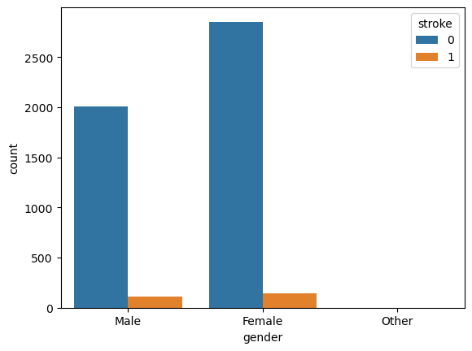
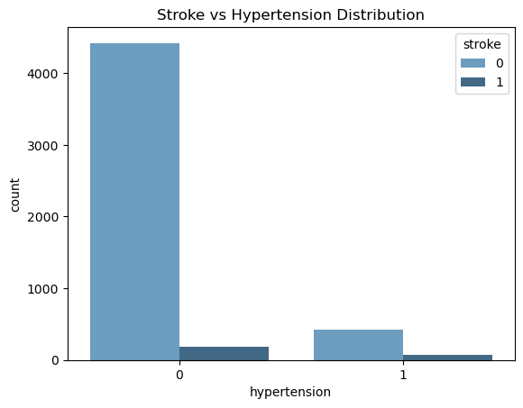
07 · EDA — BIVARIATE ANALYSIS
Stroke vs. Gender & Hypertension
Why this plot
Grouped count plots compare stroke occurrence across categories of each variable.
Observations
Stroke distribution is broadly similar across genders
Patients with hypertension show a relatively higher proportion of stroke cases
Hypertension appears to be a meaningful risk factor
12

Slide 12
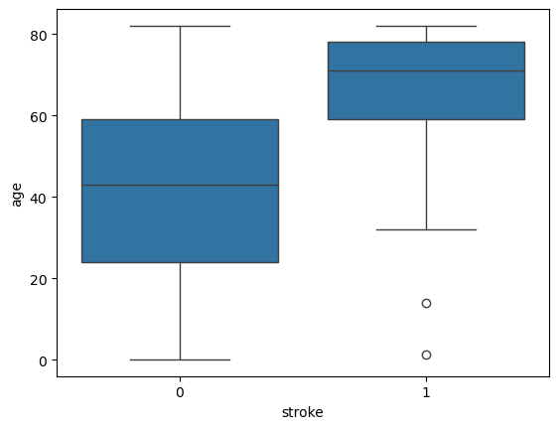
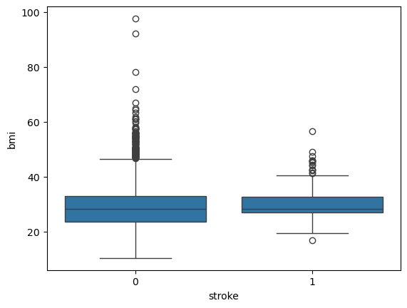
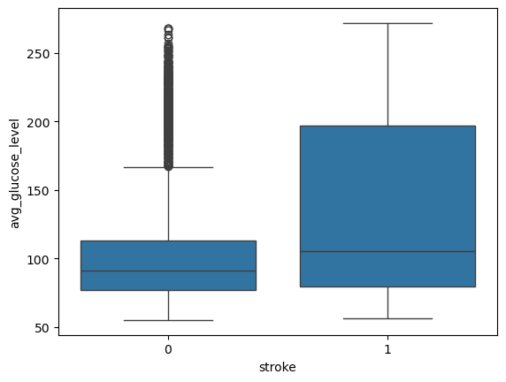
07 · EDA — BIVARIATE ANALYSIS
Age, BMI & Glucose vs. Stroke
Why this plot
Boxplots compare the distribution of each numeric variable across stroke classes.
Observations
Stroke patients generally have a higher median age
BMI distributions overlap heavily — BMI alone doesn't separate the classes
Stroke patients tend to have higher glucose levels
14

Slide 13
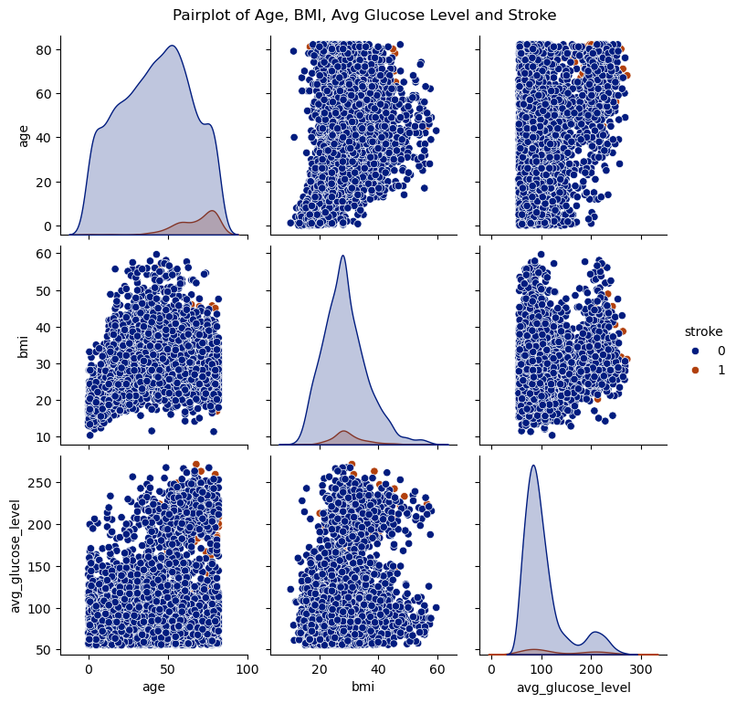
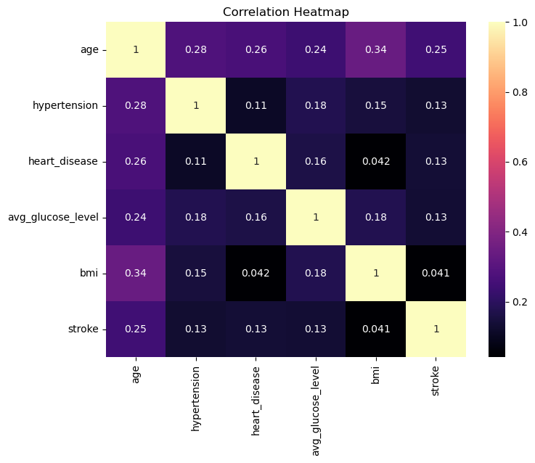
07 · EDA — MULTIVARIATE ANALYSIS
Correlation Heatmap & Pair Plot
Why this plot
Correlation heatmap quantifies linear relationships; pair plot visualizes pairwise patterns across numeric variables, colored by stroke.
Observations
Age shows a positive relationship with stroke
avg_glucose_level also shows a mild positive association with stroke
Correlations are weak to moderate — stroke risk is multi-factorial, not driven by one variable
11

Slide 14
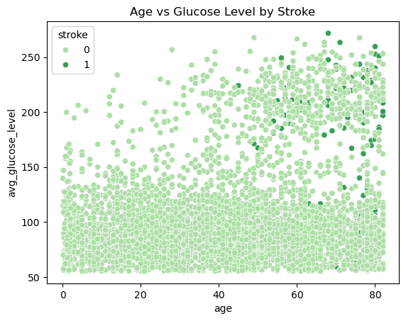
08 · EDA — MULTIVARIATE ANALYSIS
Age vs. Glucose Level, Colored by Stroke
Why this plot
Scatter plot with stroke as hue examines how two numeric variables jointly relate to the target.
Observations
Stroke cases concentrate among older patients with higher glucose levels
No single clean boundary separates classes — relationships are complex and non-linear
Reinforces that stroke risk depends on a combination of factors, not one variable alone
15

Slide 15
09 · VISUAL & NON-VISUAL INSIGHTS
Summary Statistics & Key Insights
Metric | Value
Total patients | 5,110
Stroke cases (class 1) | 249 (4.87%)
No-stroke cases (class 0) | 4,861 (95.13%)
Missing bmi (before cleaning) | 201 (3.93%)
Duplicate rows | 0
Unknown smoking_status | 1,544 (30.2%)
Key Insights
Age is a major risk factor.
High glucose levels increase stroke risk.
Hypertension and heart disease are strongly associated with stroke.
BMI alone is not a strong predictor.
The dataset is imbalanced because stroke cases are much fewer than non-stroke cases.
16

Slide 16
10 · CONCLUSION
Final Insights & Learnings
Final Insights
Learnings from the Project
Practiced end-to-end EDA: cleaning, univariate, bivariate, and multivariate analysis
Learned to judge when outliers represent real signal vs. noise (e.g., genuine high BMI/glucose)
Gained experience interpreting visualizations to derive actionable healthcare insights
Understood the importance of class imbalance for future model design and evaluation
Age and average glucose level emerged as the strongest associations with stroke occurrence
Hypertension and heart disease are clinically meaningful risk indicators within this dataset
Stroke risk is multi-factorial — no single variable cleanly separates stroke from non-stroke patients
Thank You

Slide 17


