Slide 1




IMAGE SEGMENTATION USING K-MEANS CLUSTERING
TEAM MEMBERS:
N.DEEPIKA MERLIN [927622BAL006]
R.M.MONESHA [927622BAL025]
S.POOJA [927622BAL035]
N.SUDHARSANA [927622BAL045]

Slide 2
PROBLEM STATMENT
The problem statement for image segmentation using k-means clustering involves dividing an image into distinct regions or segments based on similarities in pixel intensity.
This process aims to partition the image into K clusters, where each cluster represents a segment with similar pixel values.
The objective is to accurately segment the image into meaningful regions to aid in further analysis or processing tasks.

Slide 3
ABSTRACTION
Data Preparation: Convert the image into a feature space suitable for clustering, like RGB values for each pixel.
Initialization: Randomly initialize cluster centroids.
Assignment Step: Assign each pixel to the nearest centroid based on distance
(usually Euclidean distance)
Update Step: Recalculate the centroids based on the mean of pixels assigned to each cluster.

Slide 4
CONT…
Iteration: Repeat steps 3 and 4 until convergence or a predefined number of iterations.
Segmentation: After convergence, pixels assigned to the same cluster represent segments of the image.
Post-processing: Refine the segmentation if necessary, like merging adjacent segments or applying filters."

Slide 5
PROPOSED SOLUTION
Matplotlib and Sklearn Imports: Importing necessary libraries including matplotlib.pyplot for visualization and sklearn.cluster.KMeans for K-means clustering.
Image Loading and Display: Loading the image using mpl.image.imread() and displaying it using plt.imshow().
Reshaping Image: Reshaping the image array into a 2D array suitable for clustering.
K-means Clustering: Initializing and fitting the KMeans model to the image data.
Segmentation: Reconstructing the segmented image based on the cluster assignments.
Display and Save: Displaying and saving the original and segmented images.
Elbow Method Implementation: Implementing the elbow method to find the optimal number of clusters for segmentation.

Slide 6
DATASET
Dataset: The dataset here is the image itself, represented as an array of pixel values.
Independent values: In the context of K-means clustering, the independent values are the features used for clustering. In this case, the features are the pixel values.
Dependent values: Since K-means clustering is unsupervised, there are no dependent values. K-means assigns each data point (pixel in this case) to a cluster based on its distance to the cluster centers.

Slide 7
PRE-PROCESSING
Load the Image: The code begins by loading an image using mpl.image.imread(). This function reads the image file and returns a NumPy array representing the image.
2.Display the Image: The code then uses plt.imshow() to display the loaded image. This step is for visualization purposes to show the original image.
3.Reshape the Image Array: Next, the image array is reshaped using image.reshape(-1,3). This reshaping operation is done to convert the 3-dimensional image array (height x width x channels) into a 2-dimensional array, where each row represents a pixel and each column represents a color channel (in this case, RGB).

Slide 8
CONT…
4.K-means Clustering: K-means clustering is applied to the reshaped image array (x). The number of clusters is set to 2 (n_clusters = 2). This means the algorithm will try to group similar pixels into 2 clusters.
5.Reconstruct Segmented Image: After clustering, the code reconstructs the segmented image by assigning each pixel to the centroid of its cluster. This is done by accessing the cluster centers (kmeans.cluster_centers_) and labels (kmeans.labels_). The segmented image is reshaped back to its original shape.

Slide 9
CONT…
6.Display the Segmented Image: The segmented image is then displayed using plt.imshow(segmented_img/255). The division by 255 is likely to scale the pixel values back to the range [0, 1], assuming the original pixel values were in the range [0, 255].
7.Save Images: Finally, the original and segmented images are saved using cv2.imwrite(). The segmented image is converted to the appropriate data type (uint8) before saving.

Slide 10
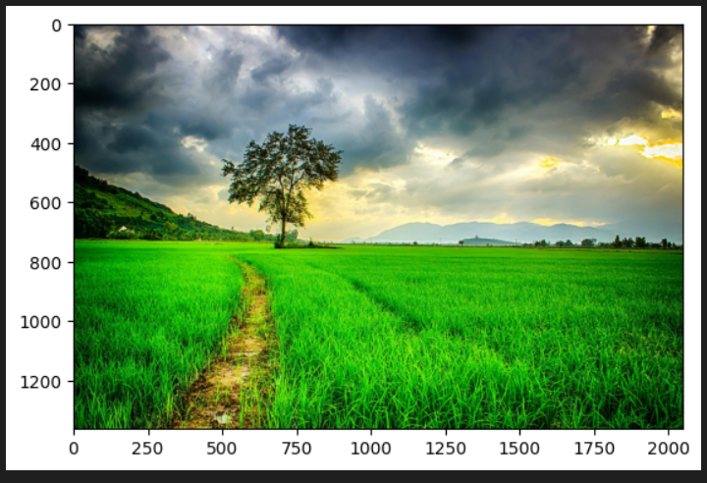
PROJECT CODE
import matplotlib as mpl
import matplotlib.pyplot as plt
from sklearn.cluster import Kmeans
image = mpl.image.imread("/content/nature.jpg")
plt.imshow(image)

Slide 11
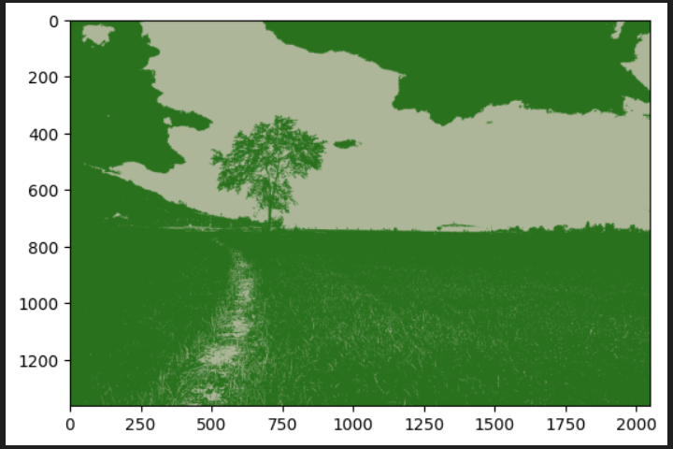
CONT…
image.shape
x = image.reshape(-1,3)
x.shape
kmeans = KMeans(n_clusters = 2)
kmeans.fit(x)
segmented_img = kmeans.cluster_centers_[kmeans.labels_]
segmented_img = segmented_img.reshape(image.shape)
plt.imshow(segmented_img/255)

Slide 12
CONT…
import cv2
cv2.imwrite("image1.jpg",cv2.cvtColor(image, cv2.COLOR_BGR2RGB))
cv2.imwrite("image2.jpg",cv2.cvtColor(segmented_img.astype("uint8"), cv2.COLOR_BGR2RGB))
import matplotlib.pyplot as plt
from sklearn.cluster import KMeans
import numpy as np
image = plt.imread("/content/nature.jpg")
if len(image.shape) == 3:
image_gray = np.mean(image, axis=2)
else:
image_gray = image
image_flat = image_gray.reshape((-1, 1))
num_clusters = 5
kmeans = KMeans(n_clusters=num_clusters, random_state=42)

Slide 13
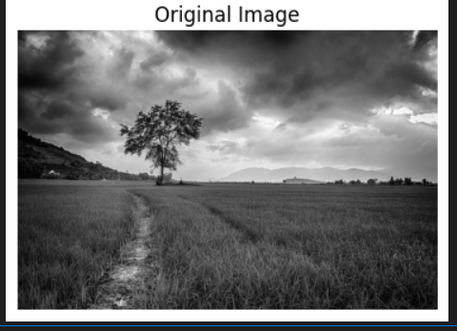
CONT…
kmeans.fit(image_flat)
cluster_centers = kmeans.cluster_centers_
cluster_labels = kmeans.labels_
segmented_image = cluster_centers[cluster_labels].reshape(image_gray.shape) plt.figure(figsize=(10, 5))
plt.subplot(1, 2, 1)
plt.imshow(image_gray, cmap='gray')
plt.title('Original Image')
plt.axis('off')

Slide 14
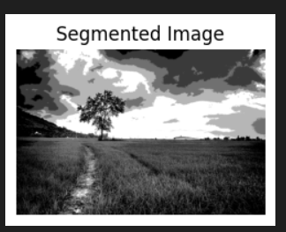
CONT…
plt.subplot(1, 2, 2)
plt.imshow(segmented_image, cmap='gray')
plt.title('Segmented Image')
plt.axis('off')

Slide 15
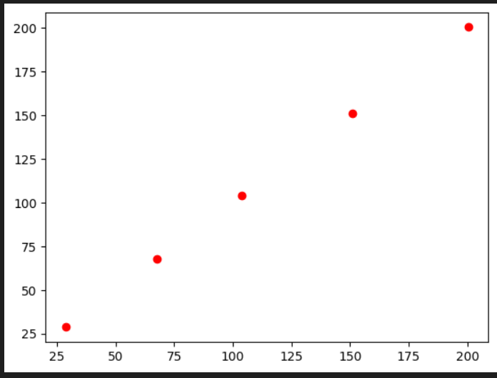
CONT…
for center in cluster_centers:
plt.plot(center[0], center[0], 'ro')

Slide 16
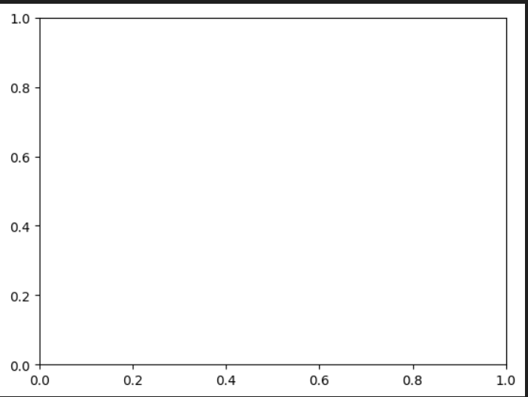
CONT…
plt.axis('on')
plt.axis('on')

Slide 17
CONT…
individual_clustering_score=[]
for i in range(1,4):
kmeans=KMeans(n_clusters=i,init='random',random_state=42)
kmeans.fit(x)
individual_clustering_score.append(kmeans.inertia_)
plt.plot(range(1,4),individual_clustering_score)
plt.title("ELBOW")
plt.show()

Slide 18
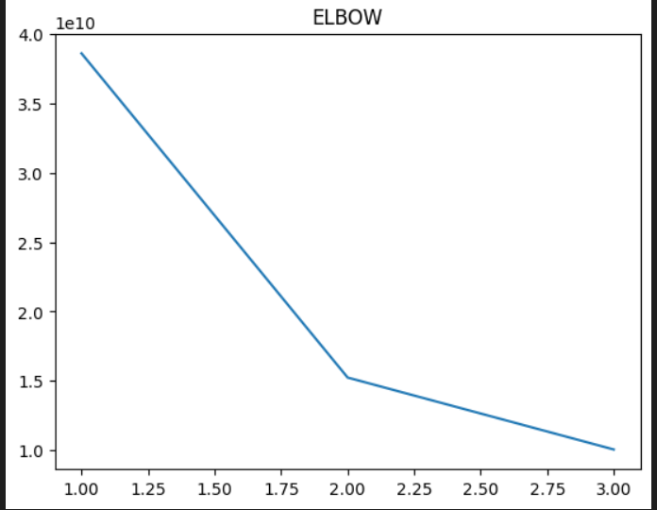
OUTPUT

