Slide 1
Q01
deviation = (estimated – actual)/actual*100
Q06
No. of training queries
Notes:
TPC-H

Slide 2
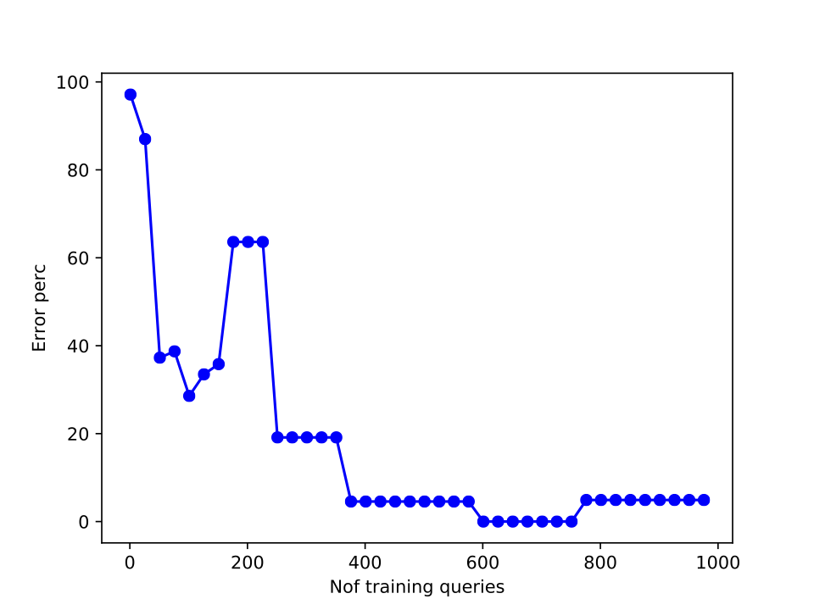
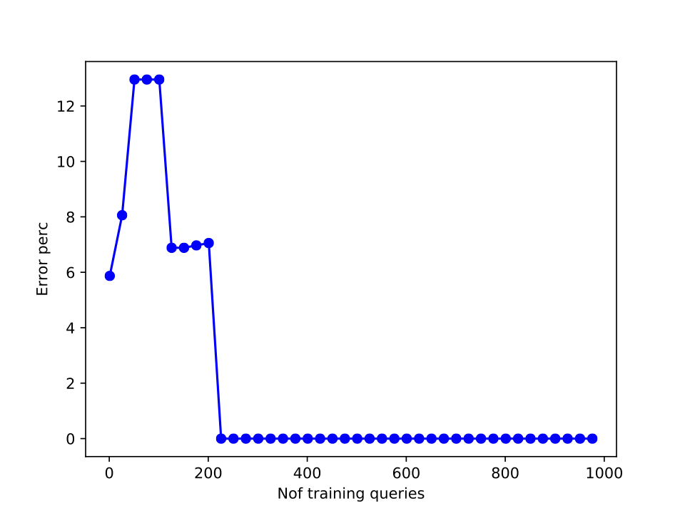
Q04
deviation = (estimated – actual)/actual*100
Q15
No. of training queries
Notes:
Air Traffic

Slide 3
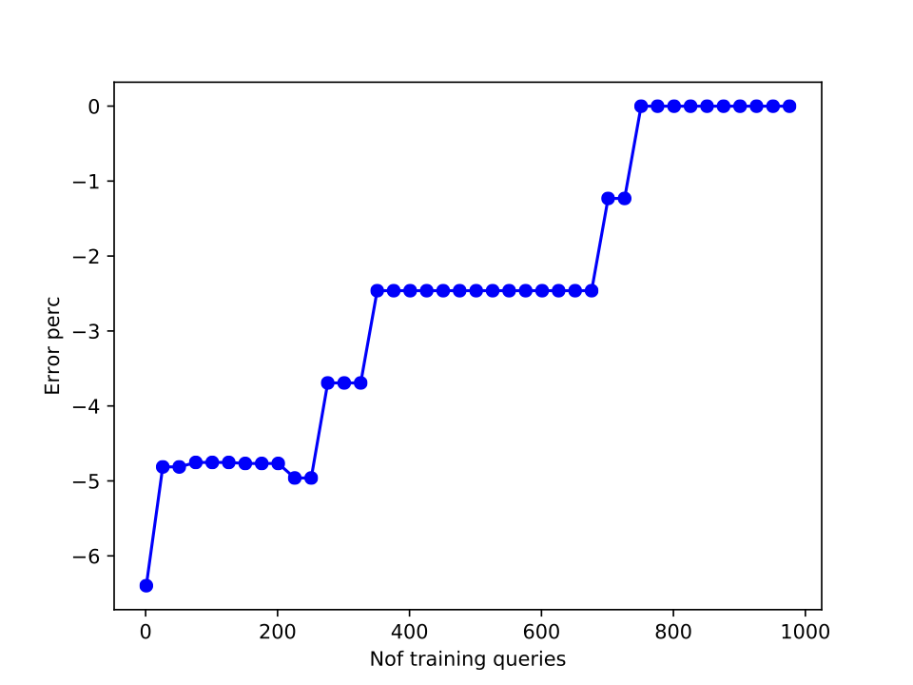
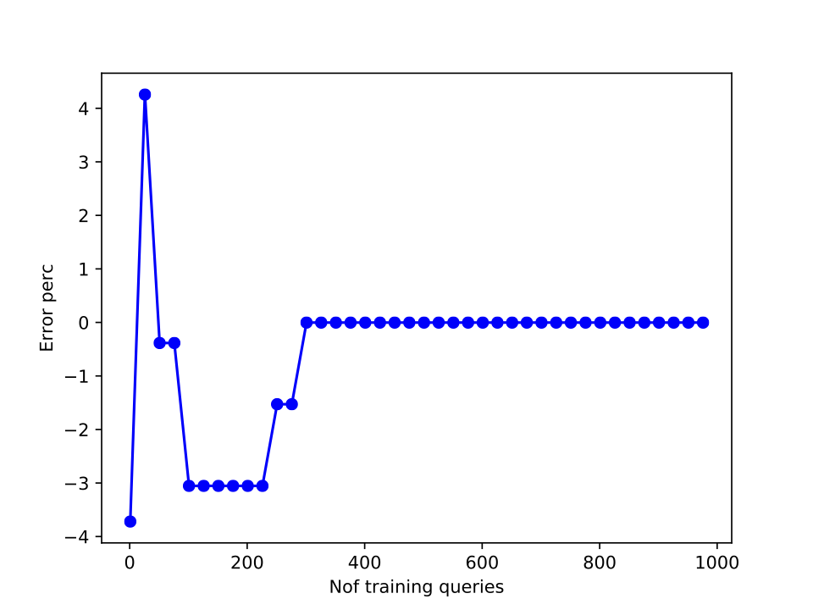
Q10
deviation = (estimated – actual)/actual*100
Q19
No. of training queries
Notes:
Air Traffic

