Slide 1
Naïve Bayes: Capstone Project Report
Zafir Shaikh | BINF_5507 | Humber IGS
July 21, 2025

Slide 2
1. Introduction
Naïve Bayes is a probabilistic classification technique based on Bayes’ Theorem. It assumes feature independence and is commonly used in text classification tasks.
Despite its simplicity, it is powerful and performs well on high-dimensional data, especially when the independence assumption is valid.

Slide 3



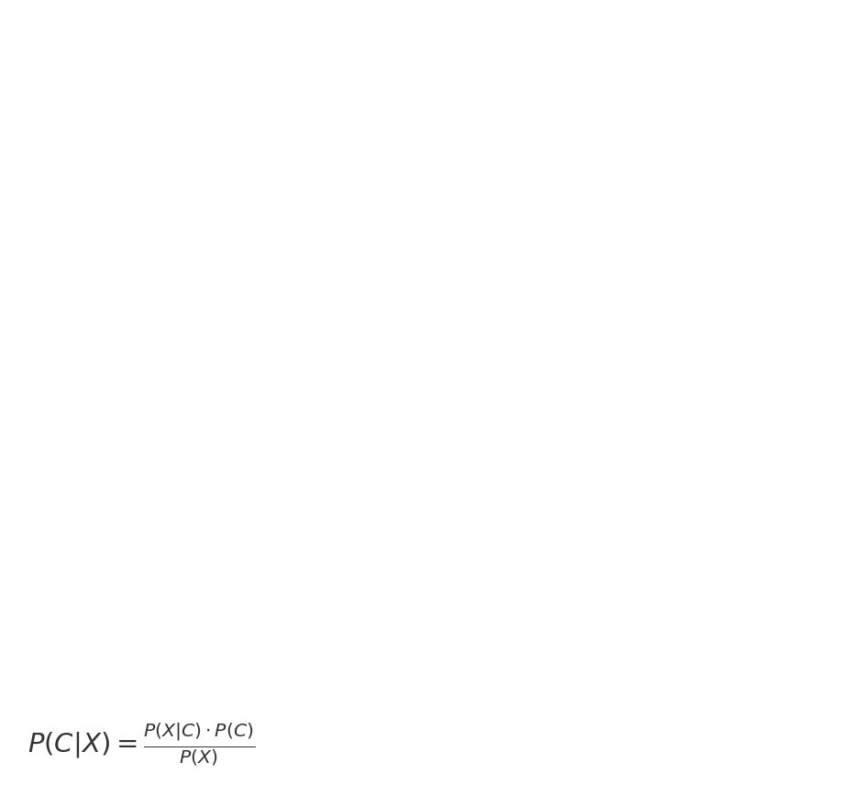
2. Bayes' Theorem
The foundation of Naïve Bayes is Bayes’ Theorem:

Slide 4
3. Probability Definitions
• P(C|X): Posterior probability of class C given features X
• P(X|C): Likelihood of features X given class C
• P(C): Prior probability of class C
• P(X): Evidence or marginal probability

Slide 5
4. Independence Assumption
Naïve Bayes assumes all features are conditionally independent given the class.
This simplifies the likelihood calculation into a product of individual probabilities.

Slide 6
5. Common Use Cases
• Spam Detection
• Sentiment Analysis
• Medical Diagnosis
• News Categorization
• Recommender Systems

Slide 7
6. Dataset Description
For demonstration, the Iris dataset was used.
It contains 150 samples with 4 features each, classified into 3 flower species.

Slide 8
7. Model Training
The dataset was split into training and testing sets.
A Gaussian Naïve Bayes classifier was used and trained using scikit-learn.

Slide 9
8. Results
• Accuracy: 0.93
• Correctly classified most samples across all three classes
• Fast training and prediction time

Slide 10
9. Evaluation Metrics
• Precision: 0.94
• Recall: 0.93
• F1-Score: 0.93
The model performs well with balanced precision and recall.

Slide 11
10. Advantages of Naïve Bayes
• Simple and fast
• Works well with small datasets
• Handles high-dimensional data efficiently
• Requires less training data

Slide 12
11. Limitations
• Assumes feature independence (often not true in real data)
• May not perform well with correlated features
• Output probabilities can be unreliable

Slide 13
12. References
• Scikit-learn documentation: https://scikit-learn.org
• Géron, A. (2019). Hands-On Machine Learning
• Wikipedia – Naïve Bayes classifier
• BINF_5507 course materials

Slide 14
13. Thank You
Thank you for your attention.
Gratitude to Prof. [Instructor's Name], Humber IGS faculty,
and my peers for their guidance and support.

