Slide 1
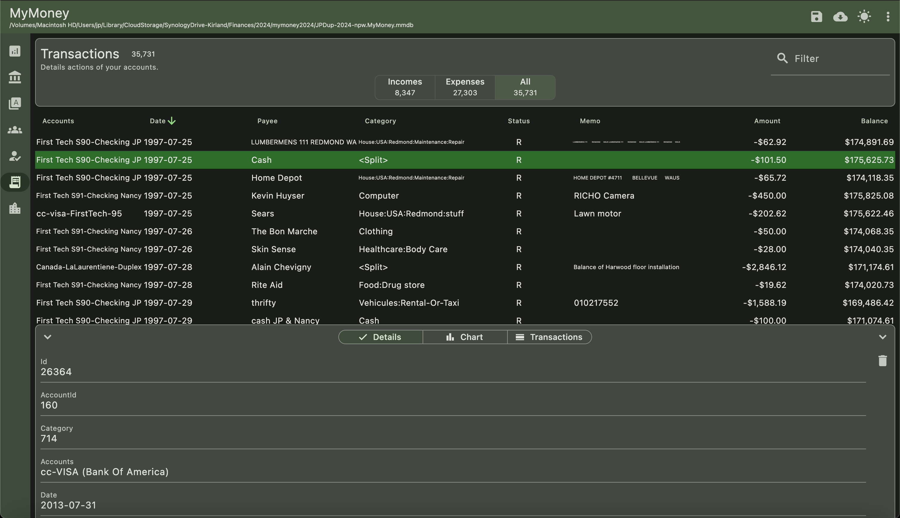
Row count
Input file
Domain filter
Save
Import
DarkMode
Navigation
Theme
Text Filter
Sort
Select
Row
Menu
- Delete
Detail panel of selected row
Chart
Transaction related to selected row

