Slide 1
Walk-in slide

Slide 2
Extract insights from visual data in Azure​
Introduction
August 2025

Slide 3
Hello!
Trainers:
Customize this content with your information, image, and background. Delete this note before teaching.
Thank you for joining me today
Instructor: <Name>
<Title or other credentials, e.g., Microsoft Certified Trainer>
<Affiliation/Company>
<A few words about my technical and professional experience>
twitter.com/[Name]
linkedin.com/[Name]
[first.last]@[email.com]
Blog

Slide 4
About this course
What we’ll cover
This 1‑day course focuses on building intelligent applications that can see, interpret, and reason over images and documents using different multimodal models and agent-based tools. Learners explore how visual and document inputs can be combined with language models to enable structured extraction, analysis, and decision-making workflows. The course emphasizes practical patterns for extracting information, orchestrating tools, and grounding model responses in visual data.
Intended audience
This course is designed for developers, AI engineers, and technical professionals who want to build applications that work with images and documents using multimodal, agent-driven approaches. It’s best suited for learners with basic programming experience and a general understanding of cloud or AI concepts.

Slide 5


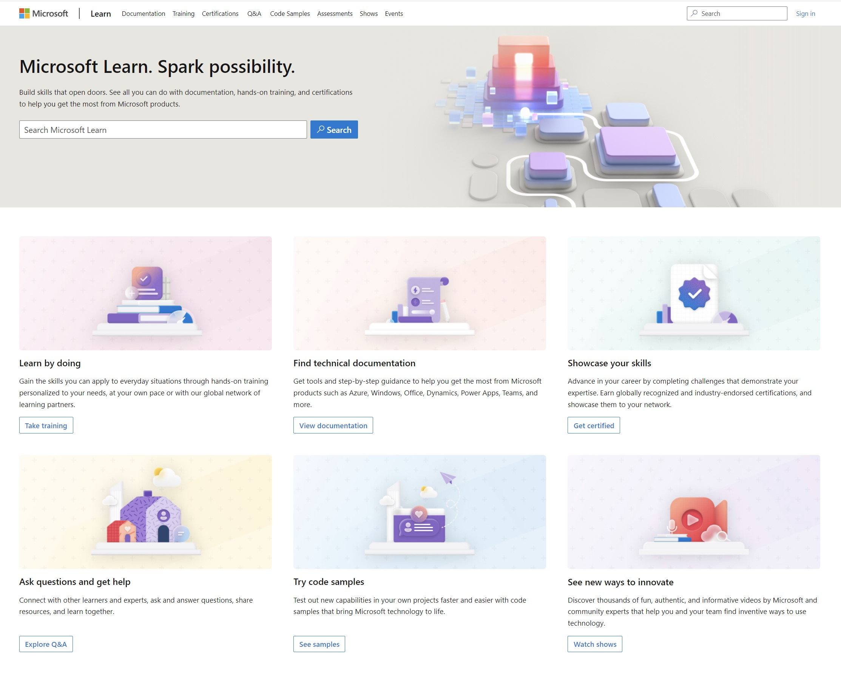
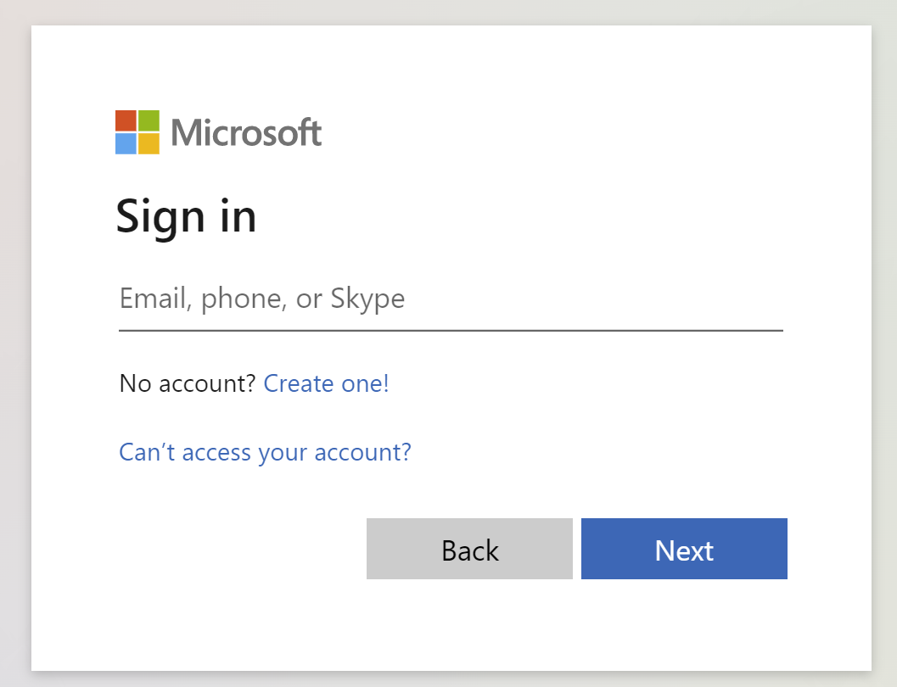
Get the most out of your Microsoft Learn profile
Create your Microsoft Learn profile
at learn.microsoft.com
Select Sign in at the top, right corner of any Microsoft Learn page.
Follow the Microsoft account authentication process.
If the account that you have chosen to sign-in with doesn't already have a Microsoft Learn profile, you’ll be guided to create one.
Verify, track, and share your training and certification progress and accomplishments—all on one platform
Claim your achievement code for this course and share you have completed it.
Access your course material and track progress on your learning activities.
Share and verify your Microsoft Certifications via email, on social networking platforms, and on your résumé.
Download and print transcripts and certificates.
Manage your upcoming activities and certification exam appointments.
www.aka.ms/MyMicrosoftLearnProfile

Slide 6
Access your course material
All course content is available on Microsoft Learn
https://aka.ms/CourseAI-102
Trainers:
Update the lab URL for the hosted lab environment as appropriate (if you have a single source). Or delete this box.
Then delete this note.
This course includes lab exercises:
We’ll go through this content together and as the course progresses, I will advise you on which modules to review.
The content on Microsoft Learn may include details not covered in the class due to time constraints.
You can provide feedback for modules on Microsoft Learn. Find how at the bottom of each page.
Detailed exercise instructions are included in your lab environment.
https://aka.ms/mslearn-visual-insights

Slide 7

Become
Microsoft Certified
92%
of certified IT professionals feel more confident in their abilities after earning certifications¹
Get recognized by earning industry validation for technical knowledge. Ensure you stay current with the necessary skills and expertise for continued success​.
Start at learn.microsoft.com/certifications
Microsoft role-based and specialty certifications require annual renewal.²
Learn about certification renewal at aka.ms/RenewYourCert
¹ “2023 Value of IT Certification | Candidate Report,” Pearson VUE, 2023 ² Microsoft fundamentals certifications don’t expire

