Slide 1
DP-800: Develop
AI-enabled database solutions
Date

Slide 2
Hello!
Trainers:
Customize this content with your information, image, and background.
Delete this note before presenting to your Learners.
Thank you for joining me today
Instructor: <Name>
<Title or other credentials, e.g., Microsoft Certified Trainer>
<Affiliation/Company>
<A few words about my technical and professional experience>
twitter.com/[Name]
linkedin.com/[Name]
[first.last]@[email.com]
Blog

Slide 3
Let’s get to know each other
Trainers:
Customize this content with your information and background.
Delete this note before presenting to your Learners.
Your name
Company affiliation
Title/function
Your experience
Your expectations
for the course

Slide 4


Let’s have a great time together
Trainers:
Customize this slide for your course.
Delete this note before presenting to your Learners.
We all contribute to a great class
What you should know about our facilities
This placeholder is designed with bulleted text
It’s easy to remove or add bullets
Be on time (class hours)
Be present (avoid mail, calls, side meetings)
This placeholder is designed with bulleted text
This section can be removed if the class is online
Accommodations
Internet access
Parking
Restrooms
Emergency

Slide 5
About this course
Course description
Database professionals learn to design, secure, and optimize SQL Server and Azure SQL solutions. It covers advanced T-SQL, AI-assisted development, security, performance tuning, and CI/CD for database projects. The final learning path builds end-to-end RAG solutions using vector embeddings, similarity search, and Azure OpenAI directly inside the database engine.
Learning objectives
After completing this course, you will be able to:
Design tables, views, stored procedures, and triggers for SQL Server and Azure SQL.
Write advanced T-SQL with window functions, pivots, and dynamic SQL.
Accelerate development with GitHub Copilot and AI-assisted tooling.
Implement row-level security, data masking, and encryption.
Optimize performance and build CI/CD pipelines with SqlPackage.
Build RAG solutions with vector embeddings and Azure OpenAI in SQL.

Slide 6
Course schedule
Trainers:
Find the proposed schedule in the Trainer Prep Guide (PDF) and customize more if needed.
Delete this note before presenting to your Learners.
 | Day 1 | Day 2 | Day 3 | Day 4
Early morning | <Instructor, insert your course plan here>
Break
Late morning | <Instructor, insert your course plan here>
Lunch
Early afternoon | <Instructor, insert your course plan here>
Break
Late afternoon | <Instructor, insert your course plan here>

Slide 7


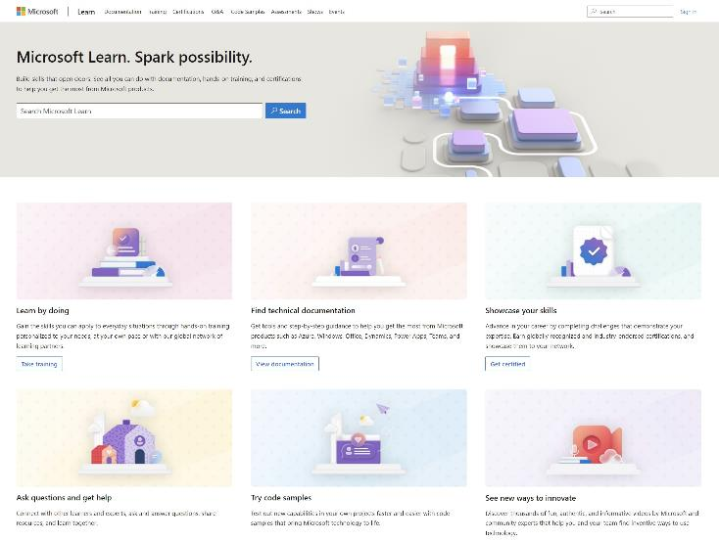
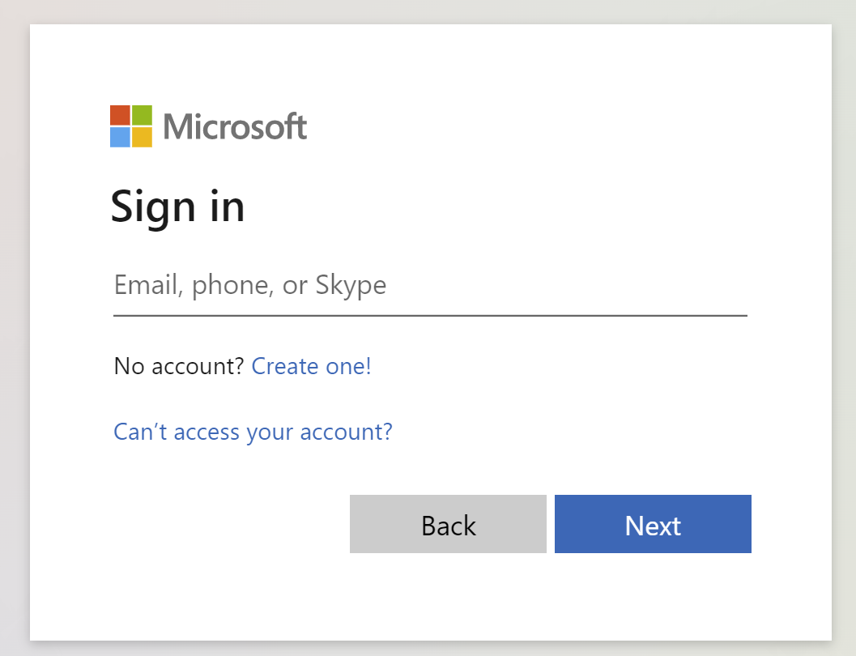
Get the most out of your Microsoft Learn profile
Create your Microsoft Learn profile
at learn.microsoft.com
Select Sign in at the top, right corner of any Microsoft Learn page.
Follow the Microsoft account authentication process.
If the account that you have chosen to sign-in with doesn't already have a Microsoft Learn profile, you’ll be guided to create one.
Verify, track, and share your training and certification progress and accomplishments—all on one platform.
Claim your achievement code for this course and share you have completed it.
Access your course material and track progress on your learning activities.
Share and verify your Microsoft Credentials via email, on social networking platforms, and on your resume.
Download and print transcripts and certificates.
Manage your upcoming activities and credential appointments.
www.aka.ms/MyMicrosoftLearnProfile

Slide 8
Access your course material
All course content is available on Microsoft Learn.
https://aka.ms/develop-ai-enabled-database-solutions
This course includes labs:
Trainers:
Update the lab URL for the hosted lab environment as appropriate.
Then delete this note.
Detailed lab instructions are included in your lab environment.
We’ll go through this content together and, as the course progresses, I will advise you on which modules to review.
You can provide feedback for modules on Microsoft Learn. Find out how at the bottom of each page.
https://aka.ms/SQLAIDevLabs
Need help? See our troubleshooting guide or provide feedback for Microsoft Learn content.

Slide 9

Become
Microsoft Certified
91%
of certified IT professionals feel more confident in their abilities after earning certifications¹
Get recognized by earning industry validation for technical knowledge. Ensure you stay current with the necessary skills and expertise for continued success​.
Start at learn.microsoft.com/credentials
Microsoft role-based and specialty certifications require annual renewal.²
Learn about certification renewal at aka.ms/RenewYourCert
¹ “2023 Value of IT Certification | Candidate Report,” Pearson VUE, 2023 ² Microsoft fundamentals certifications don’t expire

Slide 10

Get ready for your Microsoft Credential
DP-800: Develop AI-enabled database solutions
Understand the skills measured by the credential
Build confidence in your skills
Study area | Percentage
Design and develop database solutions | 35-40%
Secure, optimize, and deploy database | 35-40%
Implement AI capabilities in database solutions | 25-30%
Find in the credential page resources
to help prepare:
Watch exam prep videos
Review the exam study guide
Demo the exam experience with the exam sandbox
Take a practice assessment

