Slide 1
Design and develop database solutions
Notes:
This learning path covers four modules that build core database development skills across Azure SQL Database, Azure SQL Managed Instance, SQL database in Fabric, and SQL Server 2025.
Design and Implement Database Objects: Platform selection, table design with appropriate data types, rowstore and columnstore indexes, specialized table types (temporal, ledger, graph, in-memory, external), constraints and sequences, JSON columns, and table partitioning.
Implement Programmability Objects: Views, stored procedures with transactions and error handling, scalar and table-valued functions, DML and DDL triggers, and a decision framework for choosing the right object.
Write Advanced SQL Code: Recursive and non-recursive CTEs, window functions, JSON functions, regular expressions, fuzzy matching, graph queries, correlated subqueries, and structured error handling with TRY...CATCH.
Design and Implement SQL Solutions Using AI-Assisted Tools: GitHub Copilot in SSMS and VS Code, Fabric Copilot, AI security considerations, Model Context Protocol (MCP) configuration, and instruction files for team-wide coding standards.

Slide 2
Agenda
Design and implement database objects
Implement programmability objects
Write advanced SQL code
Design and implement SQL solutions using AI-assisted tools
Design and Develop Database Solutions teaches database professionals to design optimized schemas, encapsulate business logic in programmability objects, write advanced analytical T-SQL, and accelerate development with AI-assisted tools across Azure SQL Database, Azure SQL Managed Instance, SQL database in Fabric, and SQL Server 2025.

Slide 3
Design and implement database objects
Notes:
Welcome to the module on designing and implementing database objects.
You will learn how to design tables with appropriate data types, implement rowstore and columnstore indexes, use specialized table types (temporal, ledger, graph, in-memory, external), enforce data integrity with constraints and sequences, work with JSON columns, and implement partitioning strategies.
These skills apply across SQL Server, Azure SQL Database, Azure SQL Managed Instance, and SQL database in Microsoft Fabric.

Slide 4


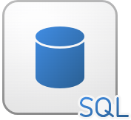
SQL platform choices
Azure SQL Database
Azure SQL Managed Instance
SQL database in Fabric
Fully managed PaaS with 99.99% SLA
Hyperscale tier - limitless scale-out
Serverless - auto-pause, pay for use
Intelligent query processing + auto tuning
Near 100% SQL Server compatibility
SQL Agent, Service Broker, linked servers
In-Memory OLTP (Business Critical tier)
MI link for hybrid + disaster recovery
OLTP + automatic analytics integration
Auto-mirroring to OneLake Delta Parquet
Automatic tuning (inherited from Azure SQL DB)
Cross-database queries via three-part naming
Notes:
Three PaaS platforms for database object design:
AZURE SQL DATABASE: Fully managed, Hyperscale for limitless scale-out, serverless for auto-pause. Intelligent query processing and automatic tuning optimize workloads.
AZURE SQL MANAGED INSTANCE: Near 100% SQL Server Enterprise compatibility. SQL Agent, Service Broker, linked servers, cross-database queries. In-Memory OLTP in Business Critical tier. MI link synchronizes data from SQL Server for hybrid scenarios.
SQL DATABASE IN FABRIC: OLTP engine with built-in analytics. Auto-mirroring replicates to OneLake as Delta Parquet without ETL. SQL analytics endpoint reads copies, keeping OLTP unaffected. GraphQL APIs and git-based source control.
SQL Server on Azure VMs provides IaaS with full OS control when maximum compatibility or specific versions are needed.

Slide 5
Design and implement tables
Numeric
INT · BIGINT · DECIMAL · FLOAT
Data types and column design
Numeric:
  Avoid FLOAT for money; DECIMAL gives exact precision
String:
  VARCHAR vs NVARCHAR - single-byte saves ~50% space over Unicode
Date/Time:
  DATETIME2 replaces legacy DATETIME
Special:
  GUID primary keys are 4x wider than INT; JSON is native in SQL 2025+
Right-size columns:
  Smaller types = faster I/O, less storage
String
VARCHAR · NVARCHAR · CHAR
Date/Time
DATE · DATETIME2 · DATETIMEOFFSET
Binary
VARBINARY(MAX)
Special
UNIQUEIDENTIFIER · XML · JSON
Notes:
Table design decisions are more permanent than application code.
DATA TYPES: FLOAT for financial data introduces rounding errors, so use DECIMAL(10,2). UNIQUEIDENTIFIER PKs 4x the index size vs INT. NVARCHAR costs 2 bytes/char; VARCHAR 1 byte for single-byte data.
DATETIME2 provides better precision and smaller storage than legacy DATETIME. SQL Server 2025+ adds native JSON type.
SIZING: Estimate row size to project storage, backup times, I/O. A poorly designed table at 200 bytes/row instead of 100 doubles everything. 100M rows × 50 extra bytes = 5 GB/day wasted.
BEST PRACTICES: use appropriate data types, implement constraints, plan for growth, choose columnstore for analytics, monitor compression.

Slide 6
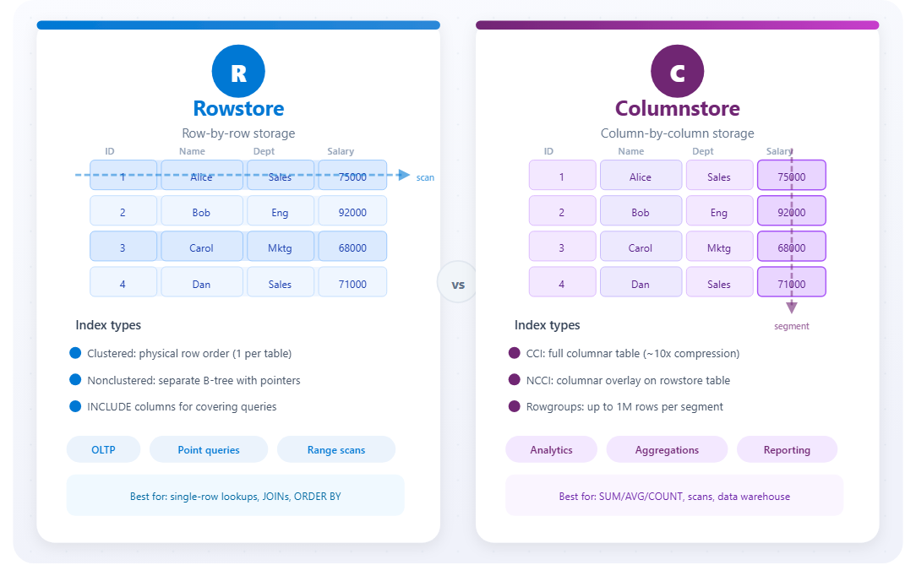
Design and implement indexes
Rowstore vs. columnstore
Clustered index:
  Best for range queries on identity or date keys
Nonclustered:
  Multiple per table; INCLUDE avoids expensive key lookups
Columnstore (CCI):
  Compressed rowgroups of up to 1M rows; use for fact tables and reporting
Nonclustered CS:
  Enables hybrid OLTP + analytics on one table
Trade-off:
  Faster reads vs. slower writes
Notes:
Indexes accelerate data retrieval but cost storage and write throughput. Without indexes, full table scans.
ROWSTORE INDEXES:
- Clustered: defines physical row order. Best for range queries, identity/date keys. One per table.
- Nonclustered: separate structure with pointers. INCLUDE columns avoid key lookups. Multiple per table.
COLUMNSTORE INDEXES:
- CCI (Clustered Columnstore): replaces rowstore entirely. Stores data column-by-column in compressed rowgroups (up to 1M rows). Great for analytics, aggregations.
- NCCI: columnar copy alongside rowstore for hybrid OLTP+analytics.
WHEN TO USE COLUMNSTORE: data warehouse fact tables, reporting DBs, historical data, tables with millions+ rows.
WHEN TO AVOID: small tables (<1M rows), high-frequency updates, single-row lookups.
Monitor health via sys.dm_db_column_store_row_group_physical_stats. Rebuild or reorganize to fix fragmentation.

Slide 7
Specialized table types
In-Memory
RAM
Lock-free
Temporal
History
AS OF query
External
Data lake
No import
Ledger
Crypto hash
Immutable
Graph
Node/Edge
MATCH
In-memory optimized - Best for 10K+ TPS workloads; trade-off is RAM capacity limits
Temporal tables - Compliance and auditing with AS OF queries; roughly doubles storage
External tables - Read-only with limited indexing; use for Parquet and CSV files
Ledger tables - Updatable or append-only; use for financial and supply chain audit trails
Graph tables - Ideal for social networks, org charts, and recommendation engines
Choose during design, it’s hard to change after deployment
Notes:
Five specialized table types beyond standard disk-based tables:
IN-MEMORY: MEMORY_OPTIMIZED = ON. Data in RAM, lock-free optimistic concurrency. Use for session state, real-time analytics, high-frequency OLTP (10K+ TPS), caching, ETL staging. Trade-off: limited by RAM, no VARCHAR(MAX).
TEMPORAL: SYSTEM_VERSIONING = ON. Automatic history table with SysStartTime/SysEndTime. FOR SYSTEM_TIME AS OF queries. Compliance, auditing, trend analysis, data recovery. Roughly doubles storage.
EXTERNAL: CREATE EXTERNAL TABLE with DATA_SOURCE. Query Parquet/CSV in data lakes without importing. Read-only, limited indexing.
LEDGER: LEDGER = ON. Cryptographic hashes link every modification. Updatable or APPEND_ONLY. Financial, supply chain, legal, healthcare.
GRAPH: AS NODE / AS EDGE. Hidden $node_id, $from_id, $to_id. MATCH syntax for relationship traversal. Best for connected data like social networks, org charts, recommendations.

Slide 8
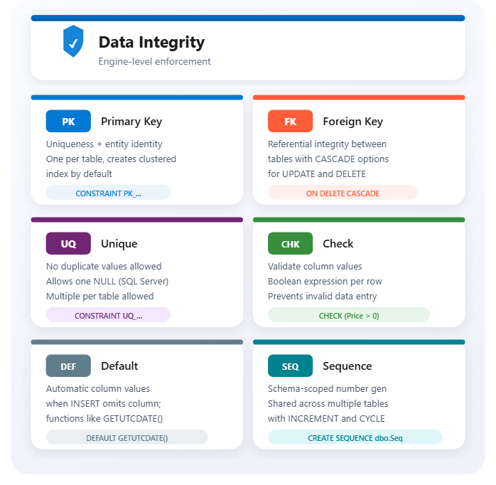
Constraints and sequence objects
Enforce data integrity at the engine level
PRIMARY KEY:
  Auto-creates clustered index; columns must be NOT NULL
FOREIGN KEY:
  Prevents orphaned records; always index FK columns for join performance
UNIQUE:
  Auto-creates nonclustered index; multiple UNIQUE constraints per table
CHECK:
  Boolean per row; beware that NULL evaluates to UNKNOWN, not FALSE
DEFAULT:
  Name explicitly (DF_Table_Column) for consistent database projects
SEQUENCE:
  Use instead of IDENTITY when cross-table numbering is needed
Notes:
Constraints enforce rules at the database engine level. They cannot be bypassed by app code, ad-hoc queries, or bulk imports.
PRIMARY KEY: guarantees unique identity. Automatically creates a unique index. One per table. Columns must be NOT NULL.
FOREIGN KEY: prevents orphaned records. Supports CASCADE, SET NULL, SET DEFAULT. Index FK columns for join performance.
UNIQUE: prevents duplicate values. Allows one NULL. Creates a unique nonclustered index automatically.
CHECK: validates domain rules. Logical expression returning TRUE/FALSE. NULL evaluates to UNKNOWN, not FALSE.
DEFAULT: provides values when none specified. Name explicitly (DF_Table_Column) for consistent DB projects.
SEQUENCE: independent number generator. Shared across tables, get value before INSERT, cycle/restart, reserve ranges. Use instead of IDENTITY when cross-table numbering is needed.

Slide 9
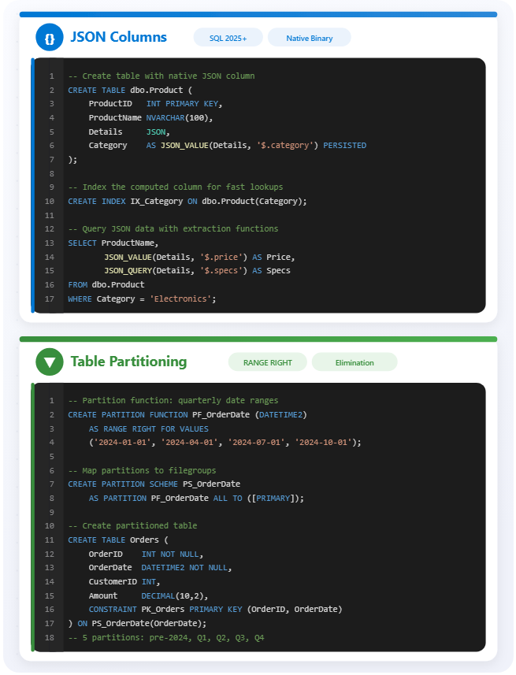
JSON columns and partitioning
Flexible data and large-table management
JSON data type:
  Use for user preferences, API responses, and multi-tenant custom fields
JSON_VALUE / JSON_QUERY:
  Add CHECK + JSON_PATH_EXISTS to enforce required JSON fields
Index computed columns:
  Native JSON type is more efficient to parse than NVARCHAR storage
Partition function:
  Choose the column filtered in 80%+ of queries
Partition scheme:
  Enables parallel processing and fast archival via partition switching
Partition elimination:
  Avoid partitioning small tables or those without a clear partition key
Notes:
JSON COLUMNS:
SQL Server 2025+ adds native json type (binary format, more efficient than NVARCHAR). Use for user preferences, API responses, audit logs, multi-tenant custom fields.
JSON_VALUE extracts scalars, JSON_QUERY returns objects. Index computed columns for frequent JSON path queries. CHECK constraints with JSON_PATH_EXISTS validate required fields.
PARTITIONING:
Divides large tables into smaller physical segments while appearing as one logical table.
PARTITION FUNCTION: defines boundary values (RANGE RIGHT for dates).
PARTITION SCHEME: maps partitions to filegroups.
Benefits: partition elimination (query only relevant partitions), parallel processing, granular index rebuilds, fast archival via partition switching (metadata only, seconds vs hours).
WHEN TO PARTITION: queries filter on one column 80%+ of time, regular archival needed, multi-TB tables, tiered storage.
AVOID: most queries scan full table, small tables, no clear partition key. Target millions of rows per partition.

Slide 10
Exercise: Create database objects
Hands-on lab
Build an e-commerce database schema in SQL Server 2025 with constrained tables, a temporal table for price history tracking, JSON-typed columns for flexible metadata, date-based table partitioning, and SEQUENCE-generated identifiers.
1
Create the EcommerceDB database
2
Create tables with constraints and indexes
3
Add a temporal table for price history
4
Add JSON columns with indexes
5
Partition a table by date
6
Use SEQUENCE for identifiers
7
Verify objects
Notes:
This lab uses SQL Server 2025 (not Azure SQL Database). Students build an EcommerceDB from scratch.
Key concepts to highlight: CHECK and UNIQUE constraints enforce data integrity at the table level. The temporal table (Products with history) uses system-versioned rows so students can query price changes over time with FOR SYSTEM_TIME. JSON columns use the new json data type with computed-column indexes for performant lookups.
Partitioning splits the Orders table by OrderDate across multiple filegroups using a partition function and scheme. The SEQUENCE object generates ProductIDs independently of any single table.
Estimated time: 45 minutes.

Slide 11
Knowledge check - Design and implement database objects
You need to create a table to store user profile data that changes over time. You want to maintain a full history of changes without creating a separate history table manually. Which table type should you implement?
a) In-memory optimized table
b) Temporal table
c) Graph table
You need to design a table that will store product information. The ProductID must uniquely identify each row, and the Category must not allow null values. Which constraints should you implement?
a) PRIMARY KEY on ProductID and DEFAULT on Category
b) UNIQUE constraint on ProductID and CHECK constraint on Category
c) PRIMARY KEY on ProductID and NOT NULL on Category
You have a large sales table with millions of rows. You want to improve query performance and maintenance by splitting the table data based on date ranges. Which feature should you implement?
a) Clustered index
b) JSON columns
c) Table partitioning
Notes:
Knowledge check. Use click-to-reveal to show answers one at a time.
Q1: Answer is (b). Correct. Temporal tables automatically maintain full history of changes without requiring manual history table management.
Q2: Answer is (c). Correct. PRIMARY KEY ensures uniqueness of ProductID, and NOT NULL ensures Category always has a value.
Q3: Answer is (c). Correct. Partitioning allows you to split large tables into smaller, manageable pieces based on specified ranges.

Slide 12

Summary - Design and implement database objects
What you learned
Database objects
Platform choices: Azure SQL DB, Managed Instance, Fabric
Table design: data types, column sizing, estimation
Indexes: rowstore for OLTP, columnstore for analytics
Specialized tables: temporal, ledger, graph, in-memory, external
Constraints: PK, FK, UNIQUE, CHECK, DEFAULT + sequences
JSON + partitioning: flexible schemas and large-table management
Notes:
Summary of what was covered:
1. Platform choices: Azure SQL Database (Hyperscale, serverless), Azure SQL Managed Instance (near 100% compatibility), SQL database in Fabric (OLTP + auto analytics), SQL Server on Azure VMs (full IaaS control).
2. Table design: choosing appropriate data types, right-sizing columns, estimating table size for storage planning.
3. Indexes: rowstore (clustered/nonclustered) for OLTP, columnstore (CCI/NCCI) for analytics and compression.
4. Specialized tables: in-memory for high-throughput, temporal for change history, external for data lakes, ledger for tamper-evident compliance, graph for relationships.
5. Constraints and sequences: PK, FK, UNIQUE, CHECK, DEFAULT enforce integrity at the engine level. SEQUENCE objects for cross-table number generation.
6. JSON columns for semi-structured data (native type in SQL 2025+). Partitioning for large tables: partition function, scheme, elimination, and fast archival via switching.

Slide 13
Implement programmability objects
Notes:
This module covers the core programmability objects in SQL Server: views, stored procedures, scalar functions, table-valued functions, and triggers. Each serves a distinct purpose for encapsulating logic, improving code reusability, and enforcing business rules within the database.
The scenario frames these concepts around a database developer at a growing e-commerce company who faces common problems: developers writing the same JOIN queries repeatedly, business logic scattered across application code, data modifications needing automatic validation and logging, and complex calculations appearing in multiple queries leading to inconsistencies. The programmability objects covered in this module address each of these challenges.

Slide 14
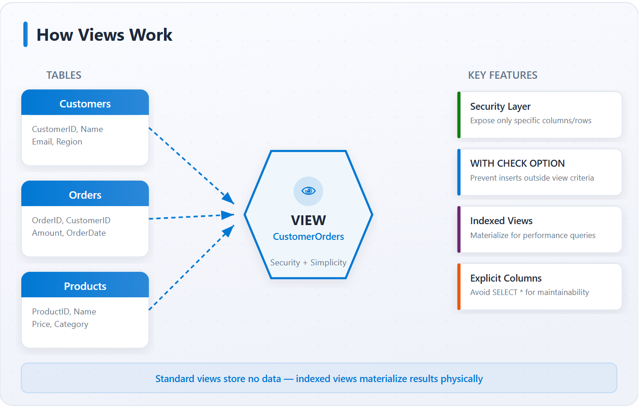
Create views
Virtual tables that simplify data access
Virtual table:
  SELECT query stored as a named object.
Security layer:
  Grant view access without exposing underlying table permissions.
WITH CHECK OPTION:
  Ensures modified rows stay visible through the view after update
Explicit columns:
  Schema changes to base tables won't silently break dependent queries
Indexed views:
  Physical storage adds write overhead; best for read-heavy, stable data
Notes:
A view is a virtual table based on a SELECT statement. Views do not store data themselves. They retrieve data from underlying tables each time you query them. This makes them ideal for hiding the complexity of JOIN clauses, calculations, and filters from application code.
Views also serve as a security layer. You can grant users access to specific columns through a view while restricting access to the underlying tables, exposing only the data users need without giving full table access.
Key design considerations from the unit:
- Specify column names explicitly instead of using SELECT * to make views more maintainable
- Use WITH CHECK OPTION when views handle data modifications, ensuring INSERT and UPDATE operations only affect rows visible in the view
- Keep view definitions focused on a specific purpose rather than building one complex view for multiple use cases
Views excel when you need to simplify complex queries used by multiple applications, restrict data access at the column or row level, or present data in different formats. For performance-critical queries that always return the same results, indexed views (materialized views) store the result set physically. When parameters are needed, user-defined functions provide more flexibility.

Slide 15
Create stored procedures
@P
TRY
✓
Parameters
Transactions & errors
Best practices
Input: @Param datatype [= default]
Output: @Result datatype OUTPUT
EXECUTE with named or positional args
Plan caching on first execution
BEGIN TRY / BEGIN CATCH blocks
BEGIN/COMMIT/ROLLBACK TRANSACTION
ERROR_MESSAGE(), ERROR_SEVERITY()
Check @@TRANCOUNT before ROLLBACK
Schema-qualify all object names
Validate parameters early (fail fast)
Avoid SELECT *, list columns
Never use sp_ prefix (reserved)
Notes:
Stored procedures are compiled collections of T-SQL statements that SQL Server stores and executes as a single unit. The execution plan is compiled on first execution and cached, reducing overhead for subsequent calls.
Parameters make stored procedures flexible and reusable. Input parameters accept values from the calling application, with optional default values. Output parameters return values back to the caller using the OUTPUT keyword. Robust stored procedures include TRY...CATCH error handling to manage unexpected conditions and maintain data integrity, checking @@TRANCOUNT before rolling back transactions in the CATCH block.
Best practices from the unit:
- Use schema-qualified names for all objects (dbo.Orders, not just Orders) to eliminate ambiguity and improve performance
- Implement parameter validation at the start and fail fast on invalid inputs
- Avoid SELECT * in production code; explicitly list columns
- Use meaningful names with verbs indicating the operation (Get, Insert, Update, Delete, Calculate)
- Do not use the sp_ prefix, which SQL Server reserves for system procedures in the master database. This adds unnecessary overhead as SQL Server searches master first
SET NOCOUNT ON prevents the "rows affected" message from being sent to the client, reducing network traffic especially when procedures execute multiple statements.

Slide 16
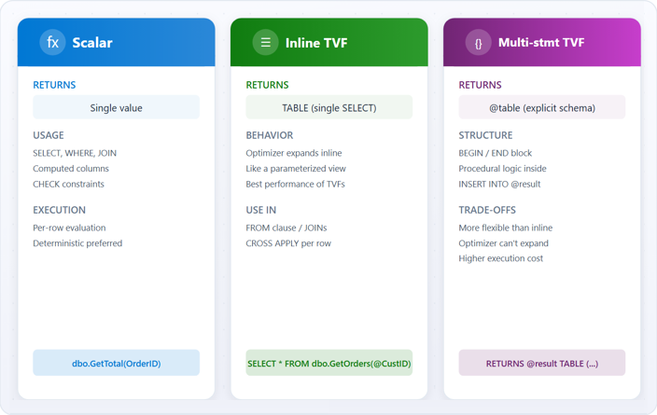
Create user-defined functions
Scalar functions and table-valued functions
Scalar:
  Per-row execution cost, avoid in WHERE clauses on large tables
Inline TVF:
  Best performance of all TVF types, optimizer inlines into the calling query plan
Multi-statement TVF:
  Optimizer treats as black box, use only when procedural logic is required
CROSS APPLY:
  Call TVF per row for correlated results
Best practice:
  Keep deterministic, avoid side effects
Notes:
This slide covers both scalar functions and table-valued functions (TVFs).
Scalar functions accept parameters and return a single value. They can be embedded directly in SELECT statements, WHERE clauses, and other T-SQL expressions. Key considerations: keep scalar functions deterministic when possible (same input always produces same output), avoid side effects (do not modify database state), and be mindful that scalar functions in WHERE clauses on large tables execute for every row, which can degrade performance.
Table-valued functions come in two types. Inline TVFs contain a single SELECT statement. The optimizer treats them like views with parameters, often producing better execution plans. Multi-statement TVFs use a BEGIN/END block and explicitly declare the returned table structure, giving more control for complex logic but with a performance trade-off since the optimizer treats them as "black boxes."
The CROSS APPLY operator is particularly useful with table-valued functions, allowing you to call the function for each row from another table, passing column values as parameters. This enables row-by-row processing within queries while keeping code readable and reusable.
ALTER FUNCTION lets you modify a function without dropping and recreating it, which preserves permissions and dependencies. Use DROP FUNCTION IF EXISTS in deployment scripts to prevent errors.

Slide 17
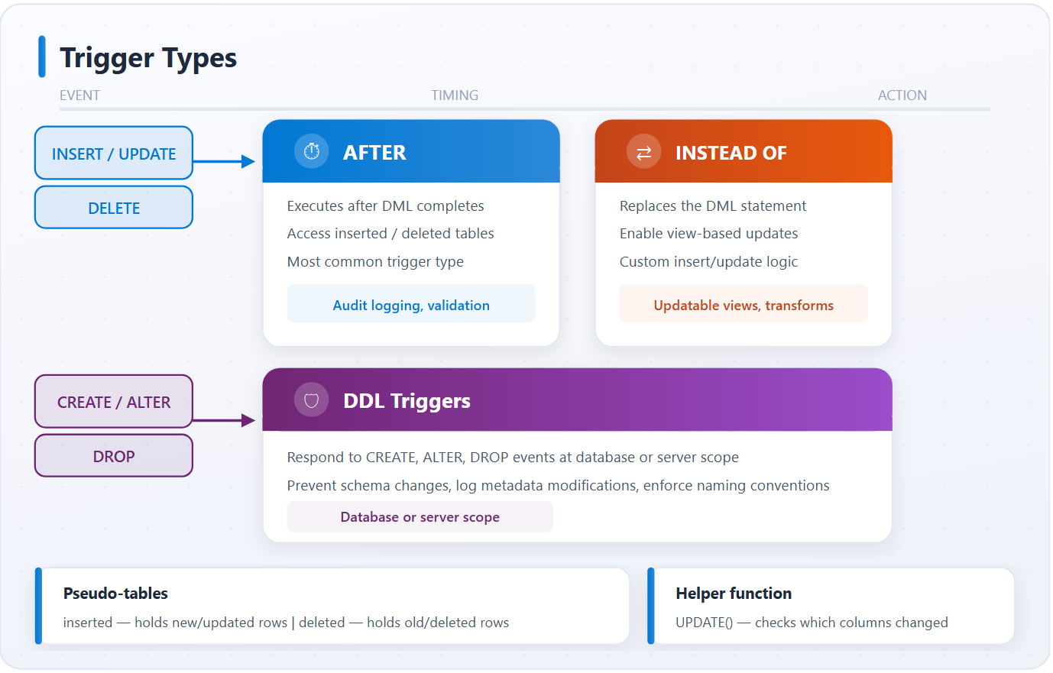
Create triggers
Notes:
Triggers are special stored procedures that execute automatically when specific events occur. DML triggers respond to INSERT, UPDATE, and DELETE operations on tables. DDL triggers respond to schema changes like CREATE, ALTER, or DROP statements.
DML triggers come in two types. AFTER triggers execute after the triggering statement completes. The database performs the modification first, then runs the trigger code. These are used for validation, updating related tables, or logging. INSTEAD OF triggers replace the original operation entirely. They are useful for modifying views that would not normally accept direct modifications.
The inserted and deleted pseudo-tables are central to trigger logic. INSERT operations populate the inserted table, DELETE operations populate the deleted table, and UPDATE operations populate both (old values in deleted, new values in inserted). The UPDATE() function helps determine which specific columns changed, allowing you to avoid unnecessary processing.
Best practices from the unit:
- Keep trigger logic focused and minimal to reduce impact on transaction throughput
- Avoid recursive operations where a trigger modification causes the same trigger to fire again
- Handle errors properly. If a trigger encounters an unhandled error, SQL Server rolls back both the trigger and the original statement
- Document triggers thoroughly, since they execute invisibly during normal database operations
- For complex or time-consuming operations, consider logging event details in the trigger and processing them asynchronously

Slide 18
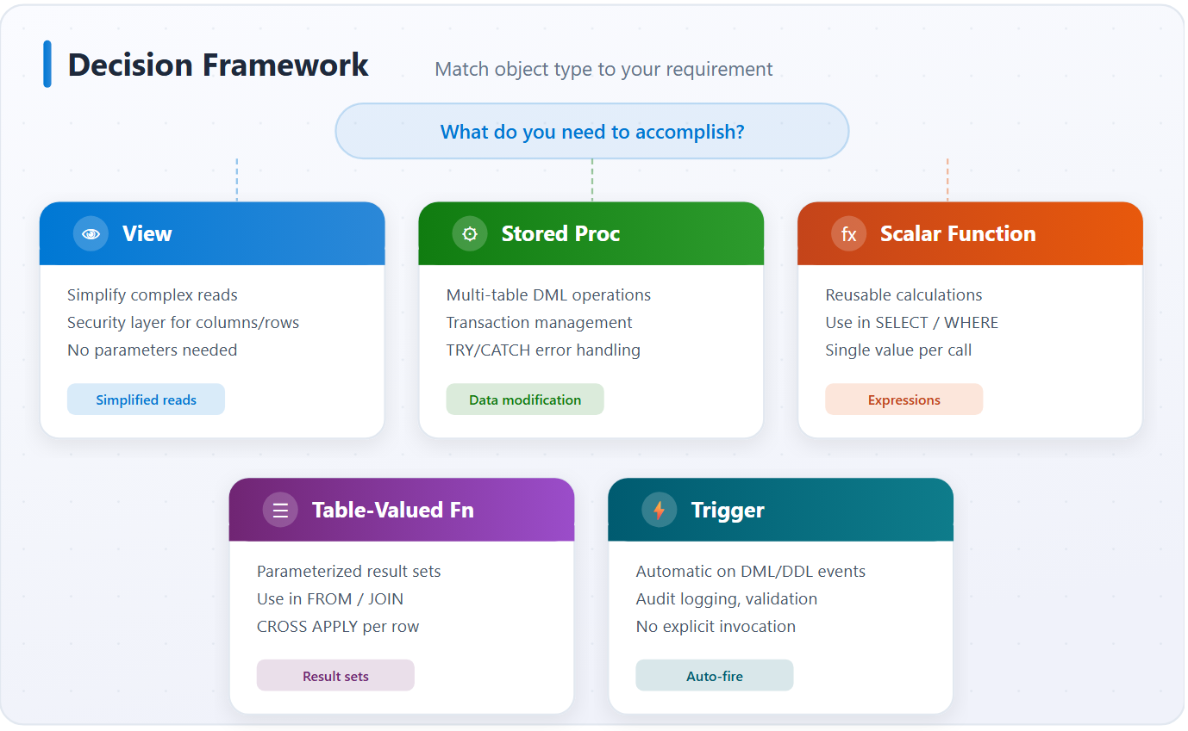
Choose the right object
Decision framework for programmability objects
View:
  No transaction control, limited data modification, avoid deeply nested views
Stored procedure:
  Cached execution plans, output params, return codes for flow control
Scalar function:
  No data modification allowed, watch per-row cost on large tables
Table-valued function:
  Prefer inline TVF over multi-statement for optimizer compatibility
Trigger:
  Runs inside the firing transaction, keep lightweight; prefer stored procs for complex logic
Notes:
This slide presents a decision framework for selecting the appropriate programmability object. The unit includes a comparison table of capabilities:
- Views: no parameters, limited data modification, usable in SELECT/JOIN, no transaction control, no automatic execution
- Stored procedures: accept parameters, full data modification, return result sets, transaction control, execution plan caching
- Functions: accept parameters, no data modification, usable in SELECT/JOIN (TVFs), no transaction control
- Triggers: no parameters, can modify data, automatic execution, transaction control, execution plan caching
Decision guidance:
- Views: simplify complex joins, provide security layers, create stable interfaces, present data without parameters
- Stored procedures: complex business logic with multiple statements, multi-table data modifications in a single transaction, error handling and transaction control
- Functions: reusable calculations returning values for use in queries, parameterized result sets (TVFs), embed logic in SELECT/WHERE/JOIN clauses
- Triggers: automatic responses to data modification events, enforcing complex rules beyond constraints, audit logs, synchronize related data
Common pitfalls to avoid: using scalar functions in WHERE clauses on large tables (executes per row), creating triggers for logic that stored procedures handle better, building deeply nested views, and choosing stored procedures when a function would integrate more cleanly into a SELECT statement.

Slide 19
Exercise: Implement
programmability objects
Hands-on lab
Create core programmability objects in AdventureWorksLT: a view simplifying multi-table joins, a transactional stored procedure with validation, a scalar function for calculations, an inline table-valued function for parameterized queries, and a trigger for automatic audit logging.
1
Create a view for customers and orders
2
Create a stored procedure for order items
3
Create a scalar function for totals
4
Create a table-valued function
5
Create a trigger for audit logging
Notes:
Uses AdventureWorksLT on a local SQL Server instance.
The view (vwCustomerOrders) joins SalesLT.Customer, SalesOrderHeader, and SalesOrderDetail to simplify reporting queries. The stored procedure (spInsertOrderDetail) wraps an INSERT inside BEGIN TRY/BEGIN CATCH with explicit transactions and validates that the referenced SalesOrderID exists before inserting.
The scalar function computes line-item totals (quantity x unit price minus discount). The inline TVF returns a parameterized result set (orders by customer) that the optimizer can inline like a view. The AFTER INSERT trigger on SalesOrderDetail writes to an AuditLog table automatically.
Emphasize the difference between scalar UDFs (row-by-row) and inline TVFs (set-based).
Estimated time: 30 minutes.

Slide 20
Knowledge check - Implement programmability objects
Which programmability object should you use when you need to simplify a complex query that joins multiple tables and expose only specific columns to users?
a) Stored procedure
b) View
c) Trigger
What is a key advantage of using stored procedures over embedding T-SQL directly in application code?
a) Stored procedures automatically create indexed views
b) Stored procedures are precompiled and can include transaction management and error handling
c) Stored procedures can only be executed by database administrators
When should you choose a table-valued function over a scalar function?
a) When you need to return a single calculated value
b) When you need to modify data in the database
c) When you need to return a result set that can be used in a FROM clause
Notes:
Four knowledge check questions for this module:
Q1: Which object should you use to simplify a complex multi-table join and expose only specific columns to users? Answer: (b) View. Views act as virtual tables that encapsulate SELECT queries, ideal for simplifying complex joins and controlling column access. Stored procedures are better for data modification or procedural logic. Triggers respond to data modifications. Scalar functions return single values, not result sets.
Q2: What is a key advantage of stored procedures over embedding T-SQL directly in application code? Answer: (b) Stored procedures are precompiled and can include transaction management and error handling. They support BEGIN TRANSACTION/COMMIT/ROLLBACK and TRY...CATCH. They do not automatically create indexed views or encrypt data, and they can be granted EXECUTE permissions to any user, not just administrators.
Q3: When should you choose a table-valued function over a scalar function? Answer: (c) When you need to return a result set that can be used in a FROM clause. TVFs return result sets joinable with other tables. Scalar functions return single values. Neither type can modify data. Triggers handle automatic execution on data changes.
Q4: Which type of trigger executes automatically on INSERT, UPDATE, or DELETE? Answer: (c) DML trigger. DML triggers fire in response to data manipulation operations. DDL triggers respond to schema changes (CREATE, ALTER, DROP). Logon triggers fire when user sessions are established. "Schema trigger" is not a standard SQL Server trigger type.

Slide 21
Summary - Implement programmability objects
What you learned
Programmability objects
Views: virtual tables for simplified reads and security boundaries
Stored procedures: compiled T-SQL with params, transactions, error handling
Scalar functions: single-value calculations embedded in expressions
Table-valued functions: inline or multi-stmt, used in FROM/CROSS APPLY
Triggers: DML and DDL - automatic audit, validation, sync
Decision: match object type to requirement: reads, DML, calculation, auto-fire
Notes:
This module covered SQL Server programmability objects and how to use them effectively in database solutions.
Key takeaways:
- Views simplify data access, hide complexity, and provide security boundaries by exposing only specific columns or rows
- Stored procedures encapsulate complex business logic with transactions, error handling, and reusable data modification operations
- Scalar functions create reusable calculations returning single values for more readable and consistent queries
- Table-valued functions (inline and multi-statement) return result sets usable in FROM clauses like tables
- Triggers automatically respond to DML operations (INSERT, UPDATE, DELETE) or DDL events for audit logging, validation, and business rule enforcement
- Choosing the right object depends on whether you need to modify data, return single values or result sets, accept parameters, or respond automatically to database events
The module recommends considering implementing views in existing databases to simplify complex queries, converting repetitive application logic into stored procedures, creating functions to standardize calculations, and adding audit triggers to track changes in critical tables.

Slide 22
Write advanced SQL code
Notes:
This module covers advanced T-SQL techniques for SQL Server, Azure SQL Database, and SQL databases in Microsoft Fabric. The focus is on capabilities that let you solve complex analytical and data processing challenges directly in the database engine rather than pulling data into application code.
The learning objectives include writing CTEs for complex queries and hierarchical traversal, applying window functions for ranking and analytical calculations, using JSON functions to parse and construct JSON data, implementing regular expressions and fuzzy string matching, querying graph structures with the MATCH operator, writing correlated subqueries for row-by-row comparisons, and building structured error handling with TRY...CATCH and proper transaction management.

Slide 23
Common Table Expressions (CTEs)
How Recursion Works
1 Anchor Query
Runs ONCE to seed recursion
→ CEO - Level 0 => 1 row
The Query
The Org chart graph
-- Example of a recursive CTE that returns
-- all employees and their managers
WITH OrgChart AS (
-- Anchor: find the root
SELECT EmployeeID, Name,
ManagerID, 0 AS Level
FROM Employees
WHERE ManagerID IS NULL
UNION ALL
-- Recursive member
SELECT e.EmployeeID, e.Name,
e.ManagerID, o.Level + 1
FROM Employees e
JOIN OrgChart o
ON e.ManagerID = o.EmployeeID
)
SELECT * FROM OrgChart;
CEO
Level 0
2 Recursive Pass 1
JOIN on anchor output
→ VP Eng, VP Mkt, VP Sales
Level 1 => 3 rows
L0
VP Eng
Level 1
VP Mkt
Level 1
VP Sales
Level 1
3 Recursive Pass 2
JOIN on Pass 1 output
→ Dev Lead, QA Lead
Level 2 => 2 rows
L1
Dev Lead
Level 2
QA Lead
Level 2
4 Pass 3: 0 rows → STOP
UNION ALL merges
Final results => all 6 rows
L2
WITH clause: names temporary result set
Nonrecursive: simplify complex joins, multi-step calculations
Multiple CTEs: later CTEs reference earlier ones
Recursive: anchor + UNION ALL + recursive member
Hierarchy traversal: org charts, bill-of-materials
Sequence generation: date ranges, numbers tables
Notes:
A CTE is a temporary named result set defined with the WITH clause that exists only during a single query. CTEs provide improved readability by breaking complex logic into named sections, self-referencing capability for recursive traversal, the ability to reference the same CTE multiple times in the outer query, and a modular approach to building queries incrementally.
Nonrecursive CTEs define straightforward result sets and are useful for simplifying complex joins or multi-step calculations. You can define multiple CTEs in a single WITH clause separated by commas, where later CTEs can reference earlier ones for progressive data transformation.
Recursive CTEs reference themselves to process hierarchical data. They consist of two parts: an anchor member (the starting point) and a recursive member that references the CTE to build on previous results, joined by UNION ALL. A classic use case is traversing an organizational hierarchy where each employee has a manager. SQL Server limits recursion to 100 levels by default. Use OPTION (MAXRECURSION n) to change this, and be aware that infinite loops are possible if the termination condition is never met.
Recursive CTEs also excel at generating sequences of numbers or dates without requiring a physical numbers table. This is useful for creating date ranges, filling gaps in data, or building calendar reports.
CTEs work with INSERT, UPDATE, and DELETE statements, not just SELECT. This is useful when modification logic requires complex filtering or calculations. The CTE identifies the target rows, and the DML statement operates on the CTE result.

Slide 24
Window functions
-- Rolling 3-row sum of Amount, ordered by RowID
SELECT
RowID, Amount,
SUM(Amount) OVER(
ORDER BY RowID
ROWS BETWEEN 2 PRECEDING AND CURRENT ROW
) AS FrameSum
FROM Sales;
OVER(PARTITION BY · ORDER BY · ROWS/RANGE)
Ranking: assign position to rows
  ROW_NUMBER, RANK, DENSE_RANK, NTILE
Frames: define rows to include
  ROWS BETWEEN n PRECEDING AND CURRENT ROW
Aggregates: running totals over sets
  SUM, AVG, COUNT, MIN, MAX with OVER
Analytical: access other rows by offset
  LAG, LEAD, FIRST_VALUE, LAST_VALUE
Per-group: restart per partition
  PARTITION BY restarts calculations per group
RowID | Amount | FrameSum | Frame window (what the engine sums)
1 | $120 | $120 | SUM( 120 )
2 | $85 | $205 | SUM( 120 + 85 )
3 | $200 | $405 | SUM( 120 + 85 + 200 )
4 | $150 | $435 | SUM( 85 + 200 + 150 )
5 | $45 | $395 | SUM( 200 + 150 + 45 )
6 | $310 | $505 | SUM( 150 + 45 + 310 )
7 | $175 | $530 | SUM( 45 + 310 + 175 )
↑ Frame slides down 1 row at a time - always 3 rows max
Notes:
Window functions perform calculations across a set of rows related to the current row without collapsing the result set. The OVER clause defines the window with three components: PARTITION BY (divides rows into groups), ORDER BY (determines row order within each partition), and ROWS/RANGE (defines frame boundaries relative to the current row).
Four ranking functions, each handling ties differently:
- ROW_NUMBER(): unique sequential number, no duplicates even for tied values
- RANK(): same rank for ties, then skips numbers (1, 1, 3)
- DENSE_RANK(): same rank for ties, no gaps (1, 1, 2) and counts distinct value levels
- NTILE(n): distributes rows into n roughly equal groups, useful for percentile analysis
Use ROW_NUMBER() when you need exactly one row per rank (top N per group). Use RANK() or DENSE_RANK() when tie information matters for reporting. Combine PARTITION BY with ranking functions for per-group rankings.
Standard aggregates (SUM, AVG, COUNT, MIN, MAX) become window functions when you add the OVER clause. Without ORDER BY in OVER, the aggregate covers the entire partition. Adding ORDER BY creates a running calculation from partition start to the current row. Window frames (ROWS BETWEEN) let you specify exactly which rows to include. For example, ROWS BETWEEN 2 PRECEDING AND CURRENT ROW creates a 3-row moving average.
Analytical functions access data from other rows without self-joins: LAG() and LEAD() retrieve values from previous or subsequent rows (useful for period-over-period changes). FIRST_VALUE() and LAST_VALUE() return values from the first or last row in the frame. Note that LAST_VALUE() requires an explicit frame specification. PERCENT_RANK() and CUME_DIST() calculate relative position within a partition for percentile analysis.

Slide 25
JSON functions
Parse, construct, and transform JSON in T-SQL
JSON_VALUE
Extract scalar values with path expressions
Extract objects or arrays (preserves structure)
Parse JSON array → relational rows with WITH schema
Construct JSON from key-value pairs
Aggregate rows into JSON array for nested output
Transforms relational query results into JSON output
Relational
Tables · Rows
Columns · Types
JSON_OBJECT · FOR JSON
JSON
Objects · Arrays
$.path expressions
JSON_QUERY
OPENJSON
OPENJSON · JSON_VALUE
JSON_OBJECT
JSON_ARRAYAGG
FOR JSON PATH
Notes:
SQL Server, Azure SQL, and SQL databases in Fabric provide built-in JSON support for parsing, querying, creating, and transforming JSON data directly in T-SQL.
Extracting values: JSON_VALUE() extracts scalar values (string, number, boolean) as NVARCHAR(4000) using path expressions with dot notation. JSON_QUERY() extracts JSON objects or arrays, preserving the JSON structure. Array elements are accessed with bracket notation (zero-based indexing).
Parsing arrays: OPENJSON is a table-valued function that transforms JSON into relational rows. Without a schema, it returns key, value, and type columns. With a WITH clause, it maps JSON properties to typed columns. Combine OPENJSON with CROSS APPLY to join JSON column data with relational table rows. Use OUTER APPLY if you need to include rows with NULL or empty JSON.
Constructing JSON (SQL Server 2022+): JSON_OBJECT() creates JSON objects from key-value pairs with automatic type conversion and escaping. JSON_ARRAY() creates JSON arrays from values. Nest these functions to build hierarchical structures. JSON_ARRAYAGG aggregates values from multiple rows into a single JSON array. Combine it with JSON_OBJECT to create arrays of complex objects from grouped relational data.
Validation and checking: ISJSON validates well-formed JSON (use in WHERE clauses to filter). JSON_PATH_EXISTS checks whether a specific path exists. JSON_CONTAINS checks if a JSON document contains a specific value. Lax mode (default) returns NULL for missing paths; strict mode raises an error.
Performance optimization: For frequently queried JSON properties, create computed columns that extract JSON values, then index those columns. This avoids re-parsing JSON on every query. Persisted computed columns store the extracted value on disk so JSON is parsed only during INSERT and UPDATE, not SELECT.
FOR JSON PATH transforms relational query results into JSON output. Use dot notation in column aliases to create nested objects in the output.

Slide 26
Regular expressions & fuzzy matching
Regex functions
Fuzzy matching
Use cases
REGEXP_LIKE: filter rows by pattern
REGEXP_REPLACE: clean/standardize text
REGEXP_SUBSTR: extract matched substrings
REGEXP_COUNT + REGEXP_INSTR
REGEXP_SPLIT_TO_TABLE: split to rows
EDIT_DISTANCE: Levenshtein distance
EDIT_DISTANCE_SIMILARITY: 0-100 score
JARO_WINKLER_DISTANCE: name matching
Prefix-weighted: better for short names
Pre-filter with LIKE before fuzzy
Email/phone validation with regex
Duplicate detection with fuzzy scores
Data cleansing: standardize formats
Typo-tolerant search (Jon ≈ John)
Performance: pre-filter, then match
Notes:
Regular expressions (SQL Server 2025 and SQL databases in Fabric) provide complex pattern matching beyond what LIKE can handle. They use ECMAScript standard syntax (same as JavaScript), making patterns portable across technologies.
Key regex functions:
- REGEXP_LIKE: returns 1 or 0 for pattern match. Use it in WHERE clauses for filtering and validation. Supports a flags parameter ('i' for case-insensitive).
- REGEXP_REPLACE: finds pattern occurrences and replaces them, which is useful for data cleansing and standardization. Supports capture groups with backreferences ($1, $2) for restructuring text.
- REGEXP_SUBSTR: extracts the portion of a string matching a pattern, with parameters for occurrence and capture groups.
- REGEXP_INSTR: returns the starting position of a pattern match (0 if not found).
- REGEXP_COUNT: counts how many times a pattern appears in a string.
- REGEXP_SPLIT_TO_TABLE: table-valued function that splits a string into rows based on a delimiter pattern. Combine it with CROSS APPLY for splitting column values.
- REGEXP_MATCHES: table-valued function returning all pattern matches as separate rows.
Fuzzy string matching finds records that are similar but not identical. This is useful for duplicate detection, misspelled names, and flexible search.
Three primary functions:
- EDIT_DISTANCE (Levenshtein distance): counts minimum single-character operations (insert, delete, substitute) to transform one string into another. Lower values mean more similar. For short strings (5-10 chars), distance of 1-2 indicates similarity.
- EDIT_DISTANCE_SIMILARITY: normalized similarity score 0-100 (100 = identical). Easier to interpret than raw edit distance, especially for strings of different lengths. Use a threshold (70+) for approximate matching.
- JARO_WINKLER_DISTANCE: specifically designed for name comparison, gives higher scores to strings matching from the beginning. Returns 0-1 where scores above 0.9 typically indicate strong matches for names. Better for short strings like names; use EDIT_DISTANCE_SIMILARITY for longer strings.
Performance: fuzzy matching is computationally expensive. Always pre-filter with indexed columns (LIKE 'Jo%') before applying fuzzy functions to reduce the candidate set.

Slide 27
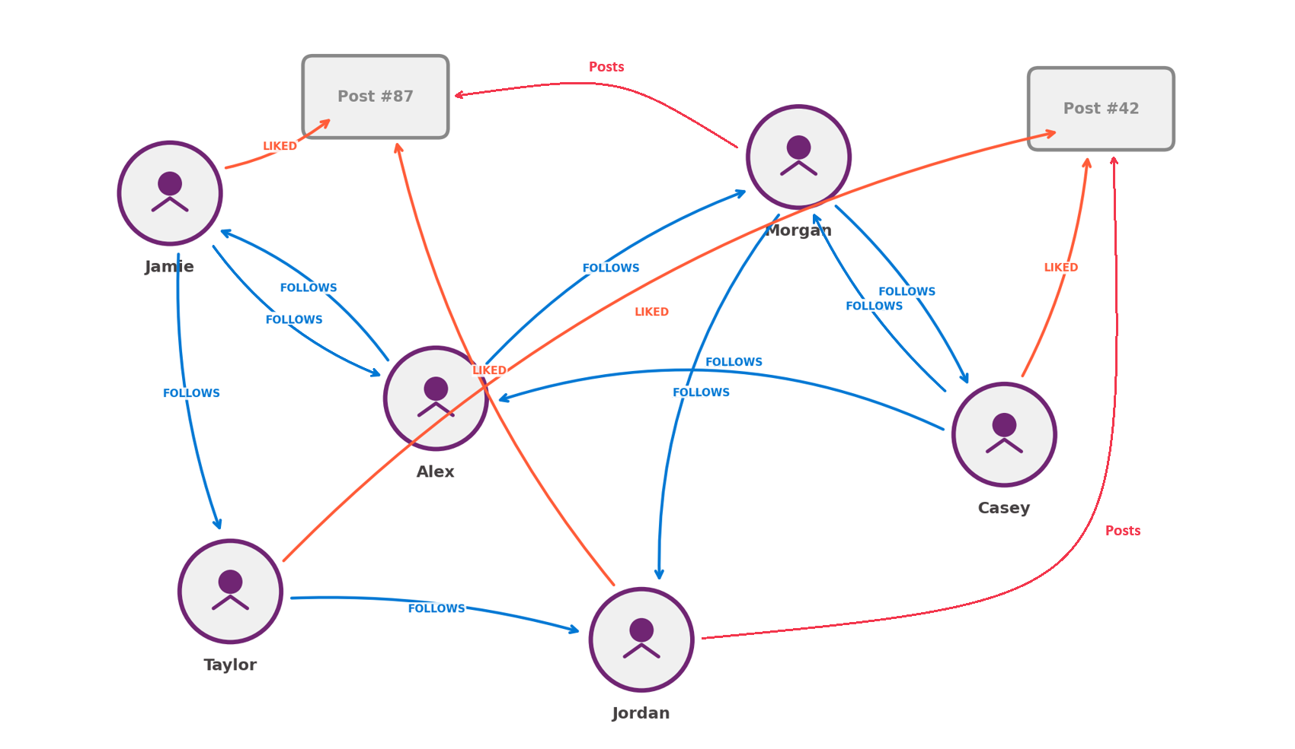
Graph queries & correlated subqueries
MATCH traversal · EXISTS ·
Per-row calculations
Node tables:
CREATE TABLE Person AS NODE
→ Each person gets a $node_id
Edge tables:
CREATE TABLE Follows AS EDGE
→ Links $from_id → $to_id
Use cases:
• Social networks: who follows whom
• Fraud: multi-hop transaction chains
• Recommendation: friends-of-friends
Legend:
Person (node)
FOLLOWS (edge)
Content (node)
-- Posts liked by friends-of-friends of Alex
SELECT DISTINCT p.Title FROM Person AS alex,
Follows, Person AS friend, Follows AS f2,
Person AS fof, Liked, Post AS p
MATCH(alex-(Follows)->friend-(f2)->fof-(Liked)->p)
WHERE alex.Name = 'Alex';
LIKED (edge)
Posts (edge)
Notes:
Graph queries model data as nodes (entities) and edges (relationships). SQL Server extends the relational model with dedicated node and edge tables using AS NODE and AS EDGE syntax. The key advantage is pattern matching with the MATCH operator. Instead of writing complex multi-way joins, you express the pattern you are looking for using ASCII-style arrow syntax.
Node tables store entities (CREATE TABLE ... AS NODE). SQL Server automatically adds a $node_id column. Edge tables store relationships (CREATE TABLE ... AS EDGE) with automatic $edge_id, $from_id, and $to_id columns. Edges can also store properties about the relationship itself (dates, weights, types).
The MATCH clause uses arrow syntax to show relationship direction: Node1-(Edge)->Node2. Arrow direction must match how edges were inserted. Multi-hop traversals chain multiple edge patterns in a single MATCH to follow paths through several relationships, answering questions like "what products did my colleagues purchase?" SHORTEST_PATH handles variable-length traversals with quantifiers like {1,3} for one to three hops.
Use graph queries when relationships are the primary focus, you need variable-depth traversal, or the data naturally forms a network. Use relational queries when relationships are simple and fixed-depth, or you are primarily filtering and aggregating entity attributes.
Correlated subqueries reference columns from the outer query, executing once for each outer row, similar to a nested loop. They enable row-by-row comparisons that regular subqueries cannot express (for example, finding products priced above their own category's average).
Key correlated patterns: filtering with WHERE (compare each row against its group's aggregate), EXISTS/NOT EXISTS (test for presence or absence, which is more efficient than IN because the engine stops at the first match), calculated columns in SELECT (include per-row aggregates without GROUP BY), top-N per group (find top items within each category), and consecutive row comparisons (access previous/next row values, though LAG/LEAD window functions are typically more efficient for this).

Slide 28
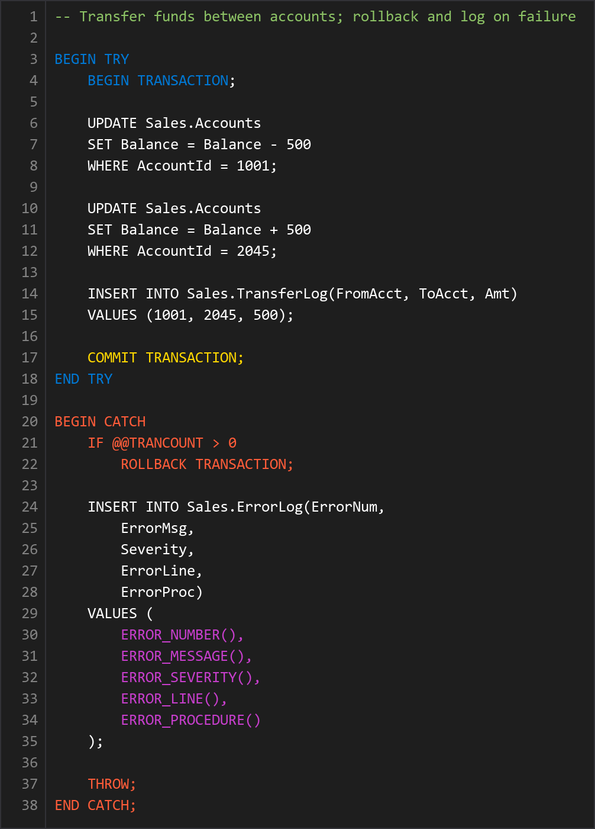
Error handling
TRY...CATCH · THROW · transaction safety
TRY...CATCH:
  Structured error handling; on error, execution jumps to CATCH
Transactions:
  IF @@TRANCOUNT > 0 ROLLBACK; always check first
ERROR functions:
  ERROR_NUMBER, MESSAGE, SEVERITY, STATE, LINE, PROCEDURE
THROW:
  Re-raise current error or raise custom errors (50000+)
XACT_ABORT:
  Auto-rollback on any error; combine with TRY...CATCH
Notes:
Production database code must handle errors gracefully. Unhandled errors can leave data in an inconsistent state with some rows inserted and others not, or with locks held indefinitely.
TRY...CATCH blocks provide structured error handling similar to other programming languages. When an error occurs in the TRY block, execution transfers to the CATCH block. Note that TRY...CATCH cannot catch compilation errors (syntax, missing objects) or errors with severity 20+ that close the connection.
Error information functions in the CATCH block: ERROR_NUMBER(), ERROR_MESSAGE(), ERROR_SEVERITY(), ERROR_STATE(), ERROR_LINE(), ERROR_PROCEDURE(). Always log errors before reraising them. Once you use THROW, the error functions return NULL if called again.
Transaction handling: when errors occur within transactions, you must explicitly roll back. Always check @@TRANCOUNT > 0 before calling ROLLBACK TRANSACTION in the CATCH block. Some errors auto-rollback before reaching CATCH, and rolling back without an active transaction causes another error.
THROW raises custom exceptions (error numbers 50000+) and reraises the current error when called without parameters. RAISERROR provides printf-style parameter substitution for formatted messages. THROW is recommended for new code because it is simpler and always includes a stack trace.
Nested error handling: inner procedures should reraise with THROW and let the outer procedure handle rollback, keeping transaction management in one place.
SET XACT_ABORT ON causes automatic rollback on any error. Combine it with TRY...CATCH for the best of both approaches. XACT_ABORT guarantees immediate rollback while TRY...CATCH lets you log error details and perform custom cleanup. This is a best practice for stored procedures that span multiple operations.

Slide 29
Exercise: Write advanced SQL code
Hands-on lab
Practice JSON functions and advanced T-SQL with AdventureWorksLT. Build JSON output with FOR JSON PATH, create nested structures with JSON_OBJECT, rank products using CTEs with window functions, and parse JSON arrays into rows with OPENJSON.
1
Build JSON output with FOR JSON PATH
2
Create nested JSON with JSON_OBJECT
3
Rank products with CTE and ROW_NUMBER
4
Output results as JSON with ROOT
5
Parse JSON arrays with OPENJSON
Notes:
Also uses AdventureWorksLT locally.
FOR JSON PATH converts relational rows into JSON arrays with nested dot-path column aliases. JSON_OBJECT (new syntax) builds JSON inline without the FOR JSON clause, useful for single-row construction.
The CTE with ROW_NUMBER() demonstrates window functions for ranking products by price within each category. FOR JSON PATH with ROOT('Products') wraps the output in a named root element.
OPENJSON with an explicit schema (WITH clause) shreds a JSON array into typed relational columns. Point out that OPENJSON without a schema returns key/value/type rows, while WITH returns strongly-typed columns.
Estimated time: 30 minutes.

Slide 30
Knowledge check - Write advanced SQL code
You need to write a query that calculates a running total of sales ordered by date, while still showing individual order details. Which T-SQL approach should you use?
a) A correlated subquery that sums all orders with a date less than or equal to the current row's date
b) A recursive CTE that accumulates totals by iterating through each date
c) An aggregate function with `OVER (ORDER BY)` clause to create a window function
You're building a JSON response from relational data and need to include an array of related order items for each customer. Which combination of functions creates nested JSON with arrays from grouped rows?
a) `FOR JSON PATH` with nested subqueries
b) `JSON_OBJECT` combined with `JSON_ARRAYAGG` to aggregate rows into arrays
c) `OPENJSON` with a `WITH` clause to define the output schema
You need to find customer records where names might be misspelled, such as finding 'John Smith' when the database contains 'Jon Smyth'. Which approach provides the best results for name matching?
a) Use `LIKE` with wildcards such as `WHERE Name LIKE '%ohn%'`
b) Use `SOUNDEX` to compare phonetic representations
c) Use `JARO_WINKLER_DISTANCE` which is optimized for name comparison and considers prefix matching
Notes:
Five knowledge check questions for this module:
Q1: Which approach should you use for a running total of sales by date while showing individual order details? Answer: (c) An aggregate function with OVER (ORDER BY) clause to create a window function. SUM(...) OVER (ORDER BY date) efficiently calculates running totals while preserving row details. Correlated subqueries would work but execute per row and are slower. Recursive CTEs and self-joins are unnecessarily complex for running totals.
Q2: Which combination of functions creates nested JSON with arrays from grouped rows? Answer: (b) JSON_OBJECT combined with JSON_ARRAYAGG to aggregate rows into arrays. JSON_OBJECT creates JSON objects from key-value pairs and JSON_ARRAYAGG aggregates multiple rows into a JSON array. FOR JSON PATH does not directly aggregate rows into arrays. OPENJSON parses existing JSON into rows (the opposite direction).
Q3: Which approach best finds customer records where names might be misspelled? Answer: (c) JARO_WINKLER_DISTANCE, which is optimized for name comparison and considers prefix matching. It gives higher scores to strings matching from the beginning and handles common typos well. LIKE cannot handle character substitutions or transpositions. SOUNDEX has limited phonetics and too many false positives. Regex patterns for all possible misspellings are impractical.
Q4: What is the correct pattern for a stored procedure that updates multiple tables within a transaction when an error occurs? Answer: (b) TRY...CATCH with IF @@TRANCOUNT > 0 ROLLBACK in the CATCH block, then reraise with THROW. This ensures cleanup, allows error logging, and propagates the error to callers. Checking @@TRANCOUNT prevents errors when no transaction is active. XACT_ABORT alone does not allow error logging. Checking @@ERROR after each statement is unreliable since it resets.
Q5: Which approach best handles variable-depth hierarchical traversal? Answer: (b) A recursive CTE. The anchor member starts at the root and the recursive member joins to find the next level, continuing until no more matches are found. Multiple self-joins require knowing the maximum depth. Window functions cannot traverse relationships. Single correlated subqueries can only look one level up or down.

Slide 31
Summary - Write advanced SQL code
What you learned
Write advanced SQL code
CTEs: WITH clause for readable queries; recursive for hierarchies
Window functions: OVER clause for ranking, running totals, analytics
JSON: JSON_VALUE, OPENJSON, JSON_OBJECT, JSON_ARRAYAGG
Text processing: regex (REGEXP_LIKE) + fuzzy (JARO_WINKLER_DISTANCE)
Graph + patterns: MATCH traversal, correlated subqueries, TRY...CATCH
Notes:
This module covered advanced T-SQL techniques for writing more expressive, efficient, and maintainable database code.
Key takeaways:
- Recursive CTEs are the standard approach for traversing hierarchical data. Nonrecursive CTEs improve readability for complex multi-step queries. Both types work with INSERT, UPDATE, and DELETE, not just SELECT.
- Window functions with OVER clauses enable running totals, rankings, moving averages, and analytical calculations without collapsing rows. Use ROW_NUMBER() for top-N per group. LAG/LEAD access previous/next row values for trend analysis.
- JSON_OBJECT, JSON_ARRAY, and JSON_ARRAYAGG construct JSON from relational data. OPENJSON parses JSON into relational rows. Index computed columns on frequently queried JSON properties for performance.
- Regular expressions provide complex pattern matching beyond LIKE and are available in SQL Server 2025 and Fabric. REGEXP_LIKE for filtering, REGEXP_REPLACE for cleansing, REGEXP_SPLIT_TO_TABLE for splitting strings.
- JARO_WINKLER_DISTANCE is optimized for name matching. EDIT_DISTANCE_SIMILARITY works better for longer strings. Always pre-filter before applying fuzzy functions.
- Graph tables with MATCH syntax handle network-style data naturally. Use SHORTEST_PATH for variable-length traversals.
- Correlated subqueries enable row-by-row comparisons. EXISTS is more efficient than IN for existence checks.
- Always check @@TRANCOUNT before ROLLBACK in CATCH blocks. Combine SET XACT_ABORT ON with TRY...CATCH for the most robust transaction protection.

Slide 32
Design and implement SQL solutions using AI-assisted tools
Notes:
This module covers AI-assisted development tools for database professionals working with SQL Server, Azure SQL, and Microsoft Fabric. The scenario: a database developer working on a complex enterprise application who needs to write dozens of stored procedures, optimize query performance, and ensure code follows team standards. Traditionally this means hours of boilerplate code, searching documentation, and reviewing query plans. AI-assisted tools change that workflow.
GitHub Copilot and Fabric Copilot are AI assistants that understand database context and help write T-SQL faster and more accurately. They suggest complete queries from natural language descriptions, explain existing code, help diagnose performance issues, and learn team coding standards through custom instruction files.
By the end, students will be able to describe available AI tools for SQL platforms, interpret security impacts, enable GitHub Copilot and Fabric Copilot, configure model and MCP tool options, create instruction files for consistent behavior, and connect MCP server endpoints.

Slide 33


AI-assisted development tools
GitHub Copilot & Fabric Copilot
GitHub Copilot
Fabric Copilot
VS Code | SSMS | Visual Studio
Microsoft Fabric portal
Code completion: Suggests T-SQL as you type
Natural language to SQL: Describe queries in plain English
Code explanation: Understand unfamiliar stored procedures
Query optimization: Performance suggestions for your schema
MCP integration: Live database context for accurate results
Code completion as you type
Data exploration
Natural language to SQL
Query generation
Code explanation
Lakehouse structures
Query optimization
Warehouse analytics
Error diagnosis
Semantic models
MCP tool integration
Notebook integration
Works with your actual schema via MCP
Requires F2+ or P1+ capacity
Both tools: natural language to SQL | context-aware suggestions | review & explain code
Notes:
AI-assisted development tools use large language models to help write, understand, and optimize code. They analyze code context, database schema, and natural language prompts to generate relevant suggestions. Two primary assistants are available for SQL platforms:
GitHub Copilot works directly in Visual Studio Code, Visual Studio, or SQL Server Management Studio (SSMS). It provides code completions, answers questions about your database, and generates T-SQL queries by understanding your schema and patterns. Fabric Copilot is integrated into Microsoft Fabric workspaces and provides AI assistance for data engineering, data science, and analytics workloads. It helps explore data, generate queries, and understand lakehouse structures.
Key capabilities include: code completion (suggesting complete statements, column names, and table references), natural language to SQL, code explanation (useful for unfamiliar stored procedures or complex queries), query optimization based on best practices and your schema, and error assistance for diagnosing issues. SQL Server and Azure SQL Database are supported through GitHub Copilot in SSMS and VS Code. SQL databases in Fabric benefit from both Fabric Copilot in the portal and GitHub Copilot in external tools. Model Context Protocol (MCP) extends capabilities by allowing assistants to connect directly to data sources, querying actual schema, sample data, and metadata in real time for more accurate suggestions.

Slide 34
Interpret the security impact
Data processing
Prompts and code context sent to cloud AI models
Data is NOT used to train underlying models
Content filtering blocks harmful code patterns
Review data classification and compliance policies
Never paste credentials into prompts
Use environment variables for connection strings
Encrypted in transit - not used for model training
Organization policies
Enforce data classification and compliance rules
Credential safety
Use env variables - never paste secrets into prompts
Code review
Validate GRANT statements and check dynamic SQL
AI-generated code must always be reviewed before production use
Notes:
Before enabling AI-assisted tools, you need to understand the security implications. When using GitHub Copilot or Fabric Copilot, prompts and code context are sent to cloud-based AI models. GitHub Copilot transmits the code being edited, content from open files, database schema information when connected, and natural language prompts. Fabric Copilot processes similar data within the Fabric workspace context. Both are designed to protect data. Prompts and responses are not used to train the underlying models, and data is encrypted in transit and at rest.
Organizational policy considerations include: data classification (does the database contain PII, financial, or healthcare data?), compliance requirements, intellectual property (proprietary schema designs may be trade secrets), and access controls. GitHub Copilot includes content filtering to avoid harmful code patterns including SQL injection, organization policies for administrators, and audit logging through Enterprise Cloud.
Critical security practices: never paste credentials into prompts, use environment variables rather than hardcoding in AI-visible files, and review generated code before committing. AI-generated code requires the same security review as any code. Verify GRANT/REVOKE statements align with least-privilege, validate dynamic SQL for injection risks with sp_executesql, and check SELECT statements for unintended data exposure. For MCP servers, use dedicated service accounts with read-only access when only schema querying is needed, and consider network security for sensitive environments.

Slide 35


Enable GitHub Copilot and Fabric Copilot
SSMS 22+
Visual Studio Code
Microsoft Fabric
Launch Visual Studio Installer
Modify SSMS → AI Assistance workload
Sign in with GitHub account
Copilot badge appears in toolbar
Install GitHub Copilot extension
Install GitHub Copilot Chat extension
Install MSSQL extension for SQL context
Right-click DB → Chat with this database
Requires F2+ or P1+ capacity
Admin enables Copilot at tenant level
Available in SQL query editor
Works across warehouse and Lakehouse
Notes:
For SSMS: SSMS 22+ includes native GitHub Copilot support. Install via the Visual Studio Installer. Locate SSMS, select Modify, check AI Assistance on the Workloads tab, and apply. After installation, a Copilot badge appears in the upper-right corner. Sign in with a GitHub account that has Copilot access (Individual, Business, or Enterprise subscription).
For VS Code: install the GitHub Copilot and GitHub Copilot Chat extensions, sign in to GitHub. For SQL development, also install the MSSQL extension. With both installed, you can right-click a connected database and select "Chat with this database" for context-aware conversations.
For Fabric Copilot: requires F2+ Fabric capacity or P1+ Premium capacity. A Fabric Administrator enables it at the tenant level through Admin portal > Tenant settings > "Users can use Copilot and other features powered by Azure OpenAI." Then users access Copilot within Data Engineering, Data Warehouse, or Data Science experiences.
For enterprise teams: standardize subscriptions so all members have the same Copilot access, document approved uses especially for production changes, and set up shared instruction files for coding standards.

Slide 36
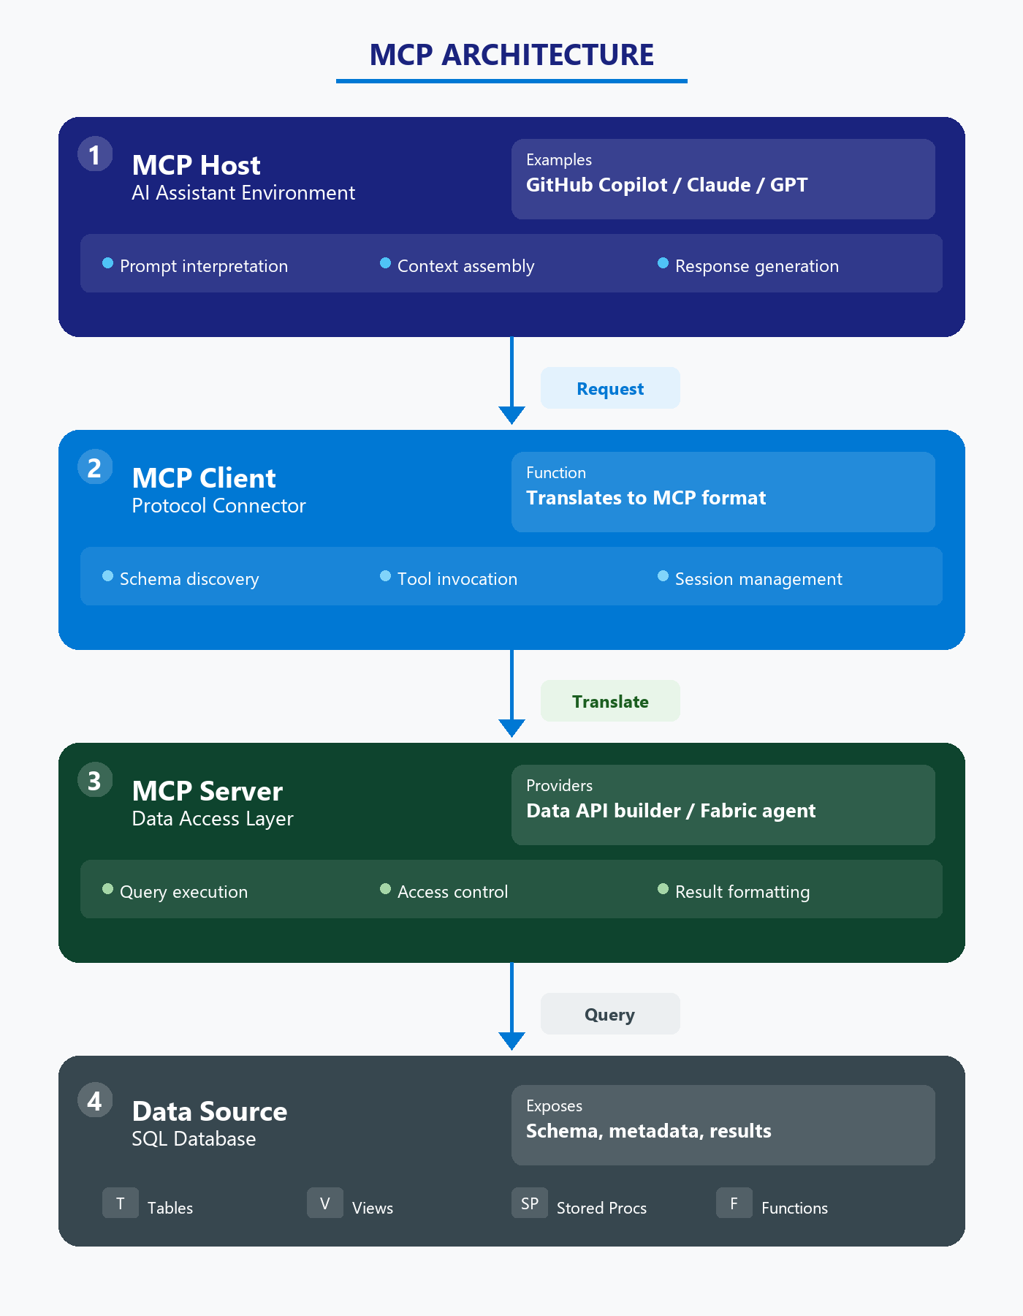
Configure model and MCP tool options
Model Context Protocol (MCP)
MCP = open standard for AI → data source connections
AI queries your actual schema and metadata in real time
Select AI models per session (GPT, Claude, Gemini)
Agent mode in VS Code enables MCP tools
Configure servers in .vscode/mcp.json
Notes:
GitHub Copilot supports multiple AI models that can be selected per chat session. Available models include GPT (advanced reasoning for complex T-SQL and database design), Claude models (strong code explanation and documentation), and Gemini models. In SSMS, use the model selector dropdown at the top of the chat. In VS Code, use the model picker in the chat interface.
Model Context Protocol (MCP) is an open standard that allows AI assistants to connect directly to external data sources and tools. Instead of only seeing editor code, MCP enables querying actual database schema, sample data, and metadata in real time. It follows a client-server architecture: MCP Host (GitHub Copilot, Claude, etc.), MCP Client (protocol client connecting to servers), and MCP Server (service exposing specific data sources).
In VS Code, MCP works through Agent mode. Switch from Ask/Edit to Agent to access MCP tools. Add servers via Command Palette (MCP: Add Server) or by editing .vscode/mcp.json. Several MCP server options exist: SQL MCP Server (Microsoft's open-source solution built on Data API builder for SQL Server/Azure SQL), Microsoft Fabric MCP Server (connects to Fabric data agents), and Azure MCP Server (broader Azure resource integration). Configure MCP connections with least-privilege access. If your workflow only needs schema information, don't grant data read permissions.

Slide 37
Copilot instruction files
REPOSITORY STRUCTURE
Consistent AI behavior across your team
DIR
.github/
Repository configuration folder
MD
copilot-instructions.md
copilot-instructions.md: Repo-wide standards in .github/
prompt.md files: Reusable task templates in .github/prompts/
Naming conventions: PascalCase tables, usp_ procs, vw_ views
T-SQL style: Explicit columns, schema prefix, TRY...CATCH
Security rules: No GRANT to public, parameterized queries
Team-wide T-SQL coding standards
DIR
prompts/
Reusable prompt template library
MD
create-procedure.prompt.md
Stored procedure scaffold
MD
review-query.prompt.md
Performance review checklist
EXAMPLE copilot-instructions.md
## T-SQL Naming Conventions
- Schema-qualify all objects (Sales.Orders)
- PascalCase for tables and views
- Prefix: usp_ for procs, vw_ for views
## Security Rules
- Wrap DML in explicit transactions
- Never GRANT permissions to public
- Use parameterized queries only
Notes:
Custom instruction files are markdown documents that guide GitHub Copilot's behavior consistently across projects and teams. Instead of repeating context in every prompt, you define preferences, coding standards, and project-specific guidance in files that Copilot reads automatically.
Two main types: Repository instructions (copilot-instructions.md) go in the .github folder at the repository root and apply to everyone in the repository. Prompt files (.prompt.md) go in .github/prompts and define reusable templates for specific tasks, like creating stored procedure templates, migration scripts, or performance reviews.
The instruction file should be specific. Example content includes naming conventions (tables in PascalCase singular, procedures as usp_ActionEntity, indexes as IX_TableName_ColumnName), T-SQL style rules (explicit column lists, schema prefixes, ANSI JOIN syntax, TRY...CATCH blocks), security requirements (never GRANT to public, parameterized queries, avoid dynamic SQL), and performance guidelines (SET NOCOUNT ON, EXISTS over COUNT).
For enterprise teams: maintain a master instruction file in a shared repository, use layered instructions (org-level general + repo-specific additions), track changes in version control, and review periodically as practices evolve. Be specific rather than vague, provide code examples demonstrating preferred patterns, prioritize the most important guidelines first, and test iteratively.

Slide 38
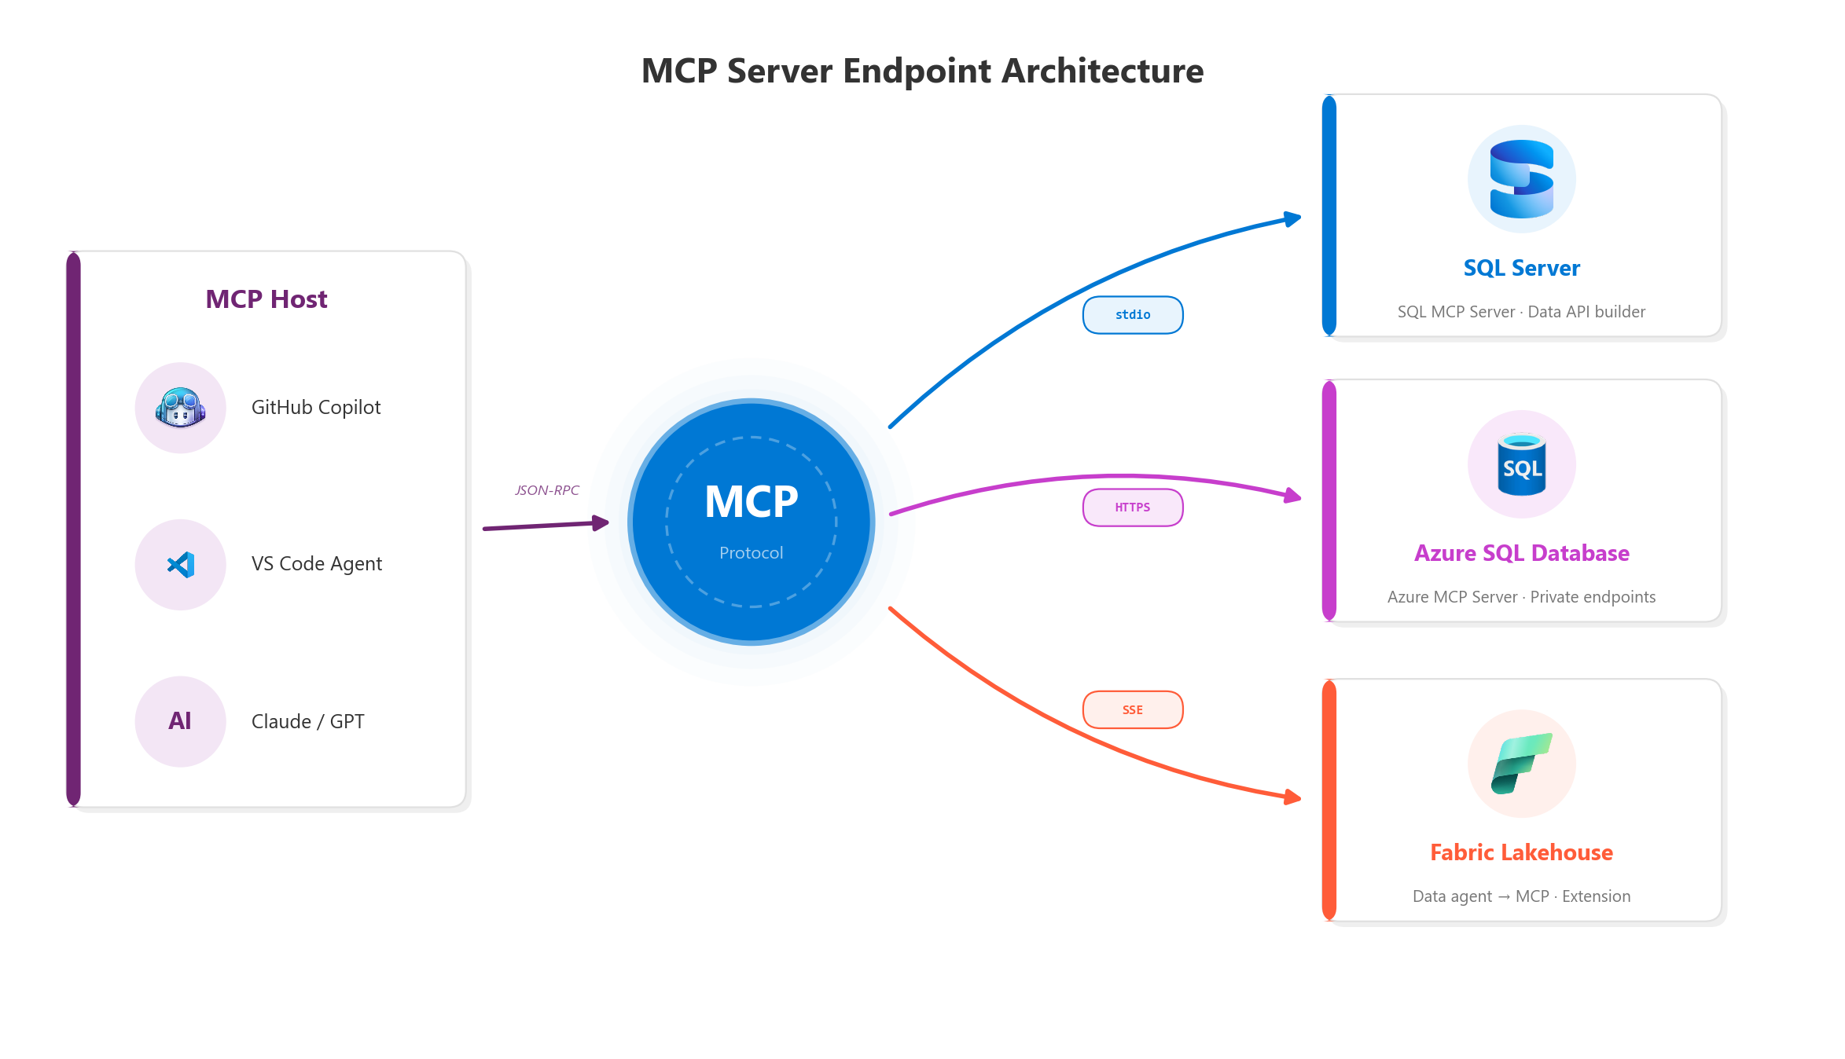
Connect MCP server endpoints
SQL Server, Azure SQL, and Fabric
SQL MCP Server:
  Built on Data API builder
Azure MCP Server:
  Broader Azure integration
Fabric data agent:
  Publish as MCP server
Authenticate:
  Interactive, service principal, or API key
MCP config lives in .vscode/mcp.json
Notes:
This unit covers connecting MCP servers to specific SQL platforms. For SQL Server and Azure SQL: use the SQL MCP Server (Microsoft's open-source solution built on Data API builder), or use the MSSQL extension's built-in integration in VS Code. Right-click a connected database and select "Chat with this database" for schema-aware conversations without a separate MCP server.
For Azure SQL databases: additionally consider the Azure MCP Server for broader Azure resource integration. Network configuration is important. Ensure client IP is allowed through the Azure SQL firewall, configure network for private endpoints, and consider service principals for automated access.
For Fabric Lakehouse: create a data agent in your Fabric workspace, configure it with lakehouse or warehouse access, publish it, then copy the MCP server URL from Settings > Model Context Protocol tab. Add this URL to your .vscode/mcp.json. The Fabric MCP Server VS Code extension provides a streamlined experience.
Authentication options include interactive authentication (sign in via browser, best for development), service principal (Microsoft Entra ID application, best for automated scenarios), and API keys (store securely using environment variables or VS Code input prompts). Never store credentials directly in configuration files that might be committed to source control. Best practices: use least-privilege access, separate environments for dev/test/production, monitor connection usage, and share configurations through version control.

Slide 39
Exercise: AI-assisted SQL development
Hands-on lab
Use GitHub Copilot in VS Code to accelerate T-SQL development against Azure SQL Database. Create custom instruction files for coding standards, generate stored procedures and views via Copilot Chat, and use Copilot to explain code and suggest optimizations.
1
Provision Azure SQL Database
2
Set up VS Code with Copilot extensions
3
Create a custom instruction file
4
Generate a stored procedure with Copilot
5
Generate a view with Copilot
6
Explain code and optimize queries
Notes:
First lab that uses Azure SQL Database. Students install the GitHub Copilot and GitHub Copilot Chat extensions in VS Code, plus the SQL tools extension.
The custom instruction file (.github/copilot-instructions.md) sets coding standards like "use schema prefixes," "include error handling," and "add comments." Copilot then generates a stored procedure and a view following those standards.
The "explain" feature helps students understand generated code, and the optimization suggestions show how Copilot can recommend indexing or query rewrites.
Remind students that Copilot suggestions should always be reviewed before running against production.
Estimated time: 30 minutes.

Slide 40
Knowledge check - Design and implement SQL solutions using AI-assisted tools
A database developer wants to use AI assistance while writing T-SQL in SQL Server Management Studio. Which tool should they install?
a) Fabric Copilot extension
b) GitHub Copilot through the AI Assistance workload
c) Azure OpenAI extension
What security practice should you follow when using AI-assisted tools with database credentials?
a) Store credentials in instruction files so Copilot can access them
b) Include connection strings in prompts for accurate suggestions
c) Use environment variables and never paste credentials into prompts
What does Model Context Protocol (MCP) enable AI assistants to do?
a) Generate code faster by using more powerful models
b) Connect directly to data sources for real-time schema and metadata access
c) Encrypt communications between the IDE and AI service
Notes:
Question 1: "Which tool should a developer install for AI assistance in SSMS?" Answer: GitHub Copilot through the AI Assistance workload. It's installed in SSMS 22+ through the Visual Studio Installer by selecting the AI Assistance workload. Fabric Copilot is for Fabric workspaces, not SSMS.
Question 2: "What security practice for database credentials?" Answer: Use environment variables and never paste credentials into prompts. Never store credentials in instruction files or any AI-visible files.
Question 3: "What does MCP enable AI assistants to do?" Answer: Connect directly to data sources for real-time schema and metadata access. MCP doesn't change model speed - it provides context by connecting to external data sources for more accurate suggestions.
Question 4: "Where to place copilot-instructions.md?" Answer: In the .github folder at the repository root. This applies instructions to all repository users.
Question 5: "How to connect AI assistant to Fabric Lakehouse?" Answer: Publish a Fabric data agent as an MCP server and connect using the MCP endpoint URL. Copy the URL from the agent's settings and configure it in mcp.json.

Slide 41
Summary - Design and implement SQL solutions using AI-assisted tools
What you learned
AI-assisted SQL tools
AI development tools: GitHub Copilot and Fabric Copilot for SQL platforms
Security impact: Data processing, credential protection, code review
Enable Copilot: SSMS 22+, VS Code, and Microsoft Fabric setup
MCP configuration: Model selection and real-time database context
Instruction files: copilot-instructions.md for team-wide standards
MCP endpoints: SQL Server, Azure SQL, and Fabric Lakehouse connections
Notes:
This module covered AI-assisted development tools for SQL platforms. Students learned to describe GitHub Copilot (for SSMS and VS Code) and Fabric Copilot (for Fabric workspaces), interpret security impacts including data processing, organizational policies, and credential protection, and enable both tools in their development environments.
They configured model selection to match different tasks and set up MCP tools for real-time database context. They created custom instruction files (copilot-instructions.md and .prompt.md files) to guide Copilot behavior consistently across teams. And they connected MCP server endpoints for SQL Server, Azure SQL, and Fabric Lakehouse. Key takeaways: MCP enables AI assistants to access actual database schema for more accurate suggestions, custom instruction files codify coding standards for consistent AI behavior, and security awareness is essential. Never expose credentials to AI tools and always review generated code before execution.

