Slide 1
Secure, optimize, and deploy database solutions
Notes:
This learning path covers four modules that address security, performance tuning, deployment automation, and Azure service integration for Azure SQL Database, Azure SQL Managed Instance, SQL database in Fabric, and SQL Server 2025.
Implement Data Security and Compliance: Encryption layers (TDE, column-level, Always Encrypted), Dynamic Data Masking, Row-Level Security with filter and block predicates, role-based access control with Entra ID and Managed Identity, auditing with Extended Events and Log Analytics, and securing AI model, GraphQL, REST, and MCP endpoints.
Optimize Database Performance: Azure SQL Database service tiers (General Purpose, Business Critical, Hyperscale), isolation levels and row versioning (RCSI, snapshot, optimized locking), execution plan analysis with DMVs and missing index recommendations, Query Store with plan forcing and QS hints, and identifying and resolving blocking and deadlocks.
Implement CI/CD for SQL Database Projects: SDK-style SQL projects with .dacpac artifacts, Git source control with post-deployment scripts, branching and pull request workflows, schema drift detection with schema comparison and SqlPackage, CI/CD pipelines with GitHub Actions and Azure DevOps, and database testing with unit and integration tests.
Integrate SQL Solutions with Azure Services: Data API Builder configuration for REST and GraphQL endpoints, entity definitions for tables, views, and stored procedures, deployment to Container Apps, App Service, and Static Web Apps, monitoring with Application Insights and KQL dashboards, and event-driven patterns with CDC, Change Tracking, and Change Event Streaming.

Slide 2
Agenda
Implement data security and compliance
Optimize database performance
Implement CI/CD for SQL Database Projects
Integrate SQL solutions with Azure services
Secure, Optimize, and Deploy Database Solutions teaches database professionals to implement defense-in-depth security, tune query performance using execution plans and Query Store, automate schema deployments with CI/CD pipelines, and integrate SQL databases with Azure services through Data API Builder and event-driven patterns.

Slide 3
Implement data security and compliance
Notes:
This module covers how to implement comprehensive data security and compliance features for SQL Server, Azure SQL Database, and SQL databases in Microsoft Fabric. The approach follows a defense-in-depth strategy, layering multiple security mechanisms so that if one control is bypassed, others continue to protect the data.
The learning objectives span eight key areas:
- Designing and implementing data encryption using Always Encrypted and column-level encryption
- Configuring Dynamic Data Masking to protect sensitive columns
- Designing Row-Level Security policies for data filtering based on user context
- Implementing object-level permissions with Microsoft Entra ID and Managed Identity
- Enabling auditing for tracking database activity and compliance
- Securing AI model endpoints with Managed Identity authentication
- Protecting GraphQL, REST, and MCP endpoints from unauthorized access
Each of these layers addresses a different threat vector, from data at rest to API-level access controls.

Slide 4
Data encryption layers
Protect data at rest and during processing
TDE
COLUMN LEVEL
ALWAYS ENCRYPTED
Transparent Data Encryption
Column-Level Encryption
Always Encrypted
Data at rest
Selected columns
Full data lifecycle
Encrypts entire database files
Targets specific sensitive columns
Keys never enter the database
Protects .mdf, .ldf, and .bak files
ENCRYPTBYKEY / DECRYPTBYKEY
Client app encrypts / decrypts
AES-256 algorithm
Symmetric + asymmetric keys
DB engine sees ciphertext only
Zero application code changes
Keys stored inside the database
Even DBAs cannot read plaintext
Database Encryption Key (DEK)
App opens / closes keys explicitly
Column Master Key (CMK):
protected by server certificate
Protected by certificate chain:
Azure Key Vault or HSM
Azure SQL: enabled by default
Master Key > Certificate > Sym Key
Column Encryption Key (CEK):
Supports customer-managed keys
Granular GRANT / DENY on keys
stored encrypted by CMK
(BYOK via Azure Key Vault)
Flexible but more app code
Deterministic = equality queries
Scope: Storage layer only
Scope: Column level, server-side
Randomized = strongest protection
Scope: Rest + transit + in use
.mdf
.ldf
.bak
ID
SSN
Name
Credit Card#
Client App
SQL Database
1
0x7F3B967…
Alice
0xA36AB1E…
holds CMK
0xF3A09BF…
ciphertext only
increasing protection scope
Notes:
This slide covers three encryption approaches that can be combined for defense in depth.
Transparent Data Encryption (TDE) encrypts data at rest and is transparent to the application. No code changes are required. It protects database files, backups, and transaction logs, making it a baseline encryption layer that satisfies many compliance requirements.
Always Encrypted keeps encryption keys outside the database engine entirely. They stay on the client side, stored in Azure Key Vault or Windows Certificate Store. This means even database administrators cannot view plaintext values. There are two encryption types: deterministic encryption supports equality searches and can be used in WHERE clauses, while randomized encryption provides stronger protection but does not support searching or indexing on the encrypted column. The architecture involves a Column Master Key (CMK) that protects a Column Encryption Key (CEK), which actually encrypts the data.
Column-level encryption uses the ENCRYPTBYKEY and DECRYPTBYKEY functions with symmetric keys protected by certificates. This gives you granular control over which columns to encrypt and requires explicit decrypt calls in your queries.
Choose TDE for compliance and at-rest protection, Always Encrypted when you need to protect data from database administrators, and column-level encryption when you need granular, application-controlled encryption. These methods can be combined for layered security.

Slide 5
Dynamic Data Masking
Real data stays intact - unauthorized users see obfuscated values
ACTUAL DATA
MASKING FUNCTION
USER SEES
478-23-9012
default()
XXXX
Complete obfuscation - strings, numbers, dates
SSN
john.smith@contoso.com
email()
jXXX@XXXX.com
First character + domain format preserved
Email
$85,000.00
random(10k, 100k)
$47,312.00
Random number in range - different each query
Income
206-555-0189
partial(3,"XXX-",2)
206-XXX-XX89
Show prefix + custom padding + suffix
Phone
Without UNMASK
GRANT UNMASK
With UNMASK
Users see masked values
Users see actual data
SQL Server 2022+: UNMASK at database / schema / table / column level
Notes:
Dynamic Data Masking protects sensitive columns at the presentation layer without changing the actual data stored in the database. Four masking functions are available:
- Default masking replaces values with XXXX (or fewer X characters for shorter fields)
- Email masking shows the first letter, replaces the middle with XXX, and preserves the domain format (for example, jXXX@XXXX.com)
- Random masking substitutes a random number within a specified range, useful for numeric columns
- Partial masking is the most configurable. You specify how many characters to expose from the start and end, and what padding string to use in the middle
Masking is configured with the MASKED WITH clause in the column definition. The UNMASK permission controls which users see the actual data. Starting with SQL Server 2022 and Azure SQL, you can grant granular UNMASK permissions at the schema, table, or column level rather than only at the database level.
Important to note: masking is a presentation-layer feature. The underlying data remains unchanged, and determined users could potentially infer masked values through query patterns. Masking works best as one layer in a broader security strategy alongside encryption and Row-Level Security.

Slide 6
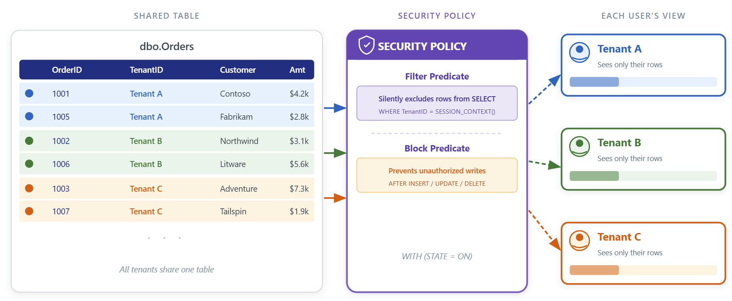
Row-Level Security
How RLS Works
Inline table-valued function returns 1 or 0
Security policy binds predicate to table(s)
SQL Server evaluates on every query automatically
No application code changes required
Filter vs. Block Predicates
Filter: silently excludes rows from SELECT
Block: prevents unauthorized INSERT / UPDATE / DELETE
Combine both for complete read + write protection
Best Practices
Index predicate columns for performance
Test with EXECUTE AS to verify isolation
Use SCHEMABINDING on predicate functions
Start with filter predicates, add block later
Multitenant Filtering
SESSION_CONTEXT(N'TenantID')
App sets context - zero code changes
User-Based Access
DATABASE_PRINCIPAL_ID()
Managers see team via IS_MEMBER()
Hierarchical Access
Recursive CTE traversal
Directors see full subordinate chain
Notes:
Row-Level Security (RLS) automatically filters which rows each user can see or modify, based on their identity or session context. It has two components: security predicates and security policies.
Security predicates are inline table-valued functions that return 1 (access allowed) or 0 (access denied) for each row. These functions typically check the current user via DATABASE_PRINCIPAL_ID() or retrieve context values set by the application using SESSION_CONTEXT. Security policies bind one or more predicates to target tables.
There are two types of predicates. Filter predicates silently exclude unauthorized rows from SELECT results. The user never knows those rows exist. Block predicates prevent unauthorized INSERT, UPDATE, or DELETE operations and raise an error when a user tries to modify rows they should not access.
A common use case is multitenant data isolation. The application sets a TenantID in SESSION_CONTEXT at connection time, and the filter predicate ensures each tenant only sees its own rows. For hierarchical access patterns where a manager should see data for their entire team, RLS supports recursive CTEs within the predicate function.
Security policies can be enabled or disabled, and individual predicates can be added or removed from a policy as requirements change.

Slide 7
Permissions and authentication
Role-Based Access Control
Schema Separation
Microsoft Entra & MI
GRANT / REVOKE / DENY hierarchy
DENY overrides all other grants
Create roles per job function
Nest roles for hierarchical access
Group objects by department/function
GRANT SELECT ON SCHEMA::Sales
Auto-covers future objects in schema
CONTROL on schema = full ownership
CREATE USER [...] FROM EXTERNAL PROVIDER
Managed Identity = zero credentials
System-assigned or user-assigned MI
Store connection strings in Key Vault
Notes:
This slide covers the permission hierarchy and modern authentication methods. SQL Server uses a hierarchical permission model: server, database, schema, and object levels. Permissions granted at a higher level cascade down. For example, granting SELECT on a schema gives access to all tables and views in that schema, including objects created in the future.
Three statements control permissions: GRANT gives access, REVOKE removes a previously granted permission, and DENY explicitly blocks access. The key distinction is that DENY overrides any grants. Even if a user gets access through multiple role memberships, a DENY always wins. REVOKE simply removes one grant but does not prevent access through other sources.
Role-based access control is the recommended approach. Create database roles that represent job functions, assign permissions to roles, and add users to the appropriate roles. Roles can be nested to build hierarchical permission structures. Schema separation provides a natural way to organize objects and manage permissions at the schema level.
For authentication, Microsoft Entra authentication eliminates password-based risks. You create database users from Entra identities, managed identities, or groups using CREATE USER ... FROM EXTERNAL PROVIDER. Managed identities are the most secure option for Azure-hosted applications. Azure handles the identity lifecycle automatically, and there are no credentials that could be leaked or stolen. The connection string simply specifies Authentication=Active Directory Managed Identity with no password or secret required.
Connection strings should be stored in Azure Key Vault or environment variables, encrypted connections should be enabled, and network access should be restricted with firewall rules and private endpoints.

Slide 8
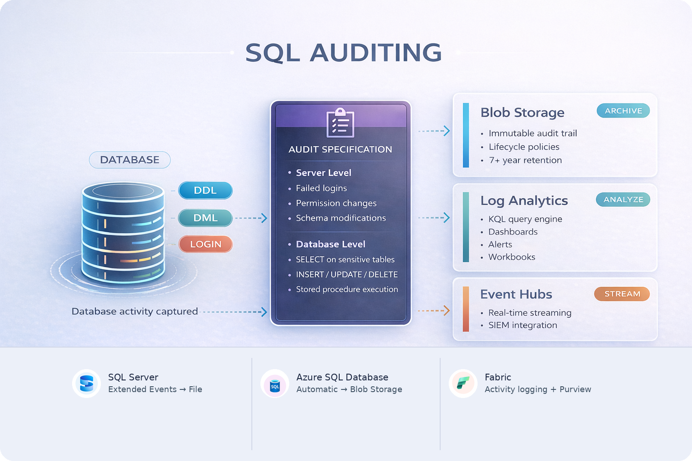
Implement auditing
Why audit?
• Detect security threats early
• Track compliance with regulations
• Investigate incidents with full trail
• Accountability: who accessed what, when
Configuration tips
• QUEUE_DELAY controls write buffering
• ON_FAILURE = SHUTDOWN for critical compliance
• Start focused - high-volume auditing impacts performance
Querying audit logs
• SQL Server: fn_get_audit_file()
• Azure SQL: KQL via Log Analytics
• Look for failed logins, unusual access patterns
Retention best practices
• Store logs separately from monitored databases
• Use immutable storage to prevent tampering
• Retain per regulation (often 7 years for financial)
• Archive to cold storage for cost management
Notes:
Auditing provides visibility into database activity by recording who accessed what data and when. It supports security monitoring, compliance tracking, and incident investigation.
For SQL Server, auditing uses the Extended Events infrastructure. You create a server audit object that defines the destination (file, Windows Security log, or Application log), then create audit specifications that define what events to capture. Server audit specifications track server-level events like login attempts and permission changes. Database audit specifications track database-level events like data access on specific tables and role membership changes. Key parameters include QUEUE_DELAY (how long to buffer events before writing) and ON_FAILURE (whether to continue or shut down the server if audit writing fails).
Azure SQL Database auditing writes to Azure Blob Storage, Log Analytics, or Event Hubs. The managed service handles the infrastructure. Auditing to Log Analytics enables powerful querying with KQL, making security monitoring and compliance reporting more accessible.
Common audit action groups include authentication events (successful and failed logins), permission changes (GRANT/REVOKE/DENY operations, role membership changes), data access (SELECT, INSERT, UPDATE, DELETE on specific objects), and schema changes (DDL statements). Start with a focused set of audit actions rather than capturing everything. High-volume auditing impacts performance and creates logs that are difficult to analyze.
For compliance, define retention periods based on regulatory requirements, use immutable storage to prevent log deletion, and store audit logs separately from the databases they monitor so attackers cannot tamper with the audit trail.

Slide 9
Secure model and API endpoints
AI Model Endpoints
GraphQL
REST API
MCP (Model Context Protocol)
sp_invoke_external_rest_endpoint
Managed Identity - no secrets in DB
Database-scoped credentials fallback
Track latency, errors, retry count
JWT / OAuth2 via EasyAuth or Entra ID
Field-level permissions per role
Disable introspection in production
Limit query depth and complexity
HTTP verbs → role-based actions
Database policies for item security
@claims inject user context into queries
Rate limiting + CORS allow list
Read-only by default for AI agents
denied-tables, max-rows-returned
Prompt injection defense is critical
Parameterized queries - validate all SQL
🔒 AUTHENTICATION & AUTHORIZATION LAYER
Azure SQL Database
Network Security: Private Endpoints · Firewall Rules · VNet Integration
Notes:
This slide combines two topics: securing AI model endpoints and securing GraphQL, REST, and MCP endpoints.
For AI model endpoints, the key recommendation is to use Managed Identity instead of API keys. You create a database-scoped credential with IDENTITY = 'Managed Identity' and a secret that specifies the resource scope. Then you create an external data source of TYPE = REST that references the AI endpoint and uses this credential. Stored procedures that call sp_invoke_external_rest_endpoint can then make authenticated calls to Azure OpenAI or Azure Machine Learning endpoints without ever storing an API key. Access to these procedures should be controlled through dedicated roles so only authorized users can invoke AI capabilities that incur costs and process sensitive data.
Endpoint monitoring is also important. Creating a logging table that captures caller identity, input length, response status, and duration helps detect unusual patterns like excessive API calls from unexpected principals.
For GraphQL endpoints (via Data API builder), key security measures include disabling introspection in production to prevent schema discovery, configuring entity-level permissions to control which roles can access which data, and using field-level include/exclude lists to hide sensitive columns. REST endpoints follow similar patterns with database policies that can filter results for anonymous access and role-based permissions for CRUD operations.
MCP endpoints, which enable AI agents to interact with your database, require extra attention. Limit operations to read-only when writes are not needed, explicitly deny access to tables containing credentials, restrict result set sizes, and validate AI-generated queries to prevent prompt injection attacks and access to system objects.

Slide 10
Exercise: Implement security features
Hands-on lab
Implement security features in Azure SQL Database. Apply Dynamic Data Masking to sensitive columns (SSN, salary, email, credit card, phone) and configure Row-Level Security with predicate functions to restrict data access by user region.
1
Provision Azure SQL Database
2
Create sample tables with sensitive data
3
Apply Dynamic Data Masking
4
Verify masked vs. unmasked access
5
Configure Row-Level Security
6
Test access as different users
Notes:
Uses Azure SQL Database.
Dynamic Data Masking (DDM) is applied to five column types: default mask on SSN, random(1,100) on salary, email() on email, partial(0,"XXXX-",4) on credit card, and custom partial on phone. DDM does not encrypt data; it only masks query results for non-privileged users. UNMASK permission lets specific users see real values.
Row-Level Security (RLS) uses a schema-bound inline TVF as a filter predicate, applied via CREATE SECURITY POLICY. Each test user (EastUser, WestUser) can only see rows matching their region.
Key point: RLS filter predicates silently exclude rows, while block predicates prevent writes. This lab uses filter predicates only.
Estimated time: 30 minutes.

Slide 11
Knowledge check - Implement data security and compliance
A financial services company needs to protect credit card numbers stored in an Azure SQL Database. The application must be able to perform equality searches on the encrypted column, but database administrators should not be able to view the plaintext values. Which encryption approach should you recommend?
a) Transparent Data Encryption (TDE)
b) Always Encrypted with deterministic encryption
c) Always Encrypted with randomized encryption
A retail company wants support staff to verify customer phone numbers by seeing only the last four digits. The actual phone numbers must remain unchanged in the database for billing system integration. Which security feature should you implement?
a) Row-Level Security with a filter predicate
b) A view that truncates phone numbers
c) Dynamic Data Masking with partial masking
A multitenant SaaS application stores data for multiple customers in the same database tables. Each table includes a TenantID column. You need to ensure users can only query rows belonging to their own tenant, even if they write SELECT statements directly. Which implementation approach should you use?
a) Create separate views for each tenant and grant SELECT only on views
b) Create a security policy with a filter predicate that checks TenantID against session context
c) Implement Dynamic Data Masking on the TenantID column
Notes:
Five knowledge check questions for this module:
Q1: A financial services company needs to protect credit card numbers with equality search capability, and DBAs should not see plaintext. Answer: (b) Always Encrypted with deterministic encryption. Always Encrypted keeps keys outside the database engine so administrators cannot see plaintext. Deterministic encryption supports the equality searches needed. TDE does not protect from users with database access. Column-level encryption stores keys in the database. Randomized encryption does not support equality searches.
Q2: Support staff need to see only the last four digits of phone numbers, but actual data must remain unchanged for billing. Answer: (c) Dynamic Data Masking with partial masking. Partial masking reveals only specified portions of data while keeping actual values unchanged. Users without UNMASK permission see masked values. RLS filters rows, not column values. Always Encrypted does not support partial visibility.
Q3: A multitenant SaaS app needs to ensure users query only their own tenant rows from shared tables with a TenantID column. Answer: (b) Create a security policy with a filter predicate that checks TenantID against session context. RLS filter predicates transparently restrict query results. Per-tenant views do not scale. Dynamic Data Masking hides values but does not filter rows. Object-level permissions apply to whole objects, not individual rows.
Q4: An Azure App Service needs to connect to Azure SQL Database with no stored credentials. Answer: (c) System-assigned managed identity with Microsoft Entra authentication. Managed identity eliminates credentials entirely with Azure managing the lifecycle. SQL auth with Key Vault still involves credential management. Service principals with client secrets still require stored secrets. Contained users with passwords require credential rotation.
Q5: An organization needs to audit all data modifications to a sensitive table with seven-year retention, protected from admin deletion. Answer: (b) Azure SQL auditing to Blob Storage with immutable storage policy. Immutable storage prevents deletion even by admins, and lifecycle management ensures retention. Windows Application log is only for on-premises. Extended Events do not provide built-in deletion protection. File-based auditing is not available for Azure SQL Database.

Slide 12

Summary - Implement data security and compliance
What you learned
Data security and compliance
Encryption: TDE, column-level, Always Encrypted (deterministic/randomized)
Masking: Default, email, random, partial + granular UNMASK
RLS: Filter/block predicates, multitenant, hierarchical
Permissions: RBAC with roles/schemas, Entra ID, Managed Identity
Auditing: SQL Server Audit, Azure SQL → Blob/Log Analytics/Event Hubs
Endpoints: Managed Identity for AI; JWT/RBAC for GraphQL/REST/MCP
Notes:
This module covered a comprehensive set of security and compliance features across SQL Server, Azure SQL Database, and SQL databases in Microsoft Fabric.
Key takeaways from the source material:
Defense in depth requires combining multiple security features. Encryption protects data at rest and in transit, Dynamic Data Masking provides presentation-layer security, and Row-Level Security controls access at the row level. No single feature provides complete protection on its own.
Managed Identity eliminates credential management risks by letting Azure handle authentication automatically. This is the recommended approach for Azure-hosted applications connecting to SQL databases and AI service endpoints.
Auditing provides accountability, but it requires planning your retention strategy and storage location to meet compliance requirements while managing costs. Store audit logs separately from monitored databases and use immutable storage for tamper protection.
For API endpoints, whether GraphQL, REST, or MCP, authentication and authorization controls must be configured at each layer. MCP endpoints for AI agents require particular attention due to prompt injection risks and the potential for unexpected operations.

Slide 13
Optimize database performance
Notes:
This module covers a systematic approach to database performance optimization in Azure SQL Database, starting with infrastructure decisions, working through concurrency controls, and applying diagnostic tools.
The learning objectives include evaluating and recommending database configurations (service tiers, compute tiers, resource limits), choosing transaction isolation levels that balance consistency with throughput, analyzing query performance using execution plans and DMVs, monitoring and tuning queries with Query Store and Query Performance Insight, and identifying and resolving blocking and deadlocks.

Slide 14
Recommend database configurations
General Purpose
Business Critical
Hyperscale
Remote Azure Blob Storage
5 - 10 ms I/O latency
Max 4 TB storage
Budget-friendly for most workloads
Provisioned or Serverless compute
Local SSD: Always On AG replicas
1 - 2 ms I/O latency, highest IOPS
Free read-only replica for reports
~2.7× cost of General Purpose
Sub-2 ms for latency-sensitive apps
Decoupled storage + page servers
Up to 128 TB, 0 - 4 HA replicas
Scale compute without copying data
Pay for allocated storage only
Widest variety of workloads
Notes:
Azure SQL Database offers two resource models: vCore (direct control over cores, memory, storage) and DTU (bundled units). Microsoft recommends vCore for most new deployments due to higher limits, greater granularity, and pricing flexibility.
Three vCore service tiers:
- General Purpose: remote Azure Blob Storage, 5-10ms I/O latency, budget-friendly, no free read replicas
- Business Critical: local SSDs with Always On availability groups, 1-2ms latency, free read-only replica, roughly 2.7x the cost of General Purpose
- Hyperscale: decoupled storage with page servers and multi-tiered cache, up to 128 TB, 0-4 configurable HA replicas, scales compute without copying data
Compute tiers: Provisioned (fixed vCores, consistent pricing) versus Serverless (auto-scales, bills per second, can autopause when idle).
Key database-level settings:
- MAXDOP defaults to 8 in Azure SQL Database. Avoid MAXDOP 0 in production as unlimited parallelism causes resource exhaustion
- Automatic tuning: FORCE_LAST_GOOD_PLAN (enabled by default) catches plan regressions; CREATE_INDEX and DROP_INDEX are disabled by default
- Compatibility level 170 unlocks the latest intelligent query processing features (batch mode on rowstore, parameter sensitive plan optimization, etc.). Test before upgrading in production
- OPTIMIZE_FOR_AD_HOC_WORKLOADS stores a stub on first execution to keep the plan cache lean
- Accelerated Database Recovery (ADR) is always enabled in Azure SQL Database, providing constant recovery time and instant rollback via a persistent version store (PVS)

Slide 15
Preserve data integrity with isolation levels
LOCK-BASED
ROW-VERSIONING
READ
UNCOMMITTED
READ
COMMITTED
REPEATABLE
READ
SERIALIZABLE
RCSI
SNAPSHOT
SQL Server default
Azure SQL Database default
Dirty reads
✕
✓
✓
✓
✓
✓
Non-repeatable
✕
✕
✓
✓
~
✓
Phantoms
✕
✕
✕
✓
~
✓
Blocking
None
Shared locks
Held locks
Range locks
None
None
Mechanism
No locks
Lock per read
Hold til commit
Key-range lock
Row versions
Txn snapshot
Increasing isolation and blocking →
✓
Protected
✕
Vulnerable
~
Statement-level only
CONCURRENCY SIDE EFFECTS
Dirty Read
Non-repeatable Read
Phantom
Blocking
Reading uncommitted data from another transaction that may roll back.
Same row returns different values when read twice since another transaction modified it.
A second query finds new rows that weren't there before because another transaction inserted them.
A session waits because another holds an incompatible lock on the same resource.
Notes:
Isolation levels control how much one transaction can see of another's uncommitted work. Three concurrency side effects frame the trade-offs: dirty reads (reading uncommitted changes that may roll back), nonrepeatable reads (same row returns different values on re-read), and phantom reads (new rows appear on re-query within the same transaction).
Four lock-based levels with increasing restrictions:
- READ UNCOMMITTED: no shared locks, allows dirty reads. Use it only when approximate results are acceptable
- READ COMMITTED: shared lock per read released immediately; prevents dirty reads but allows nonrepeatable and phantom reads
- REPEATABLE READ: holds shared locks until transaction completes; prevents dirty and nonrepeatable reads, allows phantoms
- SERIALIZABLE: range locks prevent all three side effects but cause significantly more blocking and deadlocks
Two row-versioning levels:
- Read Committed Snapshot Isolation (RCSI): enabled by default in Azure SQL Database; per-statement snapshot from the version store means readers never block writers
- SNAPSHOT: per-transaction snapshot for consistency across multiple queries; raises update conflict errors (error 3960) on write-write conflicts rather than blocking
Optimized locking (always enabled in Azure SQL Database) further reduces write-write blocking using Transaction ID (TID) locking (fewer locks held in memory) and Lock After Qualification (locks released per row update rather than at transaction end). The practical guidance: for most Azure SQL workloads, the default RCSI plus optimized locking provides the best balance. Step up to SNAPSHOT for multi-query transaction consistency, and reserve SERIALIZABLE only when phantom reads would cause real business errors.

Slide 16
Evaluate query performance
QUERY PERFORMANCE EVALUATION PIPELINE
1
2
3
4
IDENTIFY
ANALYZE
DISCOVER
OPTIMIZE
Find slow queries
Read execution plans
Find missing indexes
Apply improvements
DMV Analysis
Execution Plan Analysis
Missing Indexes & Warnings
Primary DMV
Compare Plans
Index Discovery DMV
sys.dm_exec_query_stats
Estimated Plan
vs
Actual Plan
dm_db_missing_index_details
Sort & Rank By
Inspect
Ranked by improvement_measure score
CPU Time
Logical Reads
Exec Count
Operator types & costs
Warning Signs in Plans
Row count estimates vs actuals
Stale statistics
TempDB spills
Goal
Implicit conversions
No join predicate
Find the top resource-consuming queries that are candidates for optimization.
TIP: Key Lookups found?
Add INCLUDE columns to create covering indexes
Each warning = potential performance bottleneck
✓
Optimized Result
Covering indexes created · Statistics updated · Queries rewritten · Key Lookups eliminated
Best Practice
Performance Impact
Always compare estimated vs actual execution plans - row count mismatches could reveal stale statistics.
If the filter returns many rows, Key Lookups add up fast and become a major performance bottleneck.
Notes:
Execution plans show exactly how the query optimizer executes a query. Estimated plans show planned operators and estimated row counts without running the query. Actual plans include runtime metrics (actual row counts, execution times, memory grants, and warnings), revealing discrepancies between optimizer estimates and reality.
Key things to look for in execution plans:
- Operator types: Index Seek is efficient, targeting specific rows; Table Scan or Index Scan reads every row and often signals a missing index (though scans on small tables or queries returning most rows can be appropriate)
- Estimated vs. actual row counts: divergence indicates stale statistics, leading to bad join choices or insufficient memory grants; fix with UPDATE STATISTICS
- Key Lookup operators: occur when a nonclustered index finds rows but needs extra columns from the clustered index; eliminate by adding included columns to the nonclustered index (creating a covering index)
- Thick arrows: unexpectedly large data flow early in the plan suggests missing filters or indexes
- Warnings (yellow triangle): missing statistics, excessive memory grants, no join predicate (Cartesian product), implicit conversions (turning seeks into scans), and sort/hash spills to tempdb
Dynamic Management Views (DMVs) complement execution plans with system-wide data:
- sys.dm_exec_query_stats: find top queries by average CPU time or logical reads
- sys.dm_exec_requests: snapshot of currently running queries with wait types and blocking info
- Missing index DMVs (sys.dm_db_missing_index_details, sys.dm_db_missing_index_group_stats): calculate an improvement measure to prioritize which indexes to create
The systematic approach: start broad with DMVs to identify the most expensive queries, then drill into individual execution plans to understand why they are expensive.

Slide 17
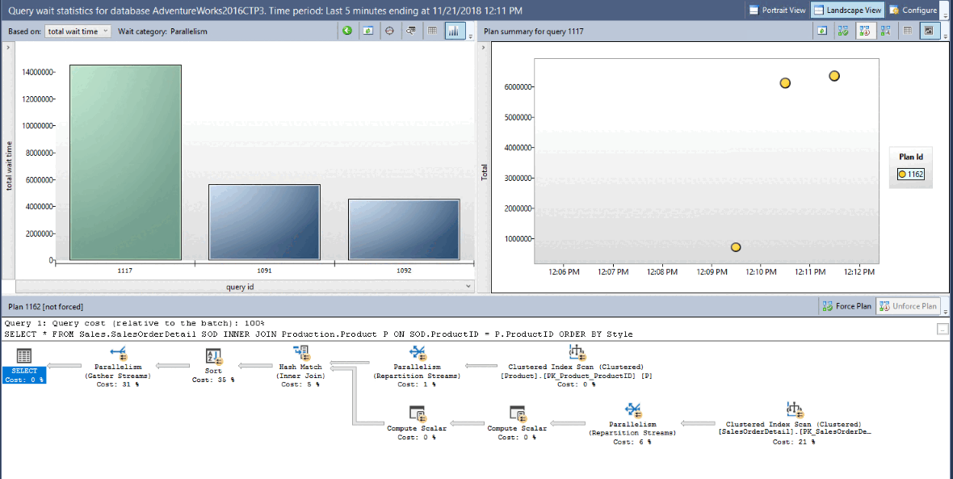
Monitor and tune with Query Store
QUERY STORE CAPABILITIES
Plan Store
Persisted execution plans; multiple plans per query
Runtime Stats
CPU, duration, reads aggregated per time interval
Regressed Queries
Detect plan changes that degraded performance
Plan Forcing
sp_query_store_force_plan for immediate rollback
QS Hints
Query Store - Wait Statistics Detail View
MAXDOP, RECOMPILE without modifying application code
i
Key Benefit
Historical performance tracking + plan forcing + QPI - detect regressions and fix them without code changes
Plan Forcing
QPI Integration
Force a known-good plan immediately - no application restart or code deploy needed.
Query Performance Insight in Azure portal surfaces top queries, wait categories, and trends at a glance.
Notes:
Query Store captures query text, execution plans, and runtime statistics over time, stored in three internal stores: plan store (execution plans), runtime stats store (aggregate execution statistics per configurable time interval), and wait stats store (wait statistics per query and plan). It is enabled by default in Azure SQL Database.
Key capabilities:
- Regressed Queries view: surfaces queries that switched to a slower plan after a deployment, statistics update, or schema change. Compare two plans side by side to see what changed. Common patterns include switching from seek to scan, losing efficient lookups, or introducing sort spills.
- Plan forcing (sp_query_store_force_plan): direct the optimizer to use a specific previously captured plan for immediate fix without modifying application code. Think of it as a performance rollback.
- Query Store hints (sp_query_store_set_hints): attach query hints like OPTION(MAXDOP 1) or OPTION(RECOMPILE) to a specific query through Query Store, without touching application code. Hints override hard-coded statement-level hints and plan guides.
- Wait statistics per query: enable with WAIT_STATS_CAPTURE_MODE = ON. Groups waits by category (CPU, Lock, Buffer IO, Memory) and connects them to specific queries. This is a major advantage over server-level wait stats.
Query Performance Insight (QPI) in the Azure portal visualizes Query Store data graphically, showing top CPU-consuming queries with DTU percentage over time. Can switch between Duration, Execution Count metrics and integrates with Database Advisor recommendations.
Best practices: use Auto capture mode, enable size-based cleanup, check Regressed Queries after every deployment, and monitor for Query Store switching to read-only mode when running out of space (check sys.database_query_store_options).

Slide 18
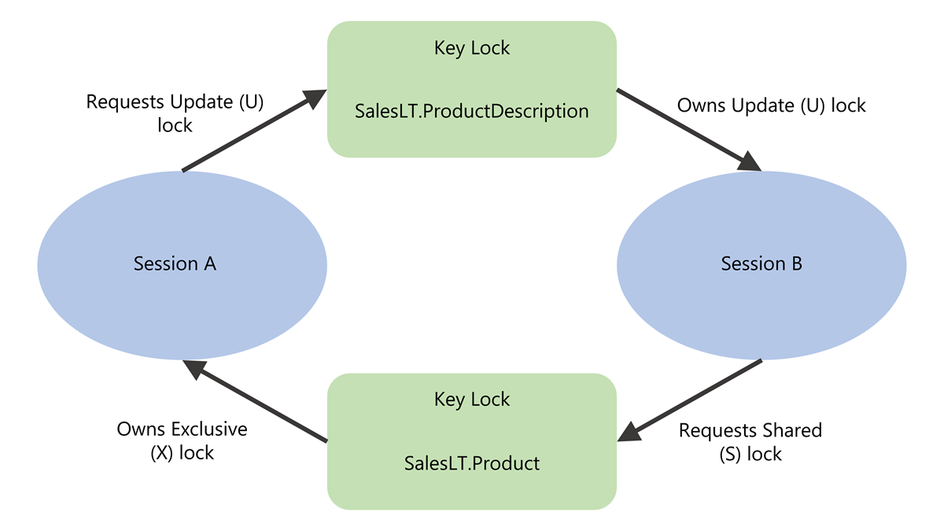
Identify and resolve blocking & deadlocks
Deadlock Cycle - Session A & B circular lock dependency
Deadlock
Circular lock dependency, engine kills cheapest transaction.
Extended Events
Create an XEvent session with database_xml_deadlock_report to capture deadlock graphs. Use ring_buffer or Azure Blob Storage as the target, Azure SQL DB has no system_health session.
Blocking
Use sys.dm_exec_requests to find the blocking chain. Head blocker has blocking_session_id = 0.
Common fix: commit or kill the orphaned session.
!
Common causes: uncommitted transactions, orphaned sessions, long-running queries
PREVENTION STRATEGIES
Consistent Access Order
Short Transactions
XACT_ABORT ON
Retry Error 1205
Access tables in the same order across all transactions to break circular dependencies.
Keep transactions brief and in one batch - reduces lock hold time.
Auto-rollback on error ensures locks are released immediately on failure.
Catch deadlock victim error in TRY/CATCH and retry with randomized back-off.
Notes:
Blocking occurs when one session holds a lock and another requests a conflicting lock on the same resource. With RCSI enabled by default in Azure SQL Database, read-write blocking is eliminated, but write-write blocking still occurs.
Identify the head blocker by querying sys.dm_exec_requests for sessions where blocking_session_id is nonzero, then find the session that blocks others but is not blocked itself (blocking_session_id = 0). Common blocking scenarios: long-running queries holding locks, sleeping sessions with uncommitted transactions (fix with SET XACT_ABORT ON), sessions that did not fetch all result rows, sessions in rollback state, and orphaned connections (terminate with KILL).
Deadlocks are circular lock dependencies where neither transaction can proceed. The deadlock monitor checks periodically (default 5 seconds, drops to 100ms when frequent) and terminates the least expensive transaction (error 1205). In Azure SQL Database, capture deadlocks by creating a custom Extended Events session for sqlserver.database_xml_deadlock_report, then query the ring buffer target.
Deadlock prevention strategies:
- Access objects in consistent order across transactions to prevent circular dependencies
- Keep transactions as short as possible
- Use row-versioning isolation levels (RCSI removes shared locks from the equation)
- Add indexes to narrow scans and reduce lock conflicts
- Use plan forcing in Query Store if a plan change caused wider scans
Applications should always include retry logic for error 1205, catching the error, pausing briefly (with randomized delay), and resubmitting the transaction.

Slide 19
Exercise: Optimize query performance
Hands-on lab
Investigate and resolve performance issues in Azure SQL Database using execution plans, DMVs, and Query Store. Identify missing indexes, simulate and fix a parameter sniffing regression via plan forcing, apply Query Store hints, and diagnose blocking scenarios.
1
Create test workload and enable Query Store
2
Analyze plans and add a covering index
3
Find expensive queries with DMVs
4
Simulate parameter sniffing regression
5
Force the better plan via Query Store
6
Apply a Query Store hint (MAXDOP)
7
Diagnose and resolve blocking
Notes:
Uses Azure SQL Database. Students enable Query Store (if not already on) and run a workload to populate it.
The first exercise identifies a missing index through an execution plan's missing index suggestion, then adds a covering index and compares before/after plans. DMV queries use sys.dm_exec_query_stats and sys.dm_exec_sql_text to find top resource consumers.
The parameter sniffing scenario creates a stored procedure that compiles an optimal plan for one parameter value but performs poorly for another; students use Query Store to identify the regression and force the better plan.
The MAXDOP hint is applied through ALTER DATABASE SCOPED CONFIGURATION or sp_query_store_set_hints. The blocking exercise uses two sessions to demonstrate lock waits, diagnosed with sys.dm_exec_requests and sys.dm_tran_locks.
Estimated time: 45 minutes.

Slide 20
Knowledge check - Optimize database performance
A team needs I/O latency under 2 milliseconds and a free read-only replica for reporting queries. Which Azure SQL Database service tier should they choose?
a) General Purpose
b) Business Critical
c) Hyperscale
Which isolation level is the default in Azure SQL Database and uses row versioning to prevent readers from blocking writers?
a) READ COMMITTED with shared locks
b) READ COMMITTED SNAPSHOT (RCSI)
c) SNAPSHOT
Which Query Store feature restores query performance after a plan regression without modifying application code?
a) Query Store hints
b) Regressed Queries view
c) Plan forcing
Notes:
Six knowledge check questions for this module:
Q1: Which service tier provides I/O latency under 2ms and a free read-only replica? Answer: (b) Business Critical. It uses locally attached SSDs with 1-2ms latency and includes a free read-only replica via Always On availability groups. General Purpose provides 5-10ms latency. Hyperscale supports named replicas but not a free one by default.
Q2: Which isolation level is the default in Azure SQL Database and uses row versioning? Answer: (b) Read Committed Snapshot Isolation (RCSI). Readers access row versions instead of acquiring shared locks, preventing read-write blocking. READ COMMITTED with shared locks is the default in SQL Server (not Azure SQL). SNAPSHOT must be explicitly enabled.
Q3: Which Query Store feature restores performance after a plan regression without modifying code? Answer: (c) Plan forcing. It directs the optimizer to use a specific previously captured plan via sp_query_store_force_plan. Query Store hints apply hints but do not revert to a previous plan. The Regressed Queries view identifies regressions but does not fix them alone.
Q4: How do you eliminate a Key Lookup in an execution plan? Answer: (c) Add included columns to the nonclustered index. A Key Lookup occurs when the nonclustered index does not cover all columns the query needs. Adding missing columns as included columns creates a covering index. Filtered indexes, rebuilding clustered indexes, and NOLOCK hints do not address this.
Q5: How do you identify the head blocker using DMVs? Answer: (c) Query sys.dm_exec_requests for sessions where blocking_session_id = 0 that also appear as blocking_session_id for other sessions. The head blocker blocks others but is not blocked itself. Highest wait_time may be a blocked session. The head blocker may be sleeping, not running.
Q6: What happens when two SNAPSHOT isolation transactions both read and then try to update the same row? Answer: (c) The first to commit succeeds; the second fails with an update conflict error (3960). Snapshot isolation detects write-write conflicts rather than allowing unrestricted concurrent writes or blocking. This is not a deadlock - it is detected immediately as an update conflict.

Slide 21
Summary - Optimize database performance
What you learned
Optimize database performance
Configurations: vCore tiers - GP / BC / HS + provisioned vs serverless
Isolation levels: RCSI default + optimized locking; SERIALIZABLE for phantom reads
Query performance: Execution plans, DMVs, missing index improvement measure
Query Store: Regressed queries, plan forcing, QS hints, QPI
Blocking & deadlocks: Head blocker DMVs, Extended Events, retry error 1205
Notes:
This module covered a systematic approach to performance optimization in Azure SQL Database.
Key takeaways:
- The vCore model with General Purpose covers most workloads. Business Critical adds sub-2ms latency and a free read-only replica. Hyperscale removes storage and scaling limits. Inside the database, MAXDOP 8 is the safe default, automatic tuning catches plan regressions, and upgrading compatibility level unlocks latest IQP features.
- RCSI (default in Azure SQL) and optimized locking together minimize both read-write and write-write blocking. Reserve SERIALIZABLE only when phantom reads would cause real business errors.
- Execution plans and DMVs provide complementary views. DMVs identify the most expensive queries system-wide, execution plans reveal why individual queries are expensive. Look for scans, row estimate errors, Key Lookups, and warnings.
- Query Store captures query text, plans, and statistics over time. Use plan forcing for immediate regression fixes, Query Store hints for code-free tuning, and Regressed Queries view after every deployment.
- Find head blockers with sys.dm_exec_requests. Prevent deadlocks by accessing objects consistently, keeping transactions short, and using row-versioning isolation. Applications should always implement retry logic for error 1205.

Slide 22
Implement CI/CD for
SQL Database Projects
Notes:
This module covers treating database code with the same rigor as application code, versioning every object, automating builds and deployments, detecting schema drift, and testing changes before they reach production.
The scenario is a team managing an e-commerce application on Azure SQL Database where multiple developers make schema changes simultaneously. Without source control and CI/CD, changes collide, hotfixes fall out of sync, and deployments overwrite production fixes.
Learning objectives: create, build, and validate SQL Database Projects (including SDK-style); configure source control and manage reference data with pre/post-deployment scripts; manage branching, pull requests, and conflict resolution; detect schema drift with schema comparison tools and SqlPackage; implement CI/CD pipelines with GitHub Actions and Azure DevOps including secrets management and deployment controls; and design a testing strategy with unit tests and integration tests.

Slide 23
SQL Database Projects & .dacpac
Declarative database-as-code with compiled artifacts
Project:
  Every table, view, SP lives in its own .sql file
SDK-style:
  Microsoft.Build.Sql: .NET 8+, cross-platform, NuGet refs
Build:
  Dotnet build → .dacpac; validates references + syntax
Deploy:
  SqlPackage calculates diff → only ALTER/CREATE needed
Preview:
  Script and DeployReport actions before production
1
2
3
4
5
.sql files
dotnet build
.dacpac
SqlPackage
Database
Declare
Validate
Artifact
Diff & Deploy
Updated
One file per object
Syntax check
Compiled model
Calculate diff
Production DB
Schema-qualified
Ref validation
Portable package
ALTER/CREATE only
Minimal changes
SDK-STYLE PROJECT
.NET 8+
Cross-platform
NuGet refs
Microsoft.Build.Sql
Notes:
A SQL database project stores every database object (tables, stored procedures, views, functions) as individual .sql files declaring the desired end state. This is the opposite of migration scripts. Instead of sequential ALTER statements, you maintain the final state of each object, and the tooling calculates the difference at deployment time.
Building the project produces a .dacpac file, which is a compiled model of the entire database schema. The build validates object references and T-SQL syntax against the target platform before anything is deployed, and creates a single deployable artifact for the pipeline.
Two formats: the original format (MSBuild/.NET Framework, SSDT in Visual Studio) and the SDK-style format (Microsoft.Build.Sql). For new projects, use SDK-style because it supports .NET 8+ for cross-platform builds on Windows/Linux/macOS, NuGet package references for dependency management, and default globbing that automatically includes .sql files without manual entries.
Create a project with "dotnet new sqlproj -n MyDatabaseProject" and build with "dotnet build". The build output is a .dacpac in the bin/Debug folder. Enable SQL code analysis rules to flag best practice violations (deprecated syntax, SELECT *, etc.).
SqlPackage handles deployment. For a new database, it creates objects in dependency order. For an existing database, it calculates the diff and generates only the ALTER statements needed. The process is idempotent. Deploy the same .dacpac five times and the fifth run changes nothing. Preview planned changes before deploying with the Script action (produces exact T-SQL) or the DeployReport action (produces XML summary of every CREATE, ALTER, and DROP).

Slide 24
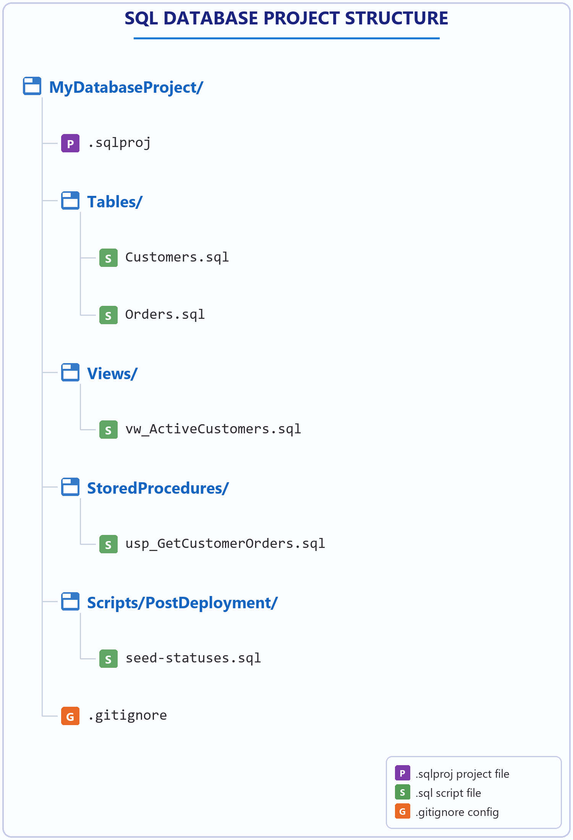
Source control & reference data
Git + pre-deployment/post-deployment scripts
Git init:
  each object = one file → granular diffs per commit
Folder layout:
  Tables/, Views/, StoredProcedures/, Scripts/
.gitignore:
  exclude bin/, obj/, .dacpac, .user
Post-deploy:
  SQLCMD :r includes for reference data seed scripts
Idempotent:
  MERGE statements → safe to run on every deployment
Notes:
Because a SQL database project is just .sql files and a .sqlproj file, it fits naturally into Git. Each database object lives in its own file, so commits show exactly which objects changed, not a monolithic migration script. Organize files by object type (Tables/, Views/, StoredProcedures/, Scripts/). Use a .gitignore to exclude bin/, obj/, *.dacpac, and *.user since the .dacpac gets rebuilt on every CI/CD build.
Reference data (status codes, lookup tables, default configurations) is as essential as the schema. If it disappears, the application breaks. Manage it with pre-deployment and post-deployment scripts:
- Pre-deployment scripts run before schema changes. Use them for dropping constraints or migrating data
- Post-deployment scripts run after schema changes. Use them for populating reference data, seeding lookup tables, setting defaults
A project supports exactly one pre-deployment and one post-deployment script, declared in the .sqlproj file. Use SQLCMD :r syntax to pull in multiple files from a single entry point (for example, PostDeploy.sql references seed-statuses.sql, seed-regions.sql, etc.). Each referenced file must be excluded from the build with "Build Remove" and kept visible with "None Include" in the .sqlproj file.
Critical: post-deployment scripts run on every deployment, not just the first. Plain INSERT statements fail on the second deployment with duplicate key violations. Use MERGE statements instead to make reference data scripts idempotent. They insert new rows and update existing ones safely on every run.

Slide 25
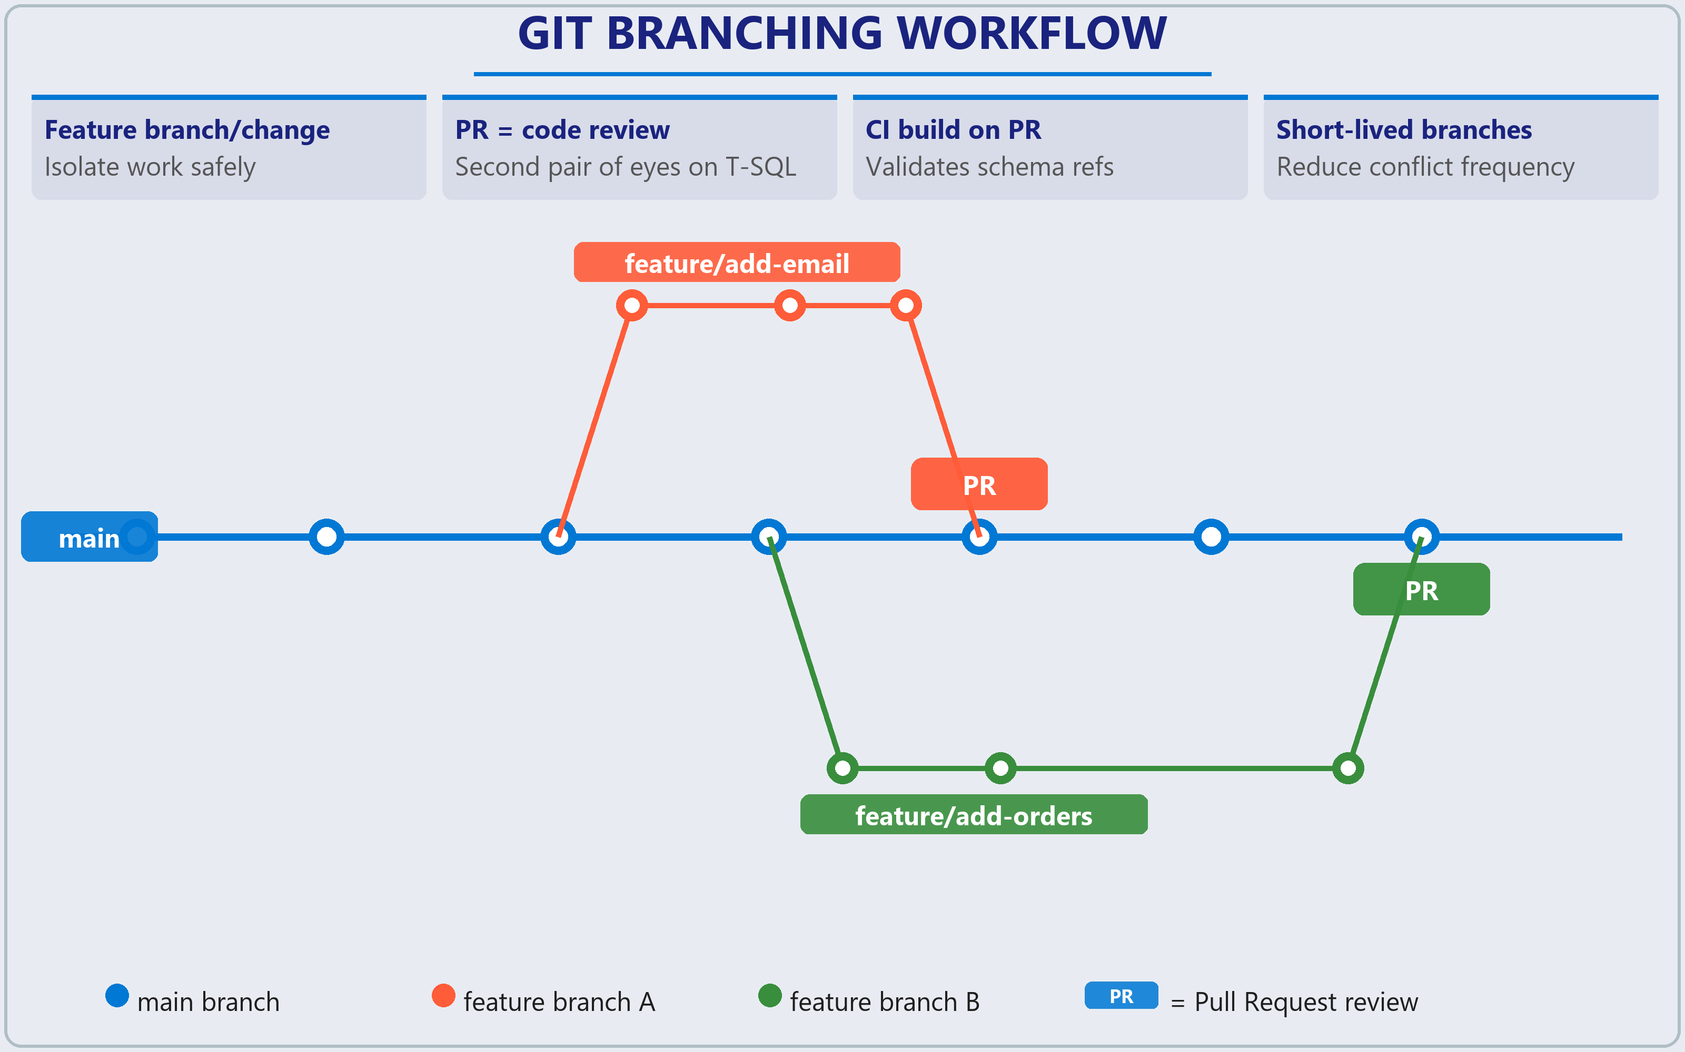
Branching, PRs & conflict resolution
Feature branch per change → isolate work
Pull request = second pair of eyes on T-SQL diffs
CI build on PR validates schema references
Merge conflicts: edit same CREATE TABLE file
Always dotnet build after resolving conflicts
Short-lived branches reduce conflict frequency
Notes:
The branching strategy follows three principles: create a feature branch for every change, merge feature branches into main through pull requests, and always keep main in a deployable state.
Because each object has its own file, a commit that adds a column to Customers touches only Tables/Customers.sql. Pull request diffs show the precise T-SQL that changed, making review far easier than a 500-line migration script. PR reviewers should check: does the schema change break existing queries or procedures? Are naming conventions consistent? Does the change require a corresponding post-deployment script update? Does it cause data loss or require data migration?
Connect PRs to CI builds so a green build gives reviewers confidence. Configure the PR to trigger a dotnet build of the SQL project. In Azure DevOps, use a Build Validation branch policy. In GitHub, use a workflow triggered on pull_request events targeting main.
Merge conflicts happen when two branches modify the same file. A common scenario is two developers editing the same CREATE TABLE statement. Resolution: pull latest from main into your feature branch, review conflicting sections, edit to include both changes, then commit. Keep feature branches short-lived to reduce conflict frequency.
Critical: a clean text merge does not guarantee a valid schema. One branch might rename a column while another adds a procedure referencing the old name. Always rebuild the project after resolving conflicts with "dotnet build" to verify all object references are intact.

Slide 26
Detect & resolve schema drift
!
?
✓
What causes drift
How to detect it
How to resolve it
Manual changes via SSMS
Schema comparison
Cherry-pick from comparison
Ad-hoc ALTER/CREATE in production
Compare DB vs project side-by-side
Selectively import detected changes
Emergency hotfixes at 2 AM
SqlPackage Extract
Import hotfix into project
Bypassing source control under pressure
Pull live schema, diff with git status
Bring valid production fixes home
ORM frameworks creating objects
DeployReport
Review Script action
Entity Framework migrations gone wild
XML change summary before deploy
Never deploy blind to production
Monitoring agent temp tables
Script action
DacpacVerify
Third-party tools adding objects
Preview exact T-SQL that would run
Compare two .dacpacs for parity
Untracked production patches
Save .scmp files
Block on data loss option
Changes nobody documented
Repeatable comparison configs
Safety net for destructive changes
Notes:
Schema drift is the gap between what your project defines and what actually exists in the live database. Common causes: manual changes via SSMS, emergency hotfixes at 2 AM that never make it back into the project, and third-party tools (monitoring agents, ORM frameworks) creating or modifying objects. The danger is that your next pipeline deployment will quietly drop objects the project does not know about.
Detection with schema comparison: compare a live database against your project to surface every difference, grouped by action type (Create, Alter, Delete). Direction is reversible. Database-to-project finds drift, project-to-database previews what deployment would change. Tune comparison options to ignore whitespace, column order, or block on possible data loss. Save settings as .scmp files committed to the repository for repeatable checks.
When drift is detected, decide: does the live database have the correct version? If the production hotfix was correct, import it into the project using schema compare (cherry-pick specific differences) or automate with SqlPackage Extract, which pulls the live schema into files organized by type. Under Git, running git status after extraction reveals exactly which files changed. That is your automated drift report.
DacpacVerify compares two .dacpac files and reports differences including pre/post-deployment scripts, SQLCMD variables, database references, and schema objects. Useful when converting from original SSDT to SDK-style or validating pipeline artifacts.
Preview deployment changes before applying: the Script action produces exact T-SQL, the DeployReport action produces XML summary. Parse the XML in your pipeline to trigger alerts for high-impact operations like data motion, clustered index rebuilds, or column drops.

Slide 27
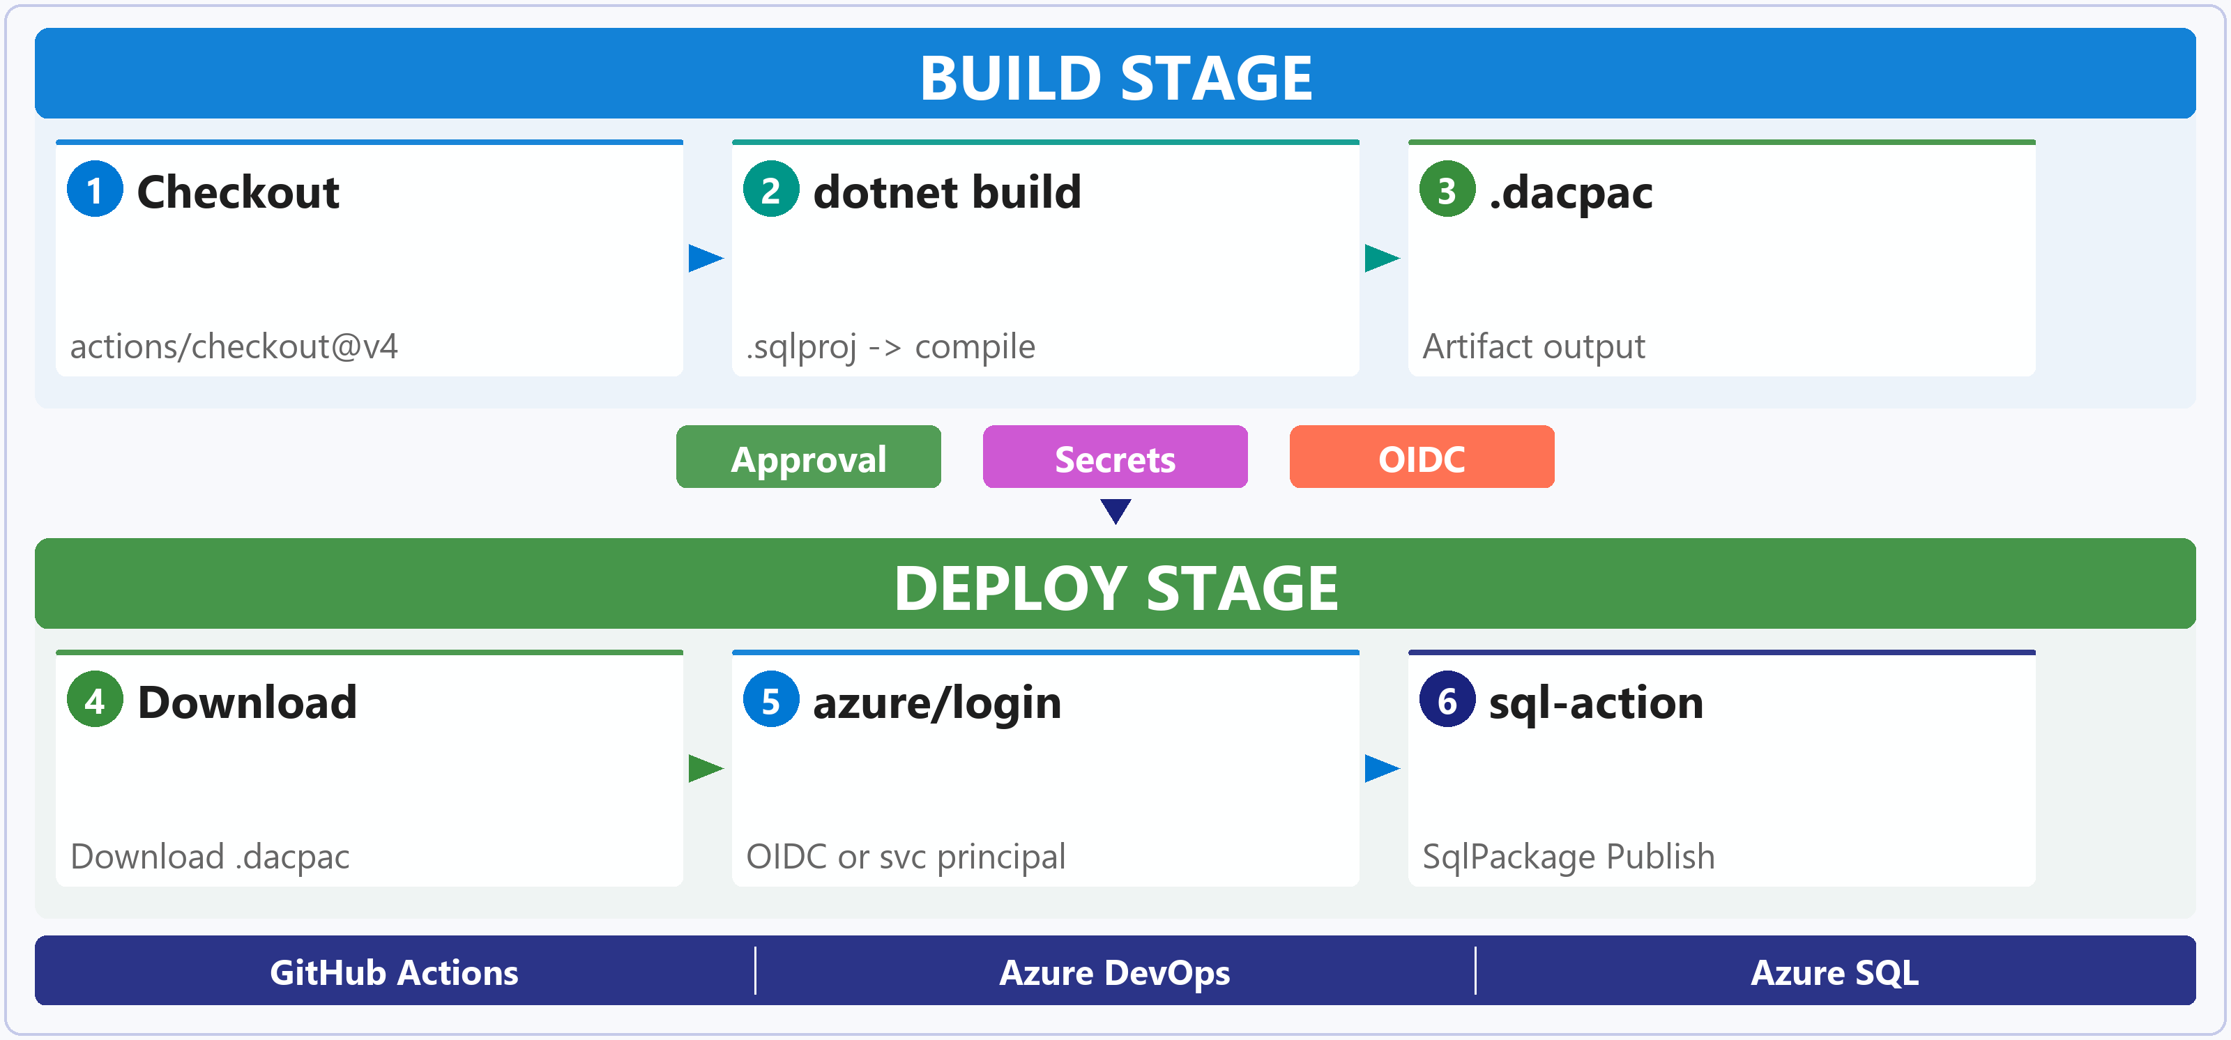
CI/CD pipelines
GitHub Actions · Azure DevOps · secrets · controls
Build once:
  compile .dacpac artifact, deploy same file everywhere
GitHub Actions:
  azure/sql-action + azure/login for .dacpac deploy
Azure DevOps:
  SqlAzureDacpacDeployment task or direct SqlPackage
Secrets:
  repo secrets, OIDC, Azure Key Vault: never hardcode
Controls:
  required reviewers, CODEOWNERS, branch policies
Notes:
Most database pipelines follow a two-stage pattern: Build (compile the project, produce the .dacpac artifact) and Deploy (publish that .dacpac to target databases moving through environments). Building once and deploying the same artifact everywhere eliminates "works in dev, breaks in prod."
GitHub Actions: use azure/sql-action for .dacpac deployment to Azure SQL Database. It supports .dacpac, .sqlproj, and .sql scripts with SQL authentication, Microsoft Entra ID, and service principal authentication. When paired with azure/login, it automatically adds and removes temporary firewall rules for the runner IP.
Azure DevOps: use SqlAzureDacpacDeployment task for .dacpac deployment. For Linux agents, install and use SqlPackage directly via dotnet tool.
Secrets management: never hardcode credentials in YAML:
- GitHub: store as repository secrets or environment secrets (scoped to specific deployment environments)
- OpenID Connect (OIDC) with azure/login for passwordless authentication using federated credentials, so there is no client secret to rotate
- Azure Key Vault for centralized secrets management. The pipeline pulls credentials at deployment time
Deployment controls are critical for database changes:
- Environment protection rules: required reviewers (must approve before deploy runs), wait timers, deployment branch restrictions (only main deploys to production)
- Branch policies: minimum reviewers, build validation as PR check, comment resolution, automatically included reviewers
- CODEOWNERS file (GitHub) or automatically included reviewers (Azure DevOps) ensure the database team reviews every SQL file change
- Branch control checks on service connections lock down which pipelines can access production credentials

Slide 28
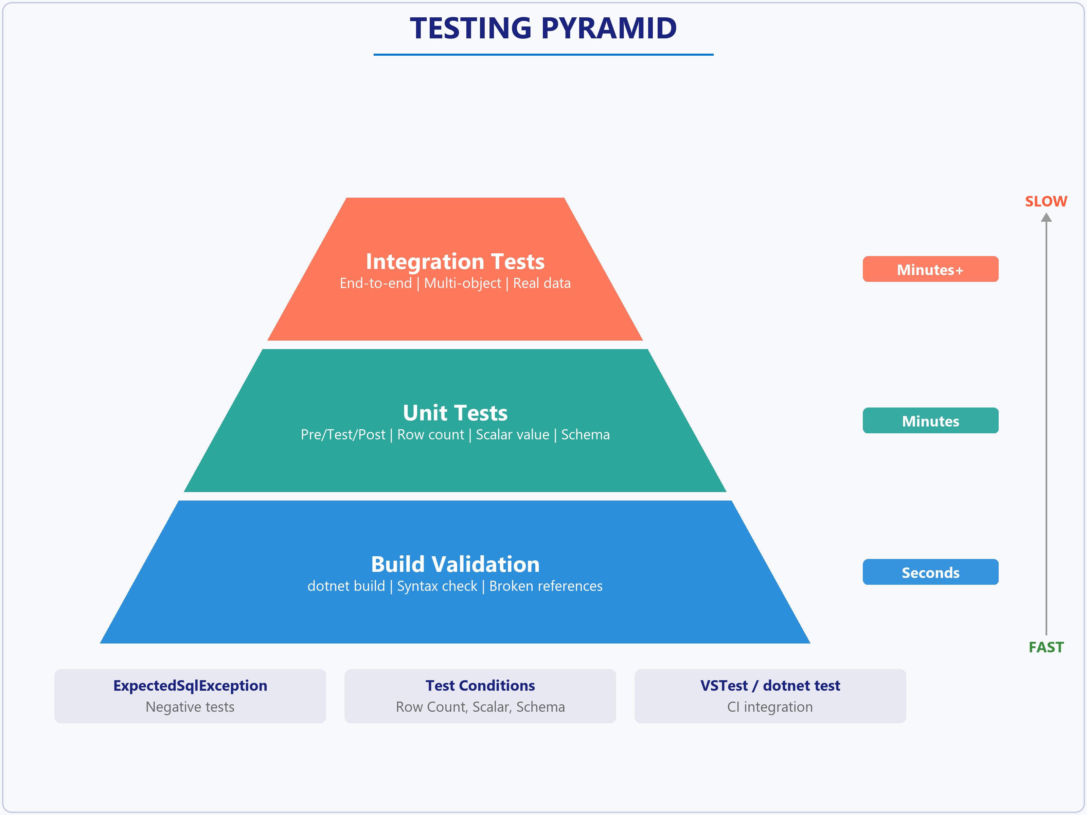
Testing strategy
Build validation · unit tests · integration tests
Build validation:
  dotnet build catches syntax errors, broken refs
Unit tests:
  pre-test → test → post-test pattern; test conditions
Conditions:
  Row Count, Scalar Value, Expected Schema, Execution Time
Negative tests:
  [ExpectedSqlException] for error handling paths
CI integration:
  VSTest task (DevOps) or dotnet test (GitHub Actions)
Notes:
Database testing works in three layers, each slower but catching different problems:
- Build validation (dotnet build): catches syntax errors and broken object references. This is fast but only proves structural validity
- Unit tests: verify that individual stored procedures and functions return the right results for given inputs, catching logic errors
- Integration tests: exercise end-to-end scenarios against a deployed database and proves objects work together, but requires a running instance
SQL Server unit tests (SSDT in Visual Studio) follow a three-phase structure: Pre-test (set up data), Test (execute the operation), Post-test (clean up). Test conditions validate results: Row Count (expected number of rows), Scalar Value (specific cell contains expected value), Expected Schema (correct column names and types). Other conditions include Data Checksum, Empty/Not Empty ResultSet, and Execution Time.
Negative tests verify that stored procedures fail correctly for invalid inputs. Add the [ExpectedSqlException] attribute above the test method, specifying Severity and State. The test passes only when the procedure raises an error matching those parameters.
Integration tests span multiple operations, testing whether a sequence of procedure calls leaves the database in the expected state, whether triggers fire correctly, whether views return accurate results after related table changes. Use a dedicated test database, reset to known state before each run, and externalize connection strings.
Integrate tests into CI/CD: add a test step after build and deployment. In Azure DevOps use VSTest task, in GitHub Actions use "dotnet test". When a test fails, the pipeline stops and the change does not reach staging or production.

Slide 29
Exercise: Implement CI/CD for SQL Database Projects
Hands-on lab
Create a SQL database project, build a .dacpac, push to GitHub, and configure a GitHub Actions pipeline that automatically builds and deploys schema changes to Azure SQL Database, including verifying that a column addition triggers an automatic ALTER TABLE.
1
Provision Azure SQL Database
2
Set up Git, GitHub CLI, and .NET SDK
3
Create SQL project with table and procedure
4
Build the .dacpac locally
5
Push to GitHub and configure secrets
6
Create GitHub Actions workflow
7
Push a schema change and verify deployment
Notes:
Uses Azure SQL Database, Git, GitHub, .NET SDK, and GitHub Actions.
Students create a SQL project using the new SDK-style .sqlproj format (Microsoft.Build.Sql). The project contains .sql files for tables and stored procedures. Building produces a .dacpac (data-tier application package).
The GitHub Actions workflow uses dotnet build to compile the .dacpac and sql-action (azure/sql-action@v2) to deploy it using SqlPackage under the hood. Connection string and credentials are stored as GitHub repository secrets.
The verification step adds a new column to a table .sql file, pushes the commit, and confirms that the pipeline runs ALTER TABLE automatically. Key point: SqlPackage performs a diff-based deployment, only applying changes.
Estimated time: 45 minutes.

Slide 30
Knowledge check - Implement CI/CD for SQL Database Projects
A database administrator applied a hotfix directly to production by adding a missing index. The SQL Database Project doesn't have this index. What is this situation called, and which tool detects it?
a) Schema drift, detected by schema comparison
b) A build error, detected by dotnet build
c) A merge conflict, detected by Git
Which GitHub Actions action deploys a .dacpac file to Azure SQL Database and can automatically configure firewall rules for the runner?
a) azure/sql-action
b) azure/webapps-deploy
c) actions/upload-artifact
A developer writes a SQL Server unit test for a stored procedure that should raise an error when a required parameter is NULL. Which attribute marks the test as expecting a SQL exception?
a) [ExpectedException]
b) [ExpectedSqlException]
c) [TestMethod]
Notes:
Three knowledge check questions for this module:
Q1: A DBA applied a hotfix directly to production by adding a missing index. The SQL Database Project does not have this index. What is this situation called, and which tool detects it? Answer: (a) Schema drift, detected by schema comparison. Schema drift occurs when the live database diverges from the project definition. Schema comparison tools highlight differences like the extra index. The project builds successfully because it does not know about the production index. SqlPackage Publish would actually remove the index to match the project - which is worse than a detection failure.
Q2: Which GitHub Actions action deploys a .dacpac file to Azure SQL Database and can automatically configure firewall rules for the runner? Answer: (a) azure/sql-action. It deploys .dacpac, .sql, or SqlPackage projects. When used with azure/login, it automatically adds and removes firewall rules for the GitHub Actions runner IP. azure/webapps-deploy is for App Service. actions/upload-artifact stores outputs but does not deploy. azure/login authenticates but does not deploy.
Q3: A developer writes a SQL Server unit test for a stored procedure that should raise an error when a required parameter is NULL. Which attribute marks the test as expecting a SQL exception? Answer: (b) [ExpectedSqlException]. This SQL-specific attribute marks a unit test as expecting a SQL exception, filterable by MessageNumber, Severity, and State. [ExpectedException] is a general .NET attribute. [TestMethod] marks a method as a test but does not configure exception expectations. [ShouldThrow] is not a valid attribute in the SQL Server unit test framework.

Slide 31
Summary - Implement CI/CD for SQL Database Projects
What you learned
Implement CI/CD for SQL Database Projects
SQL DB Projects: .sql files → .dacpac; SDK-style for cross-platform
Source control: Git + post-deploy scripts with MERGE for reference data
Branching: Feature branches, PRs with CI build validation, conflict resolution
Schema drift: Schema comparison, SqlPackage Extract, DeployReport preview
CI/CD + Testing: GitHub Actions / Azure DevOps pipelines; unit + integration tests
Notes:
This module covered CI/CD for SQL Database Projects, bringing the same automation, consistency, and safety to database development that application teams rely on.
Key takeaways:
- SQL Database Projects store every object as a declarative .sql file. The build produces a .dacpac artifact that SqlPackage deploys by calculating only the changes needed. SDK-style projects support cross-platform builds, NuGet references, and default globbing.
- Place the project in Git with one file per object. Manage reference data with post-deployment MERGE scripts (not plain INSERTs) so they are idempotent on every deployment.
- Use feature branches and pull requests with CI builds as PR checks. Always rebuild after resolving merge conflicts since a clean text merge does not guarantee a valid schema.
- Schema drift is the gap between project and live database. Detect it with schema comparison tools or automate with SqlPackage Extract. Preview deployment impact with Script and DeployReport actions before running against production.
- Deploy .dacpac files with azure/sql-action (GitHub) or SqlAzureDacpacDeployment (Azure DevOps). Use OIDC for passwordless authentication. Gate production with required reviewers, branch restrictions, and CODEOWNERS.
- Test at three levels: build validation for structure, unit tests for logic, integration tests for end-to-end workflows. Use [ExpectedSqlException] for negative tests. Wire tests into the pipeline so failures block deployment.

Slide 32
Integrate SQL solutions with Azure services
Notes:
This module covers how to use Data API Builder (DAB) to automatically generate REST and GraphQL endpoints from your database schema without writing backend code. It also covers deployment options, monitoring with Azure Monitor, and responding to database changes with event-driven patterns.
The module learning objectives include creating and configuring Data API Builder configuration files, defining entities with field mappings, caching, pagination, and filtering, configuring REST and GraphQL endpoints, exposing views and stored procedures, exploring deployment options (Azure Container Apps, App Service, Static Web Apps), setting up Azure Monitor with Application Insights, and handling database changes using Change Data Capture, Azure Functions triggers, and Change Event Streaming.

Slide 33
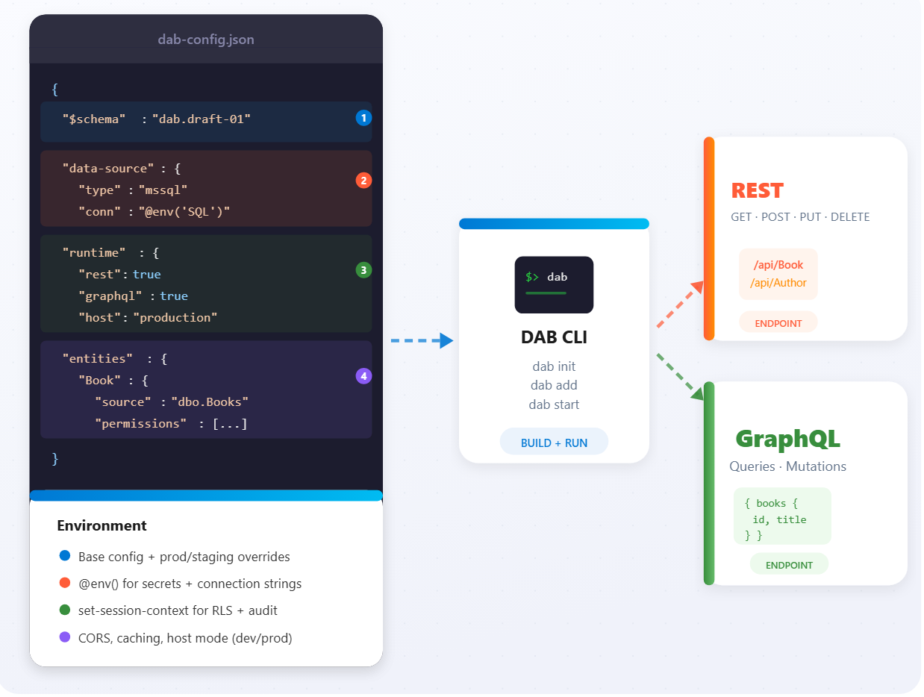
Data API Builder configuration
Single JSON config → REST + GraphQL endpoints
data-source: mssql connection via @env() syntax
runtime: CORS, caching, host mode (dev/prod)
DAB CLI: dab init, dab add, dab start
Environment merging: base + prod/staging overrides
set-session-context for RLS + audit logging
Notes:
Data API Builder is a cross-platform, open-source engine that creates REST and GraphQL endpoints from a single JSON configuration file. The configuration file has four main sections:
- data-source: defines the database connection string and type (use "mssql" for SQL Server, Azure SQL, and SQL databases in Microsoft Fabric)
- runtime: controls host settings, authentication, caching, and enables/disables REST and GraphQL endpoints separately with configurable paths
- entities: specifies which database objects to expose and how to configure them
- $schema: references the JSON schema for validation and IntelliSense
Connection strings should never be hardcoded. Use the @env() syntax to reference environment variables. The set-session-context option passes user identity to SQL Server through SESSION_CONTEXT(), which is useful for row-level security and audit logging.
Runtime settings include CORS configuration for browser-based access, mode switching between development and production (affecting error message detail), and caching with configurable TTL. The DAB CLI (dab init, dab add) helps create and modify configuration files without manual JSON editing. For multiple environments, DAB supports configuration merging. A base dab-config.json with environment-specific override files like dab-config.production.json.

Slide 34
Define entities and expose objects
Tables, views, stored procedures → APIs
Tables:
  full CRUD with field mappings, caching, pagination
Views:
  read-only with key-fields; operation: query
Stored procs:
  parameters mapped to API args; query or mutation
Relationships:
  GraphQL traversal via cardinality + source/target fields
Filtering:
  OData ($filter) for REST, typed inputs for GraphQL
Table
CRUD + mappings
REST API
/api/Entity
OData filter · pagination
View
Read-only + keys
GraphQL
Queries · mutations
Relationships · caching
Stored Proc
Params + execute
Notes:
Entities are the core building blocks of Data API Builder. Each entity maps to a database object (table, view, or stored procedure) and defines how it appears through REST and GraphQL APIs.
For tables, DAB automatically generates CRUD operations mapped to HTTP verbs: GET for reading, POST for creating, PUT/PATCH for updating, DELETE for removing. Field mappings let you rename columns. For example, mapping ProductName to "name" in the API while keeping the database schema unchanged. Clients then use the mapped names in their queries.
Caching reduces database load with configurable TTL per entity. Pagination is built in using cursor-based navigation with $first and $after parameters for REST, and first/after arguments for GraphQL. Filtering uses OData-style syntax for REST and typed filter objects for GraphQL, with operators generated automatically based on field data types.
For GraphQL, entity relationships map to database foreign keys. You define cardinality (one or many) and source/target fields, enabling clients to traverse connections in a single query. Views are exposed as read-only entities with key-fields specified manually since DAB cannot auto-detect primary keys on views. Stored procedures support both query operations (read) and mutation operations (data modification), with parameters mapped to API parameter names.

Slide 35
Deploy to Azure services
Container Apps
App Service
Static Web Apps
Serverless containers, scale-to-zero
Dockerfile with DAB image + config
Managed Identity → Azure SQL
Health probes: liveness + readiness
Deployment slots for staging/prod
Custom domains and TLS certificates
Key Vault references in app settings
Built-in auth and monitoring
Built-in DAB (database connections)
staticwebapps.database.config.json
Auto-auth integration with SWA
Limited vs standalone DAB features
Notes:
Three main Azure hosting options for Data API Builder, each with different trade-offs:
Azure Container Apps provides serverless container hosting with automatic scaling from zero based on request volume. You create a Dockerfile from the official DAB image, add your configuration file, and deploy with az containerapp create. It integrates with Azure Key Vault for secret management and supports managed identity for credential-free database authentication.
Azure App Service offers a mature platform with deployment slots, custom domains, and comprehensive monitoring. It uses Key Vault reference syntax in app settings to pull secrets at runtime. Teams already using App Service can follow familiar deployment patterns.
Azure Static Web Apps includes DAB as a built-in feature called "database connections," providing the simplest deployment when the API complements a static frontend. Configuration uses the same entity structure as standalone DAB, and authentication integrates with SWA's built-in auth providers. Note that SWA has some limitations compared to standalone DAB, including restricted stored procedure support.
For CI/CD, GitHub Actions workflows can trigger on changes to configuration files, build container images, push to Azure Container Registry, and update deployments automatically. Health probes should include a liveness probe (checks DAB responding) and a readiness probe (verifies database connectivity with an actual API request).

Slide 36
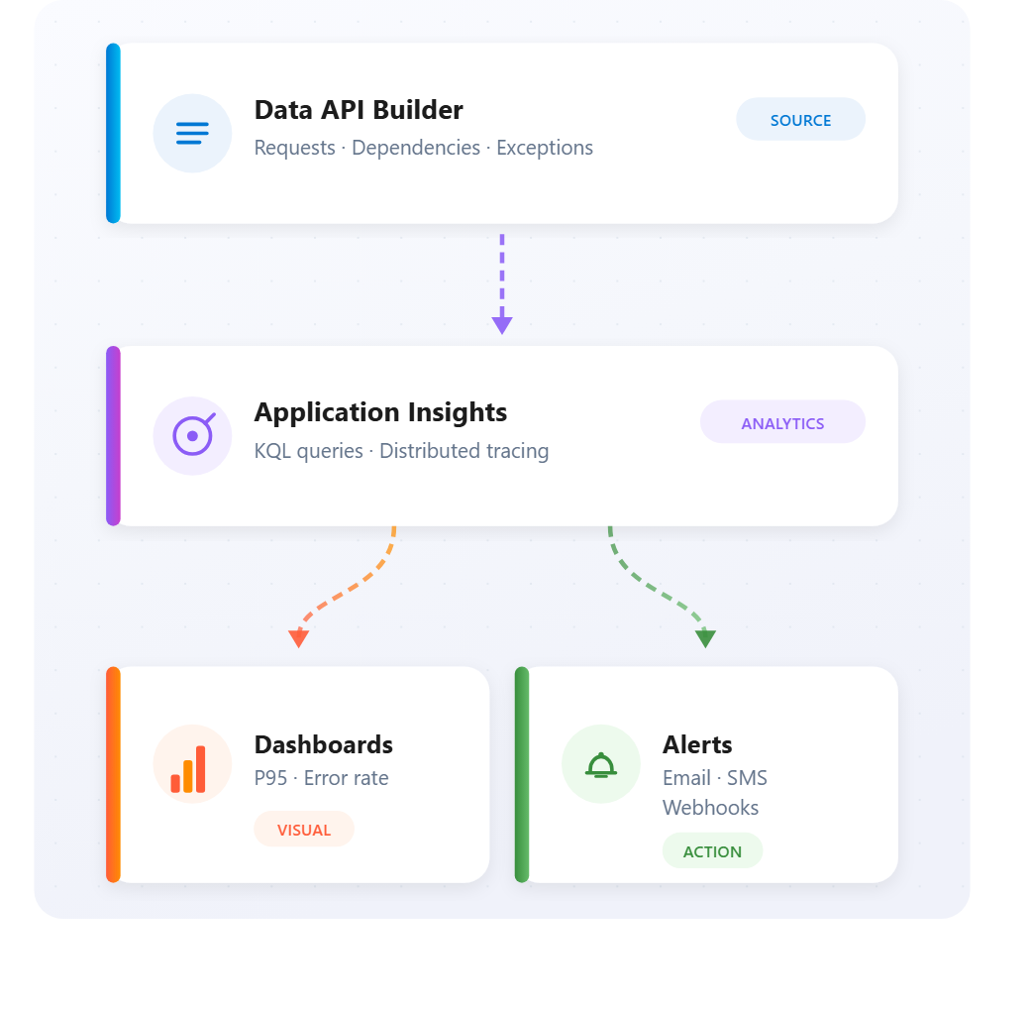
Monitor with Azure services
Application Insights + Log Analytics + alerts
App Insights:
  request traces, dependency calls, exceptions
KQL dashboards:
  P95 latency, failure rate, slow endpoints
Log Analytics:
  container logs + App Insights correlation
Alerts:
  error rate > 5%, P95 > 2 s, sampling for cost control
Distributed tracing:
  end-to-end from client → API → DB
Notes:
Azure Monitor and Application Insights provide observability for Data API Builder in production. Enable Application Insights by setting the APPLICATIONINSIGHTS_CONNECTION_STRING environment variable. DAB detects it automatically and begins sending telemetry.
Application Insights captures request telemetry (every REST and GraphQL request with timing, status, and response size), dependency telemetry (database queries with execution time), exception telemetry (unhandled errors with stack traces), and custom metrics like cache hit rates.
Key monitoring queries use Kusto Query Language (KQL):
- Request metrics: summarize request count, average duration, P95 latency, and failure rate over a time window
- Top slow endpoints: identify the slowest API endpoints to prioritize optimization
- Database query performance: use dependency tracking to find slow or frequently executed SQL queries
Alert rules notify the team when behavior deviates from normal. Examples include high error rate alerts (trigger when failure rate exceeds a threshold over a time window) and response time degradation alerts (trigger when P95 latency exceeds a threshold). A sampling rate should be configured for high-volume production to control costs.
Distributed tracing connects the complete request flow from client through API to database using trace context headers. For resource monitoring, track CPU percentage, memory percentage, network bytes, and replica count to inform autoscaling decisions.

Slide 37
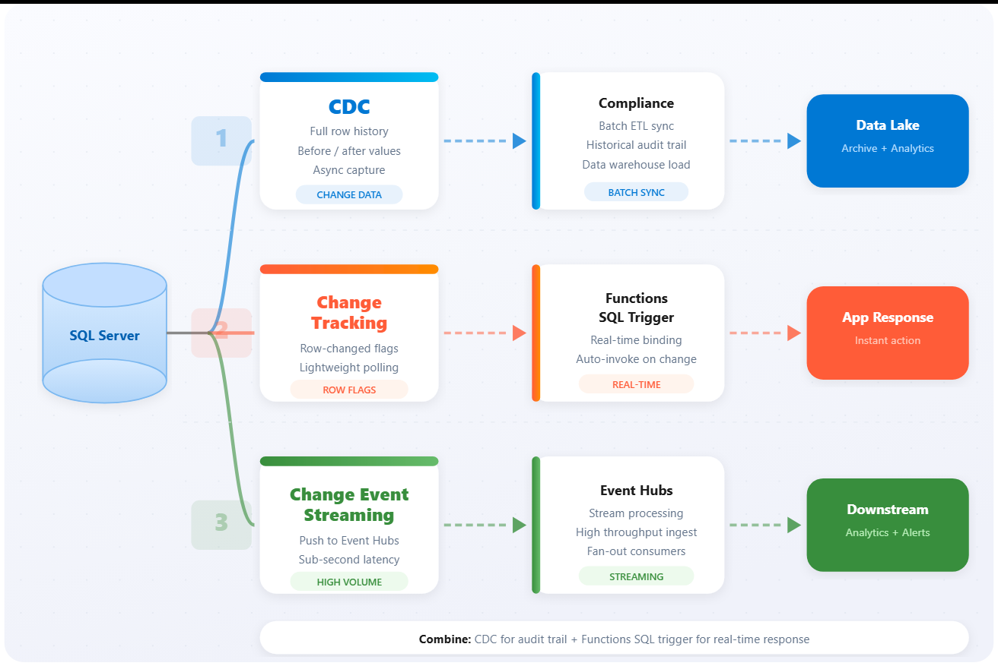
Handle changes with event-driven patterns
CDC, Change Tracking, and Change Event Streaming
CDC:
  full before/after history - compliance, batch sync
Change Tracking:
  lightweight row-changed flags - Functions trigger
CES:
  push to Event Hubs - sub-second latency, high throughput
Functions SQL trigger:
  real-time response via Change Tracking binding
Combine:
  CDC for audit + Functions trigger for real-time
Notes:
Three mechanisms for tracking and responding to database changes:
Change Data Capture (CDC) records insert, update, and delete operations to special change tables, capturing complete before-and-after state. Enable with sp_cdc_enable_db and sp_cdc_enable_table. Query changes using fn_cdc_get_all_changes with log sequence numbers. CDC requires SQL Server Agent to be running and is best for audit requirements and data synchronization where batch processing is acceptable.
Change Tracking is lighter-weight. It records which rows changed without capturing actual values. Enable at the database level (ALTER DATABASE SET CHANGE_TRACKING) and on individual tables. It is the mechanism required by Azure Functions SQL trigger binding. The SQL trigger monitors tables and invokes functions when rows change, receiving batches of SqlChange<T> objects with operation type and current row data.
Change Event Streaming (CES) pushes changes directly to Azure Event Hubs without polling, providing sub-second latency at high throughput. Configure with CREATE EVENT STREAMING GROUP specifying an Event Hub target, then add tables to the group. Changes flow to Event Hubs as transactions commit.
Decision guidance from the unit: use CDC for complete change history and compliance, Change Tracking with Functions for real-time event-driven responses, and CES for sub-second latency and high-volume streaming scenarios. These approaches can be combined. For example, CDC for audit alongside Functions triggers for real-time notifications.

Slide 38
Exercise: Data API Builder
Hands-on lab
Configure Data API Builder (DAB) to expose a product catalog database through REST and GraphQL endpoints. Define entities for tables and views, configure field mappings and relationships, and test locally with Docker.
1
Set up sample ProductCatalog database
2
Install DAB CLI and create configuration
3
Add entities with permissions
4
Configure field mappings and relationships
5
Add a view as read-only entity
6
Test REST and GraphQL with Docker
Notes:
Uses Azure SQL Database and Data API Builder (DAB). DAB is a .NET-based engine that auto-generates REST and GraphQL endpoints from database objects.
Students install the DAB CLI (Microsoft.DataApiBuilder) and run dab init to create a configuration file pointing to the SQL connection string. Each dab add command registers a table or view as an entity with CRUD permissions (anonymous or authenticated).
Field mappings rename database columns to API-friendly names. Relationships link entities (e.g., Products to Categories) so GraphQL nested queries work. Views are added as read-only entities (permissions: read only).
Testing uses dab start with Docker. REST endpoints follow /api/<entity> conventions; GraphQL is at /graphql.
Estimated time: 30 minutes.

Slide 39
Knowledge check - Integrate SQL solutions with Azure services
You're creating a Data API Builder configuration and need to store the database connection string securely without hardcoding it. Which approach should you use?
a) Store the connection string directly in the dab-config.json file for easy access
b) Use the @env() syntax to reference an environment variable containing the connection string
c) Create a separate credentials.json file and import it into the configuration
A development team wants to ensure their Data API Builder entity only allows clients to retrieve data, not modify it. Which permission configuration achieves this?
a) Configure permissions with only the 'read' action for the appropriate roles
b) Set the source type to 'view' which automatically prevents all write operations
c) Disable REST and only enable GraphQL with operation set to 'mutation'
Your organization is deploying Data API Builder to production and needs to use managed identity for database authentication. Which Azure hosting option supports this requirement while also providing automatic scaling based on request volume?
a) Azure Virtual Machines with autoscale sets
b) Azure Container Apps with system-assigned managed identity
c) Azure Functions consumption plan
Notes:
Three knowledge check questions for this module:
Q1: How should you store the database connection string in a DAB configuration? Answer: (b) Use the @env() syntax to reference an environment variable. This keeps credentials out of configuration files and source control. Storing directly in config is a security risk. DAB does not support importing separate credential files. Base64 encoding is not encryption.
Q2: How do you ensure a DAB entity only allows data retrieval, not modification? Answer: (a) Configure permissions with only the 'read' action for the appropriate roles. The source type alone does not control permissions. Setting operation to 'mutation' indicates write operations, the opposite of read-only. The 'anonymous' role has no default permissions - actions must be explicitly defined.
Q3: Which Azure hosting option supports managed identity and automatic scaling based on request volume? Answer: (b) Azure Container Apps with system-assigned managed identity. Container Apps provides automatic scaling from zero and supports managed identity for secure database authentication. VMs require manual configuration. Functions consumption plan is not how DAB runs. Static Web Apps has limitations for managed identity scenarios.
Q4: How do you create alerts when P95 response time exceeds 2 seconds? Answer: (b) Application Insights with a Kusto query using the percentile() function on request duration. Average response time does not capture P95. CPU metrics do not measure response time. Health probes check availability, not response time distribution.

Slide 40
Summary - Integrate SQL solutions with Azure services
What you learned
Azure services integration
DAB config: JSON file → REST + GraphQL, @env() for secrets
Entities: Tables, views, stored procs with mappings + permissions
Deploy: Container Apps, App Service, or Static Web Apps
Monitor: App Insights + KQL dashboards + P95 alerts
Changes: CDC for audit, Change Tracking for Functions, CES for streaming
Notes:
This module covered integrating SQL databases with Azure services through Data API Builder and event-driven patterns.
Key takeaways from the source material:
- Data API Builder eliminates custom API code by generating REST and GraphQL endpoints from a single JSON configuration file
- Entity relationships enable GraphQL clients to traverse connections between tables in single queries, reducing round trips
- Azure Container Apps provides serverless hosting with automatic scaling and managed identity support for production deployments
- Application Insights integration gives visibility into request performance, database queries, and error rates through KQL queries and custom dashboards
- Change capture mechanisms (CDC, Change Tracking, Change Event Streaming) enable event-driven architectures that respond to database modifications in real time, each suited to different latency and throughput requirements

