Slide 1
Implement AI capabilities in database solutions

Slide 2
Agenda
Design and implement models and embeddings with SQL
Design and implement intelligent search with SQL
Design and implement RAG with SQL
Implement AI Capabilities in Database Solutions teaches database professionals to integrate AI models, generate and maintain vector embeddings, implement full-text, vector, and hybrid search, and build complete Retrieval Augmented Generation (RAG) pipelines entirely in T-SQL using Azure SQL Database and Azure OpenAI.
Notes:
This learning path covers three modules that bring AI capabilities into Azure SQL Database and Fabric SQL database using native T-SQL features.
Design and Implement Models and Embeddings with SQL: Evaluating AI models by modality, size, language, and output format, creating external model references with CREATE EXTERNAL MODEL, designing embedding strategies with chunking via AI_GENERATE_CHUNKS, generating and storing vectors with AI_GENERATE_EMBEDDINGS and the native VECTOR data type, and maintaining embeddings with triggers, Change Tracking, CDC, or Azure Functions.
Design and Implement Intelligent Search with SQL: Choosing between full-text, vector, and hybrid search approaches, implementing full-text indexes with CONTAINS, FREETEXT, and CONTAINSTABLE predicates, preparing vector search with VECTOR columns, distance metrics (cosine, Euclidean, dot product), and DiskANN indexes, using VECTOR_DISTANCE for exact and VECTOR_SEARCH for approximate nearest neighbor queries, and combining results with Reciprocal Rank Fusion (RRF) for hybrid search.
Design and Implement RAG with SQL: Understanding when RAG is the right pattern over fine-tuning, preparing retrieval context with FOR JSON AUTO/PATH and WITHOUT_ARRAY_WRAPPER, building augmented prompts with system and user roles using JSON_OBJECT and JSON_ARRAY, calling Azure OpenAI via sp_invoke_external_rest_endpoint with database-scoped credentials, and packaging the complete retrieve-augment-generate pipeline into a reusable stored procedure.

Slide 3
Design and implement models and embeddings with SQL
Notes:
Building intelligent applications with Azure SQL Database involves more than storing and querying relational data. Developers need to integrate AI models, generate embeddings from text, and perform vector searches to enable features like semantic search and RAG. Azure SQL Database and Fabric SQL database support these capabilities through external models, the vector data type, and built-in AI functions.
The scenario: a retail development team uses Azure SQL Database to manage product catalogs, customer reviews, and support documentation. Their work includes generating embeddings from product descriptions, enabling semantic search across support articles, and keeping embeddings current as content changes. All of this happens entirely within T-SQL.
By the end of this module, students will be able to evaluate AI models for SQL workloads, create and manage external models, design embeddings with appropriate chunking strategies, generate and store embeddings using built-in AI functions, and choose maintenance approaches to keep embeddings aligned with source data.

Slide 4
Understand and evaluate models
Key factors when evaluating models for SQL database workloads
Modalities
Language
Size
Output
Foundry
Text, images, or structured data
Choose based on your stored data types
Multilingual support for global apps
Matches content across regions
Larger = stronger reasoning
Smaller = lower latency and cost
Structured JSON for SQL integration
Process responses programmatically
Model catalog to compare and select
Benchmarks, versions, lifecycle status
These characteristics influence whether a model is a good fit for generating embeddings, supporting RAG patterns, or enabling conversational access to database content.
Notes:
LLMs enable applications to generate responses, summarize information, and reason over user input, and their usefulness increases when they can access application data stored in a database. Before integrating a model, it's important to understand how different models behave.
Models differ in several key characteristics. Modalities vary across models. Some process only text, others support images or structured data. Language support matters when applications serve users across regions or content spans multiple languages. Model size and capacity matter because larger models provide stronger reasoning but consume more tokens with higher latency and cost; smaller models may suit focused tasks like embedding generation. Structured output also matters. Models that produce JSON are easier to integrate into SQL workflows where responses must be processed programmatically.
Selecting a model is a design decision affecting performance, cost, and maintainability. Consider the type and format of data stored, performance and scalability requirements, language or modality needs, and deployment lifecycle considerations. Microsoft Foundry Models provides a catalog for evaluating models, exposing capabilities, benchmarks, version details, and lifecycle status to help ensure the selected model aligns with SQL-based application requirements.

Slide 5
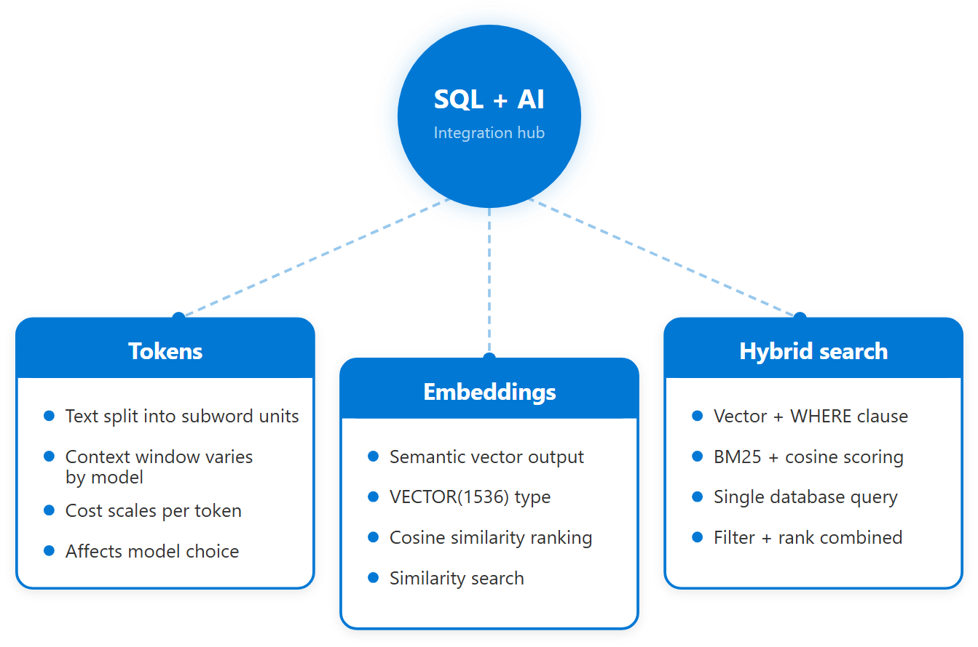
How models interact with SQL data
Key concepts for SQL: AI integration
Tokens:
  Text split into sub-word units
Embeddings:
  Vectors representing semantic meaning
Hybrid search:
  Combine vector + relational queries
One database:
  No separate search service needed
Notes:
Azure SQL Database and Fabric SQL database support intelligent application patterns by combining relational storage with AI features such as vector data types and vector functions. A common pattern is RAG, where relevant data is retrieved from the database and supplied to a model as context before generating a response, grounding it in application data rather than the model's pretrained knowledge.
Several concepts affect how models interact with database data. Tokens are the units models use to process text. They are small chunks like words, parts of words, or punctuation. Token counts matter for two reasons: input limits (a model might accept 8,000 or 128,000 tokens per request, constraining how much context you include) and cost (providers charge per token, so efficient text handling directly affects operating expenses).
Embeddings represent data as vectors that enable semantic similarity comparisons. Because vectors live alongside relational data in Azure SQL Database, you can combine vector similarity search with standard SQL by narrowing results with WHERE clauses, joining to related tables, or blending vector cosine rankings with full-text BM25 scores. This combination of vector search with regular SQL operations is known as hybrid search: you query one database that handles both semantic similarity and relational filtering together, instead of sending requests to a separate search service.

Slide 6
Create and manage external models
CREATE EXTERNAL MODEL
AI functions
Authentication
Define endpoint URL and model type
Set API_FORMAT (e.g. Azure OpenAI)
Reference from any AI function by name
ALTER to update without rewriting queries
AI_GENERATE_EMBEDDINGS: vector output
Other AI-assisted operations supported
Pass model name in USE MODEL clause
Results integrate with T-SQL queries
Managed Identity (recommended)
Grant Cognitive Services OpenAI User
API key via DATABASE SCOPED CREDENTIAL
GRANT EXECUTE ANY EXTERNAL ENDPOINT
Notes:
An external model is a database object that stores metadata about an AI model endpoint, including the endpoint URL, authentication details, and model-specific configuration. External models don't run inside SQL Server; they act as a managed reference that allows SQL Server to call an external AI service when executing AI functions. Once created, they can be reused across queries and workloads.
You create an external model using CREATE EXTERNAL MODEL, specifying LOCATION (the endpoint URL), API_FORMAT, MODEL_TYPE, MODEL, CREDENTIAL, and optional PARAMETERS. Before creating the model, you need a database-scoped credential: either Managed Identity (recommended for Azure SQL Database. Grant the Cognitive Services OpenAI User role) or an API key stored via HTTPEndpointHeaders. Avoid hardcoding API keys; use managed identities when possible for better security and easier key rotation.
Once created, AI functions like AI_GENERATE_EMBEDDINGS reference the external model to determine which endpoint to call and how to authenticate. You can update models with ALTER EXTERNAL MODEL to change endpoints, credentials, or configuration without rewriting dependent queries. Because external models are database-scoped objects, they fit into existing database management practices like permissions, deployment pipelines, naming conventions, and lifecycle management alongside other schema objects. The EXECUTE ANY EXTERNAL ENDPOINT permission must be granted to users or roles that call external endpoints.

Slide 7
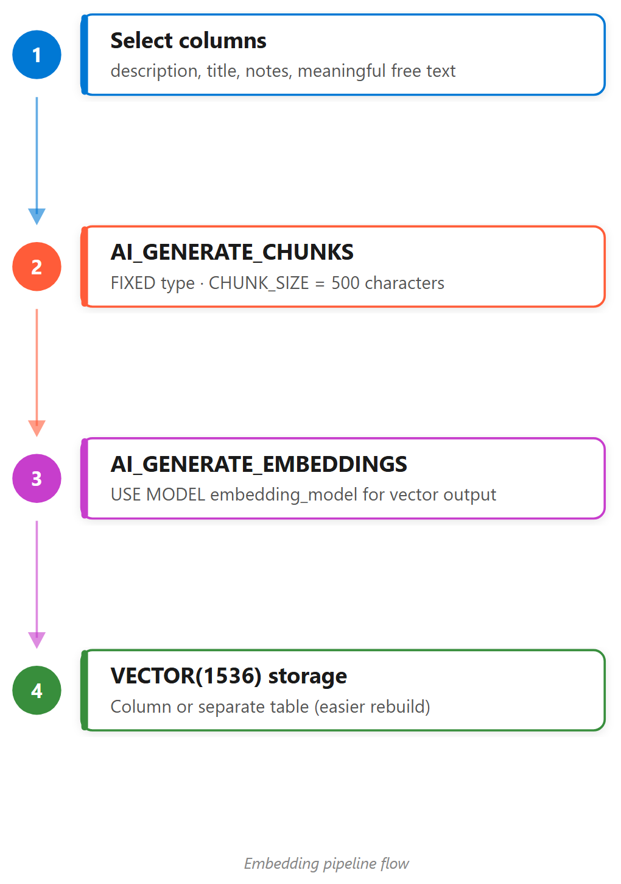
Design embeddings for SQL workloads
Chunking and input design
Choose meaningful columns:
  Descriptions, titles, free-form text
Exclude noise:
  IDs, numeric values, operational metadata
Chunk long text:
  AI_GENERATE_CHUNKS with FIXED type
Balance chunk size:
  Too large = diluted; too small = no context
Store vectors separately:
  Easier rebuild, track space usage
Notes:
Embeddings represent data as vectors so that similarity between pieces of text can be compared. An AI model creates a vector. SQL sends text to the model and the model returns a list of numbers representing the meaning of that text. For example, "lightweight hiking backpack" might produce [0.12, -0.87, 0.45, 0.31, ...], and "compact backpack for day hikes" produces a similar vector [0.10, -0.85, 0.47, 0.29, ...]. Because the vectors are similar, SQL treats the two texts as related even though the wording differs.
Embeddings work best on text that carries semantic meaning, such as descriptions, titles, free-form text. Columns storing identifiers, numeric values, or operational metadata usually don't add semantic value and should be excluded. Limiting embeddings to meaningful text reduces token usage and improves similarity results.
Embedding models impose token limits on input, so long text values need to be divided into smaller units. This process is called chunking. Chunks that are too large may exceed limits or dilute semantic focus; chunks that are too small lose important context. AI_GENERATE_CHUNKS(SOURCE = description, CHUNK_TYPE = FIXED, CHUNK_SIZE = 500) handles this directly in SQL. One design pattern is storing vectors in a separate table from source text data. A dedicated embeddings table makes it easier to track space usage and rebuild embeddings without affecting the original data.

Slide 8
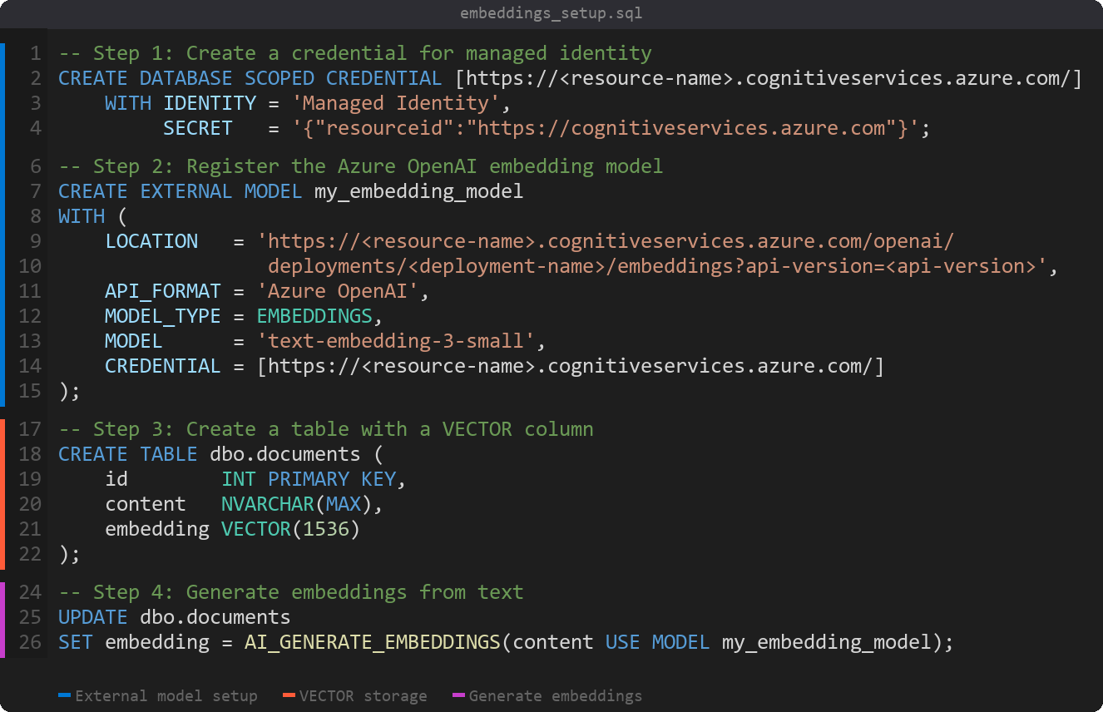
Design embeddings for SQL workloads (continue)
External model setup workflow
Create a credential first:
Managed Identity (recommended)
or API key authentication
Register the external model:
Database object with endpoint URL,
format, and model name
Store vectors in VECTOR columns:
Native type with fixed dimensions
(e.g. 1536 for text-embedding-3-small)
Generate with AI functions:
AI_GENERATE_EMBEDDINGS calls
the model and returns vectors
Notes:
Before using AI functions, you need to set up the infrastructure. Start by creating a database-scoped credential using either Managed Identity (recommended for Azure SQL Database) or an API key stored via HTTPEndpointHeaders. Then register the external model with CREATE EXTERNAL MODEL, specifying the endpoint URL, API format, model type, and credential reference.
Store the resulting vectors in columns using the VECTOR data type with fixed dimensions matching the model output (for example, 1536 dimensions for text-embedding-3-small). Once the model and storage are in place, use AI_GENERATE_EMBEDDINGS to send text to the model and store the returned vectors for similarity queries.

Slide 9
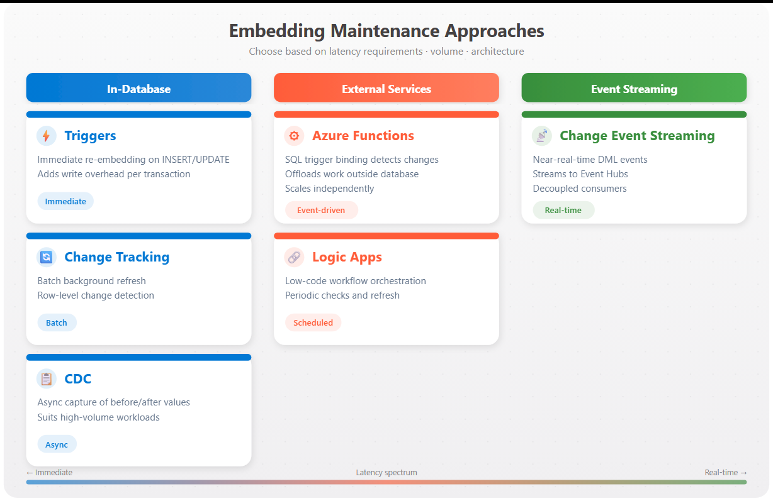
Generate and maintain embeddings
Keeping vectors current
UPDATE SET embedding = AI_GENERATE_EMBEDDINGS(...)
Batch initial load: Then incremental refresh
VECTOR(1536) data type: Efficient vector storage
Choose maintenance: Based on volume, latency, architecture
Notes:
AI_GENERATE_EMBEDDINGS generates embeddings directly from text stored in database columns, using an external model to convert text into a vector. A common pattern is generating embeddings during initial load or as a batch process. You create a table with a VECTOR(1536) column, then UPDATE the table: SET embedding = AI_GENERATE_EMBEDDINGS(description USE MODEL my_embedding_model). Each row's text is sent to the model, and the returned vector is stored for later querying.
Generating embeddings is not a one-time operation. When source data changes, embeddings may fall out of sync. The module covers several maintenance approaches:
- Table triggers: run automatically on insert/update, can mark rows needing new embeddings or regenerate immediately. Reflects changes quickly but adds work to write operations.
- Change Tracking: records that a row changed since a given point; a background process identifies rows needing refreshed embeddings and processes them in batches.
- Change Data Capture (CDC): records detailed before/after values; embedding maintenance uses CDC tables to identify changed text and regenerate asynchronously. Suitable for high-volume workloads.
- Azure Functions with SQL trigger binding: runs embedding generation outside the database engine, responding to data changes while scaling independently.
- Logic Apps: orchestrate embedding updates as part of workflows, periodically checking for changed rows.
- Change Event Streaming: streams DML changes to Azure Event Hubs in near real-time, decoupling embedding generation from the database.
- Microsoft Foundry: manages and evaluates the models generating embeddings, while another process handles change detection.
The right approach depends on data volume, update frequency, latency requirements, and where embedding generation fits in the overall solution.

Slide 10
Exercise: Generate and update embeddings
Hands-on lab
Generate and store vector embeddings in Azure SQL Database using AI_GENERATE_EMBEDDINGS with an Azure OpenAI model. Configure managed identity, create external model references, generate embeddings in batches, validate with vector search, and explore embedding maintenance when source data changes.
1
Provision Azure SQL Database and Azure OpenAI
2
Configure managed identity access
3
Create credential and external model
4
Add vector column and generate embeddings
5
Verify with VECTORPROPERTY
6
Validate with vector similarity search
7
Explore stale embedding maintenance
Notes:
Uses Azure SQL Database and Azure OpenAI (text-embedding-3-small model).
The database's system-assigned managed identity must be granted the Cognitive Services OpenAI User role on the Azure OpenAI resource. Students create a DATABASE SCOPED CREDENTIAL and EXTERNAL MODEL referencing the OpenAI deployment.
The vector column uses the new vector(1536) data type (1536 dimensions for text-embedding-3-small). AI_GENERATE_EMBEDDINGS calls the model directly from T-SQL. Batch processing handles large tables in chunks to avoid API throttling.
VECTORPROPERTY returns metadata (dimensions, type) for validation. Vector similarity search uses VECTOR_DISTANCE with cosine similarity. The final exercise discusses how embeddings become stale when source text changes, requiring regeneration.
Estimated time: 45 minutes.

Slide 11
Knowledge check - Design and implement models and embeddings
What is an external model in Azure SQL Database?
a) A database object that stores metadata about an AI model endpoint
b) A machine learning model that runs inside the SQL Server engine
c) A copy of an AI model downloaded to the database server
What is the purpose of chunking in embedding design?
a) To compress vectors for faster storage
b) To divide large text into smaller segments that fit within token limits
c) To encrypt sensitive data before embedding
What data type does Azure SQL Database use to store embeddings?
a) NVARCHAR(MAX)
b) VECTOR
c) JSON
Notes:
Question 1: "What is an external model in Azure SQL Database?" Answer: A database object that stores metadata about an AI model endpoint. As covered in the unit, external models store metadata such as the endpoint URL, authentication details, and model configuration. They don't run inside the SQL engine or download model files. They reference endpoints hosted elsewhere.
Question 2: "What is the purpose of chunking in embedding design?" Answer: To divide large text into smaller segments that fit within token limits. Chunking applies to input text, not resulting vectors. It splits text into manageable pieces that stay within model token limits while preserving semantic meaning.
Question 3: "What data type does Azure SQL Database use to store embeddings?" Answer: VECTOR. The VECTOR data type is designed to store embeddings efficiently and supports vector operations like similarity comparison. While vectors can be represented as JSON arrays, the dedicated data type provides optimized storage and operations.

Slide 12

Summary - Design and implement models and embeddings
What you learned
Models & embeddings
Evaluate AI models By modality, size, language, and output format
Create external models With CREATE EXTERNAL MODEL in T-SQL
Design embeddings With chunking via AI_GENERATE_CHUNKS
Generate embeddings With AI_GENERATE_EMBEDDINGS and VECTOR(1536)
Maintain embeddings Using triggers, Change Tracking, CDC, or Functions
Notes:
This module covered designing and implementing models and embeddings for Azure SQL Database and Fabric SQL database. Students learned how to evaluate AI models based on capabilities and performance requirements by considering modalities, language support, model size, and structured output. They created external models using CREATE EXTERNAL MODEL to reference AI endpoints from T-SQL, and designed embeddings with appropriate chunking strategies using AI_GENERATE_CHUNKS.
They explored generating embeddings with AI_GENERATE_EMBEDDINGS and storing them in VECTOR columns, then learned how to choose maintenance approaches to keep embeddings aligned with source data, from triggers and Change Tracking for tight coupling, to CDC, Change Event Streaming, and Azure Functions for asynchronous or decoupled approaches.

Slide 13
Design and implement intelligent search with SQL
Notes:
Finding relevant information in a database often requires more than matching keywords. Users search for concepts, not just words. A customer looking for "lightweight hiking backpack" might find nothing if the product is listed as "ultralight trail bag." SQL Server and Azure SQL Database provide multiple search approaches: full-text search for keyword matching, vector search for semantic similarity, and hybrid search that combines both.
The scenario for this module: a retail team building a product search feature. They have embeddings stored for product descriptions and support articles. Some customers type exact product names, others describe what they need in natural language. The team decides to implement hybrid search so the application handles both patterns effectively.
By the end of this module, students can evaluate full-text, vector, and hybrid search for different query types, implement full-text search with indexes and predicates, prepare databases for vector search with embeddings and distance metrics, write vector search queries with VECTOR_DISTANCE and VECTOR_SEARCH, and combine results using Reciprocal Rank Fusion (RRF).

Slide 14
Choose a search approach
Full-Text Search
Vector Search
Hybrid Search
CONTAINS · FREETEXT predicates
Keyword matching with linguistic rules
Inflectional forms: ride → riding, rode
BM25 relevance scoring
Best for exact term lookups
VECTOR_DISTANCE · VECTOR_SEARCH
Semantic similarity via embeddings
Finds meaning, not just words
Cosine, Euclidean, or dot metrics
Best for concept-based queries
Full-text + vector combined
RRF merges ranked lists fairly
1/(k + rank) scoring per source
FULL OUTER JOIN includes all
Best of both approaches
Your choice depends on how users search and what trade-offs you can accept between precision, recall, and performance.
Notes:
SQL Server and Azure SQL Database provide three ways to search text data. Full-text search looks for words and phrases. When a customer searches for "mountain bike helmet," it finds products containing those exact terms and understands language rules so "ride" also finds "riding" or "rode." Semantic vector search looks for meaning instead of matching words. For example, "something to keep me visible on evening rides" finds "reflective cycling vest" or "LED bike lights" even though those words don't appear in the search. Hybrid search uses both, running a full-text search and a vector search, then combining the results.
Choosing the right approach involves trade-offs. Full-text search returns fewer results but they closely match query terms (high precision). Vector search returns more results including conceptually related items (better recall). Full-text needs a full-text index on text columns; vector search needs embeddings stored in vector columns. Full-text indexes are optimized for fast keyword lookup; vector performance depends on how many vectors you're comparing and whether you use exact or approximate methods.
When you can't predict how users search, hybrid search covers both cases. Reciprocal Rank Fusion (RRF) combines two ranked lists into one using the formula 1/(rank + k) where k is 60. Documents appearing in multiple result sets have their scores summed, so items that perform well across both search methods rise to the top. RRF works on rank positions rather than raw scores, which avoids problems with different scoring scales.

Slide 15
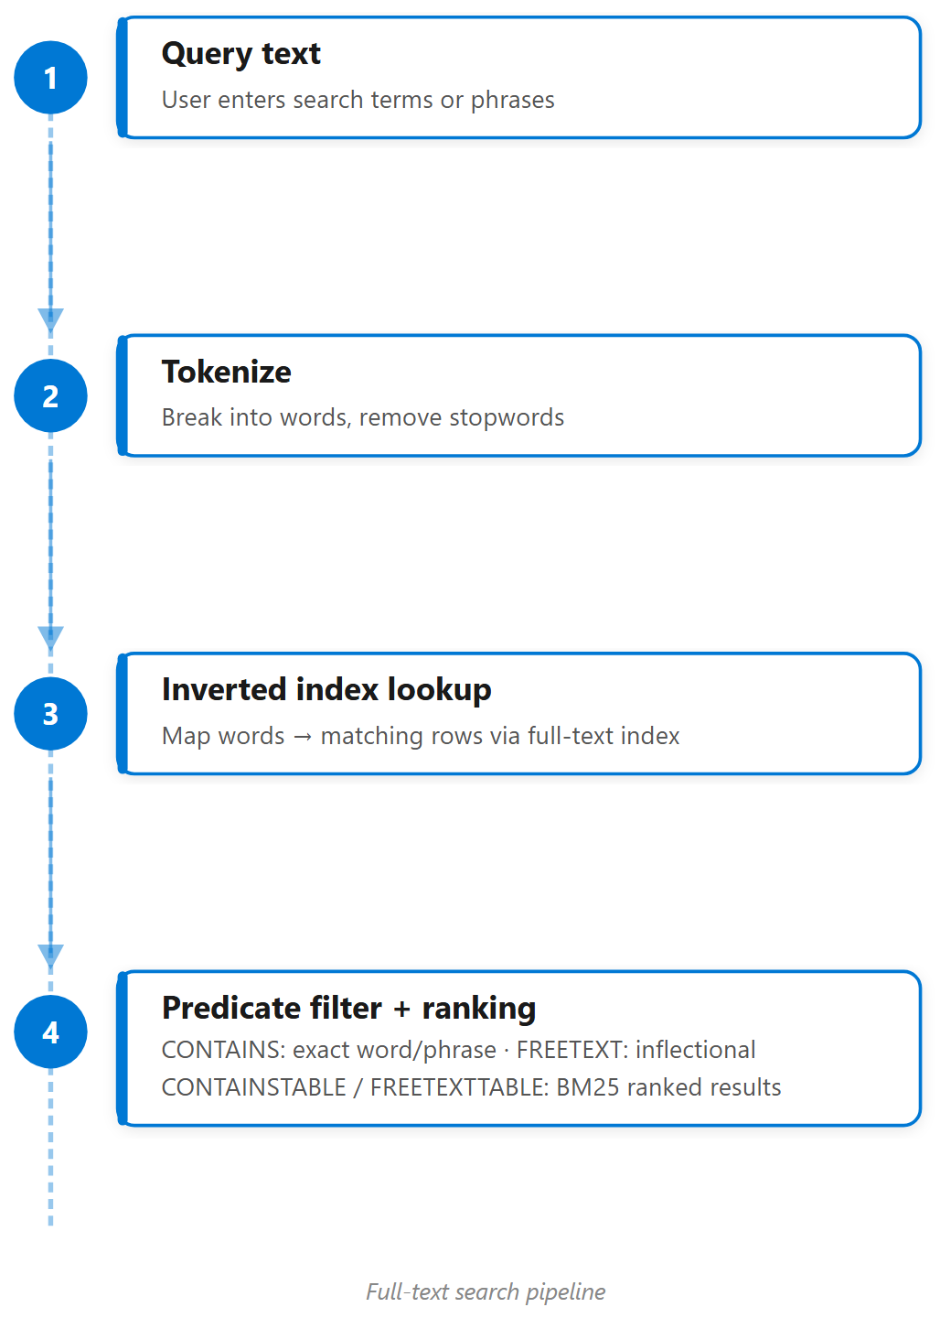
Implement full-text search
Indexes, predicates, and query patterns
Full-text index:
  Tokenizes text, removes stopwords, inverted index
CONTAINS:
  Exact word/phrase matching with control
FREETEXT:
  Automatic inflectional expansion
CONTAINSTABLE:
  Returns ranked results with BM25 scores
Patterns: Term,
  phrase, prefix, inflectional, proximity
Notes:
Full-text search lets you run linguistic searches against text data. Unlike the LIKE operator, which only matches character patterns, full-text search understands words, phrases, and language rules. It handles inflections out of the box. Searching for "ride" finds "riding," "rides," and "rode."
Full-text search requires two things: a full-text index on your text columns, and predicates to query that index. The full-text index breaks text into tokens, removes stopwords (common words like "the" and "is"), and builds an inverted index mapping words to the rows containing them. Two main predicates query this index: CONTAINS searches for exact matches of words and phrases, while FREETEXT searches for meaning and automatically looks for inflectional forms. The table-valued functions CONTAINSTABLE and FREETEXTTABLE return ranked results with relevance scores, useful for sorting by how well they match.
Several query patterns address different search needs: term search for a specific word, phrase search for words in a specific order (wrapped in quotes), prefix search for words starting with specific characters (using an asterisk wildcard), inflectional search with FORMSOF(INFLECTIONAL) for different word forms, and proximity search with NEAR for words appearing close together. When evaluating results, watch for precision problems (irrelevant items), noise (common words diluting results), and query intent mismatch (users searching for concepts rather than words. This is a signal you might need vector or hybrid search).

Slide 16
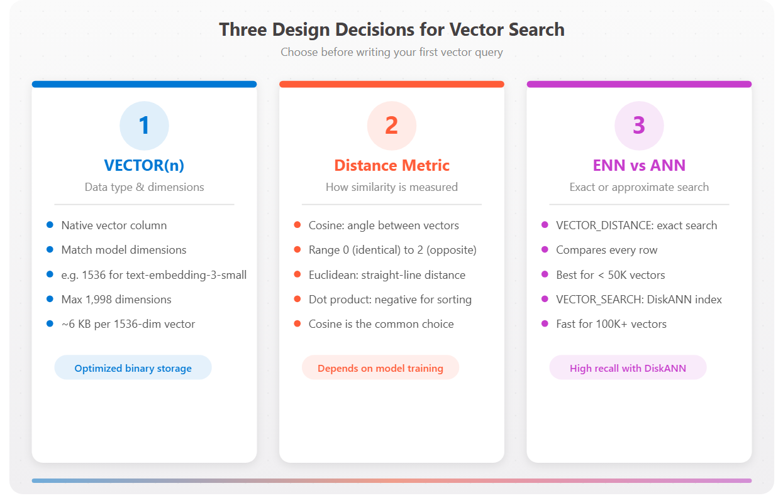
Prepare SQL vector search
Three design decisions before your first query
Vector column:
  VECTOR(n): match embedding model dimensions
Distance metric:
  Cosine (0: 2), Euclidean (0: ∞), dot product
Search type:
  Exact (VECTOR_DISTANCE) vs. approximate (VECTOR_SEARCH)
DiskANN index:
  Graph structure for fast approximate retrieval
Trade-off:
  Exact = guaranteed accuracy;
  approximate = speed at scale
Notes:
Before running vector searches, you need to store vectors and make design decisions. SQL Server and Azure SQL Database provide a native vector data type for storing embeddings. Each vector is an array of floating-point numbers stored in optimized binary format. When defining a vector column, specify the number of dimensions to match your embedding model. For example, OpenAI's text-embedding-3-small produces 1,536 dimensions, so the column is VECTOR(1536). Maximum supported is 1,998 dimensions. Each element is a 4-byte float, so a 1,536-dimension vector uses about 6 KB per row.
SQL Server supports three distance metrics. Cosine distance measures the angle between vectors, ignoring magnitude. The range is 0 (identical) to 2 (opposite). Euclidean distance measures straight-line distance. The range is 0 to infinity. Dot product calculates the sum of element-wise products, returned as negative so smaller values indicate more similar vectors. Most embedding models are optimized for cosine similarity, making cosine distance the common choice.
You choose between exact nearest neighbor (ENN) with VECTOR_DISTANCE, which compares the query vector against every row (good for under 50,000 vectors), and approximate nearest neighbor (ANN) with VECTOR_SEARCH and a DiskANN index, which trades perfect accuracy for speed on larger datasets. Vector indexes have specific limitations: the table needs a single-column integer primary key, tables with vector indexes become read-only (you must drop the index to modify data), and vector indexes can't be partitioned.

Slide 17
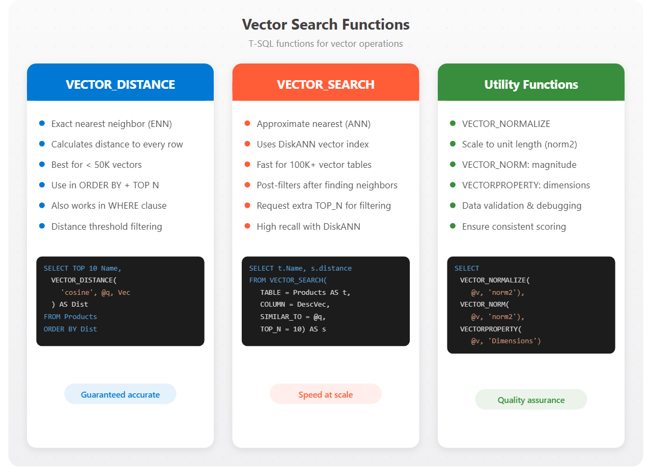
Vector search functions
Notes:
Four T-SQL functions power vector search. VECTOR_DISTANCE calculates distance between two vectors using a specified metric (cosine, euclidean, or dot) and performs exact nearest neighbor search. It compares the query against every qualifying row. The typical pattern is to generate an embedding for the search phrase with AI_GENERATE_EMBEDDINGS, then SELECT TOP N with ORDER BY VECTOR_DISTANCE to get the closest matches. You can also use VECTOR_DISTANCE in a WHERE clause with a threshold (like < 0.3) when you want everything meeting a quality bar rather than a fixed count.
VECTOR_SEARCH uses a vector index for approximate nearest neighbor retrieval on large datasets. It returns all source columns plus a distance column. An important behavior: WHERE clause conditions are applied after finding the nearest neighbors, not before. If you request TOP 10 and then filter by category, you might get fewer results. The workaround is to request more candidates (e.g., TOP 50) and then apply TOP 10 after filtering.
VECTOR_NORMALIZE scales vectors to unit length. This is useful when comparing vectors from multiple sources or when your model doesn't normalize outputs. The norm_type can be norm2 (Euclidean, most common), norm1, or norminf. Most modern embedding models already produce normalized vectors. VECTORPROPERTY returns metadata about a vector (Dimensions and BaseType) for validating data or debugging dimension mismatches.

Slide 18
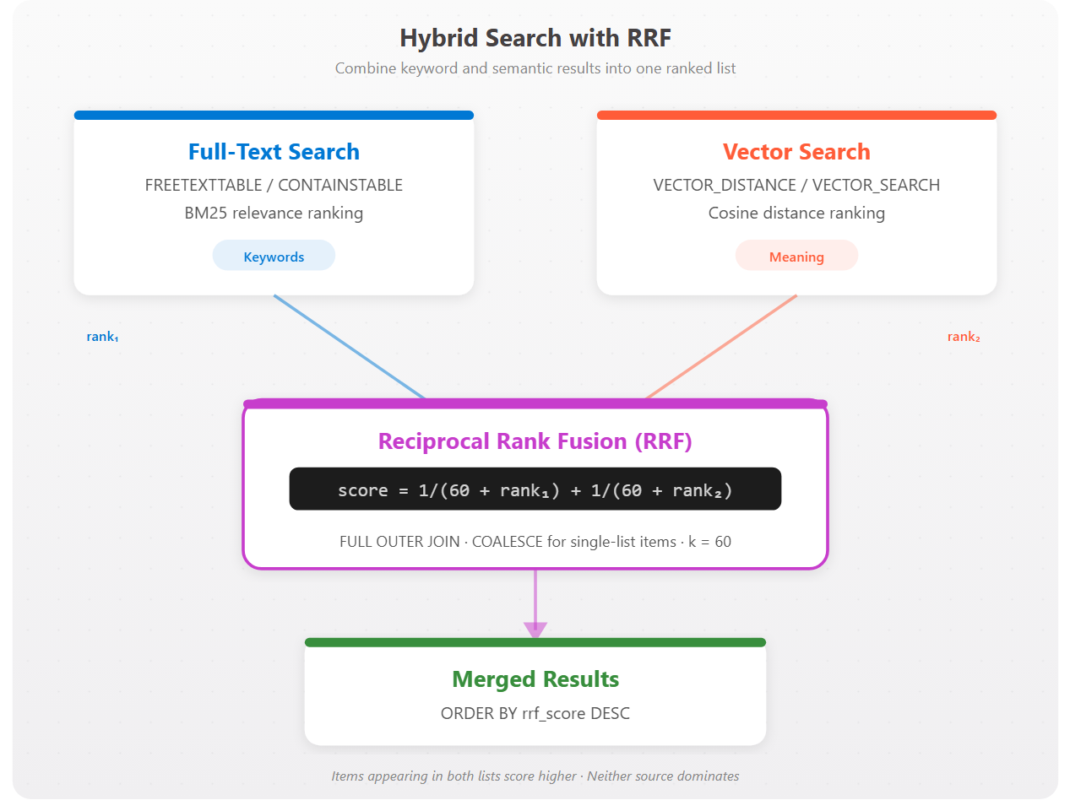
Hybrid search and RRF
Combine full-text and vector results
Hybrid pattern:
  Run both searches, merge with RRF
RRF formula:
  1/(k + rank) per source; sum across sources
k = 60:
  Standard constant from original RRF research
FULL OUTER JOIN:
  Include results from either search
Weighting:
  Multiply one source’s contribution to bias results
Evaluate:
  Precision, recall, MRR on test query sets
Notes:
Hybrid search runs a full-text search and a vector search in parallel, then merges results with Reciprocal Rank Fusion (RRF). Full-text search uses FREETEXTTABLE or CONTAINSTABLE to find keyword matches ranked by BM25. Vector search uses VECTOR_DISTANCE or VECTOR_SEARCH to find similar embeddings ranked by distance. RRF combines these using rank positions with the formula: RRF_score = 1/(k + rank_from_source_1) + 1/(k + rank_from_source_2), where k is typically 60.
RRF has two key advantages: score normalization is not needed (BM25 scores and cosine distances use completely different scales, but RRF uses ranks instead), and neither source dominates. The implementation uses CTEs: keyword_search runs FREETEXTTABLE with RANK() for positions, vector_search calculates distances with RANK() for positions, combined uses a FULL OUTER JOIN so products from either list are included with COALESCE handling missing ranks as zero, and the final SELECT joins back to get full details ordered by RRF score.
Tunable parameters include the result set size (@topN, start with 50), the RRF constant (@rrfK, standard is 60), and optional weighting to favor one source over the other (multiply the contribution). Search quality can be measured with precision (percentage of results that are relevant), recall (percentage of relevant documents found), and Mean Reciprocal Rank (how high the first relevant result appears). Hybrid search typically improves recall compared to either approach alone.

Slide 19
Exercise: Implement intelligent search
Hands-on lab
Implement and compare three search approaches in Azure SQL Database: full-text search with keyword predicates, vector search with DiskANN indexes, and hybrid search combining both via Reciprocal Rank Fusion (RRF).
1
Create full-text index on reviews
2
Search with CONTAINS, FREETEXT, CONTAINSTABLE
3
Search with VECTOR_DISTANCE and VECTOR_SEARCH
4
Combine with hybrid search using RRF
5
Compare all three approaches
Notes:
Uses Azure SQL Database with the product reviews data and embeddings from Module 9.
Full-text search requires a full-text catalog and index on the review text column. CONTAINS searches for exact words/phrases, FREETEXT searches for meaning (inflectional forms), and CONTAINSTABLE returns ranked results with a KEY and RANK column.
Vector search uses VECTOR_DISTANCE (cosine) or VECTOR_SEARCH with a DiskANN index for approximate nearest neighbor at scale.
Hybrid search combines both approaches using Reciprocal Rank Fusion (RRF): each result gets a score of 1/(k+rank) from each method, and scores are summed. The comparison exercise runs the same question through all three approaches so students can see how keyword search, semantic search, and hybrid search return different (and overlapping) results.
Estimated time: 30 minutes.

Slide 20
Knowledge check - Design and implement intelligent search with SQL
Which full-text predicate finds documents containing words that are inflectional forms of a search term, such as finding 'running' when searching for 'run'?
a) CONTAINS with FORMSOF(INFLECTIONAL)
b) FREETEXT
c) Both CONTAINS with FORMSOF(INFLECTIONAL) and FREETEXT
What is the range of cosine distance values when comparing two vectors?
a) -1 to 1
b) 0 to 1
c) 0 to 2
Which function should be used for vector search on a table with 500,000 rows when query speed is the priority?
a) VECTOR_DISTANCE
b) VECTOR_SEARCH
c) VECTOR_NORMALIZE
Notes:
Question 1: "Which full-text predicate finds inflectional forms?" Answer: Both CONTAINS with FORMSOF(INFLECTIONAL) and FREETEXT. FREETEXT automatically expands to inflectional forms, and CONTAINS can do this explicitly using FORMSOF(INFLECTIONAL, term).
Question 2: "What is the range of cosine distance values?" Answer: 0 to 2. Cosine distance ranges from 0 (identical vectors) to 2 (completely opposite vectors). This is different from cosine similarity, which ranges from -1 to 1.
Question 3: "Which function for vector search on 500,000 rows when speed is priority?" Answer: VECTOR_SEARCH. It uses a DiskANN vector index for approximate nearest neighbor search, which is much faster for large datasets than VECTOR_DISTANCE (exact search calculating distance to every row).

Slide 21
Summary - Design and implement intelligent search with SQL
What you learned
Intelligent search
Search approaches: Full-text, vector, and hybrid trade-offs
Full-text search: Indexes, CONTAINS, FREETEXT, ranked results
Vector preparation: VECTOR(n), distance metrics, ENN vs ANN
Vector functions: VECTOR_DISTANCE, VECTOR_SEARCH, NORMALIZE
Hybrid search: RRF merges ranked lists without normalization
Notes:
This module covered designing and implementing intelligent search capabilities for SQL Server and Azure SQL Database. Full-text search excels at finding exact keywords and phrases using full-text indexes and predicates like CONTAINS and FREETEXT. Vector search uses embeddings stored in native vector columns with VECTOR_DISTANCE for exact search on smaller datasets and VECTOR_SEARCH with DiskANN indexes for approximate search on larger ones. Three distance metrics are available: cosine, euclidean, and dot product.
Hybrid search combines both approaches to handle keyword-focused and concept-focused queries. Reciprocal Rank Fusion merges the ranked results without requiring score normalization, using rank positions and the formula 1/(k + rank) to treat both sources fairly. Students learned to evaluate trade-offs between precision and recall, tune parameters like result set size and weighting, and measure quality with precision, recall, and Mean Reciprocal Rank.

Slide 22
Design and implement
RAG with SQL
Notes:
Large language models can answer questions, summarize content, and generate text, but they only know what they learned during training. Ask about your company's products, customer orders, or compatible components, and the model has no useful answer. Retrieval Augmented Generation (RAG) solves this by giving the model access to your data at query time. You retrieve relevant products from your database and include them in the prompt, so the model generates a response grounded in actual, current information.
RAG keeps AI processing inside the database layer, where your data already lives. This avoids moving data between systems and lets you use T-SQL to control what context the model receives. The scenario used throughout this module: a retail team building a customer support application. A customer asks "Which gloves work best for cold weather cycling?" The application searches the catalog, finds matching accessories, and generates a response using an LLM. That's RAG in action.
By the end of this module, students will be able to: identify when RAG is the right approach, convert SQL results to JSON for LLM processing, construct prompts that combine instructions with database context, call LLM endpoints from SQL, and parse responses back to the application.

Slide 23
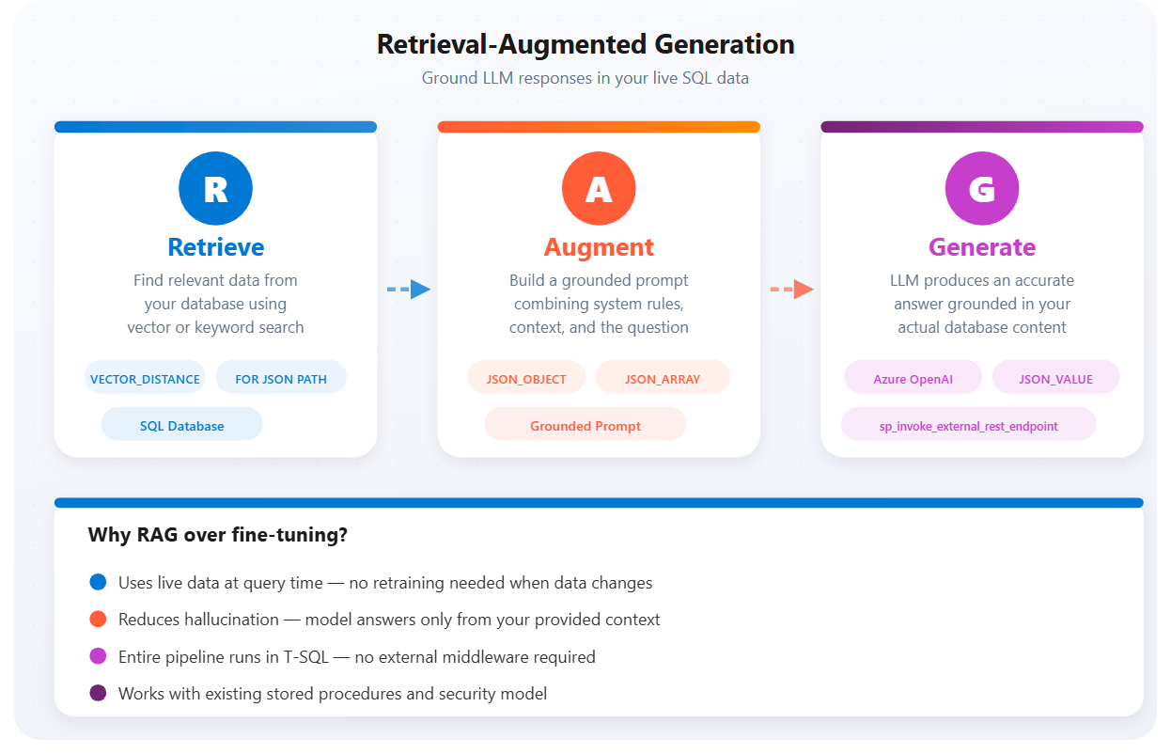
What is RAG?
The problems RAG solves
LLMs hallucinate when they lack context
Fine-tuning is expensive and static
RAG retrieves live data at query time
The model generates grounded answers
All processing stays inside the database
Notes:
LLMs do not know your organization, including your products, customers, or policies. When a customer asks "Which pedals fit the mountain bike I bought last month?", the model can only guess. RAG fixes this by feeding the model your data when it needs to answer: retrieve information from your database, add it to the prompt, and let the model respond based on what you provided.
RAG combines three steps. First, retrieve relevant data from your database. For the pedals question, find the customer's order, identify the bike model, and look up compatible components. Second, augment the prompt by adding that data as context so the model receives both the question and the information to answer it. Third, the model generates a response grounded in your data rather than its training.
This approach differs from fine-tuning, which retrains a model on your data. Fine-tuning bakes knowledge in permanently. RAG keeps data in your database and supplies only what each request needs. When specs change or new components arrive, answers reflect those changes immediately. Azure SQL Database and SQL Server 2025 participate in RAG without hosting models. Your database stores data and embeddings, T-SQL handles retrieval using full-text, vector, or hybrid search, you format results as JSON, construct prompts, call the LLM via sp_invoke_external_rest_endpoint, and parse responses. The LLM runs elsewhere (e.g., Azure OpenAI), while your T-SQL orchestrates the entire flow.

Slide 24
When to use RAG with SQL
Customer support
Knowledge bases
Sales and configuration
Answer product questions from live catalog data
Look up orders, warranties, and policies
Responses always reflect current inventory
Internal documentation Q&A for employees
Compliance and regulatory lookups
Onboarding guides grounded in company data
Pricing and availability from transactional data
Product recommendations from real specs
Compatibility checks across components
Notes:
RAG works when data changes frequently. Fine-tuned models cannot keep pace with daily inventory updates, but RAG retrieves current data every time. It also fits when you need to trace answers, since you control retrieval and know which records informed each response. Privacy matters too: fine-tuning sends data to the model provider for training, while RAG keeps data in your database and sends only the context needed per request.
The module describes several common scenarios where SQL-based RAG adds value:
- Customer support: "Can I return the bike I ordered three weeks ago?" The system retrieves their order history, checks the return policy, and generates an answer citing the specific order.
- Product configuration: "Build me a complete mountain biking setup under $2,000." RAG retrieves compatible frames, components, and accessories, checks inventory and pricing, and assembles a configuration meeting the budget.
- Internal knowledge base: An employee needs the expense reimbursement process for international travel. RAG searches policy documents in the database and summarizes the steps.
- Sales enablement: "Draft a follow-up email based on recent purchases and open issues." RAG pulls order history and support tickets, then generates a personalized email.
- Technical documentation: "Generate a migration script for our user table to the new schema." RAG retrieves documentation and schema definitions.
Each scenario follows the same pattern: retrieve context from SQL, augment the prompt, generate a grounded response. SQL Server 2025 and Azure SQL Database both support RAG, though sp_invoke_external_rest_endpoint is enabled by default only in Azure SQL Database. In SQL Server 2025, enable it with sp_configure.

Slide 25
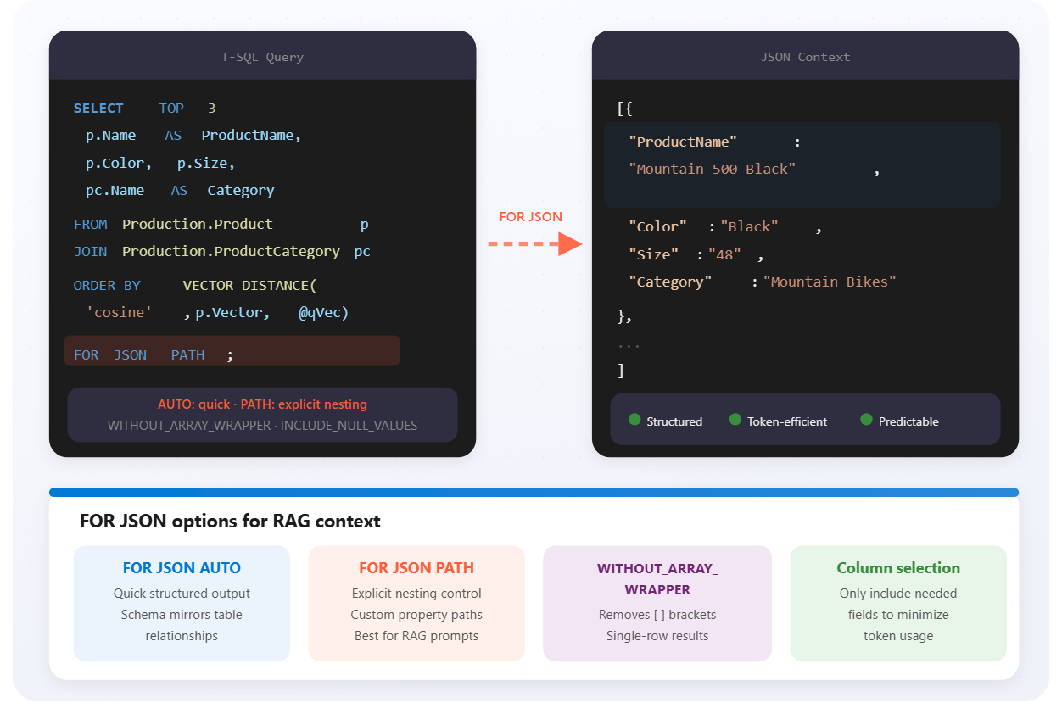
Prepare retrieval context for augmentation
SQL to JSON for LLMs
FOR JSON AUTO:
  Quick, auto-structured output
FOR JSON PATH:
  Explicit control over nesting
WITHOUT_ARRAY_WRAPPER:
  Single-record queries
VECTOR_DISTANCE:
  Semantically similar data
Include only what the model needs
Notes:
Language models process text, not relational structures. If you pass raw query results, the model can't interpret column names, data types, or relationships. JSON solves this by preserving structure in text. Field names stay attached to values, nested objects represent relationships. The model can read "ProductName": "Mountain-500" and reference that product in its response. JSON also keeps things predictable: you know the answer came from fields you explicitly provided.
FOR JSON AUTO formats output based on your query structure, with column names becoming field names automatically. FOR JSON PATH gives explicit control. You define field names and nesting using column aliases (e.g., Name AS 'product.name' creates nested JSON). A few options shape the output: WITHOUT_ARRAY_WRAPPER removes the square brackets when retrieving a single record, which is useful for RAG since you often retrieve one customer, one product, or one order at a time. INCLUDE_NULL_VALUES keeps null fields instead of omitting them. Use this when the absence of a value is meaningful. ROOT('name') wraps output in a named root element to help the model understand what kind of data it's receiving.
Not every column belongs in context. Internal IDs, audit timestamps, and warehouse codes don't help the model answer customer questions. They just consume tokens and add noise. For a product question, include name, description, specifications, and pricing; skip the rowguid, modified date, and discontinued flag unless directly relevant. Token limits matter: every token costs money and counts against the context window, so keep each record lean.
RAG context often comes from multiple tables. A pedal compatibility question needs product details, specs, and related components. The module shows converting the question into an embedding with AI_GENERATE_EMBEDDINGS, then using VECTOR_DISTANCE to find the closest matches, joining related tables, and formatting everything with FOR JSON PATH.

Slide 26
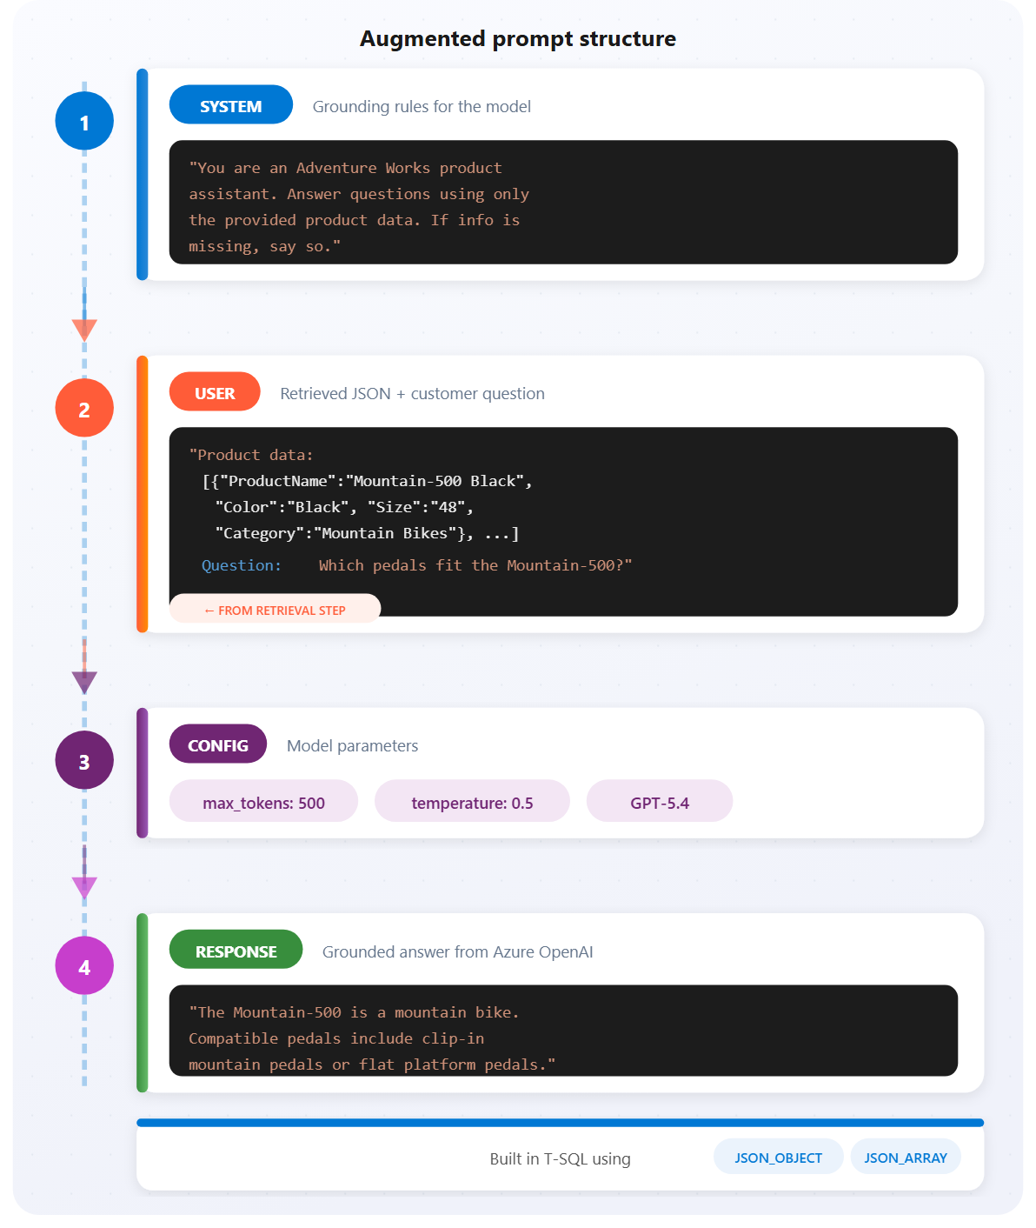
Augment prompts with database context
Build grounded prompts in T-SQL
System role:
  Grounding rules: "use only provided data"
User role:
  Retrieved JSON context + customer question
JSON_OBJECT / JSON_ARRAY:
  Build valid payloads
Temperature (0.3–0.5):
  Factual, consistent answers
max_tokens:
  Control response length (500–1,000)
Notes:
Retrieval gets the data, but a JSON blob alone doesn't answer anyone's question. Now you need to tell the language model what to do with it. That is the augmentation step. Azure OpenAI chat models expect messages with roles: the system role defines how the assistant should behave, and the user role contains the question along with the database context the model should ground its answer in. Optionally, an assistant role holds previous responses in a multi-turn conversation.
The system message sets ground rules: scope ("use only the provided product data"), honesty ("if you don't have enough information, say so"), and format ("keep responses under 100 words"). These grounding instructions are critical because without them, the model might rely on its training data, which could be outdated or wrong for your domain. A customer asking about Adventure Works bike warranties shouldn't get generic warranty information from the internet.
The user message combines the retrieved JSON context with the actual customer question. JSON_OBJECT and JSON_ARRAY handle the JSON formatting directly in T-SQL, so your retrieval, context formatting, and prompt construction all live together in the database. The complete payload includes the messages array, plus parameters that affect generation: max_tokens limits response length (500 to 1,000 works well for product answers), and temperature controls creativity on a 0-to-2 scale. Lower values (0.3 to 0.5) produce more consistent, factual responses, which is what you usually want for RAG.

Slide 27
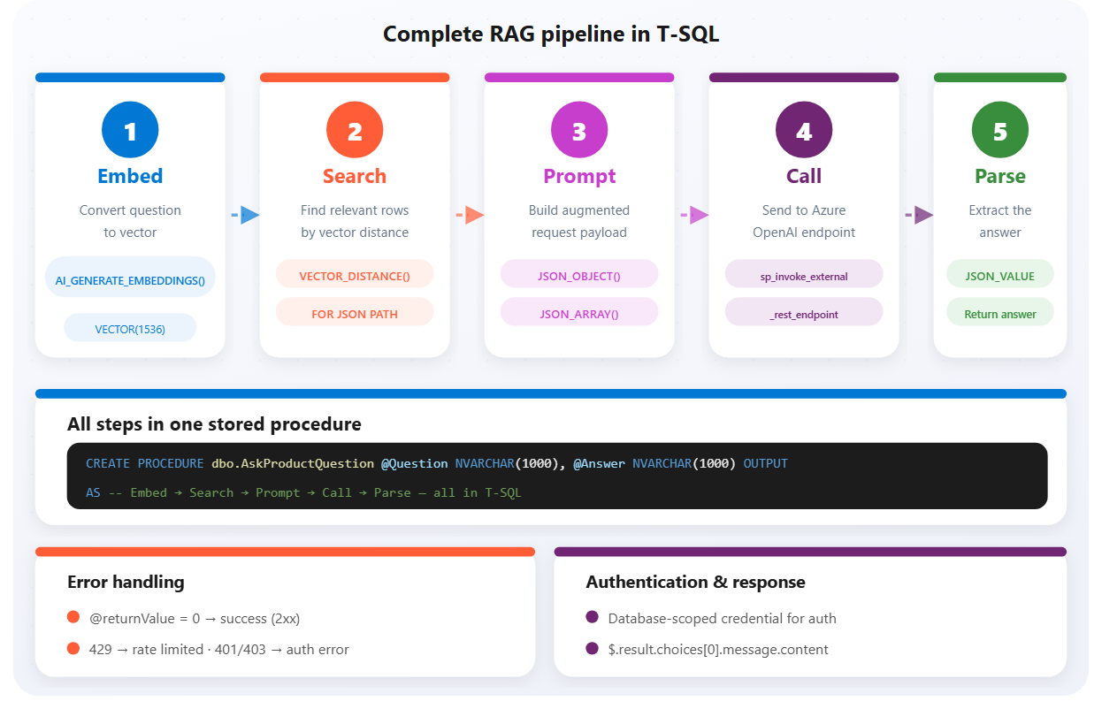
Generate and process RAG responses
sp_invoke_external_rest_endpoint calls Azure OpenAI
Database-scoped credentials for auth
Return value 0 = success; handle 429, 401/403
JSON_VALUE extracts
$.result.choices[0].message.content
@retry_count handles transient failures
One stored procedure = complete RAG pipeline
Notes:
The generation step is where the RAG pipeline delivers value. sp_invoke_external_rest_endpoint sends HTTPS requests to external services directly from T-SQL and returns the response. The @url points to your Azure OpenAI deployment, @method is POST, @payload contains the prompt, and @credential references a database-scoped credential holding your authentication details. The stored procedure returns 0 when the HTTP call succeeds (2xx status), or the HTTP status code itself when it fails.
The answer lives at $.result.choices[0].message.content in the response JSON. Use JSON_VALUE to extract it. Always check @returnValue before parsing. If the call failed, the response will not contain model output.
Error handling is essential since calling an external service introduces failure modes you don't encounter with local queries. A 429 means rate limiting. The module shows using @retry_count = 3 for automatic retries, attempting the call up to three times before giving up. A 401 or 403 points to credential problems. For other failures, capture the HTTP status and description for troubleshooting.
The module culminates in dbo.AskProductQuestion, a complete stored procedure that: (1) converts the question to an embedding with AI_GENERATE_EMBEDDINGS, (2) finds relevant products using VECTOR_DISTANCE, (3) builds the augmented prompt with JSON_OBJECT/JSON_ARRAY, (4) calls Azure OpenAI via sp_invoke_external_rest_endpoint, and (5) extracts the answer with JSON_VALUE. The application calls this procedure with a question and gets back a grounded answer. No middleware, no external application code. Just SQL calling AI and returning results. With all three RAG steps running in T-SQL, the database becomes more than storage; it becomes an intelligent service that answers questions using your data.

Slide 28
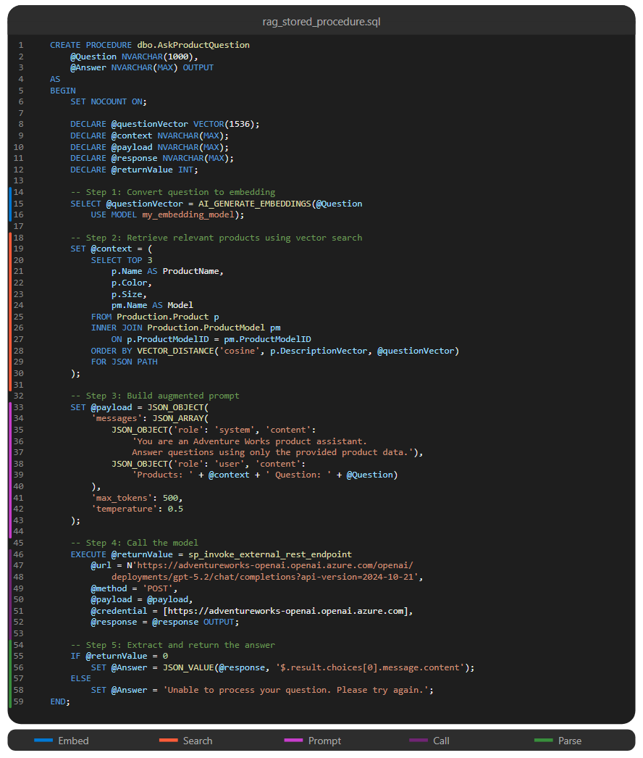
Putting it all together: RAG in T-SQL
Complete RAG stored procedure
1. Embed: Convert question to vector
2. Search: Find rows by VECTOR_DISTANCE
3. Prompt: Build JSON payload with context
4. Call: Send to Azure OpenAI endpoint
5. Parse: Extract answer with JSON_VALUE

Slide 29
Exercise: Implement a RAG solution
Hands-on lab
Implement a complete RAG solution using Azure SQL Database and Azure OpenAI. Retrieve relevant reviews via vector search, build augmented prompts with JSON context, call the OpenAI endpoint from T-SQL, and package the pipeline into a reusable stored procedure.
1
Retrieve reviews with VECTOR_SEARCH
2
Build augmented prompt with JSON context
3
Call Azure OpenAI from T-SQL
4
Create a reusable RAG stored procedure
5
Test with various questions
Notes:
Uses Azure SQL Database and Azure OpenAI (gpt-4.1-mini for generation, text-embedding-3-small for embeddings).
RAG (Retrieval-Augmented Generation) grounds LLM responses in actual data.
Step 1 retrieves the top-K relevant reviews using VECTOR_SEARCH on the user's question embedding.
Step 2 builds an augmented prompt by serializing the retrieved reviews as JSON context inside the system message.
Step 3 calls the Azure OpenAI chat completion endpoint from T-SQL using sp_invoke_external_rest_endpoint.
The final stored procedure packages the entire pipeline: embed the question, retrieve context, build the prompt, call the LLM, and return the answer.
Test questions should vary (product quality, comparisons, specific complaints) to show how the grounded answers change based on retrieved context. Key point: without RAG, the model would hallucinate or give generic answers; with RAG, answers cite actual review content.
Estimated time: 30 minutes.

Slide 30
Knowledge check - Design and implement RAG with SQL
What is the primary advantage of RAG over fine-tuning?
a) RAG produces faster Large Language Models (LLM) responses than fine-tuned models
b) RAG uses data retrieved at query time, so responses reflect current information without retraining
c) RAG requires less storage space than fine-tuned models
Which T-SQL option removes the square brackets from JSON output when retrieving a single row for RAG context?
a) INCLUDE_NULL_VALUES
b) ROOT('name')
c) WITHOUT_ARRAY_WRAPPER
What permission must be granted to a database user before they can call sp_invoke_external_rest_endpoint?
a) EXECUTE ANY EXTERNAL ENDPOINT
b) CONTROL SERVER
c) ALTER ANY DATABASE SCOPED CREDENTIAL
Notes:
Question 1: "What is the primary advantage of RAG over fine-tuning?" Answer: RAG uses data retrieved at query time, so responses reflect current information without retraining. As covered in the module, fine-tuning bakes knowledge in permanently, while RAG retrieves current data for each request. When specs change or new components arrive, answers reflect those changes immediately.
Question 2: "Which T-SQL option removes the square brackets from JSON output?" Answer: WITHOUT_ARRAY_WRAPPER. As the module explains, FOR JSON adds square brackets by default. WITHOUT_ARRAY_WRAPPER removes them, producing a single JSON object rather than an array. This is useful for RAG since you often retrieve one record at a time.
Question 3: "What permission must be granted before calling sp_invoke_external_rest_endpoint?" Answer: EXECUTE ANY EXTERNAL ENDPOINT. This is the database permission specifically required to invoke external REST endpoints from Azure SQL Database.

Slide 31
Summary - Design and implement RAG with SQL
What you learned
RAG + SQL
Identify RAG use cases For SQL-based applications
Prepare context With FOR JSON (AUTO / PATH)
Build augmented prompts With JSON_OBJECT / JSON_ARRAY
Call Azure OpenAI Via sp_invoke_external_rest_endpoint
Parse responses With JSON_VALUE - entire pipeline in T-SQL
Notes:
RAG connects your database to the capabilities of large language models. Instead of relying on a model's training data, you provide current, relevant information from your own tables. The entire RAG pattern executes in T-SQL. Your database orchestrates the flow: search, format, prompt, call, parse. You can add AI capabilities to existing applications by modifying stored procedures, without rearchitecting your application stack.
In this module, students learned how to identify RAG use cases by recognizing scenarios where grounding LLM responses in database content improves accuracy and relevance. They learned to prepare context from SQL using FOR JSON to convert query results into text that LLMs can process. They practiced constructing augmented prompts that combine system instructions, retrieved context, and user questions. And they executed the RAG pipeline by calling Azure OpenAI endpoints with sp_invoke_external_rest_endpoint and parsing the responses with JSON_VALUE.

