Slide 1

Presentation on
Task Management System
Course Title : System Analysis and Design Sessional
Course Code: CSE 420
Presented By Ahla Mong Marma Mehedi Hasan Md . Moshiur Rahman Abubakar Saidu
Hajee Mohammad Danesh Science and Technology University, Dinajpur-5200

Slide 2
About our project
The project's core objectives encompass creating an intuitive interface for task creation, assignment, and real-time monitoring. By enabling seamless communication and document sharing, the system aims to enhance team synergy. With the flexibility to adapt to individual preferences and the capacity to generate insightful reports, it strives to elevate task-oriented decision-making.

Slide 3
Motivation
Empower productivity with our Task Management System. Streamline workflows, enhance collaboration, and achieve goals efficiently. Elevate your project management experience with simplicity and success

Slide 4
Objectives of our project
Develop a user-friendly digital platform that facilitates task creation, assignment, and monitoring in real time . Provide customizable task views and filters to cater to individual user preferences and workflows.
Enable data-driven decision-making by collecting and presenting task performance metrics and analytics.

Slide 5
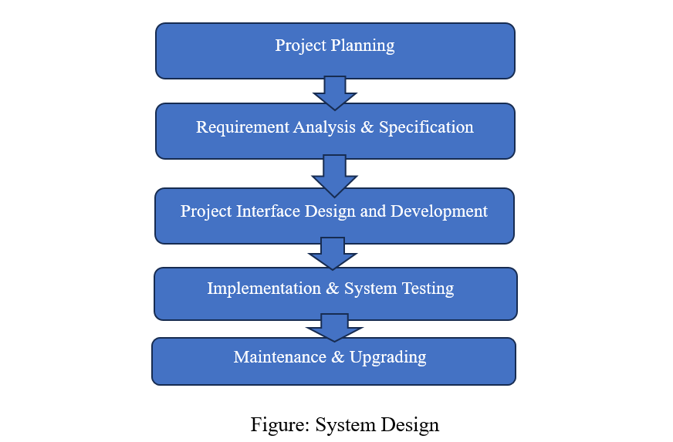
Proposed system analysis and design

Slide 6
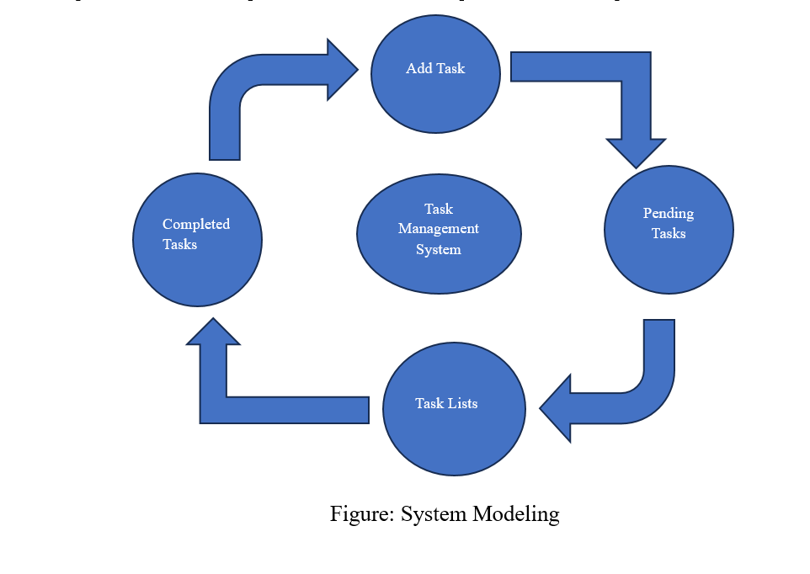
System Modeling

Slide 7
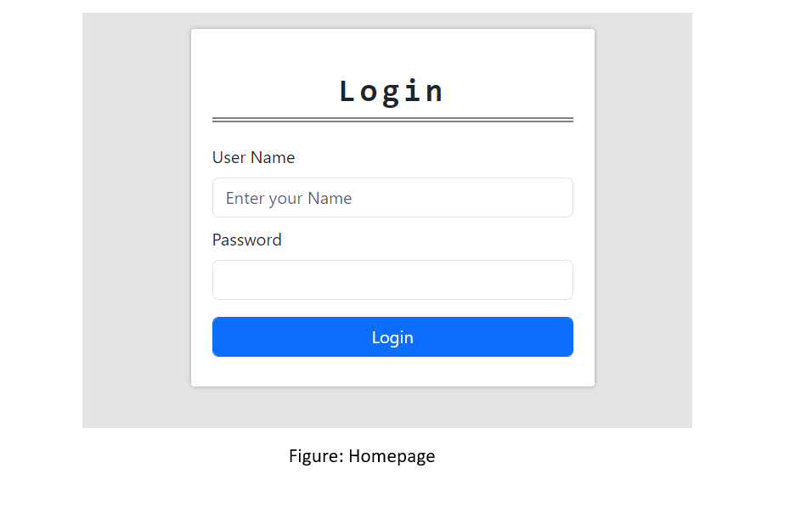
Login page

Slide 8
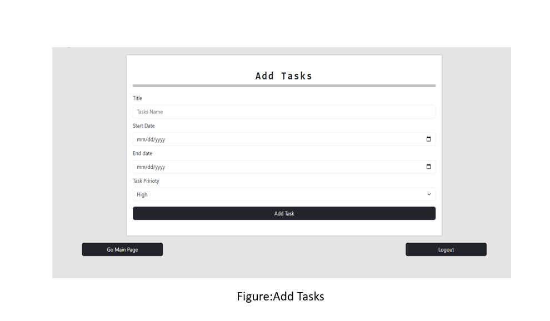
Adding task

Slide 9
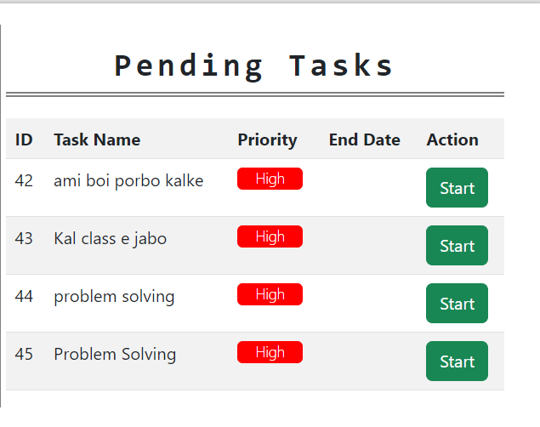
Pending task

Slide 10
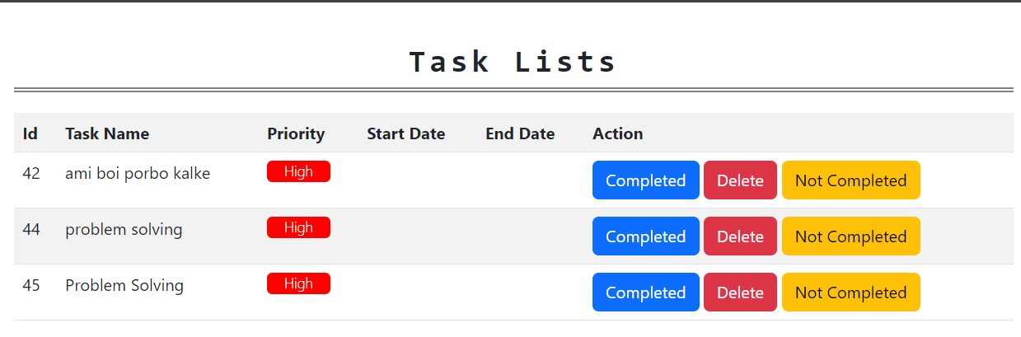
Task list

Slide 11
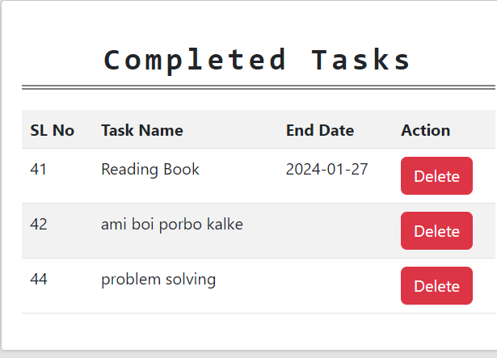
Completed task

Slide 12
Limitations
Since the software is still in beta, there are still a few limitations and room for improvements.
The software is not platform independent; it can’t run on all devices.
Minor bugs exist.
Need to install in the computer before using
Features are still limited since it’s in it’s early stage

Slide 13
Future goals
We intend to update the software and add some new features in the future. One of them is barcode reader. We intend to fix the bugs in the upcoming updates. We intend to add additional features according to the users’ feedback. Also, we intend to make the software cross-platform in the future updates.

Slide 14

Thank you!

