Slide 1
istick dsl Final project
Team Member B02902027 楊承勳 B02902045 林雅琦
B02902053 黃亦晨 B02902081 李怡璇
B02902121 黃刻力

Slide 2
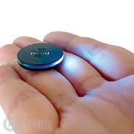
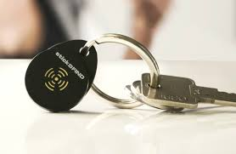
ideal Look

Slide 3
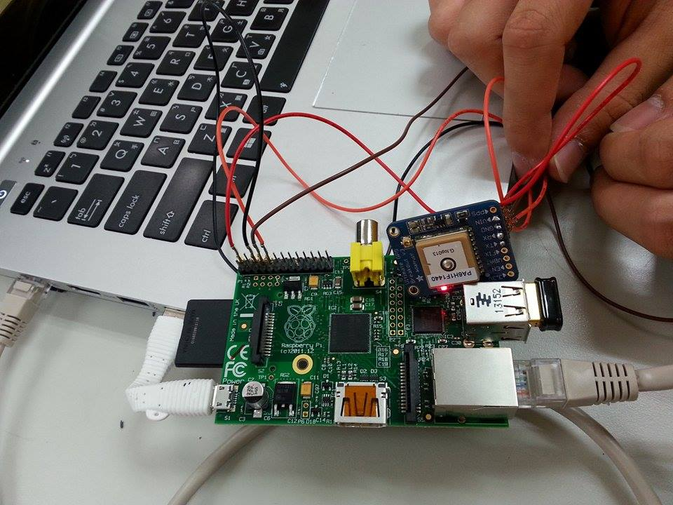
But …

Slide 4
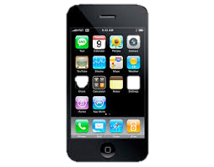
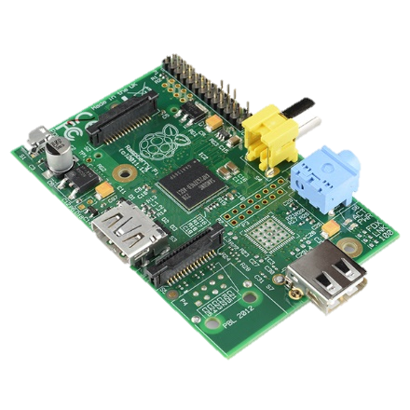

SErVER
APP
GPS DEVICE

Slide 5
demo

Slide 6
pROSPECT
Accuracy
Buzzer
Size
Power efficiency

Slide 7
Q & A

