Slide 1
Advanced Programming
Lab 1 of Rust
于仕琪, 王薇

Slide 2
Topics
1. Tools of Rust
rustc
cargo
new, check, build, run, test
2. Practices

Slide 3
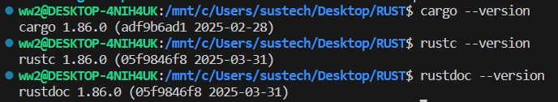
Installation
Install rust in wsl, run the following commad in terminal of wsl:
curl --proto '=https' --tlsv1.2 -sSf https://sh.rustup.rs | sh
after installation, using following command to check the installation is ok or not
cargo：Rust's compilation manager, package manager, and general tool. Cargo can be used to create new projects, build and run programs, and manage external libraries that code depends on.
rustc: Rust compiler, which can be called through cargo or directly used.
rustdoc: Rust documentation tool. If the documentation is written in an appropriate format in the code comments, Rustdoc can generate formatted HTML based on them, which can be executed separately or by Cargo as well.

Slide 4
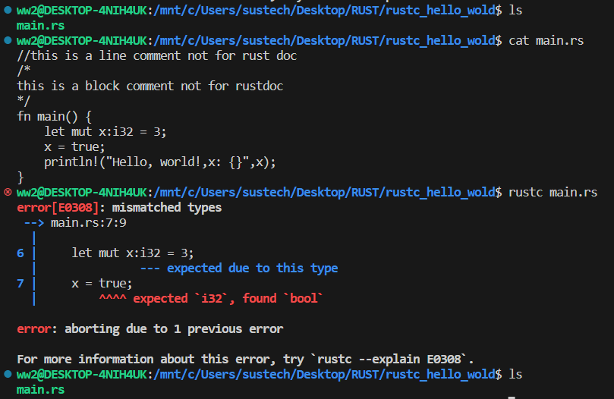
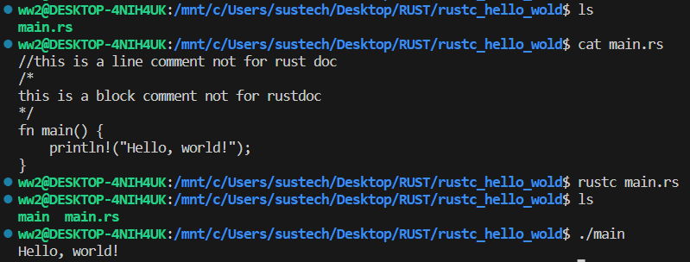
rustc (rust compiler)
“rustc [rust_souce_file]” is used to compile the source file(here main.rs is the rust_souce_file), If no other parameters are used and there are no errors during compilation, an executable file with the same name but no suffix(here main is the execuateable file) will be generated .
Q. In the yellow box code in the screenshot above, what is the data type of ‘x’, is ‘x’ a variable that can be changed? and how to modify the code to perform forced type conversion here?

Slide 5
cargo Rust's compilation manager, package manager, and general tool
Cargo commands:
build, b Compile the current package
check, c Analyze the current package and report errors, but don't build object files
clean Remove the target directory
doc, d Build this package's and its dependencies' documentation
new Create a new cargo package
init Create a new cargo package in an existing directory
add Add dependencies to a manifest file
remove Remove dependencies from a manifest file
run, r Run a binary or example of the local package
test, t Run the tests
bench Run the benchmarks
update Update dependencies listed in Cargo.lock
search Search registry for crates
publish Package and upload this package to the registry
install Install a Rust binary
uninstall Uninstall a Rust binary

Slide 6
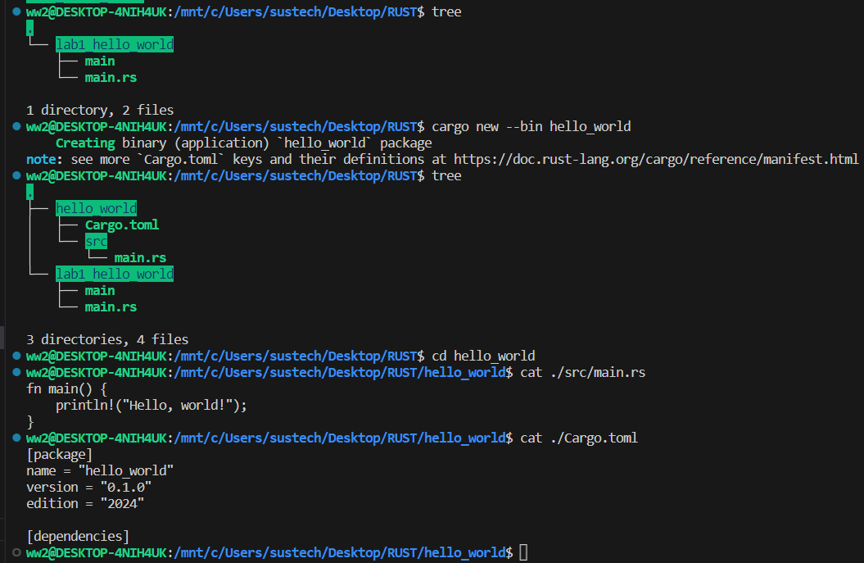
cargo new
generate executable project

Slide 7
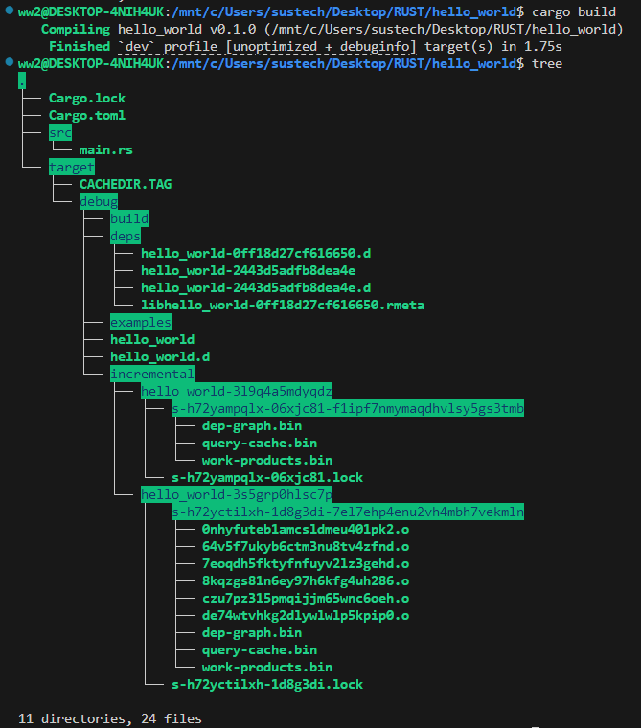
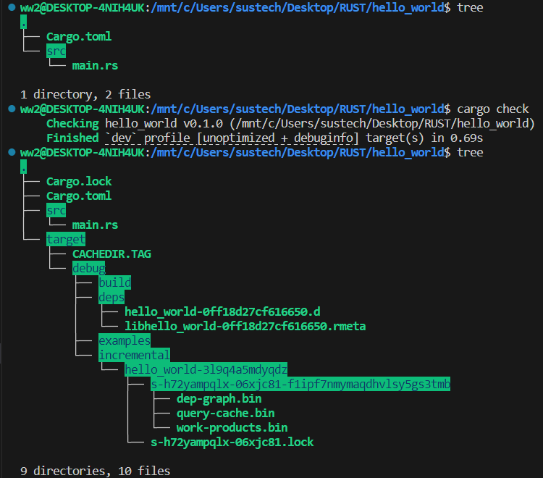
cargo check, cargo build
cargo build: generate executable file while not execute
cargo check: check file without executable file generated.

Slide 8
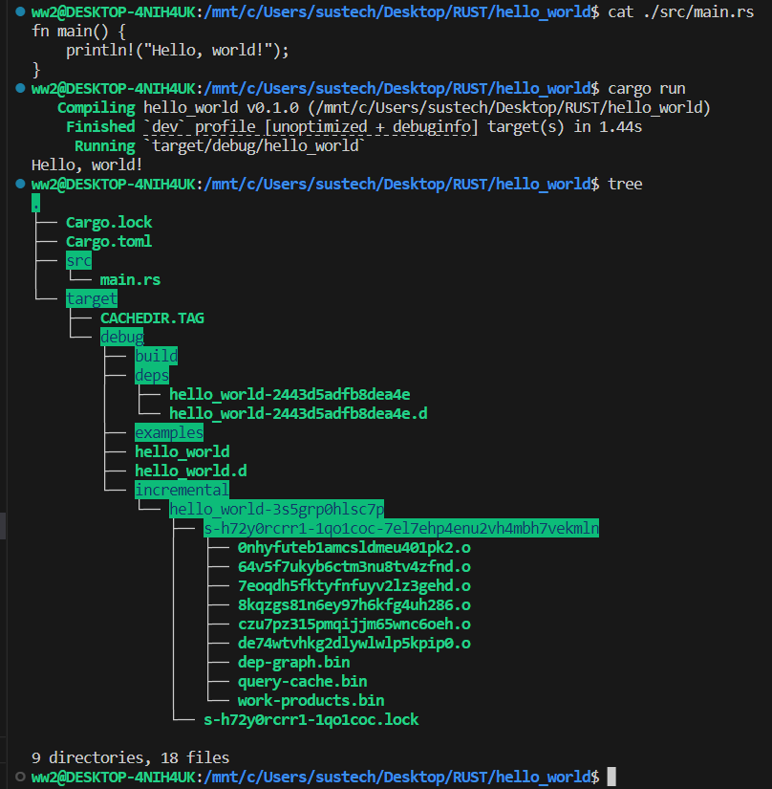
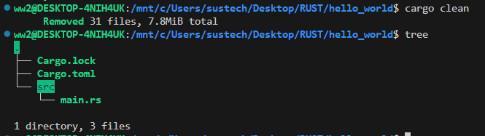
cargo run, cargo clean
cargo run:
generate executable file and run the execuatbale file.
cargo clean:
remove all the executable file and the intermediate files.

Slide 9
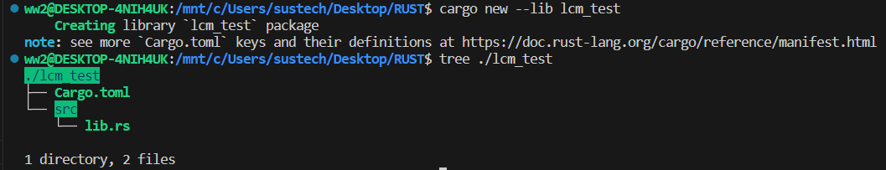
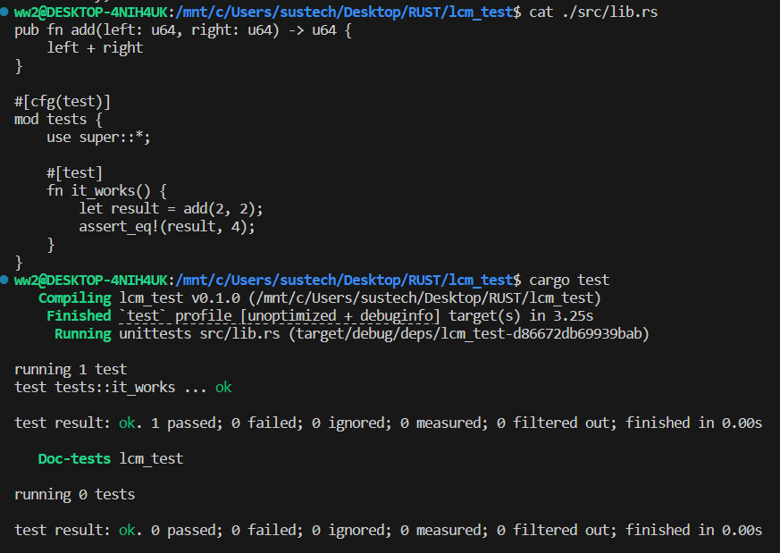
cargo test
generate library project
Q1. What’s the difference between cargo new --lib and cargo new --bin ?
Q2. change “lib.rs” as following code, what happens ? fix it.
pub fn add(left:u8, right:u8) ->u8 {
left+right
}
#[cfg(test)]
mod tests {
usesuper::*;
#[test]
fn it_works() {
let result=add(2, 2);
assert_eq!(result, 4);
let result:u16=add(255, 255).into();
assert_eq!(result, 510asu16);
}
}

Slide 10
Write a Rust program that reads an integer from the command line and determines whether it is a prime number. Option 1: Use rustc to compile the source code, and then run the generated program. Option 2: Use Cargo to manage the source code, compile and run the program.
Exercise1

Slide 11
2.1 Answer the question on page 4 and page9. 2.2 Please use “cargo test to” test the function “gcd” and function “lcm”, identify the issues in the code and solve them. If necessary, please further improve the test cases and conduct testing.
Exercise2
fn gcd(a:u8, b:u8) ->u8 {
letmut a=a;
letmut b=b;
while b!=0 {
let temp=b;
b=a%b;
a=temp;
}
a
}
fn lcm(a:u8, b:u8) ->u8 {
let gcd_val=gcd(a, b);
let product=a*b;
let result:u8=product/gcd_val;
result
}
#[test]
fn test_lcm() {
assert_eq!(lcm(1,4),4);
assert_eq!(lcm(8,9),72);
assert_eq!(lcm(8,16),16);
assert_eq!(lcm(1024,2),1024);
assert_eq!(lcm(256,2),256);
assert_eq!(lcm(256,0),0);
}

