Slide 1
Advanced Programming
Lab 2 of Rust
王薇，于仕琪

Slide 2
Topics
1. Memory details in RUST
stack vs heap (vec, String)
alignment rules on Structure
2. Memory Security in RUST
ownership, reference, drop
Smart pointer
box, rc
The problem and solution of circular referencing caused by RC\
3. Practices

Slide 3
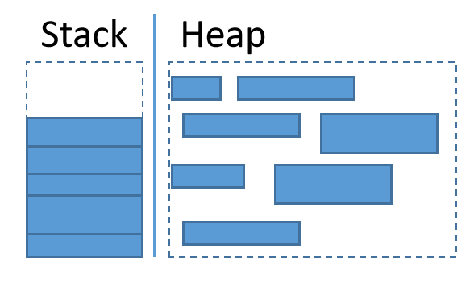
Stack vs Heap in (1)
stack | heap
Stored in the RAM of the computer | Stored in the RAM of the computer
Fast allocation speed | Slow allocation speed
Stored are: local variables, return addresses, function parameters | Allocate a data block to the program, and the created data will be pointed to by pointers. Fragmentation may occur when there are many allocations and releases.
If it is known at compile time how much data needs to be allocated and the data is not too large, then stack can be used | If the size of memory space is only known at runtime or need to allocate a large amount of data, then heap can be used
stack：normal data type, array, .etc.
heap：vec, string .etc.

Slide 4
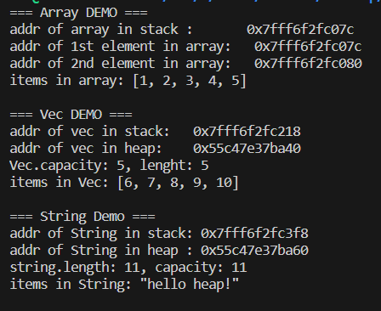
Stack vs Heap (2)
fn main() {
// =============== （Stack） ===============
let array= [1, 2, 3, 4, 5];
println!("=== Array DEMO ===");
println!("addr of array in stack : {:p}", &array);
println!("addr of 1st element in array: {:p}", &array[0]);
println!("addr of 2nd element in array: {:p}", &array[1]);
println!("items in array: {:?}\n", array);
// =============== Vec（Heap） ===============
let vec=vec![6, 7, 8, 9, 10];
println!("=== Vec DEMO ===");
println!("addr of vec in stack: {:p}", &vec);
println!("addr of vec in heap: {:p}", vec.as_ptr());
println!("Vec.capacity: {}, lenght: {}", vec.capacity(), vec.len());
println!("items in Vec: {:?}\n", vec);
// =============== String（Heap） ===============
let s=String::from("hello heap!");
println!("=== String Demo ===");
println!("addr of String in stack: {:p}", &s);
println!("addr of String in heap : {:p}", s.as_ptr());
println!("string.length: {}, capacity: {}", s.len(), s.capacity());
println!("items in String: {:?}\n", s);
}

Slide 5
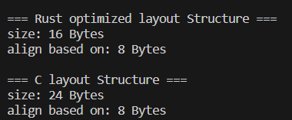
Alignment rules on Structure
Default alignment rule:
Same as the core principle of "natural alignment" in C/C++(member addresses must be integer multiples of their type size)
Key difference: The Rust compiler optimizes field order by default (repr (Rust) mode), while C/C++maintains declaration order.
You can force the use of C language compatible layouts through # [repr (C)]
Design considerations:
Memory optimization: Reduce padding bytes through field rearrangement
Performance optimization: Place frequently accessed fields on the same cache line
Hardware adaptation: supports special alignment requirements for different architectures
use std::mem::{size_of_val, align_of_val};
struct RustStyle {
a:u8, // 1 BYTE
b:u32, // 4 BYTES
c:u16, // 2 BYTES
d:f64, // 8 BYTES
}
#[repr(C)]
struct CStyle {
a:u8,
b:u32,
c:u16,
d:f64,
}
fn print_struct<T>(instance:&T, name:&str) {
println!("\n=== {} Structure ===", name);
println!("size: {} Bytes", size_of_val(instance));
println!("align based on: {} Bytes", align_of_val(instance));
}
fn main() {
let rust_struct=RustStyle { a:1, b:2, c:3, d:4.0 };
let c_struct=CStyle { a:1, b:2, c:3, d:4.0 };
print_struct(&rust_struct, "Rust optimized layout");
print_struct(&c_struct, "C layout");
}

Slide 6
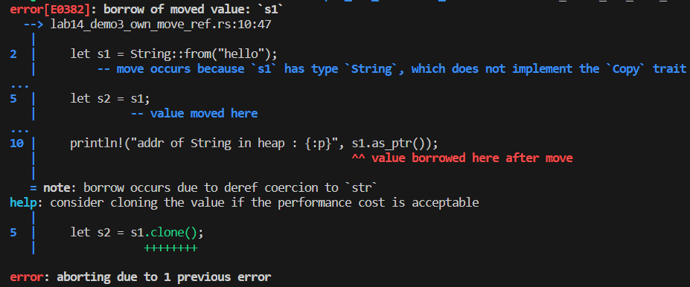
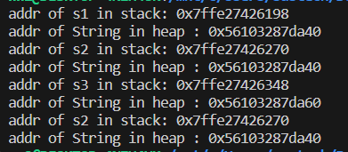
Memory Security(1)- one owner(1)
fn main() {
let s1=String::from("hello");
println!("addr of s1 in stack: {:p}", &s1);
println!("addr of String in heap : {:p}", s1.as_ptr());
let s2=s1;
println!("addr of s2 in stack: {:p}", &s2);
println!("addr of String in heap : {:p}", s2.as_ptr());
// println!("addr of s1 in stack: {:p}", &s1);
// println!("addr of String in heap : {:p}", s1.as_ptr());
let s3=s2.clone();
println!("addr of s3 in stack: {:p}", &s3);
println!("addr of String in heap : {:p}", s3.as_ptr());
println!("addr of s2 in stack: {:p}", &s2);
println!("addr of String in heap : {:p}", s2.as_ptr());
}
ownership is moved from s1 to s2
create new place in both stack and heap

Slide 7
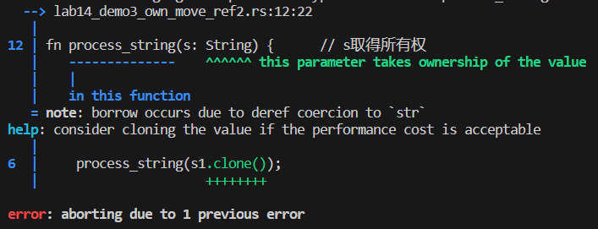
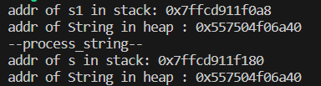
Memory Security(1)- one owner(2)
fn main() {
let s1=String::from("hello");
println!("addr of s1 in stack: {:p}", &s1);
println!("addr of String in heap : {:p}", s1.as_ptr());
process_string(s1);
//println!("addr of s1 in stack: {:p}", &s1);
//println!("addr of String in heap : {:p}", s1.as_ptr());
}
fn process_string(s:String) {
println!("--process_string--");
println!("addr of s in stack: {:p}", &s);
println!("addr of String in heap : {:p}", s.as_ptr());
}
ownership moved from s1 to s

Slide 8
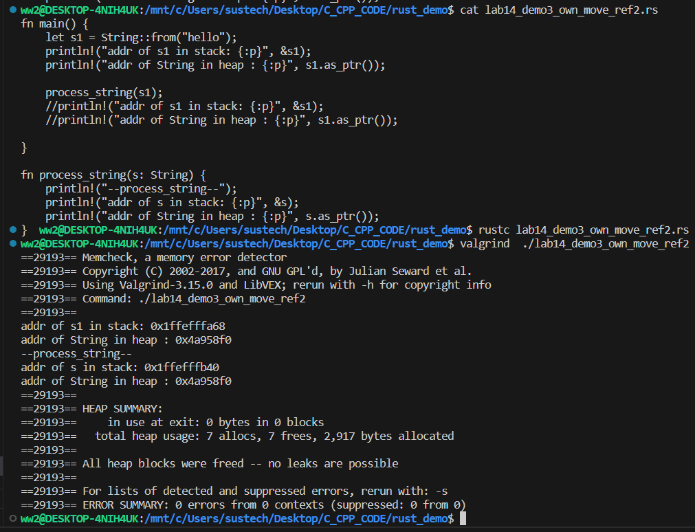
Memory Security(2)
Automatically released upon exiting the lifecycle, there is no memory leaks.

Slide 9
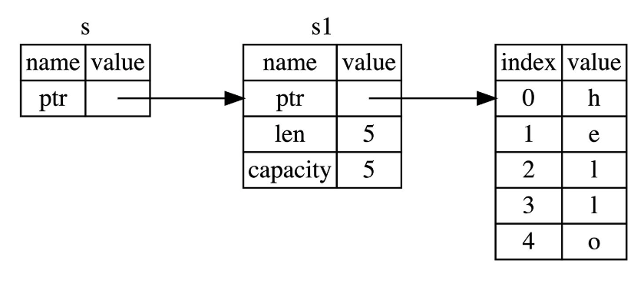
Memory Security(3-1)
reference type: use&T to represent the reference type of type T. Reference type is a data type that indicates that the value it holds is a reference.
&i32 represents the reference type of i32;
&&i32 represents the reference type referenced by i32;
Default as immutable reference;
Use symbol * to dereference references
fn main() {
let s1 = String::from("hello");
let len = calculate_length(&s1); // &s1 is the reference of s1
println!("The length of '{}' is {}.", s1, len);
}
// the type of parameter is reference
fn calculate_length(s: &String) -> usize {
s.len()
}
Stack
Stack
heap

Slide 10
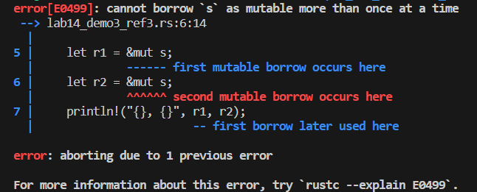
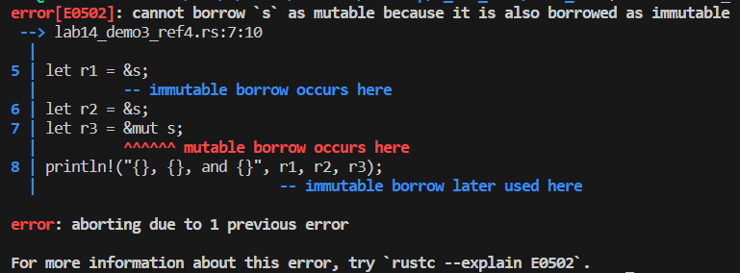
Memory Security(3-2)
Rulers about reference:
mutable references can only exist once at a time.
mutable and immutable references cannot exist simultaneously.
//ERROR DEMO
let mut s = String::from("hello");
// mutable references can only exist once at a time;
let r1 = &mut s;
let r2 = &mut s;
println!("{}, {}", r1, r2);
//ERROR DEMO
let mut s = String::from("hello");
// mutable and immutable references cannot exist simultaneously
let r1 = &s;
let r2 = &s;
let r3 = &mut s;
println!("{}, {}, and {}", r1, r2, r3);

Slide 11
Memory Security(4) Smart pointers
Smart pointers are data structures in Rust that have pointer semantics and ensure the correctness and security of values throughout their lifecycle. Smart pointers are typically implemented using structures.
Type | Ownership Mechanism | Thread Safe | Primary Use Cases | Internal Mutability | Runtime Checks | Clone Behavior
‌Box<T>‌ | Single ownership | Yes | Heap allocation, recursive types, trait objects | No | None | Deep copy (full value)
‌Rc<T>‌ | Reference-counted shared | No | Single-thread shared ownership | No | Reference counting | Increments counter
‌Arc<T>‌ | Atomic reference-counted | Yes | Thread-safe shared ownership | No | Atomic operations | Atomic counter increment
‌RefCell<T>‌ | Single ownership | No | Interior mutability (single-thread) | Yes | Borrow checking | Panics on invalid borrows
‌Cell<T>‌ | Single ownership | No | Copy-type interior mutability | Yes (swap-based) | None | Copies value
‌Mutex<T>‌ | Lock-guarded access | Yes | Thread-safe mutable access | Yes | Lock acquisition | Guard-based access
‌RwLock<T>‌ | Lock-guarded access | Yes | Thread-safe multiple readers or single writer | Yes | Lock acquisition | Guard-based access

Slide 12
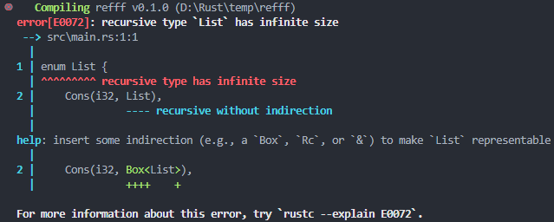
Memory Security(4) Smart pointers : Box
Box allows assigning a value to the heap and then keeping a smart pointer on the stack pointing to the data on the heap; When there is a type of unknown size at compile time and you want to use its value in a context that requires an exact size.
let b = Box::new(5); // 5 is stored in heap
println!("b = {}", b);
// OK DEMO
enum List {
Cons(i32, Box<List>),
Nil,
}
use List::{Cons, Nil};
fn main() {
let list = Cons(1, Box::new(Cons(2, Box::new(Cons(3,Box::new(Nil))))));
}
Box smart pointers can solve recursive typing problems:
Recursive type: can have another value of the same type as a part of it.
This creates a problem because Rust needs to know how much space types occupy at compile time. The value nesting of recursive types can theoretically continue infinitely, so Rust does not know how much space recursive types require. For example, the following example:
// ERROR DEMO
enum List {
Cons(i32, List),
Nil,
}
use List::{Cons, Nil};
fn main() {
let list = Cons(1, Cons(2, Cons(3, Nil)));
}

Slide 13
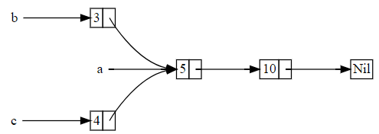
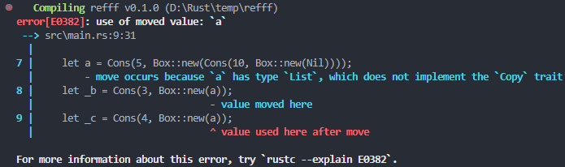
Memory Security(4) Smart pointers : RC(1)
Rc is a reference count pointer, which records the number of references to a value to determine if it is still in use; If a value has zero references, it means there are no valid references and it can be cleaned up; Cannot be used in multithreading.
enum List {
Cons(i32, Box<List>),
Nil,
} use crate::List::{Cons, Nil};
fn main() {
let a = Cons(5, Box::new(Cons(10, Box::new(Nil))));
let _b = Cons(3, Box::new(a));
let _c = Cons(4, Box::new(a));
}
Rc smart pointers can solve the problem of a resource having multiple owners. For example:
enum List {
Cons(i32, Rc<List>),
Nil,
} use crate::List::{Cons, Nil};
use std::rc::Rc;
fn main() {
let a = Rc::new(Cons(5, Rc::new(Cons(10, Rc::new(Nil)))));
let _b = Cons(3, Rc::clone(&a));
let _c = Cons(4, Rc::clone(&a));
}

Slide 14
RC(2)
use std::rc::{Rc, Weak};
use std::cell::RefCell;
struct Node {
name:String,
// Break the cycle with Weak
partner:RefCell<Option<Weak<Node>>>,
}
impl Node {
fnnew(name:&str) ->Rc<Self> {
Rc::new(Node {
name:name.to_string(),
partner:RefCell::new(None),
})
}
}
fn main() {
let alice=Node::new("Alice");
let bob=Node::new("Bob");
// Alice(Bob) holds Bob(Alice)'s Wear reference
*alice.partner.borrow_mut() =Some(Rc::downgrade(&bob));
*bob.partner.borrow_mut() =Some(Rc::downgrade(&alice));
// Strong references can be obtained through upgrade()
if let Some(partner) =alice.partner.borrow().as_ref() {
if let Some(p) =partner.upgrade() {
println!("Alice's partner: {}", p.name);
}
}
}
Using Weak to break cycle reference invoked by Rc.
use std::rc::Rc;
use std::cell::RefCell;
struct Node {
name:String,
partner:RefCell<Option<Rc<Node>>>,
}
impl Node {
fn new(name:&str) ->Rc<Self> {
Rc::new(Node {
name:name.to_string(),
partner:RefCell::new(None),
})
}
}
fn main() {
let alice=Node::new("Alice");
let bob=Node::new("Bob");
// Establish cycle references
*alice.partner.borrow_mut() =Some(Rc::clone(&bob));
*bob.partner.borrow_mut() =Some(Rc::clone(&alice));
}

Slide 15
Exercises
use std::mem::{size_of_val, align_of_val};
struct RustStyle {
a:u8, // 1 BYTE
b:u32, // 4 BYTES
c:u16, // 2 BYTES
d:f64, // 8 BYTES
}
#[repr(C)]
struct CStyle {
a:u8,
b:u32,
c:u16,
d:f64,
}
fn print_struct<T>(instance:&T, name:&str) {
println!("\n=== {} Structure ===", name);
println!("size: {} Bytes", size_of_val(instance));
println!("align based on: {} Bytes", align_of_val(instance));
}
fn main() {
let rust_struct=RustStyle { a:1, b:2, c:3, d:4.0 };
let c_struct=CStyle { a:1, b:2, c:3, d:4.0 };
print_struct(&rust_struct, "Rust optimized layout");
print_struct(&c_struct, "C layout");
}
1. Please complete the code on page 5(as shown in the code on the right), print out the addresses of each element(a,b,c,d) in the two structures(RustStyle, CStyle).
Compare the differences between RUST and C when storing structure data.

Slide 16
Exercises
2. Will the following code encounter an error during execution? If not, will the program cause a memory leak during runtime?
Please rewrite this code in C++. A pointer can be defined in a function, and it points to the memory allocated from the heap. The pointer will be returned. Another pointer in the main function can be assigned to the memory address allocated in the first function.
Compare C/C++and Rust, use tools to determine which implementation will cause memory leakage, compare the differences between the two, and if there is a memory leakage, modify the code to solve the problem.
fn main() {
let s = gives_ownership();
println!("{}", s);
}
fn gives_ownership() -> String {
let some_string = String::from("Rust");
some_string
}

Slide 17
Exercises
struct DangerousContainer {
data: *mut i32,
}
impl DangerousContainer {
fn new(value: i32) -> Self {
let ptr = Box::into_raw(Box::new(value));
DangerousContainer { data: ptr }
}
fn create_dangling() -> *mut i32 {
let local_data = 42;
&local_data as *const i32 as *mut i32
}
unsafe fn get(&self) -> i32 {
*self.data
}
}
fn main() {
let container1 = DangerousContainer::new(10);
let dangling_ptr = DangerousContainer::create_dangling();
unsafe {
println!("Dangling value: {}", *dangling_ptr);
}
let ptr = Box::into_raw(Box::new(20));
let container2 = DangerousContainer { data: ptr };
let container3 = DangerousContainer { data: ptr };
// drop(container2);
// drop(container3);
}
3 (optional)
The following code poses a memory risk. Please identify the issue and use a smart pointer solution to solve the memory problem

