Slide 1
Advanced Programming
Lab 5. Precautions for pointer ,
Memory Management(1)
王薇，于仕琪，廖琪梅, 王大兴

Slide 2
Topic
Precautions for pointer
DON’TS
Suggestion
Coding specification
Tool: valgrind
Memory Management(1)
Stack vs Heap
compiler+system vs programmer
C/C++ vs Python
compiler vs interpreter
compiler+system+programmer vs interpreter+programmer

Slide 3
Precautions for Pointer
DON’TS
1. whild pointer
2. memory leak
3. free less or free more
4. free stack
5. dangling pointer
Suggestion
Coding specification
Tools

Slide 4
DON’TS : 1. wild pointer
#include<stdio.h> //wild_pointer.c
#include<stdlib.h>
int main(intargc, char* argv[]){
int*p1;
*p1=0x12345678;
printf("address: %p\tdata: 0x%x\n",p1,*p1);
return 0;
}
#include<stdio.h> //wild_pointer.c
#include<stdlib.h>
int main(int argc, char* argv[]){
int *p1=NULL;
*p1=0x12345678;
printf("address: %p\tdata: 0x%x\n",p1,*p1);
return 0;
}
Wild pointers refer to pointers that have not been initialized or have been released but are still in use. The positions pointed to by these pointers are uncertain, random, and have no clear limitations.
Wild pointers may cause program crashes or unpredictable results, as the memory addresses they point to may already be occupied by other objects or programs, or reclaimed by the operating system

Slide 5
DON’TS : 2. memory leak
#include<stdio.h> //demo1.c
#include<stdlib.h>
int main(intargc, char* argv[]){
int *p1=(int*)malloc(sizeof(int));
*p1=0x12345678;
printf("address: %p\tdata: 0x%x\n",p1,*p1);
return 0;
}
#include<stdio.h> //demo2.c
#include<stdlib.h>
int main(intargc, char* argv[]){
int d1=0x12345678;
int *p1=&d1;
printf("address: %p\tdata: 0x%x\n",p1,*p1);
return 0;
}
Memory leak refers to the waste of system memory caused by dynamically allocated heap memory in a program that is not released or cannot be released for some reason, resulting in serious consequences such as slow program running speed or even system crashes.
Q: Which piece(s) of code would lead to memory leak? demo1.c, demo2.c or both ?

Slide 6
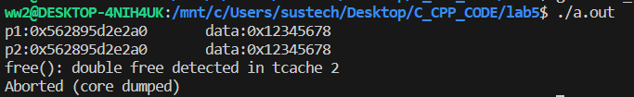
DON’TS : 3. free more or free less
#include <stdio.h> //free less
#include <stdlib.h>
int main(int argc, char*argv[]){
int *p1 = (int *)malloc(sizeof(int)*1);
int *p2 = (int *)malloc(sizeof(int)*1);
*p1=0x12345678;
*p2=*p1;
printf(“p1:%p\tdata:0x%x\n"
p2:%p\tdata:0x%x\n",p1,*p1,p2,*p2);
free(p1);
return 0;
}
#include <stdio.h> //free more
#include <stdlib.h>
int main(int argc, char*argv[]){
int *p1 = (int *) malloc(sizeof(int)*1);
*p1=0x12345678;
int *p2 = p1;
printf("p1:%p\tdata:0x%x\n
p2:%p\tdata:0x%x\n",p1,*p1,p2,*p2);
free(p1);
free(p2);
return 0;
}
Q. Which piece of code would lead to memory leak, which piece of code would lead to program abort with error?

Slide 7

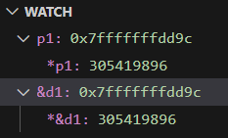
DON’TS : 4. free stack
#include <stdio.h>
#include <stdlib.h>
int main(int argc, char*argv[]){
int *p1=NULL;
int d1=0x12345678;
p1 = &d1;
printf("address: %p\tdata: 0x%x\n",p1,*p1);
free(p1);
return 0;
}
Q1. What’s the value of p1 after finish the assignment “p1 = &d1;”?
Q2. Is the address of P1 belongs to stack or heap?
Q3. While using free/del to release the space on stack, what would happen?

Slide 8


DON’TS : 5. dangling pointer
#include <stdio.h> //dangling_pointer
#include <stdlib.h>
int main(int argc, char*argv[]){
int *p1 = (int*) malloc(sizeof(int)*1);
*p1 = 0x12345678;
printf("address: %p\tdata: 0x%x\n",p1,*p1);
free(p1);
*p1 = 0x78563421;
printf("address: %p\tdata: 0x%x\n",p1,*p1);
return 0;
}
#include <stdio.h> //dangling_pointer
#include <stdlib.h>
int main(int argc, char*argv[]){
int *p1 = (int*) malloc(sizeof(int)*1);
*p1 = 0x12345678;
printf("address: %p\tdata: 0x%x\n",p1,*p1);
free(p1);
p1=NULL;
*p1 = 0x78563421;
printf("address: %p\tdata: 0x%x\n",p1,*p1);
return 0;
}
Seems Ok But Dangerous!!

Slide 9
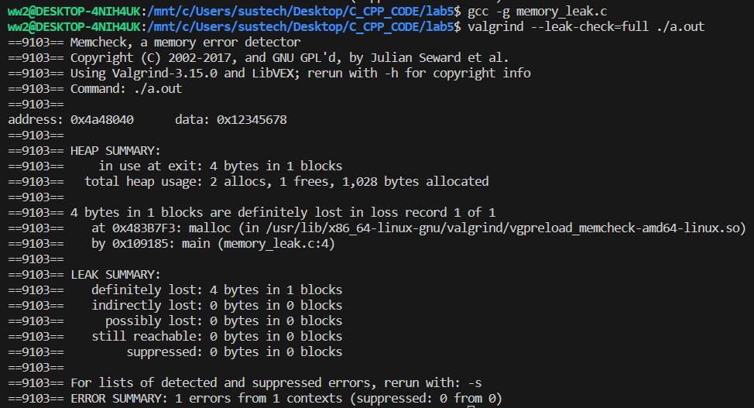
Tools： valgrind(1)
step1. using “-g” option along with gcc/g++ to generate the executable file.
step2. invoke valgrind with “--leak-check=full” as option, the executable file as parameter to check the memory leak on the executable file.
#include<stdio.h> //memory_leak.c
#include<stdlib.h>
int main(int argc, char*argv[]){
int *p1=(int*)malloc(sizeof(int));
*p1=0x12345678;
printf("address: %p\tdata: 0x%x\n",p1,*p1);
return0;
}
program running results
Valgrind is an instrumentation framework for building dynamic analysis tools. There are Valgrind tools that can automatically detect many memory management and threading bugs, and profile your programs in detail. You can also use Valgrind to build new tools.
https://valgrind.org/
details about the memory leak

Slide 10
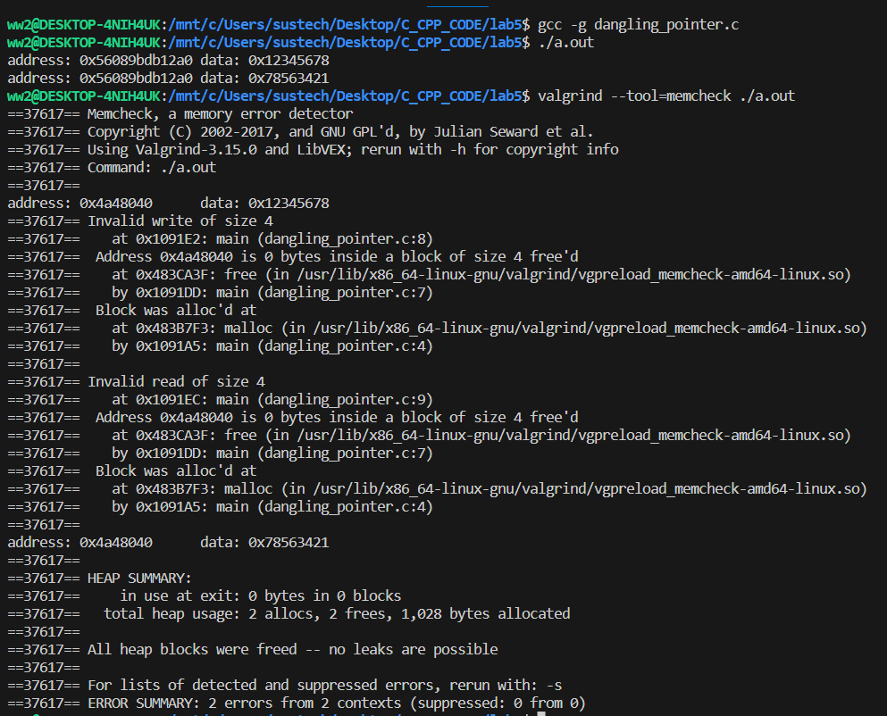
Tools： valgrind(2)
#include <stdio.h> //dangling_pointer
#include <stdlib.h>
int main(int argc, char*argv[]){
int *p1 = (int*) malloc(sizeof(int)*1);
*p1 = 0x12345678;
printf("address: %p\tdata: 0x%x\n",p1,*p1);
free(p1);
*p1 = 0x78563421;
printf("address: %p\tdata: 0x%x\n",p1,*p1);
return 0;
}
program running results
invalid write/read on memory
NOTES:
The program can be executed and the results appear correct,
but it brings greater risks!!!
program running results

Slide 11
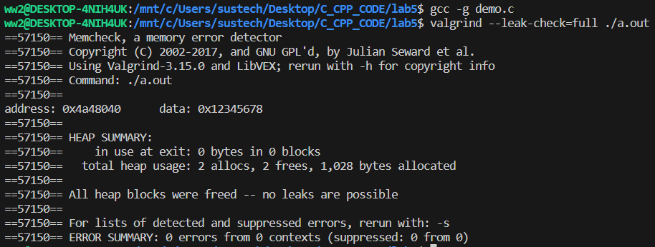
Coding specification
#include<stdio.h> //demo.c
#include<stdlib.h>
int main(int argc, char*argv[]){
int *p1=(int*)malloc(sizeof(int));
if(NULL!=p1){
*p1=0x12345678;
printf("address: %p\tdata: 0x%x\n",p1,*p1);
free(p1);
p1=NULL;
}
return 0;
}
Tips1:
check if malloc/new is successful
Tips2:
don’t forget to free/del the space
Tips3:
assign NULL to the pointer after del/free the related space

Slide 12
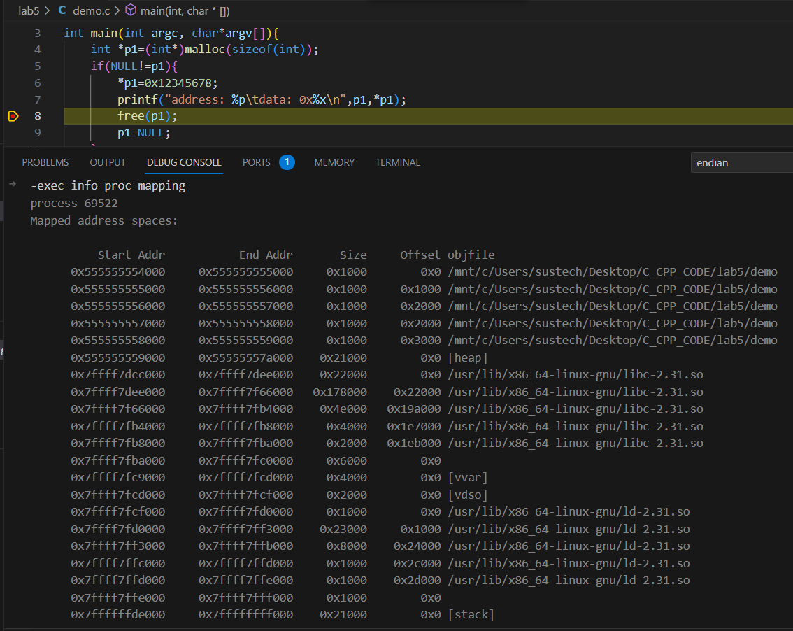
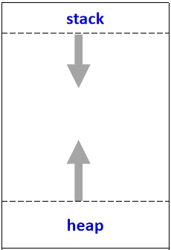
Memory Managment-Stack vs Heap(1)
Both Stack and heap belongs to dynamic memory area.
Stack: LIFO, expand from high address to low address.
heap: expand from low address to high address.
high address
low address

Slide 13
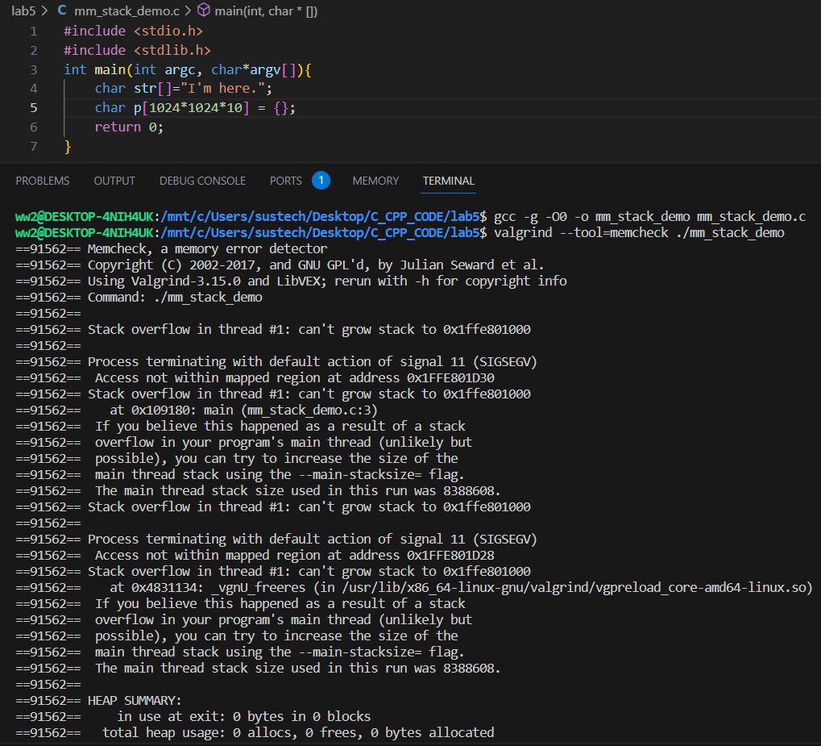
Memory Managment-Stack vs Heap(2)
#include <stdio.h>
#include <stdlib.h>
int main(int argc, char*argv[]){
char str[]="I'm here.";
char p[1024*1024*10] = {};
return 0;
}
Requesting a large space in the stack space may lead to stack overflow.
In this demo, the size of the space is 1024*1024*10 sizeof char.
The space on stack for C/C++ is managed by Compiler and the system.
Q. Smaller the size of char array “p”, such as 1024*10, generate the executable file and use valgind again, what’s the result?
stack overflow

Slide 14
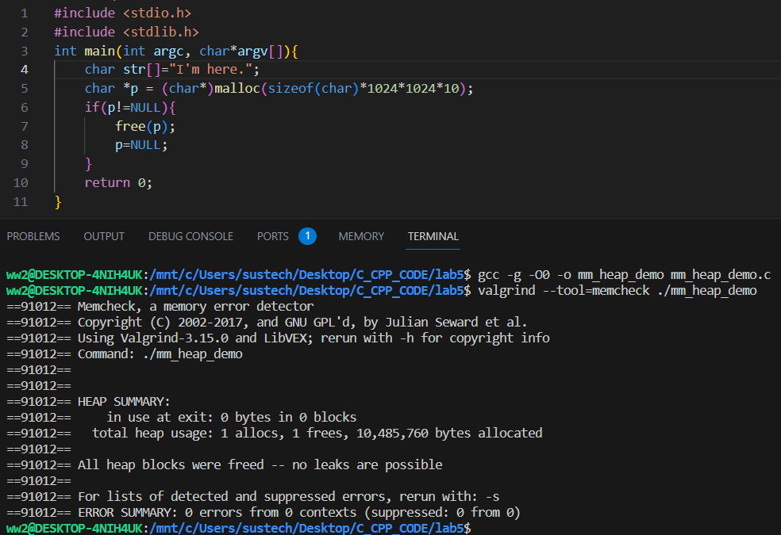
Memory Managment-Stack vs Heap(3)
#include <stdio.h>
#include <stdlib.h>
int main(int argc, char*argv[]){
char str[]="I'm here.";
char *p = (char*)malloc(sizeof(char)*1024*1024*10);
if(p!=NULL){
free(p);
p=NULL;
}
return 0;
}
Requesting a large space in the heap space would not lead to heap overflow.
In this demo, the size of the space is 1024*1024*10 sizeof char.
The space on heap for C/C++ is managed by programmer.
it’s ok to apply for a large space on heap.
DO remember to free it.

Slide 15
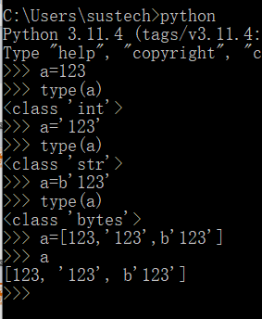
Memory Managment-C/C++ VS Python(1)
 | C/C++ | Python
Language Type | Compiled | Interpreted
Operating efficiency | Faster, real time | Slower
Static/dynamic type | Static type languages determine variable types at compile time | Dynamic type languages determine variable types at runtime.
Memory Mangment | 1. Compiler + System for non-heap space 2. programmer for heap | 1. interpreter for most situation 2. garbage collector used by programmer for very few situation
others | ... | ...
https://docs.python.org/3/c-api/memory.html

Slide 16
Exercise 1
#include<stdio.h>
int main()
{
int numbers1[] = {2,4,6,8,10};
int sum = 0;
int *p1 = &numbers1[1];
printf("numbers1 = %p\n", numbers1);
printf("p1 = %p\n", p1);
for(int i = 0; i < 3; i++)
sum += *(p1+i);
printf("sum = %d\n",sum);
int numbers2[5]={1,2,3,4,5};
int *p2 = (int*)(&numbers2 + 1);
printf("numbers2 = %p\n", numbers2);
printf("numbers2 + 4 = %p\n", numbers2 + 4);
printf("p2 = %p\n", p2);
printf("*(numbers2+1)= %d\n",*(numbers2+1));
printf("(p2-1) = %d\n",*(p2-1));
return 0;
}
Run the program and explain the result to SA.

Slide 17
Exercise 2
#include <iostream>
using namespace std;
int main()
{
int matrix[][4] = {1,3,5,7,9,11,13,15,17,19};
int *p = *(matrix + 1);
p += 3;
cout << "*p++ = " << *p++ << endl;
const char *str = "Welcome to programming.";
long *q = (long *)str;
q++;
char *r = (char *)q;
cout << r << endl;
unsigned int num = 0x3E56AF67;
unsigned short *pshort = (unsigned short *) &num;
cout << "*pshort = 0x" << hex << *pshort << endl;
return 0;
}
Run the program and explain the result to SA.

Slide 18
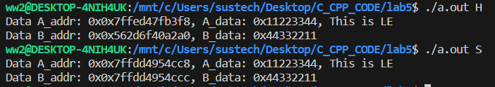
Exercises 3
#include <stdio.h>
#include <stdlib.h>
int main(int argc, char *argv[]){
int numA = 0x11223344;
if(argc == 2){
if(argv[1][0]=='H'){
int *pnumB = (int*)malloc(sizeof(int));
if(pnumB!=NULL){
/*complete code here*/
}
}
else if(argv[1][0]=='S'){
/*complete code here*/
}
}
return 0;
}
3-1. Complete the code on the right to finish the following task:
1. Determine whether the current system is in big-endian(BE) or little-endian(LE) based on the storage location of byte0 in numA.
2. Store each byte in numA to a new space (numB or pointed by pnumB) in reverse order.
If the command-line parameter of the program is ‘H’, use heap mode to implement swapping.
If the command-line parameter of the program is ‘S’, use stack mode to implement swapping.
Print out the value of numB (or pointed by pnumB) in hexadecimal.
3-2. Use the tool valgrind to check if there is memory problem on the code.

Slide 19
Tips on Big-Endian and Little-Endian
BE stores the big-end first, the lowest memory address is the biggest.
LE stores the little-end first, the lowest memory address is the littlest.
#include<stdio.h>
union data
{
int a;
char c;
};
int main()
{
union data endian;
endian.a = 0x11223344;
if(endian.c == 0x11)
printf("Big-Endian\n");
else if(endian.c == 0x44)
printf("Little-Endian\n");
return 0;
}
Big-Endian
2003
44
2002
33
Q: Run the demo on your system, is your system Big-Endian or Little-Endian?
2001
22
2000
11
Little-Endian
2003
11
2002
22
2001
33
2000
44

