Slide 1
Advanced Programming
Lab 15, Friend classes, Nested classes and RTTI
廖琪梅，王大兴，于仕琪，王薇

Slide 2
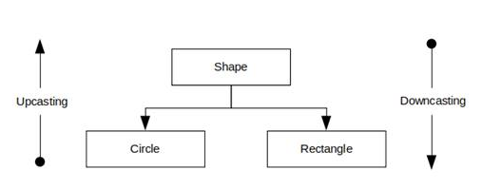
Friend classes, Nested classes and RTTI
Friend class
declaration and privilege
Friendship is not symmetric
Friendship is not transitive
Nested class
declaration in public section vs private vs protect
RTTI(Run-Time Type Identification)
Upcasting vs Downcasting
implicit casting vs explicit casting
explicit casting
staic vs dynamic(suggested)
typeid function

Slide 3
Friend Classes
Entire classes or member functions of other classes may be declared to be friends of another class.
To declare all member functions of ClassTwo as friend of ClassOne,
place a declaration of the form friend class ClassTwo; in the definition of ClassOne.
That means all member functions of ClassTwo have the right to access the private and protected class members of ClassOne.
The friend declaration(s) can appear anywhere in a class and are not affected by access specifiers public or private or protected.

Slide 4
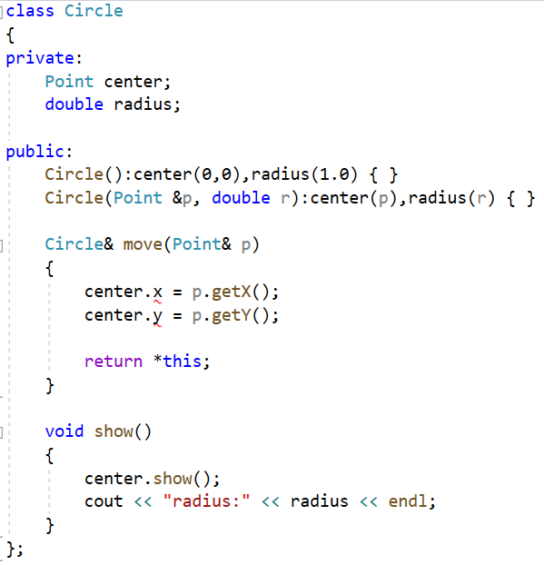
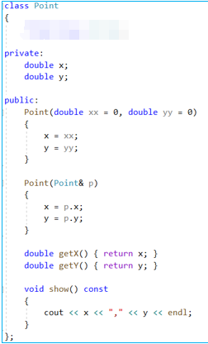

Let’s consider an example: we have a Circle class in which it has a subobject (center point) of Point class--class containment(composition).
Can we access the center’s private member(x and y) in the Point class?
class containment(or class composition)
In move function we want to set the center to the new point p.
But you CANNOT access the center’s private members x and y.
You can access the public members of the center.

Slide 5
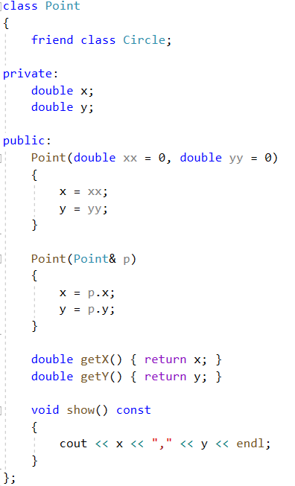
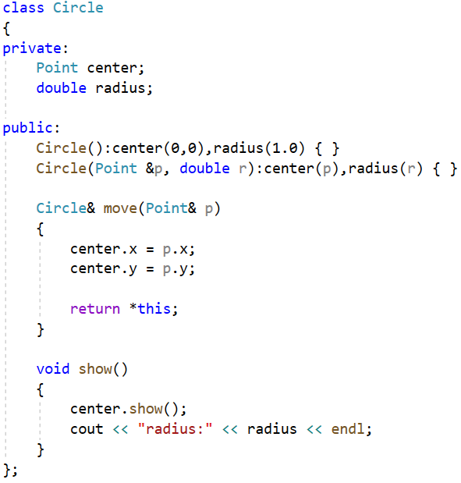
This time you can declare the Circle class as a friend class of the Point class.
This declaration is necessary which is called forward declaration.
Declare the Circle class as a friend of the Point class. That means in Circle class, its member functions can access the private members of the Point class.
Member function of the Circle class can access the private member of the Point class.

Slide 6
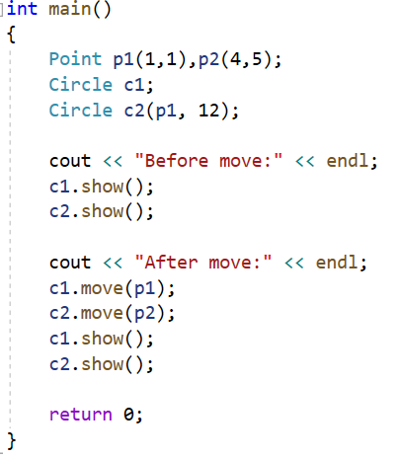
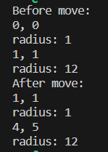
Declare the Circle class as a friend of the Point class. That means in Circle class, its member functions(e.g. move) can access the private members of the Point class.

Slide 7
Notes:
Friendship is not symmetric– if class A is a friend of class B, you CANNOT infer that class B is a friend of class A.
Friendship is not transitive ---if class A is a friend of class B and class B is a friend of class C, you CANNOT infer that class A is a friend of class C.
When to use friend class?
If one class(or object) is not another class(or object) and vice versa, so the is-a relationship of public inheritance doesn’t apply. Nor it is either a component of the other, so the has-a relationship of containment or of private or protected inheritance doesn’t apply. This suggests making the one class a friend to the other class.

Slide 8
Nested Class
A nested class is a class which is declared in another enclosing class.
Nested class can be defined in private as well as in public and in protect section of the enclosing class.
A nested class is a member and as such has the same access rights as any other member.
The members of an enclosing class have no special access to members of a nested class; the usual access rules shall be obeyed.

Slide 9

Nested class defined in public section of the enclosing class
#include<iostream>
using namespace std;
class Outer{
public:
class Inner{
public:
void Fun();
};
Inner obj_;
void Fun(){
cout<<"Outer::Fun..."<<endl;
obj_.Fun();
}
};
void Outer::Inner::Fun(){
cout<<"Inner::Fun..."<<endl;
}
int main(){
Outer o;
o.Fun();
Outer::Inner i;
i.Fun();
return0;
}
Declare a nested class Inner in the public section of Outer class
If a nested class(in the example Inner class) is declared in a public section of an enclosing class(in the example Outer class)
it is available to the enclosing class, to classes derived from the enclosing class, and, because it’s public, to the outside world.
However, because the nested class has class scope, it has to be used with a class qualifier(in the example Outer::) in the outside world.
Define the function of the nested class Inner, using a class qualifier
Define an object of the Inner class using a class qualifier

Slide 10
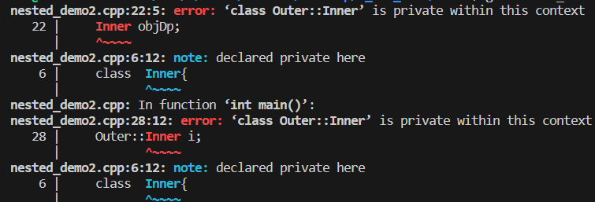
Nested class defined in private section of the enclosing class
#include<iostream>
using namespace std;
class Outer{
private:
class Inner{
public:
void Fun(){
cout<<"Inner::Fun..."<<endl;
}
};
Inner obj_;
public:
void Fun(){
cout<<"Outer::Fun..."<<endl;
obj_.Fun();
}
};
class OuterDeprive: Outer{
public:
Inner objDp;
};
int main(){
Outer o;
o.Fun();
Outer::Inner i;
i.Fun();
return0;
}
Declare a nested class Inner in the private section of Outer class
If a nested class is declared in a private section of an enclosing class, it is known only to that enclosing class. e.g. Inner class nested in a private section of Outer declaration.
Outer members can use inner objects.
Other parts of a program don’t even know that the Inner class exists.
While derive a class from Outer, inner would be invisible to that derived class(OuterDeprive), because a derived class can’t directly access the private parts of a base class.
Declare a nested class Inner in the private section of Outer class

Slide 11
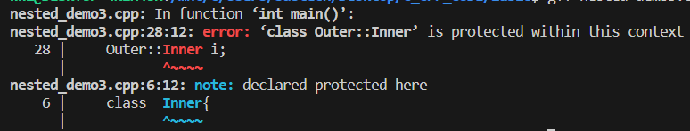
Nested class defined in protected section of the enclosing class
#include<iostream>
using namespace std;
class Outer{
protected:
class Inner{
public:
void Fun(){
cout<<"Inner::Fun..."<<endl;
}
};
Inner obj_;
public:
void Fun(){
cout<<"Outer::Fun..."<<endl;
obj_.Fun();
}
};
class OuterDeprive: Outer{
public:
Inner objDp;
};
int main(){
Outer o;
o.Fun();
Outer::Inner i;
i.Fun();
return0;
}
Declare a nested class Inner in the protected section of Outer class
If the nested class is declared in a protected section of a enclosing class, e.g. Inner class nested in a protected section of Outer declaration.
it is visible to that class(Outer) but invisible to the outside world.
a derived class(OuterDeprive) would know about the nested class and could directly create objects of that type.

Slide 12
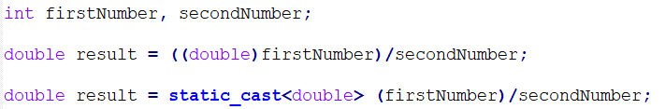
RTTI(Run-Time Type Identification)
Type conversion A type cast is basically a conversion from one type to another. C++ supports four types of casting: Static Cast, Dynamic Cast, Const Cast, Reinterpret Cast.
C style cast
C++ style cast
static_cast has basically the same power and meaning as the general-purpose C-style cast. It also has the same kind of restrictions. For example, you CANNOT cast a struct into an int or a double into a pointer. Furthermore, static_cast can’t remove constness from an expression.

Slide 13

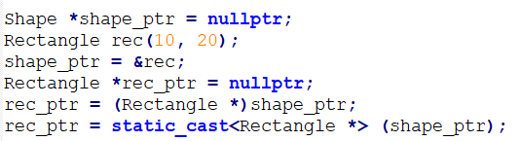
RTTI (RunTime Type Identification).
It is a mechanism to find the type of an object dynamically(in runtime) from an available pointer or reference to the base type.
It provides an explicit way to identify the runtime type separately from what is possible with the virtual function mechanism.
The casting of an object is mainly required when dealing with the inheritance hierarchy of classes.
Up casting is the process where we treat a pointer or a reference of a derived class object as a base class pointer. It is automatically accomplished by assigning a derived class pointer or a reference to its base class pointer.
Down casting is converting a base class pointer or reference to a derived class. It requires explicit cast.
downcasting, need expicitly cast
Using C-style cast or C++ static_cast, neither conversion is safety

Slide 14
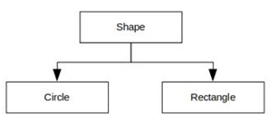
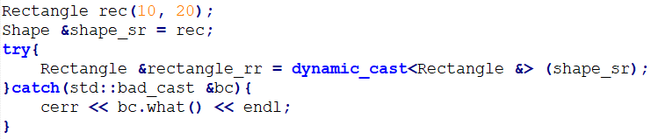
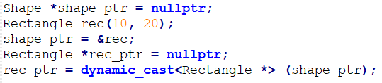
dynamic_cast is used to perform safe casts down or across an inheritance hierarchy. That is, you use dynamic_cast to cast pointers or references to base class objects into pointers or references to derived or sibling base class objects.
dynamic_cast < type-name > ( expression )
In all cases, the type of expression must be either a class type that is publicly derived from the type-name type, a public base class of the type-name which points to the type-name, or the same as the type-name.
If expression has one of these types, then the cast will succeed. Otherwise, the cast fails.
If a dynamic_cast to a pointer type fails, the result is 0. If a dynamic_cast to a reference type fails, the operator throws an exception of type bad_cast.
When failing to cast a reference, dynamic_cast throws std::bad_cast
exception defined in the typeinfo header.
Note: dynamic_casts CANNOT be applied to types lacking virtual functions, nor can they cast away constness.

Slide 15
NOTE: There MUST be at least one virtual function in the class B, otherwise it fails to compile.
class B { ... };
class D : public B { ... };
void f()
{
B* pb = new D;
B* pb2 = new B;
D* pd = dynamic_cast<D*>(pb); // ok: pb points to D
...
D* pd2 = dynamic_cast<D*>(pb2); // fail,pb2 points to B not D
// pd2 is NULL
...
}

Slide 16
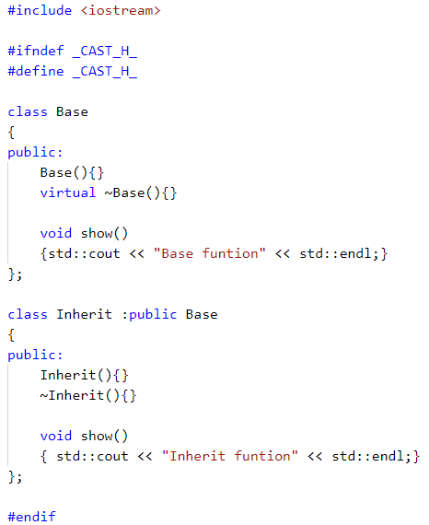
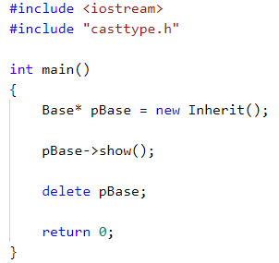
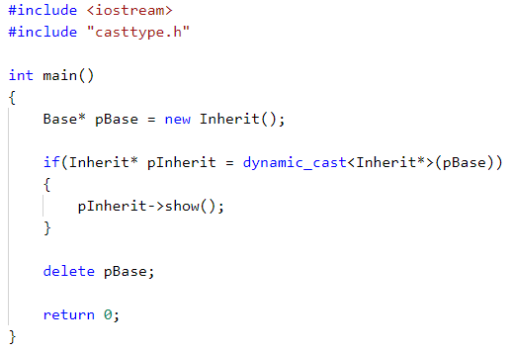
It is suggested to check whether the downcast is successful by “if” statement.
if (Derived *dp = dynamic_cast<Derived*>(bp)) //bp is a base class pointer
{
}
If bp points to a Derived object, then the cast will initialize dp to point to the Derived object to which bp points. In this case, it is safe for the code inside the if to use Derived operations. Otherwise, the result of the cast is 0.
Invoke the show() of base
class, though pBase points
to the derived object.
Invoke the show() of derived class, because
pBase is converted to the derived pointer.

Slide 17
typeid operator
typeid operator can tell you what type is the object.
typeid(expression)
The operand can be any expression or type name.
The typeid operator returns a reference to a type_info object, where type_info is a class defined in the typeinfo header file.
The type_info class overloads the == and != operators so that you can use these operators to compare types.
If the expression’s type is a class and contains at least one virtual function, the typeid operator returns the dynamic type of the expression; otherwise, it provides static type information.

Slide 18
Suppose there is at least one virtual function in the class B.
class Base { ... };
class Derived : public Base { ... };
Derived *dp = new Derived;
Base *bp = dp;
// compare the type of two objects at run time
if (typeid(*bp) == typeid(*dp))
{ … }
// test whether the run-time type is a specific type
if (typeid(*bp) == typeid(Derived))
{ … }
the operands of the typeid are objects, so use *dp not dp

Slide 19
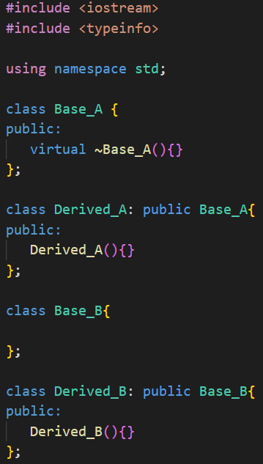
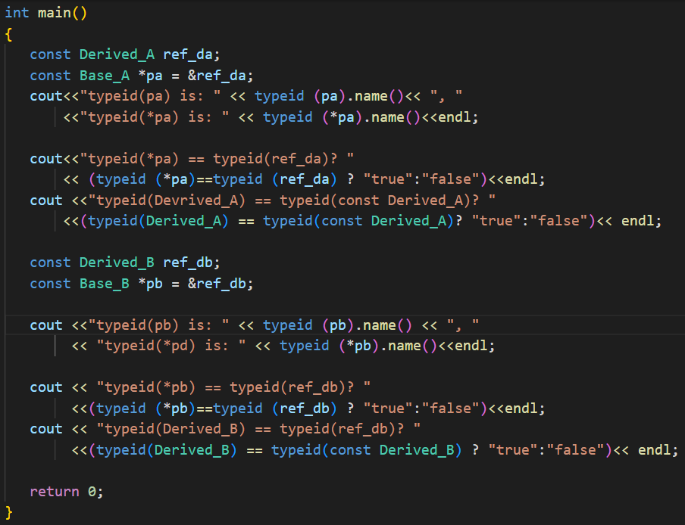
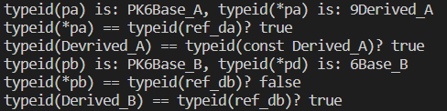
type_info class includes a name() member that returns an string that is typically the name of the class.
has no virtual
function
P:pointer, K: const,
6: numbers of the characters of the type

Slide 20
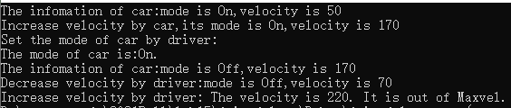
Exercise 1
There are two classes named Car and Driver, suppose the car can drive automatically, and driver also can drive the car. The declarations of car and driver are as follows:
class Car {
private:
enum {Off, On}; //Off- non automatically drive, On-automatically drive
enum {Minvel, Maxvel = 200}; //range of velocity from 0 to 200
int mode; //mode of car, Off or On
int velocity;
public:
friend class Driver;
Car(int m = On, int v = 50):mode(m),velocity(v){ }
bool velup(int v); //increase velocity by v
bool veldown(int v); //decrease velocity by v
bool ison() const; //Check whether the mode is on
int getvel() const; //get the velocity
void showinfo() const; // show the mode and velocity of car
};
class Driver {
public:
bool velup(Car& car,int v); //increase velocity by v
bool veldown(Car& car, int v); //decrease velocity by v
void setmode(Car& car); //If the mode is On, set it to Off,otherwise set it to Off
bool ison(Car& car) const; //Check whether the mode is on
};
Output sample:
Implement all the member functions of the two classes and make Driver as Car’s friend class so that it can access the members of Car. Write a program to test the two classes.

Slide 21
Exercise 2
There are two declarations of two classes, Base and Derived. You are required to implement the three kind of functions:
(1) Equality operator == is declared as a friend function of the Base class. Two objects are equal if they have the same type and same value for a given set of their data members. If two objects have different types, throw a message ”The two objects have different types, they can not be compared.” as an exception.
(2) Virtual equal member functions in Base and Derived class which check whether the data members have the same values in its own objects respectively.
(3) void process(const Base&, const Base&) function is a normal function who checks if the two objects are equal and handles the exception.
#include <iostream>
#include <typeinfo>
using namespace std;
class Base
{
protected:
int bvalue;
public:
Base(int i ) : bvalue(i) {}
virtual bool equal(const Base& b) const;
friend bool operator == (const Base&, const Base&);
};
class Derived : public Base
{
private:
int dvalue;
public:
Derived(int a, int b):Base(a), dvalue(b){}
virtual bool equal(const Base& b) const override;
};
int main()
{
Base b1(2);
Base b2(2);
Derived d1(1,2);
Derived d2(2,2);
process(b1,b2);
process(d1,d2);
process(b1,d1);
return 0;
}
Run the main function to check your defined functions.

