Slide 1
Advanced Programming
Prof. Shiqi Yu (于仕琪)
yusq@sustech.edu.cn
http://faculty.sustech.edu.cn/yusq/

Slide 2

Friend Classes

Slide 3
friend Functions
A friend function is defined out of the class.
No MyTime:: before its function name
class MyTime
{
// ...
public:
friend MyTime operator+(int m, const MyTime & t);
};
MyTime operator+(int m, const MyTime & t)
{
return t + m;
}

Slide 4
friend Classes
class Supplier
{
int storage;
public:
Supplier(int storage = 1000);
bool provide(Sniper & sniper)
{
// bullets is a private member
if (sniper.bullets < 20)
// ...
}
};
A class is a friend of another class.
The friend class can access all members even private members.
A friend class can be public, protected and private.
class Sniper
{
private:
int bullets;
public:
Sniper(int bullets = 0);
friend class Supplier;
};
friend.cpp

Slide 5
friend Member Functions
A single member function of a class is a friend.
Different from friend functions.
But very similar to a normal friend function.
But... declaration problem ...
class Sniper
{
private:
int bullets;
public:
Sniper(int bullets = 0): bullets(bullets){}
friend bool Supplier::provide(Sniper &);
};
friend2.cpp

Slide 6
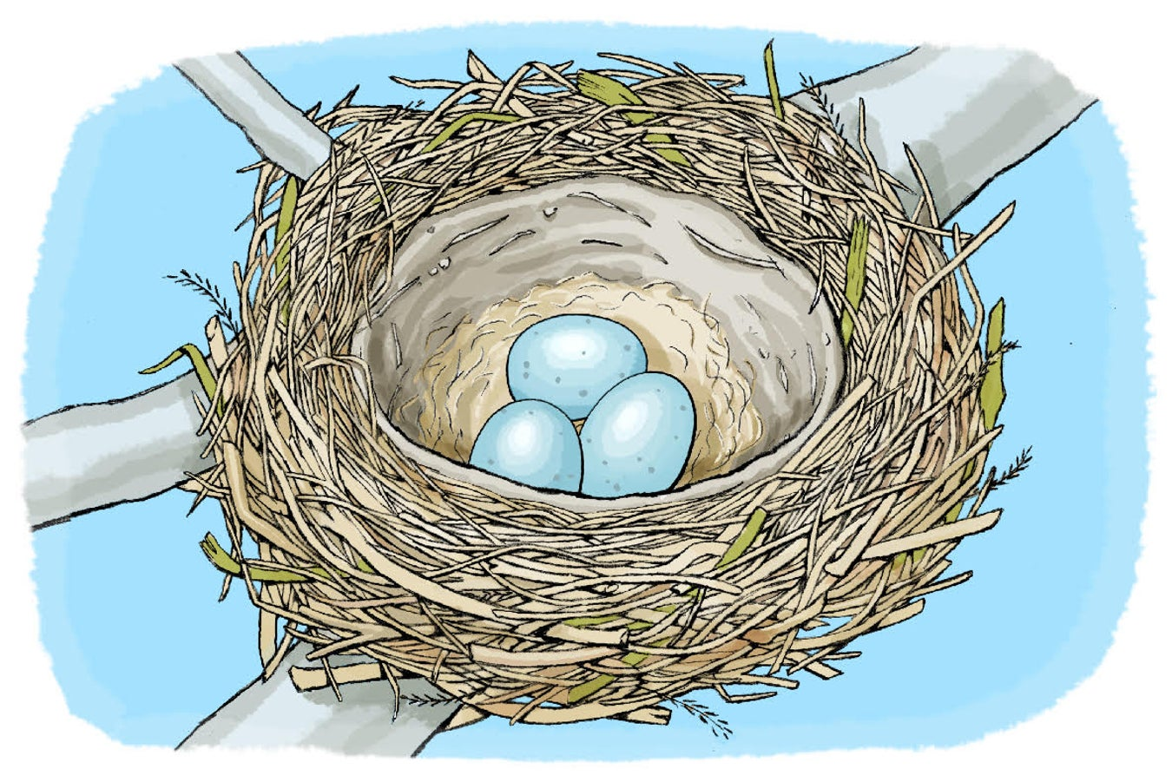
Nested Types
https://www.scientificamerican.com/article/build-a-bird-nest/

Slide 7
Nested Enumerations (C++11)
enum DataType is only used in class Mat, we can put it inside of Mat.
enum DataType
{
TYPE8U,
TYPE8S,
TYPE32F,
TYPE64F
};
class Mat
{
private:
DataType type;
void * data;
public:
Mat(DataType type) : type(type), data(NULL){} DataType getType() const { return type; }
};
nested-enum.cpp

Slide 8
Nested Enumerations (C++11)
It can be accessed outside of the class, but with the class name scope qualifier.
class Mat
{
public:
enum DataType
{
TYPE8U,
TYPE8S,
TYPE32F,
TYPE64F
};
private:
DataType type;
void * data;
public:
Mat(DataType type) : type(type), data(NULL){} DataType getType() const { return type; }
};
DataType::TYPE8U
Mat::DataType::TYPE8U
nested-enum2.cpp

Slide 9
Nested Classes
Nested classes: The declaration of a class/struct or union may appear inside another class.
class Storage
{
public:
class Fruit
{
string name;
int weight;
public:
Fruit(string name="", int weight=0);
string getInfo();
};
private:
Fruit fruit;
public:
Storage(Fruit f); };
nestedclass.cpp

Slide 10
Nested Types: Scope
Private:
Only visible to the containing class
Protected:
Visible to the containing class and its derived class.
Public:
Visible to the containing class, to its derived classes, and to the outside world.

Slide 11

RTTI and Type Cast Operators

Slide 12
Runtime Type Identification (RTTI)
We can convert a pointer explicitly to another, even it isn’t appropriate.
How to convert safely?
class Person;
class Student: public Person;
Person person("Yu");
Student student("Sam", "20210212");
Person* pp = &student;
Person& rp = student;
Student * ps = (Student*)&person; //danger!
rtti.cpp

Slide 13
RTTI and Type Cast Operators
Runtime type identification (RTTI)
C++ feature
The type of an object to be determined during runtime.
dynamic_cast operator: conversion of polymorphic types.
typeid operator: Identify the exact type of an object.
type_info class. the type information returned by the typeid operator.

Slide 14
typeid
typeid operator
determine whether two objects are the same type
Accept: the name of a class, an expression that evaluates to an object
type_info class
The typeid operator returns a reference to a type_info object
Defined in the <typeinfo> header file
Comparing type using the overloaded == and != operators
typeid.cpp

Slide 15
dynamic_cast
It can safely assign the address of an object to a pointer of a particular type.
Invoke the correct version of a class method (remember virtual functions)
Person person("Yu");
Student student("Sam", "20210212");
Person* pp = NULL;
Student * ps = NULL;
ps = dynamic_cast<Student*>(&person); // NULL
pp = dynamic_cast<Person*>(&student);

Slide 16
More Type Cast Operators
Three more operators
const_cast:
Type cast for const or volatile value
static_cast:
It’s valid only if type_name can be converted implicitly to the same type that expression has, or vice versa
Otherwise, the type cast is an error
const_cast.cpp
Base * pB = static_cast<Base*>(derived); //valid
Derived * pD = static_cast<Derived*>(base); //valid
UnRelated * pU = static_cast<UnRelated*>(base); //invalid

Slide 17
More Type Cast Operators
reinterpret_cast
Converts between types by reinterpreting the underlying bit pattern.
int i = 18;
float * p1 = reinterpret_cast<float *>(i); // static_cast will fail
int * p2 = reinterpret_cast<int*>(p1);
reinterpret_cast.cpp

Slide 18
The Style

Slide 19
A Typical Object-oriented Style
Is it a good style?
class Matrix
{
private:
size_t rows;
size_t cols;
float * data;
public:
Matrix(size_t r, size_t c){...}
size_t getRows() const {return rows;}
size_t getCols() const {return cols;}
float getElement(size_t r, size_t c)
{
if( r >= rows || c >= cols) { ... }
return data[ r * cols + c];
}
void setElement(size_t r, size_t c, float v)
{
if( r >= rows || c >= cols) { ... }
data[ r * cols + c] = v;
}
...
Matrix operator+(Matrix & other)
{
if(this->rows != other.rows ||
this->cols != other.rows)
{ ... }
Matrix result(this->rows, this->cols);
for (size_t r = 0; r < this->rows; r++)
for (size_t c = 0; c < this->cols; c++)
{
float v = this->getElement(r, c) +
other.getElement(r, c);
result.setElement(r, c, v);
//result(r, c) = (*this)(r, c) + other(r, c);
}
return result;
}
};

Slide 20
Another Style: Computational efficiency first
Another style: Is it a good style?
class Matrix
{
pubic:
size_t rows;
size_t cols;
float * data;
public:
Matrix(size_t r, size_t c){...}
size_t getRows() const {return rows;}
size_t getCols() const {return cols;}
float getElement(size_t r, size_t c)
{
if( r >= rows || c >= cols) { ... }
return data[ r * cols + c];
}
void setElement(size_t r, size_t c, float v)
{
if( r >= rows || c >= cols) { ... }
data[ r * cols + c] = v;
}
...
Matrix operator+(Matrix & other)
{
if(this->rows != other.rows ||
this->cols != other.rows)
{ ... }
Matrix result(this->rows, this->cols);
size_t length = rows * cols;
for (size_t i = 0; i < length; i++)
{
result.data[i] = this->data[i] + other.data[i];
}
return result;
}
};

Slide 21


Java vs C++: Different Philosophy
Developer: I may have some stupid colleagues.
Java: I may have some stupid developers.
Developer: Show my talent!
C++: Show your talent!

Slide 22

The Trend

Slide 23

What will happen?
I cannot predict, but …
Moore's law
the number of transistors on a microchip doubled about 18 months.
Wu, Carole-Jean & Manne, Srilatha & Ranganathan, Parthasarathy & Bird, Sarah & Greenstein, Shane. (2021). Socio-Technological Challenges and Opportunities: Paths Forward.

Slide 24
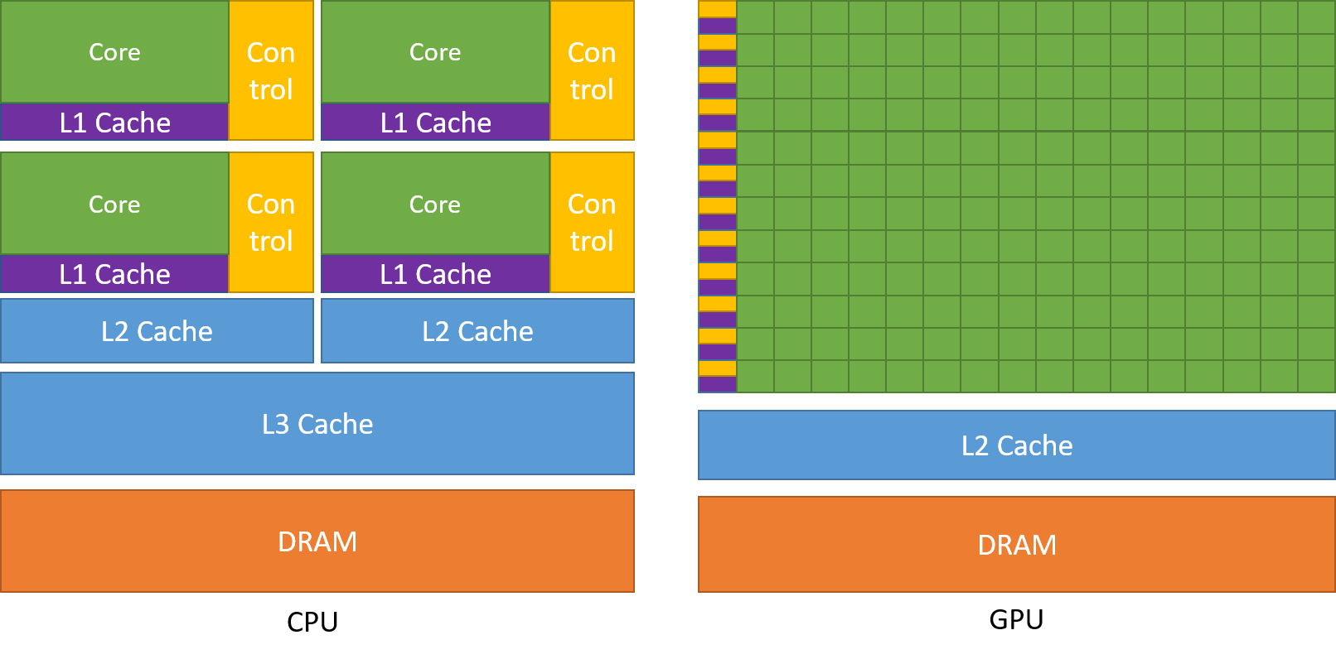
The Architecture
CPU -> CPU + *PU (GPU, NPU, TPU, etc.)
https://docs.nvidia.com/cuda/cuda-c-programming-guide/index.html

Slide 25
What’s your position?
Hardware, OS, DB, Cloud, Deep Learning, C/C++/Java/Python/JS, …

