Slide 1
Advanced Programming
Lab 14, Exceptions, assertion
廖琪梅，王大兴，于仕琪，王薇

Slide 2
topics
Exception and Exception Handling
try, throw, catch
throw(), noexcept, noexcept(true)
exception class, what()
catch-by-value vs catch-by-reference
Assertion

Slide 3
Exception and Exception Handling
What is an exception?
An exception is a situation, which occurred by the runtime error. In other words, an exception is a runtime error. An exception may result in loss of data or an abnormal execution of program. Exception handling is a mechanism that allows you to take appropriate action to avoid runtime errors.
The default behavior for unexpected is to call terminate, and the default behavior for terminate is to call abort(), so the program is to halt. Local variables in active stack frames are not destroyed, because abort() shuts down program execution without performing such cleanup.

Slide 4
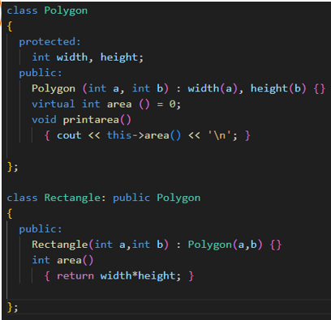
void process(){
Polygon *p =new Rectangle(INT_MAX,INT_MAX);
try{
p->printarea();
}catch(...){
delete p;
throw;
}
delete p;
}
One solution is to use try-catch block to catch and handle the exception. In catch block, free the memory and throw the exception to the caller.
void process(){
shared_ptr<Polygon>sp(newRectangle(INT_MAX,INT_MAX));
sp->printarea();
}
Another solution is to use smart pointer, thus there is no need to free the memory.
void process(){
Polygon *p1 =new Rectangle(INT_MAX,INT_MAX);
p1->printarea();
delete p1;
}
If an exception occurs, the following statements can not be executed.
The memory can not be free.
Using an object to store a resource that needs to be automatically released(resources should be encapsulated inside objects) and relying on that object's destructor to release it.

Slide 5
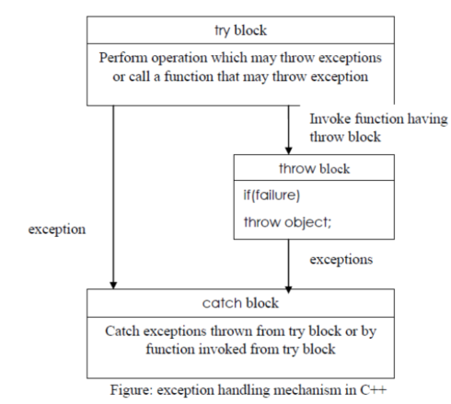
Exception handling
Exceptions provide a way to react to exceptional circumstances (like runtime errors) in programs by transferring control to special functions called handlers. C++ provides three keywords to support exception handling.
try: The try block contain statements which may generate exceptions. When an exceptional circumstance arises within that block, an exception is thrown that transfers the control to the exception handler. If no exception is thrown, the code continues normally and all handlers are ignored.
throw: When an exception occur in try block, it is thrown to the catch block using throw keyword.
catch: The catch block defines the action to be taken when an exception occur. Exception handlers are declared with the keyword catch, which must be placed immediately after the try block.

Slide 6
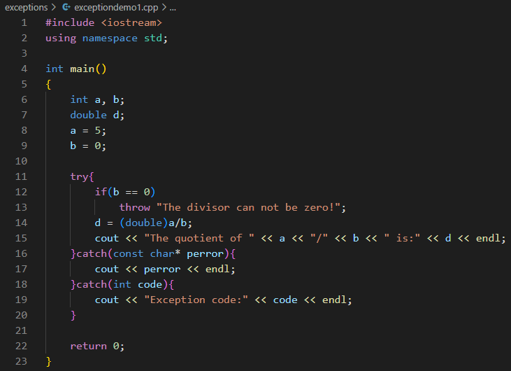
Example of a program with exception handling using try and catch, throw an exception in try block in main()
match

Slide 7
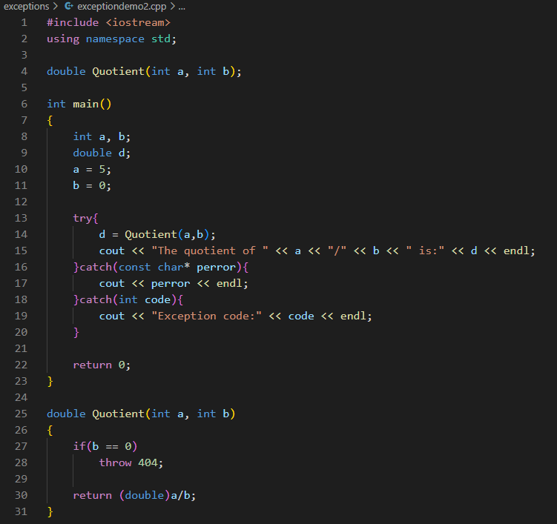
Example of a program with exception handling using try and catch, throw an exception in other function, handlers are in main()
match

Slide 8
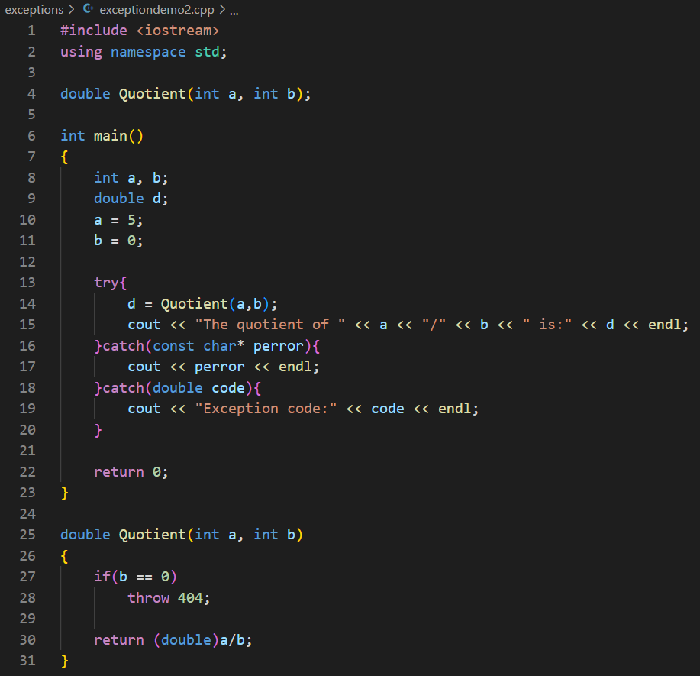

Note: In general, no conversions are applied when matching exceptions to catch clauses.
does not
match

Slide 9
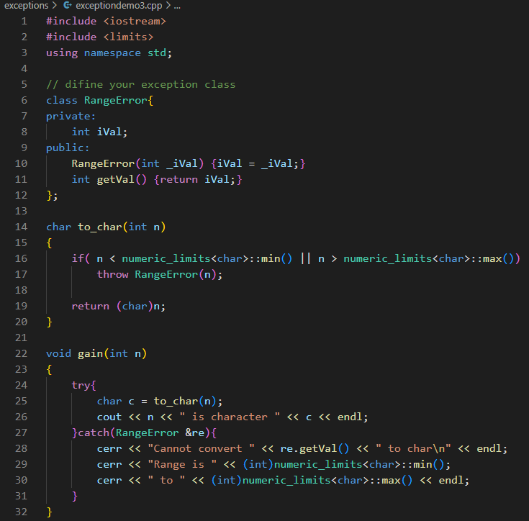
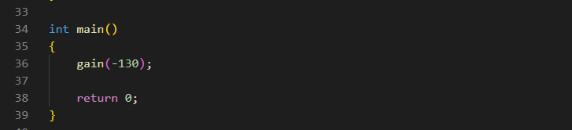

Define and using exception class
Define your exception class
Throw the exception and invoke the constructor
Catch and handle the exception

Slide 10
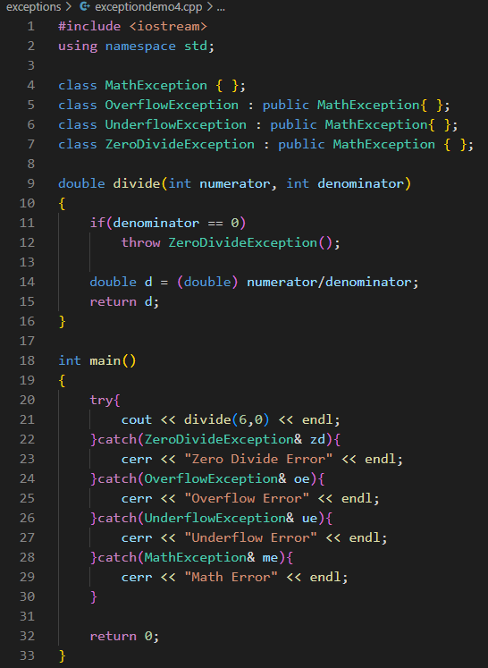
Handling exceptions from an inheritance hierarchy
Note: A kind of conversion is applied when matching exceptions to catch clauses. That is inheritance-based conversions. A catch clause for base class exceptions is allowed to handle exceptions of derived class types, too.

Slide 11

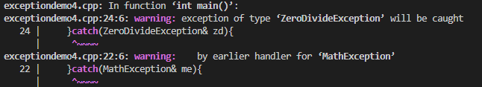
Note: catch clauses are always tried in the order of their appearance. Hence, it is possible for an exception of a derived class type to be handled by a catch clause for one of its base class types.
Compilers may warn you if a catch clause for a derived class comes after one for a base class.

Slide 12
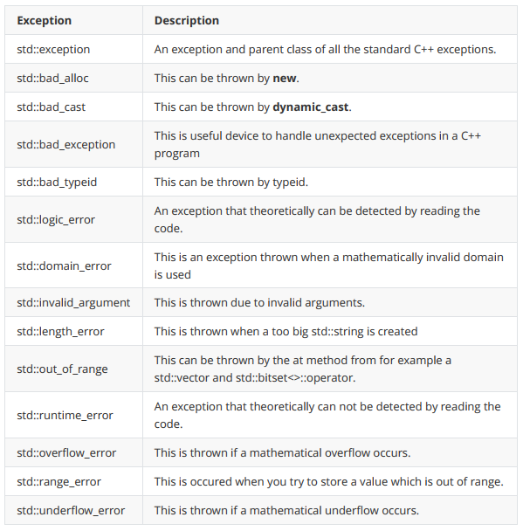
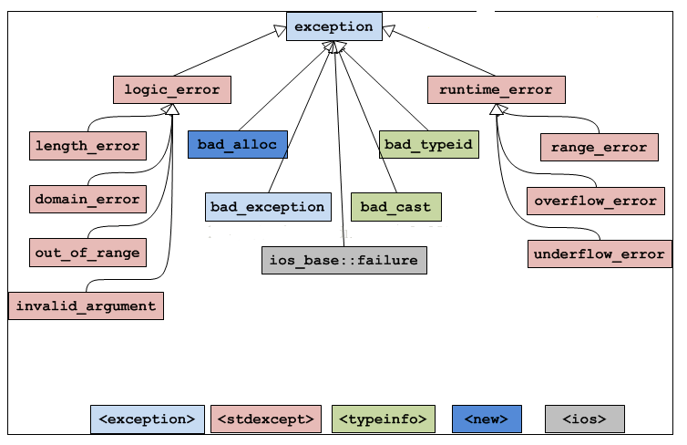
C++ Standard Exceptions
C++ provides a list of standard exceptions defined in which we can use in our programs.

Slide 13
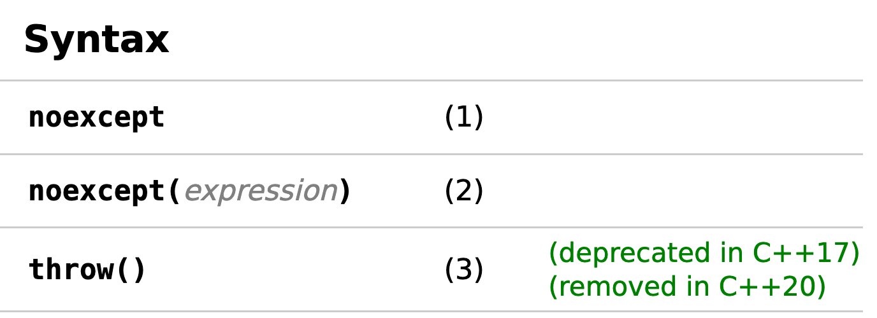
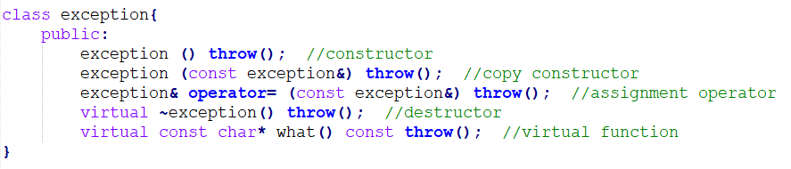
noexcept, noexcept(true), and throw() are equivalent.
Exception specification used in function declaration, with no argument indicates that the function is not allowed to throw any exceptions.
what() is a public method provided by exception class which returns a string and it has been overridden by all the child exception classes.

Slide 14
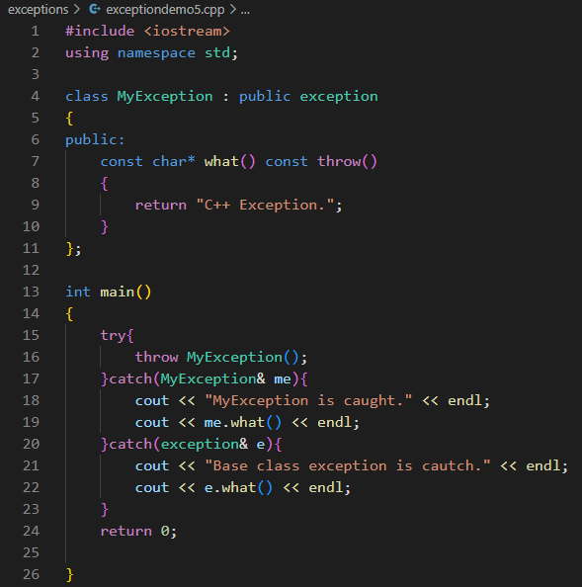

Define your own exception class derived from exception class and override what() method

Slide 15
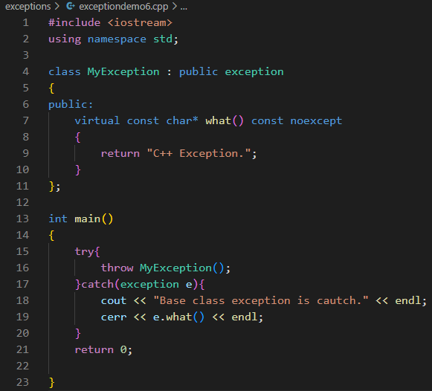

Note: use catch-by-reference for exception objects
catch-by-value:Derived class exception objects caught as base class exceptions have their derivedness "sliced off." Such "sliced" objects are base class objects: they lack derived class data members, and when virtual functions are called on them, they resolve to virtual functions of the base class. So use catch-by-reference for exception objects and invoke the virtual function of the derived class.
It will not throw any exception
Catch the exception
by value
Invoke what() of the exception class
rather than the MyException class.

Slide 16
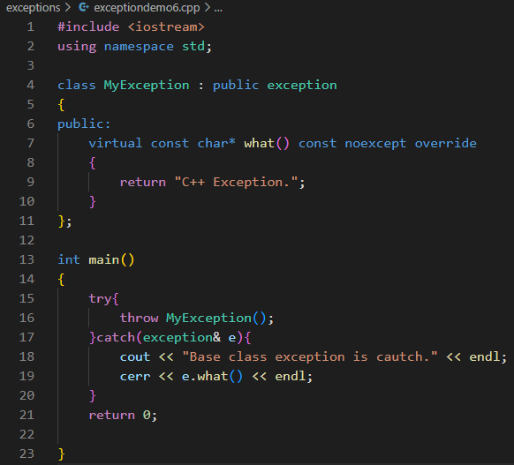

It is overriding a virtual method of the base class.
Catch the exception
by reference
Invoke what() of the MyException class
not the exception class.
Throw exceptions by value, catch them by reference.

Slide 17
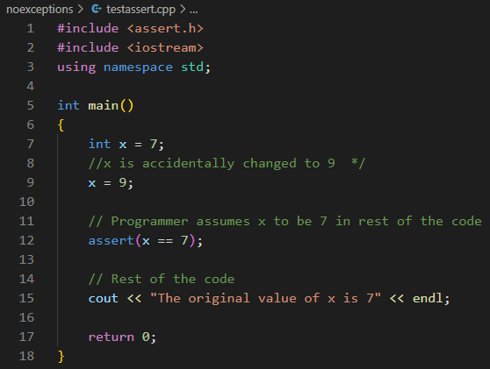
Assertions in C/C++
Assertions are statements used to test assumptions made by programmers. It is designed as a macro in C/C++. Following is the syntax for assertion:
void assert(int expression);
If the expression evaluates to 0 (false), then the expression, source code filename, and line number are sent to the standard error, and then abort() function is called.
source code filename
and line number
file name
expression
abort() function is called and display message on the screen.

Slide 18
Assertions are mainly used to check logically impossible situations. For example, they can be used to check the state of a code which is expected before it starts running, or the state after it finishes running.
Verify the validity of the passed argument at the beginning of the function.
int resetBufferSize(int nNewSize) { assert(nNewSize >= 0); assert(nNewSize <= MAX_BUFFER_SIZE);
... }
// is not recommended
assert(nOffset>=0 && nOffset+nSize<=m_nInfomationSize);
// is recommended, each assert test only on condition
assert(nOffset >= 0); assert(nOffset+nSize <= m_nInfomationSize);
Each assert tests only one condition, because when multiple conditions are tested at the same time, it is not intuitive to determine which condition failed if the assertion failed.
Ignores assertions. We can completely remove assertions at compile time using the preprocessor NDEBUG. Put #define NDEBUG at the beginning of the code, before inclusion of <assert.h>. Therefore, this macro is designed to capture programming errors, not user or run-time errors, since it is generally disabled after a program exits its debugging phase.

Slide 19
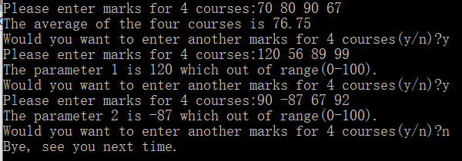
Exercise:
1. Write a function calculateAverage() which takes four int arguments, which are marks of four courses, and returns their average as a float number.
The calculateAverage() function should take only valid range for marks which is between 0-100. If the marks are out of range throw an OutOfRangeException – define this exception as a class.
Invoke the calculateAverage() function in main function and get the following inputs and outputs:

Slide 20
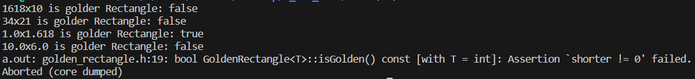
2. Define a generic class “GoldenRectangle” for a golden rectangle in the “golden_rectangle. h” , When testing based on the following main methods, the test results are shown in the bottom figure.
GoldenRectangle class:
two private properties: length and width, and a generic data type.
a public method, which returns a Boolean value.
The method calculates by dividing the long side by the short side. If the quotient is 1.618, it returns true; otherwise, it returns false.
In this method, If the shorter side is 0 (i.e. the divisor is 0), an assertion is triggered.
#include "golden_rectangle.h"
int main() {
GoldenRectangle<int>rect0(1618, 10);
std::cout <<"1618x10 is golder Rectangle: "<<std::boolalpha <<rect0.isGolden() <<std::endl;
GoldenRectangle<int>rect1(34, 21);
std::cout <<"34x21 is golder Rectangle: "<<std::boolalpha <<rect1.isGolden() <<std::endl;
GoldenRectangle<double>rect2(1.0, 1.618);
std::cout <<"1.0x1.618 is golder Rectangle: "<<rect2.isGolden() <<std::endl;
GoldenRectangle<float>rect3(10.0f, 6.0f);
std::cout <<"10.0x6.0 is golder Rectangle: "<<rect3.isGolden() <<std::endl;
GoldenRectangle<int>rect4(10, 0);
std::cout <<"10x0 is golder Rectangle: "<<rect4.isGolden() <<std::endl;
return 0;
}

Slide 21

3. 1) define a generic class “GoldenRectangle” (similar with which in the excercise2) for a golden rectangle and 2)a class “DivisionByZeroException”(inherit from “exception” class) in the “golden_rectangle2. h” , 3) complete the main method, When testing based on the following main methods, the test results are shown in the bottom figure.
DivisionByZeroException class:
public inherit from exception class.
override “what” function, return a string as “Error: divisor MUST NOT be zero”
GoldenRectangle class:
two private properties: length and width, and a generic data type.
a public method, which returns a Boolean value.
The method calculates by dividing the long side by the short side. If the quotient is 1.618, it returns true; otherwise, it returns false.
In this method, If the shorter side is 0 (i.e. the divisor is 0), throw an DivisionByZeroException object.
#include "golden_rectangle2.h"
int main() {
try {
GoldenRectangle<double>rect0(1.0, 1.618);
std::cout <<"1.0x1.618 is golder Rectangle: "<<rect0.isGolden() <<std::endl;
GoldenRectangle<int>rect1(34, 21);
std::cout <<"34x21 is golder Rectangle: " <<rect1.isGolden() <<std::endl;
GoldenRectangle<int>rect2(10.0, 0.0);
std::cout <<"10x0 is golder Rectangle: "<<rect2.isGolden() <<std::endl;
}
catch(const /*complete code here*/) {
std::cerr <<e.what() <<std::endl;
}
catch(const /*complete code here*/) {
std::cerr <<"other exception: "<<e.what() <<std::endl;
}
return 0;
}

