Slide 1
CAPSTONE PROJECT
Smart watch Fitness Data Analysis
Presented By:
1. U . Monisha –ACT , Anna University-Ceramic Technology

Slide 2
OUTLINE
Problem Statement
Proposed System/Solution
System Development Approach
Algorithm & Deployment
Result
Conclusion
Future Scope
References

Slide 3
PROBLEM STATEMENT
Development of a model to collect, analyze, and visualize fitness data from smart watches, enabling users to track their heart rate, steps, sleep quality, calories burned for improving overall health and well-being.

Slide 4
PROPOSED SOLUTION
Development of a Python-based data science project to collect, analyze and visualize fitness data such as step count, heart rate, sleep patterns, and calorie expenditure.

Slide 5
SYSTEM APPROACH
System Requirements:
1.Hardware:
A computer with adequate processing power.
Adequate RAM to handle the size of the dataset and computational requirements.
2.Software:
Library requirements:
-Pandas
-NumPy
-Matplotlib
-Plotly

Slide 6
ALGORITHM & DEPLOYMENT
Data Collection:
Collect data related to fitness such as step count, heart rate, sleep patterns, and calorie expenditure.
Data Cleaning:
Clean the collected data by handling missing values, outliers, and inconsistencies.
Data Exploration:
Visualize the data using appropriate plots such as histograms, scatter plots, and time series plots.

Slide 7
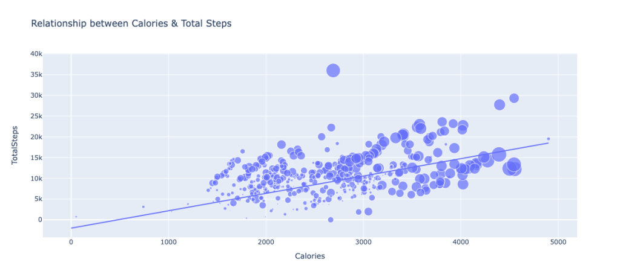
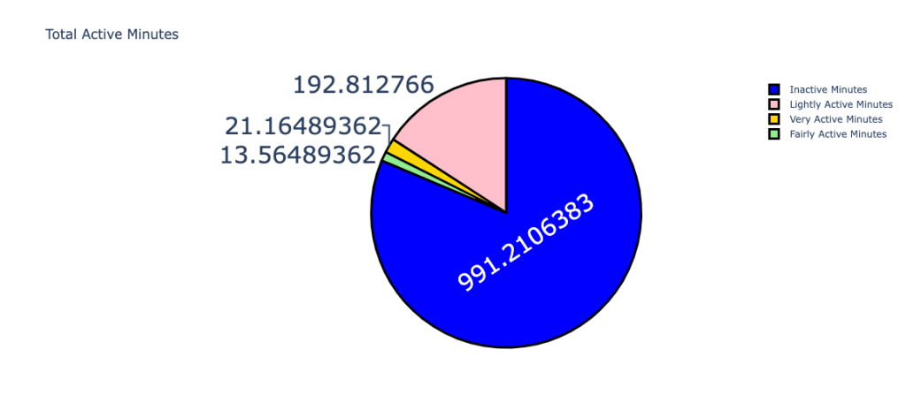
RESULT

Slide 8
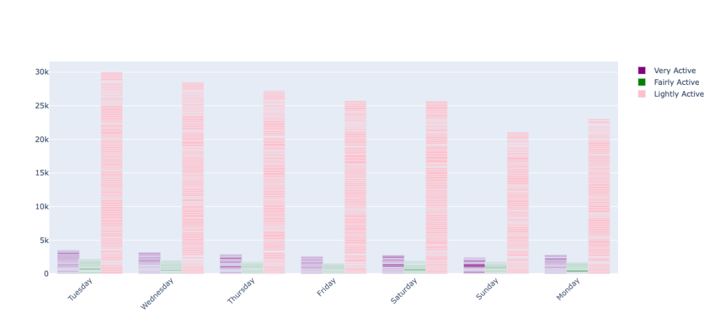
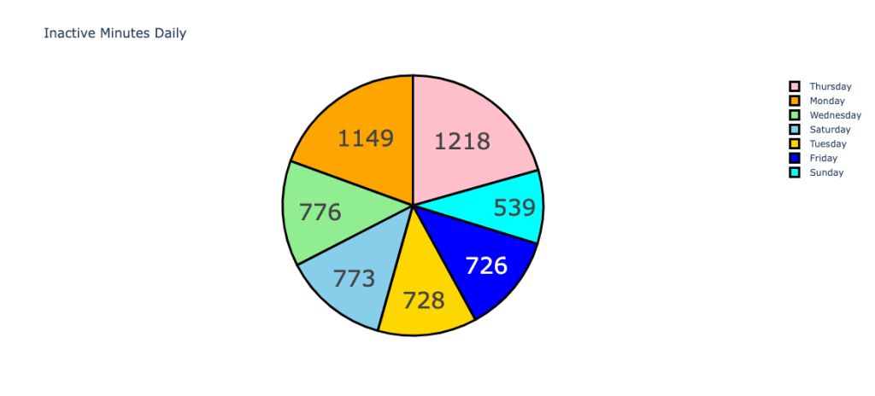
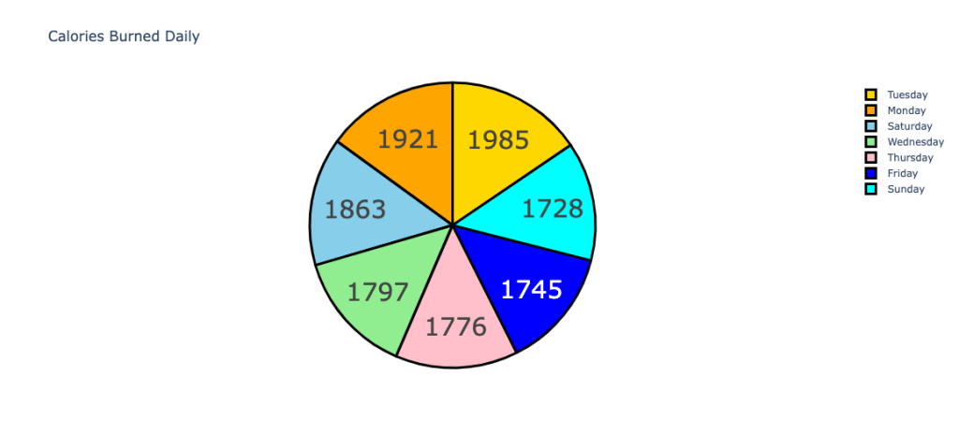

Slide 9
CONCLUSION
This project offers a simple collecting, analyzing, and visualizing fitness data from smart watches . Users can gain valuable insights into their health behaviors and make informed decisions to achieve their fitness goals. The project demonstrates the potential of technology to facilitate personal health monitoring and promote healthier lifestyles.

Slide 10
FUTURE SCOPE
Integration with additional wearable devices and fitness tracking platforms to support a wider range of users.
Implementation of machine learning algorithms for predictive analytics, such as forecasting future fitness trends or detecting anomalies in health data.
Development of a user-friendly web or mobile application to provide a more interactive and accessible interface for users.

Slide 11
REFERENCES
https://www.kaggle.com

Slide 12
THANK YOU

