Slide 1

Mini Project
M. Monisha B.E.ECE

Slide 2
Employee Data Management
Our employee data management solution provides you complete control over your employee lifecycle.
You will have access to accurate data right from the start of an employee’s journey with your organization.
This helps you to make efficient and accurate decisions for your workforce.

Slide 3
Employee Management System Modules
Login Module: There are different login details & login using their respective user id and password.
01
Update Module:
It enables admin to add and edit employee records.
02
Delete Module:
This module is created to delete any employee details.
03
Search module: It enables to search employee records easily using employee id.
04
Add Modules:
It enables admin to add employee records.
05

Slide 4
Software Used
Front-End
JDK (Java Development Kit).
IDE
Eclipse IDE for Java Developers
Back-End
MySQL Workbench

Slide 5
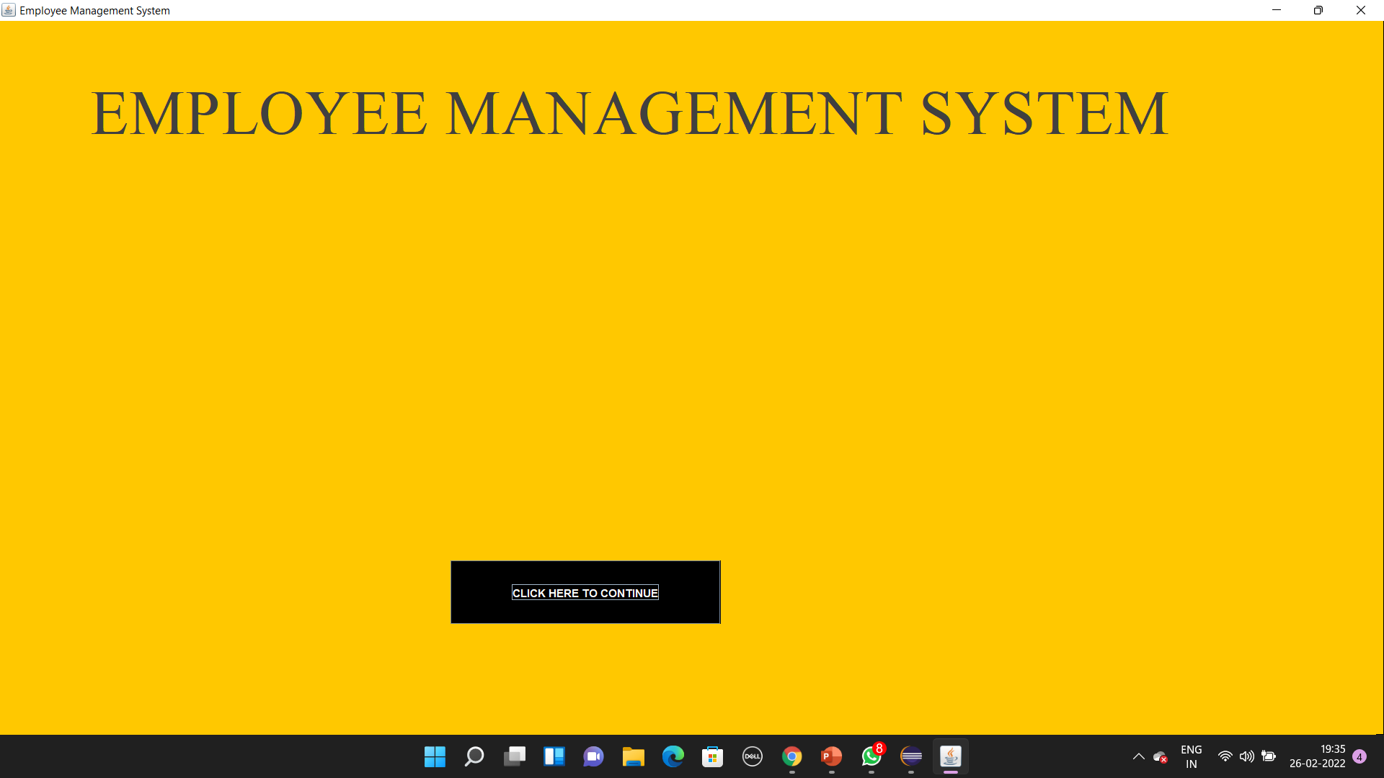
Front-Page

Slide 6
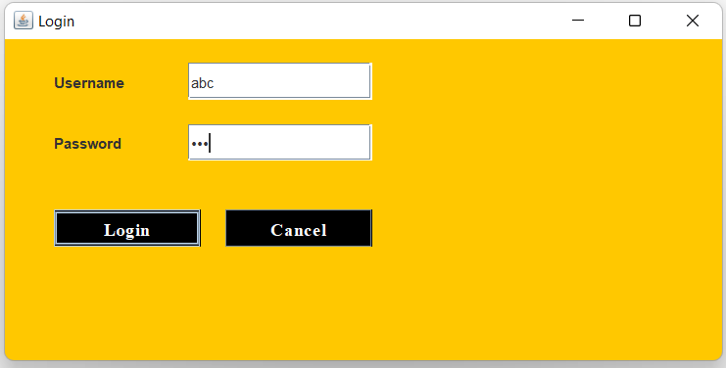
Login-Page

Slide 7
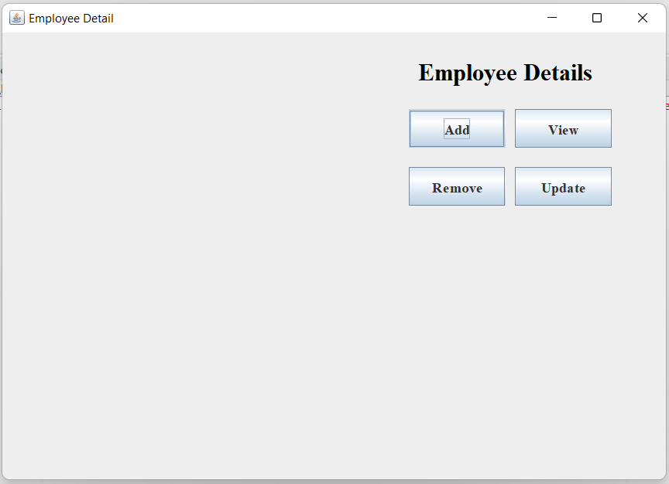
Home -Page

Slide 8
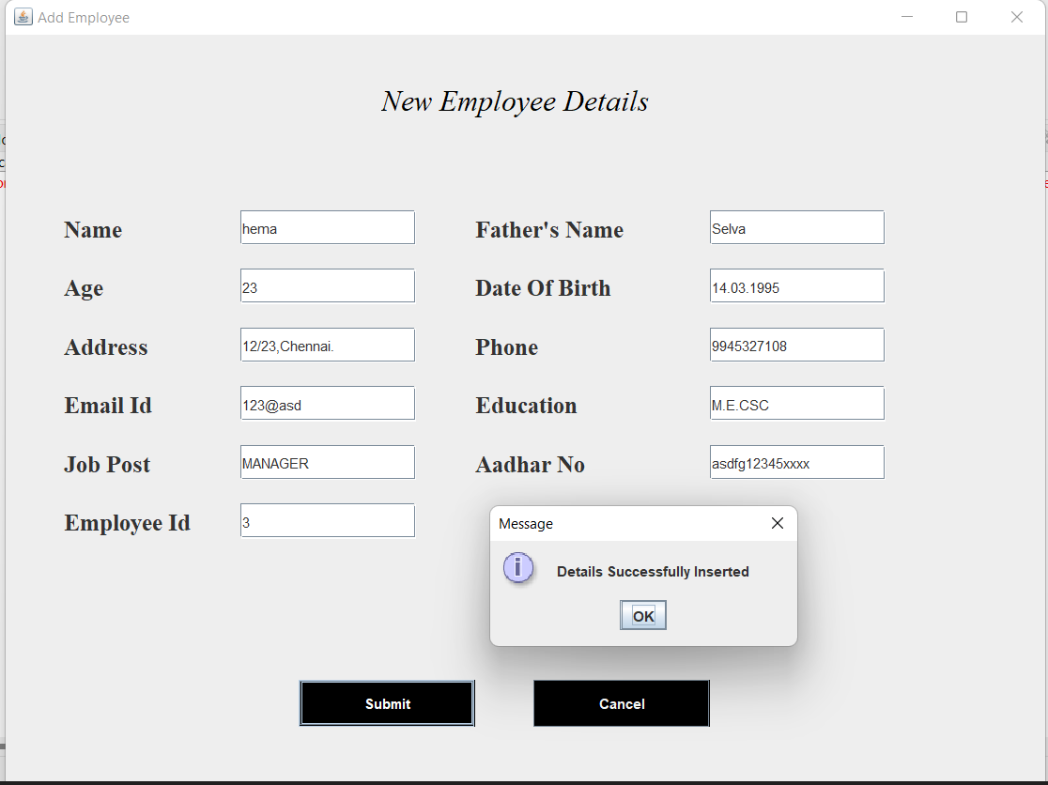
Add Employee -Page

Slide 9
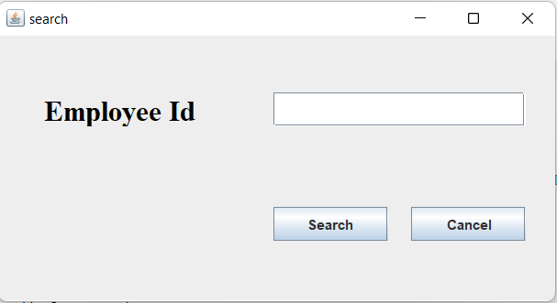
Search -Page

Slide 10
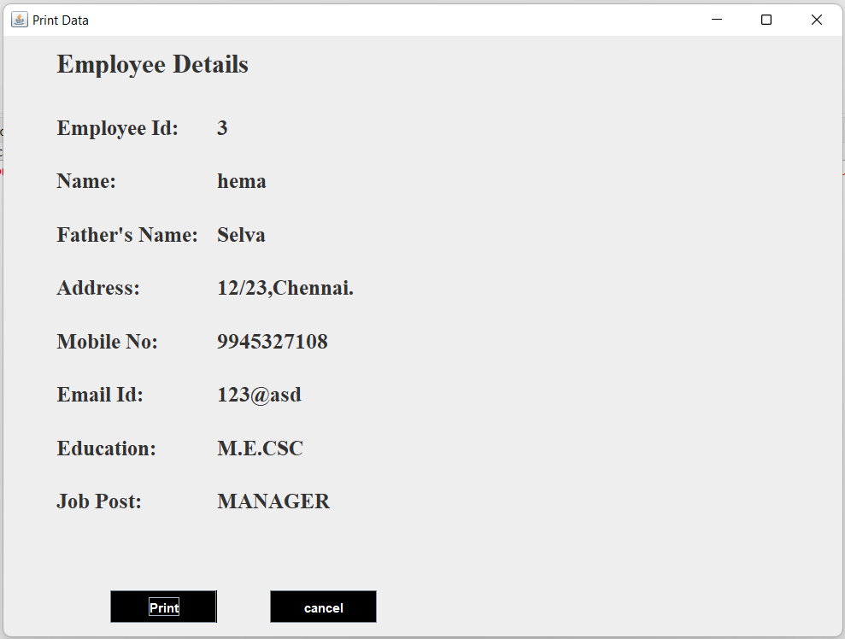
View Employee Details -Page

Slide 11
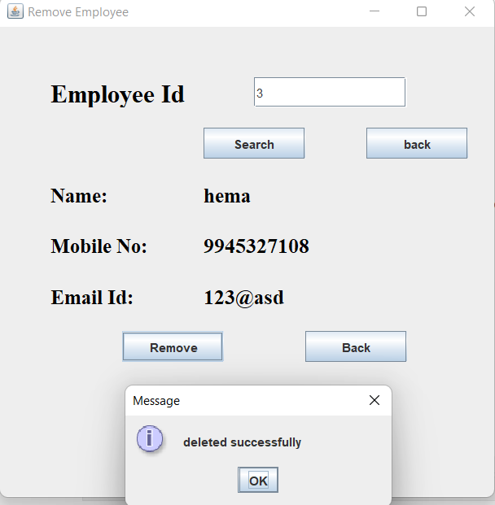
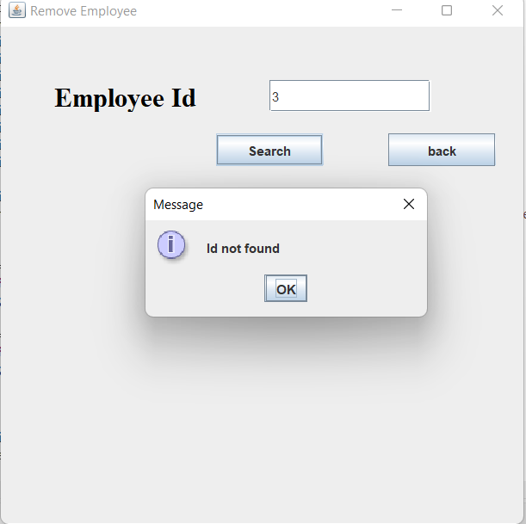
Remove Employee Details -Page

Slide 12
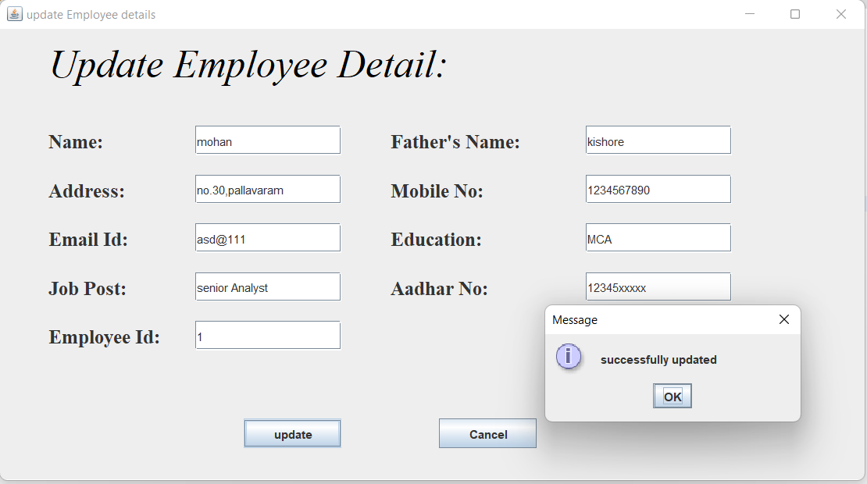
Update Employee Details -Page

Slide 13
THANK YOU

