Slide 1
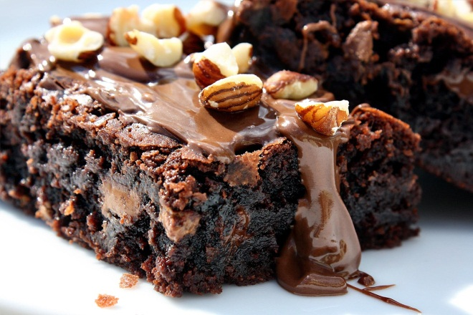
<h1>“Recipe Website name”</h1> + background image
Search: <input type=“text”/>
<figure>Relevant Recipe 1 + image
</figure>
<aside> <nav>
<ul>
<li>Breakfast
</li>
<li>Brunch</li>
<li>Lunch</li>
<li>Dinner</li>
<li>Midnight Snacks</li>
<li>Dessert
</li>
</ul>
</nav>
</aside>
<h2>Dessert->Brownies->Chocolate Brownies</h2>
<p>
INGREDIENTS:
1/2 cup butter
1 cup white sugar
2 eggs
1 teaspoon vanilla extract
1/3 cup unsweetened cocoa powder
1/2 cup all-purpose flour
1/4 teaspoon salt
1/4 teaspoon baking powder
Frosting:
3 tablespoons butter (softened)
3 tablespoons unsweetened cocoa powder
1 tablespoon honey
1 teaspoon vanilla extract
1 cup confectioners' sugar
DIRECTIONS:
1. Preheat oven to 350 degrees F (175 degrees C). Grease and flour an 8-inch square pan.
2. In a large saucepan, melt 1/2 cup butter. Remove from heat, and stir in sugar, eggs, and 1 teaspoon vanilla. Beat in 1/3 cup cocoa, 1/2 cup flour, salt, and baking powder. Spread batter into prepared pan.
3. Bake in preheated oven for 25 to 30 minutes. Do not overcook…
</p>
<figure>Relevant Recipe 2 + image
</figure>
<figure>Relevant Recipe 3 + image
</figure>
<figure>Relevant Recipe 4 + image
</figure>

