Slide 1

Hospital Bed and Resource Prediction: Improving Everyday Healthcare Planning
UIC MSBA TEAM
Notes:
Hello everyone, we are Group 4. Managing hospital resources is challenging, especially with unexpected patient surges. So today, we’re talking about Predicting ICU and Hospital Bed Utilization—building a predictive model to improve hospital resource planning.

Slide 2
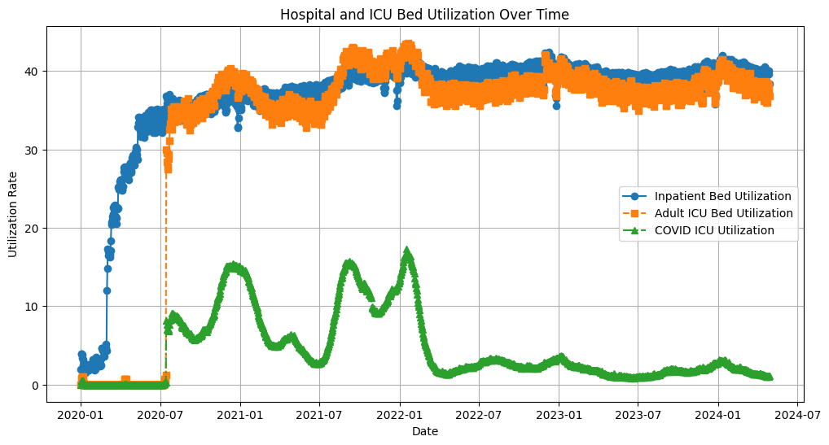
https://hospitalforecasting.com
Home | Adult | Pediatric | State | Resources | About us
Time Frame: All | State: All | Conditions
Overview
Maps
Forecasting
Inpatient Bed Utilization
Staffing Shortage Status
Alerts
Export Data
Download Image
Notes:
Here is the mockup:
【最上面的部分】The users can filter data by category, such as Adult or Pediatric, or view data by state for a more detailed analysis.
【左侧】On the left, you can explore different sections, including the overtime graph as currently displayed, as well as Maps, Forecasting, ICU Bed Utilization, and Staffing Shortage Status. Let’s try Maps. 【点Maps】

Slide 3
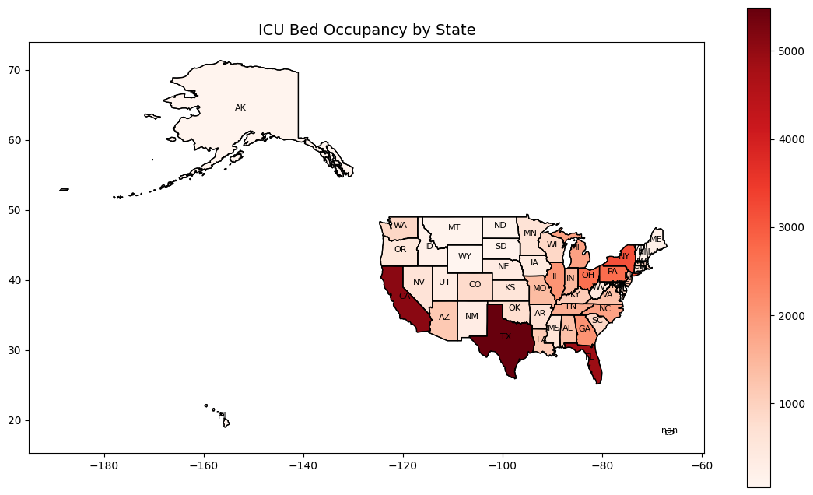
https://hospitalforecasting.com
Home | Adult | Pediatric | State | Resources | About us
Time Frame: All | State: All | Conditions
Overview
Maps
Forecasting
Inpatient Bed Utilization
Staffing Shortage Status
Alerts
Export Data
Download Image
Notes:
【整个页面滑动】This will show data by state. 【点time frame】You can also adjust the time frame…

Slide 4
https://hospitalforecasting.com
Home | Adult | Pediatric | State | Resources | About us
Time Frame: All | State: All | Conditions
Overview
Maps
Forecasting
Inpatient Bed Utilization
Staffing Shortage Status
Yersterday
Last 7 days
Last 14 days
Last 30days
Tomorrow
Next 7 days
Next14 days
Next 30 days
All
Alerts
Export Data
Download Image
Notes:
You can also adjust the time frame, allowing selection of both historical data and forecasting periods.
【点state】And you can filter by state.

Slide 5
https://hospitalforecasting.com
Home | Adult | Pediatric | State | Resources | About us
Time Frame: All | State: All | Conditions
Overview
Maps
Forecasting
Inpatient Bed Utilization
Staffing Shortage Status
All
Alabama
Alaska
Arizona
Arkansas
California
Colorado
Connecticut
Delaware
Florida
Georgia
Alerts
Export Data
Download Image
Notes:
And you can filter by state.
【点Conditions】 The Conditions filter works like a ‘What-If’ Analysis…

Slide 6
https://hospitalforecasting.com
Home | Adult | Pediatric | State | Resources | About us
Time Frame: All | State: All | Conditions
Overview
Maps
Forecasting
Inpatient Bed Utilization
Staffing Shortage Status
Seasons: Spring Summer Fall Winter
Admission Rate
0%
25%
50%
Emergency Surge:
No Surge +10% +20% +30%
Staff Current Shortage: Yes No
Staff Anticipated Shortage: Yes No
Available Beds
-25%
0%
25%
Confirmed
Alerts
Export Data
Download Image

Slide 7

https://hospitalforecasting.com
Home | Adult | Pediatric | State | Resources | About us
Time Frame: All | State: All | Conditions
Overview
Maps
Forecasting
Inpatient Bed Utilization
Staffing Shortage Status
Seasons: Spring Summer Fall Winter
Admission Rate
0%
25%
50%
Emergency Surge:
No Surge +10% +20% +30%
Staff Current Shortage: Yes No
Staff Anticipated Shortage: Yes No
Available Beds
-25%
0%
25%
Confirmed
Alerts
Export Data
Download Image

Slide 8
https://hospitalforecasting.com
Home | Adult | Pediatric | State | Resources | About us
Time Frame: All | State: All | Conditions
Overview
Maps
Forecasting
Inpatient Bed Utilization
Staffing Shortage Status
Seasons: Spring Summer Fall Winter
Admission Rate
0%
15%
25%
50%
Emergency Surge:
No Surge +10% +20% +30%
Staff Current Shortage: Yes No
Staff Anticipated Shortage: Yes No
Available Beds
-25%
0%
25%
Confirmed
Alerts
Export Data
Download Image

Slide 9
https://hospitalforecasting.com
Home | Adult | Pediatric | State | Resources | About us
Time Frame: All | State: All | Conditions
Overview
Maps
Forecasting
Inpatient Bed Utilization
Staffing Shortage Status
Seasons: Spring Summer Fall Winter
Admission Rate
0%
15%
25%
50%
Emergency Surge:
No Surge +10% +20% +30%
Staff Current Shortage: Yes No
Staff Anticipated Shortage: Yes No
Available Beds
-25%
0%
25%
Confirmed
Alerts
Export Data
Download Image

Slide 10
https://hospitalforecasting.com
Home | Adult | Pediatric | State | Resources | About us
Time Frame: All | State: All | Conditions
Overview
Maps
Forecasting
Inpatient Bed Utilization
Staffing Shortage Status
Seasons: Spring Summer Fall Winter
Admission Rate
0%
15%
25%
50%
Emergency Surge:
No Surge +10% +20% +30%
Staff Current Shortage: Yes No
Staff Anticipated Shortage: Yes No
Available Beds
-25%
0%
25%
Confirmed
Alerts
Export Data
Download Image

Slide 11
https://hospitalforecasting.com
Home | Adult | Pediatric | State | Resources | About us
Time Frame: All | State: All | Conditions
Overview
Maps
Forecasting
Inpatient Bed Utilization
Staffing Shortage Status
Seasons: Spring Summer Fall Winter
Admission Rate
0%
15%
25%
50%
Emergency Surge:
No Surge +10% +20% +30%
Staff Current Shortage: Yes No
Staff Anticipated Shortage: Yes No
Available Beds
-25%
0%
25%
Confirmed
Alerts
Export Data
Download Image

Slide 12
https://hospitalforecasting.com
Home | Adult | Pediatric | State | Resources | About us
Time Frame: All | State: All | Conditions
Overview
Maps
Forecasting
Inpatient Bed Utilization
Staffing Shortage Status
Seasons: Spring Summer Fall Winter
Admission Rate
0%
15%
25%
50%
Emergency Surge:
No Surge +10% +20% +30%
Staff Current Shortage: Yes No
Staff Anticipated Shortage: Yes No
Available Beds
-25%
-10%
0%
25%
Confirmed
Alerts
Export Data
Download Image

Slide 13
https://hospitalforecasting.com
Home | Adult | Pediatric | State | Resources | About us
Time Frame: All | State: All | Conditions
Overview
Maps
Forecasting
Inpatient Bed Utilization
Staffing Shortage Status
Seasons: Spring Summer Fall Winter
Admission Rate
0%
15%
25%
50%
Emergency Surge:
No Surge +10% +20% +30%
Staff Current Shortage: Yes No
Staff Anticipated Shortage: Yes No
Available Beds
-25%
-10%
0%
25%
Confirmed
Alerts
Export Data
Download Image

Slide 14
https://hospitalforecasting.com
Home | Adult | Pediatric | State | Resources | About us
Time Frame: All | State: All | Conditions
Overview
Maps
Forecasting
Inpatient Bed Utilization
Staffing Shortage Status
A new map should be shown
Alerts
Export Data
Download Image

Slide 15
https://hospitalforecasting.com
Home | Adult | Pediatric | State | Resources | About us
Time Frame: All | State: All | Conditions
Overview
Maps
Forecasting
Inpatient Bed Utilization
Staffing Shortage Status
Coming soon !
Alerts
Export Data
Download Image
Notes:
Additionally, you can simply click on the Forecasting section to check future predictions. This module is still being designed, and we're working to make it simple and insightful.
【滑动alerts toggle，点】There’s also a real-time alerts toggle…

Slide 16
https://hospitalforecasting.com
Home | Adult | Pediatric | State | Resources | About us
Time Frame: All | State: All | Conditions
Overview
Maps
Forecasting
Inpatient Bed Utilization
Staffing Shortage Status
Coming soon !
Alerts
Export Data
Download Image
Notes:
【警报处】…that notifies users if key metrics are expected to exceed a safe threshold.
【导出按钮】At the bottom, we also have the option to export data or download images for further analysis.
That’s what we have for today! ☺

Slide 17
THANKS!
UIC MSBA
UIC MSBA
UIC MSBA TEAM

