Slide 1
Welcome to the practical session #2 « big data & predictive models »
Deep Learning
Loic Verlingue
Yoann Pradat
IFSBM Module 12
January 24th 2020

Slide 2
Running instructions
Open your R studio project « labs »
In R studio « Files » open: /IFSBM-bigdata/TP_IFSBM_module12/2020/labs/lab_2/src/TP_MLP.Rmd
Follow the notebook instructions
Enjoy!

Slide 3
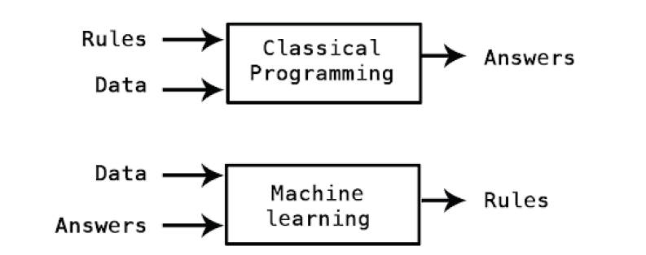
Learning

Slide 4
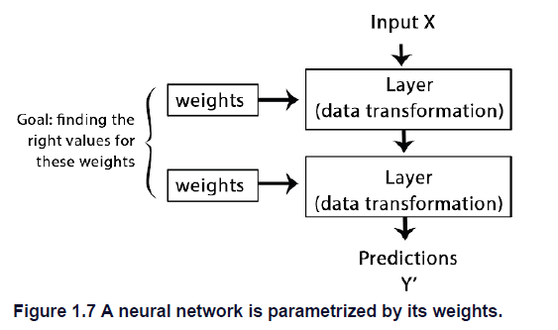
How DL works in 3 figures

Slide 5
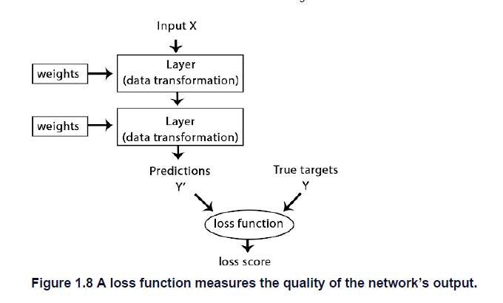
How DL works in 3 figures

Slide 6
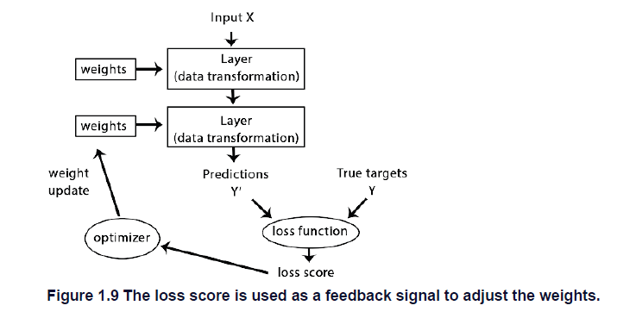
How DL works in 3 figures

Slide 7
Learning workflow
Learning
Data processing
Model
Performance metric

Slide 8
Back to.Rmd

Slide 9
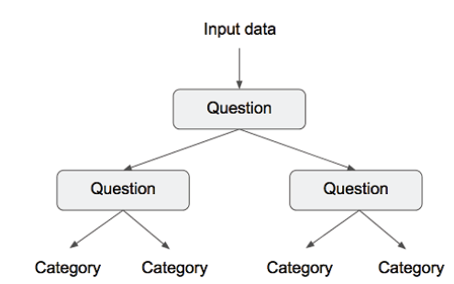
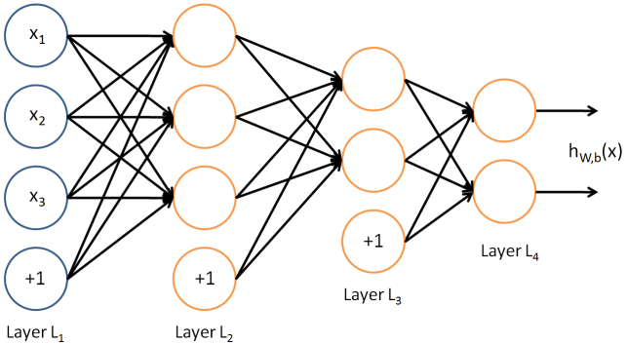
Families of models for classification
Regression /
Kernel approach eg SVM
Ensemble approach: decision tree
Multi Layer Percetron = Artificial Neural Network

Slide 10

MLP architecture
[0-1]
b3
L3
b1
b2
L2
Input
Data
L1

Slide 11

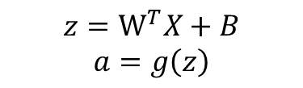
MLP architecture
$$z={\text{W}}^{T}X+B$$
$$a=g\left(z\right)$$
Unit update:
[0-1]
b3
L3
b1
b2
L2
Input
Data
L1

Slide 12
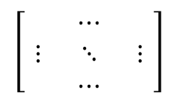
Weight matrix and vector Beta
3
$$\left[\begin{matrix} & ⋯ & \\ ⋮ & ⋱ & ⋮ \\ & ⋯ & \end{matrix}\right]$$
W =
2
Dimension: N units L, N units L-1
B : vector of N = 2
→ Random initialisation

Slide 13
Back to.Rmd

Slide 14
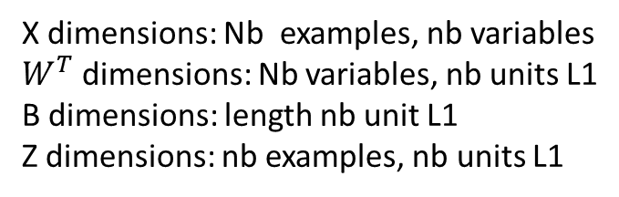
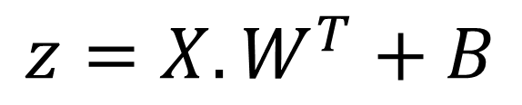
Matrix multiplication
$$z=X.W^{T}+B$$
X dimensions: Nb examples, nb variables
$W^{T}$ dimensions: Nb variables, nb units L1
B dimensions: length nb unit L1
Z dimensions: nb examples, nb units L1

Slide 15
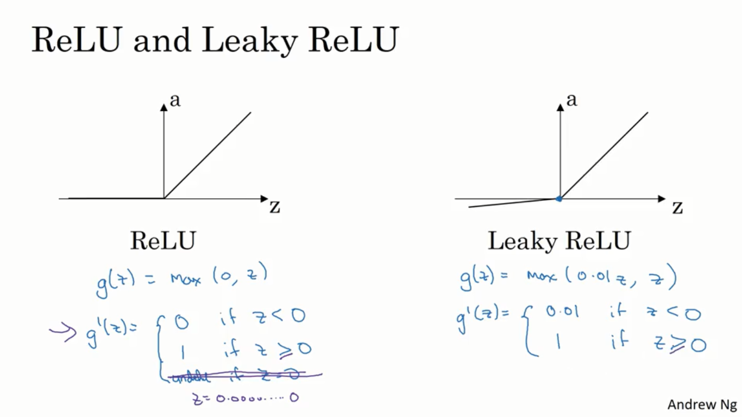

Slide 16

Quelle méthode d’apprentissage ?
Learning
Data processing
Model
Performance metric

Slide 17
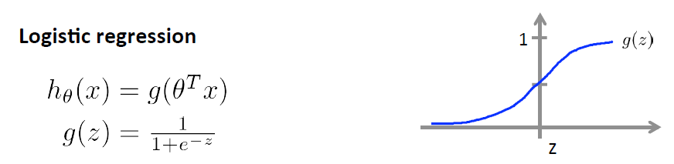
Probability to belong to a class
with a sigmoid function
Ok for:
Regression /
Kernel approach eg SVM
Multi Layer Percetron = Artificial Neural Network

Slide 18
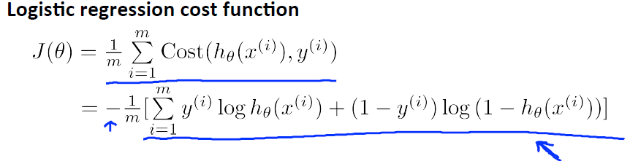
Calculate the cost / error
prediction
h(x)=
truth
If y=1
If y=0
0
h(x)
1
0
h(x)
1

Slide 19
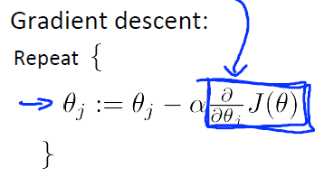
Parameters’ updates with gradient descent
Compute the cost
Derivative of the cost
Parameters’
updates
Learning rate

Slide 20
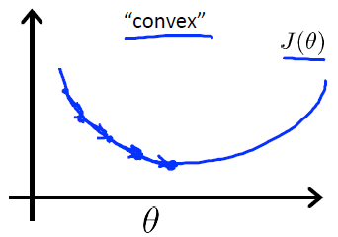
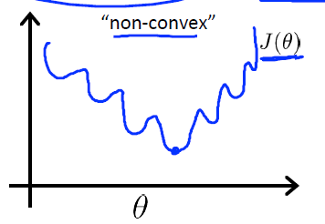
Optimisation of the cost
Best fit!
?
Updates with gradient descent
Figures from Andrew Ng Coursera

Slide 21
Advanced workflows

Slide 22
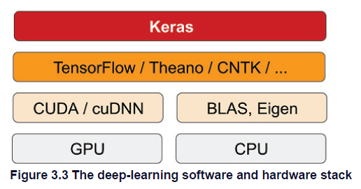
Keras & tensorflow
Keras is a model-level library, providing high-level building blocks for developing
deep-learning models. It doesn’t handle low-level operations such as tensor manipulation
and differentiation. Instead, it relies on a specialized, well-optimized tensor library to do
so, serving as the backend engine of Keras. Rather than choosing a single tensor library
and tying the implementation of Keras to that library, Keras handles the problem in a
modular way

Slide 23
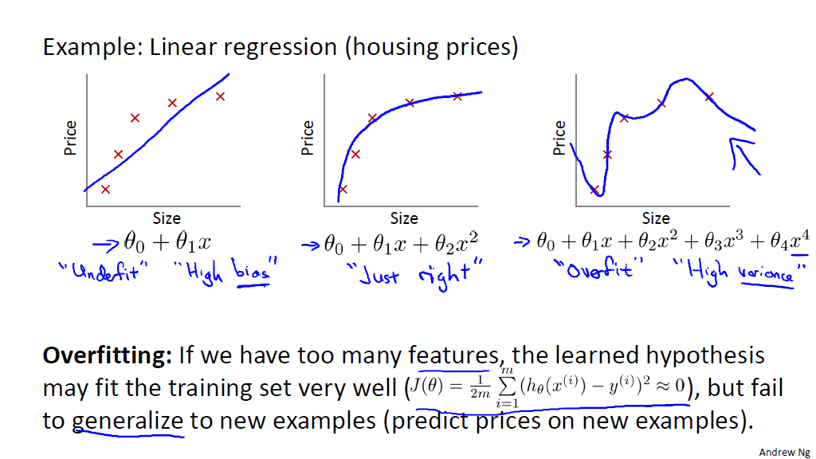
Généralisation du modèle
Biais
Variance

Slide 24
The problem of overfitting
One solution: increase observations
Other solutions: penalize the learning
constrain the model

Slide 25
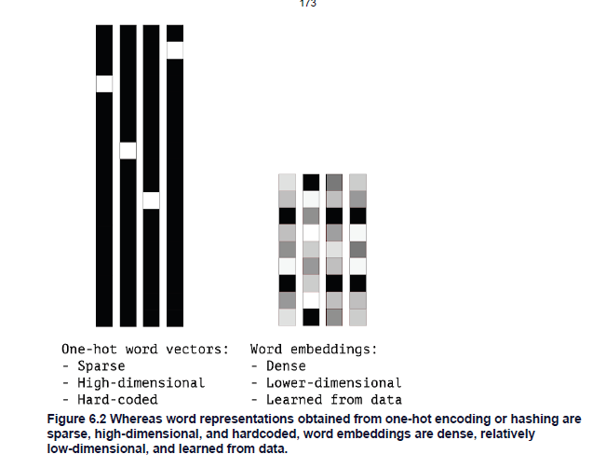
ML generalization testing workflow
split
 |  | Classe réelle
 |  | 0 | 1
Classe prédite | 0 | 141 | 11
 | 1 | 28 | 56
train
Examples
Evaluate generalizability
Variables
 |  | Classe réelle
 |  | 0 | 1
Classe prédite | 0 | 25 | 1
 | 1 | 2 | 14

Slide 26
Evaluation metrics
Learning
Data processing
Model
Performance metric
Comment évaluer les prédictions du modèle?

Slide 27
Métriques pour classification binaire
→ Matrice de confusion (1=SF)
→ Que préférez-vous evaluer?
 |  | Classe réelle
 |  | 0 | 1
Classe prédite | 0 | TN | FN
 | 1 | FP | TP
Notes:
Recall = tp / (tp + fn)
Le point particulier qui nous intéresse est la minimisation du nombre de Faux Négatifs

Slide 28
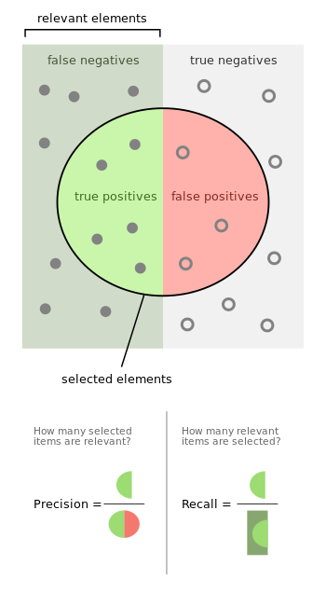
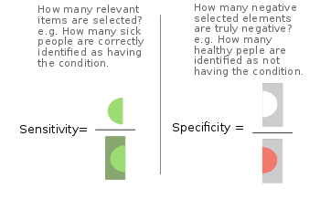
Métriques pour classification binaire
Positives
Negatives
 |  | Classe réelle
 |  | 0 | 1
Classe prédite | 0 | TN | FN
 | 1 | FP | TP
wikipedia

Slide 29
Métriques pour classification binaire
Positives
Negatives
 |  | Classe réelle
 |  | 0 | 1
Classe prédite | 0 | TN | FN
 | 1 | FP | TP
wikipedia

Slide 30
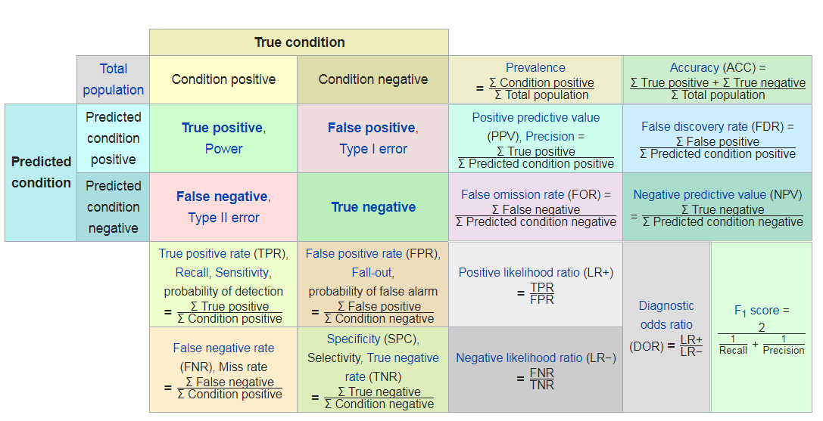
Métriques pour classification binaire
wikipedia

Slide 31
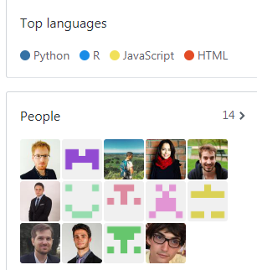
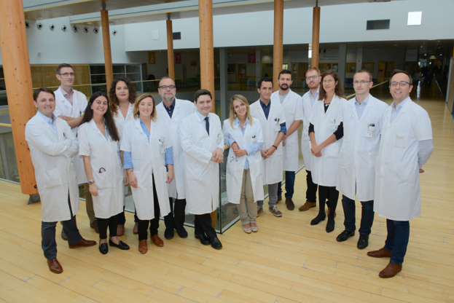
DITEP
Medical team
Data Science team
loic.verlingue@gustaveroussy.fr
https://github.com/DITEP

