Slide 1
⚡ VeriAnalyst
Automated Analytical Report: sales.csv
Generated on September 29, 2026 · Independently Grounded & Verified via Dual-Path Audit

Slide 2
Executive Summary & Performance KPIs
6
TOTAL ROWS
5
COLUMNS
692.1
AVG REVENUE
4
VERIFIED INSIGHTS
Grounded Analytical Narrative
This executive report highlights key insights from the 'sales.csv' dataset. The average revenue per transaction is $692.1, with a median of $600.0. The highest revenue was generated by the Wireless Headphones product, totaling $1,250.5. In terms of units sold, the Cotton T-Shirt had the highest with 32 units sold. Revenue breakdown by category is also provided, and we've tracked the revenue trend over time, showing how revenue has progressed across different months.
✓ All statements verified against raw dataset. No AI hallucination.

Slide 3
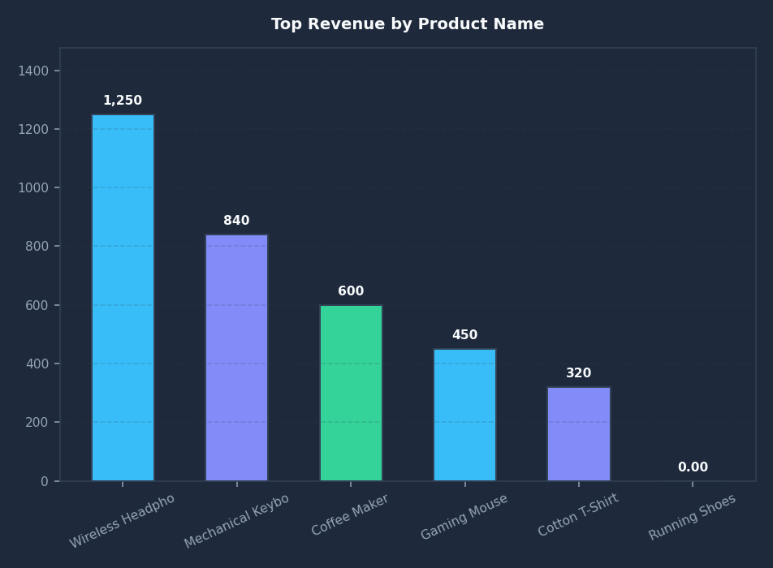
📊 Top Revenue by Product Name
Audit Verification
Status: ✓ Exact Match
Key Finding:
The product name with the highest revenue is Wireless Headphones with 1,250.5.
• Operation: MAX
• Target Column: revenue
• Group By: product_name

Slide 4
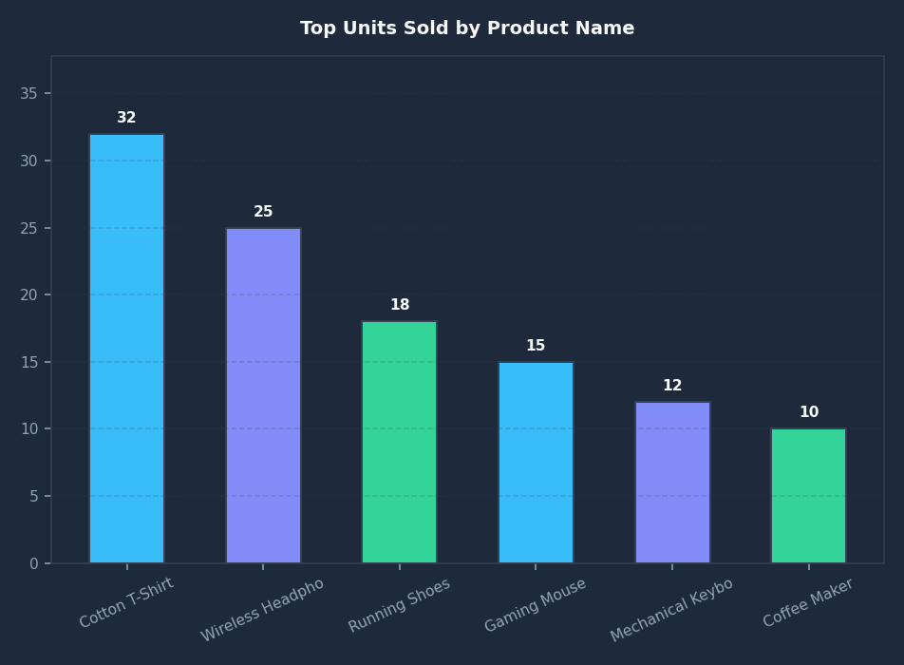
📊 Top Units Sold by Product Name
Audit Verification
Status: ✓ Exact Match
Key Finding:
The product name with the highest units sold is Cotton T-Shirt with 32.
• Operation: MAX
• Target Column: units_sold
• Group By: product_name

Slide 5
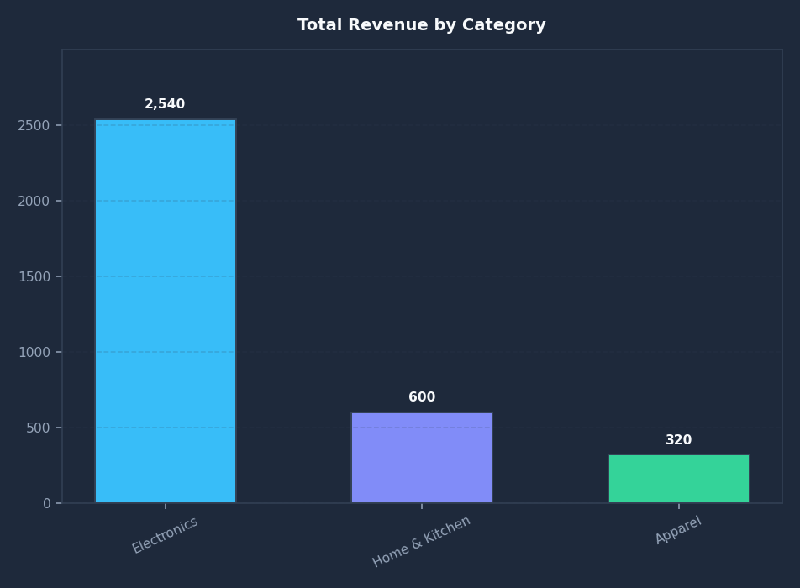
📊 Total Revenue by Category
Audit Verification
Status: ✓ Exact Match
Key Finding:
Total revenue breakdown computed across 3 category segments.
• Operation: SUM
• Target Column: revenue
• Group By: category

Slide 6
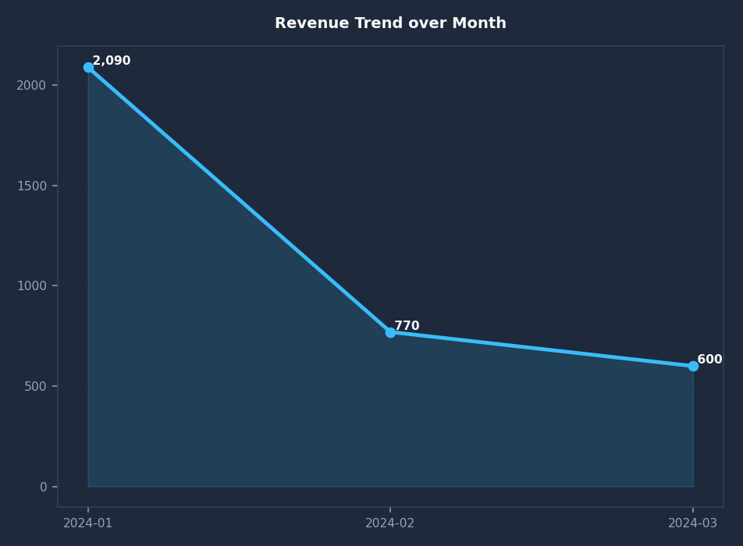
📊 Revenue Trend over Month
Audit Verification
Status: ✓ Exact Match
Key Finding:
Tracked revenue progression across time periods in 'month'.
• Operation: SUM
• Target Column: revenue
• Group By: month

