Slide 1
Gesture Based AI Virtual Whiteboard

Slide 2
Introduction
This presentation explores a Gesture-Based AI Virtual Whiteboard, focusing on real-time hand gesture drawing using MediaPipe and Flask technologies. It aims to address physical and collaboration challenges of traditional whiteboards, introducing a modern solution for intuitive, touchless interaction suited for remote and hybrid work environments. The content is tailored for technical stakeholders, developers, and investors.

Slide 3
01 Introduction & Problem Statement

Slide 4
Limitations of Traditional Whiteboards
Traditional whiteboards suffer from physical constraints, such as limited space and wear from markers running out. They lack flexibility for remote teams and do not support digital saving or sharing. These drawbacks reduce productivity in modern workspaces, where digital and collaborative tools are essential for efficiency and innovation.

Slide 5
Remote Collaboration Challenges
Remote collaboration often relies on inefficient tools like mouse or tablet drawing, which are not intuitive and limit creativity. Current digital whiteboard solutions lack the natural interaction and fluidity of real hand gestures, causing a gap in user experience and engagement during virtual meetings or brainstorming sessions.

Slide 6
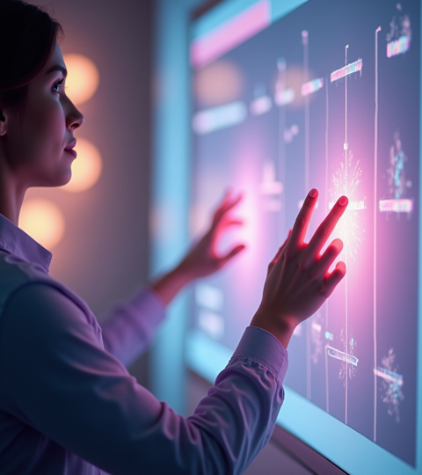
Shortcomings of Current Digital Solutions
Existing digital whiteboards often require indirect input methods like mouse or stylus, which lack natural feel and precision. These solutions are limited in replicating the fluidity of hand gestures, causing less intuitive user experiences. Additionally, they frequently fall short in real-time responsiveness and dynamic interaction, which are crucial for effective remote collaboration and creative workflows.

Slide 7
02
Technical Solution & Architecture

Slide 8
Gesture Detection and Recognition
Our system uses MediaPipe Hands, a powerful hand tracking model, to detect 21 hand landmarks in real-time. The gesture recognition logic classifies finger states to distinguish between drawing, erasing, and control gestures. This enables accurate, low-latency interaction for seamless virtual whiteboard control using natural hand movements.

Slide 9
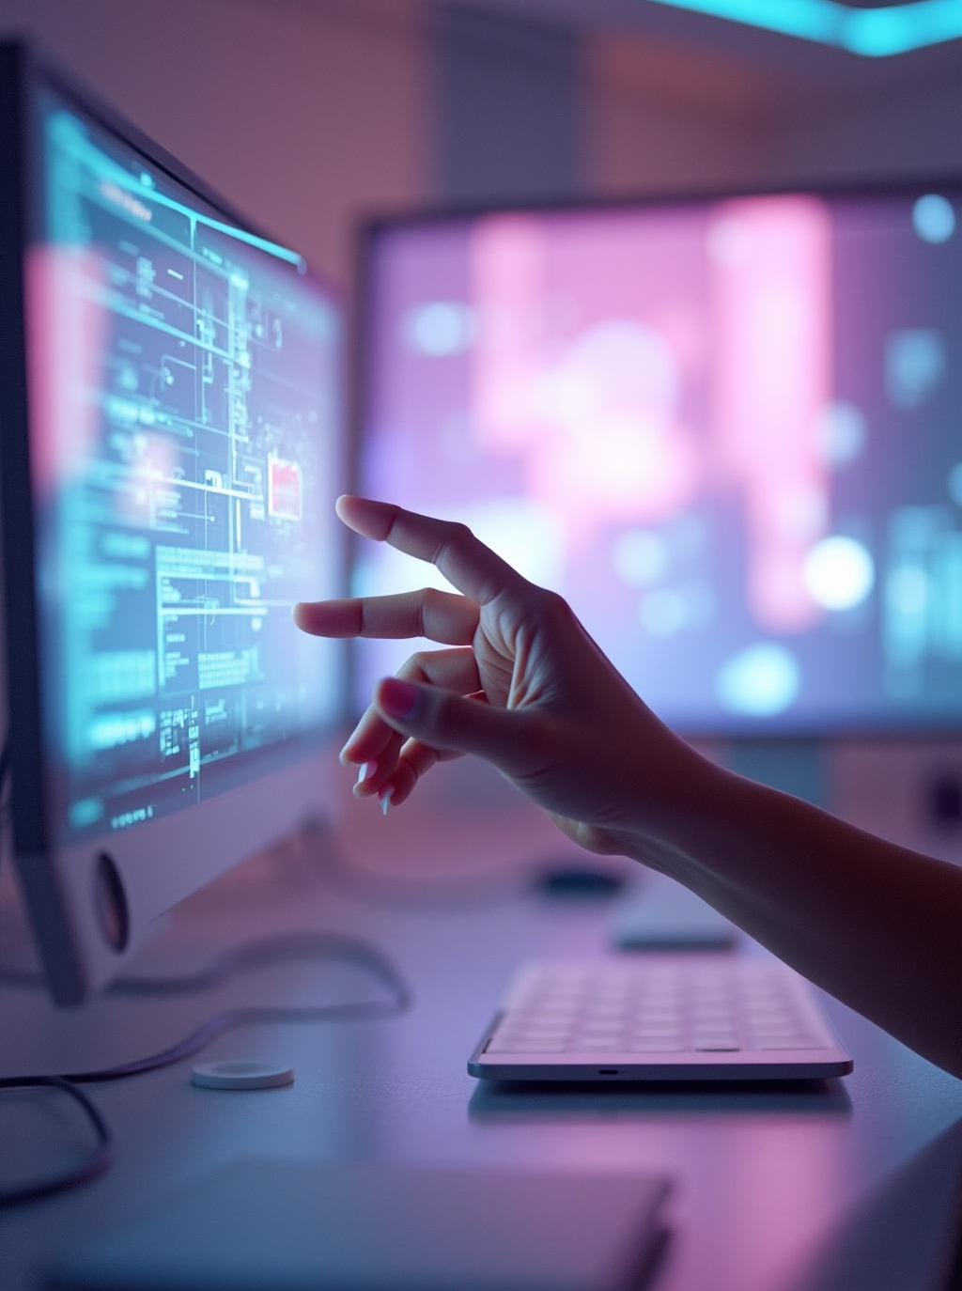
System Architecture and Tech Stack
The architecture integrates a frontend HTML5 Canvas with a Flask backend managing the machine learning pipeline. Real-time video frames are processed via OpenCV, with gesture data transmitted over WebSocket for instant drawing updates. Key technologies include MediaPipe, Flask, OpenCV, and WebSocket, ensuring a scalable and responsive platform.

Slide 10
Drawing Pipeline and Backend Integration
Video frames captured by the webcam are processed to extract finger tip coordinates, transformed into canvas coordinates for drawing. The Flask server handles API endpoints for gesture commands and streams processed data to the frontend. This pipeline supports real-time updates with high FPS and low latency, ensuring a smooth user experience.

Slide 11
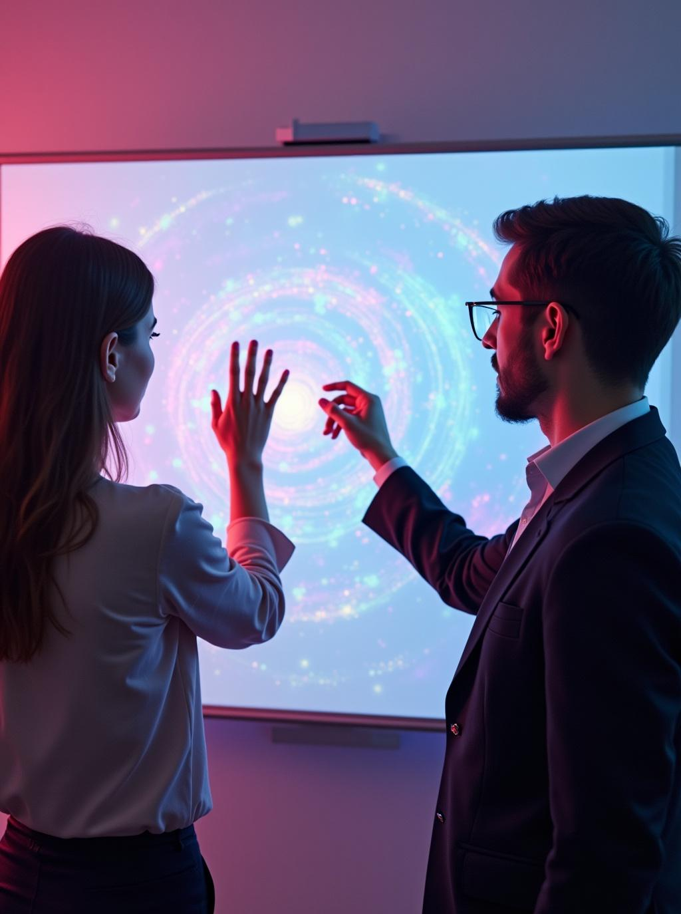
Conclusions
The Gesture-Based AI Virtual Whiteboard solution addresses major shortcomings of traditional and current digital tools by enabling intuitive, real-time hand gesture interaction. With robust architecture and advanced gesture recognition, it enhances remote collaboration and creativity. This technology offers significant potential for various professional and educational applications, promising improved productivity and user engagement.

Slide 12
Thank You!

