Slide 1
Lecture 4 Model Order Selection
EE-uy 4563/EL-GY 9123: Introduction to machine learning
Prof. Sundeep rangan

Slide 2
Learning Objectives
Identify the order of a linear model
Visually identify overfitting and underfitting in a scatterplot
Determine if there is under-modeling for a given true function and model class
Compute the irreducible error for a model
Compute bias in a model class for the case of no noise
Computing variance is more advanced and not considered here
Write a program to perform cross-validation to select an optimal model order

Slide 3
Outline
Motivating Example: What polynomial degree should a model use?
Bias and variance
Cross-validation

Slide 4
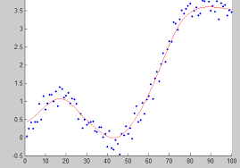
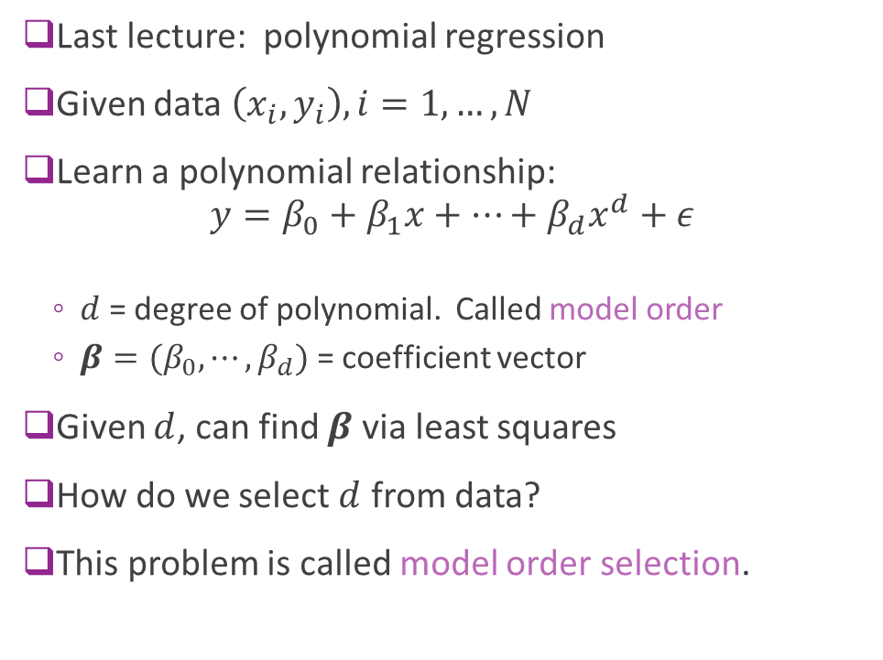
Polynomial Fitting
Last lecture: polynomial regression
Given data $\left(x_{i},y_{i}\right), i=1,…, N$
Learn a polynomial relationship: $y=β_{0}+β_{1}x+⋯+β_{d}x^{d}+ε$
$d$ = degree of polynomial. Called model order
$β=(β_{0},⋯,β_{d})$ = coefficient vector
Given $d$, can find $β$ via least squares
How do we select $d$ from data?
This problem is called model order selection.

Slide 5
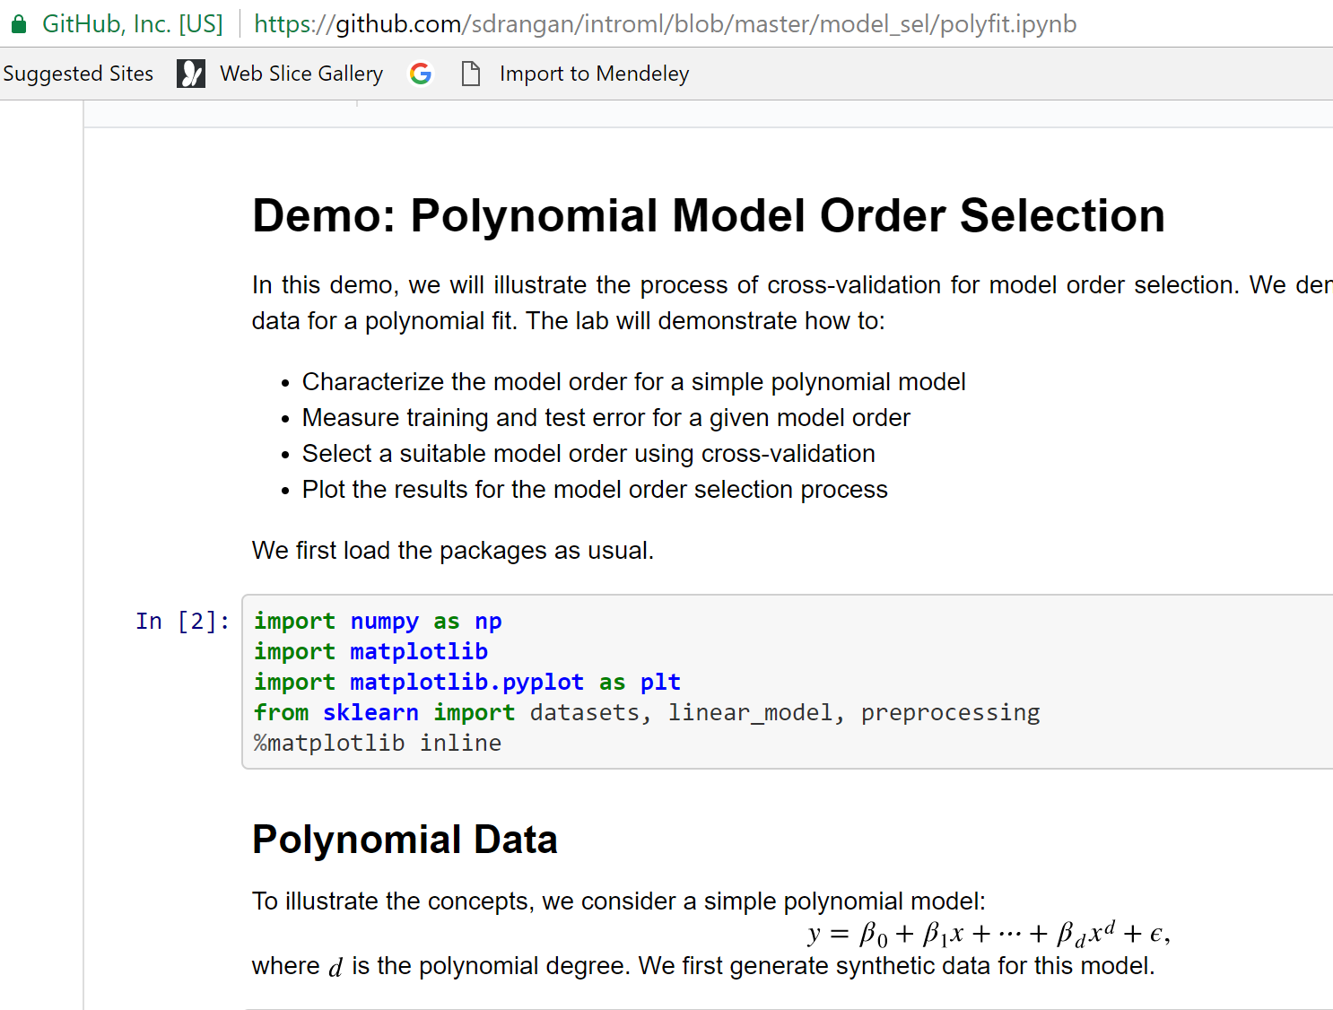
Demo on Github
Demo on github: https://github.com/sdrangan/introml/blob/master/model_sel/polyfit.ipynb

Slide 6
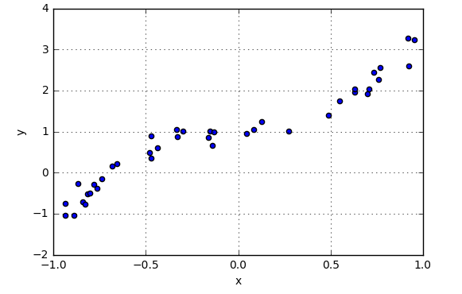
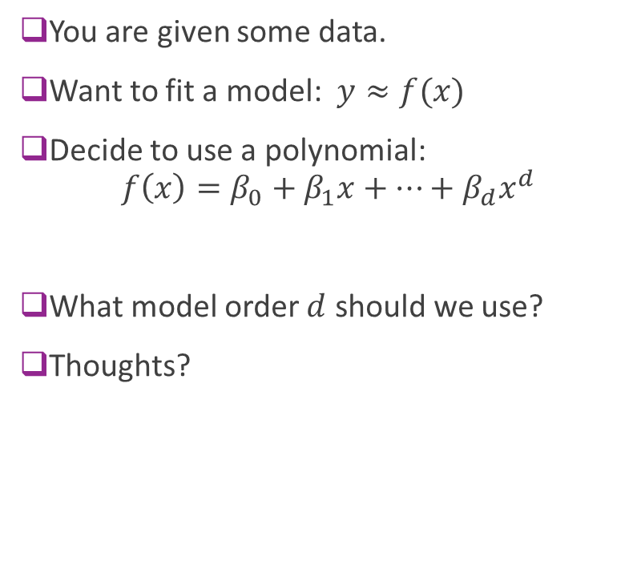
Example Question
You are given some data.
Want to fit a model: $y≈f(x)$
Decide to use a polynomial: $f\left(x\right)=β_{0}+β_{1}x+⋯+β_{d}x^{d}$
What model order $d$ should we use?
Thoughts?

Slide 7
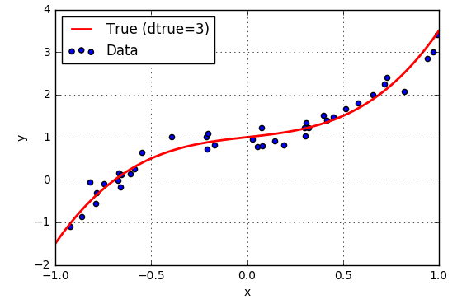
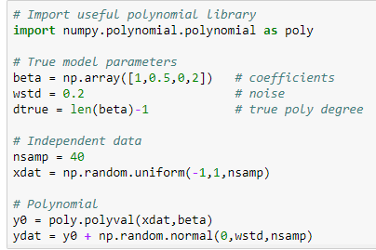
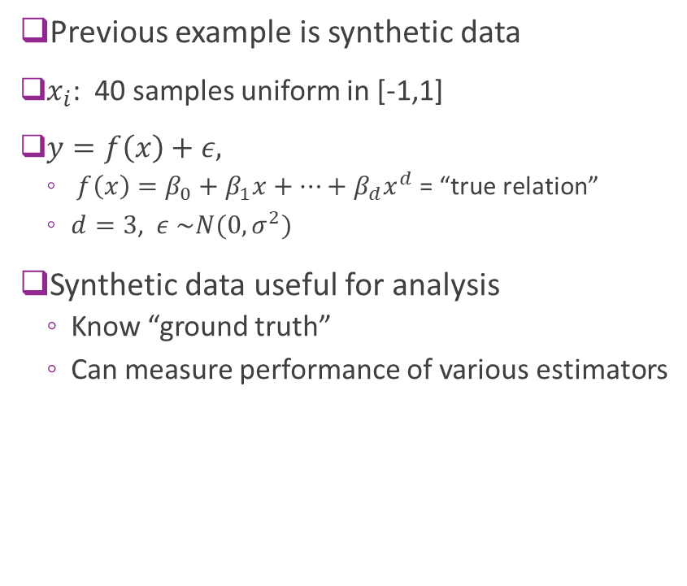
Synthetic Data
Previous example is synthetic data
$x_{i}$: 40 samples uniform in [-1,1]
$y=f\left(x\right)+ε,$
$f\left(x\right)=β_{0}+β_{1}x+⋯+β_{d}x^{d}$ = “true relation”
$d=3$, $ε \sim N(0,σ^{2})$
Synthetic data useful for analysis
Know “ground truth”
Can measure performance of various estimators

Slide 8
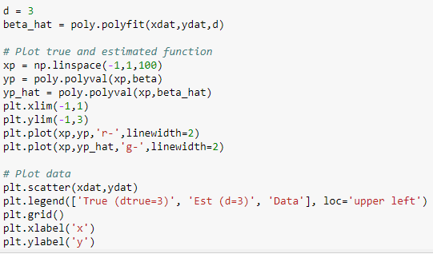
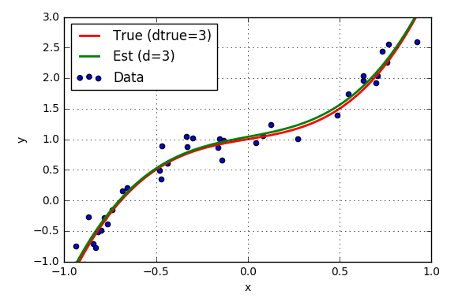
Fitting with True Model Order
Suppose true polynomial order, d=3, is known
Use linear regression
numpy.polynomial package
Get very good fit

Slide 9
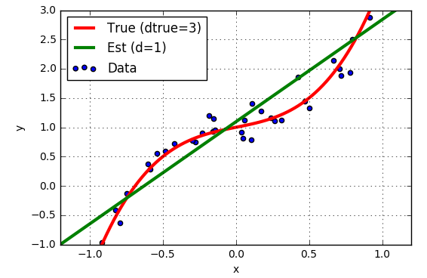
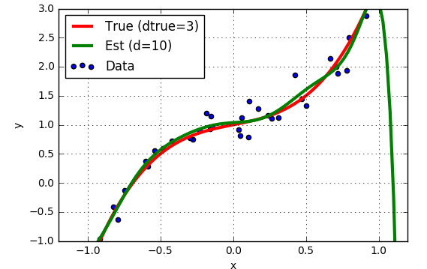
But, True Model Order not Known
Suppose we guess the wrong model order?
d=1 “Underfitting”
d=10 “Overfitting”

Slide 10
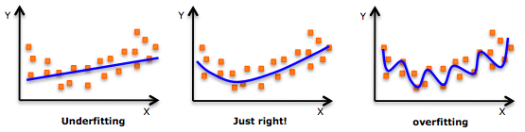
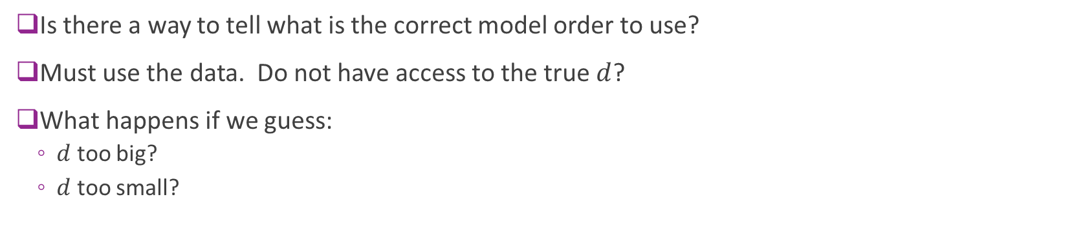
How Can You Tell from Data?
Is there a way to tell what is the correct model order to use?
Must use the data. Do not have access to the true $d$?
What happens if we guess:
$d$ too big?
$d$ too small?

Slide 11
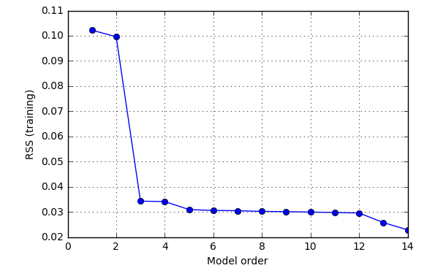
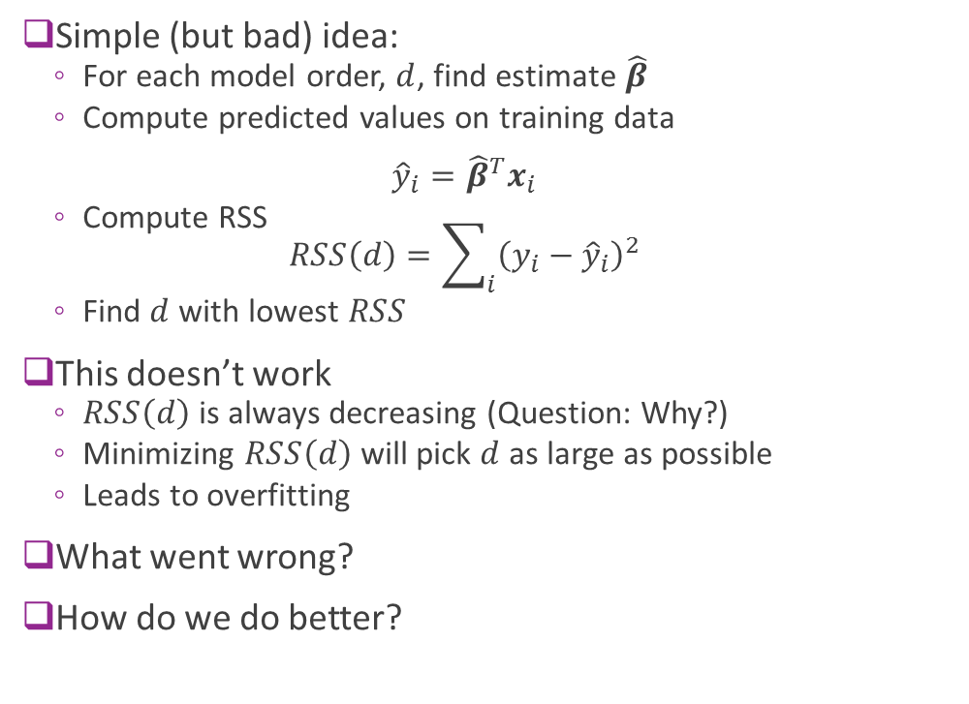
Using RSS on Training Data ?
Simple (but bad) idea:
For each model order, $d$, find estimate $\hat{β}$
Compute predicted values on training data ${\hat{y}}_{i}={\hat{β}}^{T}x_{i}$
Compute RSS $RSS\left(d\right)=\sum_{i}{{\left(y_{i}−{\hat{y}}_{i}\right)}^{2}}$
Find $d$ with lowest $RSS$
This doesn’t work
$RSS\left(d\right)$ is always decreasing (Question: Why?)
Minimizing $RSS\left(d\right)$ will pick $d$ as large as possible
Leads to overfitting
What went wrong?
How do we do better?

Slide 12
Outline
Motivating Example: What polynomial degree should a model use?
Bias and variance
Cross-validation

Slide 13
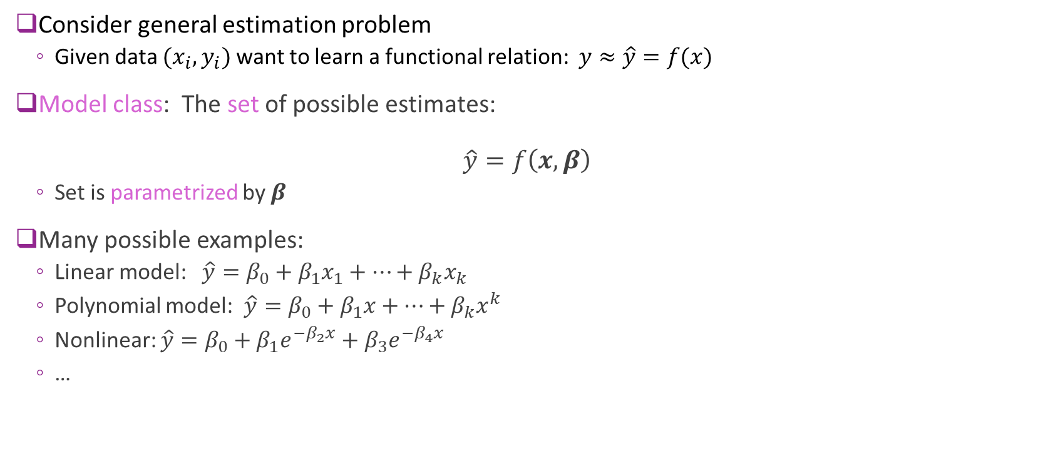
Model Class
Consider general estimation problem
Given data $(x_{i},y_{i})$ want to learn a functional relation: $y≈\hat{y}=f(x)$
Model class: The set of possible estimates: $\hat{y}=f\left(x,β\right)$
Set is parametrized by $β$
Many possible examples:
Linear model: $\hat{y}=β_{0}+β_{1}x_{1}+⋯+β_{k}x_{k}$
Polynomial model: $\hat{y}=β_{0}+β_{1}x+⋯+β_{k}x^{k}$
Nonlinear: $\hat{y}=β_{0}+β_{1}e^{−β_{2}x}+β_{3}e^{−β_{4}x}$
…

Slide 14

Model Class and True Function
Analysis set-up:
Learning algorithm assumes a model class: $\hat{y}=f\left(x,β\right)$
But, data has true relation: $y=f_{0}\left(x\right)+ε, ε\sim N(0,σ_{ε}^{2})$
Will quantify three key effects:
Irreducible error
Under-modeling
Over-fitting

Slide 15
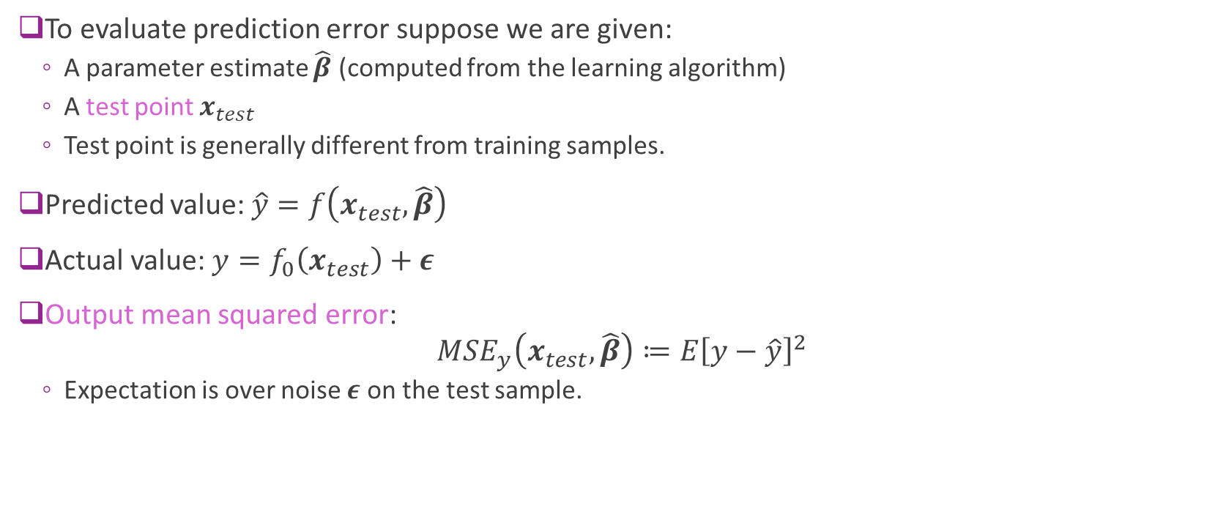
Output Mean Squared Error
To evaluate prediction error suppose we are given:
A parameter estimate $\hat{β}$ (computed from the learning algorithm)
A test point $x_{test}$
Test point is generally different from training samples.
Predicted value: $\hat{y}=f\left(x_{test},\hat{β}\right)$
Actual value: $y=f_{0}\left(x_{test}\right)+ε$
Output mean squared error: $MSE_{y}\left(x_{test},\hat{β}\right)≔E{\left[y−\hat{y}\right]}^{2}$
Expectation is over noise $ε$ on the test sample.

Slide 16
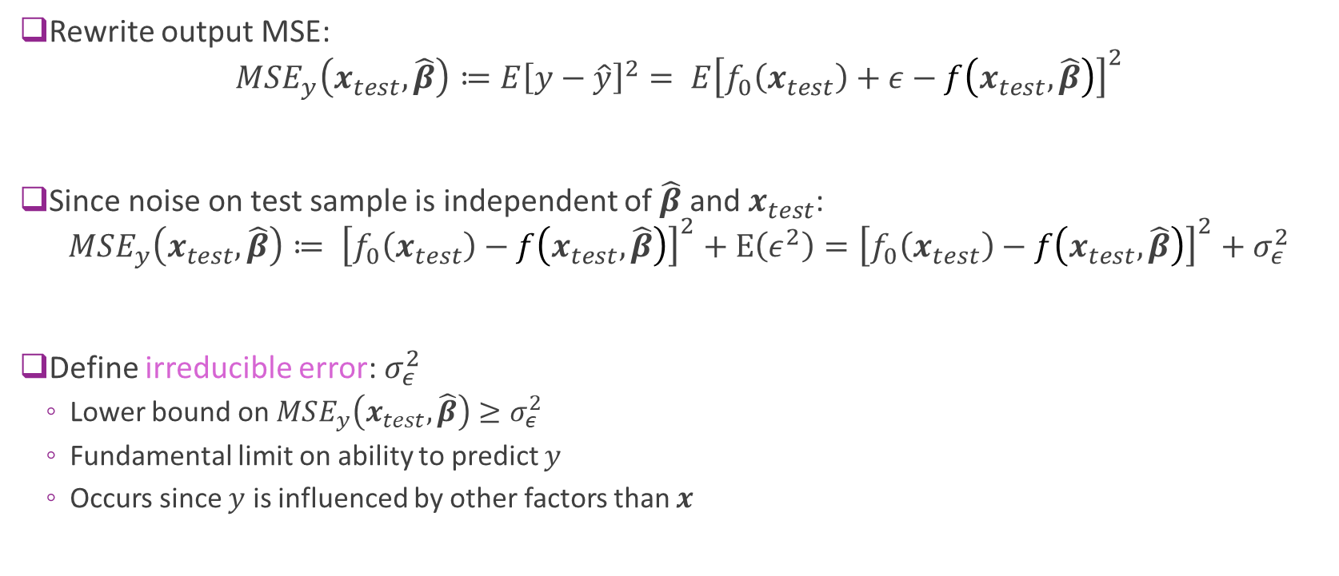
Irreducible Error
Rewrite output MSE: $MSE_{y}\left(x_{test},\hat{β}\right)≔E{\left[y−\hat{y}\right]}^{2}= E{\left[f_{0}\left(x_{test}\right)+ε−f\left(x_{test},\hat{β}\right)\right]}^{2}$
Since noise on test sample is independent of $\hat{β}$ and $x_{test}$: $MSE_{y}\left(x_{test},\hat{β}\right)≔ {\left[f_{0}\left(x_{test}\right)−f\left(x_{test},\hat{β}\right)\right]}^{2}+E\left(ε^{2}\right)={\left[f_{0}\left(x_{test}\right)−f\left(x_{test},\hat{β}\right)\right]}^{2}+σ_{ε}^{2}$
Define irreducible error: $σ_{ε}^{2}$
Lower bound on $MSE_{y}\left(x_{test},\hat{β}\right)≥σ_{ε}^{2}$
Fundamental limit on ability to predict $y$
Occurs since $y$ is influenced by other factors than $x$

Slide 17

Under-Modeling
Definition: A true function $f_{0}\left(x\right)$ is in the model class $\hat{y}=f\left(x,β\right)$ if: $f_{0}\left(x\right)=f\left(x,β_{0}\right) for all x$ for some parameter $β_{0}$.
$β_{0}$ called the true parameter
Under-modeling: When $f_{0}\left(x\right)$ is not in the model class

Slide 18
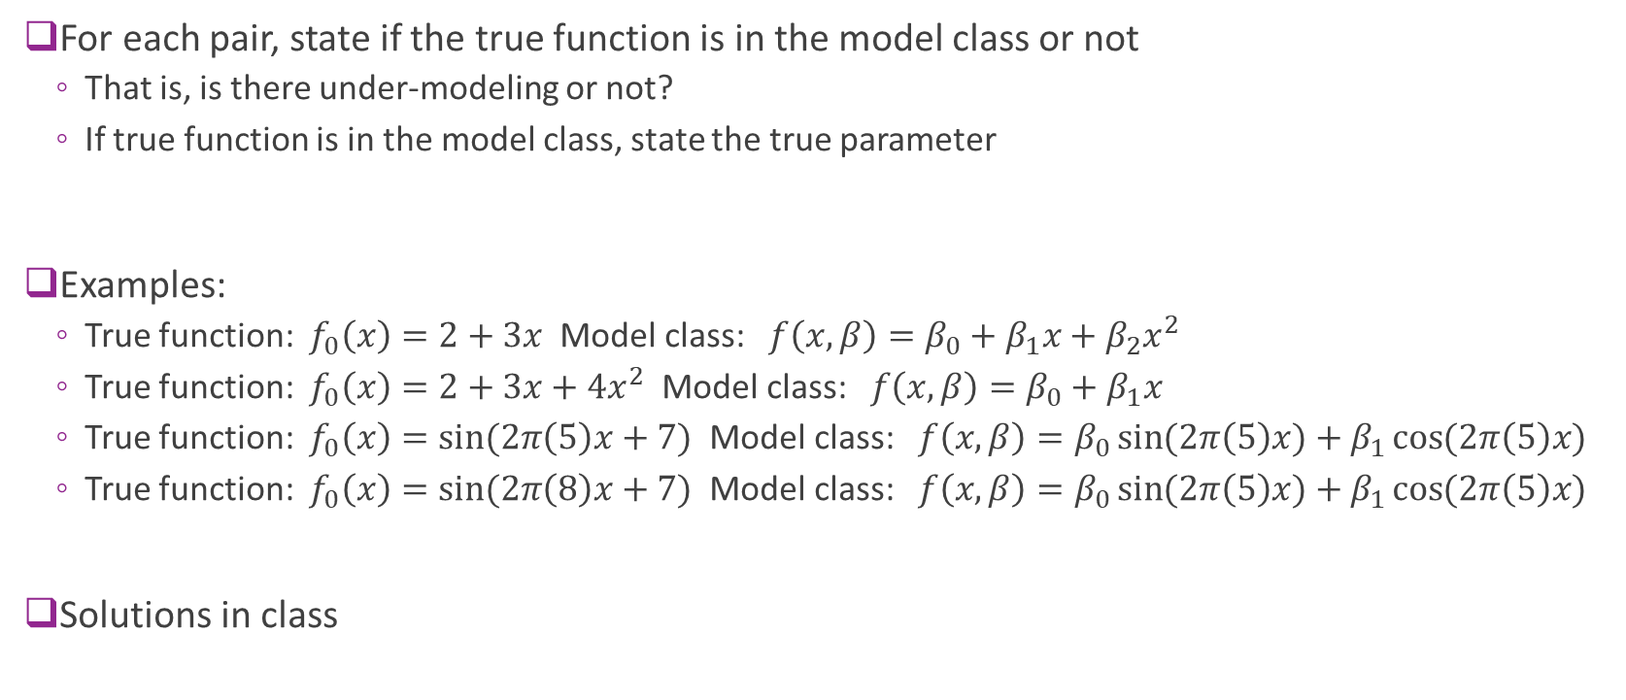
Sample Question
For each pair, state if the true function is in the model class or not
That is, is there under-modeling or not?
If true function is in the model class, state the true parameter
Examples:
True function: $f_{0}\left(x\right)=2+3x$ Model class: $f\left(x,β\right)=β_{0}+β_{1}x+β_{2}x^{2}$
True function: $f_{0}\left(x\right)=2+3x+4x^{2}$ Model class: $f\left(x,β\right)=β_{0}+β_{1}x$
True function: $f_{0}\left(x\right)=\sin{(2π\left(5\right)x+7)}$ Model class: $f\left(x,β\right)=β_{0}\sin{(2π\left(5\right)x)}+β_{1}\cos{(2π\left(5\right)x)}$
True function: $f_{0}\left(x\right)=\sin{(2π\left(8\right)x+7)}$ Model class: $f\left(x,β\right)=β_{0}\sin{(2π\left(5\right)x)}+β_{1}\cos{(2π\left(5\right)x)}$
Solutions in class

Slide 19
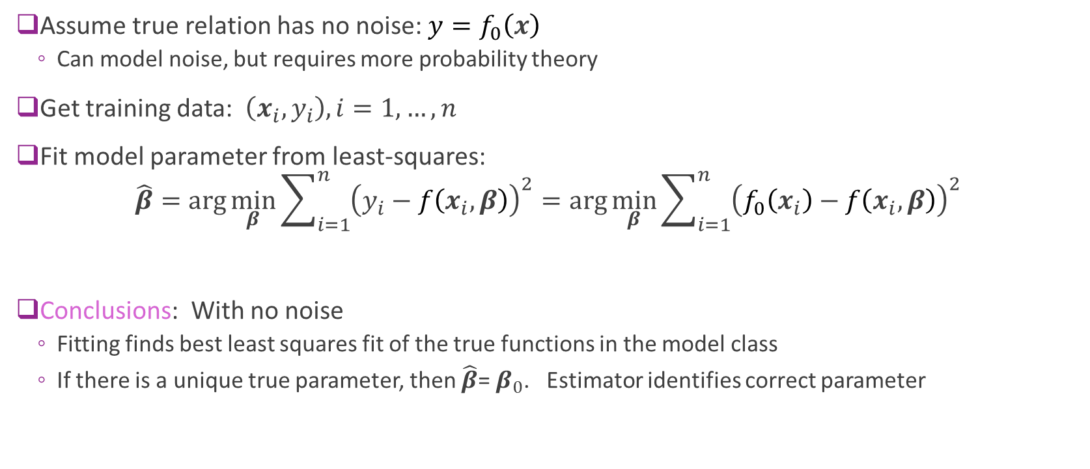
Analysis of Under-Modeling: Noise-Free Case
Assume true relation has no noise: $y=f_{0}\left(x\right)$
Can model noise, but requires more probability theory
Get training data: $\left(x_{i},y_{i}\right), i=1,…,n$
Fit model parameter from least-squares: $\hat{β}=\arg{\min_{β}{\sum_{i=1}^{n}{{\left(y_{i}−f\left(x_{i},β\right)\right)}^{2}}}}=\arg{\min_{β}{\sum_{i=1}^{n}{{\left(f_{0}\left(x_{i}\right)−f\left(x_{i},β\right)\right)}^{2}}}}$
Conclusions: With no noise
Fitting finds best least squares fit of the true functions in the model class
If there is a unique true parameter, then $\hat{β}$= $β_{0}$. Estimator identifies correct parameter

Slide 20
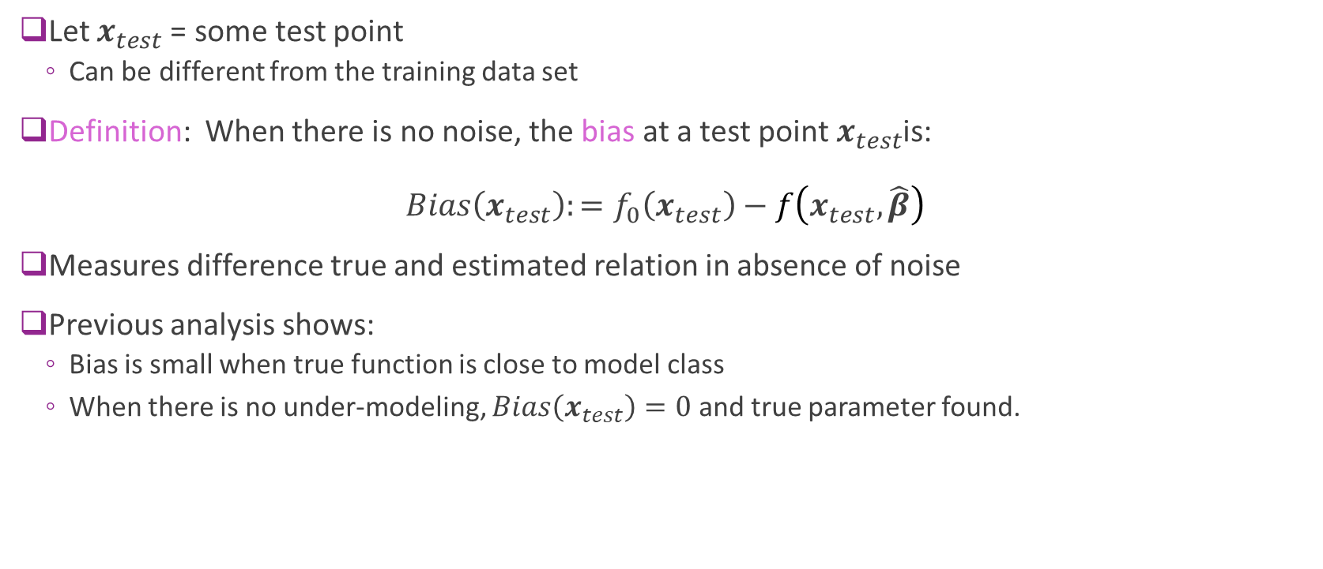
Bias: Noise-Free Case
Let $x_{test}$= some test point
Can be different from the training data set
Definition: When there is no noise, the bias at a test point$x_{test}$is: $Bias\left(x_{test}\right):=f_{0}\left(x_{test}\right)−f\left(x_{test},\hat{β}\right)$
Measures difference true and estimated relation in absence of noise
Previous analysis shows:
Bias is small when true function is close to model class
When there is no under-modeling, $Bias\left(x_{test}\right)=0$ and true parameter found.

Slide 21
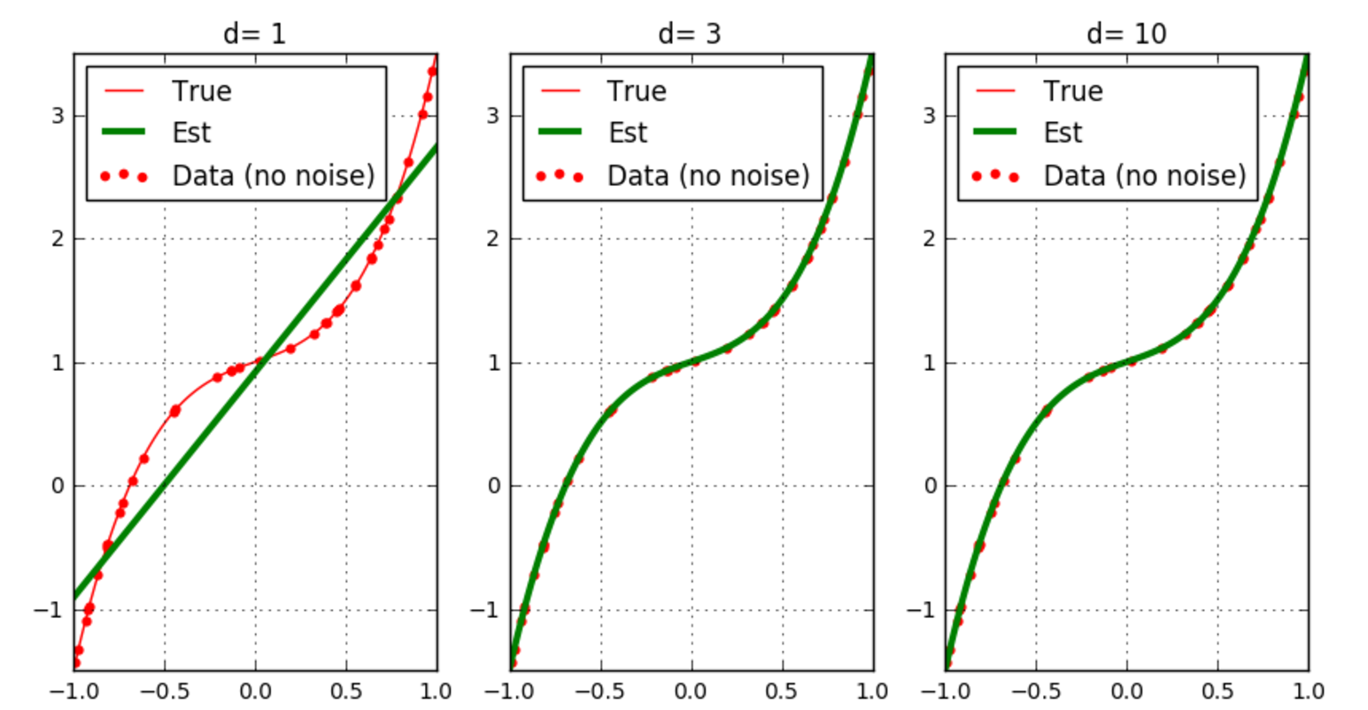
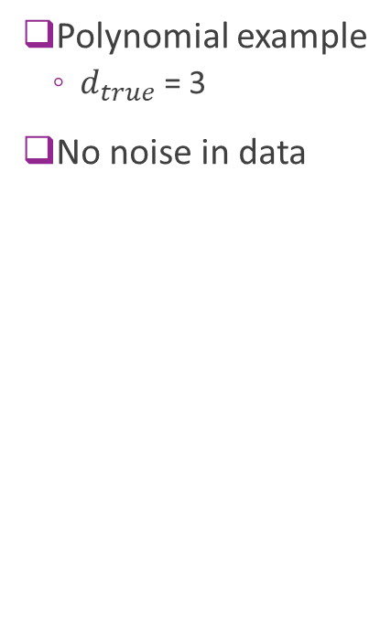
Bias Visualized
Polynomial example
$d_{true}$ = 3
No noise in data
Bias(x)
Model has bias
No bias
No bias

Slide 22
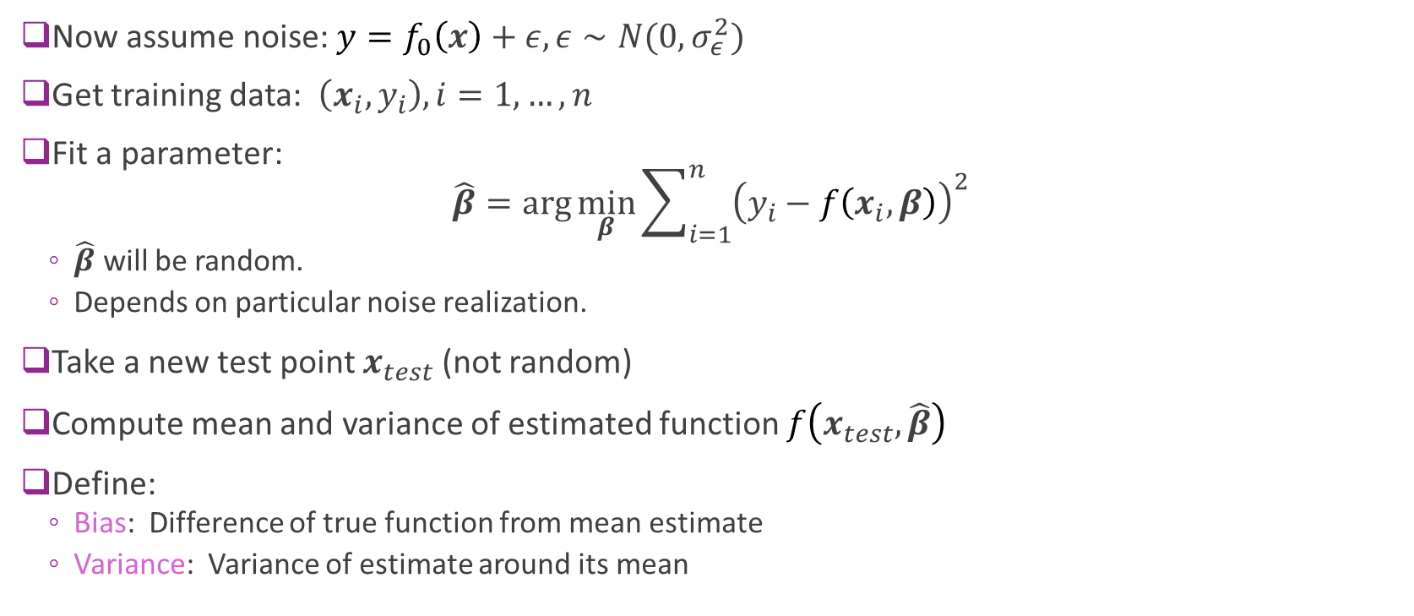
Analysis with Noise (Advanced)
Now assume noise: ${y=f}_{0}\left(x\right)+ε,ε∼N(0,σ_{ε}^{2})$
Get training data: $\left(x_{i},y_{i}\right), i=1,…,n$
Fit a parameter: $\hat{β}=\arg{\min_{β}{\sum_{i=1}^{n}{{\left(y_{i}−f\left(x_{i},β\right)\right)}^{2}}}}$
$\hat{β}$ will be random.
Depends on particular noise realization.
Take a new test point $x_{test}$ (not random)
Compute mean and variance of estimated function $f\left(x_{test},\hat{β}\right)$
Define:
Bias: Difference of true function from mean estimate
Variance: Variance of estimate around its mean

Slide 23
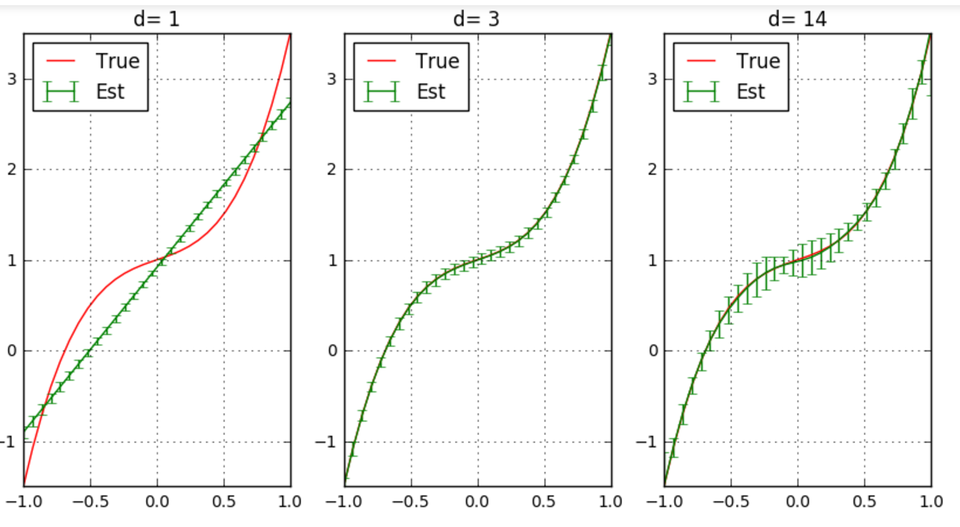
Bias and Variance Illustrated
Polynomial ex
Mean and std dev of estimated functions
100 trials
Low variance, High bias
High variance, Zero bias

Slide 24
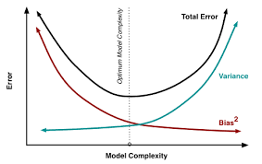
Bias-Variance Tradeoff
Optimal model order depends on:
Amount of samples available
Underlying complexity of the relation
Simpler models
Less parameters
Under-fitting
Richer models
More parameters
Over-fitting

Slide 25
Bias-Variance in Linear Models
Computing bias and variance with noise is beyond this class
Take the probability or detection and estimation class!
Not hard, but need a little more work
This class: Only compute bias in the noise-free case in this class
We state some results from probability without proof

Slide 26
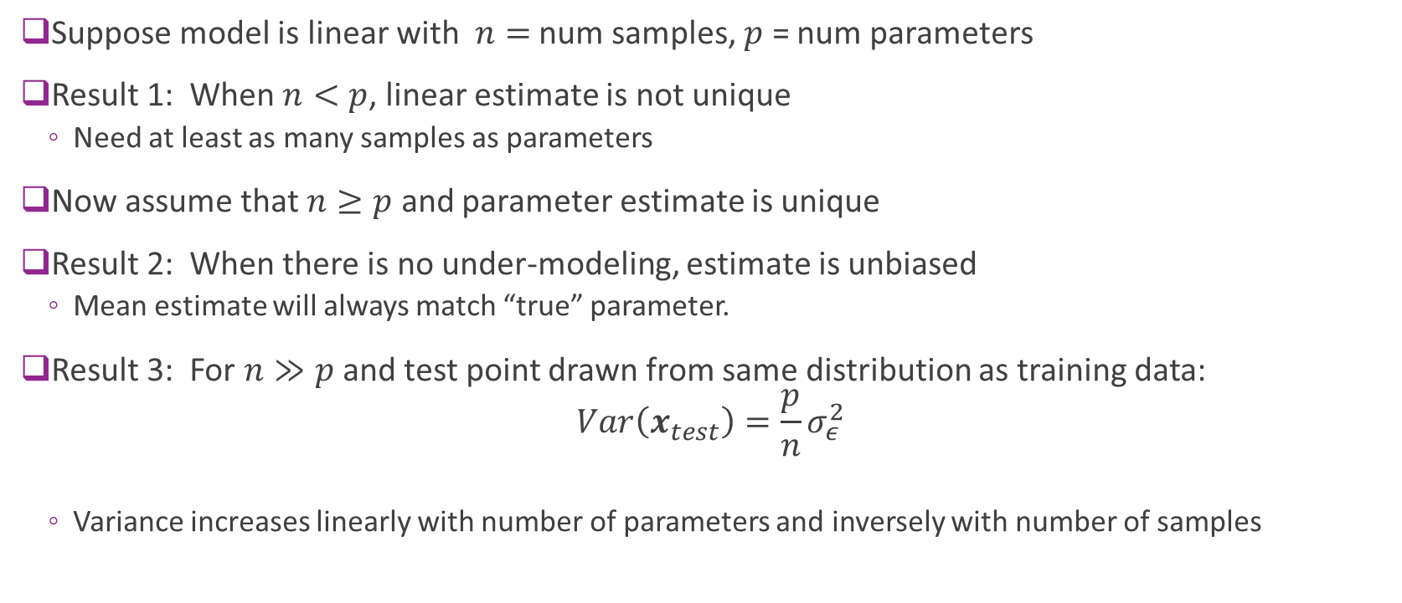
Results for Linear Models (No proof)
Suppose model is linear with $n=$ num samples, $p$ = num parameters
Result 1: When $n<p$, linear estimate is not unique
Need at least as many samples as parameters
Now assume that $n≥p$ and parameter estimate is unique
Result 2: When there is no under-modeling, estimate is unbiased
Mean estimate will always match “true” parameter.
Result 3: For $n≫p$ and test point drawn from same distribution as training data: $Var\left(x_{test}\right)=\frac{p}{n}σ_{ε}^{2}$
Variance increases linearly with number of parameters and inversely with number of samples

Slide 27
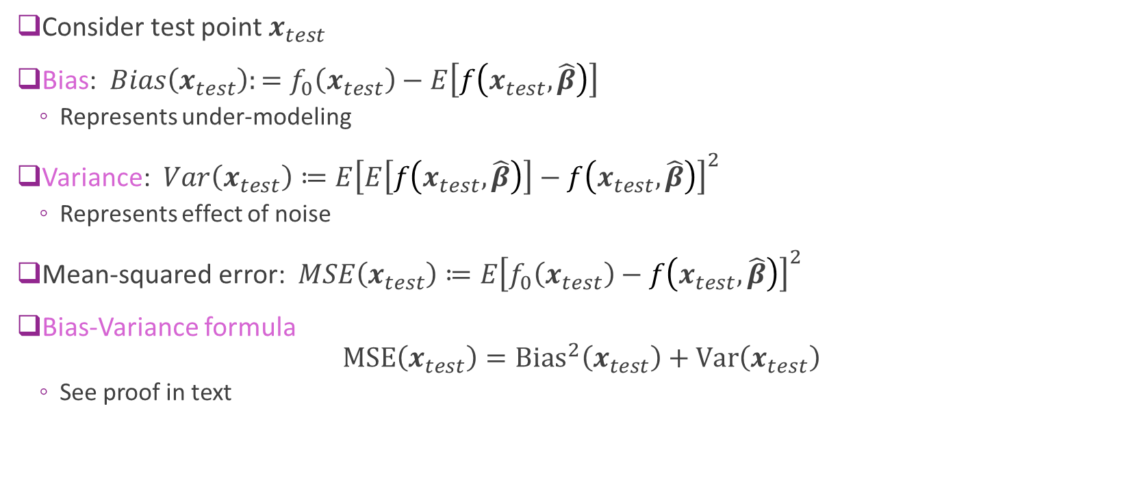
Bias-Variance Formula (Advanced)
Consider test point $x_{test}$
Bias: $Bias\left(x_{test}\right):=f_{0}\left(x_{test}\right)−E\left[f\left(x_{test},\hat{β}\right)\right]$
Represents under-modeling
Variance: $Var\left(x_{test}\right)≔E{\left[E\left[f\left(x_{test},\hat{β}\right)\right]−f\left(x_{test},\hat{β}\right)\right]}^{2}$
Represents effect of noise
Mean-squared error: $MSE\left(x_{test}\right)≔E{\left[f_{0}\left(x_{test}\right)−f\left(x_{test},\hat{β}\right)\right]}^{2}$
Bias-Variance formula $\text{MSE}\left(x_{test}\right)={\text{Bias}}^{2}\left(x_{test}\right)+\text{Var}\left(x_{test}\right)$
See proof in text

Slide 28
Outline
Motivating Example: What polynomial degree should a model use?
Bias and variance
Cross-validation

Slide 29
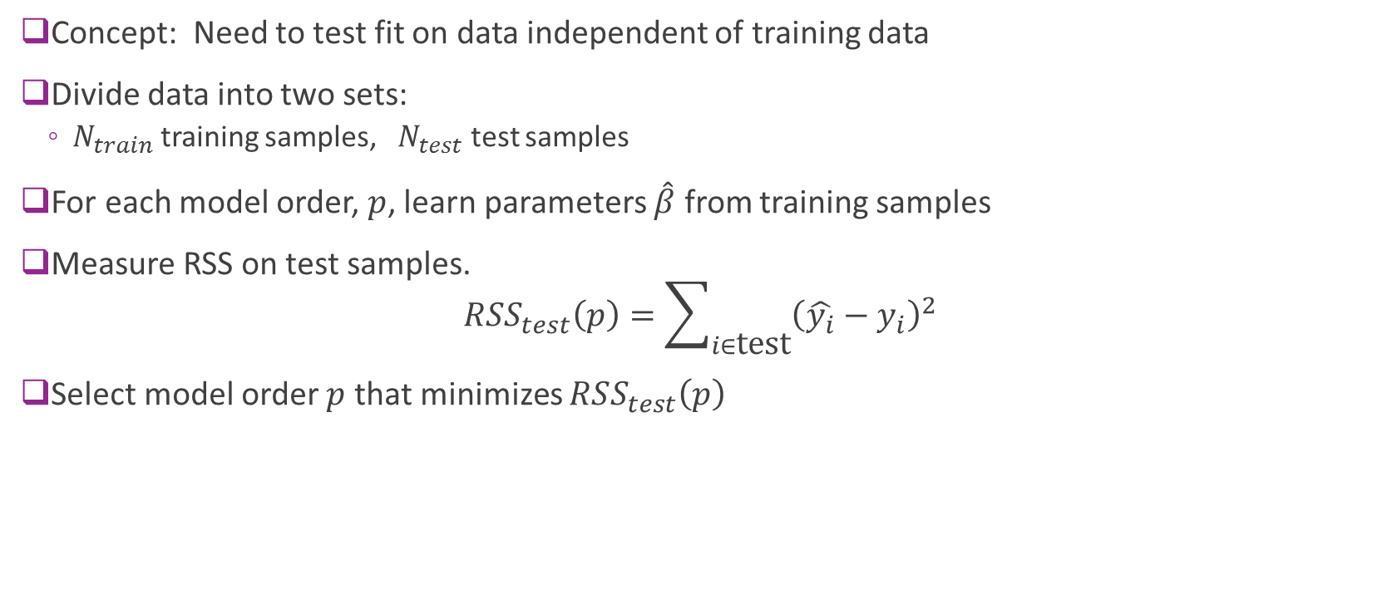
Cross Validation
Concept: Need to test fit on data independent of training data
Divide data into two sets:
$N_{train}$ training samples, $N_{test}$ test samples
For each model order, $p$, learn parameters $\hat{β}$ from training samples
Measure RSS on test samples. $RSS_{test}\left(p\right)=\sum_{i∈\text{test}}{{\left(\hat{y_{i}}−y_{i}\right)}^{2}}$
Select model order $p$ that minimizes $RSS_{test}\left(p\right)$

Slide 30
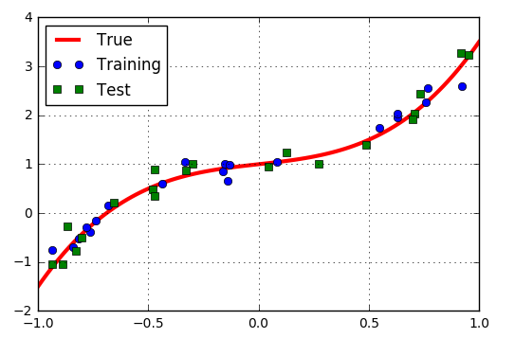
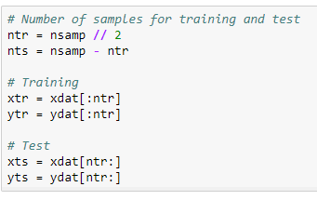
Polynomial Example: Training Test Split
Example: Split data into 20 samples for training, 20 for test

Slide 31
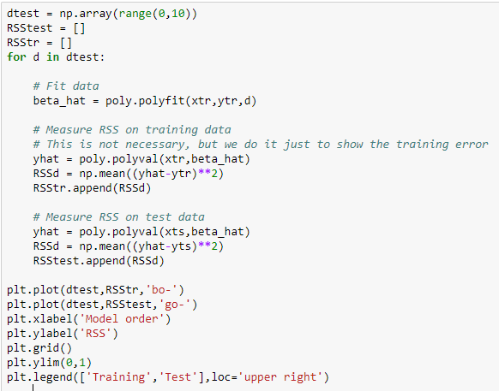
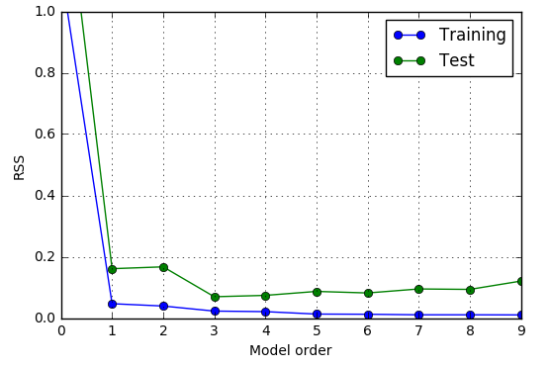
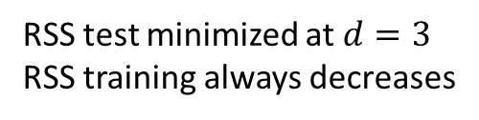
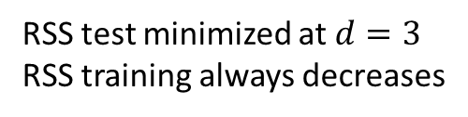
Finding the Model Order
Estimated optimal model order = 3
RSS test minimized at $d=3$
RSS training always decreases
RSS test minimized at $d=3$
RSS training always decreases

Slide 32
Problems with Simple Train/Test Split
Test error could vary significantly depending on samples selected
Only use limited number of samples for training
Problems particularly bad for data with limited number of samples

Slide 33
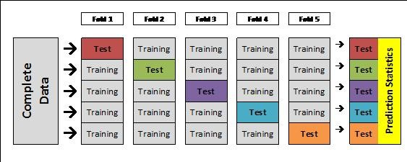
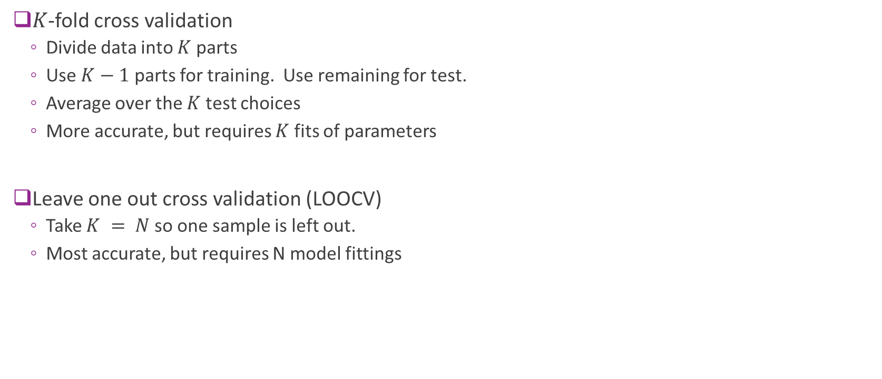
K-Fold Cross Validation
$K$-fold cross validation
Divide data into $K$ parts
Use $K−1$ parts for training. Use remaining for test.
Average over the $K$ test choices
More accurate, but requires $K$ fits of parameters
Leave one out cross validation (LOOCV)
Take $K = N$so one sample is left out.
Most accurate, but requires N model fittings
From http://blog.goldenhelix.com/goldenadmin/cross-validation-for-genomic-prediction-in-svs/

Slide 34
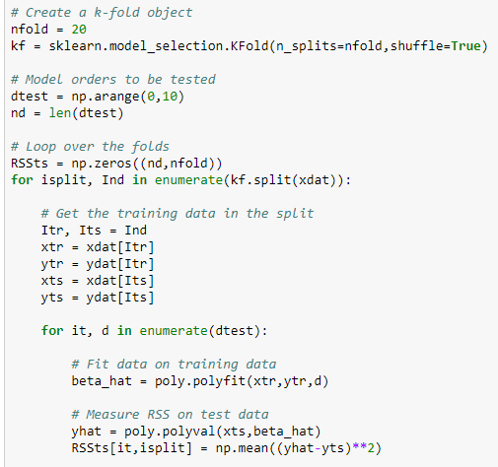
Polynomial Example
Use sklearn Kfold object
Loop
Outer loop: Over K folds
Inner loop: Over model order
Measure test error in each fold and order
Can be time-consuming

Slide 35
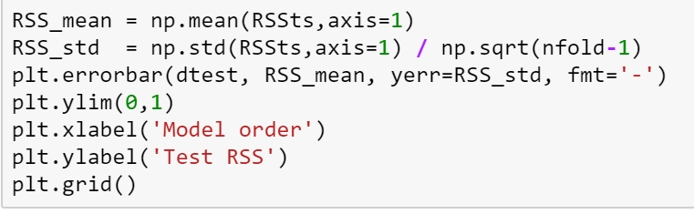
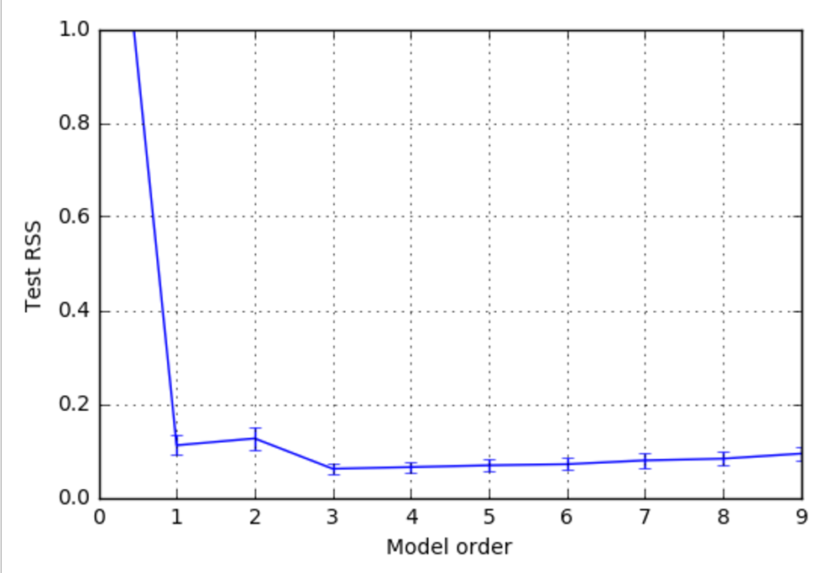

Polynomial Example CV Results
For each model order d
Compute mean test RSS
Compute std error (SE) of test RSS
SE = std dev / $\sqrt{K−1}$
Mean and SE computed over the $K$ folds
Simple model selection
Select d with lowest mean test RSS
For this example
Estimate model order = 3

Slide 36
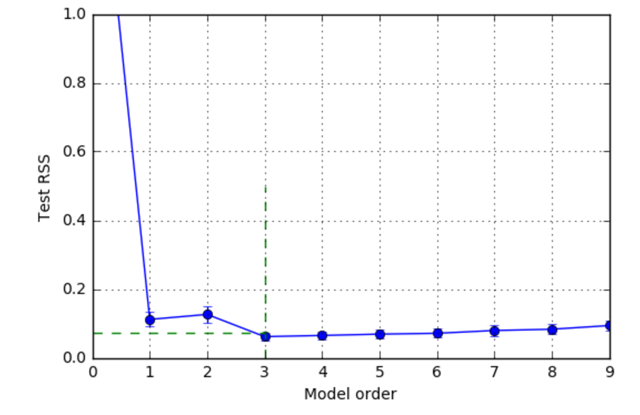
One Standard Error Rule
Previous slide: Select d to minimize mse_mean[d]
Problem: Often over-predicts model order
One standard deviation rule
Use simplest model within one SE of minimum
Detailed procedure:
Find d0 to minimize mse_mean[d]
Set mse_tgt = mse_mean[d0] + mse_std[d0]
Find dopt minimize d s.t. mse_mean[d] <= mse_tgt
mse_tgt
Optimal model order

Slide 37
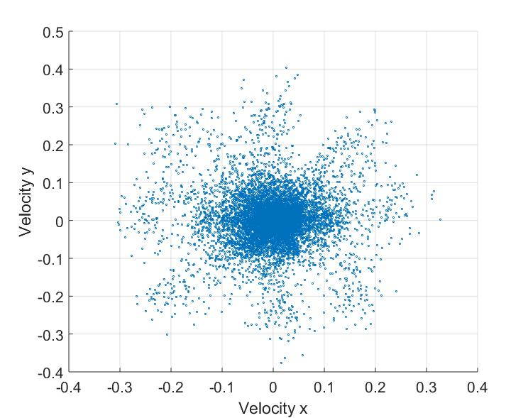
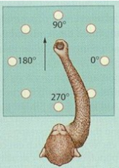

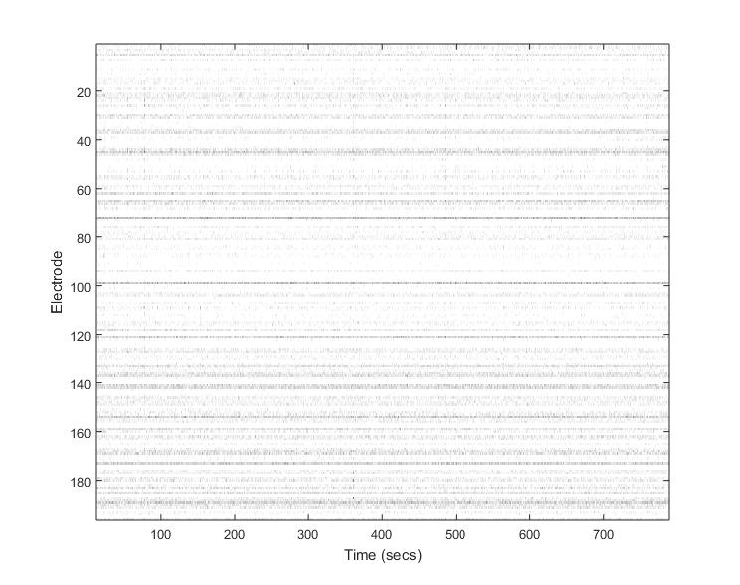
Lab: Neural ECoG Data
Record arm motion
Read a monkey’s brain!
Predict hand motion from electrode measurements
Model order selection
Which signals predict arm motion?
Data from https://crcns.org/
Open source website on neural data
Great for projects
Arm velocity
Velocity y
Velocity x
Spikes
Neuron
Record spikes (ECoG in M1)
Time

