Slide 1
Lecture 5 LASSO Regularization
EE-uy 4563/EL-GY 9123: Introduction to machine learning
Prof. Sundeep rangan

Slide 2
Learning Objectives
Formulate a linear estimation problem with a regularization
Compute an L1-regularized estimate (LASSO) using sklearn tools
Compute the optimal regularization level using cross validation
Interpret results from a LASSO path
Set regularizer based on a probabilistic prior

Slide 3
Outline
Motivating Example: Predicting prostate cancer from a PSA test
Model selection from LASSO regularization
Probabilistic interpretation

Slide 4

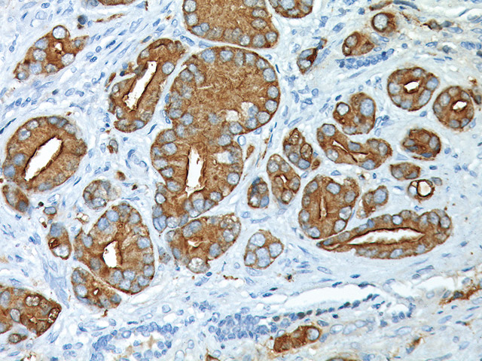
Prostate Specific Antigen Testing
PSA levels easily tested
High PSA believed to be associated with prostate cancer
Potential tool for screening
Classic 1989 study by Thomas et al:
Measured PSA level of 102 men prior to prostate removal
Measured characteristics of prostate from samples
Characteristics include cancer volume, weight, …
Data analysis:
What characteristics predict PSA?
Stamey, Thomas A., et al. "Prostate specific antigen in the diagnosis and treatment of adenocarcinoma of the prostate. II. Radical prostatectomy treated patients." The Journal of urology 141.5 (1989): 1076-1083.

Slide 5
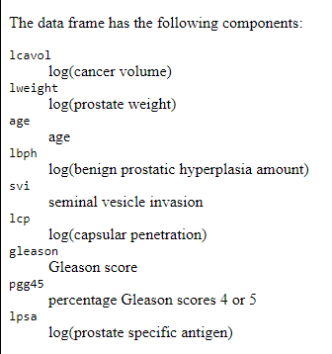

Data
Prostate dataset widely-used in ML classes
Can be downloaded from many sites
Samples = 97 patients
8 features of the prostate
Target variable = lpsa (log PSA)

Slide 6
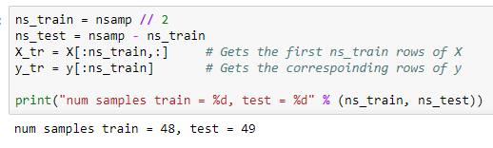

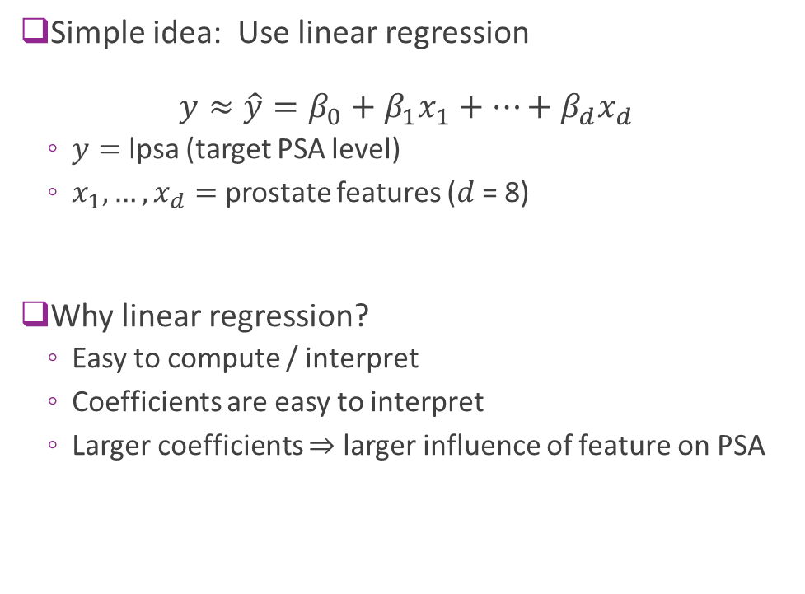
First Try: Linear Model
Simple idea: Use linear regression $y≈\hat{y}=β_{0}+β_{1}x_{1}+⋯+β_{d}x_{d}$
$y=$ lpsa (target PSA level)
$x_{1},…,x_{d}=$ prostate features ($d$ = 8)
Why linear regression?
Easy to compute / interpret
Coefficients are easy to interpret
Larger coefficients $⇒$ larger influence of feature on PSA

Slide 7
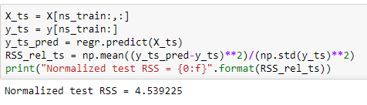
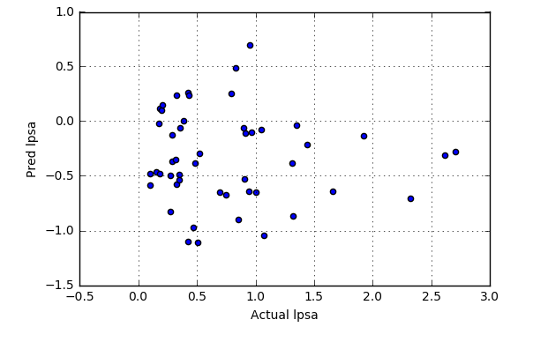
Model Does Not Generalize
Evaluate model with cross validation
Train on 48 samples
Measure RSS on 49 samples
Test RSS is very high
Scatter plot shows no predictive ability
What happened?
Can we do a better model?

Slide 8
Outline
Motivating Example: Predicting prostate cancer from a PSA test
Model selection from LASSO regularization
Probabilistic interpretation

Slide 9
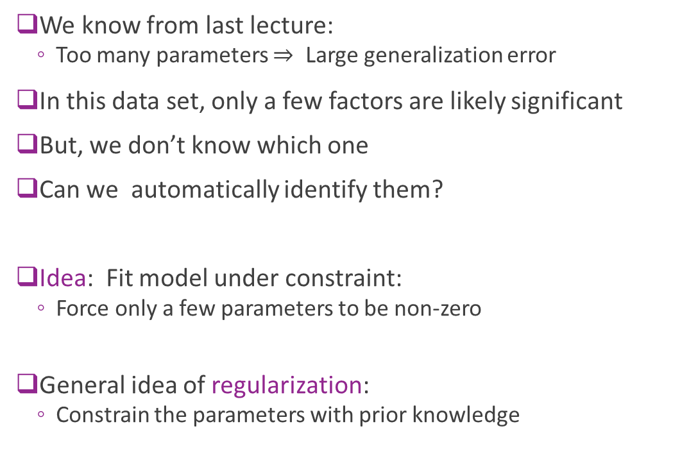
Intuition
We know from last lecture:
Too many parameters $⇒$ Large generalization error
In this data set, only a few factors are likely significant
But, we don’t know which one
Can we automatically identify them?
Idea: Fit model under constraint:
Force only a few parameters to be non-zero
General idea of regularization:
Constrain the parameters with prior knowledge

Slide 10
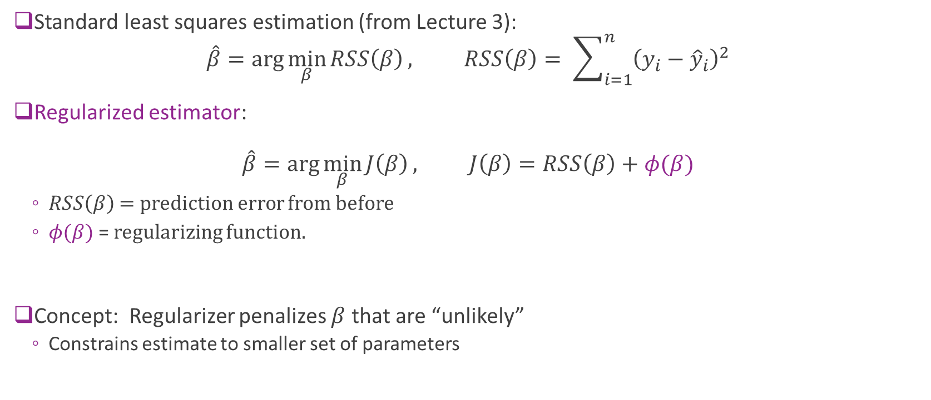
Regularized LS Estimation
Standard least squares estimation (from Lecture 3): $\hat{β}=\arg{\min_{β}{RSS\left(β\right)}}, RSS\left(β\right)= \sum_{i=1}^{n}{{\left(y_{i}−{\hat{y}}_{i}\right)}^{2}}$
Regularized estimator: $\hat{β}=\arg{\min_{β}{J\left(β\right)}}, J\left(β\right)=RSS\left(β\right)+φ(β)$
$RSS\left(β\right)$ = prediction error from before
$φ(β)$ = regularizing function.
Concept: Regularizer penalizes $β$ that are “unlikely”
Constrains estimate to smaller set of parameters

Slide 11
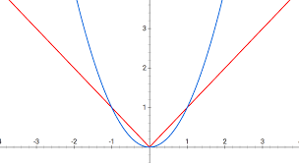
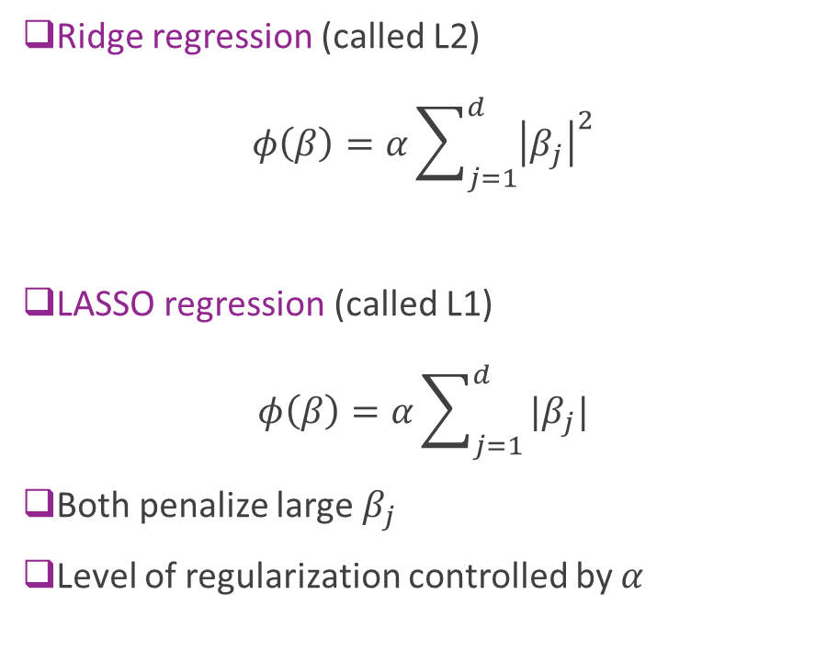



Two Common Regularizers
Ridge regression (called L2) $φ\left(β\right)=α\sum_{j=1}^{d}{{\left|β_{j}\right|}^{2}}$
LASSO regression (called L1) $φ\left(β\right)=α\sum_{j=1}^{d}{|β_{j}|}$
Both penalize large $β_{j}$
Level of regularization controlled by $α$
$$\left|β_{j}\right|$$
$${\left|β_{j}\right|}^{2}$$
$$β_{j}$$

Slide 12
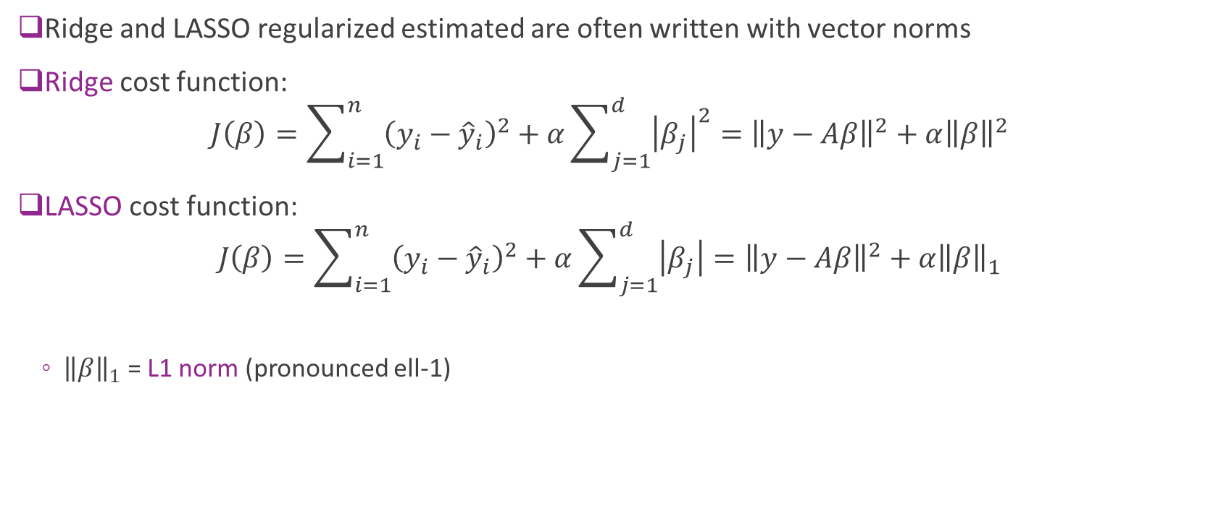
L1 and L2 Norm
Ridge and LASSO regularized estimated are often written with vector norms
Ridge cost function: $J\left(β\right)=\sum_{i=1}^{n}{{\left(y_{i}−{\hat{y}}_{i}\right)}^{2}}+α\sum_{j=1}^{d}{{\left|β_{j}\right|}^{2}}={\left\|y−Aβ\right\|}^{2}+α{\left\|β\right\|}^{2}$
LASSO cost function: $J\left(β\right)=\sum_{i=1}^{n}{{\left(y_{i}−{\hat{y}}_{i}\right)}^{2}}+α\sum_{j=1}^{d}{\left|β_{j}\right|}={\left\|y−Aβ\right\|}^{2}+α{\left\|β\right\|}_{1}$
${\left\|β\right\|}_{1}$ = L1 norm (pronounced ell-1)

Slide 13
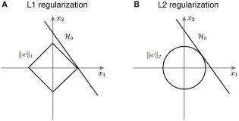
Ridge vs LASSO
Optimization can be easily performed for L1 and L2 regularizers
Regularizer is convex
More on this later
L1 tends to lead to more sparse solutions
More coefficients are zero
Will focus this lecture on L1

Slide 14

Selecting Regularization Level
How do we select regularization level $α$?
Higher $α⇒$ More constrained / simpler model
Lower $α⇒$ More complex model
Similar to inverse of model order
Find $α$via cross-validation

Slide 15
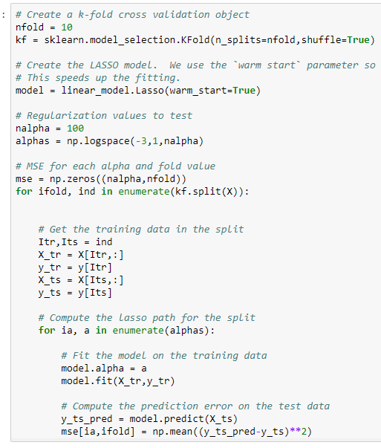
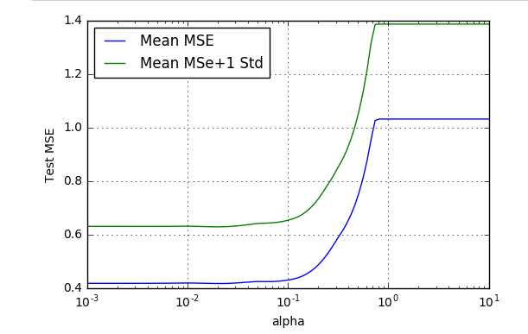

Computing LASSO in python
Use sklearn Lasso method
Cross validation loop
Outer loop: Loop over folds
Inner loop: Loop over $α$
Measure mean and std deviation of MSE

Slide 16
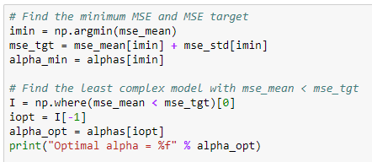
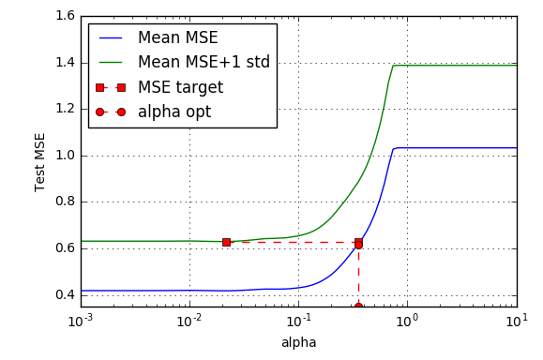

Using One Standard Deviation Rule
Use one standard deviation rule from before
Find $α_{0}$ with minimum mean MSE, mean_mean
Set $\text{mse}\text{_}\text{tgt} = \text{mse}\text{_}\text{mean}[α_{0}] + \text{mse}\text{_}\text{std}[α_{0}]$
Find largest $α$ where mse_mean[$α$] < mse_tgt

Slide 17
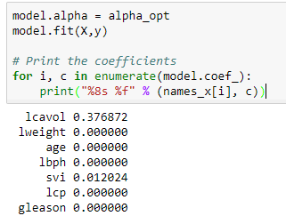

Coefficients
Select $α$ via cross-validation
Then, find coefficients using all training data.
Final coefficients are sparse:
Only two factors are non-zeros
Lcavol: log cancer volume

Slide 18
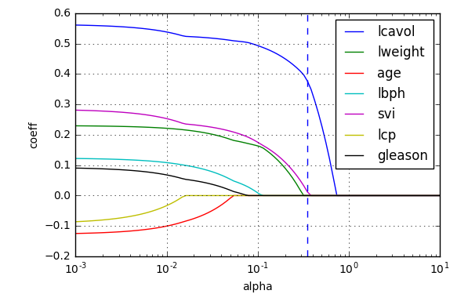

LASSO path
Useful to plot coefficients as a function of $α$.
Called the LASSO path
Indicates relative importance of different factors
For this data set:
lcavol most important
Don’t draw medical conclusions
Need more detailed significance testing
Complex subject for another class…

Slide 19
Outline
Motivating Example: Predicting prostate cancer from a PSA test
Model selection from LASSO regularization
Probabilistic interpretation

Slide 20
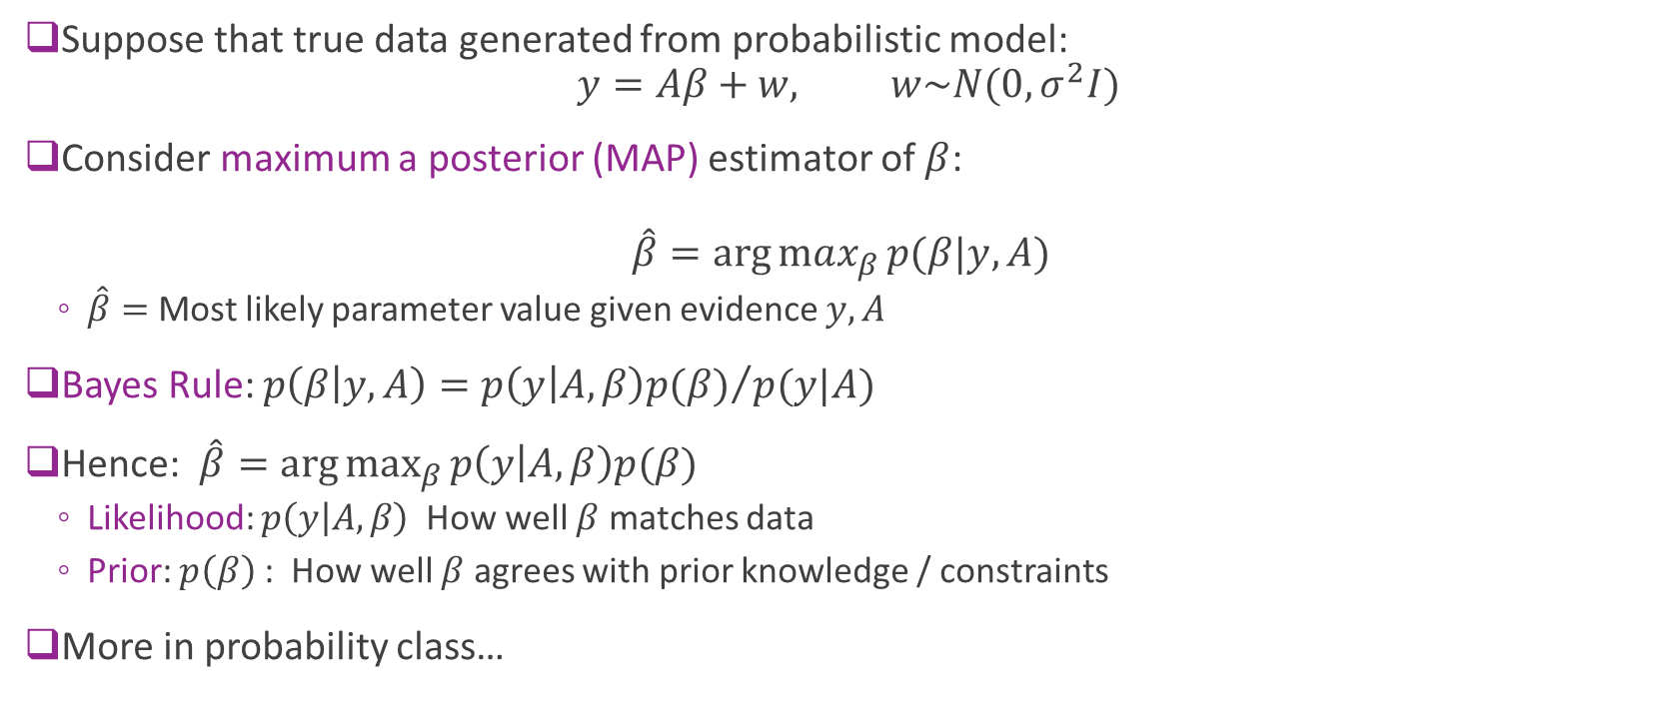
Bayesian Estimation
Suppose that true data generated from probabilistic model: $y=Aβ+w, w\sim N(0,σ^{2}I)$
Consider maximum a posterior (MAP) estimator of $β$: $\hat{β}=\arg{max_{β}{p(β|y,A)}}$
$\hat{β}=$Most likely parameter value given evidence $y,A$
Bayes Rule: $p\left(β | y,A\right)={p\left(y | A,β\right)p(β)}/{p(y|A)}$
Hence: $\hat{β}=\arg{\max_{β}{p\left(y | A,β\right)p(β)}}$
Likelihood: $p\left(y | A,β\right)$ How well $β$ matches data
Prior: $p\left(β\right)$ : How well $β$ agrees with prior knowledge / constraints
More in probability class…

Slide 21
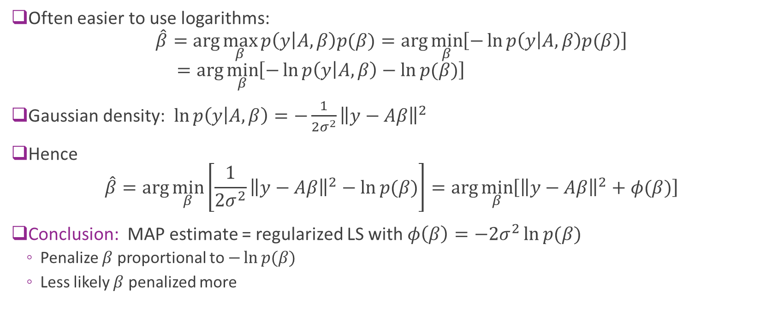
Bayes Estimation with Logarithms
Often easier to use logarithms: $\hat{β}=\arg{\max_{β}{p\left(y | A,β\right)p(β)}}=\arg{\min_{β}\left[−\ln{p\left(y | A,β\right)p(β)}\right]}$ $=\arg{\min_{β}\left[−\ln{p\left(y | A,β\right)}−\ln{p(β)}\right]}$
Gaussian density: $\ln{p\left(y | A,β\right)}=−\frac{1}{2σ^{2}}{\left\|y−Aβ\right\|}^{2}$
Hence $\hat{β}=\arg{\min_{β}\left[\frac{1}{2σ^{2}}{\left\|y−Aβ\right\|}^{2}−\ln{p(β)}\right]=\arg{\min_{β}\left[{\left\|y−Aβ\right\|}^{2}+φ(β)\right]}}$
Conclusion: MAP estimate = regularized LS with $φ\left(β\right)=−2σ^{2}\ln{p(β)}$
Penalize $β$ proportional to $−\ln{p(β)}$
Less likely $β$ penalized more

