Slide 1
Lecture 6 Linear Classification & Logistic Regression
EE-uy 4563/EL-GY 9123: Introduction to machine learning
Prof. Sundeep rangan

Slide 2
Learning Objectives
Formulate a machine learning problem as a classification problem
Identify features, class variable, training data
Visualize classification data using a scatter plot.
Describe a linear classifier as an equation and on a plot.
Determine visually if data is perfect linearly separable.
Formulate a classification problem using logistic regression
Binary and multi-class
Describe the logistic and soft-max function
Derive the loss function for ML estimation of the weights in logistic regression
Use sklearn packages to fit logistic regression models
Measure the accuracy of classification
Adjust threshold of classifiers for trading off types of classification errors. Draw a ROC curve.

Slide 3
Outline
Motivating Example: Classifying a breast cancer test
Linear classifiers
Logistic regression
Fitting logistic regression models
Measuring accuracy in classification

Slide 4
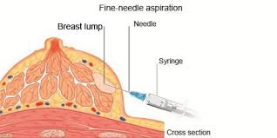
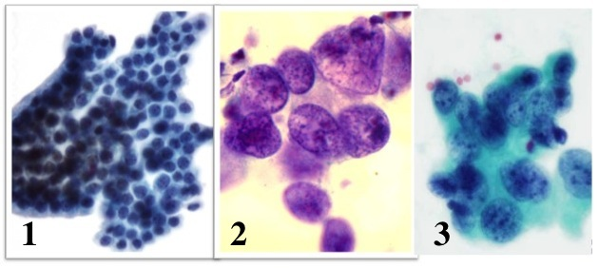
Diagnosing Breast Cancer
Fine needle aspiration of suspicious lumps
Cytopathologist visually inspects cells
Sample is stained and viewed under microscope
Determines if cells are benign or malignant
Uses many features:
Size of cells, degree of mitosis, differentiation, …
Diagnosis is not exact
If uncertain, use a more comprehensive biopsy
Additional cost and time
Stress to patient
Can machine learning provide better rules?
Grades of carcinoma cells
http://breast-cancer.ca/5a-types/

Slide 5
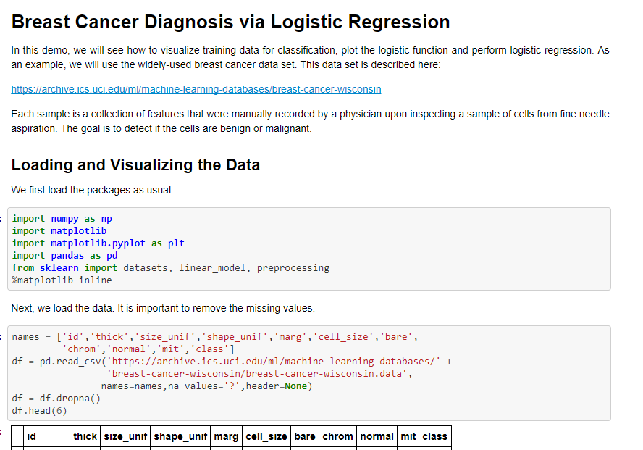
Demo on Github
Github: https://github.com/sdrangan/introml/blob/master/logistic/breast_cancer.ipynb

Slide 6
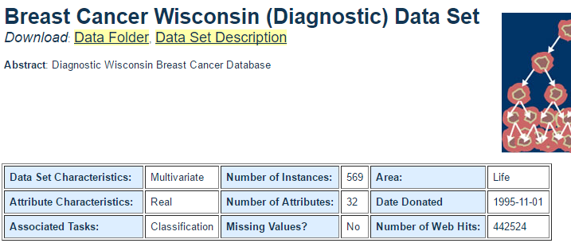
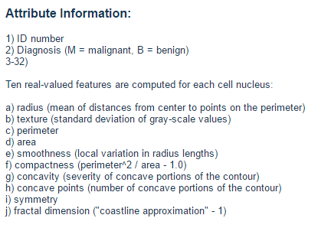
Data
Univ. Wisconsin study, 1994
569 samples
10 visual features for each sample
Ground truth determined by biopsy
First publication: O.L. Mangasarian, W.N. Street and W.H. Wolberg. Breast cancer diagnosis and prognosis via linear programming. Operations Research, 43(4), pages 570-577, July-August 1995.

Slide 7
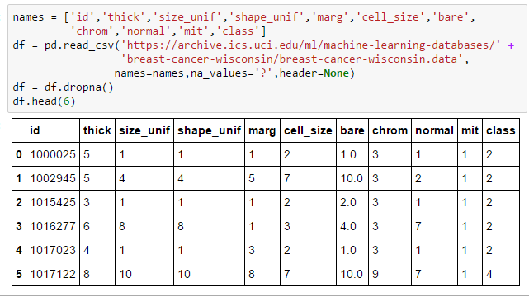
Loading The Data
Follow standard pandas routine
All code in Lect06_Demo.ipynb
Drops missing samples
Class = 2 => benign
Class = 4 => malignant

Slide 8
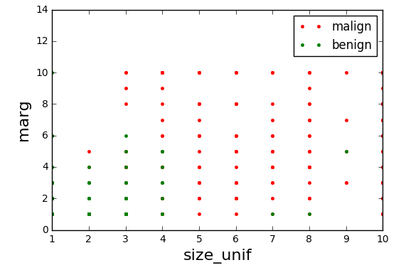
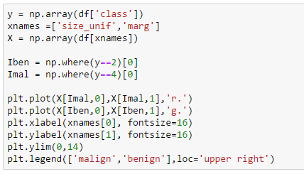
Visualizing the Data
Scatter plot of points from each class
Plot not informative
Many points overlap
Relative frequency at each point not visible

Slide 9
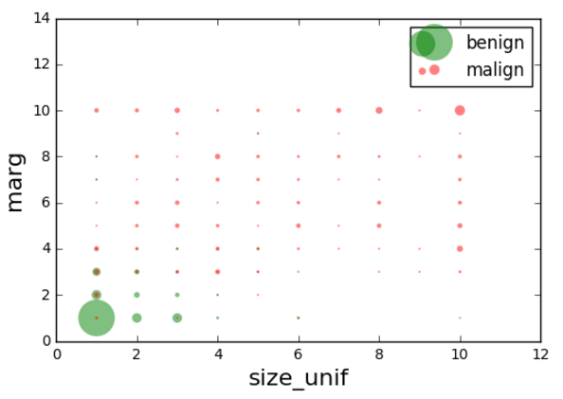
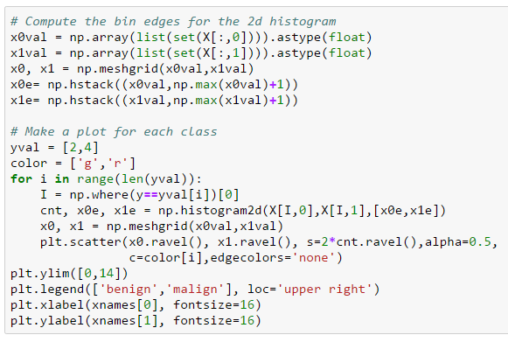
Improving the Plot
Make circle size proportional to count
Many gymnastics to make this plot in python

Slide 10
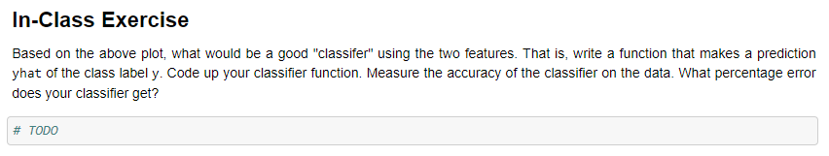
In-Class Exercise
Get into groups
At least one must have a laptop with jupyter notebook
Determine a classification rule
Predict class label from the two features
Test in python
Make the predictions
Measure the accuracy

Slide 11
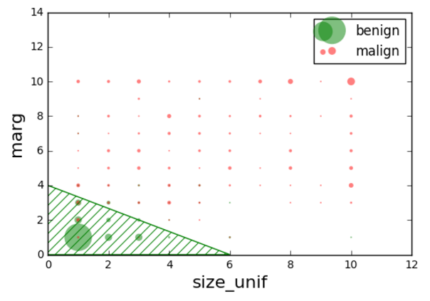
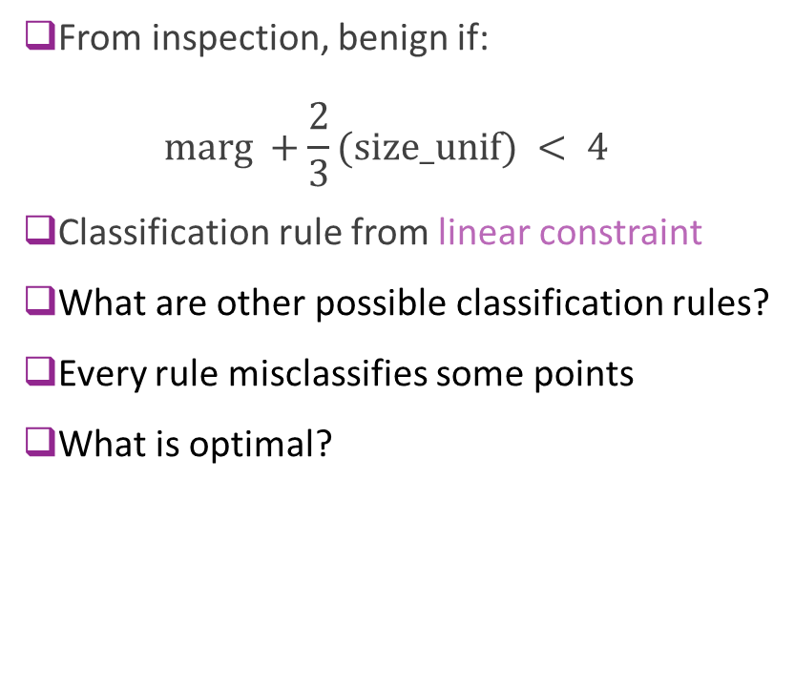
A Possible Classification Rule
From inspection, benign if: $\text{marg} +\frac{2}{3}(\text{size}\text{_}\text{unif}) < 4$
Classification rule from linear constraint
What are other possible classification rules?
Every rule misclassifies some points
What is optimal?

Slide 12
Mangasarian’s Original Paper
Proposes Multisurface method – Tree (MSM-T)
Decision tree based on linear rules in each step
Fig to left from
Pantel, “Breast Cancer Diagnosis and Prognosis,” 1995
Best methods today use neural networks
This lecture will look at linear classifiers
These are much simpler
Do not provide same level of accuracy
But, building block to more complex classifiers

Slide 13
Outline
Motivating Example: Classifying a breast cancer test
Linear classifiers
Logistic regression
Fitting logistic regression models
Measuring accuracy in classification

Slide 14
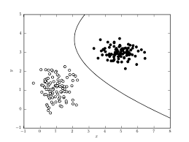
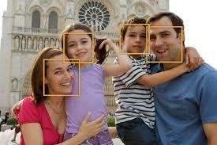
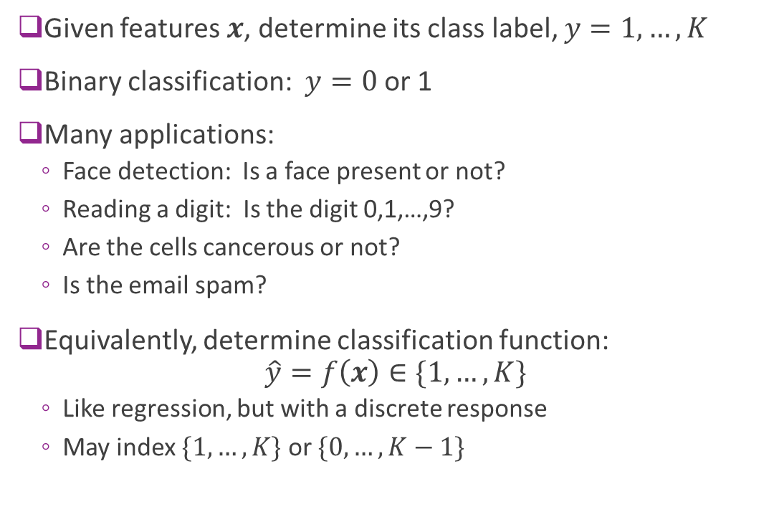
Classification
Given features $x$, determine its class label, $y=1,…,K$
Binary classification: $y=0$or 1
Many applications:
Face detection: Is a face present or not?
Reading a digit: Is the digit 0,1,…,9?
Are the cells cancerous or not?
Is the email spam?
Equivalently, determine classification function: $\hat{y}=f\left(x\right)∈\{1,…,K\}$
Like regression, but with a discrete response
May index $\{1,…,K\}$ or $\{0,…,K−1\}$

Slide 15
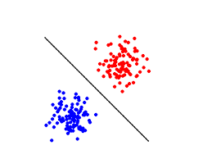
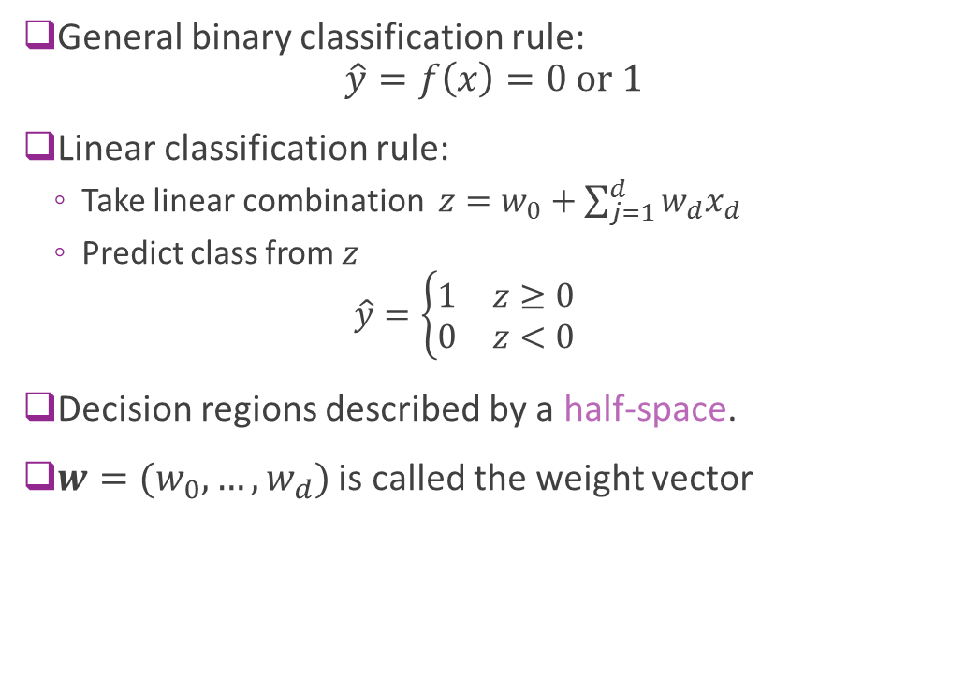
Linear Classifier
General binary classification rule: $\hat{y}=f\left(x\right)=0 \text{or} 1$
Linear classification rule:
Take linear combination $z=w_{0}+\sum_{j=1}^{d}{{w_{d}x}_{d}}$
Predict class from $z$ $\hat{y}=\left\{\begin{matrix}1 & z≥0 \\ 0 & z<0\end{matrix}\right.$
Decision regions described by a half-space.
$w=(w_{0},…,w_{d})$ is called the weight vector

Slide 16
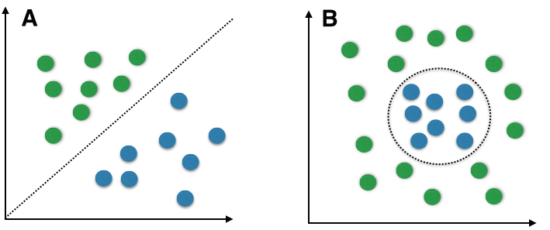
Linear vs. Non-Linear
Linear boundaries are limited
Can only describe very simple regions
But, serves as building block
Many classifiers use linear rules as first step
Neural networks, decision trees, …
Breast cancer example:
Is the region linear or non-linear?

Slide 17
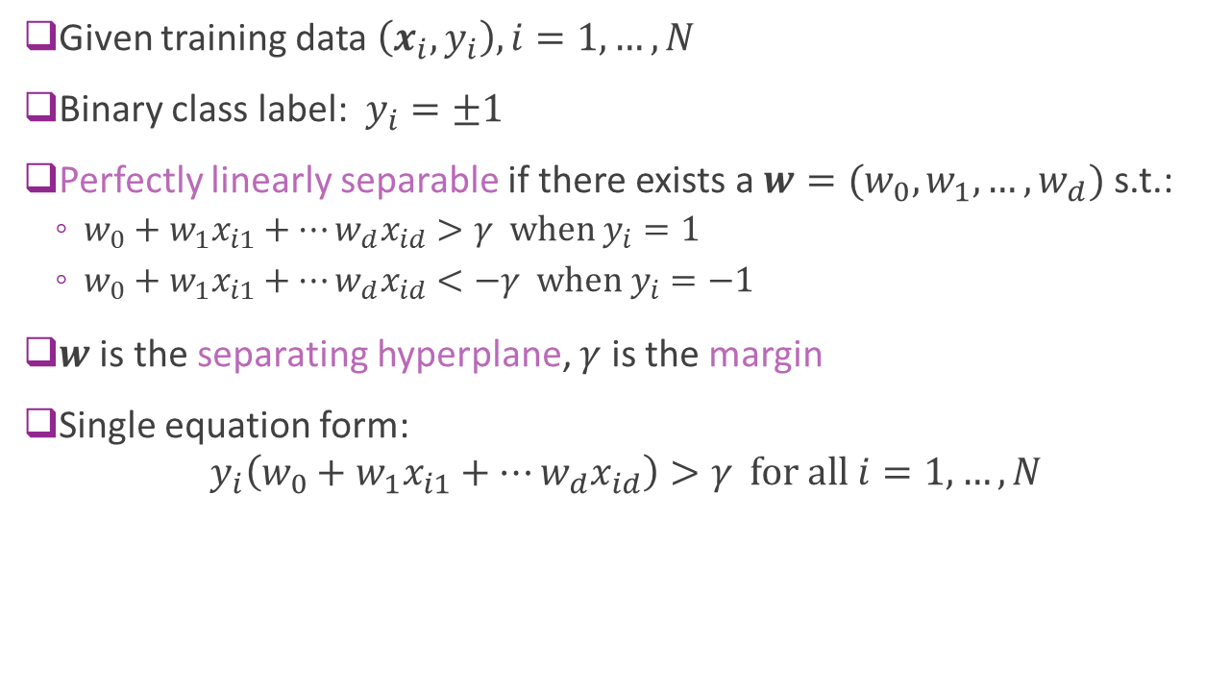
Perfect Linear Separability
Given training data $\left(x_{i},y_{i}\right), i=1,…,N$
Binary class label: $y_{i}=±1$
Perfectly linearly separable if there exists a $w=(w_{0},w_{1},…,w_{d})$ s.t.:
$w_{0}+w_{1}x_{i1}+⋯w_{d}x_{id}>γ \text{when} y_{i}=1$
$w_{0}+w_{1}x_{i1}+⋯w_{d}x_{id}<−γ \text{when} y_{i}=−1$
$w$ is the separating hyperplane, $γ$ is the margin
Single equation form:
$$y_{i}\left(w_{0}+w_{1}x_{i1}+⋯w_{d}x_{id}\right)>γ \text{for} \text{all} i=1,…,N$$

Slide 18
Most Data not Perfectly Separable
Generally cannot find a separating hyperplane
Always, some points that will be mis-classified
Algorithms attempt to find “good” hyper-planes
Reduce the number of mis-classified points
Or, some similar metric
Example: Look again at breast cancer data

Slide 19
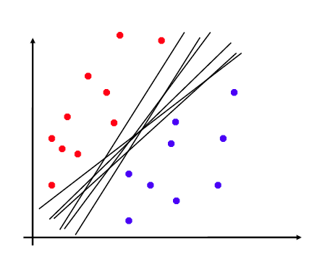

Non-Uniqueness
When one exists, separating hyper-plane is not unique
Example:
If $w$ is separating, then so is $αw$ for all $α>0$
Fig. on right: Many separating planes
Which one is optimal?

Slide 20
Outline
Motivating Example: Classifying a breast cancer test
Linear classifiers
Logistic regression
Fitting logistic regression models
Measuring accuracy in classification

Slide 21
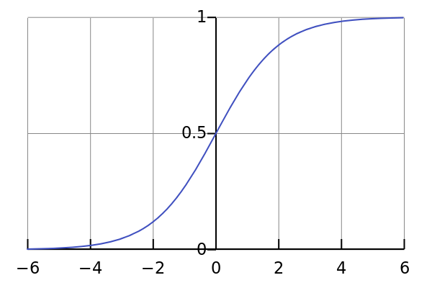
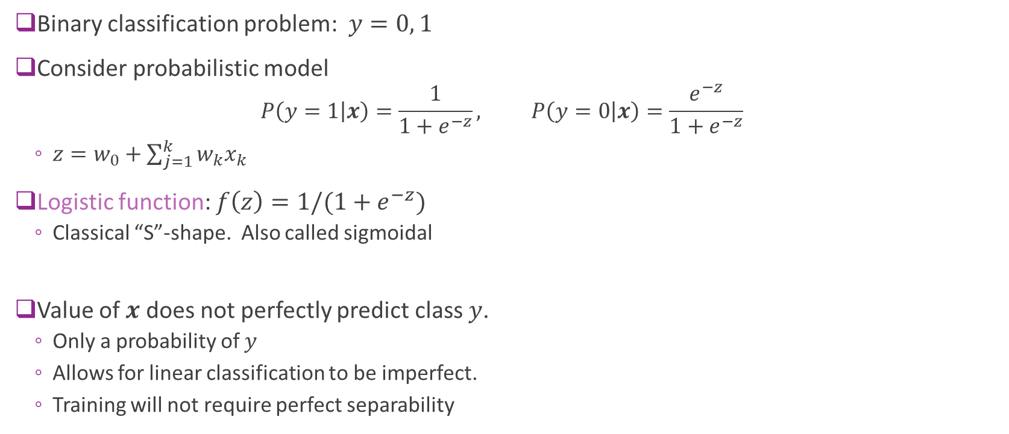
Logistic Model for Binary Classification
Binary classification problem: $y=0, 1$
Consider probabilistic model
$$P\left(y=1 | x\right)=\frac{1}{1+e^{−z}}, P\left(y=0 | x\right)=\frac{e^{−z}}{1+e^{−z}}$$
$z=w_{0}+\sum_{j=1}^{k}{{w_{k}x}_{k}}$
Logistic function: $f\left(z\right)=1/(1+e^{−z})$
Classical “S”-shape. Also called sigmoidal
Value of $x$ does not perfectly predict class $y$.
Only a probability of $y$
Allows for linear classification to be imperfect.
Training will not require perfect separability

Slide 22
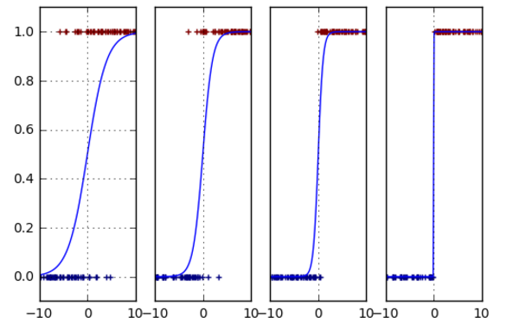

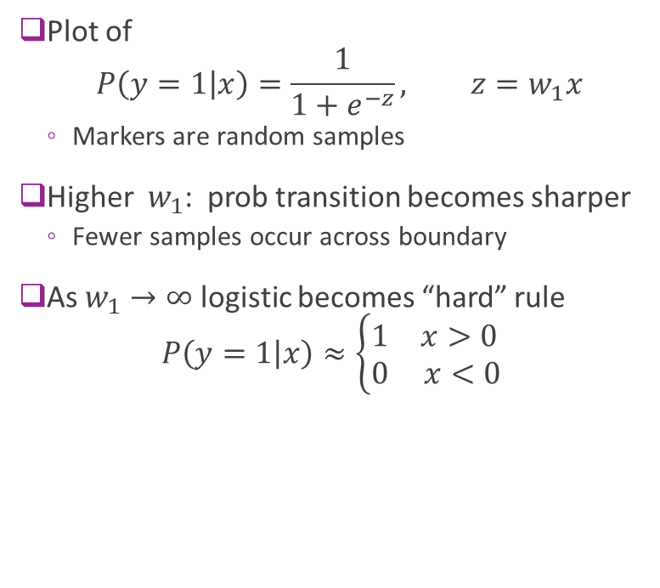



Logistic Model as a “Soft” Classifier
Plot of $P\left(y=1 | x\right)=\frac{1}{1+e^{−z}}, z=w_{1}x$
Markers are random samples
Higher $w_{1}$: prob transition becomes sharper
Fewer samples occur across boundary
As $w_{1}→∞$ logistic becomes “hard” rule $P\left(y=1 | x\right)≈\left\{\begin{matrix}1 & x>0 \\ 0 & x<0\end{matrix}\right.$
$$z=0.5x$$
$$z=x$$
$$z=2x$$
$$z=100x$$

Slide 23

Multi-Class Logistic Regression
Suppose $y∈1,…,K$
$K$ possible classes (e.g. digits, letters, spoken words, …)
Multi-class regression:
$W∈R^{K×d}, w_{0}∈R^{M}$ Slope matrix and bias
$z=Wx+w_{0}$: Creates $M$ linear functions
Then, class probabilities given by: $P\left(y=k | x\right)=\frac{e^{z_{k}}}{\sum_{ℓ=1}^{K}{e^{z_{ℓ}}}}$

Slide 24
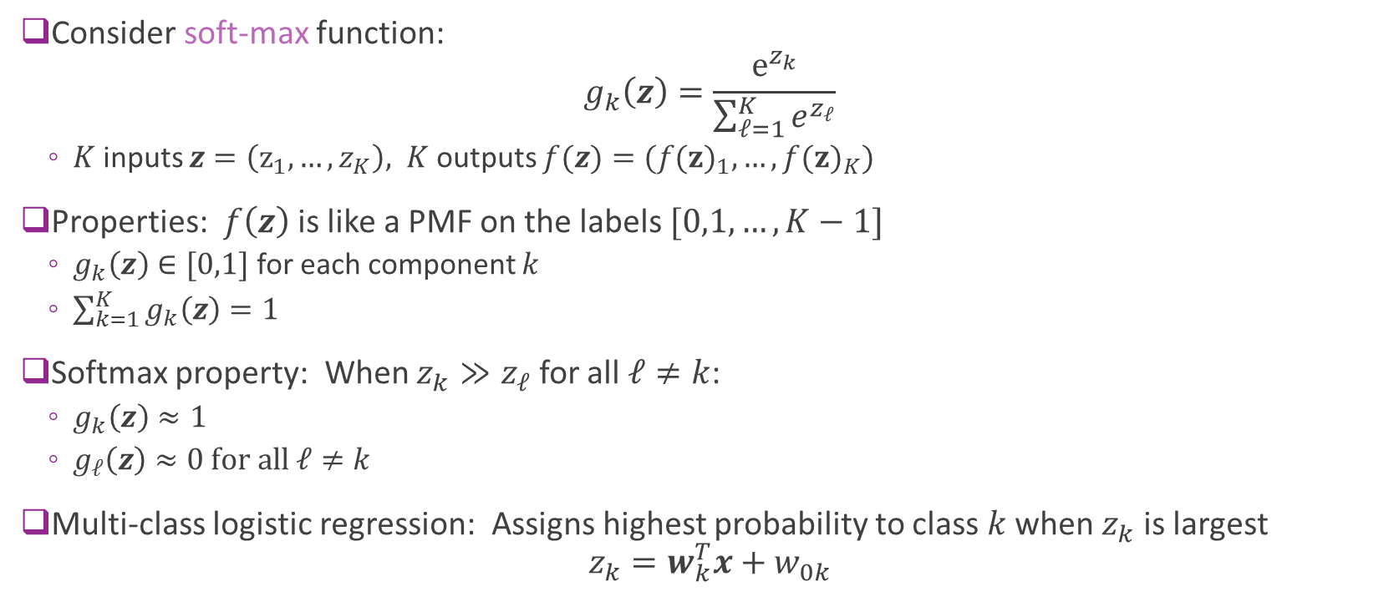
Softmax Operation
Consider soft-max function: $g_{k}\left(z\right)=\frac{e^{z_{k}}}{\sum_{ℓ=1}^{K}{e^{z_{ℓ}}}}$
$K$ inputs $z=\left(z_{1},…, z_{K}\right),$ $K$ outputs $f(z)=({f(z)}_{1},…, {f(z)}_{K})$
Properties: $f\left(z\right)$ is like a PMF on the labels $[0,1,…, K−1]$
$g_{k}\left(z\right)∈[0,1]$ for each component $k$
$\sum_{k=1}^{K}{g_{k}\left(z\right)}=1$
Softmax property: When $z_{k}≫z_{ℓ}$ for all $ℓ≠k$:
$g_{k}\left(z\right)≈1$
$g_{ℓ}\left(z\right)≈0 \text{for} \text{all} ℓ≠k$
Multi-class logistic regression: Assigns highest probability to class $k$ when $z_{k}$ is largest $z_{k}=w_{k}^{T}x+w_{0k}$

Slide 25
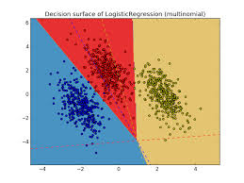
Multi-Class Logistic Regression Decision Regions
Each decision region defined by set of hyperplanes
Intersection of linear constraints
Sometimes called a polytope

Slide 26
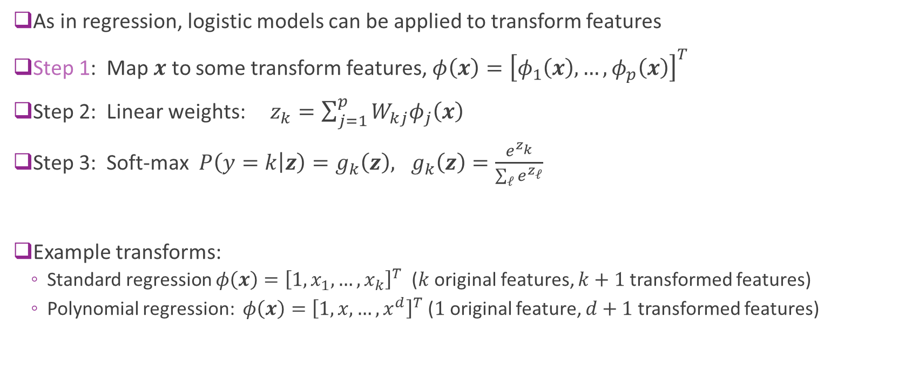
Transform Linear Models
As in regression, logistic models can be applied to transform features
Step 1: Map $x$ to some transform features, $φ\left(x\right)={\left[φ_{1}\left(x\right),…,φ_{p}\left(x\right)\right]}^{T}$
Step 2: Linear weights: $z_{k}=\sum_{j=1}^{p}{{W_{kj}φ}_{j}\left(x\right)}$
Step 3: Soft-max $P\left(y=k | z\right)=g_{k}\left(z\right), g_{k}\left(z\right)=\frac{e^{z_{k}}}{\sum_{ℓ}{e^{z_{ℓ}}}}$
Example transforms:
Standard regression $φ\left(x\right)={\left[1,x_{1},…, x_{k}\right]}^{T}$ ($k$ original features, $k+1$ transformed features)
Polynomial regression: $φ\left(x\right)={\left[1,x,…, x^{d}\right]}^{T}$ ($1$ original feature, $d+1$ transformed features)
Additional transform step

Slide 27
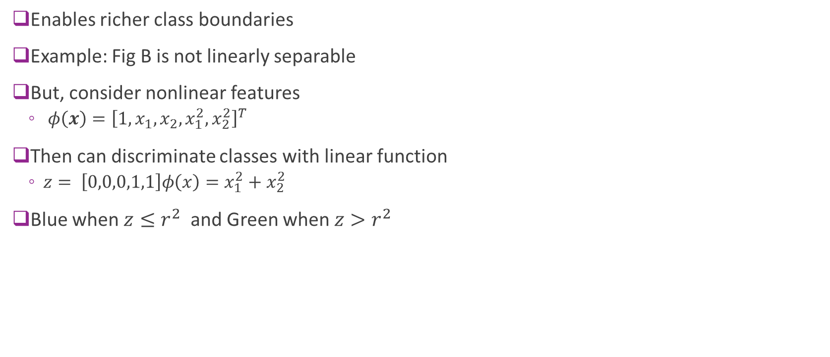
Using Transformed Features
Enables richer class boundaries
Example: Fig B is not linearly separable
But, consider nonlinear features
$φ\left(x\right)={\left[1,x_{1},x_{2},x_{1}^{2},x_{2}^{2}\right]}^{T}$
Then can discriminate classes with linear function
$z= \left[0,0,0,1,1\right]φ\left(x\right)=x_{1}^{2}+x_{2}^{2}$
Blue when $z≤r^{2}$ and Green when $z>r^{2}$

Slide 28
Outline
Motivating Example: Classifying a breast cancer test
Linear classifiers
Logistic regression
Fitting logistic regression models
Measuring accuracy in classification

Slide 29
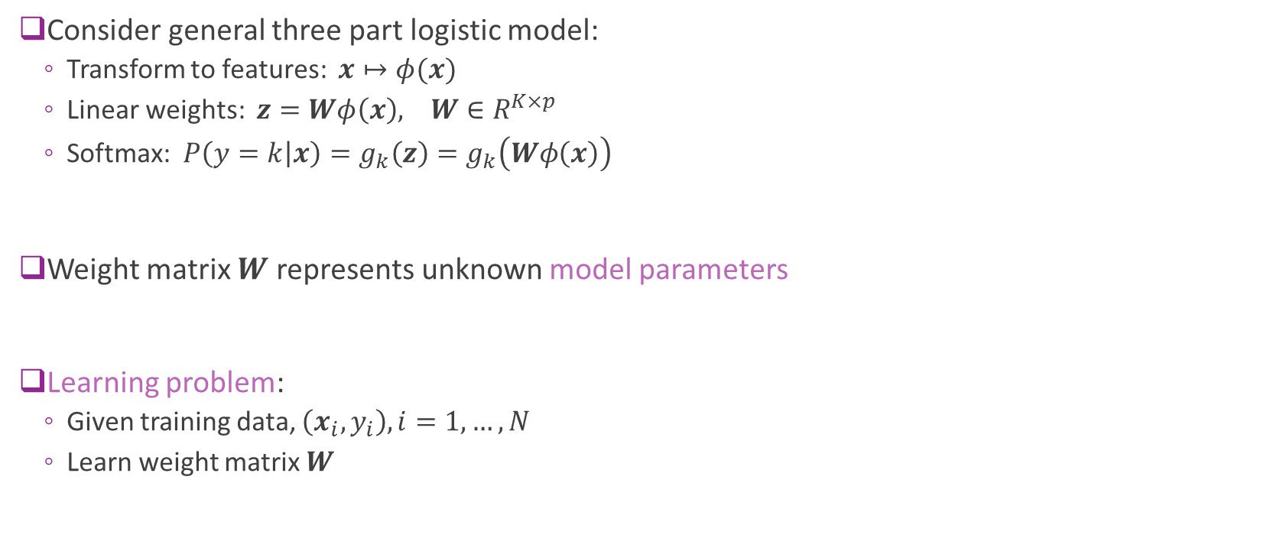
Learning the Logistic Model Parameters
Consider general three part logistic model:
Transform to features: $x↦φ(x)$
Linear weights: $z=Wφ\left(x\right), W∈R^{K×p}$
Softmax: $P\left(y=k | x\right)=g_{k}\left(z\right)=g_{k}\left(Wφ\left(x\right)\right)$
Weight matrix $W$ represents unknown model parameters
Learning problem:
Given training data, $\left(x_{i},y_{i}\right), i=1,…,N$
Learn weight matrix $W$

Slide 30
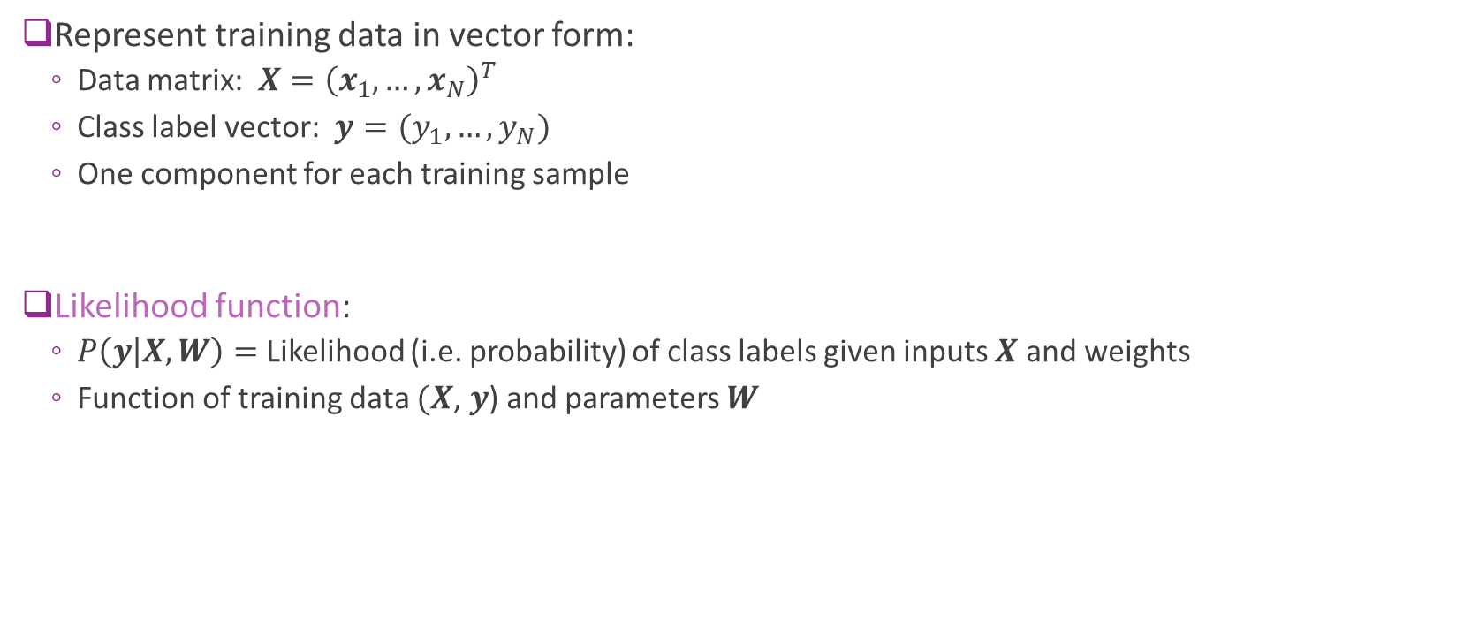
Likelihood Function
Represent training data in vector form:
Data matrix: $X={\left(x_{1},…,x_{N}\right)}^{T}$
Class label vector: $y=(y_{1},…,y_{N})$
One component for each training sample
Likelihood function:
$P\left(y | X,W\right)=$ Likelihood (i.e. probability) of class labels given inputs $X$ and weights
Function of training data $(X$, $y$) and parameters $W$

Slide 31




Min and Argmin
Given a function $f(x)$
$\min_{x}{f\left(x\right)}$
Minimum value of the $f(x)$
Point on the $y$-axis
$\underset{x}{arg min}{f\left(x\right)}$
Value of $x$where $f(x)$ is a minimum
Point on the $x$-axis
Similarly, define $\max_{x}{f\left(x\right)}$ and $\underset{x}{arg max}{f\left(x\right)}$
$$f\left(x\right)={\left(x−1\right)}^{2}+2$$
$$\min_{x}{f\left(x\right)}=2$$
0
1
$$\arg{\min_{x}{f\left(x\right)}}=1$$

Slide 32

Maximum Likelihood Estimation
Given training data $(X$, $y$)
Likelihood function: $P\left(y | X,W\right)$
Maximum likelihood estimation $\hat{W}=\arg{\max_{W}{P\left(y | X,W\right)}}$
Finds parameters for which observations are most likely
Very general method in estimation

Slide 33
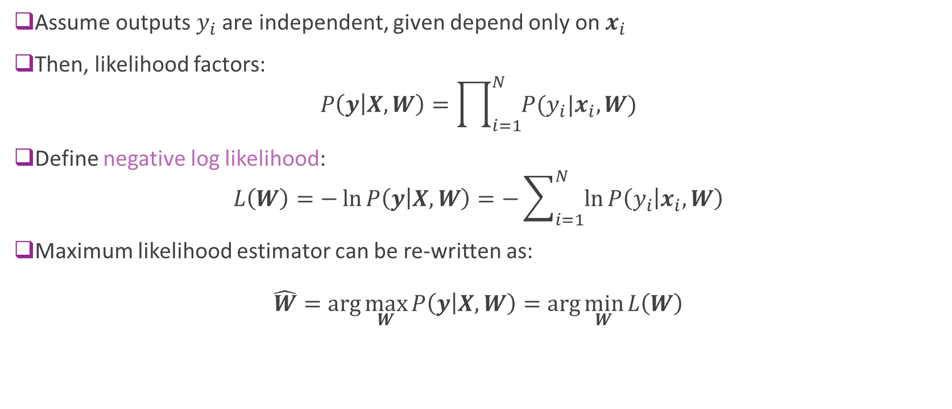
Log Likelihood
Assume outputs $y_{i}$ are independent, given depend only on $x_{i}$
Then, likelihood factors: $P\left(y | X,W\right)=\prod_{i=1}^{N}{P(y_{i}|x_{i},W)}$
Define negative log likelihood: $L\left(W\right)=−\ln{P\left(y | X,W\right)}=−\sum_{i=1}^{N}{\ln{P\left(y_{i} | x_{i},W\right)}}$
Maximum likelihood estimator can be re-written as: $\hat{W}=\arg{\max_{W}{P\left(y | X,W\right)}}=\arg{\min_{W}{L\left(W\right)}}$

Slide 34
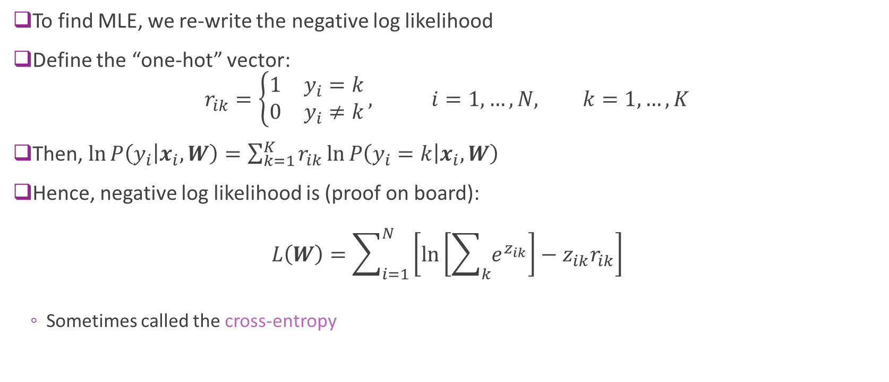
One-Hot Log Likelihood
To find MLE, we re-write the negative log likelihood
Define the “one-hot” vector: $r_{ik}=\left\{\begin{matrix}1 & y_{i}=k \\ 0 & y_{i}≠k\end{matrix}\right., i=1,…,N, k=1,…, K$
Then, $\ln{P\left(y_{i} | x_{i},W\right)}=\sum_{k=1}^{K}{r_{ik}\ln{P\left(y_{i}=k | x_{i},W\right)}}$
Hence, negative log likelihood is (proof on board): $L\left(W\right)=\sum_{i=1}^{N}{\left[\ln\left[\sum_{k}{e^{z_{ik}}}\right]−z_{ik}r_{ik}\right]}$
Sometimes called the cross-entropy

Slide 35
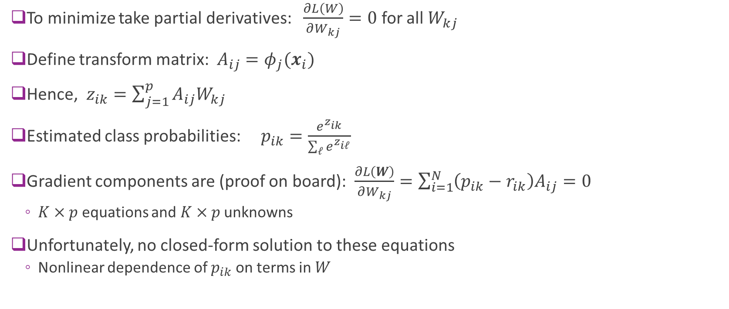
Gradient Calculations
To minimize take partial derivatives: $\frac{∂L\left(W\right)}{∂W_{kj}}=0$ for all $W_{kj}$
Define transform matrix: $A_{ij}=φ_{j}(x_{i})$
Hence, $z_{ik}=\sum_{j=1}^{p}{A_{ij}W_{kj}}$
Estimated class probabilities: $p_{ik}=\frac{e^{z_{ik}}}{\sum_{ℓ}{e^{z_{iℓ}}}}$
Gradient components are (proof on board): $\frac{∂L\left(W\right)}{∂W_{kj}}=\sum_{i=1}^{N}{\left(p_{ik}−r_{ik}\right)A_{ij}}=0$
$K×p$ equations and $K×p$ unknowns
Unfortunately, no closed-form solution to these equations
Nonlinear dependence of $p_{ik}$ on terms in $W$

Slide 36
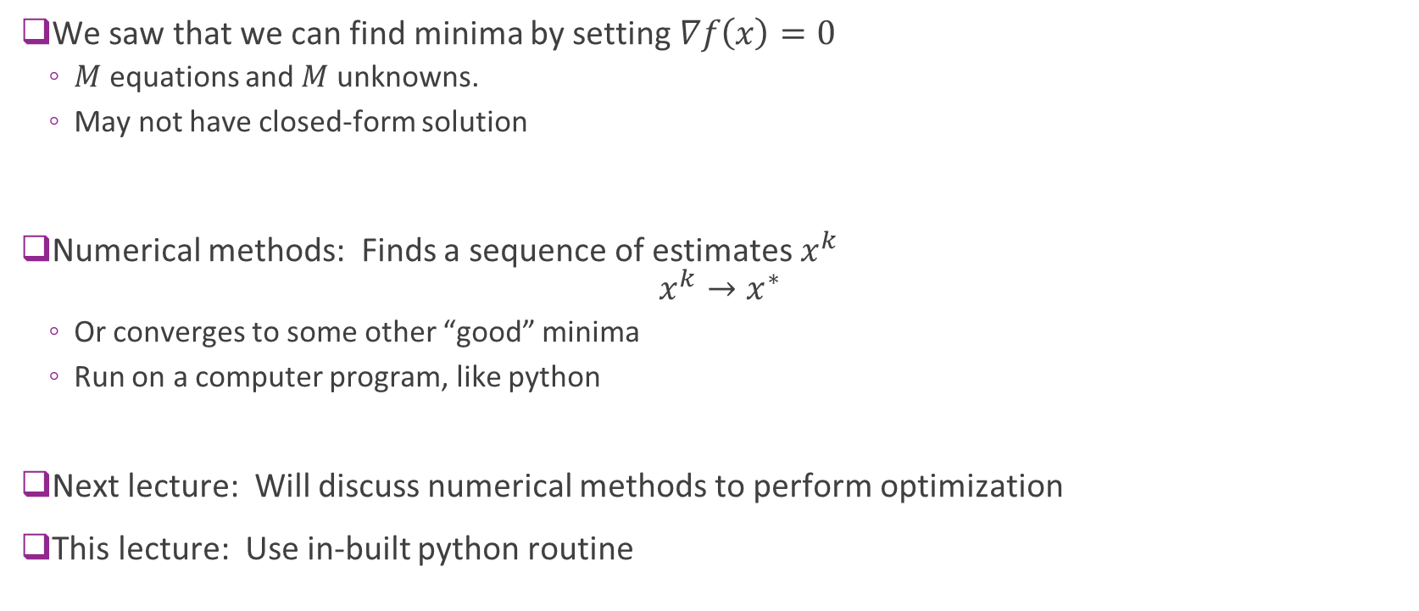
Numerical Optimization
We saw that we can find minima by setting $∇f\left(x\right)=0$
$M$ equations and $M$ unknowns.
May not have closed-form solution
Numerical methods: Finds a sequence of estimates $x^{k}$ $x^{k}→x^{∗}$
Or converges to some other “good” minima
Run on a computer program, like python
Next lecture: Will discuss numerical methods to perform optimization
This lecture: Use in-built python routine

Slide 37
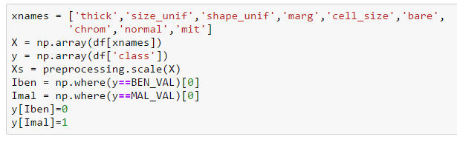
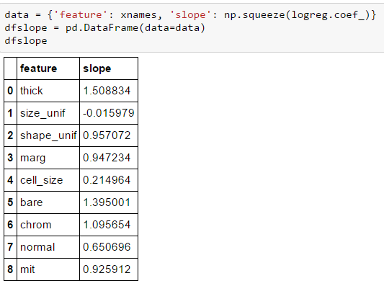


Logistic Regression in Python
w
Sklearn uses very efficient numerical optimization.
Mostly internal to user
Don’t need to compute gradients

Slide 38
Outline
Motivating Example: Classifying a breast cancer test
Linear classifiers
Logistic regression
Fitting logistic regression models
Measuring accuracy in classification

Slide 39
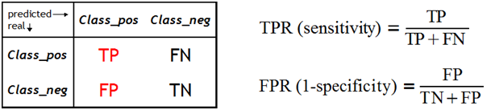
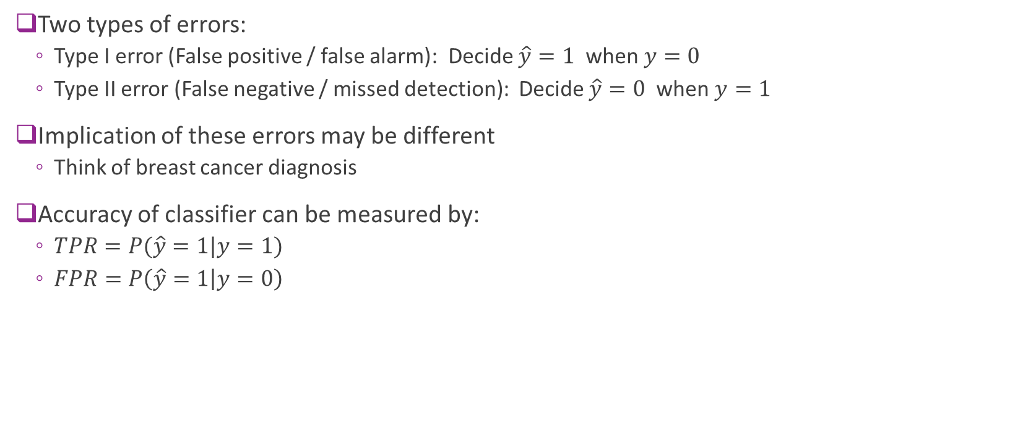
Errors in Binary Classification
Two types of errors:
Type I error (False positive / false alarm): Decide $\hat{y}=1$ when $y=0$
Type II error (False negative / missed detection): Decide $\hat{y}=0$ when $y=1$
Implication of these errors may be different
Think of breast cancer diagnosis
Accuracy of classifier can be measured by:
$TPR=P(\hat{y}=1|y=1)$
$FPR=P\left(\hat{y}=1 | y=0\right)$

Slide 40

Many Other Metrics
From previous slide
$TPR=P(\hat{y}=1|y=1)$
$FPR=P\left(\hat{y}=1 | y=0\right)$
Machine learning often uses
Precision = sensitivity = $TPR$
Recall $=P\left(y=1 | \hat{y}=0\right)$
F1-score = $\frac{2TP}{2TP+FN+N}$
Medical tests:
Sensitivity = $P\left(\hat{y}=1 | y=1\right)=TPR$
Selectivity = $P\left(\hat{y}=0 | y=0\right)=1−FPR$

Slide 41
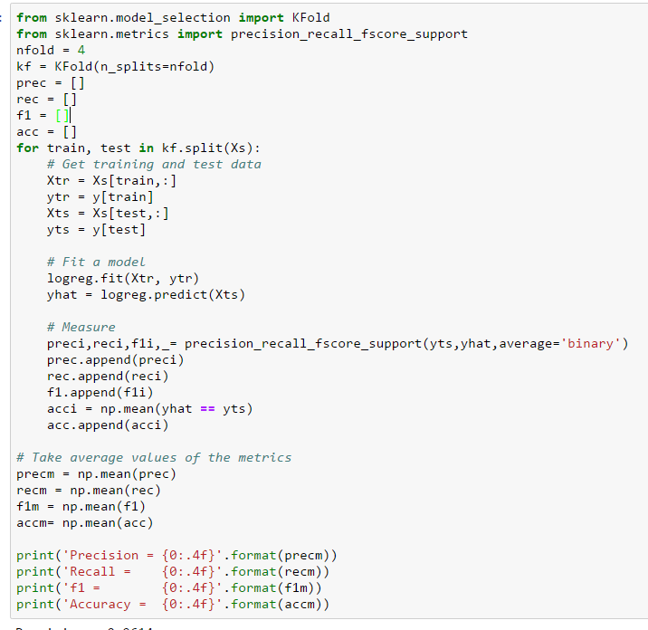

Breast Cancer
Measure accuracy on test data
Use 4-fold cross-validation
Sklearn has built-in functions for CV

Slide 42
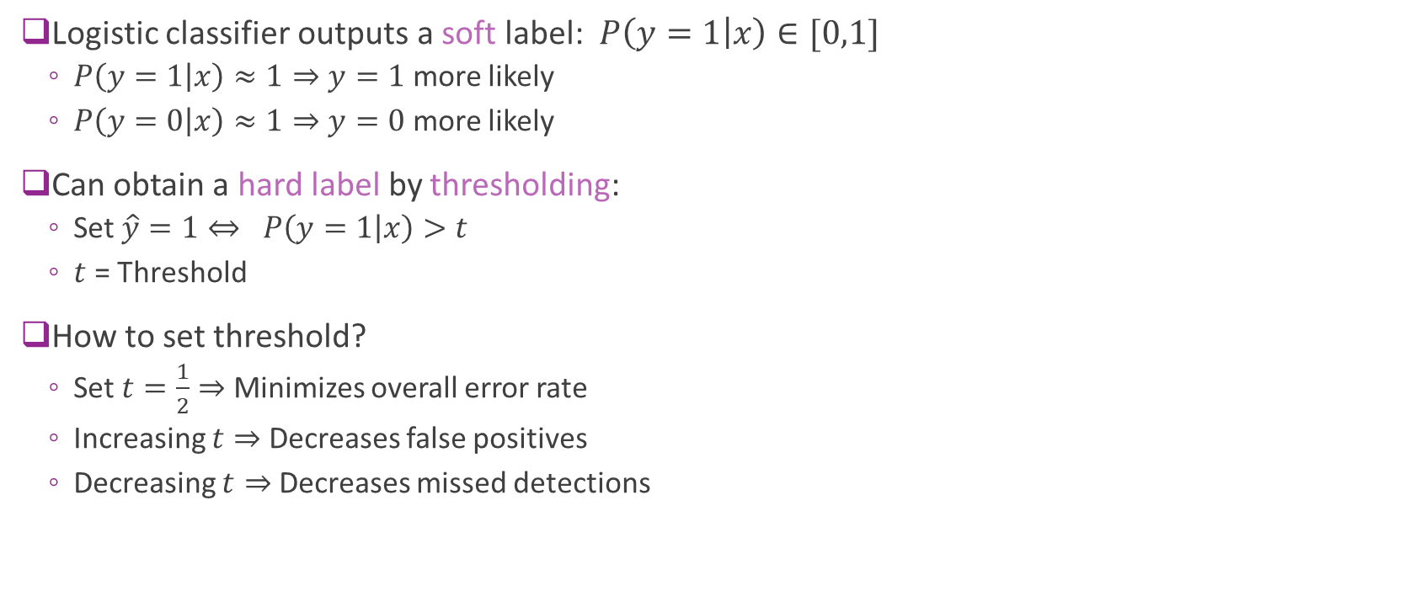
Hard Decisions
Logistic classifier outputs a soft label: $P\left(y=1 | x\right)∈[0,1]$
$P\left(y=1 | x\right)≈1⇒y=1$ more likely
$P\left(y=0 | x\right)≈1⇒y=0$ more likely
Can obtain a hard label by thresholding:
Set $\hat{y}=1⇔ P\left(y=1 | x\right)>t$
$t$ = Threshold
How to set threshold?
Set $t=\frac{1}{2}⇒$ Minimizes overall error rate
Increasing $t⇒$ Decreases false positives
Decreasing $t⇒$ Decreases missed detections

Slide 43
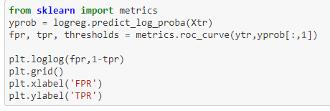
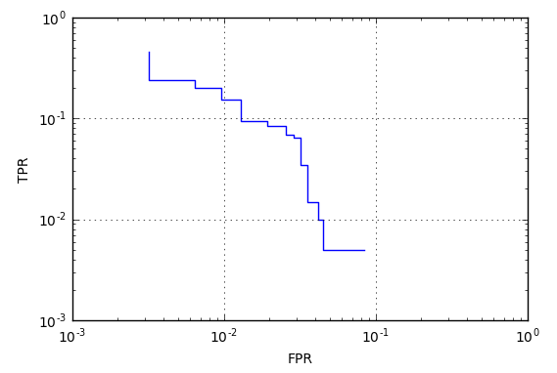
ROC Curve
Varying threshold obtains a set of classifier
Trades off FPR and TPR
Can visualize with ROC curve
Receiver operating curve
Term from digital communications

